Slide 1

Creating a Minnesota Competency-based Training Designed for and with PBS Facilitators

Slide 2
Competency-based Training
Establish evidence that PBS Facilitators can lead PBS planning
Use fidelity tools for written and direct observation
Collect baseline/intervention, quality of life data, and satisfaction data
Create community-based agreed upon expectations for PBS
Introduce Basics
  First Steps
  Online Course
  Onsite Training
  Regional Groups
  Applied Work
  Mentors Assigned
Plan Scored
Approval from Mentors and Trainers
Background Skills
Applied Experience and Mentoring

Slide 3
Core Activities
Onsite Kick Off Event (Bring people together across the state)
Online Modules (Just in time learning)
Regional meetings led by local mentors
Assign trainees to one mentor
  Invite someone to participate in person-centered planning and PBS
  Regional meetings used to guide, problem solve, etc
  Mentors observe and sign off
Not so much a written plan as a documentation system
  Document sharing key information
  Training materials
  Folder with key information
Question: Exam?
  Purpose: Evidence person understand concepts
  PBS requires understanding principles and application

Slide 4
Purpose of the Online Modules
Provide asynchronous learning that can fit the trainee’s work patterns
Focus on the conceptual in modules and application in training events
Include adult learning strategies
  Video
  Visuals
  Audio and PPT
  Test of knowledge
  Tracking that training is completed

Slide 5
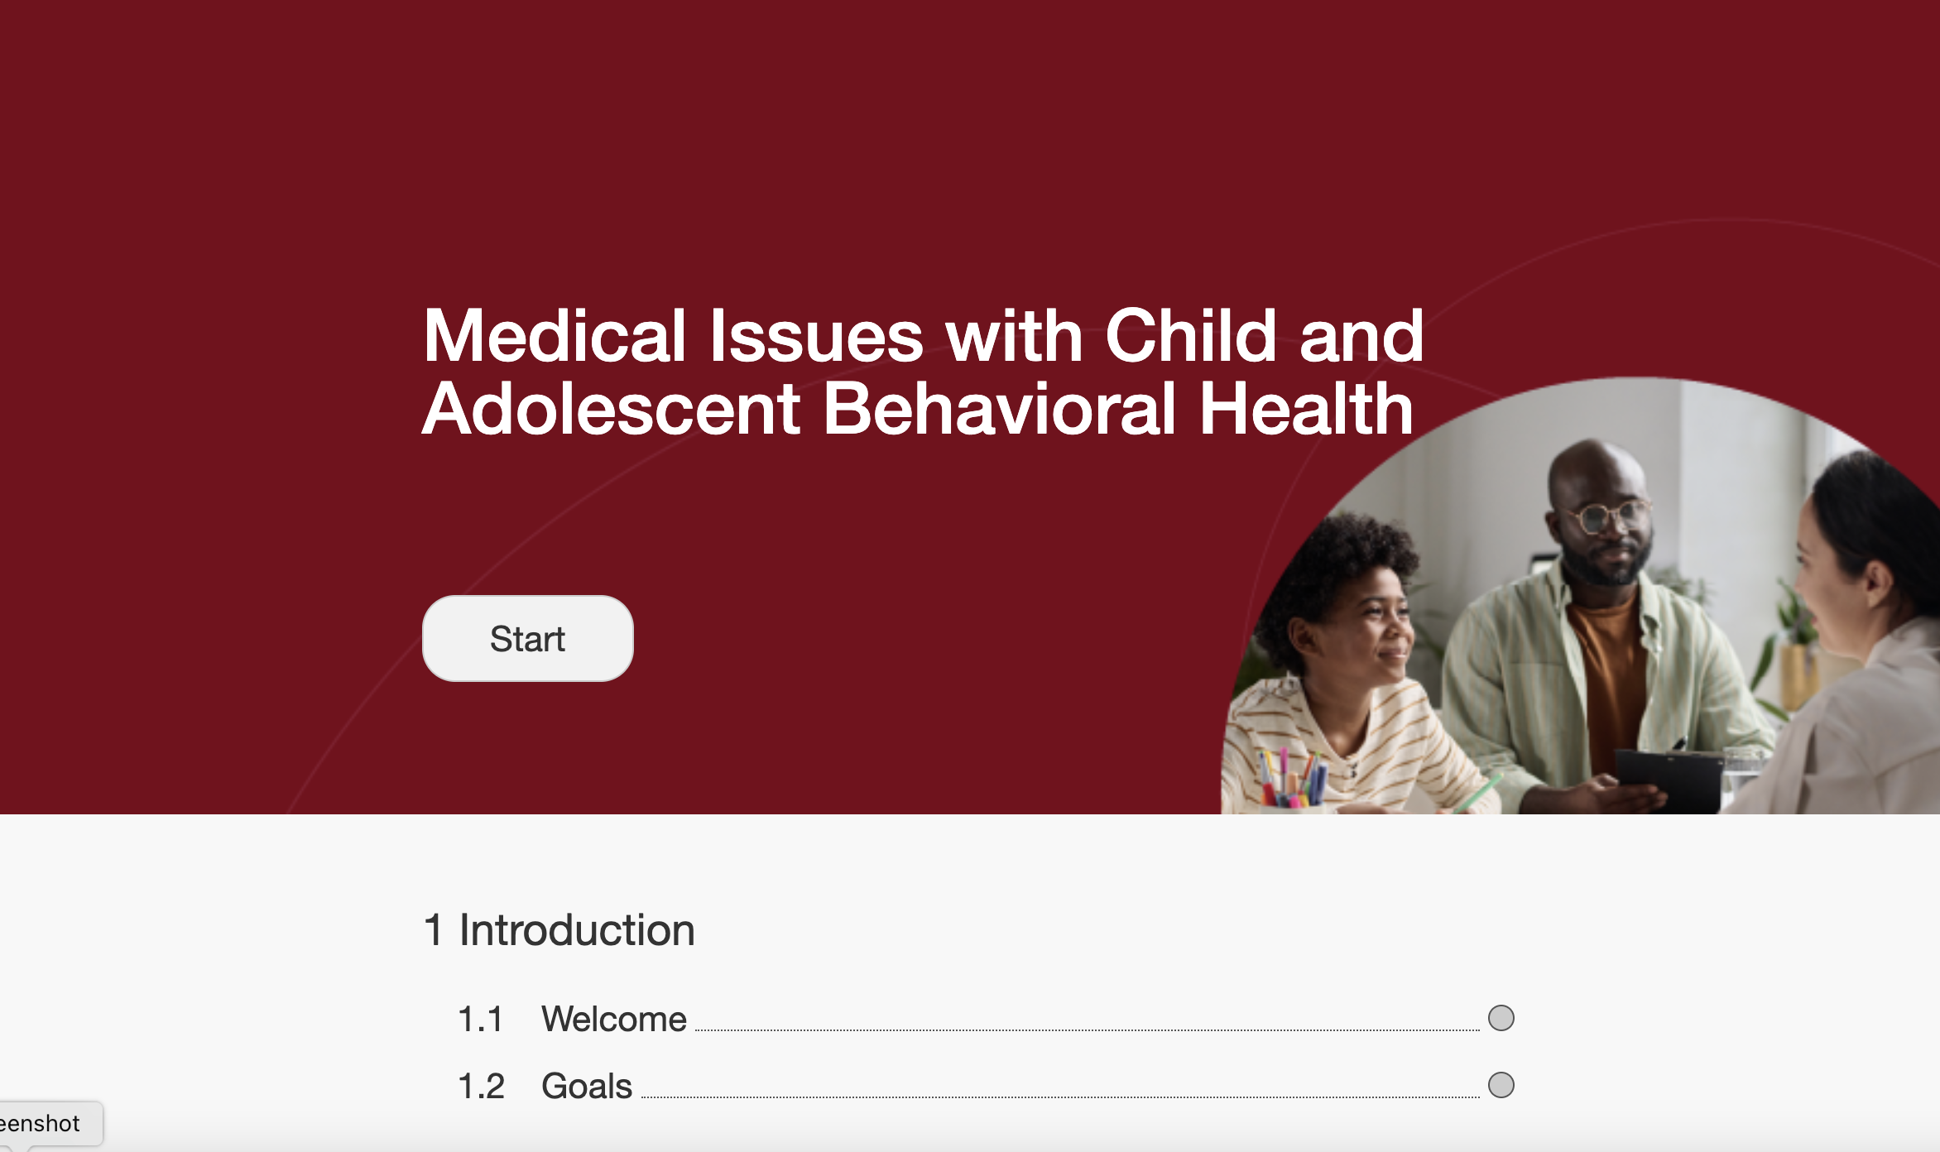
Features of Adobe Learning Management Design
Features include…..
Video segments
Written content
Stories
Power Point Narration
Records Progress
Documents Scores and Time in Site
Notes:
State of emergency in children’s mental health declared from the COVID 19 pandemic, increase in hospitalizations for psychiatric needs.
n 2021, the American Academy of Pediatrics, American
Academy of Child and Adolescent Psychiatry, and Chil-
dren’s Hospital Association declared a “…national emer-
gency in child and adolescent mental health.

Slide 6
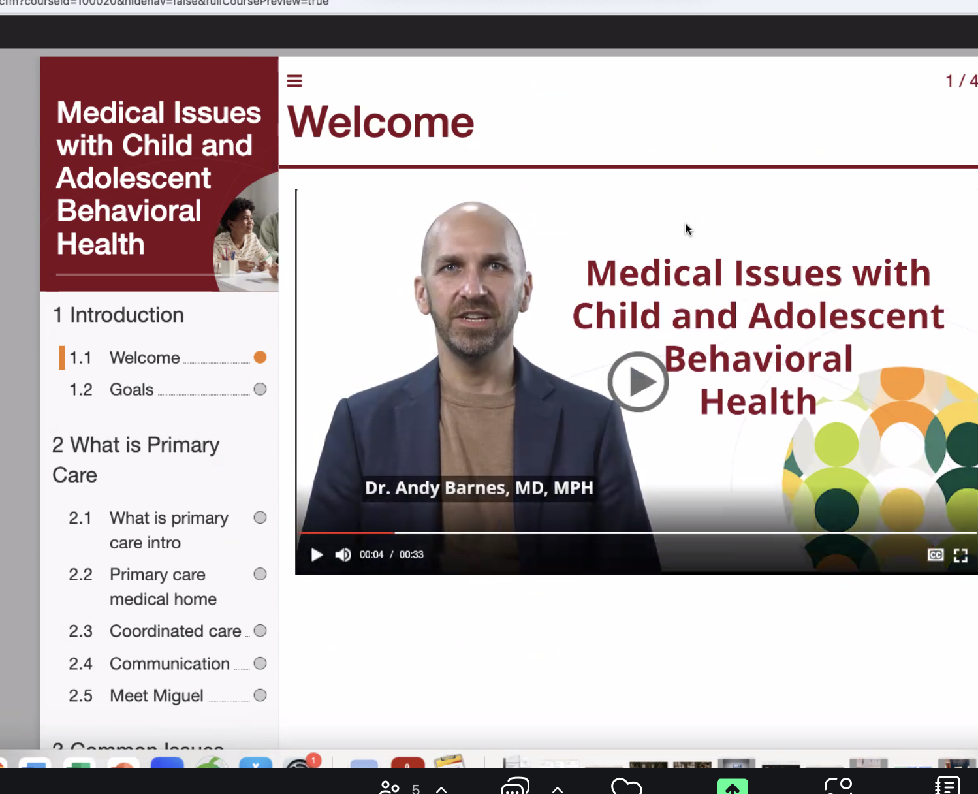
Easy Navigation on Left Side….
….Written Content on Right Side

Slide 7
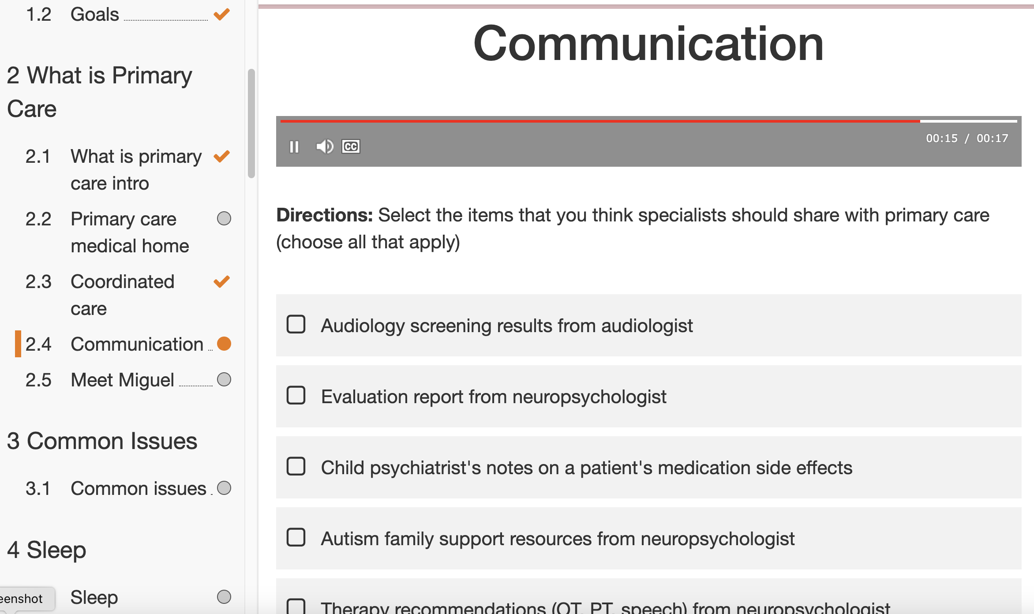
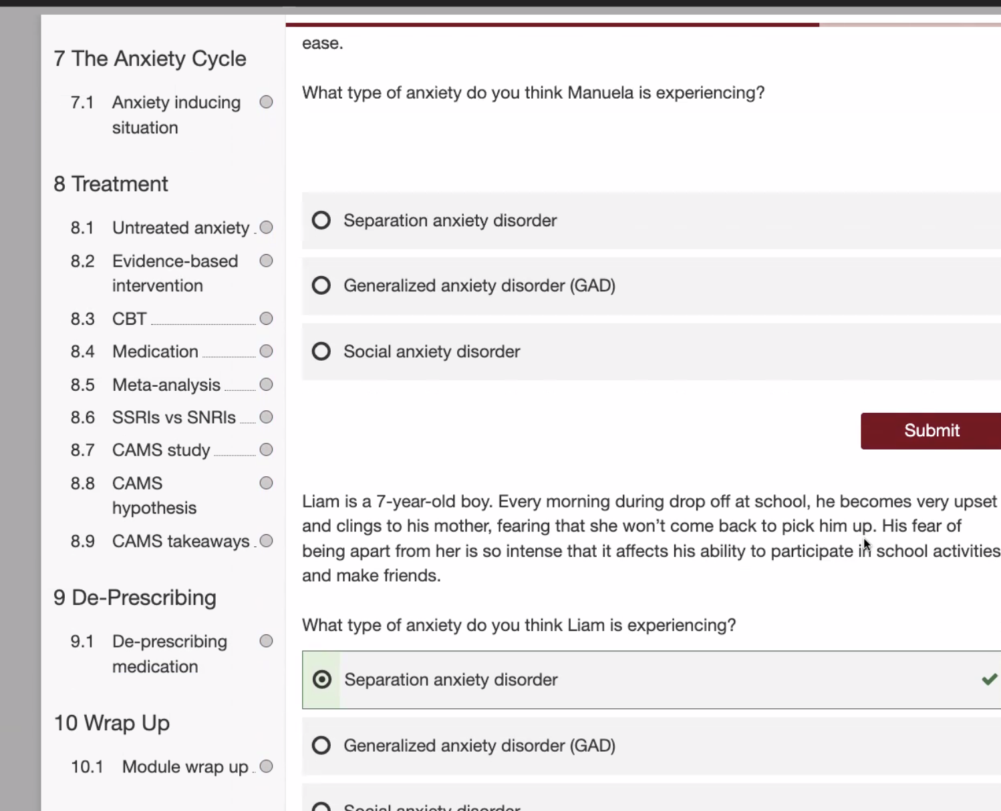
Designing Stories and Simple Test of Knowledge

Slide 8
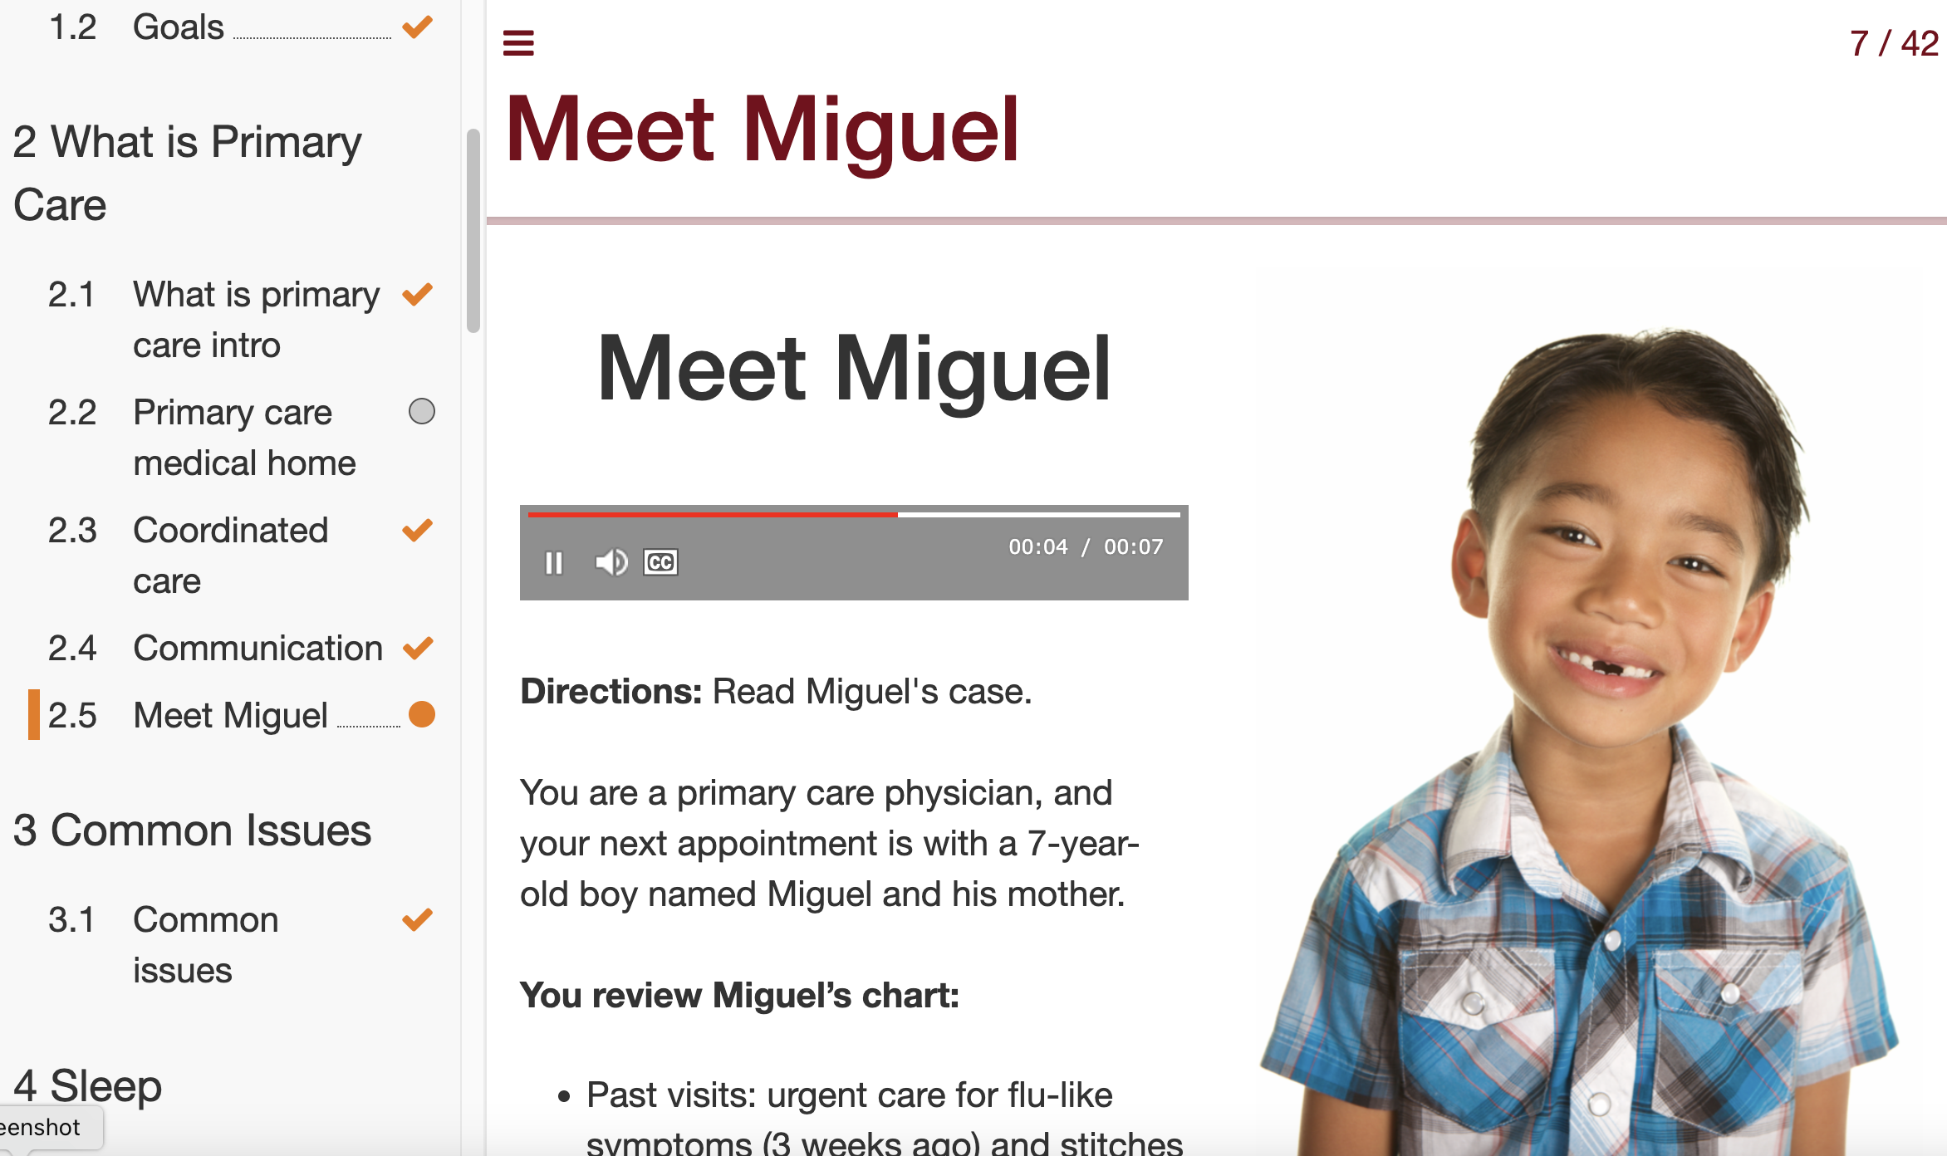

Slide 9
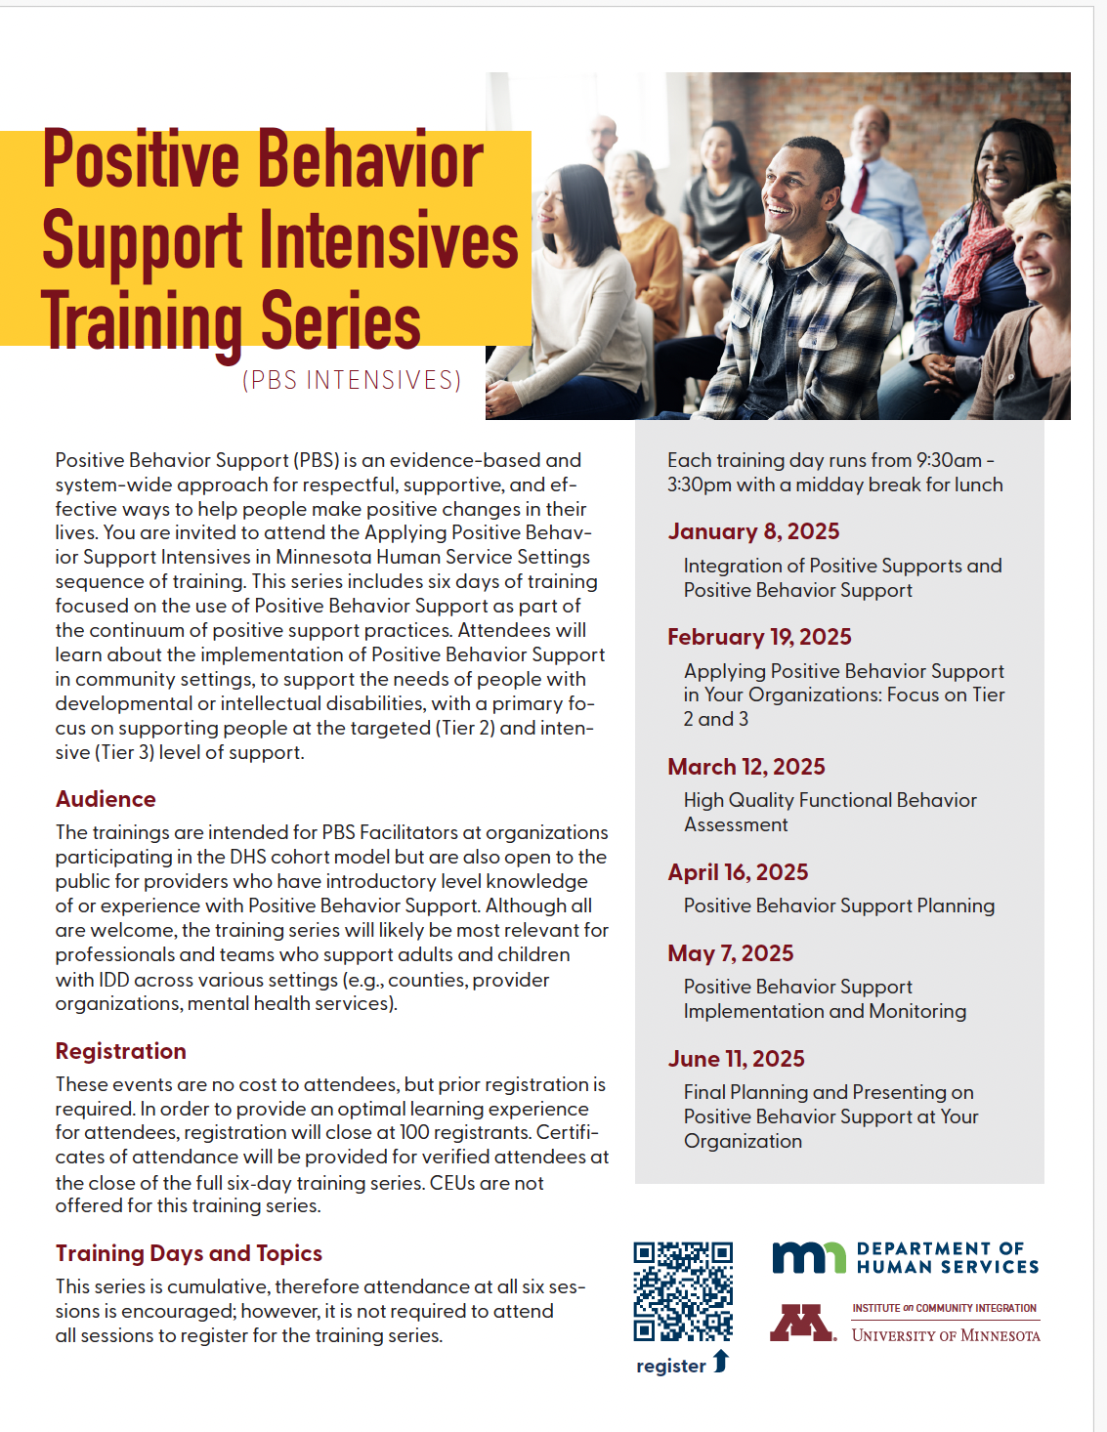
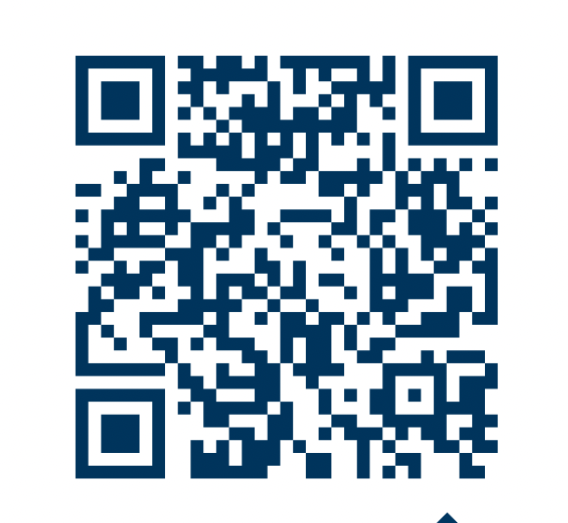


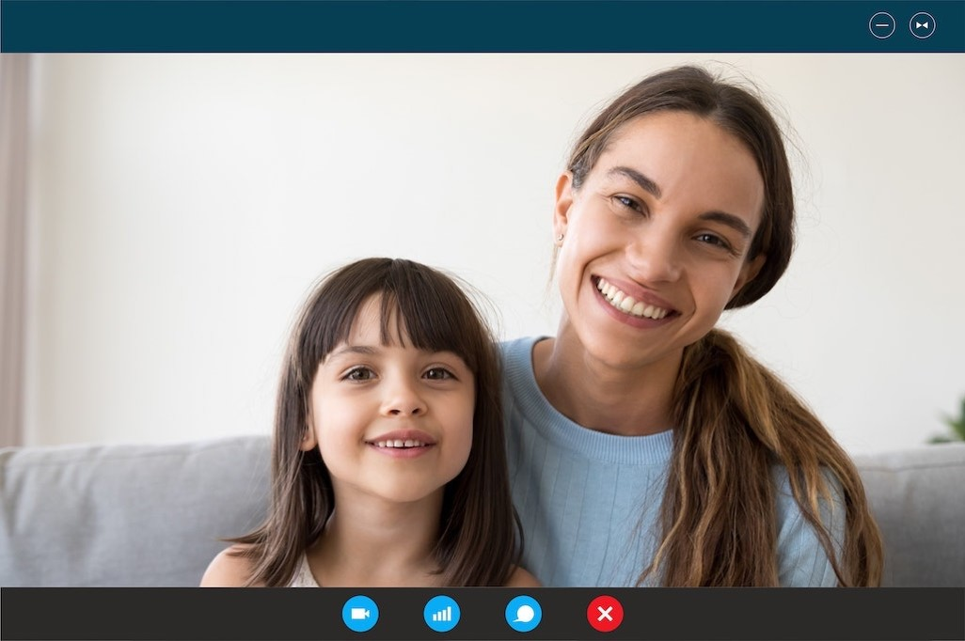
Keep PBS Intensive Training Series for General Awareness
When: 6 Monthly Sessions
Jan-June 2025
9:30-3:30
Attendees: Minnesota providers who support children, youth, and adults with IDD
Content: PBS Facilitator development, Positive Behavior Support, including Universal practices, Tiers 103, FBAs, Positive Behavior Support Plans
Register here!
Email: pbs@umn.edu for questions
Notes:
58 total ECHO sessions, 288 CEUs administered, 99 unique participants in longitudinal ECHO

Slide 10
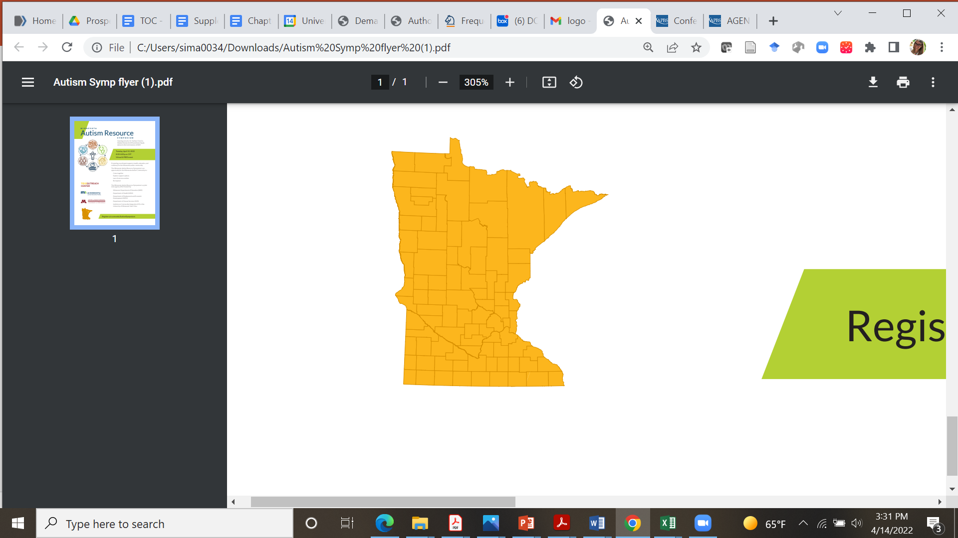
Strategies for Building Capacity
Competency-based Training
Intensive training preparing for Analyst and Professional levels
Application of PBS while supported by mentors
Evidence of competencies met
PBS Intensives
  Staff who will be involved at Tier 2 and 3
  Annual updates for people who support system
  Tracking completion for organizations
Echo Webinars & Community of Practice
Support reflective process at Tier 3
Assist organizations interested in building capacity

