Slide 2
Title of presentation
More smaller words could go here

Slide 3
Implementing Multi-Tiered Systems of Support
Notes:
This slide shows a triangle that represents a multi tiered system of support for implementing person centered and positive support practices. The triangle is divided into 3 sections: the base of triangle is the universal stage: strategies that are used to support everyone, the middle of the Triangle is the Secondary stage: these strategies build on universal and and an extra layer of support, not all people will need this level of support and finally the top of the triangle is the Tertiary stage: very few people will need this level of support. This 3rd level builds on the other two levels and adds specific additional supports, The yellow that outlines the triangle represents culture. Culture is a part of everything we do.
A multi tiered system is simply a system that starts with the universal tier and implements person-centered and positive support practices that are used with everyone. This includes a wide variety of strategies such as teaching positive social skills, relationship building, empathy, cultural responsiveness, and person-centered thinking skills.
Supporting all people includes ,people supported, families and the workforce. with these universal practices supports people to have a life that makes sense to them and increases their quality of life. When people have a life that makes sense to them it is less likely that they will need tier 2 and 3 supports. For some people they may need additional support to have a life that makes sense and is meaningful – these are tier 2 supports. The universal supports are still in place but maybe we need to add a social skills group or maybe they need a formal person centered plan to help them figure out an area of their life that doesn’t make sense. These additional supports may be all that is needed. For a few people, they will need more specific additional supports. This is where a Positive support plan might be added. Tier 3 includes universal support as well.
Person Centered Thinking and Planning
Positive Behavior Support
Cultural Humility and Responsiveness

Slide 4

Main Universal Activities – Year 1
Person-Centered Practices
Self-Assessment/Action Plan Items
Vision – Now and In Future
Outcome Statements
  People Supported
  Employees
  Organization
  Community
3-Year Backward Planning
History Map
Applied Coach Activities
Positive Behavior Support
Self-Assessment/Action Plan
Consensus-Based Sharing and Problem Solving
Social Skills Matrix
Strategies for Reinforcing Social Skills
Observations of Implementation
  Person-Centered
  Social Skills and Engagement
Introduction to Data-Based Decision Making
Notes:
Verbal reference to org-wide team training

Slide 5
Organization-Wide Team Activities
Form a Team
Confirm Readiness
Team Self-Assessment
Action Plan and Long-term Vision
Data-Based Decision Making
Monitoring Capacity Building
Preparing for Year Two

Slide 6
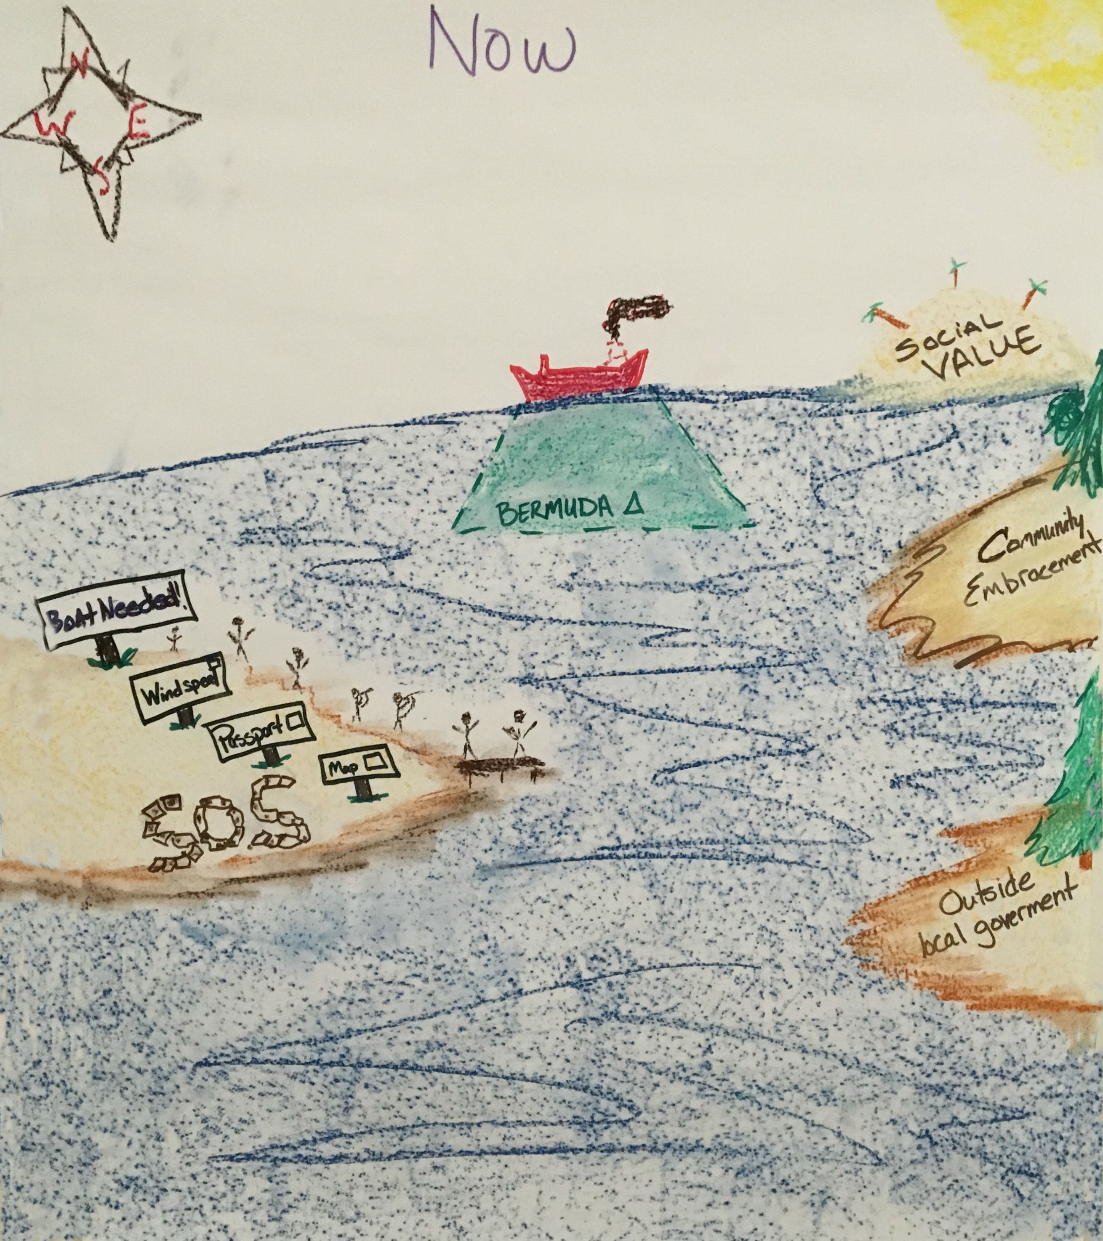
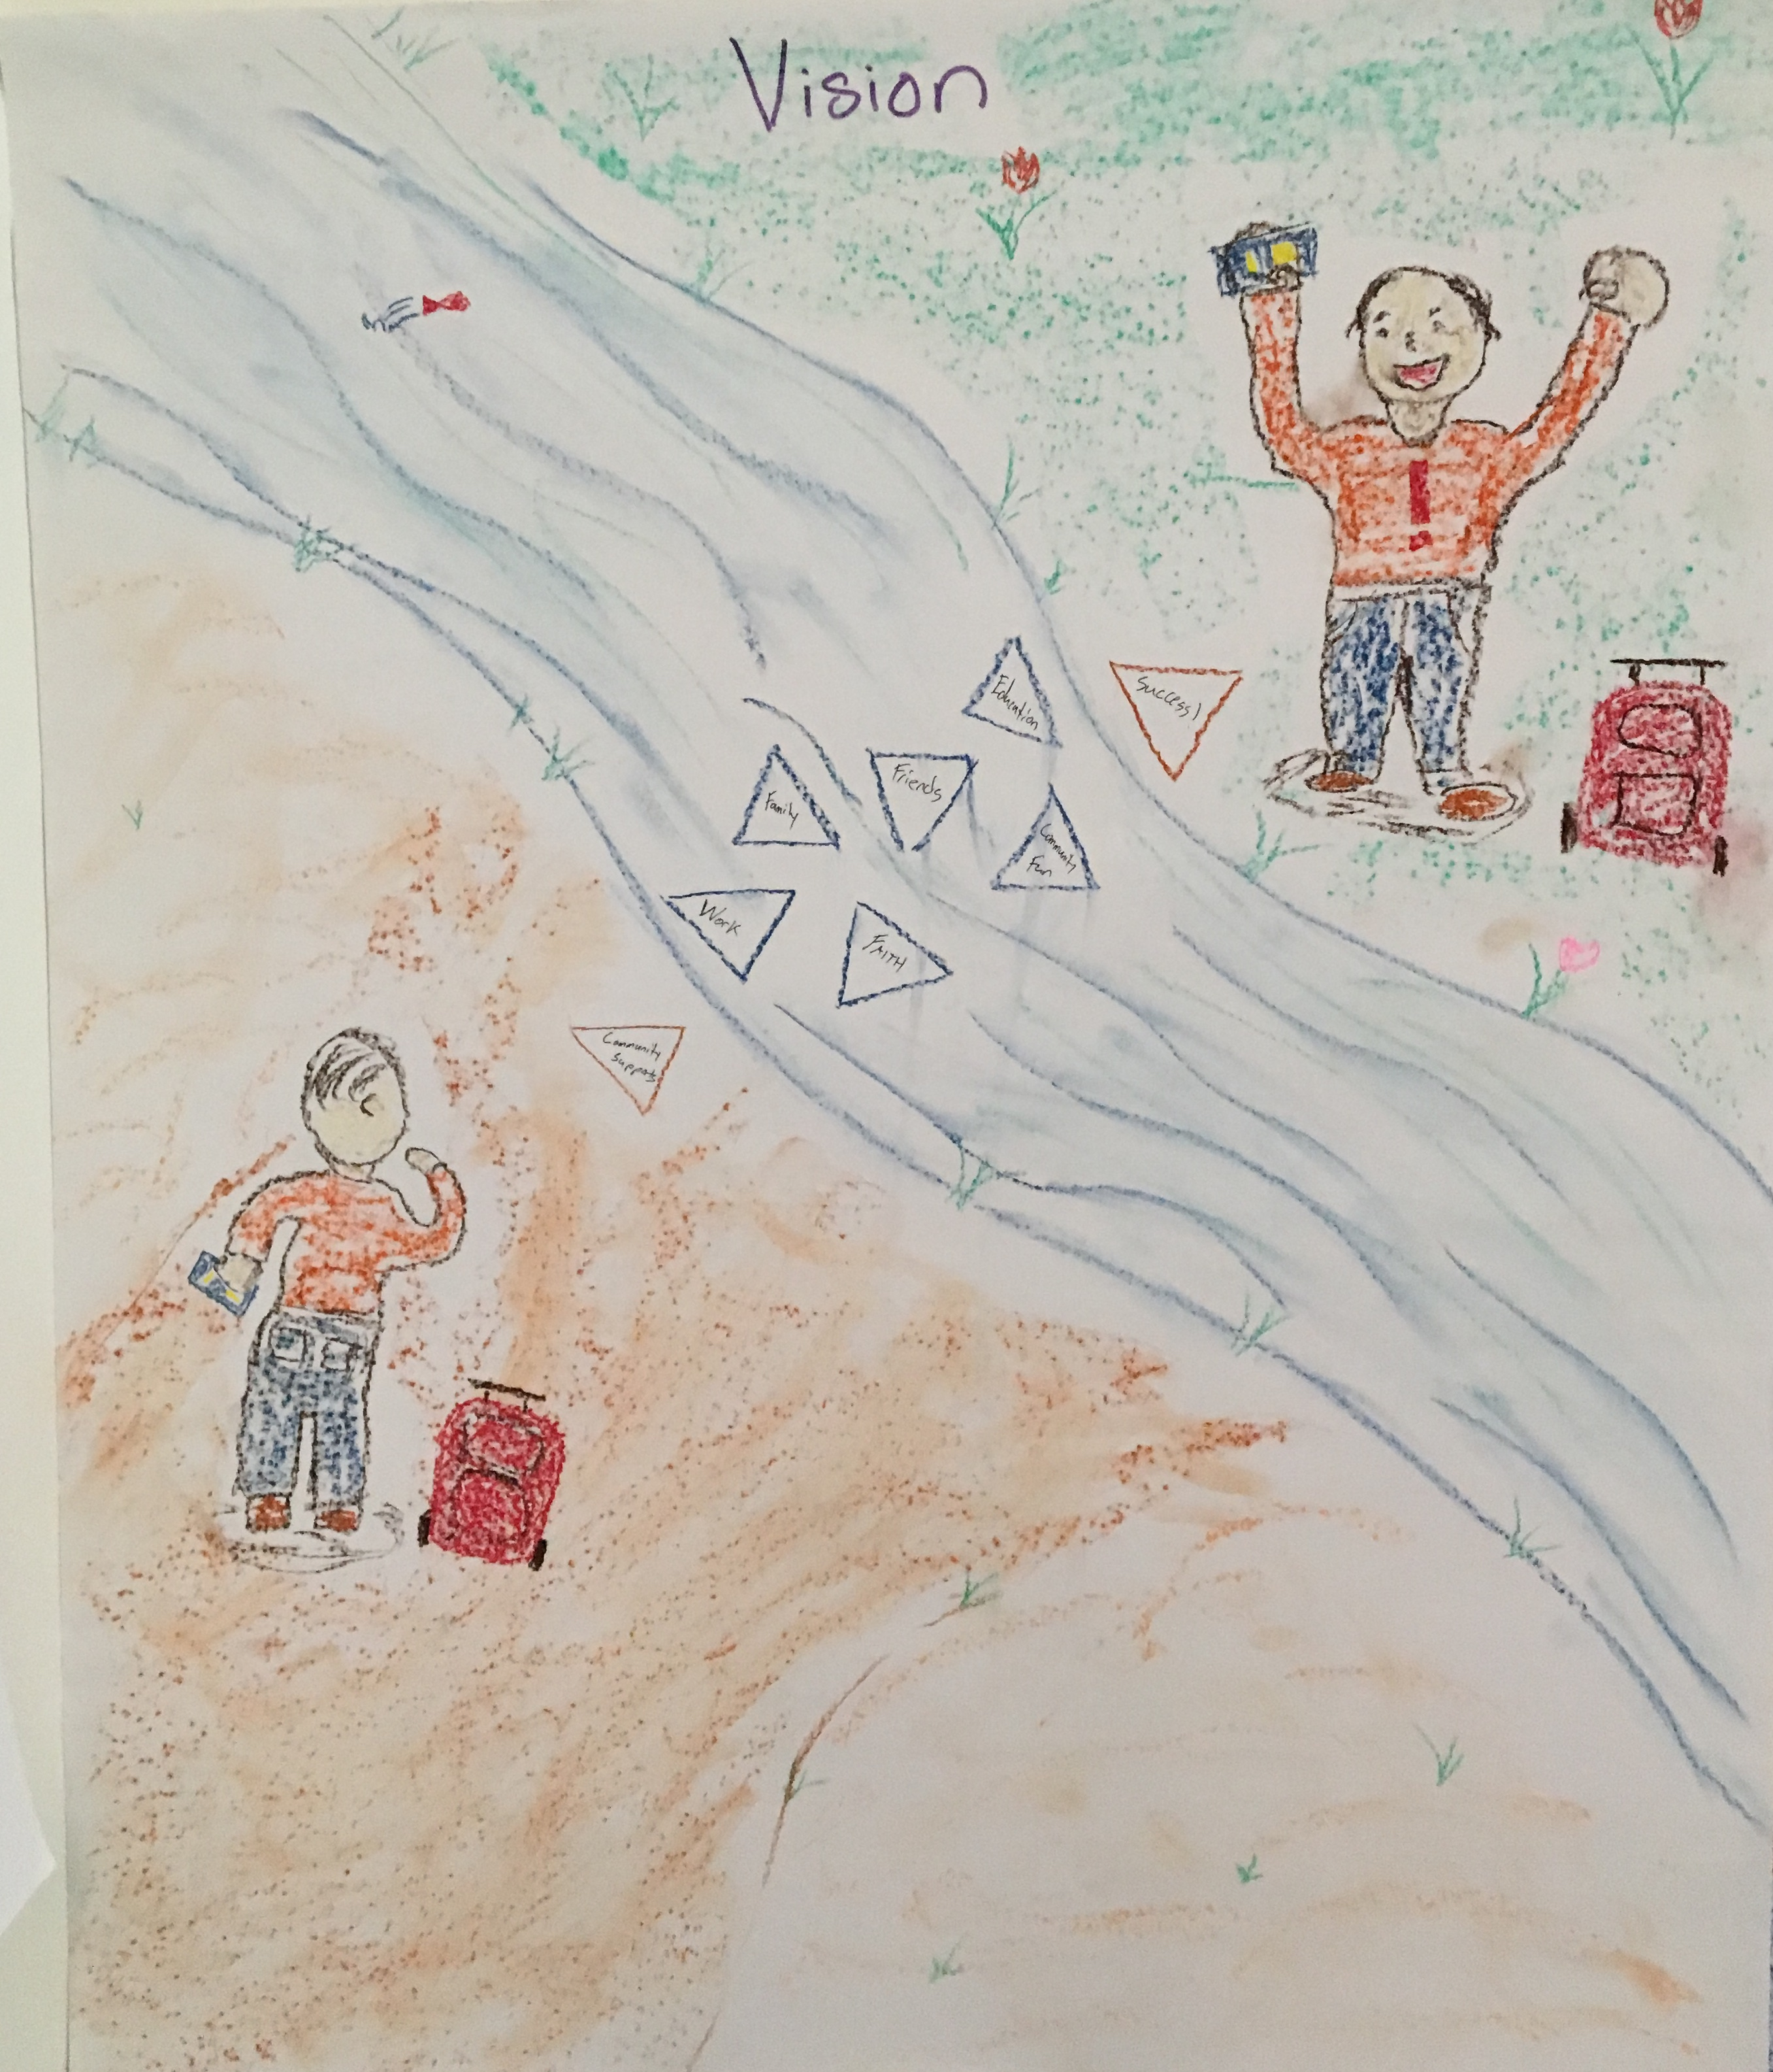
Vision for Moving Forward: Status of Our Efforts Now and For the Future
Now
Future

Slide 7
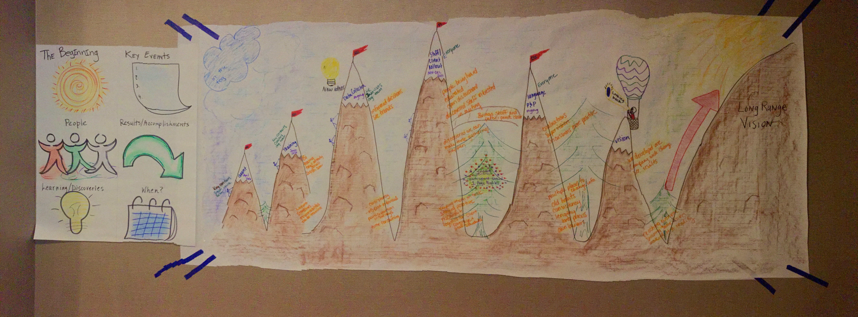
History Map Completed After Year One

Slide 8
Outcome Statements
Outcomes for People Who Receive Support:
  People who receive support feel respect, acceptance, and value in the community.
  People who receive support drive their plans and services.
Outcomes for Employees/Staff:
  Staff understand person centered thinking are are working for/with the person receiving supports.
  Staff feel valued and want to work at SSI.
Outcomes for Organization:
  SSL will match staff with person receiving supports.
  Organization will restructure the way services and supports are provided.
Outcomes for Community:
  Community members will be excited to welcome, participate, engage, with SSL and person receiving support.
  Community members expand awareness of mental health.

Slide 9
Action Plan Documentation
Overall Management Activities | Who | By When | Status Update
Last 30 minutes of Wednesday Meeting used for PC/PS Grant Discussion | ALL | Start 7/27/16 | Achieved/In progress, 1/12/17 need to look at accomplishing one task at each meeting, setting assignments to comment next meeting, look at different meeting locations, flip charts/post it notes
Exit Interviews | Anyone with employees | Start Friday 7/22/16 | Completed- distributed to all supervisors/managers 7/26/16, 1/12/17 look at if these are being done
Pancake Breakfast, changed to staff role out pizza | Chris, ryan, pete, rachel, beth, laura, steph, all organization team member assistance | 10/31/16 | Picked dates of 11/11 and 11/18, need to work on agenda and get marketing about it out by 10/30/16 Completed both roll outs as of 1/12/17
Staff matching pilot- determine plan for pilot and start system | Beth, Laura Flynn, | 10/31/16 | Will meet on 8/1/16 at 10:30am to develop action plan
Leadership training | Steph | 12/31/16 | In progress, completed, DP in progress
Meet & Greet site visit with politician | Steph, Beth, Jeff | 11/14/16 | Nothing done as of 1/12/17
Police Department Outreach | Laura F, Steph | 10/1/16 | 2 came to ice cream social First One completed 1/12/17
Booth at SLC Health & Human Services Conference | Beth | 7/1/17 | Waiting for email response from Mary Bridget Lawson, missed out on 2016 conference, will look at attending 2017
Neighborhood gathering (Ice cream social Appreciation Event for police, fire department, etc) | Laura Bussey, Rachel | 8/30/16 | Completed, 2 police came
Policy language revision | HR, Laura F | Monthly | In progress
Need Help Here

Slide 10
Action Plan Examples
9 Person-Centered Thinking Coaches trained
2 Key Contacts
2 people are trained in Picture of a Life Planning
2 people are in the process of becoming PBS Facilitators
2 PBS Trainers already within the agency
Training with new employees about Person-Centered Practices
Adding person-centered questionnaires into behavior plans
Implemented social skills instruction (matrix) in two settings
Staff training and direct observation started
Improved incident reporting data collection system

Slide 11
Adding Universal Positive Behavior Support Strategies
Teach, Promote, Model Positive Social Interactions
Design Positive, Proactive, Predictable Environments
Establish Data-based Decision Making Systems
Consistent Response to Problems
Build Capacity for Individualized PBS

Slide 12
Matrix Developed in Residential Setting
 | Time of Day
Values |  | Before Day Program | After Day Program | Dinner | Evening Activity | Night time
 |  | 7-9:30am | 3:30-5pm | 5-6pm | 6-8pm | 8-?
 | Keeping it real | Follow preferred routine | Relaxing in preferred way | Eat at respectable time | Enjoy your time | Allow housemates to do their thing
 | Open Line of communication | Respectfully being woken up | Talk about evening plan | Know your role | Discuss activity (who's going/expectations) | Talk about day if needed
 | Organization | Lunches / Tobacco for day | Dinner prep / Tobacco for evening | set/clean table | proper supplies (money, meds, clothes, tobacco) | Prepare for next day
 | Cleanliness | Clean clothes | Discuss Chores. Pick up room | Finish up chores, Compliment housemates. | Help others prepare for activity | Follow routine (Shower, clean room, pick up house
 | Respect | Let others follow preferred routine. Staff passdown | Allow other to relax as they prefer | Rinse own dishes and put in dishwasher - Thank each other | Allow housemates to enjoy activity | Respect quiet time and passdown

Slide 13
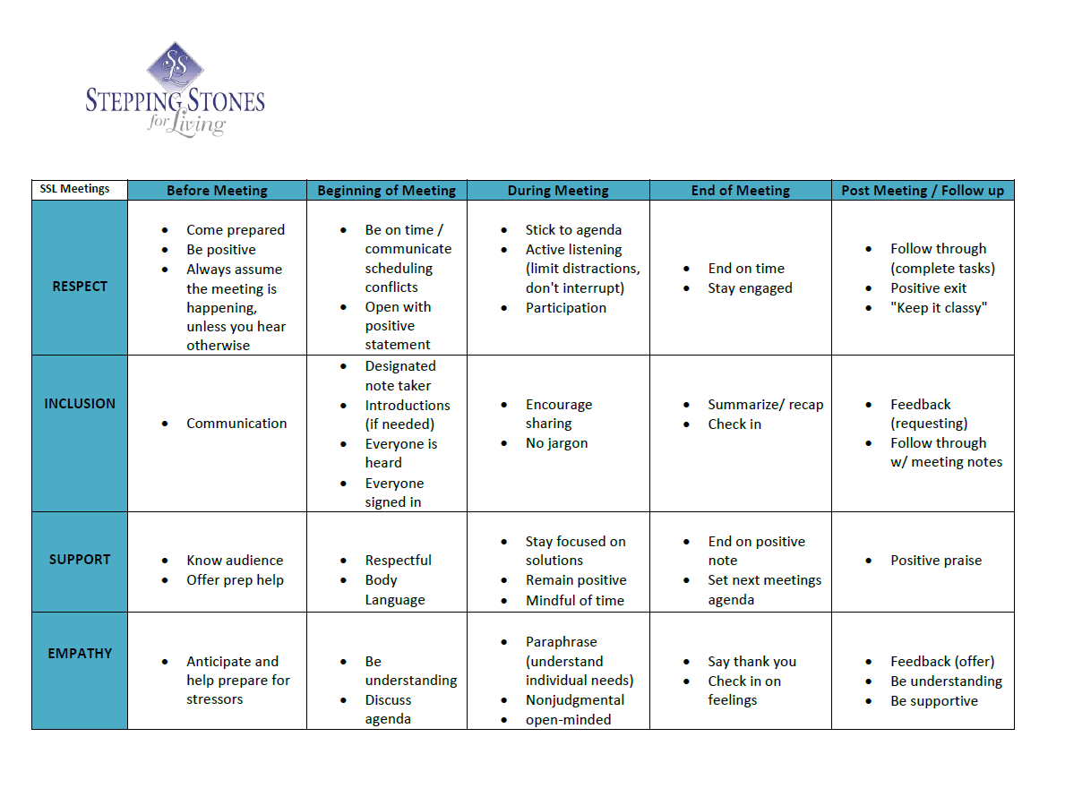
Meetings Matrix for Organizational Meetings

Slide 14



Working Towards Outcome Data
Notes:
Rachel does slides 8-15

Slide 15
Responding to:
“Our Agency is Already Person-Centered”
Fidelity of Implementation
Strategy for Providing Evidence That an Organization is Implementing a Practice in the Manner Intended
A List of Key Elements of a Practice Teams Can Use for
  Self-Assessment and Evaluation
  Help Guide Implementation
External Evaluation
  Unbiased Assessment of Practice

Slide 16
Evaluation & Data Systems
Evaluation & Data Systems
Organization-Wide Evaluation | Related Evaluation Data/Tools
What impact did the training have on capacity building? | Number of coaches, key contacts Number of staff involved in implementation Number of people supported
What are the strengths and needs of the organization? | Person-centered organizational tool Quality of social and physical environment
How well are the practices implemented? | Fidelity of implementation self-assessment (twice a year) Onsite evaluation (annual)
Are there changes in behavior of staff and people living and working in a setting? | Direct observation of staff person-centered practices (Quarterly) Direct observation of people supported (Quarterly) Incident reports, restraint, 911 calls, etc. (Quarterly) Organizational data (retention/tenure, etc.)
Are there changes in universal quality of life? | Quality of social and physical environment interviews Regional Quality Council Interview Tools

Slide 17
Examples of Evaluation Data
Effort
Coaches, Key Contacts. PBS Facilitators
Homes, Areas of Organization (parameters)
Fidelity
Self-Assessment
Onsite Evaluation
Outcome
Quality of Life
Incident Reports
Injuries, Sick Days
Attrition/Retention, Workers Compensation

Slide 18
Employment Matrix & Direct Observations

Slide 19
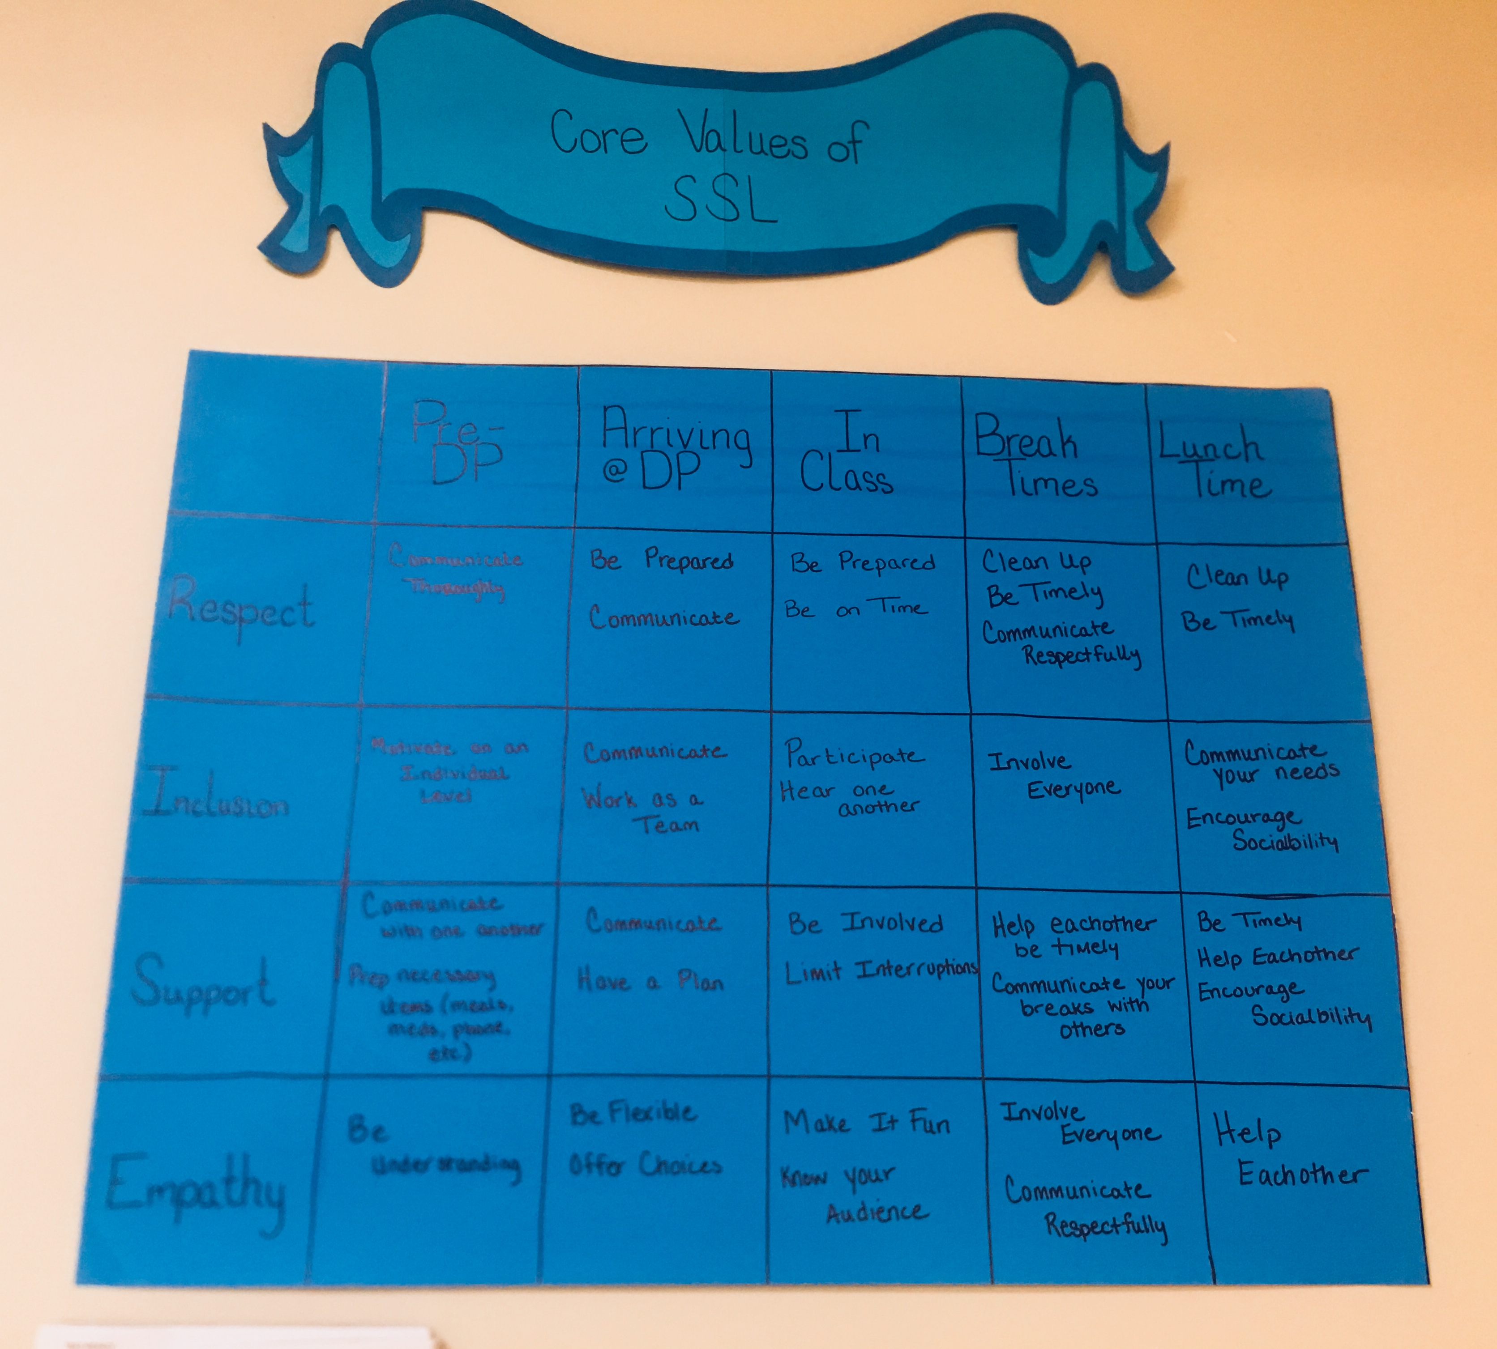
Collaborative Process for Creating the Matrix
Team of staff members, supervisor involved in observations, people supported met to identify positive social values
Following initial observations, the PBS team member and employment site supervisor initiated:
  Large printed versions of the matrix displayed in hallways, employment classrooms, and the cafeteria
  Larger scale employee training on the matrix
  Training and education on the matrix to the employees and people being supported during employment classes.

Slide 20
Development of Employment Matrix
Collaboratively Developed with People Supported & PBS Team including:
  Supervisor of the employment site (also on the PBS team)
  Employees at the employment site
  People being supported at the employment site
Observations Conducted in Two Settings
  Lunch
  Employment classes

Slide 21
 | Before Day Program | Arrival | In Class | Break Times | Lunchtime
Respect | Communicate thoroughly | Being Prepared & Communicate | Be Prepared & Be on time | Clean up, Be Timely, & Communicate Respectfully | Clean up & Be Timely
Inclusion | Motivate on an individual level | Communicate and work as a team | Participate and hear one another | Involve Everyone | Communicate your needs Encourage Socialbility
Support | Communicate with one another Prep necessary items (Meals, Meds,Phone, etc) | Communicate and have a plan | Be Involved, Limit Interruptions | Help each other be timely Communicate your breaks with others | Be Timely, Help each other Encourage Sociability
Empathy | Be understanding | Be Flexible & Offer Choices | Make it fun, Know your audience | Involve Everyone, Communicate Respectfully | Help each other

Slide 22
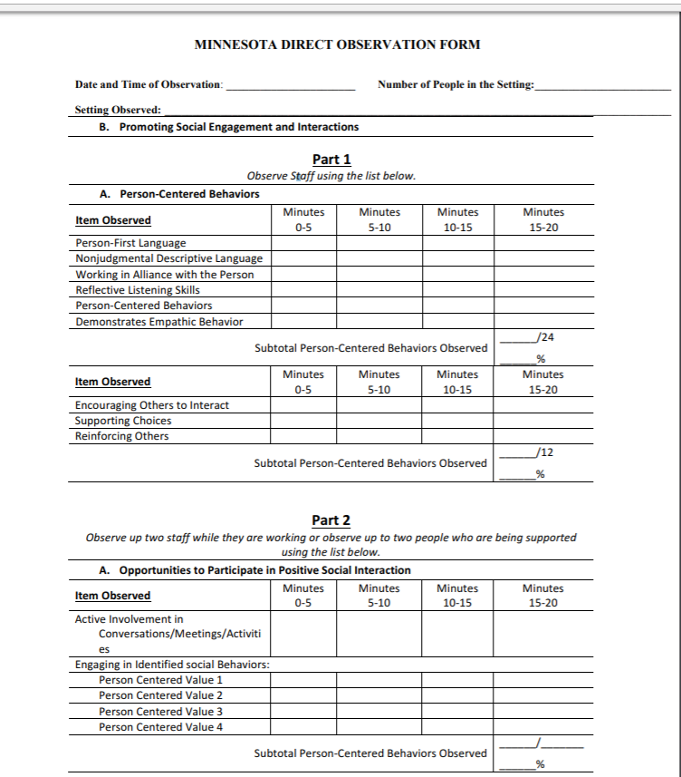
Direct Observation Tool
Train the trainer model to collect direct observation data
Utilize ‘TelePBS’ (e.g., live coaching and data collection via video conferencing) to increase the number of data collection/training opportunities
Work together to curate and analyze data to inform matrix training practices.

Slide 23
Interrater Agreement for Direct Observations
Supervisor and ICI Tele-PBS Mentor Connect Via Distance Strategies
Date Set to Organize Direct Observation
Supervisor and Tele-PBS Mentor Observe Direct Support Staff Using Direct Observation Tool
Initial Results of Inter-Rater Session

Slide 25
Part 2
Are People Actively Using the Social Interactional Skills Considered Important?

Slide 27
Overall Fidelity Data for Provider Organization
Team Self-Assessment

Slide 28
Fidelity of Implementation
Onsite External Evaluation Scores

Slide 29
Incident Report Graphs

Slide 30
Incidents by Month
Number of Incidents
Months
* The Organization Entered Data After Year Began Resulting in Some Missing Data

Slide 31
Incidents by Day of the Week
Number of Incidents
Days of the Week

Slide 32
Incidents by Location
Number of Incidents
Locations

Slide 33
Incidents by Time of Day
Number of Incidents

Slide 34
Incidents by Antecedents
Number of Incidents
Types of Antecedents

Slide 35
Incidents by Behavior
Number of Incidents
Types of Behaviors

Slide 36
Incidents by Program
Number of Incidents
A B C D E F G H I J K L M N O P
Organizational Settings

Slide 37
Incidents by Motivation
Number of Incidents

Slide 38
Incidents by Gender

Slide 39
Status of Evaluation Efforts: Establishing Outcome Measures
Incident Report Data
Direct Observation
Attrition
Worker’s Compensation
Quality of Life

Slide 40


Funding Used to Support This Story
Preparation of these modules was supported, in part, by cooperative agreement from the Minnesota Department of Human Services (MN DHS) with the Institute on Community Integration. The University of Minnesota undertaking projects under government sponsorship are encouraged to express freely their findings and conclusions. Points of view or opinions do not, therefore necessarily represent official MN DHS policy.
The University of Minnesota's mission, carried out on multiple campuses and throughout the state, is threefold: research and discovery, teaching and learning, and outreach and public service. The University of Minnesota shall provide equal access to and opportunity in its programs, facilities, and employment without regard to race, color, creed, religion, national origin, gender, age, marital status, disability, public assistance status, veteran status, sexual orientation, gender identity, or gender expression.

Slide 41
