Slide 1



Positive Supports in Minnesota

Slide 2
Implementing a Tiered Prevention Model
Tier 3 - Individual Plan with Multiple Supports
Tier 2 – Group or Simple Problem Solving
Tier 1 – Home, Work, Community

Slide 3
Universal Person-Centered Strategies are not a Person-Centered Plan
Use person-centered tools and strategies to build relationships
Practice and encourage empathy and active listening
Explore and celebrate cultural differences
Increase self-awareness of how we interact with others
Reflect and change our use of language as well as our behavior
Use data to reflect on progress

Slide 4

Universal Positive Behavior Support is not the Same as a PBS Plan
Teach, prompt, and model social and emotional skills
Reinforce and celebrate positive skills in use
Create a consistent response when challenges occur
Use data to reflect on progress
“Whatever you feed, will grow.”
~Bishop TD Jakes

Slide 5
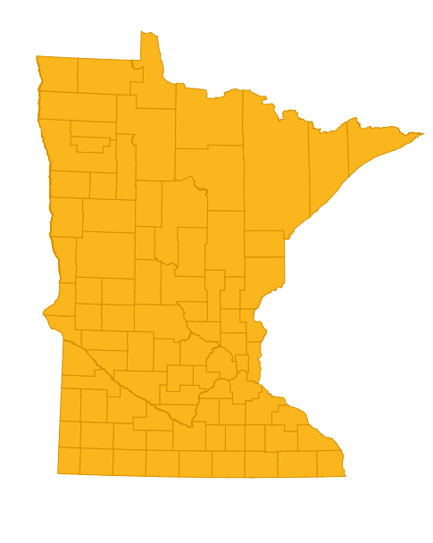
Aligning Policies and Services with PBS in Minnesota

Slide 6

Positive Supports Defined
Refers to all practices that include the following characteristics:
Person- centered interventions that demonstrate cultural competence and respect for human dignity
Evidence- based and promising practices
Include strategies for ongoing assessment and monitoring at individual and organizational levels
Are often implemented in combination with more than one practice

Slide 7

Examples of Positive Support Strategies
Person- centered thinking/ planning- foundational values
Positive behavior support
Applied behavior analysis
Assertive community treatment
Cognitive behavior therapy
Dialectical behavior therapy
Motivational interviewing
Wraparound planning/ Systems of care
Trauma informed practices
School- linked mental health

Slide 8
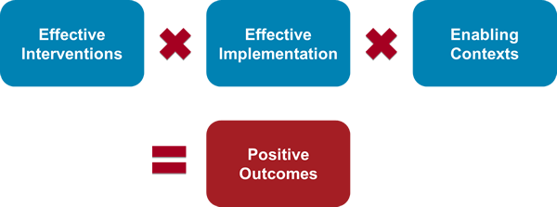
Addressing the Challenge
Statewide planning
Regional collaboration and capacity building
Use implementation science to embed evidence-based practices
Focus on establishing a continuum of increasingly intense interventions using a tiered approach

Slide 9
Minnesota Policies, Services, & TA Related to PBS
Tier 2 & 3 – Services, Training, Policies
Systems of care efforts for coordinating services
Children and adults needing intensive supports in transition
Medicaid reimbursement for staff, analysts, and professionals using positive supports
PBS standards of practice across home, school, work, and community settings
Expand trainers for evidence-based practices
Advocate-driven leadership in service, training, and policy development
Incentives for organizations supporting people who challenge our systems
Tier 1 Services, Training, & Policies
Systems of care efforts to coordinate services
Organization-wide training systems
Systems supporting smaller organizations
Regional capacity building and sustainability of practices
    Trainers - universal person-centered practices
    Awareness of key elements of PBS
Advocate-driven leadership in service, training, and policy development
Award and recognition for organizations with high fidelity

Slide 10
Minnesota Statewide Organization-Wide Training Infrastructure
Training Layers
Team Training (T1)
PCT Trainers/Coach Training (T1)
Picture of a Life Planners/Trainers
PBS Facilitators
Cohort 1 & 2A
Cohort 2B
Cohort 1 & Cohort 4
Cohort 3 & 4
Teams Trained = 29
Teams with TOET = 22
Organizations = 10
Notes:
Pope
Grant
Traverse
Stevens
Douglas
Horizon
PCS
AOC
8--5
Trillium
Range
SSL
SLC
RSI
5
Hennepin
RISE
Mainsl
2 organizations
5
ABC
Bear
Hiawatha
Olmstead
5 teams
9

Slide 11
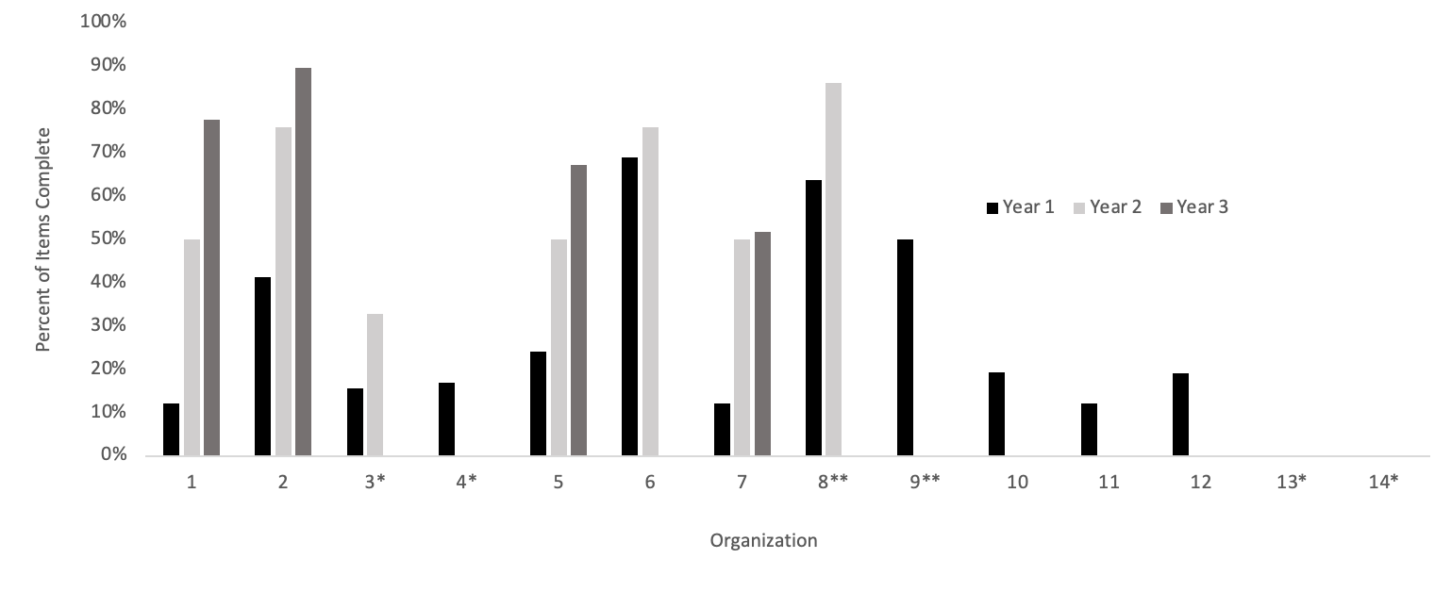
TOET Scores Across All Provider Organizations
Six+ Years of Implementation
Notes: TOET scores across participating organizations reflecting over six years of participation in TA. Organization 1 is the Case Study example. *Organizations participating that attrited. **Organizations that were part any earlier PC training funded by the state but became actively involved in the cohort model.
Freeman, R., Simacek, J., Jeffrey-Pearsall, J., Lee, S., Khalif, M., & Oteman, Q. (2022). Development of the Tiered Onsite Evaluation Tool (TOET) for organization-wide person-centered positive behavior support. Accepted with revisions. Journal of Positive Behavior Interventions.

Slide 12
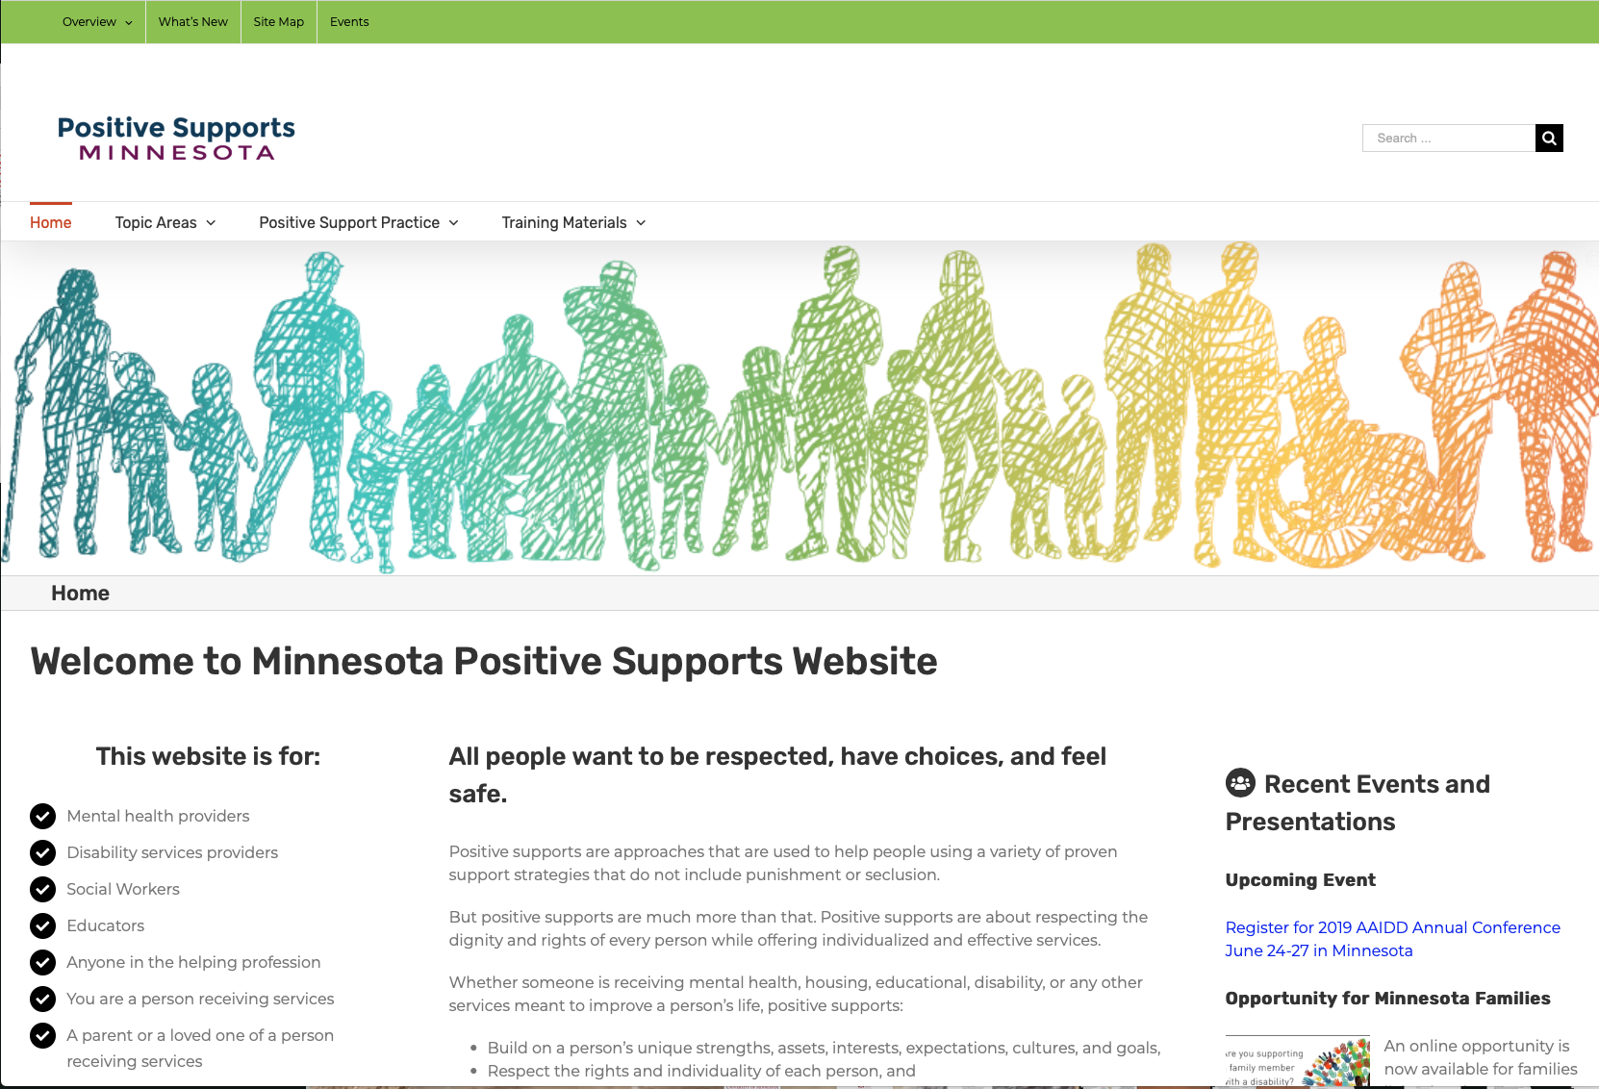
Free Resources - Visit MNPSP.ORG
MNPSP.ORG Website Training Materials Page
Notes:
Tthis is our website…if you want to see the training materials page it is free to the public….we don’t have the modules up…hopefully we will have a new version of the training materials page as we head into the new year.

Slide 13

Select Training Materials
Then Implementation Resources

Slide 14
Minnesota PBS VALUES
V=
A=
L =
U=
E=
S=
Values build on the strengths of children and adults, empower people and encourage culturally-responsiveness
All settings are important -- home, school, community
Lifespan emphasis of PBS supports diversity and inclusion
Understand & build on social and emotional skills
Evidence-based practices using behavioral, biomedical, and social science research
Systems change including universal strategies, minor problem solving, & individualized supports

Slide 15
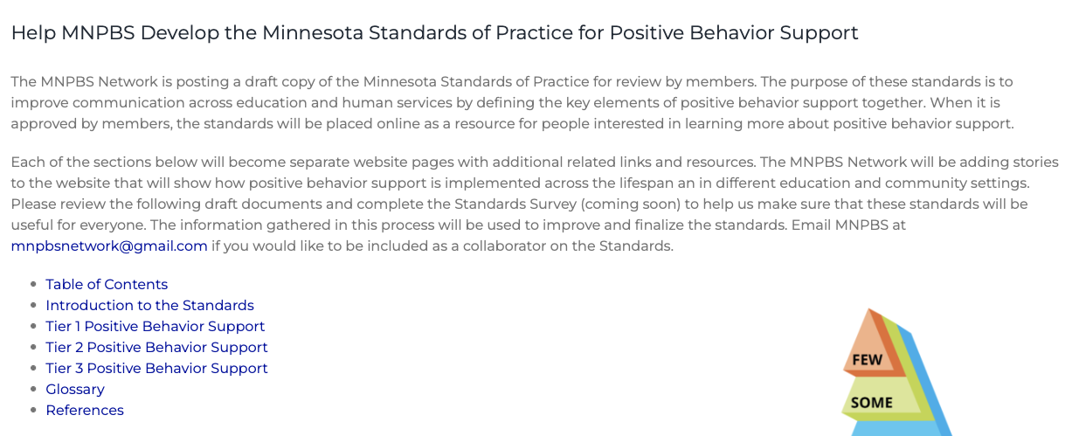
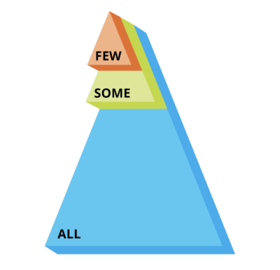
Minnesota Standards of Practice

Slide 16
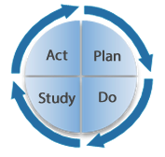
Establishing Measurement Systems for PBS
Summarized Data for Regions
Workforce and Organizational Fidelity & Outcome Measures
Quality of life
Incidents/restraint/injury
Staff attrition/retention
Climate surveys
Fidelity of implementation
State
Implementation Team
Summarized Data –More than One Organization
Regional
Teams
Regional Quality Council
Leadership
Summarized Data for Each Organization
Organizational Implementation
Team
Regional Quality Council Leadership
Improvement Cycles
Local Level Advocate Leadership
Notes:
State Quality Council, then working with regions as organizing hubs.
Local and state, then regional organizers, shows the data flow. How to work for provider orgs and counties. More details from PBIS, and the stage-based OW work. Data systems are not completely lined up yet, different organizational teams to from multi-state to local independent.
The school system has things that can be borrowed at human services systems levels.
Put the markers for OW, and show the same structures
This if the important implementation team framework that we need to have in place.

Slide 17


Minnesota’s Regional Quality Councils
(Video)

Slide 18

Minnesota’s Regional Quality Councils
Who is Involved:
People with disabilities, their families
County and state leaders
Organizations supporting people
Community members
What RQCs Do:
Collaborates with regional partners
Improve quality of services
Work with regions to monitor outcomes related to quality of life & person-centered outcomes

Slide 19
Co-Leadership Planning Efforts in Minnesota
Advise within statewide planning in positive supports
Partnership with ICI and Regional Quality Councils
  Plain language material development
  Assist with co-training in
    Universal person-centered practices
    Regional trainers supporting organizations
    PBS Facilitator training
  Quality of life measurement tools

Slide 20
Breaking Down Fragmentation Across Fields is a Challenge in the United States
Use Systems of Care to improve service coordination
Integrate interventions in behavioral health with PBS plans
Dual diagnosis including mental illness and learning disabilities
  Adapt behavioral health practices for each person supported
  Prevent self-injury and suicide before formal diagnoses

Slide 21

Minnesota Positive Behavior Support Network (MNPBS)

Slide 22
MNPBS Network is bringing practitioners together across settings, populations and the lifespan to articulate key PBS features and share about exemplary PBS at a community level.

Slide 23
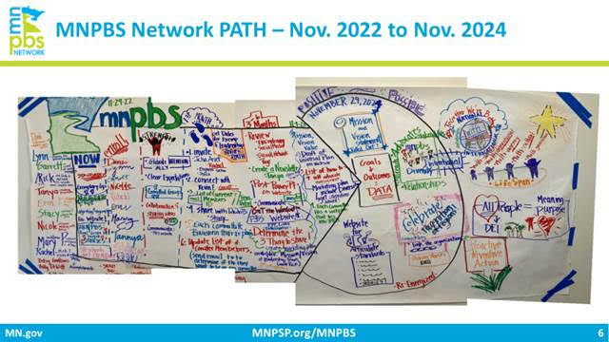
Our Current Work
PATH 2022
2024 Goals
Increase Diversity
  On MNPBS team
  Relationship building with groups that support diverse needs, listening sessions, and make the relationship mutually beneficial
Formalize Mission and Vision Statements
Complete and Place MN Standards Online
Award Celebration
Revise and Expand Evaluation & Measurement Systems

Slide 24
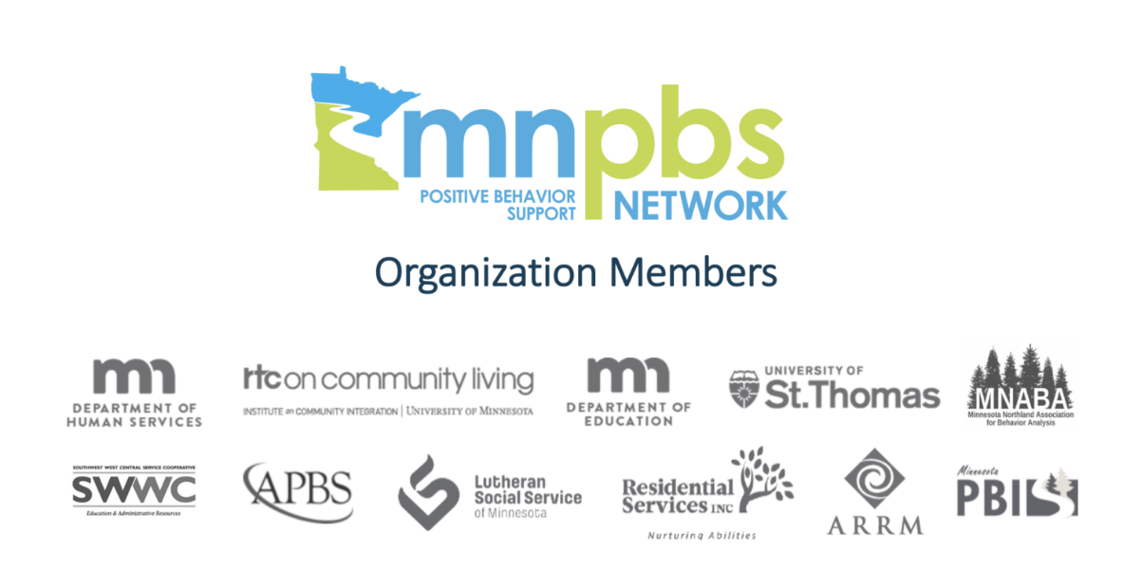
Connect With Us
Visit our website for more information:
http://mnpsp.org/mnpbs
Follow us on social media:
Facebook: @MNPBSnetwork
Twitter: @MNPBS
Subscribe to our YouTube page:
MNPBS Network YouTube Page
Join Us and Become a Member. Email us at:
mnpbsnetwork@gmail.com

Slide 25

APBS Conference in Minneapolis, 2026

Slide 26
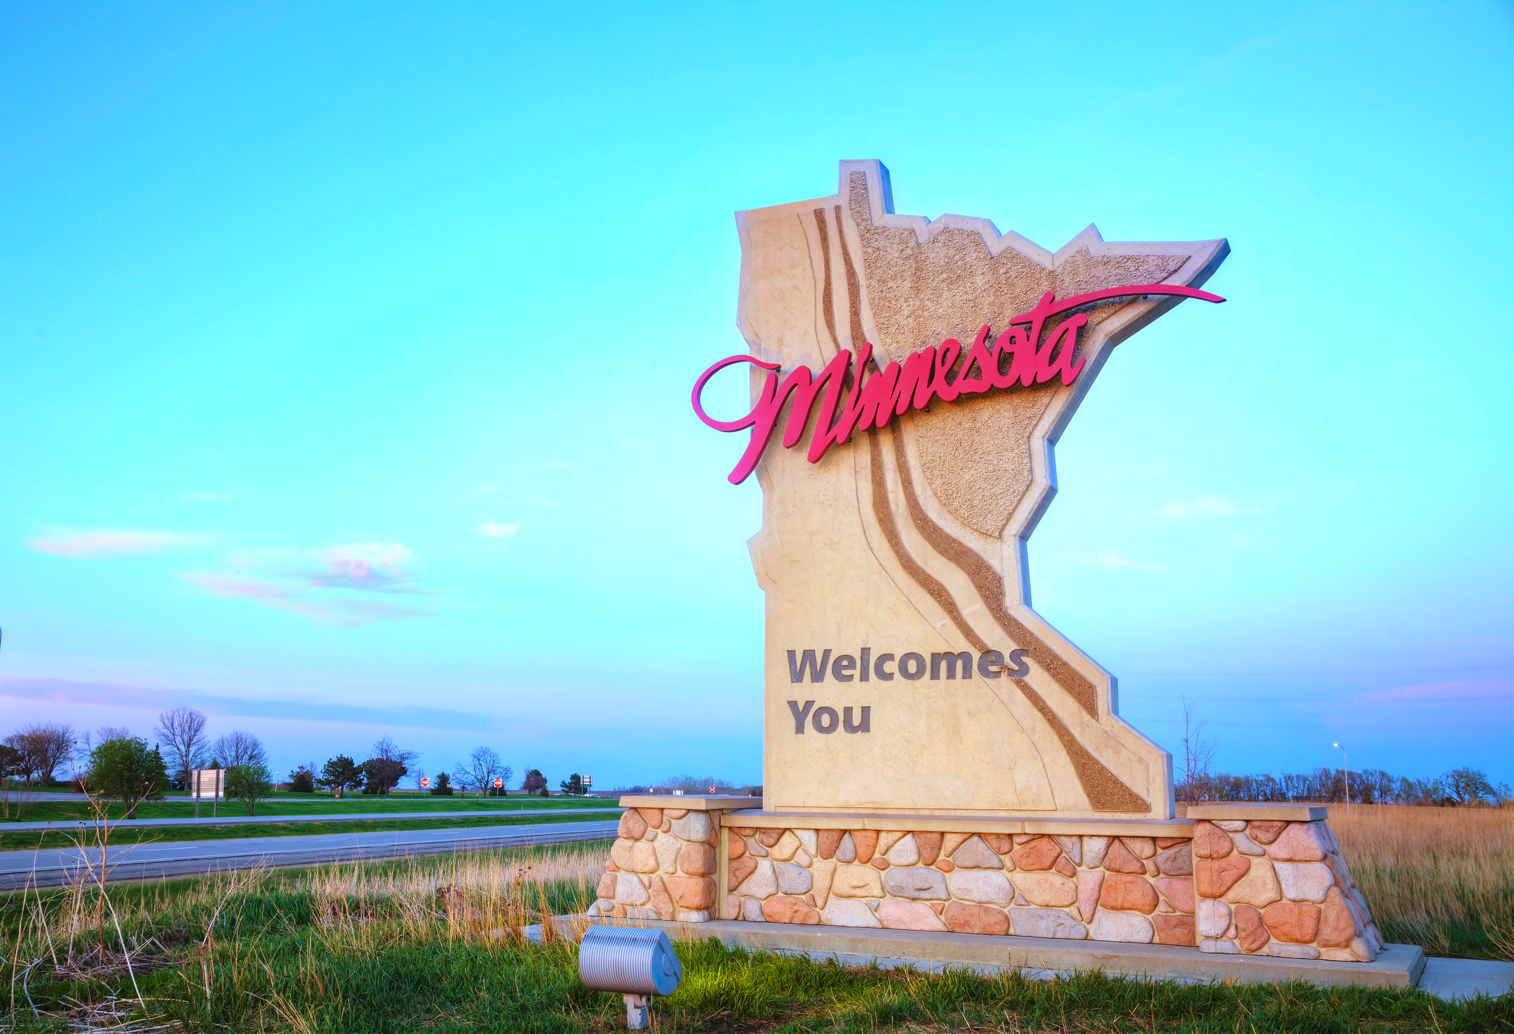

Slide 27

Resources
Home and Community Based Modules
MNPSP.ORG Universal Social Skills
Implementation Resources
Learn More About Person-Centered Strategies
Notes:
These are some direct links on MNPSP.ORG that may be helpful. Some of them are in the Training Materials section but you can find a lot of great resources related to your work.
Thanks for letting me share…I found that this panel presentation was cathartic for me….it has been a very tough year!

Slide 28


