Slide 1

Trauma Informed Care (TIC) and MTSS
Imad Zaheer
Pediatric School Psychologists
St. John’s University
Nurturing Environments Institute (NEI)

Slide 2

Agenda
Overview of trauma
Multi-tiered Systems of Support (MTSS)
Continuum of Tiered Supports
    Universal Supports (tier 1)
    Secondary Supports (tier 2)
    Tertiary Supports (tier 3)
Going beyond MTSS with Interconnected Systems Framework

Slide 3
Trauma

Slide 4
Trauma Statistics
60-80% of U.S. youth are exposed to trauma by age 18
  As high as 90% of children in an inner-city emergency department (Shemesh et al.)
Approximately 70% of adults internationally have experienced trauma
Approximately 20% of trauma survivors develop PTSD (range from 10-35%)
(Finkelhor et al., 2010, 2015)

Slide 5
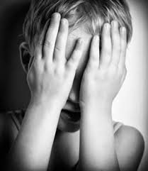
Prevalence
National prevalence surveys indicate that 13% of all children experience abuse or neglect during the prior year with the lifetime prevalence (up to age 18) of approximately one in four
Data collected by state CPS agencies shows that one in eight children in the United States experience substantiated maltreatment by age 18
Finkelhor, Turner, Shattuck, Hamby, & Kracke, 2015; Wildeman et al., 2014

Slide 6
Adverse Childhood Events
Physical, verbal, sexual abuse
Physical, emotional neglect
Alcoholic parent
Abuse of one’s mother
Family member in jail
Mentally ill family members
Loss of parent (divorce, death, or abandonment)

Slide 7
As number of ACES increases, so does the risk of the following
Alcoholism
Chronic obstructive pulmonary disease
Depression
Fetal death
Health related quality of life
Illicit drug use
Ischemic hearth disease
Liver disease
Poor work performance
Intimate partner violence
Multiple sexual partners
Sexually transmitted disease
Smoking
Suicide attempts
Unintended pregnancies
Early initiation of smoking
Early initiation of sexual activity
Adolescent pregnancy
Risk of sexual violence
Poor academic achievement

Slide 8
Defining Trauma
Trauma: an event when you or others are at risk of serious injury or death, or inappropriate touching of private parts. It counts if:
  It happens directly to you
  You see or hear it happen
  You learn about it from a family member or close friend (e.g., death)
Examples: disaster (hurricane, fire), accident (car crush, bike accident), child being hurt by an older child or adult
Acute (once) versus chronic (multiple times) versus complex (multiple incidents of multiple types of trauma)
Notes:
According to DSM-5 (APA, 2013)

Slide 9
Types of Trauma and Impact
Taking into accounts for all forms of traumas such as car accidents, community violence, and natural disasters, the number of individuals experiencing trauma increases substantially
Not all individuals who experience a potentially traumatic event develop traumatic stress symptoms
However, some develop a variety of psychological concerns that interfere with their educational performance, including but not limited to posttraumatic stress disorder (PTSD)
Ackerman, Newton, McPherson, Jones, & Dykman, 1998; Copeland, Keeler, Angold, & Costello, 2007; Perfect, Turley, Carlson, Yohanna, & Saint Gilles, 2016,

Slide 10
Response to Trauma
Trauma reactions:
  Feelings, thoughts, and behaviors about the trauma or reminders of the trauma
  For many people, this passes quickly; for some, this lasts a long time
  For many people, these reactions are not a big deal; for some, they are hard
Posttraumatic stress is one reaction to trauma:
  Feeling like the trauma is happening again (thoughts, nightmares)
  Avoiding anything that reminds you of the trauma
  Blaming yourself for the trauma
  Being jumpy, having trouble concentrating, and feeling nervous
Grief/Bereavement: deep sadness caused by someone’s death
Notes:
According to DSM-5 (APA, 2013)

Slide 11
Affective Trauma Symptoms
Fear
Sadness
Anger
Worry
Affective dysregulation

Slide 12
Physiological Trauma Symptoms
Fight/Flight/Freeze
Heart racing
Sweating
Choking sensation
Muscle tension

Slide 13
Behavioral Trauma Symptoms
Avoidance
  Modeling maladaptive behaviors
Sexualized behaviors
Violent behaviors
  Bullying
Traumatic bonding/attachment
Substance abuse
  Self-Injury

Slide 14
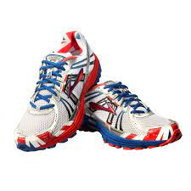

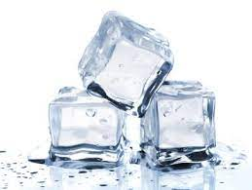
What are Behavioral Reactions to Trauma?
Common Behaviors
  Staying away from people, places or things that remind you of the trauma
    Not wanting to think or talk about it
  Acting more aggressive or acting out
  Using alcohol or drugs, hurting yourself on purpose
Notes:
EMILY SLIDE
-avoidance → flight
-aggression → fight
-alcohol/drugs/self-harm → freeze (numbing)

Slide 15
Cognitive Trauma Symptoms
Irrational Beliefs
Distrust
Causation of trauma
  Distorted self-image
  Loss/betrayal of social contract
  Accurate, but unhelpful, cognitions

Slide 16
Typical Trauma-Related Problems
Posttraumatic Stress Disorder (PTSD)
Acute Stress Disorder
Depression
Generalized Anxiety Disorder
Specific Phobias
Separation Anxiety Disorder
Secondary Enuresis or Encopresis
Oppositional Defiant Disorder
Conduct Disorder
Substance Abuse/Dependence

Slide 17
Threats Rewire the Brain Across the Life Span
Research from genetics/epigenetics, neuroscience and psychology are converging to show stress and threatening environments results in:
  Impaired self-regulation
  Hyper vigilance
  Mistrust of others
  Poor social relationships
  Deviant Peer groups
  Early childrearing
  Depression
  Obesity
  Cardiovascular disease
This pattern of behavior further increases the chances of stress and further physiological harm (Miller, Chen, Fok, et al., 2009)

Slide 18
Threats Rewire the Brain

Slide 19
We can Rewire the Brain Back with Nurturing Environments
MTSS can help us implement

Slide 20
Multi-tiered Systems of Support
(MTSS)
Framework for Effective Implementation

Slide 21
Multi-Tiered Systems of Support
FRAMEWORK for enhancing adoption & implementation of a
Continuum of evidence-based interventions to achieve
a full range of important outcomes for
All individuals served

Slide 22
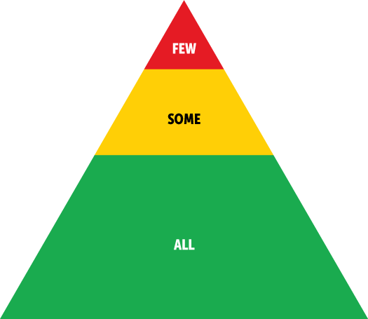
Multi-Tiered Systems Approach
5%
Promotion and Prevention
  Creating a positive, safe and supportive environment, teaching coping skills
Multi-tiered support
  Intensity of intervention matches magnitude of need
Data-based decision-making
  Making adjustments to the environment and how staff interact with individuals
15%
At least 80% Supported

Slide 23
Continuum of Support “Molcom”
PTSD
(angry outburst)
Universal
Targeted
Intensive
Prob Sol.
Ind. play
Adult rel.
Self-assess
Attend.
Coop play
Peer interac
Label behavior…not people
Dec 7, 2007
Notes:
NOTICE GREEN GOES IS FOR “ALL”
Baker, 2005 JPBI

Slide 24
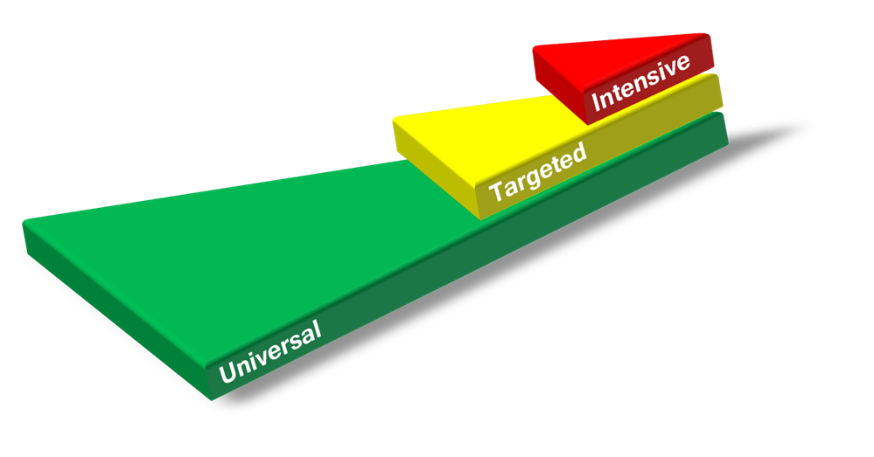
Layered
Notes:
Nate

Slide 25
Framework
& Logic
Highest needs need all three layers
Increase
Intensity
Tier 3
Tier 2
Increase
Intensity
Need at least 80% of the individuals responding at this level
Tier 1

Slide 26
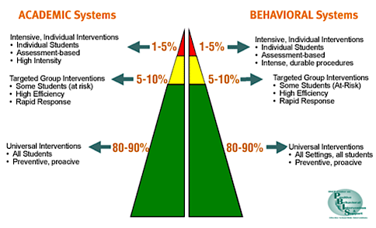
A School-wide Framework
A School-wide Multi-Tiered Systems framework
Notes:
Environmental redesign!!!
Schools throughout US and other countries are implementing academic and behavioral systems reflective of a tiered prevention model. Walker and colleagues in 1996 proposed a three-tiered model of prevention intervention approach that reflects a public health model (exercise and diet, blood pressure medication, more intensive treatments). An application of a behaviorally based system. Shift from reactive-punitive response to proactive

Slide 27
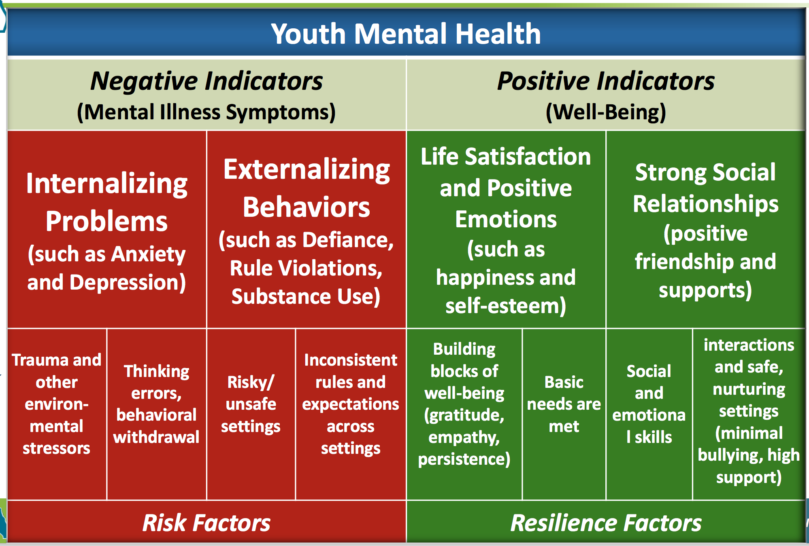
For Comprehensive Mental Health

Slide 28
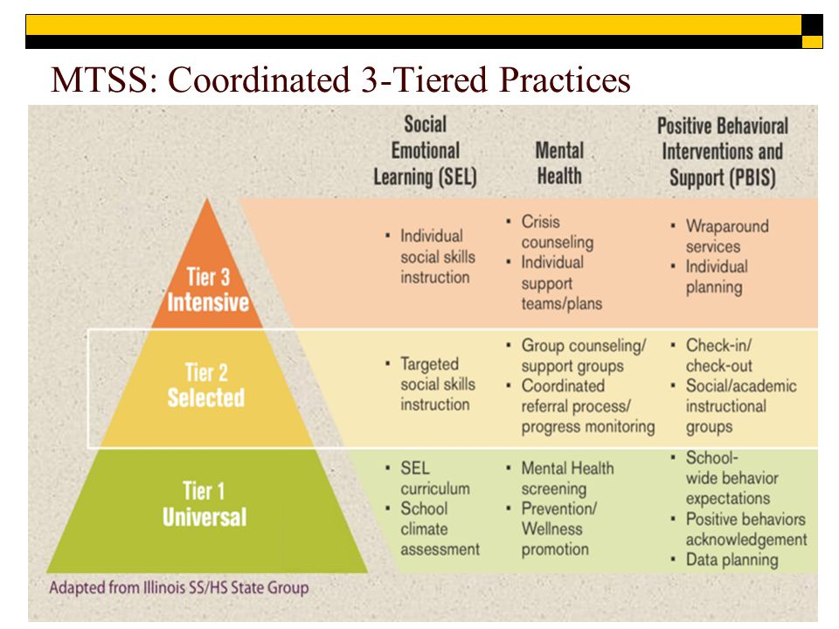
MTSS coordinated 3 tiered practices

Slide 29
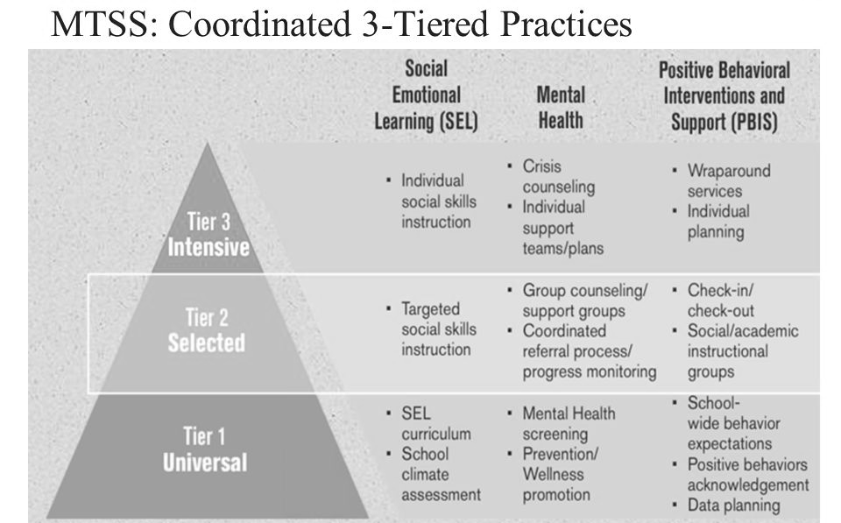
MTSS coordinated 3 tiered practices social emotional learning
Positive Indicators

Slide 30
MTSS coordinated 3 tiered practices mental health
Internalizing, traditional MH

Slide 31
MTSS coordinated 3 tiered practices positive behavioral interventions and support
Externalizing, School culture

Slide 32
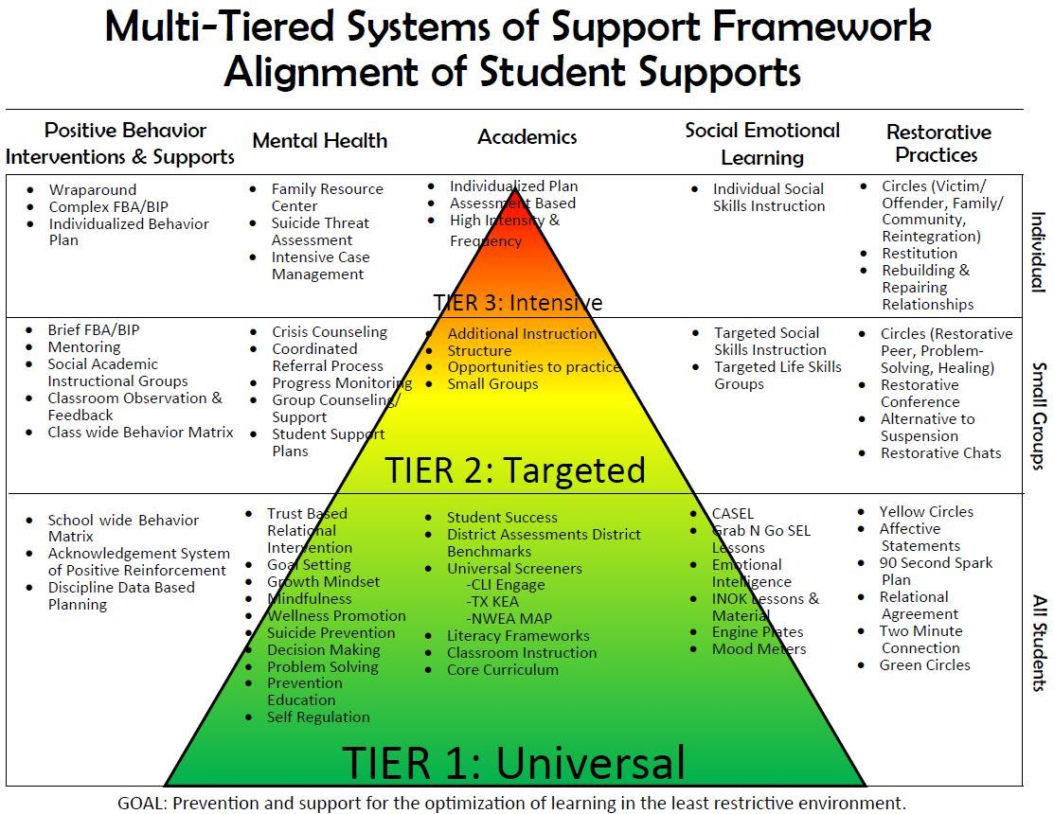
Multi-tiered systems of support framework alignment of student supports

Slide 33
Comprehensive Approach
Trauma and other environ-mental stressors

Slide 34
Multi-tiered systems of support framework alignment of student supports Including Trauma-Informed Care
Trauma Informed Care

Slide 35
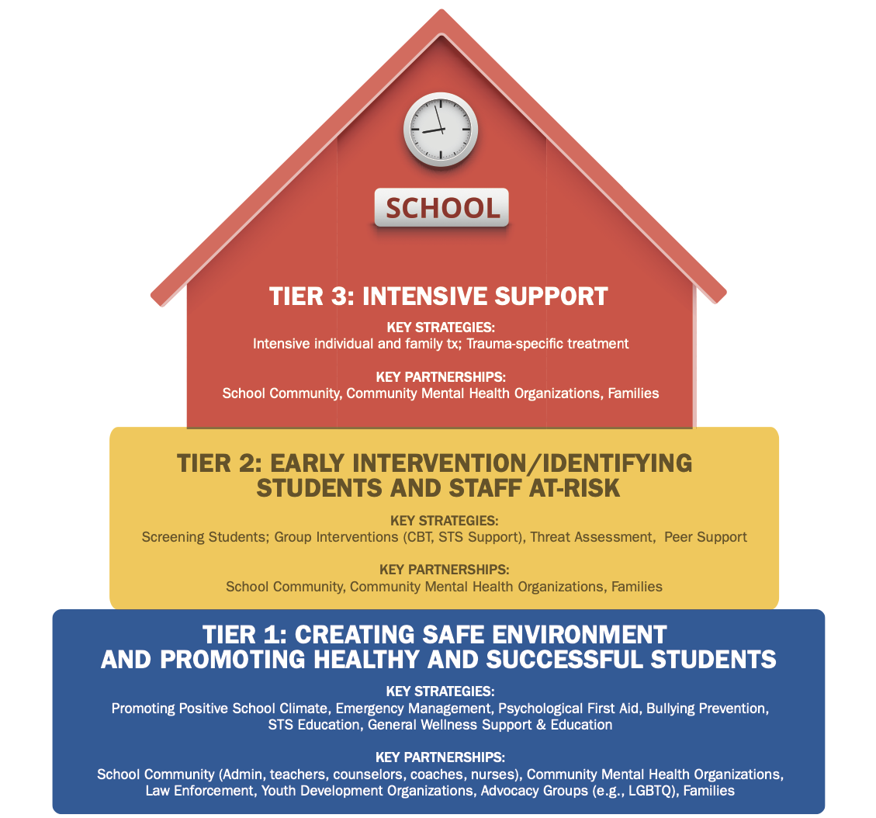
Trauma MTSS Models
NCTSN, 2018
Notes:
https://www.nctsn.org/sites/default/files/resources//creating_supporting_sustaining_trauma_informed_schools_a_systems_framework.pdf

Slide 36
Creating, supporting, sustaining trauma-informed schools, a systems framework
Notes:
https://www.nctsn.org/sites/default/files/resources//creating_supporting_sustaining_trauma_informed_schools_a_systems_framework.pdf

Slide 37
Creating, supporting, sustaining trauma-informed schools, a systems framework tier 1
Notes:
https://www.nctsn.org/sites/default/files/resources//creating_supporting_sustaining_trauma_informed_schools_a_systems_framework.pdf

Slide 38
Creating, supporting, sustaining trauma-informed schools, a systems framework tier 2
Notes:
https://www.nctsn.org/sites/default/files/resources//creating_supporting_sustaining_trauma_informed_schools_a_systems_framework.pdf

Slide 39
Creating, supporting, sustaining trauma-informed schools, a systems framework tier 3
Notes:
https://www.nctsn.org/sites/default/files/resources//creating_supporting_sustaining_trauma_informed_schools_a_systems_framework.pdf

Slide 40
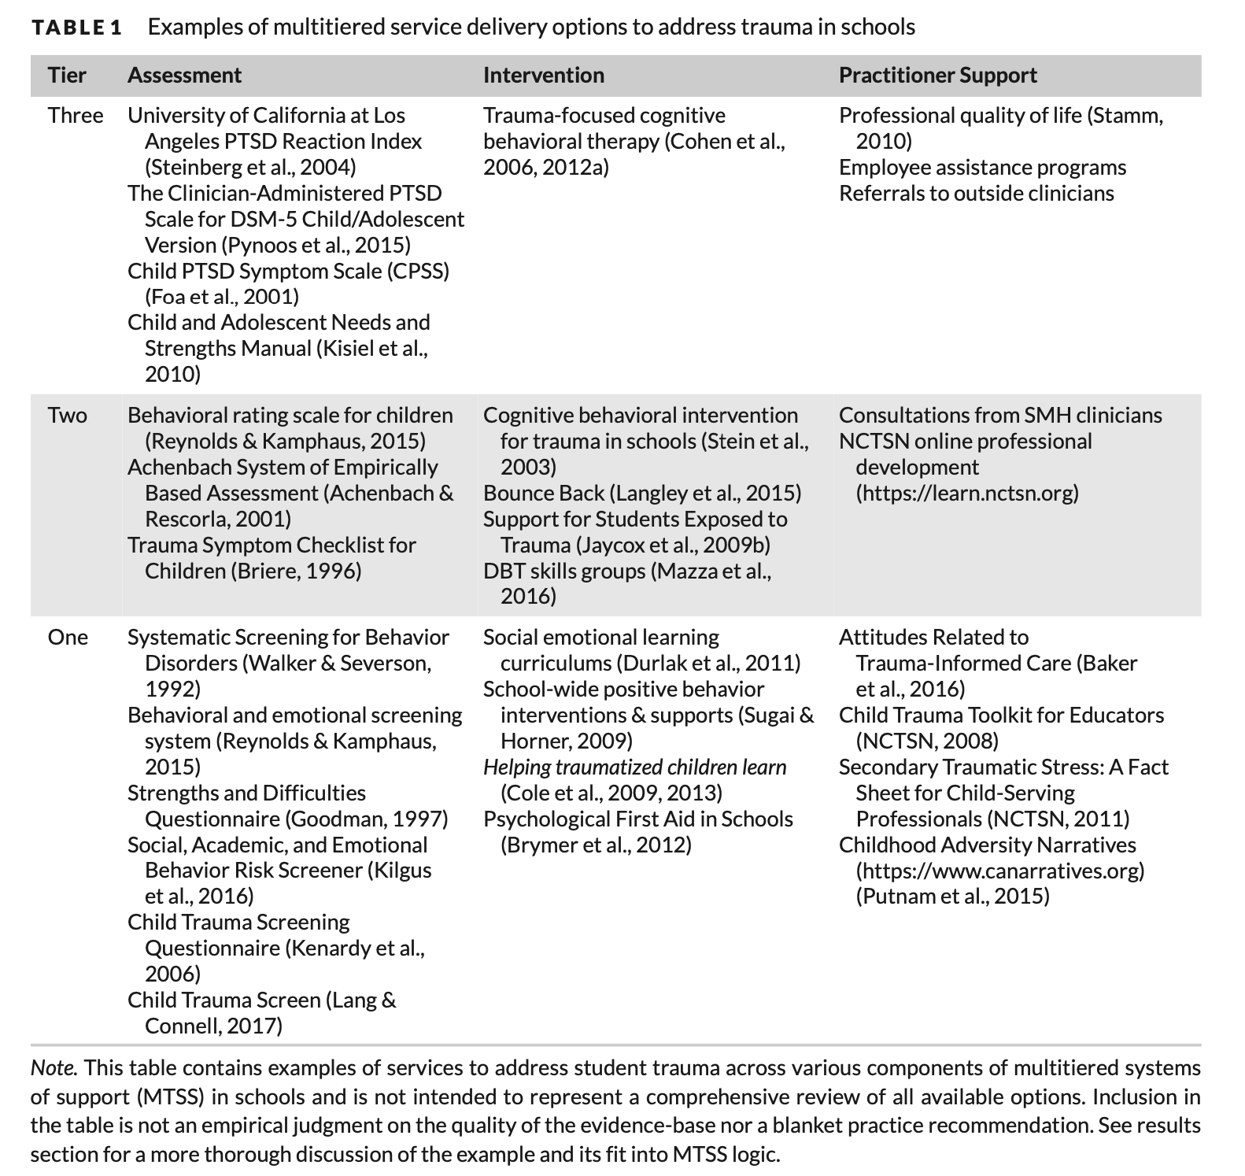
Trauma MTSS Models
Targeted Assessments Based on Suspected Risk
Reinbergs & Fefer, 2018
Universal Screening
(assess everyone)

Slide 41
Trauma-Informed Continuum of Supports

Slide 42
Trauma Informed Care (TIC)
Hard to define but broadly speaking
  “Trauma-informed care is defined as practices that promote a culture of safety, empowerment, and healing.”
  In need of specific and more concrete steps
Trauma Focused Treatments
  Clinical treatments for traumatized individuals (i.e., PTSD)
  Trauma-Focused Cognitive Behavior Therapy
  Prolonged Exposure
Continuum
of supports

Slide 43
MTSS & TIC
Trauma Focused Treatments
Intensified Individual Interventions
TF-CBT, AF-CBT
FBAs and BIPS
Small Group Treatments
CICO, Social Skills
Trauma-informed groups
SPR
System Wide practices
PBS & SEL → Align with SPR
Trauma Informed Lens
Psychological First Aid, 4 R’s of Trauma, Instructional Programs on trauma/resilience
Trauma Informed Care

Slide 44
MTSS & TIC
Trauma Focused Treatments
Intensified Individual Interventions
TF-CBT, AF-CBT
FBAs and BIPS
Small Group Treatments
CICO, Social Skills
Trauma-informed groups
SPR
System Wide practices
PBS & SEL → Align with SPR
Trauma Informed Lens
Psychological First Aid, 4 R’s of Trauma, Instructional Programs on trauma/resilience
Trauma Informed Care

Slide 45
Universal, System-Wide Supports (Tier 1)
Trauma-informed Lens
  Trauma-informed teaching
Psychoeducation- Trauma 101
PBS & SEL
Psychological First Aid

Slide 46

Changing Our Lens
Trauma Informed Lens
Shifting from “what’s wrong with you” to “what happened?” “How can I help?”
From “discipline problems” to “social emotional learning challenges”

Slide 47
Tier 1: TIC
Trauma-informed teaching recognizes the frequency and classroom impacts of childhood trauma, focuses on relationship building and emotional regulation instruction instead of punishment, and emotional safety and consistency, and tries to support the “whole student” in the classroom.

Slide 48
Tier 1: Psychoeducation (Trauma 101)
Communicating the basic information around trauma, what is it? How to spot it (in yourself or others) and what you can do about it.
https://www.youtube.com/watch?v=KoqaUANGvpA&t=280s

Slide 49
Tier 1: 3 E’s: Events, Experiences, Effects
EVENT
EXPERIENCE
EFFECT
Event and circumstances may include the actual or extreme threat of physical or psychological harm (i.e. natural disasters, violence, etc.) or severe, life-threatening neglect for a child that imperils healthy development.
The individual’s experience of these events or circumstances helps to determine whether it
is a traumatic event. A particular event may be experienced as traumatic for one individual and not for another (e.g., a child removed from an abusive home experiences this differently than their sibling; one refugee may experience fleeing one’s country differently from another refugee; one military veteran may experience deployment to a war zone as traumatic while another veteran is not similarly affected).
The long-lasting adverse effects of the event are a critical component of trauma. These adverse effects may occur immediately or may have a delayed onset. The duration of the effects can be short to long term.
https://store.samhsa.gov/sites/default/files/d7/priv/sma14-4884.pdf

Slide 50
Tier 1: 4 R’s: Realize, Recognize, Respond and Resist re-traumatization
Realize
All people at all levels of the organization or system have a basic realization about trauma and understand how trauma can affect families, groups, organizations, and communities as well as individuals.
Recognize
People in the organization or system are also able to recognize the signs of trauma. These signs may be gender, age, or setting-specific and may be manifest by individuals seeking or providing services in these settings
Respond
The program, organization, or system responds by applying the principles of a trauma-informed approach to all areas of functioning. The program, organization, or system integrates an understanding that the experience of traumatic events impacts all people involved, whether directly or indirectly.
Resist Re-Traumatization
A trauma-informed approach seeks to resist re-traumatization of clients as well as staff. Organizations often inadvertently create stressful or toxic environments that interfere with the recovery of individual, the well-being of staff and the fulfillment of the organizational mission
https://store.samhsa.gov/sites/default/files/d7/priv/sma14-4884.pdf

Slide 51
Tier 1: PBS & SEL
Creating Safe and Consistent Environment
Nurturing Positive Organizational Culture, Relationships and connectedness
Explicit instruction around social, emotional, and behavioral expectations
Teaching
  Emotion identification,
  Emotion regulation
  Social problem-solving
Promote
  Resiliency,
  Adaptive coping,
  Well-being
For everyone, including those who have been exposed to trauma
(Durlak, Weissberg, Dymnicki, Taylor, & Schellinger, 2011)

Slide 52
Tier 1: TIC
Psychological First Aid (free Training)
https://www.nctsn.org/treatments-and-practices/psychological-first-aid-and-skills-for-psychological-recovery/about-pfa
Notes:
Psychological First Aid (free Training)
https://www.nctsn.org/treatments-and-practices/psychological-first-aid-and-skills-for-psychological-recovery/about-pfa

Slide 53
Tier 1: Psychological First Aid Actions
Contact and Engagement: To respond to contacts initiated by survivors, or to initiate contacts in a non-intrusive, compassionate, and helpful manner.
Safety and Comfort: To enhance immediate and ongoing safety, and provide physical and emotional comfort.
Stabilization (if needed): To calm and orient emotionally overwhelmed or disoriented survivors.
Information Gathering on Current Needs and Concerns: To identify immediate needs and concerns, gather additional information, and tailor Psychological First Aid interventions.
Practical Assistance: To offer practical help to survivors in addressing immediate needs and concerns.
Connection with Social Supports: To help establish brief or ongoing contacts with primary support persons and other sources of support, including family members, friends, and community helping resources.
Information on Coping: To provide information about stress reactions and coping to reduce distress and promote adaptive functioning.
Linkage with Collaborative Services: To link survivors with available services needed at the time or in the future.
Notes:
Psychological First Aid (free Training)
https://www.nctsn.org/treatments-and-practices/psychological-first-aid-and-skills-for-psychological-recovery/about-pfa

Slide 54
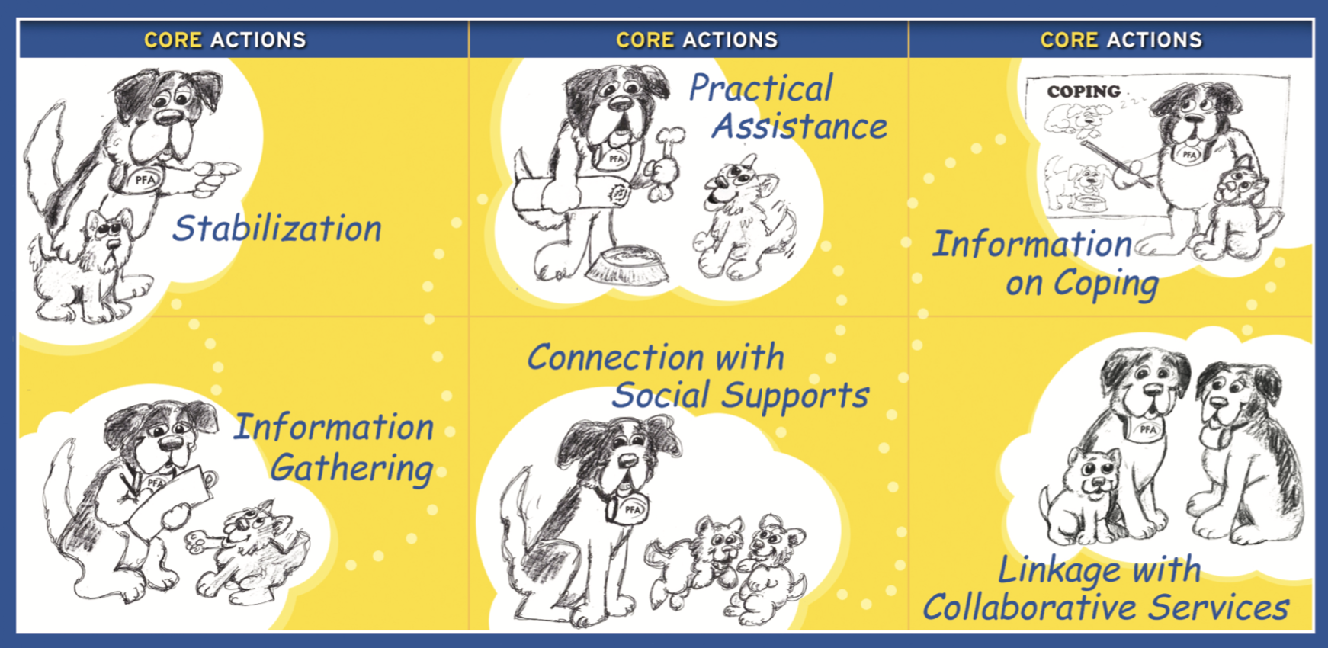
Core Actions
Notes:
Contact and Engagement: To respond to contacts initiated by survivors, or to initiate contacts in a non-intrusive, compassionate, and helpful manner.
Safety and Comfort: To enhance immediate and ongoing safety, and provide physical and emotional comfort.
Stabilization (if needed): To calm and orient emotionally overwhelmed or disoriented survivors.
Information Gathering on Current Needs and Concerns: To identify immediate needs and concerns, gather additional information, and tailor Psychological First Aid interventions.
Practical Assistance: To offer practical help to survivors in addressing immediate needs and concerns.
Connection with Social Supports: To help establish brief or ongoing contacts with primary support persons and other sources of support, including family members, friends, and community helping resources.
Information on Coping: To provide information about stress reactions and coping to reduce distress and promote adaptive functioning.
Linkage with Collaborative Services: To link survivors with available services needed at the time or in the future.

Slide 55
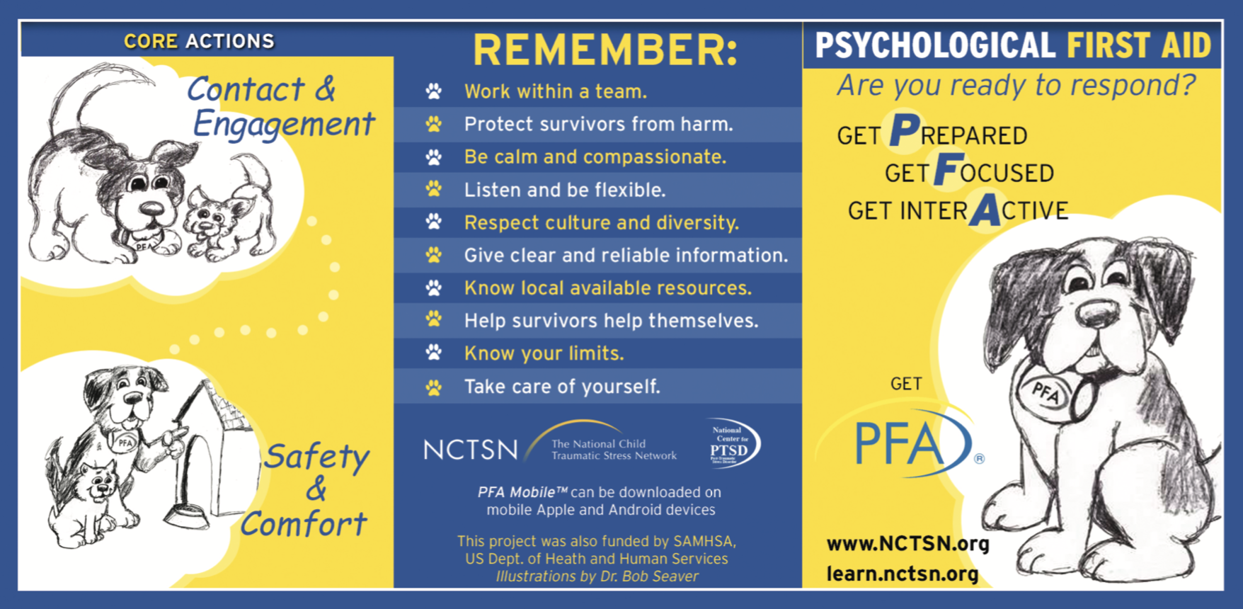
Psychological First Aid

Slide 56


Tier 1: Micro-strategies
De-escalation
Active Listening
Notes:
Psychological First Aid (free Training)
https://www.nctsn.org/treatments-and-practices/psychological-first-aid-and-skills-for-psychological-recovery/about-pfa

Slide 57
Tier 1: Micro-strategies
De-escalation
Active Listening
Notes:
Psychological First Aid (free Training)
https://www.nctsn.org/treatments-and-practices/psychological-first-aid-and-skills-for-psychological-recovery/about-pfa

Slide 58
Hostile Attribution Bias
When a individual has experienced a trauma, they can be triggered or reminded of the trauma, and may respond with FIGHT, FLIGHT or FREEZE
Sometimes a situation seems harmless or accidental, but a individual reacts as if they are threatened—this is a result of that individual having a “hostile attribution bias”
A hostile attribution bias is a tendency to think others are going to hurt you
Very common in individuals who have been through violence

Slide 59
Tripartite Model/Feelings Triangle
Situation: Two boys knock into one another while walking down the hall. One boy views it as intentional and hostile.
Thoughts
Behaviors
Body Reactions
“He did that on purpose.”
“He is going to hurt me.”
Scared
Heart racing
Sweating
Clenched fists
Punch, push, yell
Notes:
59
59
59
This is the feelings triangle. As you can see, the way we feel is shown by our thoughts, what happens in our body, and what we do. And notice the double arrows—this means that each affects the other.
Give an example (“So, if I am in a situation that makes me [emotion], my thoughts might be…. In my body, I would feel…. I would be….”)

Slide 60
Goals of De-escalation
Calm the individual who feels scared by giving them the perception of control
Calm the room
Prevent escalation so everyone is safe
Create a space in which to discuss what happened
Begin effective problem solving

Slide 61
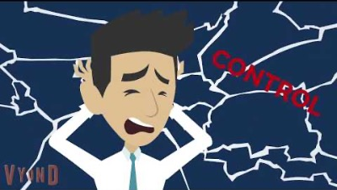
Guide to De-escalation

Slide 62
De-escalation with One Individual
Check in with yourself
Maintain a calm presence
Recognize your physiological response
Act counter to it
  If working with children, lower yourself so you are lower than the child
  Lower your voice and slow the pace of your speech
  Say little (do not try to problem solve)
Use relaxation strategies with the individual after de-escalation has begun
At a later date, process what happened (using triangle)

Slide 63
De-escalation with a Group
Identify who: group member vs whole group
Identify why: topic or timing
Check in with yourself
  It’s outside of you
  Pause and ground yourself, then be calm center
Steps
  Redirect to structured activity
  Re-engage by giving purpose / responsibilities
  Recharge through relaxation, mindfulness, or activation
  Reinforce engagement in appropriate behavior
  Review once restored

Slide 64
Takeaways
Traumatized individuals often misread social cues and think others might hurt them, resulting in anger and acting out
De-escalation is about calming the room and giving control through
  Listening (rather than explaining)
  Moving slowly
  Talking in a slow, quiet voice
  Lowering your body
Self-care is important after engaging in de-escalation

Slide 65
Tier 1: Micro-strategies
De-escalation
Active Listening
Notes:
Psychological First Aid (free Training)
https://www.nctsn.org/treatments-and-practices/psychological-first-aid-and-skills-for-psychological-recovery/about-pfa

Slide 66
Talking about Trauma
Many individuals do not disclose trauma
If they do tell someone, it is a friend or parent (mother)
How we respond when someone tells us that they have been through trauma will affect whether they tell anyone else and levels of PTSD and depression symptoms
It is critical to listen without judgement

Slide 67
Active Listening
Goal: to learn what students are thinking and feeling
  Ask open-ended questions about what they feel, know, believe
  Listen (eye contact, nodding, summarizing what they tell you)
  Validate feelings (“I understand why you would feel…”)
  Educate to normalize their experience and clarify inaccuracies; be honest about what you do not know
    “You are not alone. Many students are feeling sad and anxious right now.”
    “Not knowing when we’ll be back to normal is hard.”
  Encourage questions and answer only what is asked (children ask questions in a form that they can handle the answer to)
    “What questions do you have for me?”
  Don’t rush to fix, think positive, or problem solve

Slide 68

How you can help: Active Listening
Examples of Active Listening from TV

Slide 69
Tier 1: Micro-strategies
De-escalation
Active Listening
Key to preventing re-traumatizing and connecting to other services
Notes:
Psychological First Aid (free Training)
https://www.nctsn.org/treatments-and-practices/psychological-first-aid-and-skills-for-psychological-recovery/about-pfa

Slide 70
MTSS & TIC
Trauma Focused Treatments
Intensified Individual Interventions
TF-CBT, AF-CBT
FBAs and BIPS
Small Group Treatments
CICO, Social Skills
Trauma-informed groups
SPR
System Wide practices
PBIS & SEL → Align with SPR
Trauma Informed Lens
Psychological First Aid, 4 R’s of Trauma, Instructional Programs on trauma/resilience
Trauma Informed Care

Slide 71
MTSS & TIC
Trauma Focused Treatments
Intensified Individual Interventions
TF-CBT, AF-CBT
FBAs and BIPS
Small Group Treatments
CICO, Social Skills
Trauma-informed groups
SPR
System Wide practices
PBIS & SEL → Align with SPR
Trauma Informed Lens
Psychological First Aid, 4 R’s of Trauma, Instructional Programs on trauma/resilience
Trauma Informed Care

Slide 72
Tier 2: More Intensive/Small Group
Typically but not always in small group format
Examples:
  Skills for Psychological Recovery
  School based groups
    CBITS
    SSET
Typically, can be delivered by non-mental health professionals
http://cbitsprogram.org

Slide 73
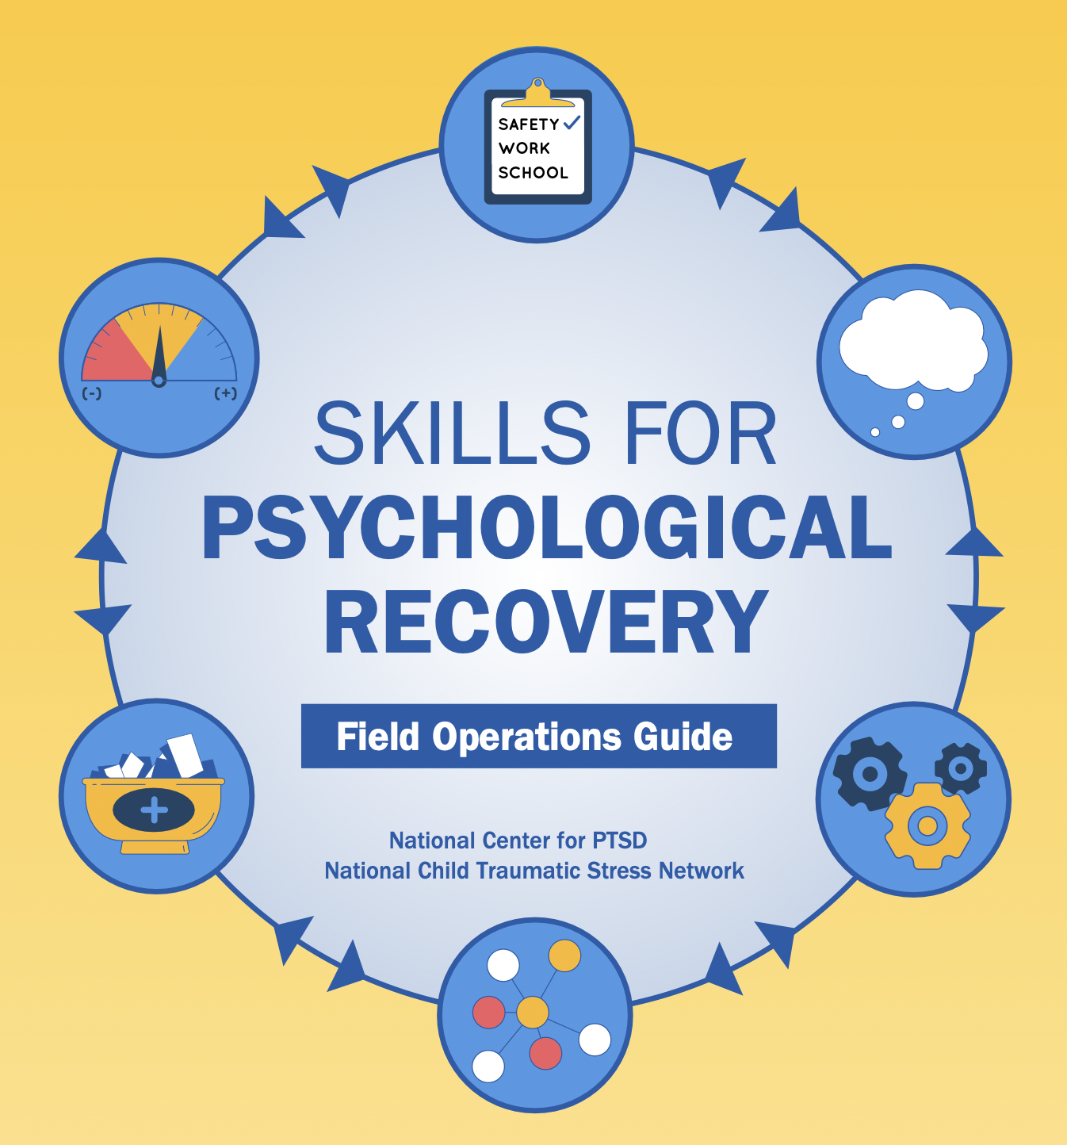
Skills for psychological recovery, field operations guide

Slide 74
Skills for Psychological Recovery (SPR)
Individual support intervention for individuals at-risk for trauma related disorders
  Made for children/adolescents but easily applicable for adults
Can be implemented by non-mental health professionals
Main modality is individual but can be applied as a group
https://www.nctsn.org/resources/skills-for-psychological-recovery

Slide 75
Skills for Psychological Recovery (SPR)
Gathering Information and Prioritizing Assistance
Building Problem-Solving Skills
Promoting Positive Activities
Managing Reactions
Promoting Helpful Thinking
Rebuilding Healthy Social Connections
6 Core Strategies
Notes:
Gathering Information and Prioritizing Assistance helps survivors to identify their primary concerns and to pick the SPR strategy to focus on.
Building Problem-Solving Skills teaches survivors the tools to break problems down into more manageable chunks, identify a range of ways to respond, and create an action plan to move forward.
Promoting Positive Activities guides survivors to increase meaningful and positive activities in their schedule, with the goal of building resilience and bringing more fulfillment and enjoyment into their life.
Managing Reactions helps survivors to better manage distressing physical and emotional reactions by using such tools as breathing retraining, writing exercises, and identifying and planning for triggers and reminders.
Promoting Helpful Thinking assists survivors learn how their thoughts influence their emotions, become more aware of what they are saying to themselves, and replace unhelpful with more helpful thoughts
Rebuilding Healthy Social Connections encourages survivors to access and enhance social and community supports while keeping in mind the current post-disaster recovery circumstances.

Slide 76
Skills for Psychological Recovery (SPR)
Gathering Information and Prioritizing Assistance
Building Problem-Solving Skills
Promoting Positive Activities
Managing Reactions
Promoting Helpful Thinking
Rebuilding Healthy Social Connections
Helps survivors to identify their primary concerns and to pick the SPR strategy to focus on.
Also decide if SPR is not appropriate and other, more intensive strategies are needed
Notes:
Gathering Information and Prioritizing Assistance helps survivors to identify their primary concerns and to pick the SPR strategy to focus on.
Building Problem-Solving Skills teaches survivors the tools to break problems down into more manageable chunks, identify a range of ways to respond, and create an action plan to move forward.
Promoting Positive Activities guides survivors to increase meaningful and positive activities in their schedule, with the goal of building resilience and bringing more fulfillment and enjoyment into their life.
Managing Reactions helps survivors to better manage distressing physical and emotional reactions by using such tools as breathing retraining, writing exercises, and identifying and planning for triggers and reminders.
Promoting Helpful Thinking assists survivors learn how their thoughts influence their emotions, become more aware of what they are saying to themselves, and replace unhelpful with more helpful thoughts
Rebuilding Healthy Social Connections encourages survivors to access and enhance social and community supports while keeping in mind the current post-disaster recovery circumstances.

Slide 77
Skills for Psychological Recovery (SPR)
Gathering Information and Prioritizing Assistance
Building Problem-Solving Skills
Promoting Positive Activities
Managing Reactions
Promoting Helpful Thinking
Rebuilding Healthy Social Connections
Teaches survivors the tools to break problems down into more manageable chunks, identify a range of ways to respond, and create an action plan to move forward.
Notes:
Gathering Information and Prioritizing Assistance helps survivors to identify their primary concerns and to pick the SPR strategy to focus on.
Building Problem-Solving Skills teaches survivors the tools to break problems down into more manageable chunks, identify a range of ways to respond, and create an action plan to move forward.
Promoting Positive Activities guides survivors to increase meaningful and positive activities in their schedule, with the goal of building resilience and bringing more fulfillment and enjoyment into their life.
Managing Reactions helps survivors to better manage distressing physical and emotional reactions by using such tools as breathing retraining, writing exercises, and identifying and planning for triggers and reminders.
Promoting Helpful Thinking assists survivors learn how their thoughts influence their emotions, become more aware of what they are saying to themselves, and replace unhelpful with more helpful thoughts
Rebuilding Healthy Social Connections encourages survivors to access and enhance social and community supports while keeping in mind the current post-disaster recovery circumstances.

Slide 78
Skills for Psychological Recovery (SPR)
Gathering Information and Prioritizing Assistance
Building Problem-Solving Skills
Promoting Positive Activities
Managing Reactions
Promoting Helpful Thinking
Rebuilding Healthy Social Connections
Guides survivors to increase meaningful and positive activities in their schedule, with the goal of building resilience and bringing more fulfillment and enjoyment into their life.
Notes:
Gathering Information and Prioritizing Assistance helps survivors to identify their primary concerns and to pick the SPR strategy to focus on.
Building Problem-Solving Skills teaches survivors the tools to break problems down into more manageable chunks, identify a range of ways to respond, and create an action plan to move forward.
Promoting Positive Activities guides survivors to increase meaningful and positive activities in their schedule, with the goal of building resilience and bringing more fulfillment and enjoyment into their life.
Managing Reactions helps survivors to better manage distressing physical and emotional reactions by using such tools as breathing retraining, writing exercises, and identifying and planning for triggers and reminders.
Promoting Helpful Thinking assists survivors learn how their thoughts influence their emotions, become more aware of what they are saying to themselves, and replace unhelpful with more helpful thoughts
Rebuilding Healthy Social Connections encourages survivors to access and enhance social and community supports while keeping in mind the current post-disaster recovery circumstances.

Slide 79
Skills for Psychological Recovery (SPR)
Gathering Information and Prioritizing Assistance
Building Problem-Solving Skills
Promoting Positive Activities
Managing Reactions
Promoting Helpful Thinking
Rebuilding Healthy Social Connections
Helps survivors to better manage distressing physical and emotional reactions by using such tools as breathing retraining, writing exercises, and identifying and planning for triggers and reminders.
Notes:
Gathering Information and Prioritizing Assistance helps survivors to identify their primary concerns and to pick the SPR strategy to focus on.
Building Problem-Solving Skills teaches survivors the tools to break problems down into more manageable chunks, identify a range of ways to respond, and create an action plan to move forward.
Promoting Positive Activities guides survivors to increase meaningful and positive activities in their schedule, with the goal of building resilience and bringing more fulfillment and enjoyment into their life.
Managing Reactions helps survivors to better manage distressing physical and emotional reactions by using such tools as breathing retraining, writing exercises, and identifying and planning for triggers and reminders.
Promoting Helpful Thinking assists survivors learn how their thoughts influence their emotions, become more aware of what they are saying to themselves, and replace unhelpful with more helpful thoughts
Rebuilding Healthy Social Connections encourages survivors to access and enhance social and community supports while keeping in mind the current post-disaster recovery circumstances.

Slide 80
Skills for Psychological Recovery (SPR)
Gathering Information and Prioritizing Assistance
Building Problem-Solving Skills
Promoting Positive Activities
Managing Reactions
Promoting Helpful Thinking
Rebuilding Healthy Social Connections
Assists survivors learn how their thoughts influence their emotions, become more aware of what they are saying to themselves, and replace unhelpful with more helpful thoughts
Notes:
Gathering Information and Prioritizing Assistance helps survivors to identify their primary concerns and to pick the SPR strategy to focus on.
Building Problem-Solving Skills teaches survivors the tools to break problems down into more manageable chunks, identify a range of ways to respond, and create an action plan to move forward.
Promoting Positive Activities guides survivors to increase meaningful and positive activities in their schedule, with the goal of building resilience and bringing more fulfillment and enjoyment into their life.
Managing Reactions helps survivors to better manage distressing physical and emotional reactions by using such tools as breathing retraining, writing exercises, and identifying and planning for triggers and reminders.
Promoting Helpful Thinking assists survivors learn how their thoughts influence their emotions, become more aware of what they are saying to themselves, and replace unhelpful with more helpful thoughts
Rebuilding Healthy Social Connections encourages survivors to access and enhance social and community supports while keeping in mind the current post-disaster recovery circumstances.

Slide 81
Skills for Psychological Recovery (SPR)
Gathering Information and Prioritizing Assistance
Building Problem-Solving Skills
Promoting Positive Activities
Managing Reactions
Promoting Helpful Thinking
Rebuilding Healthy Social Connections
Encourages survivors to access and enhance social and community supports while keeping in mind the current post-disaster recovery circumstances.
Notes:
Gathering Information and Prioritizing Assistance helps survivors to identify their primary concerns and to pick the SPR strategy to focus on.
Building Problem-Solving Skills teaches survivors the tools to break problems down into more manageable chunks, identify a range of ways to respond, and create an action plan to move forward.
Promoting Positive Activities guides survivors to increase meaningful and positive activities in their schedule, with the goal of building resilience and bringing more fulfillment and enjoyment into their life.
Managing Reactions helps survivors to better manage distressing physical and emotional reactions by using such tools as breathing retraining, writing exercises, and identifying and planning for triggers and reminders.
Promoting Helpful Thinking assists survivors learn how their thoughts influence their emotions, become more aware of what they are saying to themselves, and replace unhelpful with more helpful thoughts
Rebuilding Healthy Social Connections encourages survivors to access and enhance social and community supports while keeping in mind the current post-disaster recovery circumstances.

Slide 82
Skills for Psychological Recovery (SPR)
Gathering Information and Prioritizing Assistance
Building Problem-Solving Skills
Promoting Positive Activities
Managing Reactions
Promoting Helpful Thinking
Rebuilding Healthy Social Connections
6 Core Strategies
Missing exposure component to trauma treatments
Other tier 2 strategies do include exposure
Notes:
Gathering Information and Prioritizing Assistance helps survivors to identify their primary concerns and to pick the SPR strategy to focus on.
Building Problem-Solving Skills teaches survivors the tools to break problems down into more manageable chunks, identify a range of ways to respond, and create an action plan to move forward.
Promoting Positive Activities guides survivors to increase meaningful and positive activities in their schedule, with the goal of building resilience and bringing more fulfillment and enjoyment into their life.
Managing Reactions helps survivors to better manage distressing physical and emotional reactions by using such tools as breathing retraining, writing exercises, and identifying and planning for triggers and reminders.
Promoting Helpful Thinking assists survivors learn how their thoughts influence their emotions, become more aware of what they are saying to themselves, and replace unhelpful with more helpful thoughts
Rebuilding Healthy Social Connections encourages survivors to access and enhance social and community supports while keeping in mind the current post-disaster recovery circumstances.

Slide 83

Cognitive Behavioral Interventions for Trauma in Schools (CBITS)
Group format CBT for those who are at-risk for trauma specific disorders
Organization
  10 sessions for Main Group
  Up to 3 Individual Sessions
    Trauma Narrative
    Built in between group sessions 2-5
  2 Session Parent Group
  1 Session Educator Group
http://cbitsprogram.org
Notes:
http://cbitsprogram.org

Slide 84
Cognitive Behavioral Interventions for Trauma in Schools (CBITS)
10 sessions for Main Group
Introductions/Overview
Education & Relaxation
Introduction to Cognitive Behavior Therapy
Combating Unhelpful Negative Thoughts
Introduction to Real-Life Exposure
Exposure to Stress or Trauma Memory
Exposure to stress or Trauma Memory
Introduction to Problem Solving
Practice with Social Problem Solving
Relapse Prevention and graduation

Slide 85
Cognitive Behavioral Interventions for Trauma in Schools (CBITS)
10 sessions for Main Group
Introductions/Overview
Education & Relaxation
Introduction to Cognitive Behavior Therapy
Combating Unhelpful Negative Thoughts
Introduction to Real-Life Exposure
Exposure to Stress or Trauma Memory
Exposure to stress or Trauma Memory
Introduction to Problem Solving
Practice with Social Problem Solving
Relapse Prevention and graduation

Slide 86
Cognitive Behavioral Interventions for Trauma in Schools (CBITS)
Up to 3 Individual sessions
Trauma Narrative: Processing The Traumatic Memories
Craft a written document describing the traumatic event (exposure)
Using CBT principles (thoughts, feelings, behaviors) to make narrative more detailed and vivid

Slide 87
Cognitive Behavioral Interventions for Trauma in Schools (CBITS)
Two Caregiver Sessions
Teaching caregivers about trauma (Trauma 101)
Providing overview of CBITS
Develop caregiver skills for implementing CBT strategies with their child

Slide 88
Cognitive Behavioral Interventions for Trauma in Schools (CBITS)
One Educator Session
Teaching educators about trauma (Trauma 101)
Providing overview of CBITS
Develop educator skills for responding to students who have been traumatized

Slide 89

Support for Students Exposed to Trauma (SSET)
Also group format
Targeting children with trauma (PTSD) specifically from exposure to violence
Not for children who:
  Are in crisis and require immediate individual therapeutic intervention
  Traumatized children with severe behavioral challenges
  Have been abused (or have multiple trauma’s)
https://ssetprogram.org

Slide 90
Support for Students Exposed to Trauma (SSET)
Activities within Sessions
10 Sessions Overall:
Introduction/Overview
Common Reactions to Trauma and Strategies for Relaxation
Thoughts and Feelings
Helpful Thinking
Facing your Fears
Trauma Narrative Part 1
Trauma Narrative Part 2
Problem Solving
Practice with Societal Problems and the Hot Seat
Planning for the Future and Graduation
Activities between Sessions (Homework)

Slide 91
Support for Students Exposed to Trauma (SSET)
10 Sessions Overall:
Introduction/Overview
Common Reactions to Trauma and Strategies for Relaxation
Thoughts and Feelings
Helpful Thinking
Facing your Fears
Trauma Narrative Part 1
Trauma Narrative Part 2
Problem Solving
Practice with Societal Problems and the Hot Seat
Planning for the Future and Graduation
Exposure Component

Slide 92
Tier 3: Trauma Treatments
Not the only options
Trauma treatments (require trauma and mental health experts)
  TF-CBT- Trauma-Focused Cognitive Behavior Therapy
  AF-CBT- Alternative for Families: Cognitive Behavioral Therapy
Trauma-informed Functional Behavioral Assessment
  For trauma-related behavioral challenges

Slide 93

Trauma-Focused CBT
Trauma-Focused CBT is the most rigorously tested treatment for traumatized children and non-offending caregivers
More than 20 randomized trials
  Improved PTSD, depression, anxiety, shame and behavior problems compared to supportive treatments
  Improved caregiver distress, caregiver support, and caregiver depression compared to supportive treatment

Slide 94



What is TF-CBT?
A hybrid treatment model that integrates
  Trauma sensitive interventions
  Cognitive-behavioral principles
  Attachment theory
  Developmental neurobiology
  Family therapy
  Empowerment therapy
  Humanistic therapy

Slide 95

TF-CBT Components
PRACTICE
  Psychoeducation and Parenting skills
  Relaxation
  Affective modulation
  Cognitive processing
  Trauma narrative
  In-vivo desensitization
  Conjoint caregiver-child sessions
  Enhancing safety and social skills

Slide 96
TF-CBT Components
PRACTICE
  Psychoeducation and Parenting skills
  Relaxation
  Affective modulation
  Cognitive processing
  Trauma narrative
  In-vivo desensitization
  Conjoint caregiver-child sessions
  Enhancing safety and social skills

Slide 97
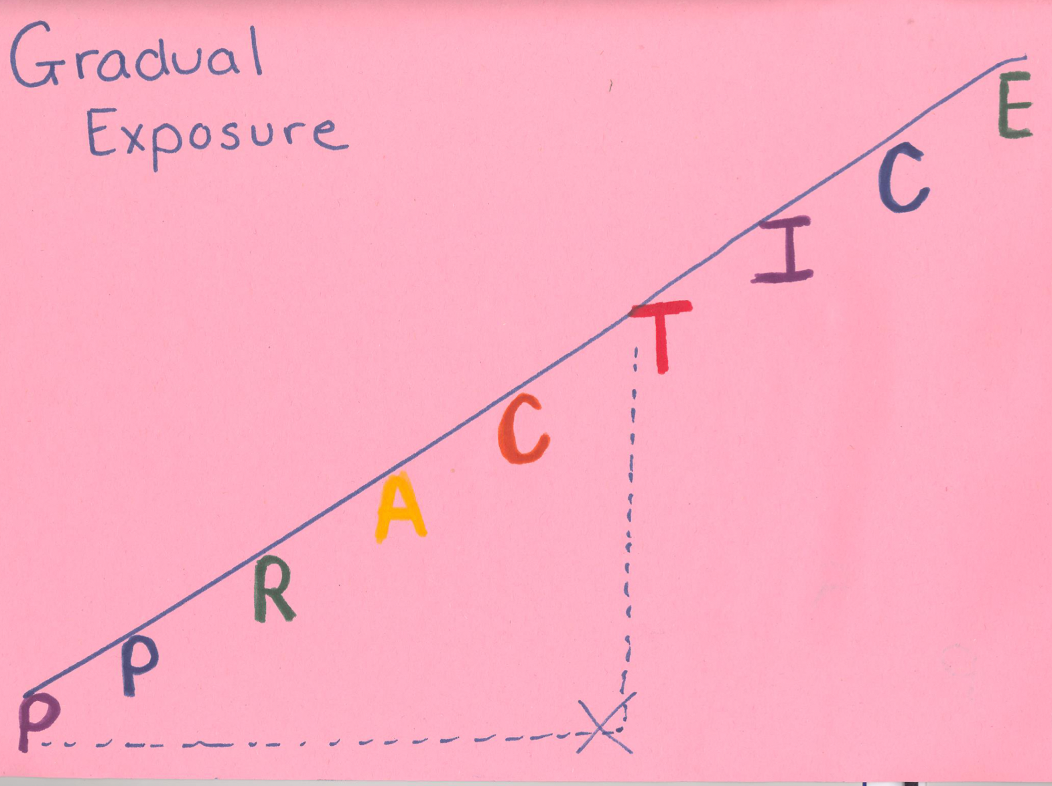
Exposure at Core of CBT and Trauma Treatment
In-vivo Exposure (even more intensive)
Trauma Narrative
(more intensive)
Gradual (indirect) exposure

Slide 98

Creating the Trauma Narrative
Give a Rationale
  Healing a cut
  Getting control of re-experiencing symptoms
  Habituation of anxiety
  Avoidance maintaining the anxiety
  Facing your fears
  Adaptive versus maladaptive coping
  Decisional balance about short- versus long-term

Slide 99
Creating the Trauma Narrative
Analogy of a book with chapters:
Innocuous narrative about the individual in the form of a story (beginning, middle, end, feelings, thoughts)
(2) Life before the trauma
  What the relationship was like with the person before the trauma started (if interpersonal trauma)
  What life was like before the index traumatic event occurred
(3) “Tell what happened” during the trauma itself using expressive arts techniques
(4) Meaning making / life now

Slide 100
Trauma Narrative
Final Chapter—making meaning
  Research shows greater decreases in PTSD with:
  More coherent narratives
  More emotion words
  •More present/future orientation
Content
  What have you learned?
  What would you tell other’s who experienced this?
How are you different now from when it happened / when you started treatment?

Slide 101
Trauma Narrative
Alternative methods for creating a trauma narrative:
  Cartoon strip
  Poem
  Computer (Word, PowerPoint)
  Talk Show Interview
  Song
  Drawings
  Brochure

Slide 102
TF-CBT Components
PRACTICE
  Psychoeducation and Parenting skills
  Relaxation
  Affective modulation
  Cognitive processing
  Trauma narrative
  In-vivo desensitization
  Conjoint caregiver-child sessions
  Enhancing safety and social skills

Slide 103
TF-CBT Components
PRACTICE
  Psychoeducation and Parenting skills
  Relaxation
  Affective modulation
  Cognitive processing
  Trauma narrative
  In-vivo desensitization
  Conjoint caregiver-child sessions
  Enhancing safety and social skills

Slide 104
Trauma-Informed FBA
Addressing co-occurring behavioral challenges

Slide 105
Trauma-Related Mental Health Problems
Anxiety
  Posttraumatic stress (re-experiencing, avoidance, negative thoughts, and hyper-arousal)
  Generalized anxiety / worry
  Specific phobias (e.g., cars, men)
  Separation anxiety
Depression
Behavior problems
  Oppositionality and defiance
  Conduct problems (e.g., aggression, stealing)
Use of alcohol/drugs
Self-injurious behavior

Slide 106
Trauma-Related Mental Health Problems
Anxiety
  Posttraumatic stress (re-experiencing, avoidance, negative thoughts, and hyper-arousal)
  Generalized anxiety / worry
  Specific phobias (e.g., cars, men)
  Separation anxiety
Depression
Behavior problems
  Oppositionality and defiance
  Conduct problems (e.g., aggression, stealing)
Use of alcohol/drugs
Self-injurious behavior

Slide 107
Functional Behavioral Assessment
Review of FBA
  Helps us determine function of behavior
  Clear case conceptualization leads to treatment planning
To determine the function of a child’s behavior, we need to know:
  Antecedents: Before the behavior occurs
  Behavior: Actual behavior
  Consequences: After the behavior occurs
Behavior that continues to occur is somehow being triggered and reinforced
  Trigger: antecedent that reminds individuals of the trauma
  Reinforcer: consequence that increases likelihood of misbehavior

Slide 108

FBA: Antecedents
There are three levels of antecedents
Setting events: Genetics/family history
Setting events: Client’s experiences/history
Immediate antecedent; in trauma work, consider all triggers
    Person, place or thing that reminds
    Thought or feeling that reminds
    Sights
    Sounds
    Smells
    Tastes
    Touches
Notes:
Role play asking these questions to the parent in the scenario we just described.

Slide 109
Setting events and antecedents
Setting Event
Antecedents
Lack of sleep
Hunger
Fatigue
Anxiety
Preferences
Past events (fight on the bus)
Trauma history
Given a direction
Demand
Lack of peer access
Presence of preferred adults/peers
Class subject
A memory of a past event
A smile

Slide 110

FBA: Consequences
What happens after the behavior occurs?
How does the individual feel about the behavior that occurs?
What do other people (e.g., teachers, parents) do when the behavior occurs?
What does the individual get, or get out of, following the behavior?

Slide 111
Common Functions in Traumatized Individuals
Avoidance of people/places/things
Individual with history of sexual abuse by karate teacher refuses to enter the dojo
Avoidance of feelings/thoughts
Teen who has PTSD secondary to peer assault smokes marijuana before going to school
Release of anger and anxiety
Latency-age child with history of family violence tantrums when she sees adults argue

Slide 112
Sample FBA
Antecedents
Behavior
Consequences
A₁
______________________
Positive
______________________
A₂
______________________
Emotional outbursts; Oppositionality; Fighting with peers
Negative
______________________
A₃
______________________
Notes:
Antecedent₁: Genetics/family history
Antecedent₂: Client’s experiences/history
Antecedent₃: Immediate triggers

Slide 113
Sample FBA
Antecedents
Behavior
Consequences
Maternal hx of depression; Paternal hx of alcohol abuse
A₁
Positive:
Reduction of anger/arousal; Tough stance
A₂
Child physical abuse; Witness domestic violence
Emotional outbursts; Oppositionality; Fighting with peers
Negative:
Criticized; Disliked by peers and teachers
A₃
Sudden, loud noises; when adults are fighting
What are interventions for the As, Bs, and Cs?
Notes:
Antecedent₁: Genetics/family history
Antecedent₂: Client’s experiences/history
Antecedent₃: Immediate triggers

Slide 114
Tier 3 and Beyond
Interconnected Systems Framework (ISF)
ISF provides a way for schools to link up with community services to collaborate on these services
  School based teams with outside service providers, family, and community members
  Collaborative across a continuum of supports
  Find common metrics to measure success
Started as a way for schools to link up with other systems of care
  Can be used for and by other systems of care, including adult services
https://assets-global.website-files.com/5d3725188825e071f1670246/5d7fcb4fa194470a0ea2d52a_INTERCONNECTED%20SYSTEMS%20FRAMEWORK%20201%20080819%20(1).pdf

Slide 115
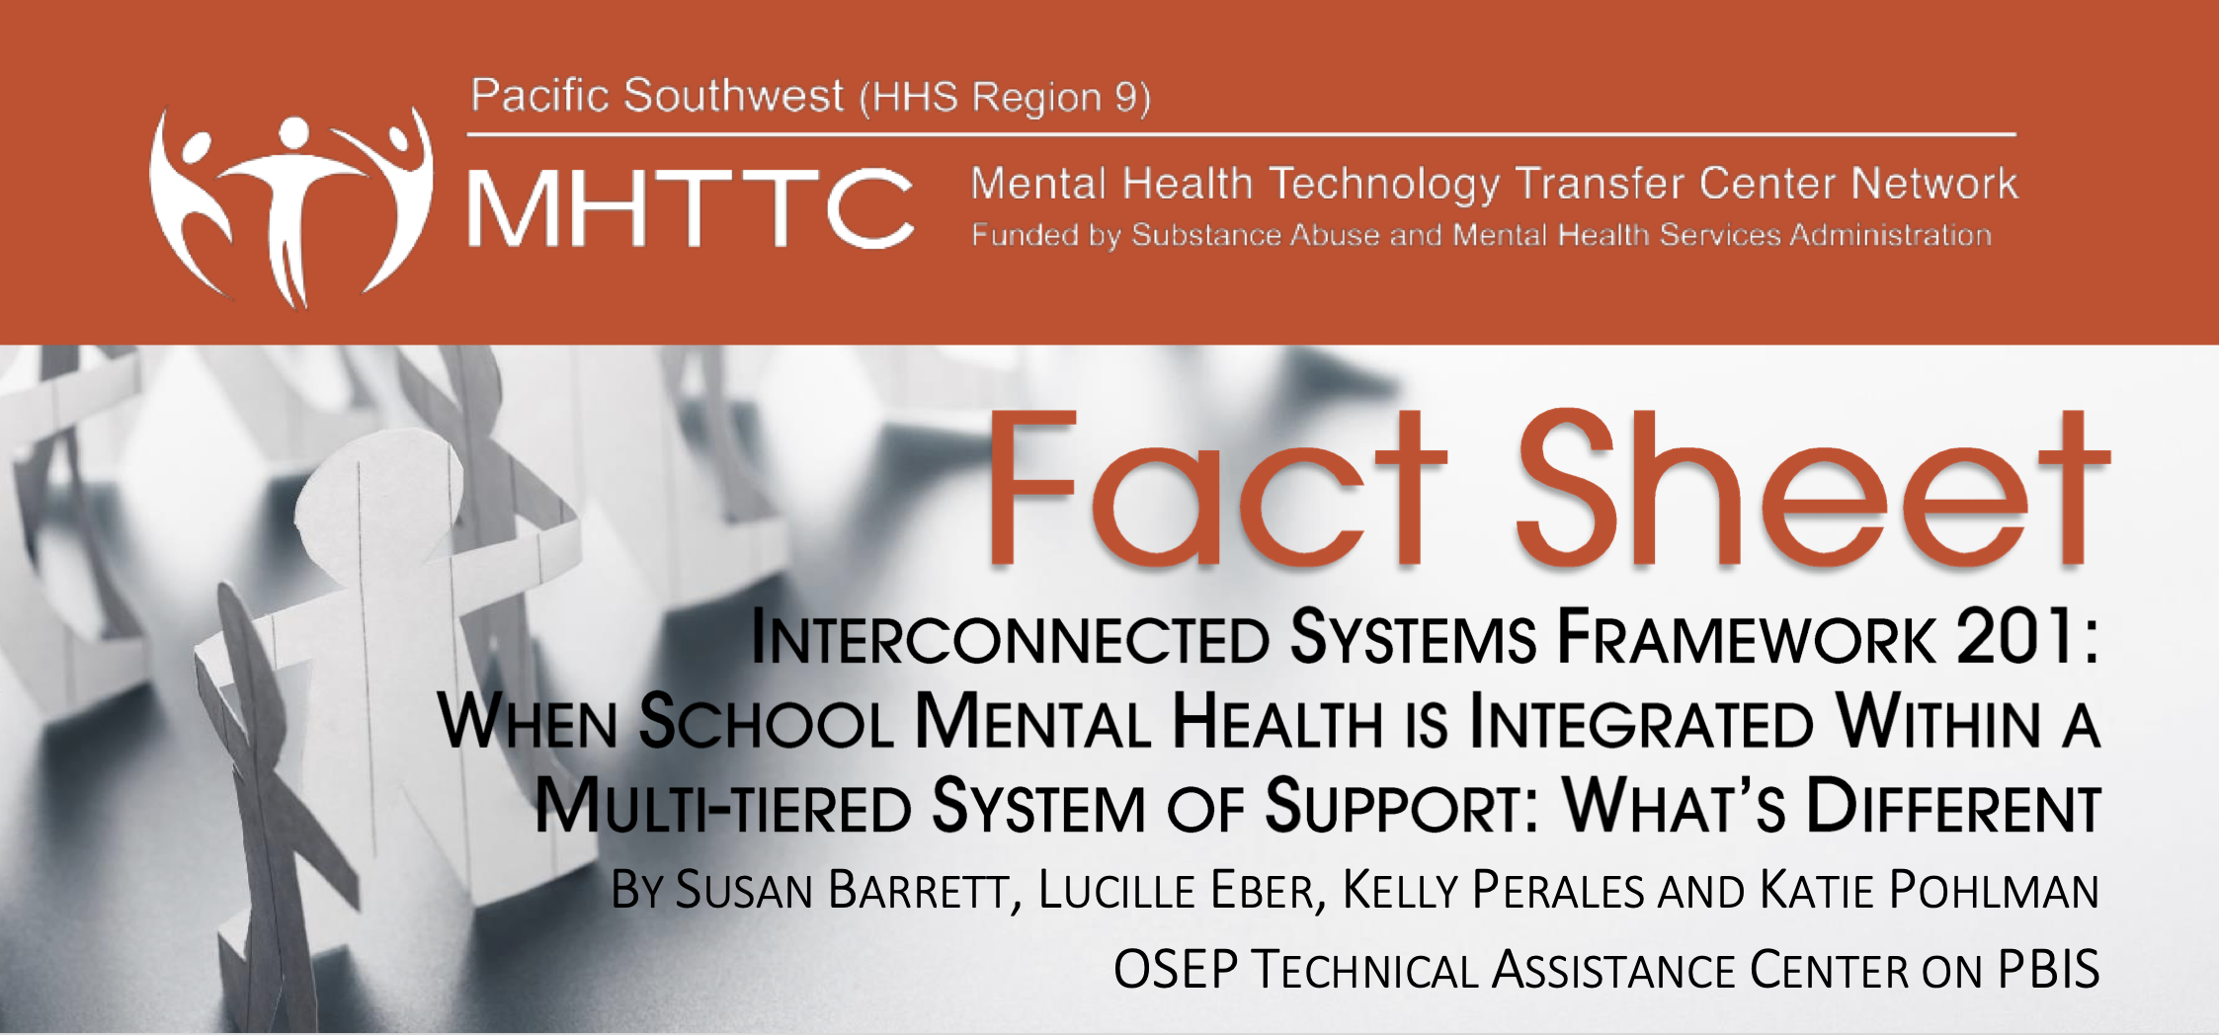
Tier 2 & 3:
Interconnected Systems Framework (ISF)
ISF provides a way for schools to link up with community services to collaborate on these services
  School based teams with outside service providers, family, and community members
  Collaborative across a continuum of supports
  Find common metrics to measure success
https://assets-global.website-files.com/5d3725188825e071f1670246/5d7fcb4fa194470a0ea2d52a_INTERCONNECTED%20SYSTEMS%20FRAMEWORK%20201%20080819%20(1).pdf

Slide 116
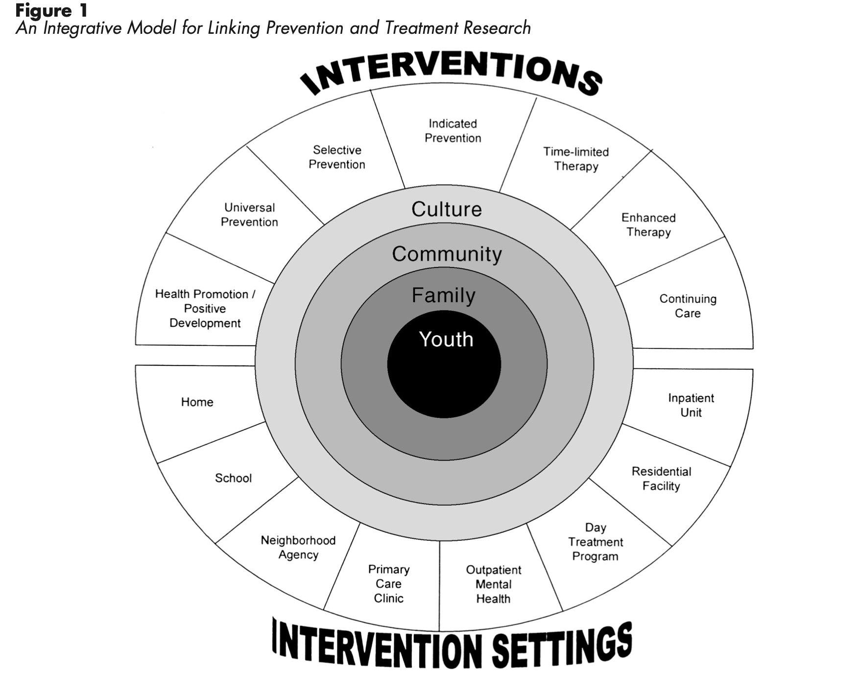
An integrative model for linking prevention and treatment research
Continuum of Supports
Individual
Setting/Services

Slide 117
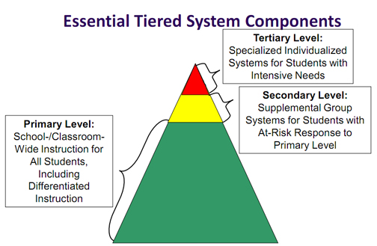
An integrative model for linking prevention and treatment research including essential tiered system components
Individual
MTSS
PBIS
RTI
SEL
SMH
Notes:
MTSS = multi-tiered systems of support
PBIS = Positive Behavioral Interventions and Supports
RTI = Response to Intervention
SEL= Social Emotional Learning
SMH = School Mental Health
ISF = Interconnected Systems Framework

Slide 118
An integrative model for linking prevention and treatment research continued
Especially important for advanced tiers
Interconnected Systems Framework (ISF)
Individual
Notes:
MTSS = multi-tiered systems of support
PBIS = Positive Behavioral Interventions and Supports
RTI = Response to Intervention
SEL= Social Emotional Learning
SMH = School Mental Health
ISF = Interconnected Systems Framework

Slide 119
An integrative model for linking prevention and treatment research cross setting partnerships
Cross Setting Partnerships
(Team-based)
Notes:
MTSS = multi-tiered systems of support
PBIS = Positive Behavioral Interventions and Supports
RTI = Response to Intervention
SEL= Social Emotional Learning
SMH = School Mental Health
ISF = Interconnected Systems Framework

Slide 120
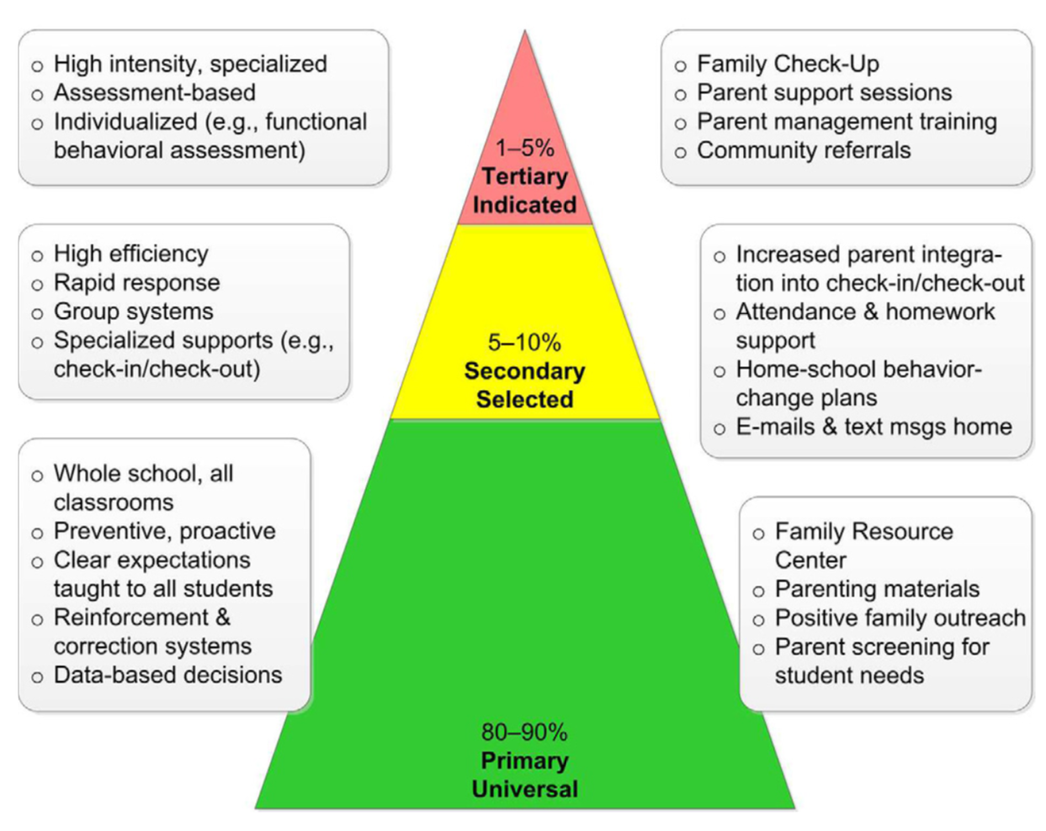
Interconnected systems framework
Schools
Family Systems
Community
ISF
Assessment and Clinical Diagnostic Services
Providing TF-CBT and AF-CBT
Same process as MTSS but expanded to include other systems
Coordinate initial assessments
Coordinate care
Support tier 2 school mental health interventions
For Example: Taking school teaming model and including community providers & families
Universal Mental Health Screenings
Mental health Awareness
ISF = Interconnected Systems Framework

Slide 121
Phew

Slide 122
Questions, Thoughts, Ideas or Comments

Slide 123

Thank you!
Contact
Imad Zaheer, Ph.D.
imadzaheer@gmail.com
https://nei.squarespace.com

