Slide 1

PBSIntensive Training Series
Day 2. Supporting People across the Continuum
of Positive Behavior Support

Slide 2

Agenda for Today
9:30 Picking up where we left off… PBS Subscale Review
9:50 PBS Intensive Training Sequence
  Activity 1- PBS Subscale Self Reflection
10:45 Matrix- development- peer review
  Activity 2- Matrix update
11:00 Integration of Positive Support Practices across the continuum and quality of life
12:00 Lunch Break
1:00 Supporting people at tiers 2 and 3: Positive supports
  Activity 4- Positive support tool practice
2:00 Building on reinforcement: Function based approaches
2:30 Activity 5- Review Leonard’s plan (integrating positive support approaches at Tier 3)
2:45 Questions, Feedback, Plan for next training

Slide 3
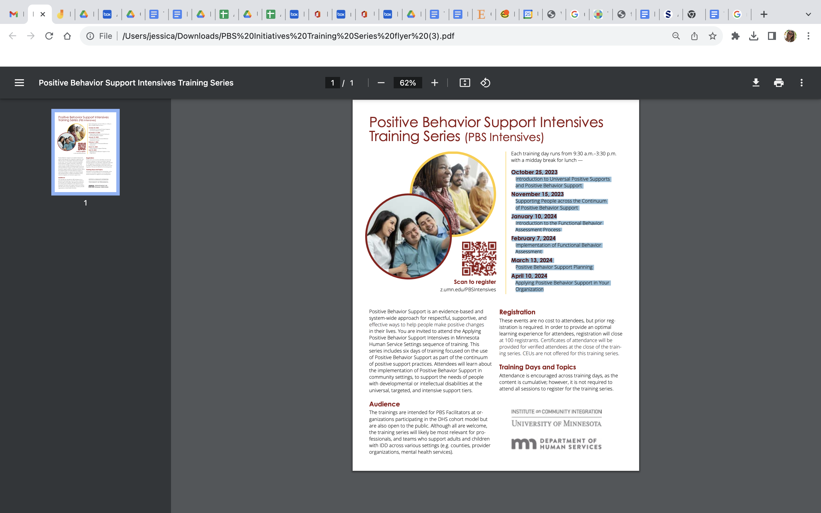
Overview of PBS Intensive Training Series
October 25, 2023. Introduction to Universal Positive Supports and Positive Behavior Support
January 10, 2024. Supporting People across the Continuum of Positive Behavior Support
February 7, 2024. Introduction to the Functional Behavior Assessment Process
March 13, 2024. Implementation of Functional Behavior Assessment
April 10, 2024. Positive Behavior Support Planning
May date TBD. Applying Positive Behavior Support in Your Organization

Slide 4
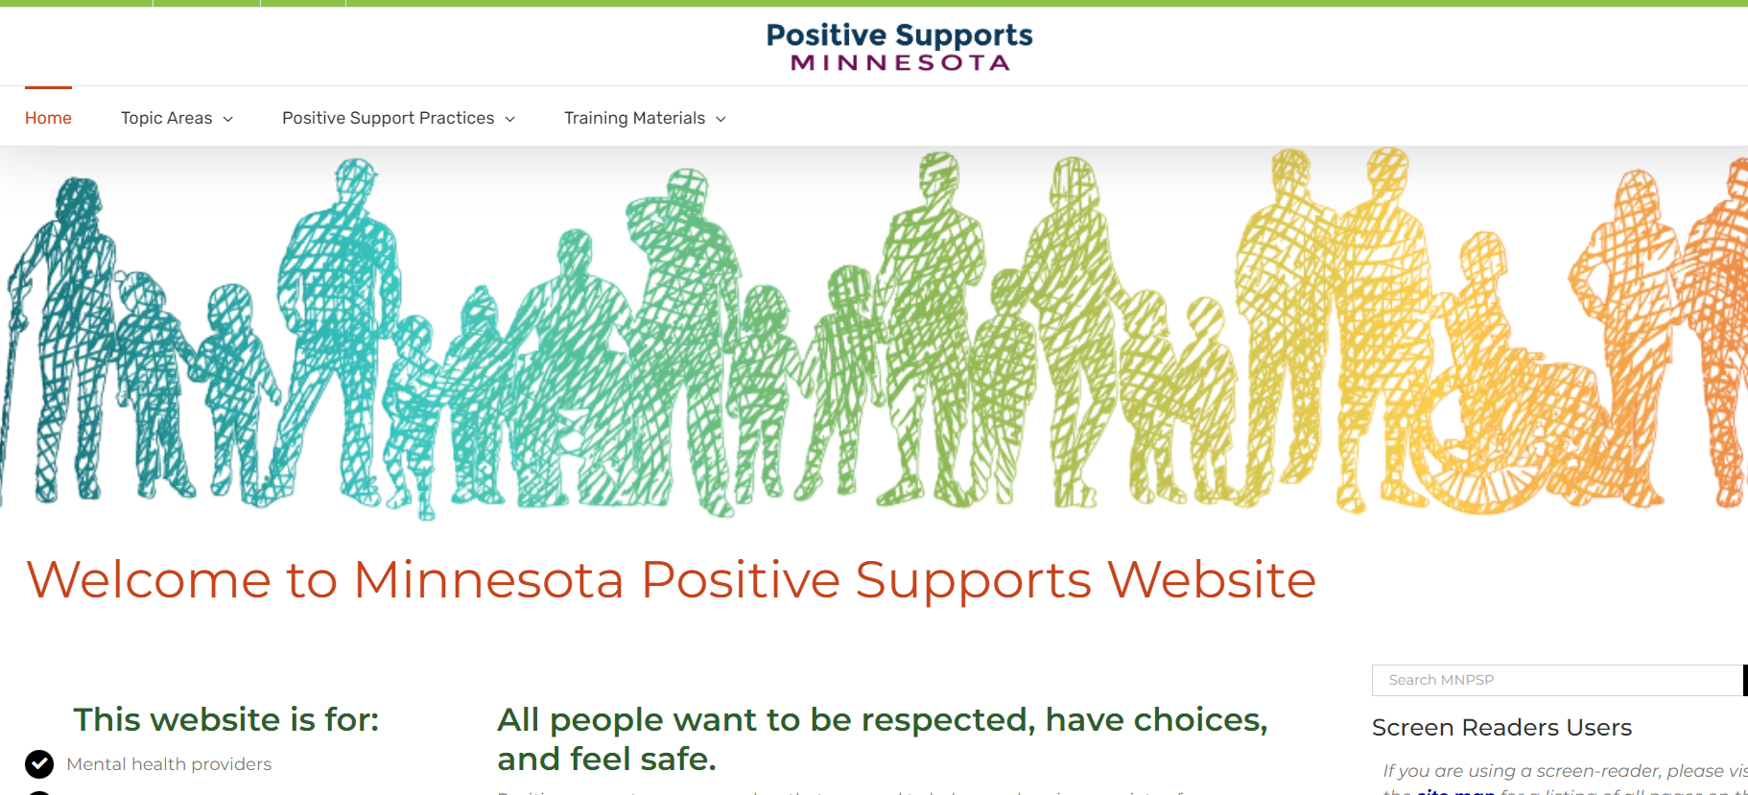
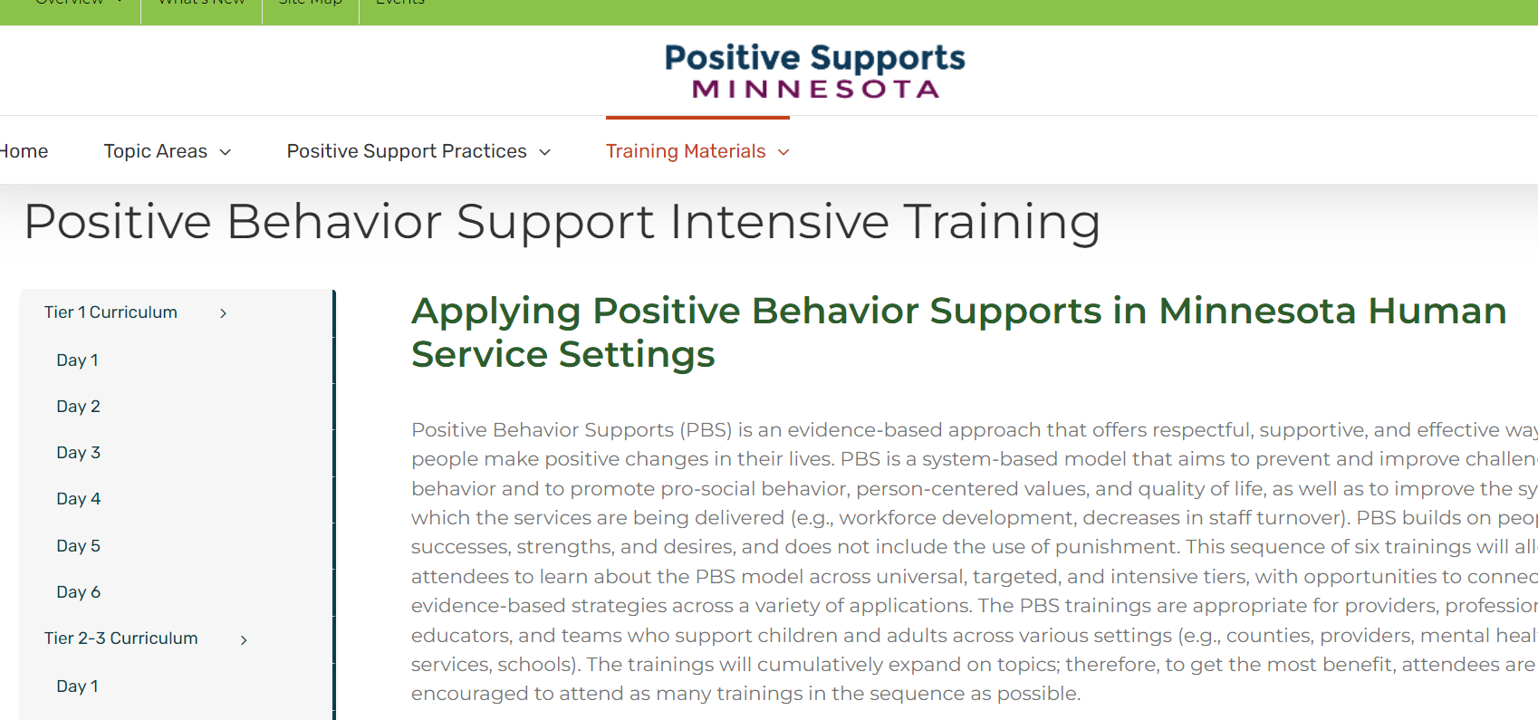
Mnpsp.org
A hub for updated training materials and resources

Slide 5
Support Across the Continuum of Needs within an Organization

Slide 6
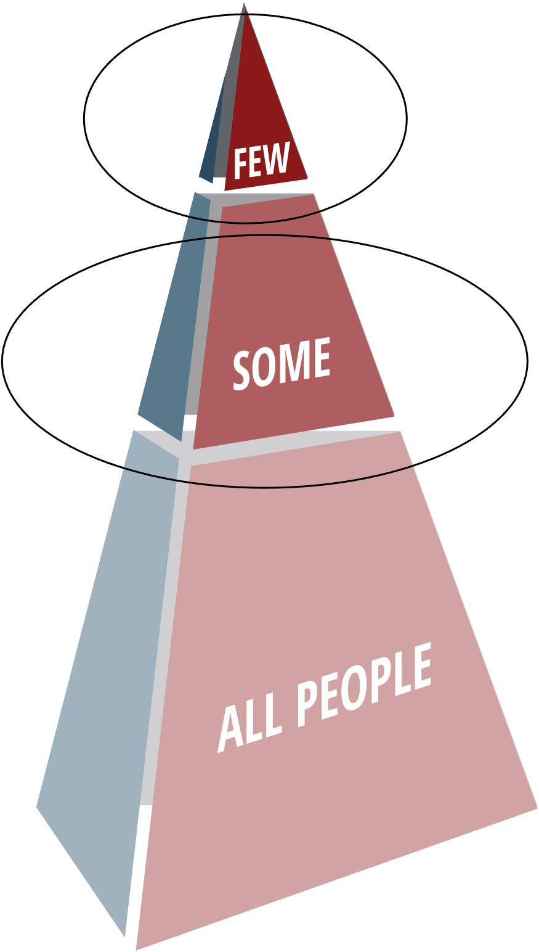
Implementing PBS-PCP in provider organizations
Person-Centered Practices & Planning
Positive Behavior Support
Tertiary Stage
Integrated Plans (PCP, PBS, Trauma-informed Therapy)
Person-Centered Plans
Teams Monitor Progress
Secondary Stage
More Intensive Supports To Improve QOL
Simple Interventions Integrated With Other Positive Supports
Independence And Community Involvement Encouraged
Mental Health And Wellness Interventions
Universal Stage
Person-Centered Thinking
Encourage Self Expression
Self-Determination And Choice Making
Predictable And Proactive Settings
Meaningful Participation In The Community
Tertiary Stage
Individualized PBS Plans
Integrated With Other Positive Supports (PCP, Trauma-Informed Care, DBT, Etc.)
Plans Are Evaluated To Ensure Plans Are Implemented With Fidelity
Outcome Measures
Secondary Stage
Use Data To Identify Individuals At Risk
Additional Supports For Key Social Skills
Group And Individual Interventions
Function-Based Decisions
Simple Interventions Integrated With Other Positive Supports
Mental Health And Wellness Interventions
Universal Stage
Teach And Encourage Communication
Encourage And Reinforce Social Skills
Consensus-Based And Team Focus
Emphasis On Using Data For Decisions
Integrated With Other Positive Support Practices (PBS, Trauma-Informed Care, Etc.)
Notes:
6
The tiered model can be applied to both PCP and PBS. There are many similarities on how this is done.
At the Universal level, this includes all people (DSPs, people being supported, etc) within an organization. This level is preventative (it is promoting and teaching these behaviors/incorporating these person centered values for everyone, and in how the organization functions as a whole). The universal level is also about having a high quality experience for everyone. In PBS the Universal may include practices like teaching and reinforcing social skills and data based decisions, promoting, teaching, and reinforcing communication for everyone. Likewise, at the universal stage everyone is engaging and promoting person centered thinking, encouraging self expression, providing meaningful integrated participation in the community (** note, you could also list some specific practices different organizations are doing at this level, or ask them if there are practices that sound familiar here that they might have an example of how they are doing this).
As people require more support and move up the levels of the tiered model (into the secondary and tertiary levels) it is important to remember that they still receive all this good stuff going on in the universal level. In that way you can think of a tiered model less as separate sections, and more as layers. Meaning that if people require additional support at higher tiers, they get the support at that higher tier IN ADDITION TO NOT INSTEAD of the universal practices.
(THEN DESCRIBE SECONDARY AND TERITIARY IN A SIMIALR WAY).

Slide 7
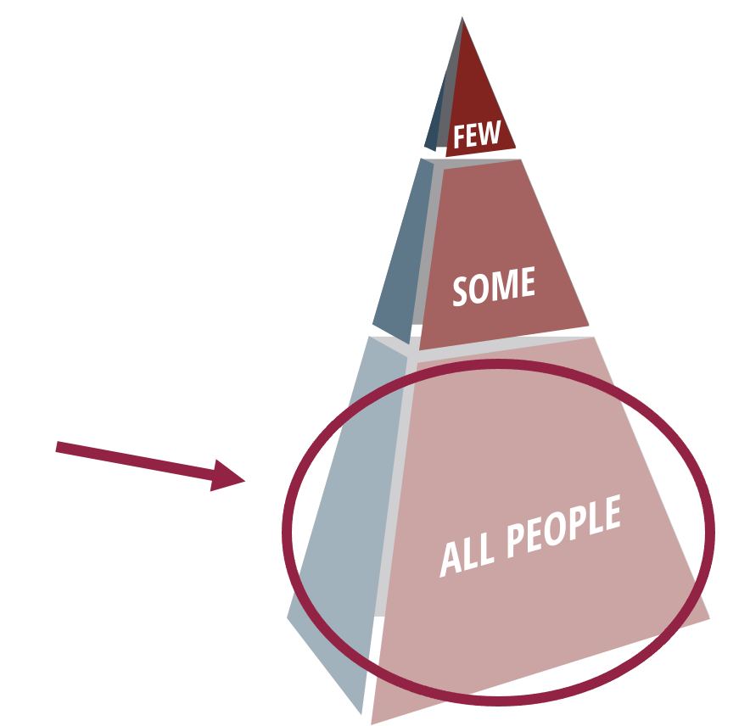
Positive Behavior Support Provides a Framework for Prevention
Build Positive Social Settings Where Everyone Practices and Celebrates Social Skills That Are Important
Focus First on Universal Positive Behavior Support
Work Together to Create a Plan
Prompt, Teach, & Encourage Positive Social Interactions
Practice New Social Skills
Reinforce, Recognize, & Celebrate Success
Consistent Responses to Problematic Social Interactions
Early Prevention and Monitoring
Notes:
Today we’re going to focus on universal
How do we set the stage for universal level

Slide 8
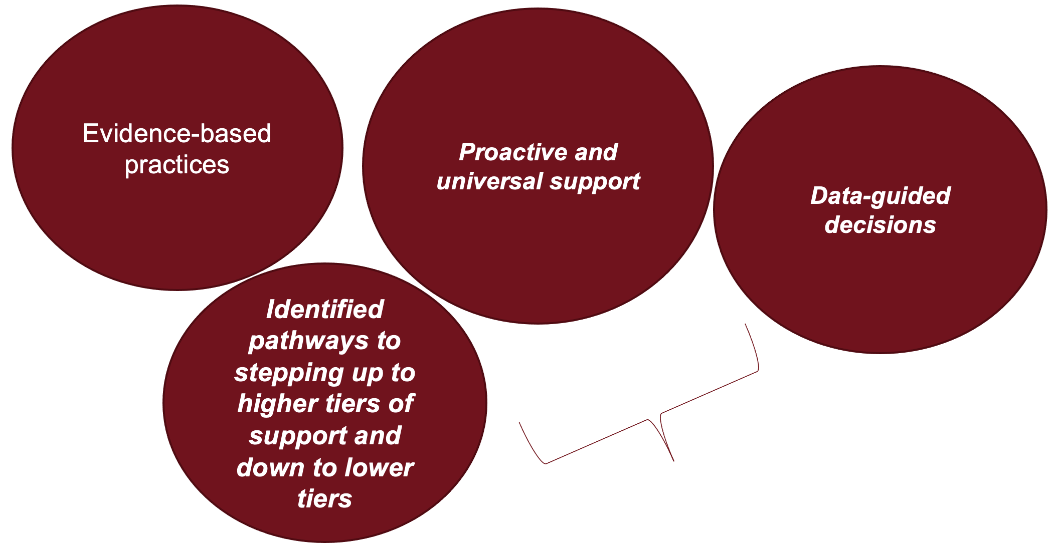
Core tenants of PBS

Slide 9
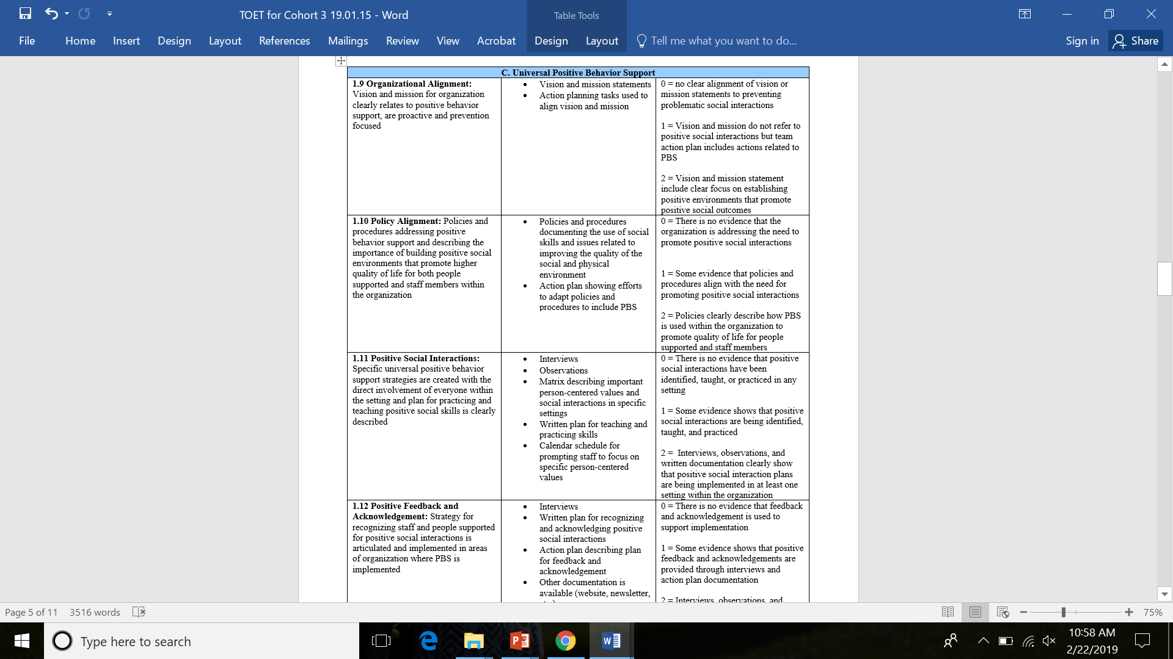
Tiered Onsite Evaluation Tool (TOET) Development
TOET—external evaluation to score fidelity of implementation (Freeman, Watts, O’Nell, & Amado, 2017)
Developed translating similar tools, are psychometrically evaluated within PBIS in educational settings (Horner, Todd, Lewis-Palmer, Irvin, Sugai, & Boland, 2004; McIntosh et al., 2016)
Notes:
The TOET was developed using similar tools designed and psychometrically evaluated within PBIS in educational settings as the foundation with modifications to address provider organizational systems (Horner, Todd, Lewis-Palmer, Irvin, Sugai, & Boland, 2004; McIntosh et al., 2016) The TOET items at the Universal level contains a total of 25 items, across the following seven subscale domains: (a) Team action planning and stakeholder involvement (examples include team composition include key roles, meetings are effective), (b) universal person-centered planning (examples include vision established, policies aligned), (c) universal PBS (examples include social behaviors identified and taught), (d) cultural awareness and competence (examples include cultural assessment and celebration, active diverse hiring strategies), (d) organization-wide data for decision-making (examples include review of data occurs regularly, fidelity data collected), (e) support for staff learning new skills (examples include coaching systems, trainers in development) and (f) visibility (team shares progress with all stakeholders, awareness information shared) (Freeman, et al., 2018). The tool is completed by a Trainer annually during a two-hour onsite visit. The TOET scoring rubric consists of a 0-2 scale, with a score of “zero” indicating that the team has not started implementing the item, “one” indicating that the team is in process of implementing the item, and “two” indicating that the item is fully implemented. Data are organized overall and by subscale.

Slide 10
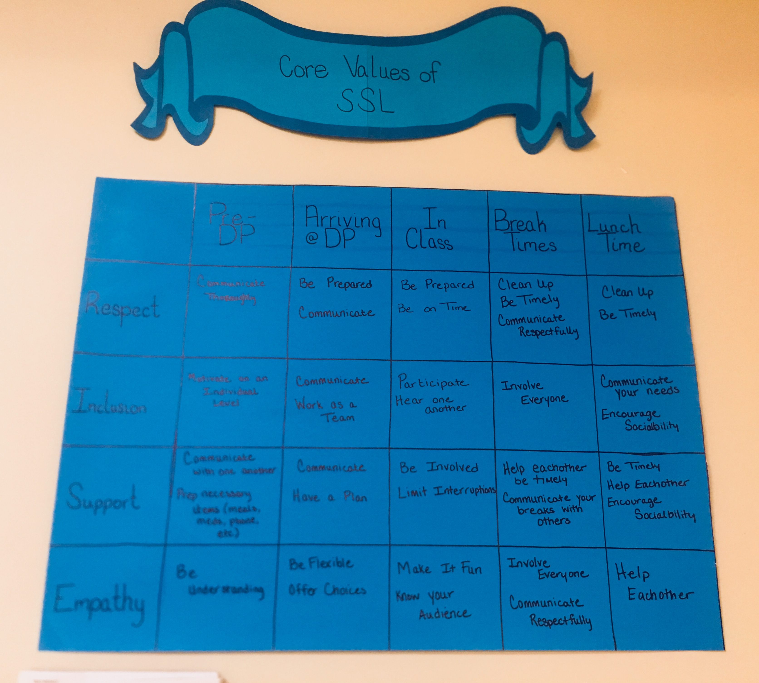
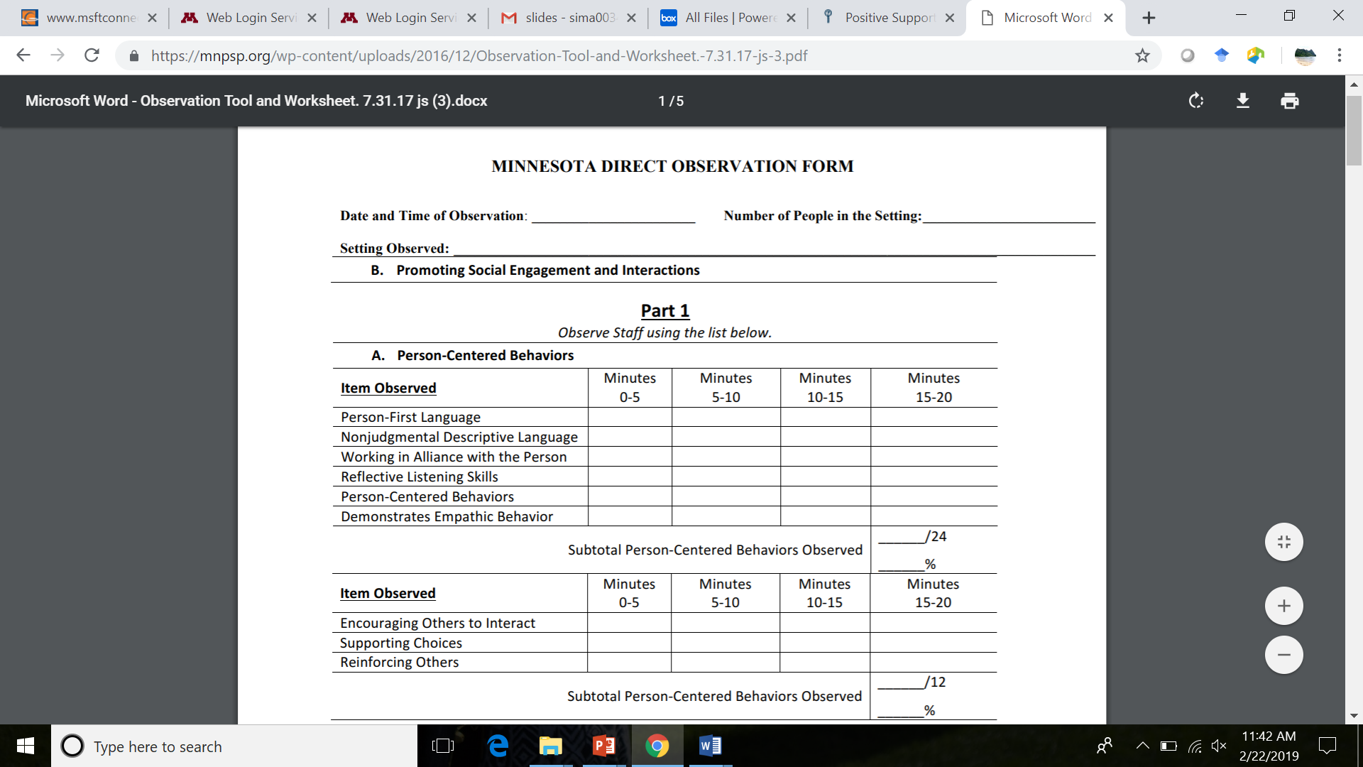
Activities that PBS Facilitators may Support
Universal practices
  Matrix
  Onboarding staff training
  In service staff training
  FBA/PBS planning or reviewing
  Data monitoring systems
PBS subscale of evaluation areas
  Identify area of strength,
  Area ‘on the cusp,’
  Area of future need.
Motivational interviewing to identify goals that are achievable, common considerations:
  It’s too big,
  “PBS doesn’t pertain to us because we don’t provide direct supports,”
  Getting buy in,
  STAFFING CRISIS.

Slide 11
Tiered support in your organization
What are some supports done for people who need intensive and individualized support at your organization?
What are some supports done for people who need some additional, targeted support at your organization?
What are some supports done for everyone at your organization?

Slide 12
PBS Subscale Activity

Slide 13
Subscale: Universal Positive Behavior Support (3)
Feature | Possible Data Sources | Scoring Criteria
1.9 Organizational Policy Alignment: Policies and procedures addressing positive behavior support and describing the importance of building positive social environments that promote higher quality of life for both people supported and staff members within the organization | Policies and procedures documenting the use of social skills and issues related to improving the quality of the social and physical environment Action plan showing efforts to adapt policies and procedures to include positive behavior support (PBS) PBS values incorporated into supervisory role: 1:1 meetings, performance reviews, professional advancement and development. Supervisor documents meetings with staff that shows the use of different values and tools used. Mission and vision statements include PBS values. PBS team involved in leadership planning regarding organizational decisions reflected in meeting minutes. Matrix used to implement positive social strategies and professional values. | 0 = There is no evidence that the organization is addressing the need to promote positive social interactions 1 = Some evidence that policies and procedures align with the need for promoting positive social interactions 2 = Policy examples clearly state how PBS is used within the organization to promote quality of life for people supported and staff members
1.10 Positive Social Interactions & Skills: Specific universal PBS strategies are created with the direct involvement of everyone within the setting, and plan for practicing and teaching positive social skills is clearly described. Plan for expanding implementation across organizational settings is documented | Interviews Direct observations Matrix describing important person-centered values and social interactions in specific settings Written plan for teaching and practicing skills Calendar schedule for prompting staff to focus on specific person-centered values Using Matrix during unit/department meetings. Regular use of Positive Social Strategies resources (video clips, training tool demos, & practice activities) during unit meetings reflected in meeting minutes. Sharepoint: “PBS Resource Folder” for all staff to access trainings, tools and other resources. | 0 = There is no evidence that positive social interactions have been identified, taught, or practiced in any setting 1 = Some evidence shows that positive social interactions are being identified, taught, and practiced 2 = Interviews, observations, and written documentation clearly show that positive social interaction plans are being implemented in at least one setting within the organization

Slide 14
Subscale: Universal Positive Behavior Support (3) Continued
1.11 Positive Feedback and Acknowledgement: Strategy for recognizing staff and people supported for positive social interactions is articulated and implemented in areas of organization where PBS is implemented | Interviews Written plan for recognizing and acknowledging positive social interactions Action plan describing plan for feedback and acknowledgement Other documentation is available (website, newsletter, etc.) Employee of the Month specifically for person centered and positive support accomplishments Performance review category created Staff unit meetings acknowledging staff and person’s served who exemplify positive support practices. Thank you cards sent to service providers who exemplify positive supports. | 0 = There is no evidence that feedback and acknowledgement is used to support implementation 1 = Some evidence shows that positive feedback and acknowledgements are provided but these strategies are not directly connected to a plan for increasing social interactions 2 = Interviews, observations, and written documentation clearly show that there is a clear plan for providing positive feedback and acknowledgement in areas where PBS is implemented
1.12 Consistent Response to Challenges That Occur: Definitions are in place that clearly outline behaviors that are considered incidents that need to be documented and minor issues that do not require documentation. Strategy for teaching staff members how to respond to minor problems is in place. | Behavioral definitions Training materials Behavior definitions within the Matrix Code of Conduct Policy Onboarding training incorporates these definitions and strategies Organizational process in place defining incidents, conflict and the positive support response rooted in the culture of trust. Systematic feedback loop process with positive regard and trust | 0 = There is no evidence that definitions and training materials are in place 1 = Some work has been completed to establish behavioral definitions and train staff 2 = The behavioral definitions and training materials are in place with a plan to train all staff members over time

Slide 15
Subscale: Monitoring Plans and Organization-wide Data for Decision Making (5)
Feature | Possible Data Sources | Scoring Criteria
1.16 Organizational Workforce: Tenure, retention, staff satisfaction data and other related workforce measures are reviewed in team meetings to assess progress | Meeting minutes Data summaries Interviews Sample of staff satisfaction surveys | 0 = There is no indication that the organization is using data related to tenure, retention, or other staffing patterns 1 = Interviews with team members indicate that retention/tenure data are reviewed during team meetings 2 = Meeting minutes, data summaries, and other evidence indicates the team regularly reviews data for decision making
1.17 Data-Based Decision Making: The organization-wide team reviews outcomes associated with effective planning (quality of life, changes in incident reports, 911 calls, injuries, restraint, etc.) on a regular basis to make data-based decisions | Quality of life surveys, interviews Incident report data, injuries, etc. Fidelity data Meeting minutes Assessment dashboard Human Resources hiring data collection process File Review using regulatory guidelines with information contained in a dashboard to inform organizational decision making. | 0 = There is no indication that the team is regularly reviewing data during meetings 1 = Interviews with team members indicate that at least one type of data are reviewed (incidents, county strategic evaluation data, attrition, etc.) 2 = Meeting minutes, data summaries, and other evidence indicates the team regularly reviews data for decision making

Slide 16
Subscale: Monitoring Plans and Organization-wide Data for Decision Making (5) Continued
1.18 On-Going Monitoring of Fidelity Data: Team reviews fidelity data (self-assessment tools, tiered onsite data) during regular team meetings and makes adjustments according to the data. | Meeting minutes Summary of self-assessment and past onsite data | 0 = There is no indication that the team is regularly reviewing fidelity data during meetings 1 = Interviews with team members indicate that fidelity data are reviewed during meetings 2 = Meeting minutes, data summaries, and other evidence indicates the team regularly reviews fidelity data for decision making
1.19 Annual Evaluation: Team conducts an annual summary and review of overall progress each year documenting major accomplishments, data collected, and products developed and disseminated (e.g., summary report or presentation slide deck, newsletter summary and celebration, etc.). | Meeting minutes Summary of data collected Documented changes in action plan linked to review Evidence that review is shared (newsletter, handouts, awards and recognition, etc.) Interviews | 0 = There is no indication that the team reviews implementation progress annually 1 = Interviews suggest annual evaluation occurs 2 = A summary of annual evaluation data is available in presentations or report form.
1.20 Direct Observation: Team member collects direct observation data in at least two locations quarterly | Summary of data Completed observation forms | 0 = There is no indication that the team is regularly reviewing observation data during meetings 1 = Interviews suggest observation data are collected 2 = Data collected are organized and available for review with summaries organized for meetings

Slide 17
Review on your own or as a team
Self assessment
  Where do you currently fall?
Where to celebrate
Where to focus some effort
  Idea generation to bring back to your team
How will you track your progress?

Slide 18
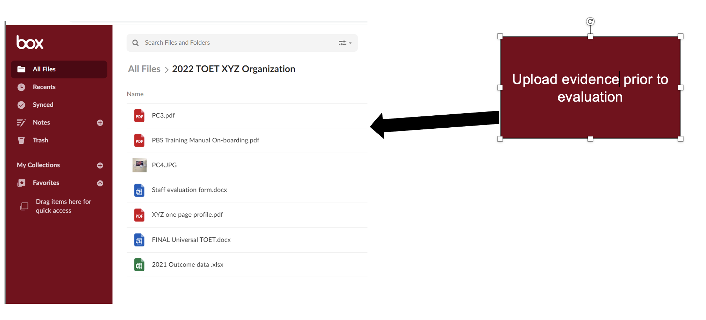
Storing Evidence From Organizations Used in a TOET

Slide 19
Matrix Update Activity

Slide 20
Activity 2: Matrix Update
What progress have you made?
What values have emerged?
What routines/activities?
What are you planning next?
Review with others at your organization
Type in chat or in our Jamboard holding tank (scroll to 3rd page) https://jamboard.google.com/d/17ViP0DEZs6K6d2201paFX8a5IGe7bpJYz3_HcV68V6Q/viewer?f=2

Slide 21
The Matrix:
A Tool for Developing a Positive Social Environment at Your Organization through Shared Values and Behavior Goals
Values | Before Meetings | At the Beginning of Meeting | While Sharing Person’s Information | Supporting Other Team Members
Use Person-Centered (PC) Language | Use PC Language in Documents (Emails, Handouts) | Provide Reminders Before Meeting (Be Sensitive to Acronyms Too) | Be Receptive and Aware of Language Used | Celebrate Use of PC Language as Team
Show Your Respect for People | Use Active Listening During Conversation | Attend Meetings on Time Cell Phones to Vibrate | Share Only Information Needed Provide Feedback to Others | Listen to Others and Ask if Feedback is Invited
Demonstrate Appreciation of Culture | Review Plans and Discuss Role and Identity & Culture | Review Possible Cultural Bias and Assumptions | Share Thoughts on the Role of Culture in Person’s Life | Discuss How Culture Can be Incorporated Into Plan

Slide 22
”The Matrix” – A tool for building positive social interactions.
Person-centered Values | Setting 1 | Setting 2 | Setting 3 | Setting 4
Value 1
Value 2
Value 3
Positive behavioral definitions of the values for each setting

Slide 23
Matrix Development
Everyone Works Together to:
Include stakeholders People being supported, team members across all levels, other relevant stakeholders should be included in the development and implementation of the matrix
List Key Person-Centered Values: e.g., Respect, Connection
Identify settings or shared activities to focus on
Identify the positive social behaviors that reflect these values
Create a plan for increasing social interactions
Support and recognize each other, help encourage and prompt
Celebrate Success

Slide 24
Example Matrix Grid
 | Times of Day | Free Time | Cleaning Up | Lunch Time | Fundraising | During Outside Activities
Values | Respecting Each Other | Respect another's privacy, Understanding differences | Offer to help each other, talk to each other kindly if something isn't working | Push in/pull out chairs for others, Ask if help is needed | Everybody can do something, break bigger jobs into smaller parts | Respect each other's preferences, follow the rules, watch out for each other
 | Having a Positive Attitude | Be aware of your environment, Be aware of how other's are feeling | Respect people's differing abilities, Get involved | Talk to people that you may not otherwise talk to | Help out where you can, participate in Clubhouse meetings and offer suggestions | Appreciate the moment and activity, say thank you to those who plan activities
 | Working Together | If there is nothing to do, get together and decide to do something, Clean up after yourself | Offer to help each other with the bigger tasks | Clean up after yourself, allow people time to finish eating before cleaning up/try not to rush people | Develop committees to break down the bigger jobs | Be friendly, clean up after yourself, be neat
 | Positive Communication | Respect boundaries, have compassion, use humor respectfully | Ask for help if you need it, offer help if you see someone needs it | Use manners (please and thank you), thank the people who cook and serve you | Plan more fundraisers, talk about how to plan them at Clubhouse meetings | Be polite to the public and each other
 | Volunteering | Welcoming new members, help others to participate more | Try out different tasks, try not to always do the same things | Pay attention to what chore/cleaning needs to be done | Volunteer for what you can, attend Clubhouse meetings to learn of and present opportunities | Help other people stay on time and with the group
 | Support for Each Other | Offer to help, share computer time, only share things with others that you are comfortable sharing | Take turns doing tasks, develop teams for getting bigger cleaning projects done | Help out where you can - 2 people can do a job faster than 1 | If someone or a committee needs help, offer assistance | Be friendly, get involved in planning activities

Slide 25
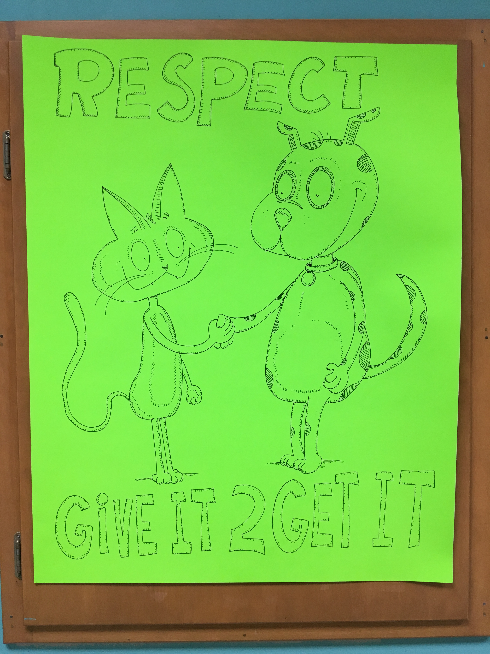
Implementation Example of Organization- wide Person- Centered Practices: Values Visual
Clubhouse Artist Created Visual Reminders of Key Person-Centered Values

Slide 26
Tier 2 and 3: Person Centered Values and Quality of Life

Slide 27
Tier 2 Level
PC Practices
PBS
Continue Expanding Impact of Work Plans Across Areas
Team Monitors Quality of Life
Early Intervention to Improve Outcomes
Simple Strategies for Improving Quality of Life
Person-Centered Planning Strategies
Build Natural Support Networks
Coach Meeting and Supports
Team Monitors for Early Intervention
Simple Function-based Problem Solving
Data-based Decision Making
Additional Supports for Social Behaviors
  Building Friendships
  Increasing Independence,
  Mental Health-related Supports

Slide 28
Tier 3 Level
PC Practices
PBS
Continue Expanding Impact of Work Plans Across Areas
Monitor Person-Centered Plans
Use Quality of Life Data for Decision Making
Tailor Types of Person-Centered Planning for People
Training and Mentoring to Expand Planners Across Organization
Functional Behavior Assessment + PBS Plans
Coordinate Quality of Life Evaluation Across Positive Supports
Data-based Decision Making
Improve Interagency Collaboration and Community Mapping
PBS Plans Integrated Within Person-centered Plan

Slide 29
Important Person Centered Elements to Consider Across Tiers: Including Tier 2 and 3
Person-Centered Thinking and Planning
Organizational Workforce Related
Cultural Competence
Positive Behavior Support

Slide 30
Quality of Life Domains (QOL) Matter at Tier 1: And need to also be re-examined at Tier 2 & 3
Emotional Wellbeing -(Feeling Empowered and Experiencing Positive Emotions)
Interpersonal Relations - (Opportunities for Friendship and Intimacy, Quality of Interactions With Others)
Material Well-being -(Ownership of Possessions, Meaningful Employment)
Personal Development –(Opportunities for Education and Habilitation)
Self-determination -(Setting Personal Goals, Making Decisions About Important Life Choices)
Physical Well-being -(Optimal Health Care and Nutrition, Mobility & General Wellness)
Social Inclusion -(Natural Support Networks Inclusive and Integrated Environments)
Rights -(Experience of Ownership of Key Items and Property, Allowed Due Process, Privacy and Barrier Free Environments are Available).
Notes:
All of the person centered plans touch on an area of the person centered plans-> areas for goals or focuses
If looking to improve quality of life then these would be reflected in the plan

Slide 31
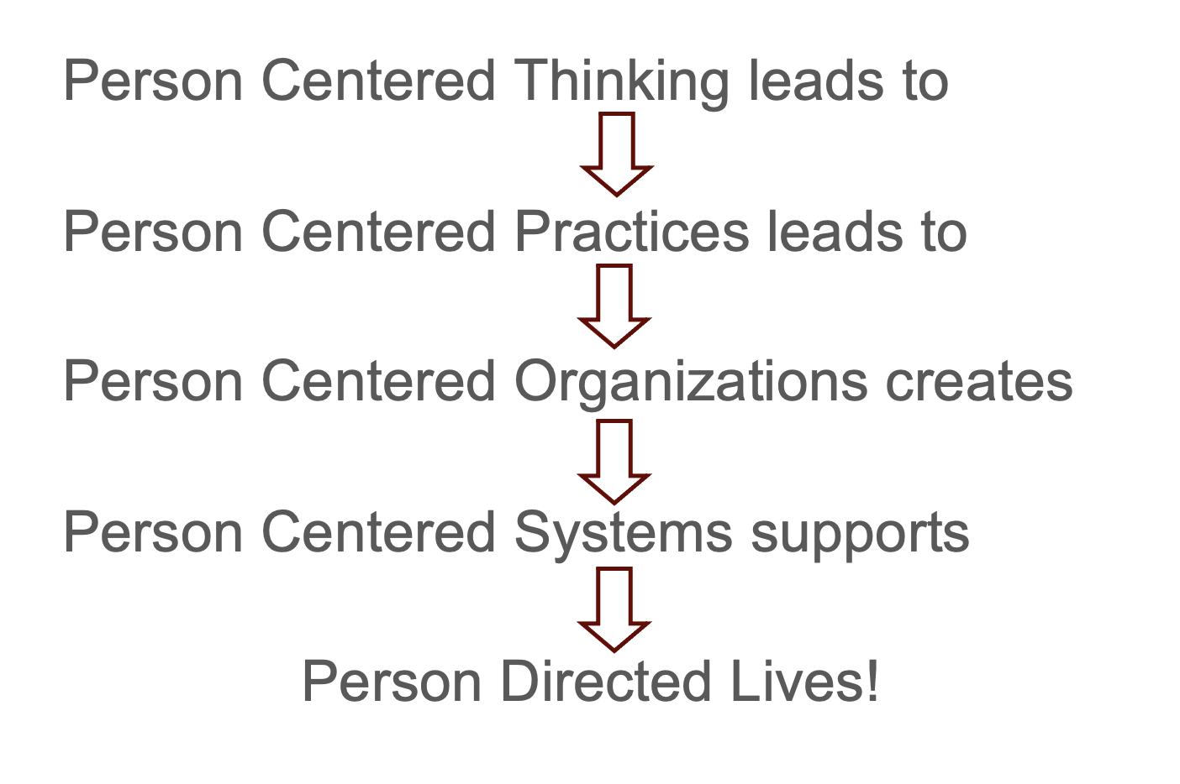
The Basic Approach

Slide 32
A Core Concept
Important To
Important For
and
The Balance Between Them
Wrkbk pg 5
Notes:
For those who have person centered thinking training-> created on important to and important for
PURPOSE:
To provide a the first introductory discussion of the fundamentals of the concept to create a foundation for a the service-community life discussion. To create a foundation to build from during the more detailed discussion and practice that comes after the overview.
SCRIPT:
Emphasize that this is about humans, not simply disability – as we move thru life all of us are juggling things that are important to us with things that are important for us.
TIPS:
TIME: 2 Minutes
NOTES;

Slide 33
Important TO
What is important to a person includes those things in life which help us to be satisfied, content, comforted, fulfilled, and happy. It includes:
    People to be with/relationships
    Status and control
    Things to do and Places to go
    Rituals or routines
    Rhythm or pace of life
    Things to have
Wrkbk pg 5
Notes:
We need to listen to behavior-> sometimes important to is difficult to verbalize for all people
PURPOSE:
Define Important TO
6 categories that commonly make people happy, fulfilled, content, satisfied, comforted. (other synonyms: pleased, at ease, comfortable)
SCRIPT
Emphasize that this is about humans not just about disability –
Ask how many people are living with another adult
How do they know if the person they live with is happy? What do they do?
Select 1 person and ask her (him) if her partner’s behavior is ever at odds with what he says (his words)
Ask “when what he says is different from what he does – which do you listen to, words or deeds?”
Hopefully the person will answer – “deeds” – so we already know that we should listen to behavior
Note that when we do not trust people we are hyper-vigilant about what they do much more than about what they say
For people who use disability services -
We often need to look at behavior because we have done a really good job of training people to tell us what we want to hear
When people don’t use words to talk, we have to listen to their behavior
TIPS:
TIME: 2 minutes
NOTES:

Slide 34
Important FOR
Issues of health
  Prevention of illness
  Treatment of illness / medical conditions
  Promotion of wellness (e.g.: diet, exercise)
Issues of safety
  Environment
  Well being ---- physical and emotional
  Free from Fear
And… what others see as necessary to help the person be valued and be a contributing member of their community
Wrkbk pg 5
Notes:
Purpose:
To define important for and help people see that that health and safety are complex issues, not just labels.
SCRIPT
Much of what is important for is already emphasized but the more nuanced parts are often omitted.
TIPS:
TIME: 1 minute
NOTES:

Slide 35
Person Centered Planning: A Tool for Creating Context
Person-Centered Planning:
Process-oriented process to empowering people.
Process of the person being able to speak up, recruit their support network to aid in creating new contexts over time.
Focusing on the people and what they need to live a preferred life with a desirable future, ultimately leading to lives of greater inclusion as valued members of both community and society.
It is an individualized process
  Can use on a continuum of intensity (planning for simple improvements in quality of life to intensive transition planning when quality of life is low)
Notes:
Important
About the process rather than the outcomes. Process of the person being able to speak up, recruit their support network to aid in creating new contexts over time .
Process of completing the plan. The process is individualized and can range in intensity from simple improvements to quality of life or intense transition plans or when quality of life is low.

Slide 36
Types of Person-Centered Planning
Essential Lifestyle Planning
Picture of a Life (PoL)
PATH
MAPS
Assertive Community Treatment
WRAP
Wraparound Planning
Resources to find out more: Link to Person-Centered Planning information
Locating and registering for PCT training: https://pctp.umn.edu/
Notes:
Lots of different methods of person centered planning they all have common elements may have different purposes

Slide 37
Integrating Positive Supports Activity #1

Slide 38
Activity
Review the Positive Social Strategies for Life Tools
Complete each page as best you can for yourself.
With this information use the One page profile template to create a one-page-profile for yourself.
Look at the examples one page profiles for ideas!

Slide 39
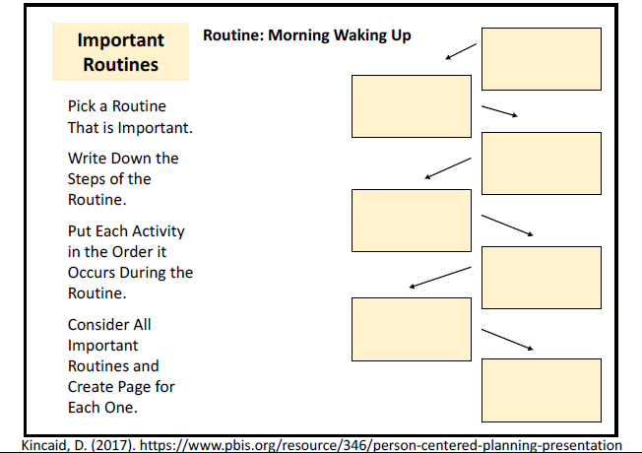
Routine: Morning Waking Up

Slide 40
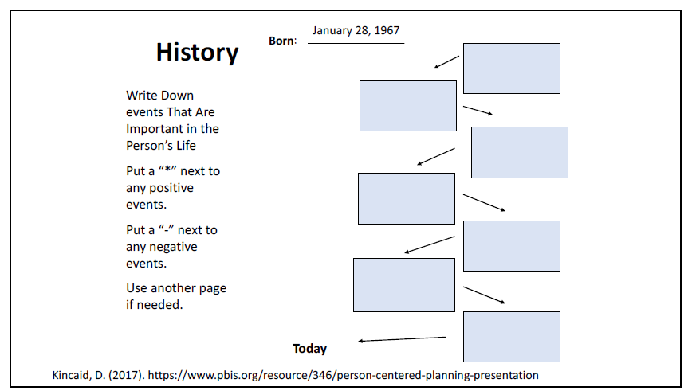
History

Slide 41
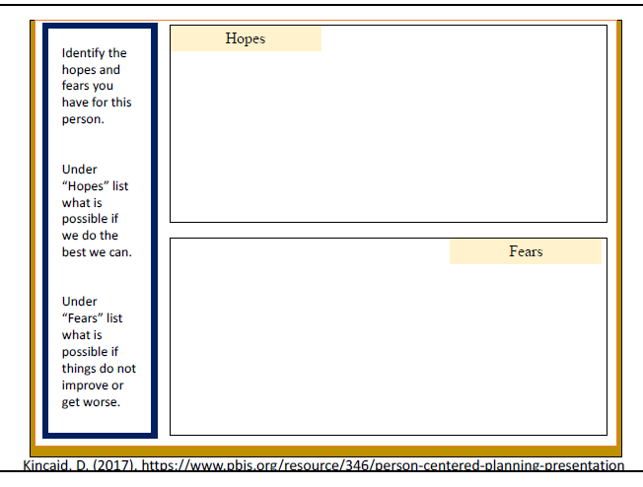
Hopes and Fears

Slide 42
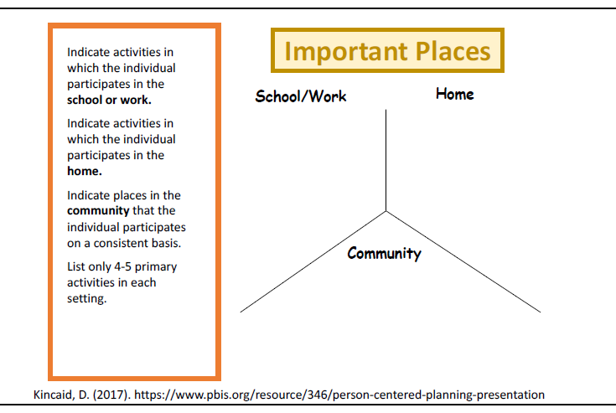
Important Places

Slide 43
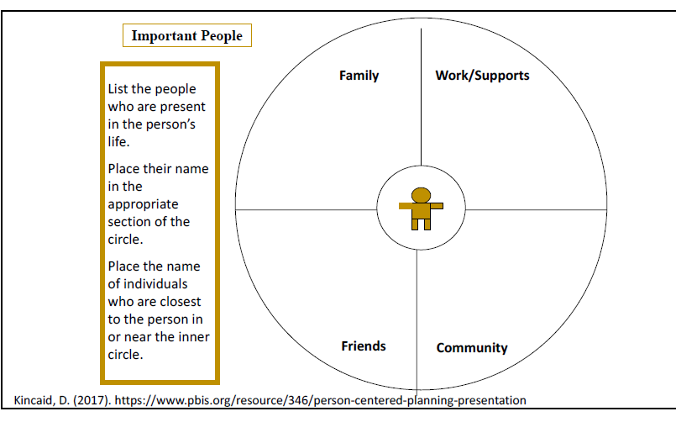
Important People

Slide 44
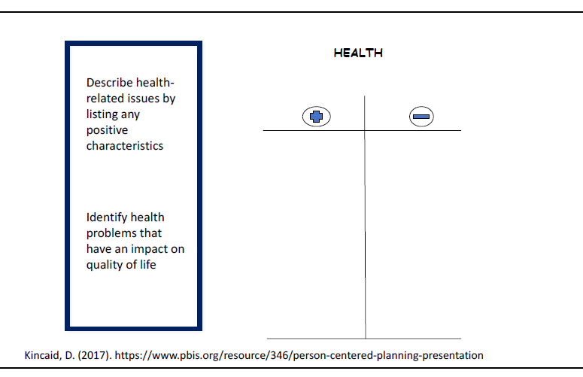
Health

Slide 45
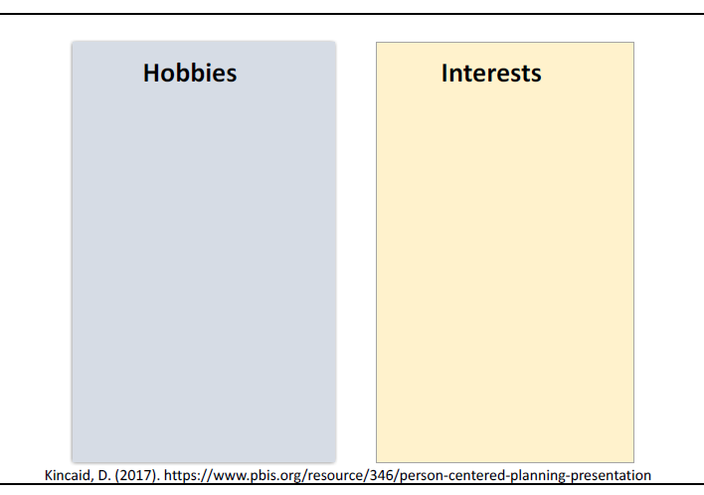
Hobbies and Interests

Slide 46
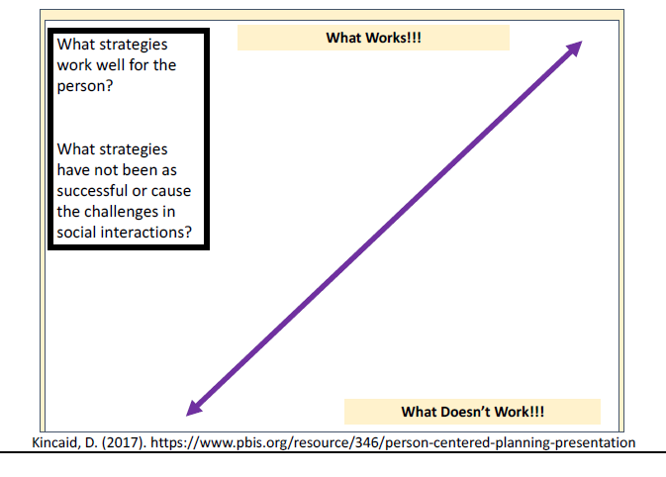
What Works? What Doesn’t Work?

Slide 47
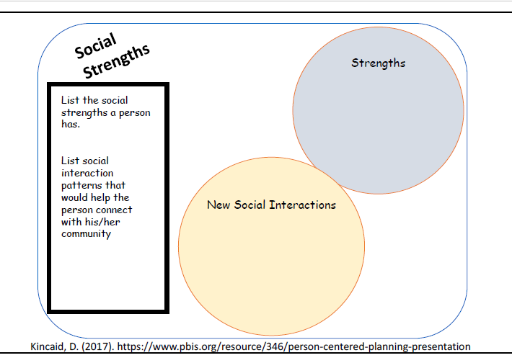
Social Strengths

Slide 48
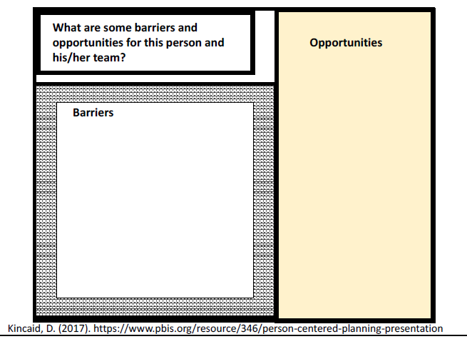
Barriers and Opportunities

Slide 49
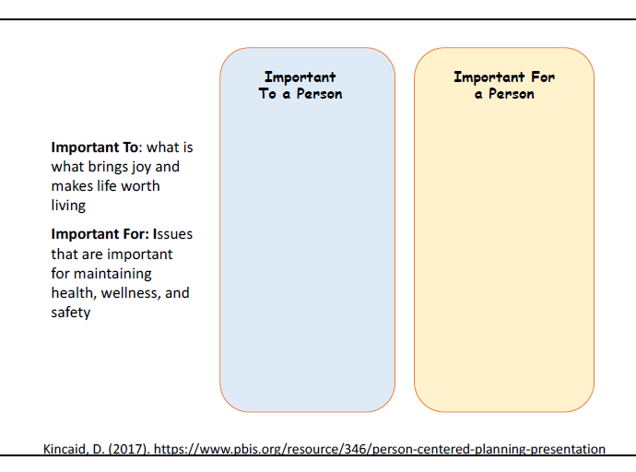
Important To and Important For

Slide 50
Getting to PBS Tier 2 and 3: A Functional Approach
Expanding on previous concepts of reinforcement and extinction
Understanding functions of behavior and why this is important
Understanding additional positive support practices to integrate

Slide 51
Functional Approach
A functional approach to assessment assumes that people behave in adaptive ways to ongoing changes in their environment.
  Behavior is “lawful” and it is happening for a reason.
  We need to figure out why it is happening to help to modify the environment, support the person, and to teach, and reinforce socially appropriate alternative behaviors for them to get their wants and needs met.
Notes:
Conceives of challenging behavior as an adaptive strategy that is the result of:
–Factors within the client –Factors within the environment
–An interaction between factors within the client and the environment

Slide 52
A Functional Approach: A Comprehensive Process
A functional approach is based on a solid evidence-base of research as a way to improve interfering behavior patterns. It is a comprehensive process, and should always be combined with person-centered thinking and practices, and with first evaluating other aspects of the person’s quality of life, such as:
  Have we ruled out a potential medical, dental, or behavioral health issue for the interfering behavior,
  Has this person had traumatic experiences or recent life events (e.g., a move, a death in the family, etc.) that may be influencing their behavior,
  Have we assessed this person’s quality of life?

Slide 53
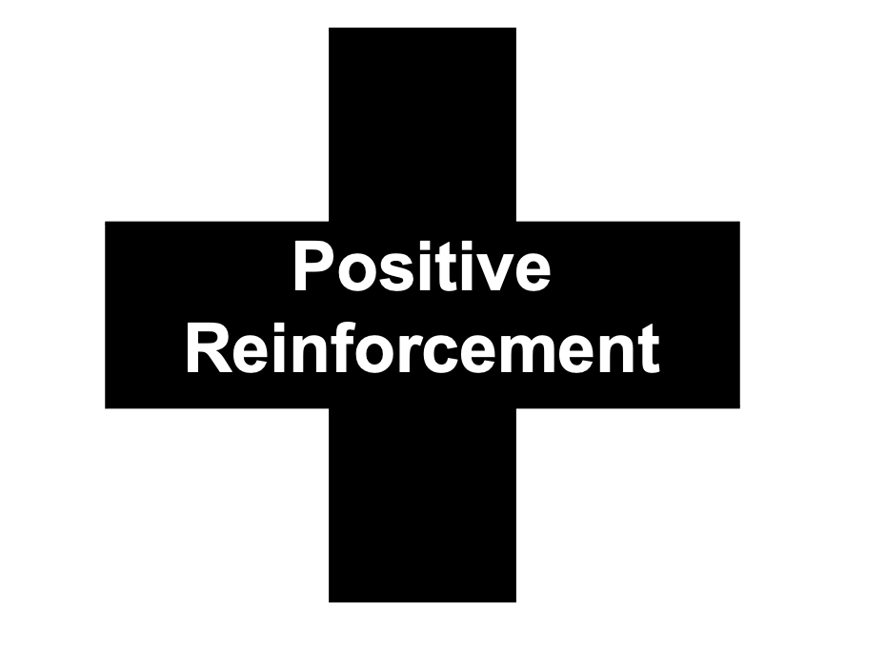
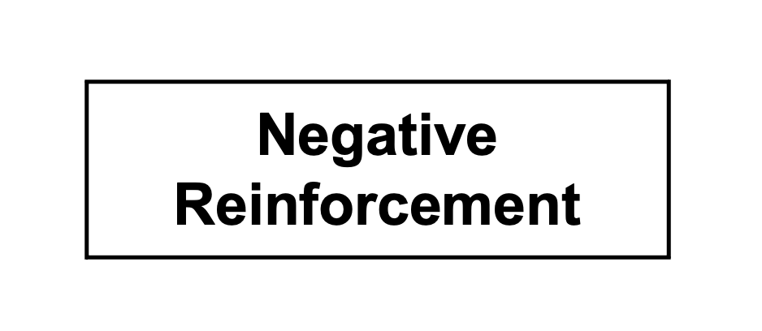
Reinforcement
Anything that increases the likelihood that a behavior will occur again

Slide 54
Positive Reinforcement
ADDING something to increase the likelihood that the behavior will occur again
EXAMPLES
Praising someone for a job well done
Offering 15 extra minutes of computer time for completing chores

Slide 55
Negative Reinforcement
TAKING AWAY something to increase the likelihood that the behavior will occur again
EXAMPLES
Taking away a chore for appropriate behavior
Allowing someone to take a short break from work after giving a break card

Slide 56
Punishment
What Punishment IS and what it DOES to behavior: when a behavior is followed by a consequence that decreases the behavior’s future rate of occurrence
NOT punishment just because someone views the consequence/event as unpleasant – the behavior must decrease
The use of punishment (e.g., response cost, rights restriction, "time out"), by 245 D licensed service providers, is prohibited per Minnesota Positive Support Rule 9544 as well as many other settings.

Slide 57
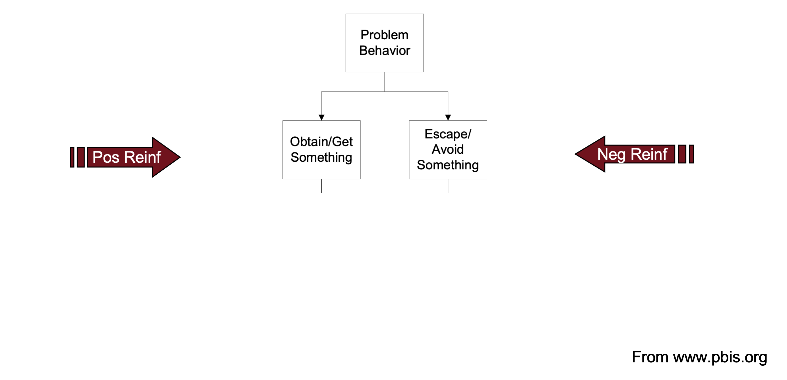
2 Basic Functions

Slide 58
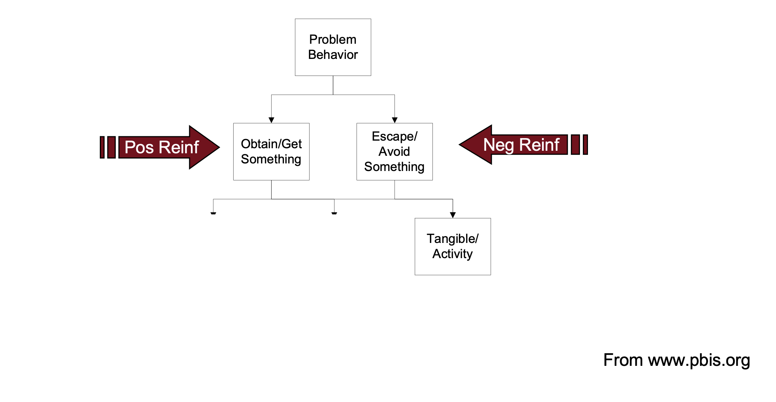
Only 2 Basic Functions (slide 1 of 4)

Slide 59
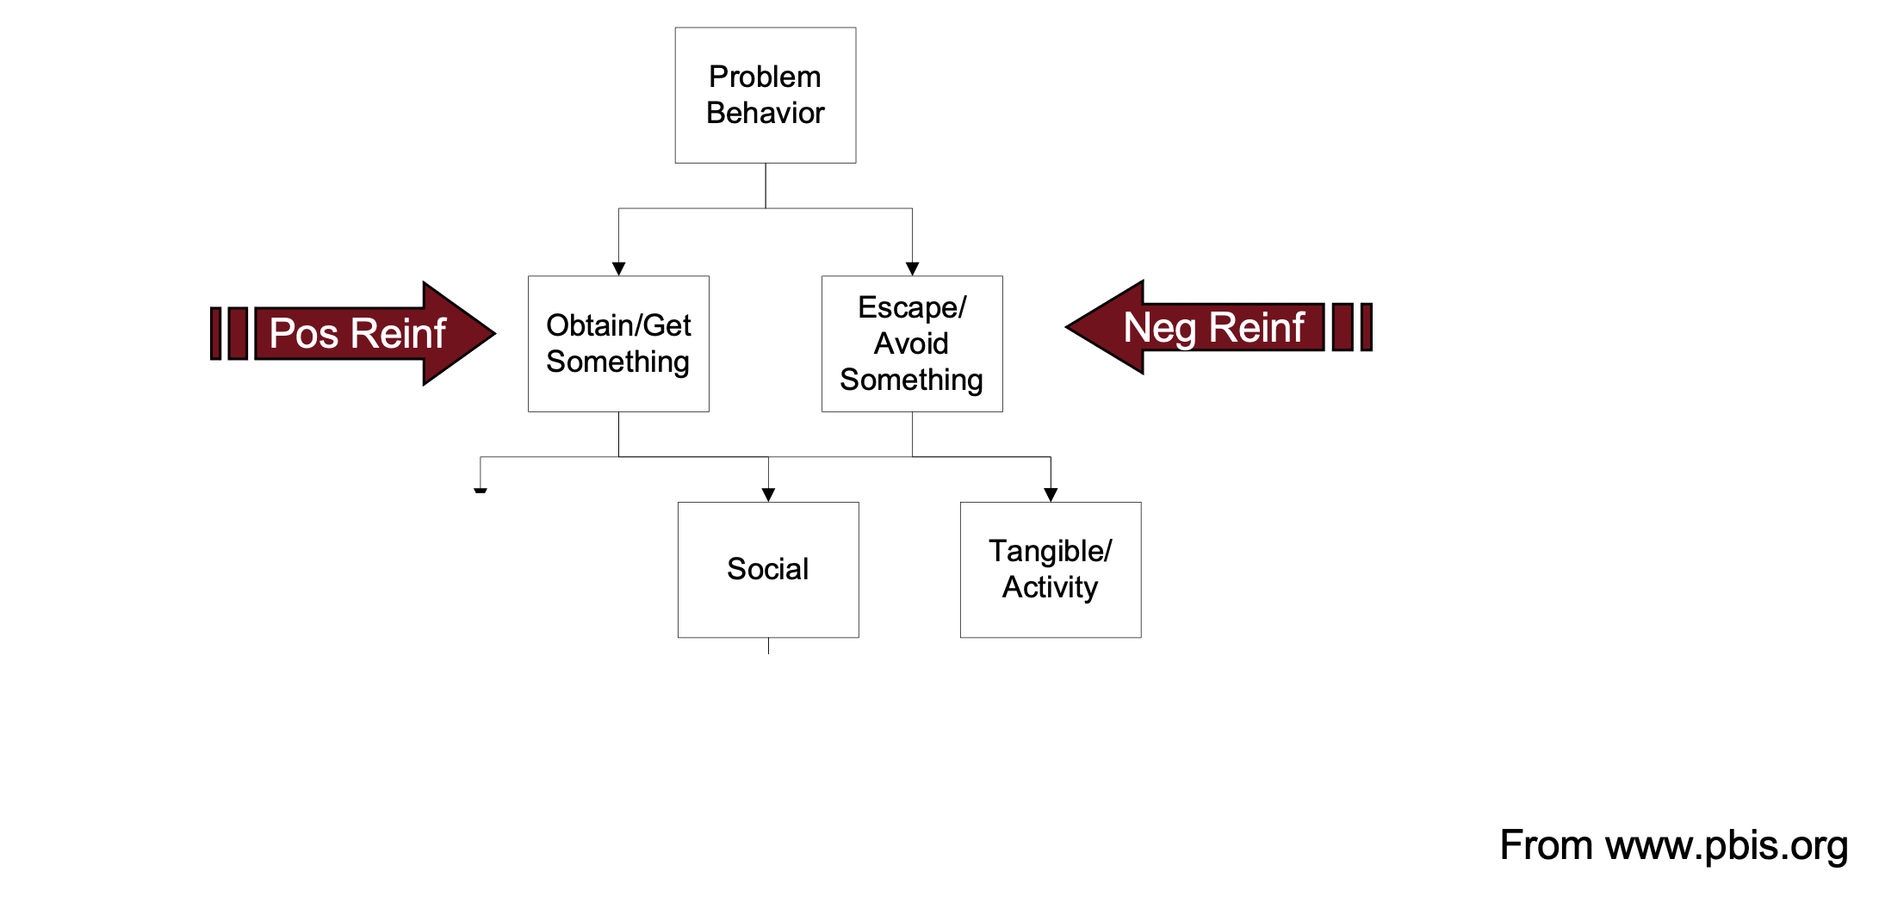
Only 2 Basic Functions (slide 2 of 4)

Slide 60
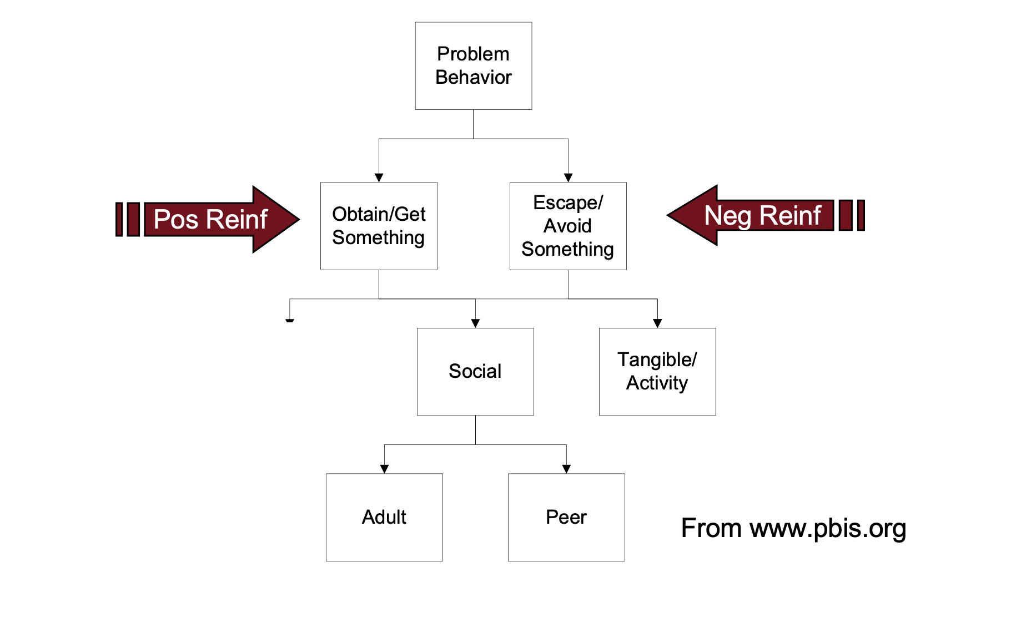
Only 2 Basic Functions (slide 3 of 4)

Slide 61
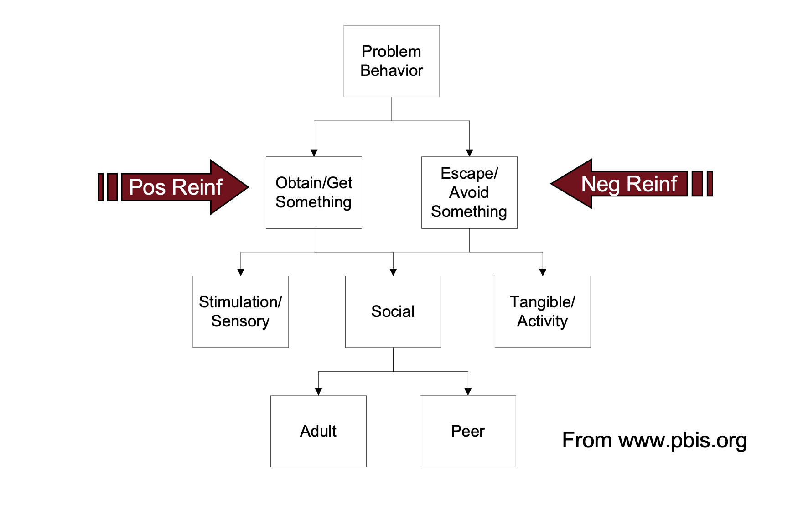
Only 2 Basic Functions (slide 4 of 4)

Slide 62
Socially Motivated and Non-Socially Motivated
Socially Motivated
Non-Socially Motivated

Slide 63
Attention, Tangibles, and Sensory
 | Seeking/Obtain | Avoiding/Escaping
Attention | Making others laugh Intimidating others or staff Slow transitions between activities because he has to stop and chat | Looking away whenever a co-worker asks a question.
Tangibles/ Activities | Working for a token (can of pop) Wants to have free time | Engaging in challenging behavior at the beginning of a work activity to go home for the day Intimidating staff because someone does not want to go on an outing.
Sensory | Acting very irritable because s/he hasn’t eaten yet today Hand-flapping | Wants to be kicked out of the room because it’s too noisy Won’t take medicine because of the way it makes him/her feel

Slide 64
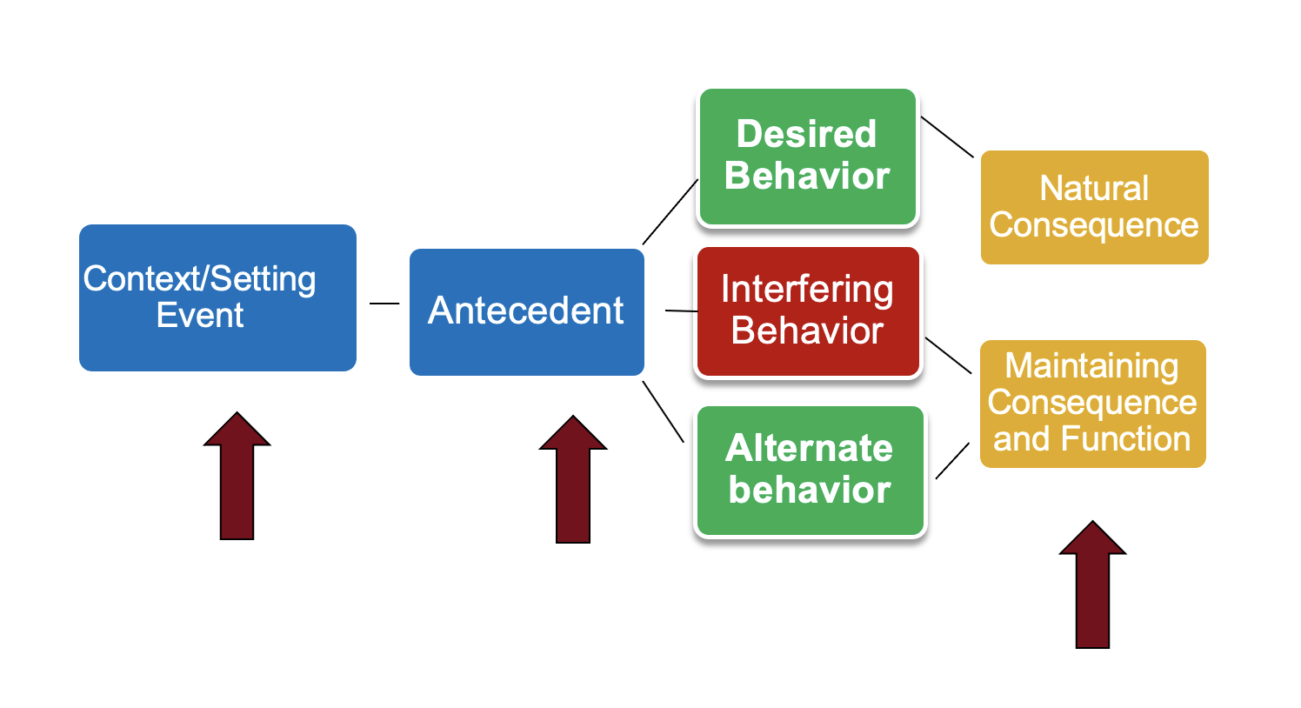
Behavior Pathway
Notes:
You may remember this behavior pathway from our last meeting. Can anyone remind us what a setting event is? The slow trigger to behavior. Things that set the occasion for the behavior to occur. These might include things like being tired, hungry, missing medication. Other examples? Antecedent? The stimulus the occurs immediately prior to the target behavior or challenging behavior
Consequence? The stimulus that occurs immediately following the target or challenging behavior
What are the functions of behavior? Obtain or Escape-> tangible, social, sensory

Slide 65
Integrating Positive Supports Activity #2

Slide 66
Jack’s Story

Slide 67
Participants
Student
Grandmother
Sister
Pastor
Boys Club Mentor
Juvenile Intake Officer
Guidance Center Case Manager
KIPBS facilitator
General Education Teacher
Special Education Teacher
School Counselor
Assistant Principal

Slide 68
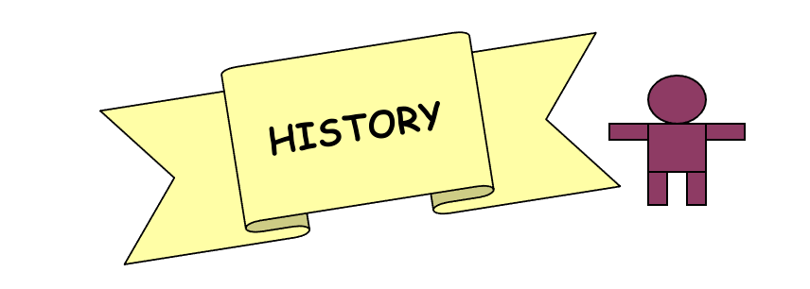
Jack’s History
Born: March 19, 1991
Never lived with dad
2005- mom went to jail
2005- grandma takes custody
2006- hit by a truck and put in hospital broke his leg
2007- great grandma died
2008- brother murdered
2010 arrested for 2 offenses and put on probation

Slide 69
Dreams
Jack wants to attend the Technical College to study the field of Auto Collision Repair.
Jack would like to have more contact with his mom.
Jack wants to make it out of his home town.

Slide 70
Preferred Lifestyle
Jack lives in low income housing with his grandmother, sister and cousin, but would like to live with his mom.
In the future, he wants to work in the field of auto collision repair.
He enjoys socializing with his sister and his friends.
Jack enjoys listening to Rap music, “bustin a flow”, “chillin with the boyz”, and attending church with his family.

Slide 71
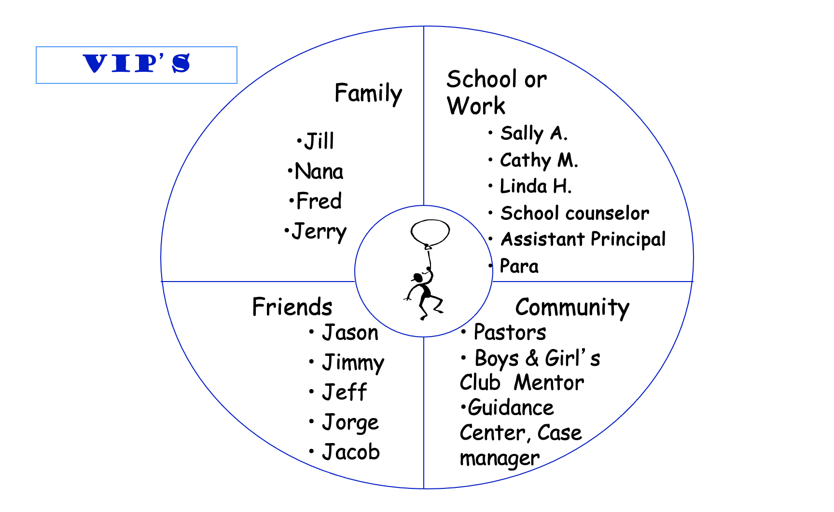
VIP’s

Slide 72
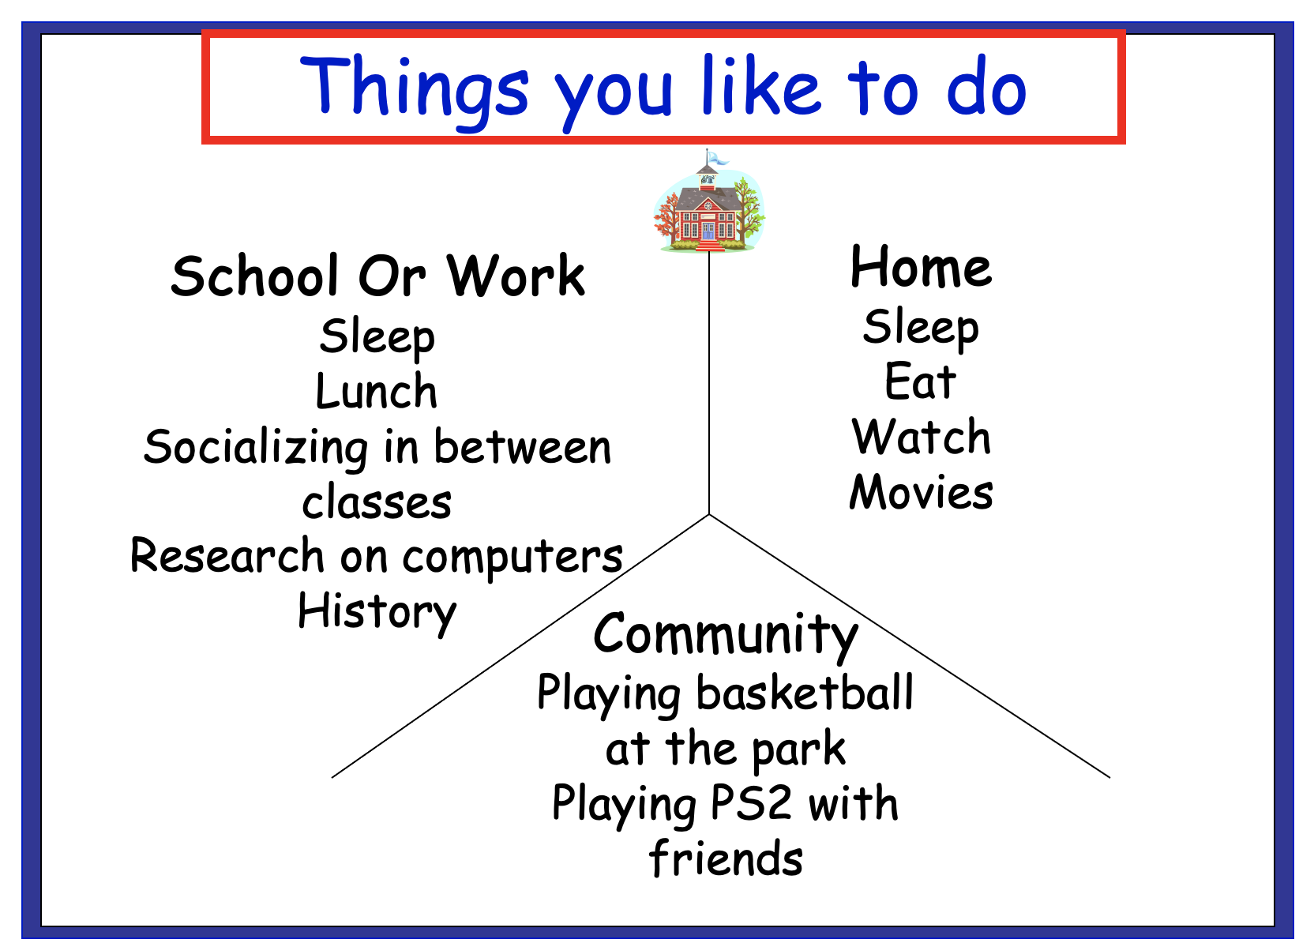
Things you Like to do

Slide 73
Strengths
Friendly
Respectful
Leader
Good friend

Slide 74
Weaknesses
Easily angered
Does not like to be corrected
Does not like authority
Does not always follow through with promises and tasks

Slide 75
What Works and What Doesn’t for Jack
What Works
Giving correction by one to one
Talk to him like an equal
Give him respect
What Doesn’t
Calling him out in public
Yelling at him
Disrespect

Slide 76
Jack’s Hopes and Fears
Hopes
Fears
To prove everyone wrong and make something out of his life.
Does not want to wind up an unsolved murder victim like his brother or in prison.

Slide 77
Priorities
Maximizing instructional time
Improving personal relationships with legal authorities
Calling grandma when staying at a friends house or coming home on time
Staying awake in class

Slide 78
Goal
To attend the technical college to study Auto Collision Repair

Slide 79
How I Will Meet My Goal
Decrease Office Referrals
Complete all assignments
Follow (city) curfew and stay awake in class
Increase positive relationships with legal authorities
Get accepted into the Technical College

Slide 80
Functional Behavior Assessment
Operational Definition:
  Choosing not to perform an important task when a request is made, arguing with the person who made the request, cursing, or verbal/physical aggression
Indirect assessments:
  Functional Assessment Interview
  Quality of Life Evaluation
  Record review
Direct assessment:
  Functional assessment observation

Slide 81
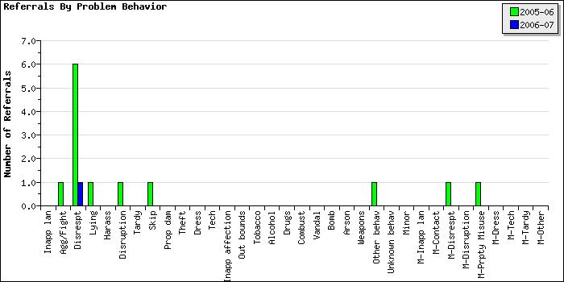
Referrals by Problem Behavior

Slide 82
Based on Functional Assessment
When Jack is given a request, he becomes verbally aggressive, escalates and walks out in order to escape the demand of an authority.

Slide 83
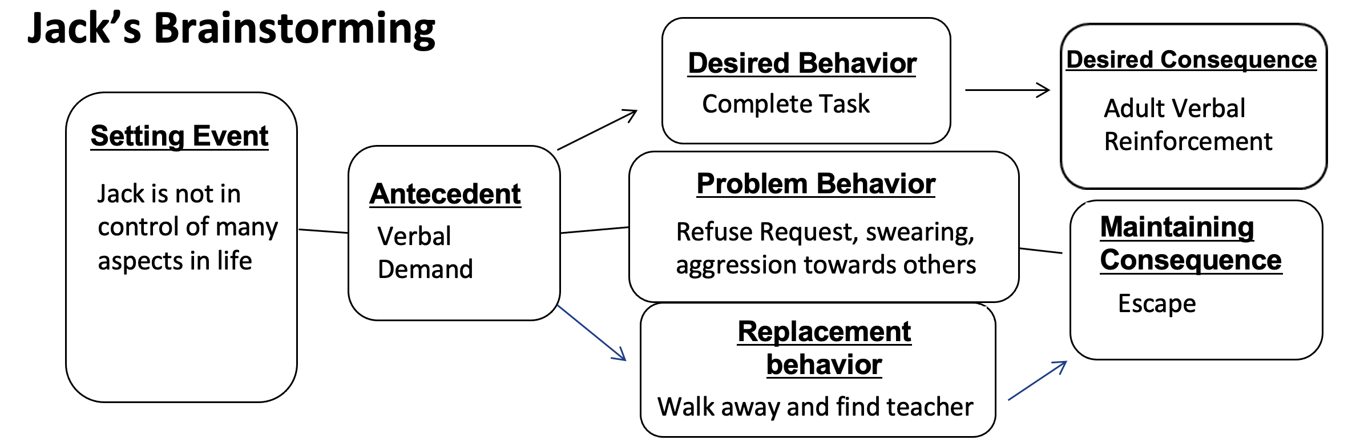
Jack’s Brainstorming
Setting Event Interventions | Antecedent Interventions | Teaching New Skills | Consequence Interventions

Slide 84
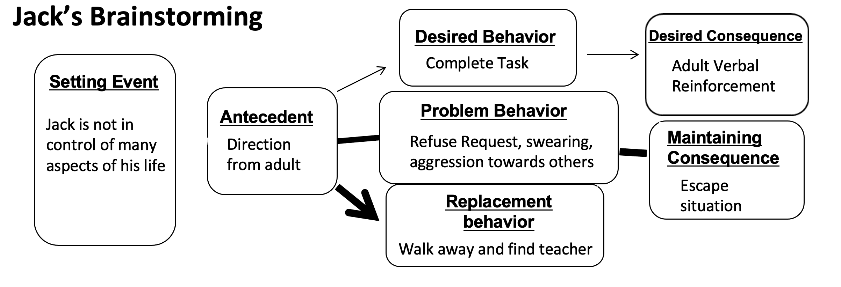
Jack’s Brainstorming Continued
Setting Event Interventions | Antecedent Interventions | Teaching New Skills | Consequence Interventions
Guidance Center case manager will help family set routines Jack is given opportunities to make choices at home Meet with all school staff to share information about Jack | Teachers and PCP team members share information about how to make requests in less authoritarian manner Include choices within interactions Modify academic tasks so they are presented in natural manner Explain why the task is meaningful to Jack’s goals | Encourage Jack to walk away when he is feeling disrespected and find his Special Education Teacher to explain the situation Teach Jack to disagree in appropriate ways, how to negotiate with others, and how to manage anger | Daily rating sheet provides a way for Jack to engage with teacher Reinforcement for replacement behavior is given Reduce attention to inappropriate responses Look for early signs of frustration or anger and prompt replacement behavior

Slide 85
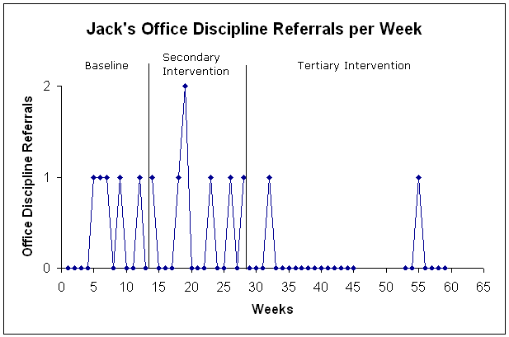
Jack’s Office Discipline Referrals per Week

Slide 86
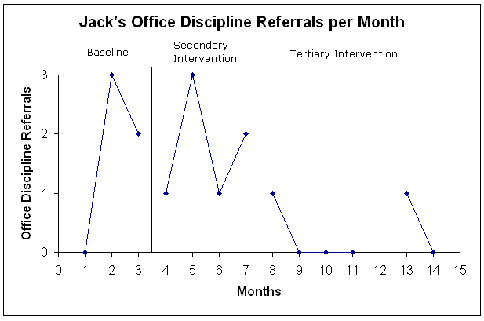
Jack’s Office Discipline Referrals per Month Continued

Slide 87
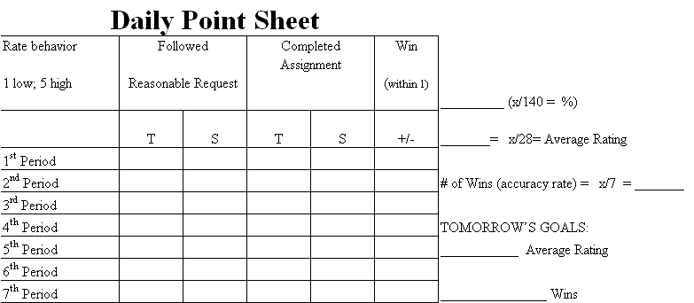
Daily Point Sheet

Slide 88
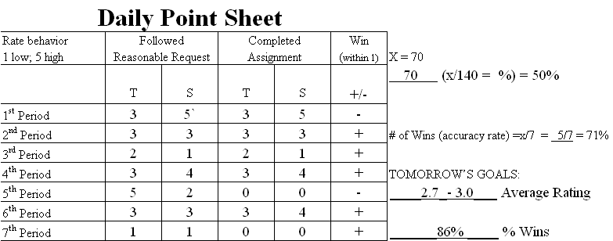
Daily Point Sheet Filled Out

Slide 89
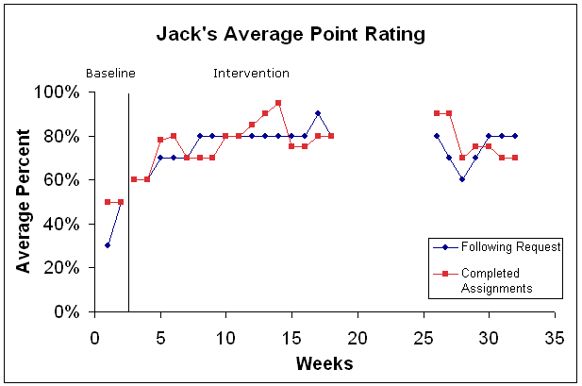
Jack’s Average Point Rating

Slide 90
When asked about PBS…
Jack says,
“It’s copasetic.”

Slide 91
Reflection Discussion
What questions should the team discuss with Jack at the next meeting to continue PBS planning to expand the PCP across home, school, and community
What kinds of plans should Jack and his team consider immediately and which activities might help Jack reach his goal (auto-collision repair job)?
How does this activity reflect an integrated approach to positive support practices at Tier 2/3?

Slide 92
Discussion
What interagency strategies should be discussed by the team?
What would you do differently?

Slide 93
Questions for today?
What are your next steps?
What are you bringing back to your team?
What do you want to try before next month?
Questions for us?

Slide 94
Like-Learn-Change
What is something you liked today?
What is something you learned today?
What is something that you would like us to change in the future?

Slide 95

University of Minnesota Information

