Slide 1
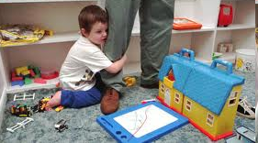
Integrating Positive Behavior Support with Cognitive Behavioral Therapy to Treat Anxiety in Youth and Adults with IDD:
Intensive Series
Lauren Moskowitz, PhD
St. John’s University
Moskowil@stjohns.edu
Part 1: May 1, 2024
Part 2: May 10, 2024
Notes:
Integrating PBS with Cognitive Behavioral Therapy (CBT) to Treat Anxiety in Youth and Adults with IDD- Intensive Series
Join Us on Zoom
5/1/24: 9 am- 11:30 AM CT, 10 am- 12:30 EST
5/10/24: 9 am- 11:30 AM CT, 10 am- 12:30 EST
Who:
This training is intended for people who have experience with Positive Behavior Support (PBS) and or have attended ICI’s PBS Intensive Series.
What:
This training workshop will discuss how to assess anxiety as part of a functional behavior assessment as well as how to address anxiety in a family-based PBS plan. We will present a multimethod strategy for assessing anxiety and a parent-implemented multicomponent intervention package that integrates PBS and CBT (Moskowitz et al., 2017). The CBT procedures include gradual exposure, psychoeducation, and cognitive restructuring. These CBT-for-anxiety strategies as well as PBS strategies that are traditionally used to address challenging behavior are incorporated into a PBS Prevent-Replace-Respond framework, with PBS Prevention strategies including incorporating the individual’s “special interests” into treatment; increasing predictability; providing choices between various aspects of the exposure; and modelling and/or verbally prompting an approach response. PBS Response strategies will include teaching the provider to positively reinforce the individual’s attempts to approach a feared situation and teaching the provider to minimize reinforcement/accommodation for the individual’s anxious behaviors. Finally, PBS Replacement strategies may include teaching the individual a competing response, Functional Communication Training (FCT), and teaching a relaxation response. Although gradual exposure and positive reinforcement are used with all individuals, other strategies are chosen in collaboration with families and providers to promote a good contextual fit.
Many providers want to address mental health problems in individuals with IDD, but do not know how. This presentation aims to empower more providers to treat anxiety in individuals with IDD.
Registration:
This event is no cost to attendees, but prior registration is required.
Registration link: https://umn.zoom.us/meeting/register/tJ0sdumrrTorHtU2wQ_Ur-ykPqcZNp1IzjYC
Questions: Please contact us at pbs@umn.edu

Slide 2
What is Anxiety?
3-Component Model:
Thoughts
Physical Feelings
Behaviors
Notes:
Example, a friend stands you up for a lunch date:
Emotion Thought Action
Fear She was in an accident call the police
Angry she is inconsiderate refuse to reschedule
Sadness she does not like me don’t call

Slide 3

Feelings
Heart beating fast
Heavy/rapid breathing
Muscles tense
Flushed face
Perspiration
Nausea

Slide 4
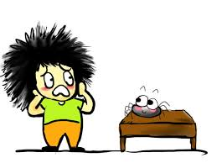
Thoughts
  Catastrophizing: Always thinking the worst ever is going to happen
  Mind-Reading: Believing you know what other people are thinking about you
  Fortune-Telling: Believing that you know that something bad will happen in the future
  All-or-Nothing Thinking: Believing if you don’t do something 100% perfectly, you have failed
  Negative Thinking: Picking out only negative aspects of situation and not considering positive aspects
What if the spider crawls on me and then bites me and I die?
Notes:
From Coping Cat Manual:
Walking with blinders
Only seeing the negative and overlooking the good in a situation [Race horses wear “blinders” to see straight and not be distracted in a race]
The repetitor
If it happened once it is always going to happen that way
The catastrophiser (or the pessimist)
Always thinking the ‘worst ever’ is going to happen
The avoider
Staying away from situations you think are scary without trying first
The mind reader (or fortune-teller, using the “crystal ball”)
Jumping to conclusions about a person/thing/situation without the facts
The shoulds (having ”the shoulds” is like having “a cold”)
I SHOULD always be perfect. I SHOULDN’T make mistakes.
The perfectionist
Setting expectations that are too high: Perfection is not a human option.

Slide 5
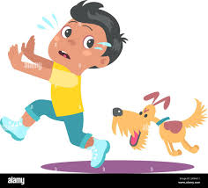
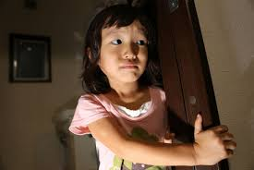

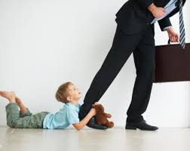
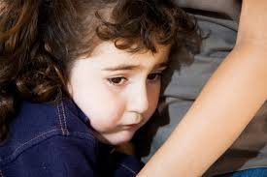
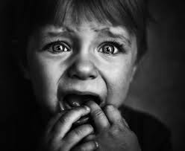
Behavior
Get away!
Avoidance/escape behavior
  running away
  cowering
Freezing
Pacing
Crying
Clinging
Reassurance-seeking
Notes:
When you’re afraid, your gut instinct is to avoid… your body automatically tells you to get away.
When kids are afraid, their "avoidance instinct" kicks in and they do anything they can to escape or avoid the situation they’re afraid of, such as running away, cowering, crying and pleading,or sometimes even aggression (like fight or flight).
In the short term, these behaviors work for the kid because they escape or avoid what they’re afraid of, whether that’s escaping from a dog they’re afraid will hurt them or keeping their parent from leaving them.
The problem is, while this may work for kids in the short term, in the long term, escaping or avoiding situations that aren’t actually dangerous prevents kids from learning to cope with these situations and learning that they can overcome challenges. Like Glennon Doyle says: “WE CAN DO HARD THINGS.” We want kids to learn that they can do hard things.

Slide 6
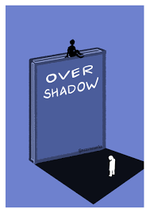
Background on Anxiety in IDD
Anxiety is more prevalent in individuals with IDD than the general population
  Anxiety is even more prevalent in autistic youth & adults than in neurotypical individuals or in those with other developmental disabilities
BUT anxiety often overlooked, unrecognized, or undiagnosed in IDD due to:
  Difficulty of assessing or measuring anxiety
    Communication deficits
    Idiosyncratic behavioral expression
  Symptom overlap between autism & anxiety disorders
    Diagnostic overshadowing
Fletcher et al., (2016); Hagopian & Jennett (2008); Kerns et al., (2021); White et al., (2009); van Steensel et al. (2011)
Notes:
Despite the increased risk for anxiety disorders in children w/ASD, there is a lack of research on assessment & treatment of anxiety in this population, relative to the large body of literature on anxiety in TD children.
This may be due in part to the difficulty of assessing anxiety in children with ASD as well as to the reluctance of operant researchers to consider factors other than behavior (i.e., cognition and affect).
https://network.autism.org.uk/sites/default/files/ckfinder/files/Anxiety%20in%20autistic%20people(1).pdf
Evidence suggests that when autistic people experience anxiety there may be some aspects of their experience that are different from anxiety as experienced by non-autistics (Kerns et al, 2014). There are 4 key areas that may especially relate to anxiety for autistic people: • difficulty recognising emotions of self and others • sensory sensitivities • difficulty with uncertainty • performance anxiety
NEW SLIDE
Anxiety and major depressive disorder (MDD) are the most prevalent comorbidities in adults with ASD (Buck et al., 2014; Joshi et al., 2013; Lever & Geurts, 2016).
Although data are inconsistent, it is widely believed that adults with intellectual disabilities (ID) have equal or greater prevalence of anxiety than the general population (Fletcher et al., 2016). In a recent review of data collected through the National Core Indicators Survey of adults with ID across the U.S., there was a reported range of 34% to 64% of respondents who met criteria for a dual diagnosis (i.e., mental illness and ID; Bradley et al., 2019). Among those dually diagnosed, the most prevalent mental health diagnoses are affective and anxiety disorders (Cooper et al., 2007; Dykens, 2007; Tassé et al., 2016). Among adults with ID, estimates of the prevalence of anxiety symptoms range from 6% to 31% (Bailey & Andrews, 2003; Ballinger & Ballinger, 1991; Reiss, 1990), and more recent studies report estimated prevalence from <2% to 17% (Bailey, 2007; Reid et al., 2011). The wide range of prevalence estimates is due to the variable reporting of symptoms associated with anxiety versus a clinical diagnosis of an anxiety disorder, and the added difficulty of differential diagnosis (i.e., distinguishing anxiety from other mental health conditions) among this population (Bailey & Andrews, 2003; Fletcher et al., 2016).
Autistic individuals commonly experience co-occurring anxiety disorders, with a life time prevalence of up to 42% (Hollocks et al., 2019). A recent study suggests that young autistic adults have a risk of an anxiety diagnosis two and a half times higher compared with non-autistic persons from the general population, with autistic individuals without intellectual disability (ID)

Slide 7
Assessing Anxiety in Autism

Slide 8
Use a Multi-Method Assessment: Autistic Youth
Questionnaires
Self-report questionnaires:
  Anxiety Scale for Children – ASD (ASC-ASD; Rodgers et al., 2016) (designed for youth with ASD who do not have ID); free to download
Parent-Report questionnaires:
  ASC-ASD – Parent Version (for youth with ASD without ID); free to download
  Parent-rated Anxiety Scale for ASD (PRAS-ASD; Scahill et al., 2019) (for youth with ASD, with or without ID); free to download
Interviews
Interviews designed for NT youth: Anxiety Disorders Interview Schedule (ADIS-IV – Parent & Child Version)
Interviews designed for autistic youth: Autism Spectrum Addendum to the ADIS-Parent Version (Kerns et al., 2014)
Direct Observation
Behavioral Avoidance Test (BAT): observe child approach a feared object or situation and collect information about child’s behavioral response
See Kerns et al. (2016) and Moskowitz, Rosen, Lerner, & Levine (2017) for a review

Slide 9
Use a Multi-Method Assessment: Autistic Adults
Questionnaires
Self-report questionnaire designed for autistic adults (without ID):
  Anxiety Scale for Autism – Adults (ASA-A; Rodgers et al., 2016); free to download
Self-report questionnaires that have been used with autistic adults (without ID):
    Hospital Anxiety and Depression Scale (HADS)
    Depression Anxiety Stress Scales (DASS-21)
Other-informant questionnaires:
  Diagnostic Assessment for the Severely Handicapped Scale-II (DASH-II; Matson, 1995)
  Anxiety, Depression, & Mood Scale (ADAMS) (ages 10-79 years old)
Interviews that have been used with autistic adults:
Interviews designed for NT adults:
  Anxiety Disorders Interview Schedule (ADIS-IV)
Interviews designed for adults with ID:
  Mini Psychiatric Assessment Schedule for Adults with a Developmental Disability (Mini PAS-ADD)
  Yale-Brown Obsessive Compulsive Scale (YBOCS)
Notes:
ABC, DASH-II, and MIPQ
Questionnaires
Comprehensive Anxiety Scale (CAS) is a brief (35-item), open-source, freely
available informant-report measure specifically developed to comprehensively
capture different types of anxiety in children and adolescents with autism spectrum
disorder and a wide variety of other neurodevelopmental and neuropsychiatric
disorders
Self-report questionnaires/rating scales
For higher-functioning youth with ASD:
Multidimensional Anxiety Scale for Children (MASC-C; March et al., 1997)
Screen for Child Anxiety Related Emotional Disorders (SCARED-C; Birmaher et al., 1997)
Spence Children’s Anxiety Scale (SCAS; Spence, 1998)
Revised Child Anxiety and Depression Scale (RCADS; Chorpita et al., 2000)
Anxiety Scale for Children with ASD (ASC-ASD; Rodgers et al., 2016) (adapted version of RCADS with additional items related to sensory anxiety, uncertainty, and phobias; free to download)
For higher- and lower-functioning youth with ASD:
Revised Children’s Manifest Anxiety Scale (RCMAS; Reynolds & Richmond, 1978)
Fear Survey Schedule for Children-Revised (FSSC-R)
Fear Survey for Children With and Without Mental Retardation (FSCMR)
For adults with ASD (without ID):
Hospital Anxiety and Depression Scale (HADS; Uljarevic et al., 2018)
Depression Anxiety Stress Scales (DASS-21; Lovibond & Lovibond, 1995)
Other-Informant Questionnaires/rating scales (e.g., parents, caretakers, teachers)
For higher-functioning youth with ASD:
Parent-report versions of the MASC, SCARED, RCADS, SCAS, and ASC-ASD
Autism Spectrum Disorders-Comorbidity for Children (ASD-CC; Matson & Gonzalez, 2007)
For higher- and lower-functioning youth with ASD:
Parent-rated Anxiety Scale for ASD (PRAS-ASD; Scahill et al., 2019); created because parents often fail to endorse language-dependent items such as “worries” or “complains”
Child and Adolescent Symptom Inventory-4th Ed Revised (CASI-4R; Gadow & Sprafkin, 2002)
The Anxiety, Depression, and Mood Scale (ADAMS; Esbensen et al., 2003)
Interviews
Interviews Designed for Typically Developing Youth (that have been used with those with ASD):
Anxiety Disorders Interview Schedule for DSM-IV, Child and Parent Versions (ADIS-IV-C/P; Silverman & Albano, 1996); gold standard for youth w/out ASD; validated in youth w/HFA
Schedule for Affective Disorders and Schizophrenia in School-Aged Children (K-SADS-PL; Kaufman et al., 1997); used less frequently in ASD and lighter coverage of anxiety disorders than ADIS, but demonstrated reliability in youth with HFA, free-of-charge, and less training
Interviews Designed Specifically for Youth with ASD:
Autism Spectrum Addendum to the ADIS-P (ADIS/A; Kerns et al., 2014); a set of guidelines and supplementary items designed to differentiate traditional DSM anxiety disorders in ASD from the more atypical anxiety (e.g., schedule, environmental changes) often present in ASD
Autism Comorbidity Interview – Present and Lifetime Version (ACI-PL; Leyfer et al., 2006); modified from K-SADS to differentiate between core symptoms of autism & symptoms of anxiety
Interviews Used With Adults with ASD:
Anxiety Disorders Interview Schedule (ADIS-IV: Brown et al., 1994), semi-structured interview
MINI-Plus (Sheehan et al., 1998), structured diagnostic interview
Mini PAS-ADD Clinical Interview, abbreviated version of the Psychiatric Assessment Schedule for Adults with Developmental Disability (PAS-ADD; Moss et al., 1998); designed for adults with ID

Slide 10
Example Functional Assessment
Interview Questions for Those with IDD
Behaviors: How do you know he/she is anxious or afraid?
  When your child feels anxious or afraid, how does he/she behave?
  What exactly do they say or do that makes you think they are anxious/afraid?
  Could you describe one of these incidents? How often does this happen?
  Here are some examples of additional probes you can ask the parent (adapted from Edwards et al., 2022) if you are unsure what behaviors indicate anxiety:
    Do you see any physical changes in their body when X is anxious or afraid?
    Do you see changes in how X moves when he/she is anxious or afraid?
    Do you see any changes in their facial expression when X is anxious/afraid?
    Do you see any changes in their speech pattern?
    Have you noticed any patterns when anxiety occurs?
Patterns of Antecedents: Does the onset of anxiety seem to be linked to any triggers or causes?
Patterns of Consequences: How do you react to his/her anxious behaviors?
Edwards, G., Tarver, J., Shelley, L., Bird, M., Hughes, J., Crawford, H., & Waite, J. (2023). Utilising interview methodology to inform the development of New Clinical Assessment Tools for anxiety in autistic individuals who speak few or no words. Journal of Autism and Developmental Disorders, 53(6), 2328-2348.
Notes:
Tell me about your child’s behavior. How do you know he/she is anxious?
When your child feels anxious or afraid, how does he/she behave?
What exactly does your child do or say that lets you know he/she is anxious?
Could you describe one of these incidents (a recent period of time when X showed this anxiety)? How often does he/she do these things?
Here are some examples of additional probes you can ask the parent (from Edwards et al., 2022) if you are unsure what behaviors indicate anxiety:
Do you see any physical changes in his/her body when X is anxious or afraid?
Do you see changes in how X moves when he/she is anxious or afraid?
Do you see any changes in his/her face (or facial expression) when X is anxious or afraid?
Have you noticed any patterns when anxiety occurs?
Patterns of antecedents frequently leading to the target behavior? Other behaviors that the student engages in that typically precede the target behavior?
Patterns of consequences frequently following the target behavior?
How do you react to your child’s anxious behaviors?
Does the onset of anxiety seem to be linked to any triggers or causes?
Can you describe a typical example of when (X) shows anxiety?
Is there a particular time of day when the anxiety is more likely to occur?
When (X) feels anxious, how do they behave during this time?
Do you see any physical changes in their body?
Do you see changes in how they moves?
Do you see any changes in their face?
Do you see any changes in their speech pattern?
Do these behaviours occur in an order/sequence?
Do the behaviours that (X) shows differ between events/bursts? Or are the same behaviours always shown?
What do you think (X) is thinking when they are feeling anxious? Why do you think that?
What behaviours does (X) show?
What does (X) say to make you think this?
Do you think they are feeling any other emotions?
Utilising Interview Methodology to Inform the Development of New
Clinical Assessment Tools for Anxiety in Autistic Individuals Who Speak
Few or no Words
Edwards, G., Tarver, J., Shelley, L., Bird, M., Hughes, J., Crawford, H., & Waite, J. (2023). Utilising interview methodology to inform the development of New Clinical Assessment Tools for anxiety in autistic individuals who speak few or no words. Journal of Autism and Developmental Disorders, 53(6), 2328-2348.

Slide 11
Assessment of Anxiety in Individuals with Autism & ID*
(*a lot of this still applies for those who are verbal and/or without ID)
Direct Observation
  Identify idiosyncratic behaviors that indicate anxiety (e.g., crying, pacing, freezing, following parent, reassurance-seeking)
  Theses are unique to each individual with IDD
Multi-Method Assessment
  Any one behavior on its own does not necessarily indicate anxiety
  Multiple sources of converging data may suggest behavior is a sign of anxiety
  Family history & medication response history
  Personal/developmental history of context (similar or repeated behaviors)
    Change from baseline? Has frequency of behaviors increased recently?
    Sometimes not new behaviors, but rather escalation of pre-existing behaviors
  Functional Assessment: what behaviors are positively or negatively reinforcing?
  If negatively reinforcing, differentiate between “escape-demand” (“I don’t want to do it”) vs. “escape-anxiety” (“I’m afraid/uncomfortable”)
Moskowitz et al., (2013); Moskowitz, Rosen, Lerner, & Levine (2017)
Notes:
For those who have ID and/or who are minimally verbal, anxiety is assessed by relying largely on DIRECT OBSERVATION
identifying the idiosyncratic behaviors that indicate anxiety (e.g., crying, pacing, reassurance-seeking), unique to each person
It is especially important to use a multi-method assessment
Although any behavior on its own does not necessarily indicate anxiety (e.g., child may cry because he is feeling anxious, sad, in pain, etc.), multiple sources of converging data may suggest that the behavior is a marker of anxiety
Family history & medication response history
Personal/developmental history of context (similar behaviors/repeated behaviors)
Has there been a change from baseline? Has the frequency of behaviors increased recently?
Sometimes not new behaviors, but rather escalation or intensification of pre-existing behaviors
Functional Assessment: what behaviors are positively or negatively reinforcing?
If negatively reinforcing, differentiate between “escape-demand” (“I don’t want to do it”) vs. “escape-anxiety” (“I’m afraid/uncomfortable”)

Slide 12
Example: Differentiating between
“dislike” versus “anxiety”
Jon behaved differently in disliked versus anxiety-provoking situations
  Verbally objects to things he dislikes &yells/tantrums when denied access
  Different from crying & fearful facial expression during birthday parties
Disliked context: Jon exhibited only challenging behaviors
Anxiety-provoking-context: Jon exhibited both anxious behaviors and challenging behaviors
Anxious Behaviors | Challenging Behaviors
clinging onto his mother crying/tearfulness freezing cowering (e.g., turning into corner) anxious vocalizations (e.g., whimper, moan, throat noises) fearful/anxious facial expression (eyes rapidly darting back& forth, eyebrows sloping down in inverted V-shape) | yelling or screaming elopement (running away; leaving room or attempting to leave) pushing another person pulling his mom’s hair
Notes:
Jon behaved differently in response to situations he simply disliked versus anxiety-provoking situations. He often verbally objected to things he did not like (such as if he were served pasta with tomato sauce instead of plain pasta, he would say “No!” and push it away) and he yelled or tantrummed when he was denied access to something such as his favorite video, but this was very different from the crying and fearful facial expression that occurred in response to birthday parties. The main way in which we discriminated between fear/anxiety versus dislike was by defining anxious behaviors and problem behaviors separately. Using a comprehensive list of behavioral descriptors compiled from existing measures (e.g., CTASS) as well as novel, idiosyncratic behaviors that were identified by Jon’s mother, father, and teacher, we identified several “anxious behaviors” for Jon: clinging onto his mother, crying/tearfulness, freezing (lack of movement except for respiration), cowering (e.g., turning into corner), anxious vocalizations (e.g., whimpering, moaning, or idiosyncratic throat noises), and a fearful/anxious facial expression consisting of eyes wide open or eyes rapidly darting back and forth, eyebrows sloping down in an inverted V-shape, and frowning (turning down of the mouth). Problem behaviors identified for Jon were yelling or screaming, elopement (running away; leaving the room or attempting to leave the room), pushing another person, and pulling his mother’s hair. Although Jon exhibited both anxious behavior and problem behavior in the context of happy birthday (given that his anxious behavior often escalated into problem behavior), he exhibited only problem behaviors such as yelling – not anxious behaviors – in contexts that were merely disliked versus anxiety-provoking. This made it easier to recognize that his anxious behaviors in response to “happy birthday” were distinctly different than his other problematic behaviors, and to conceptualize this as anxiety-based.

Slide 13
Treating Anxiety

Slide 14
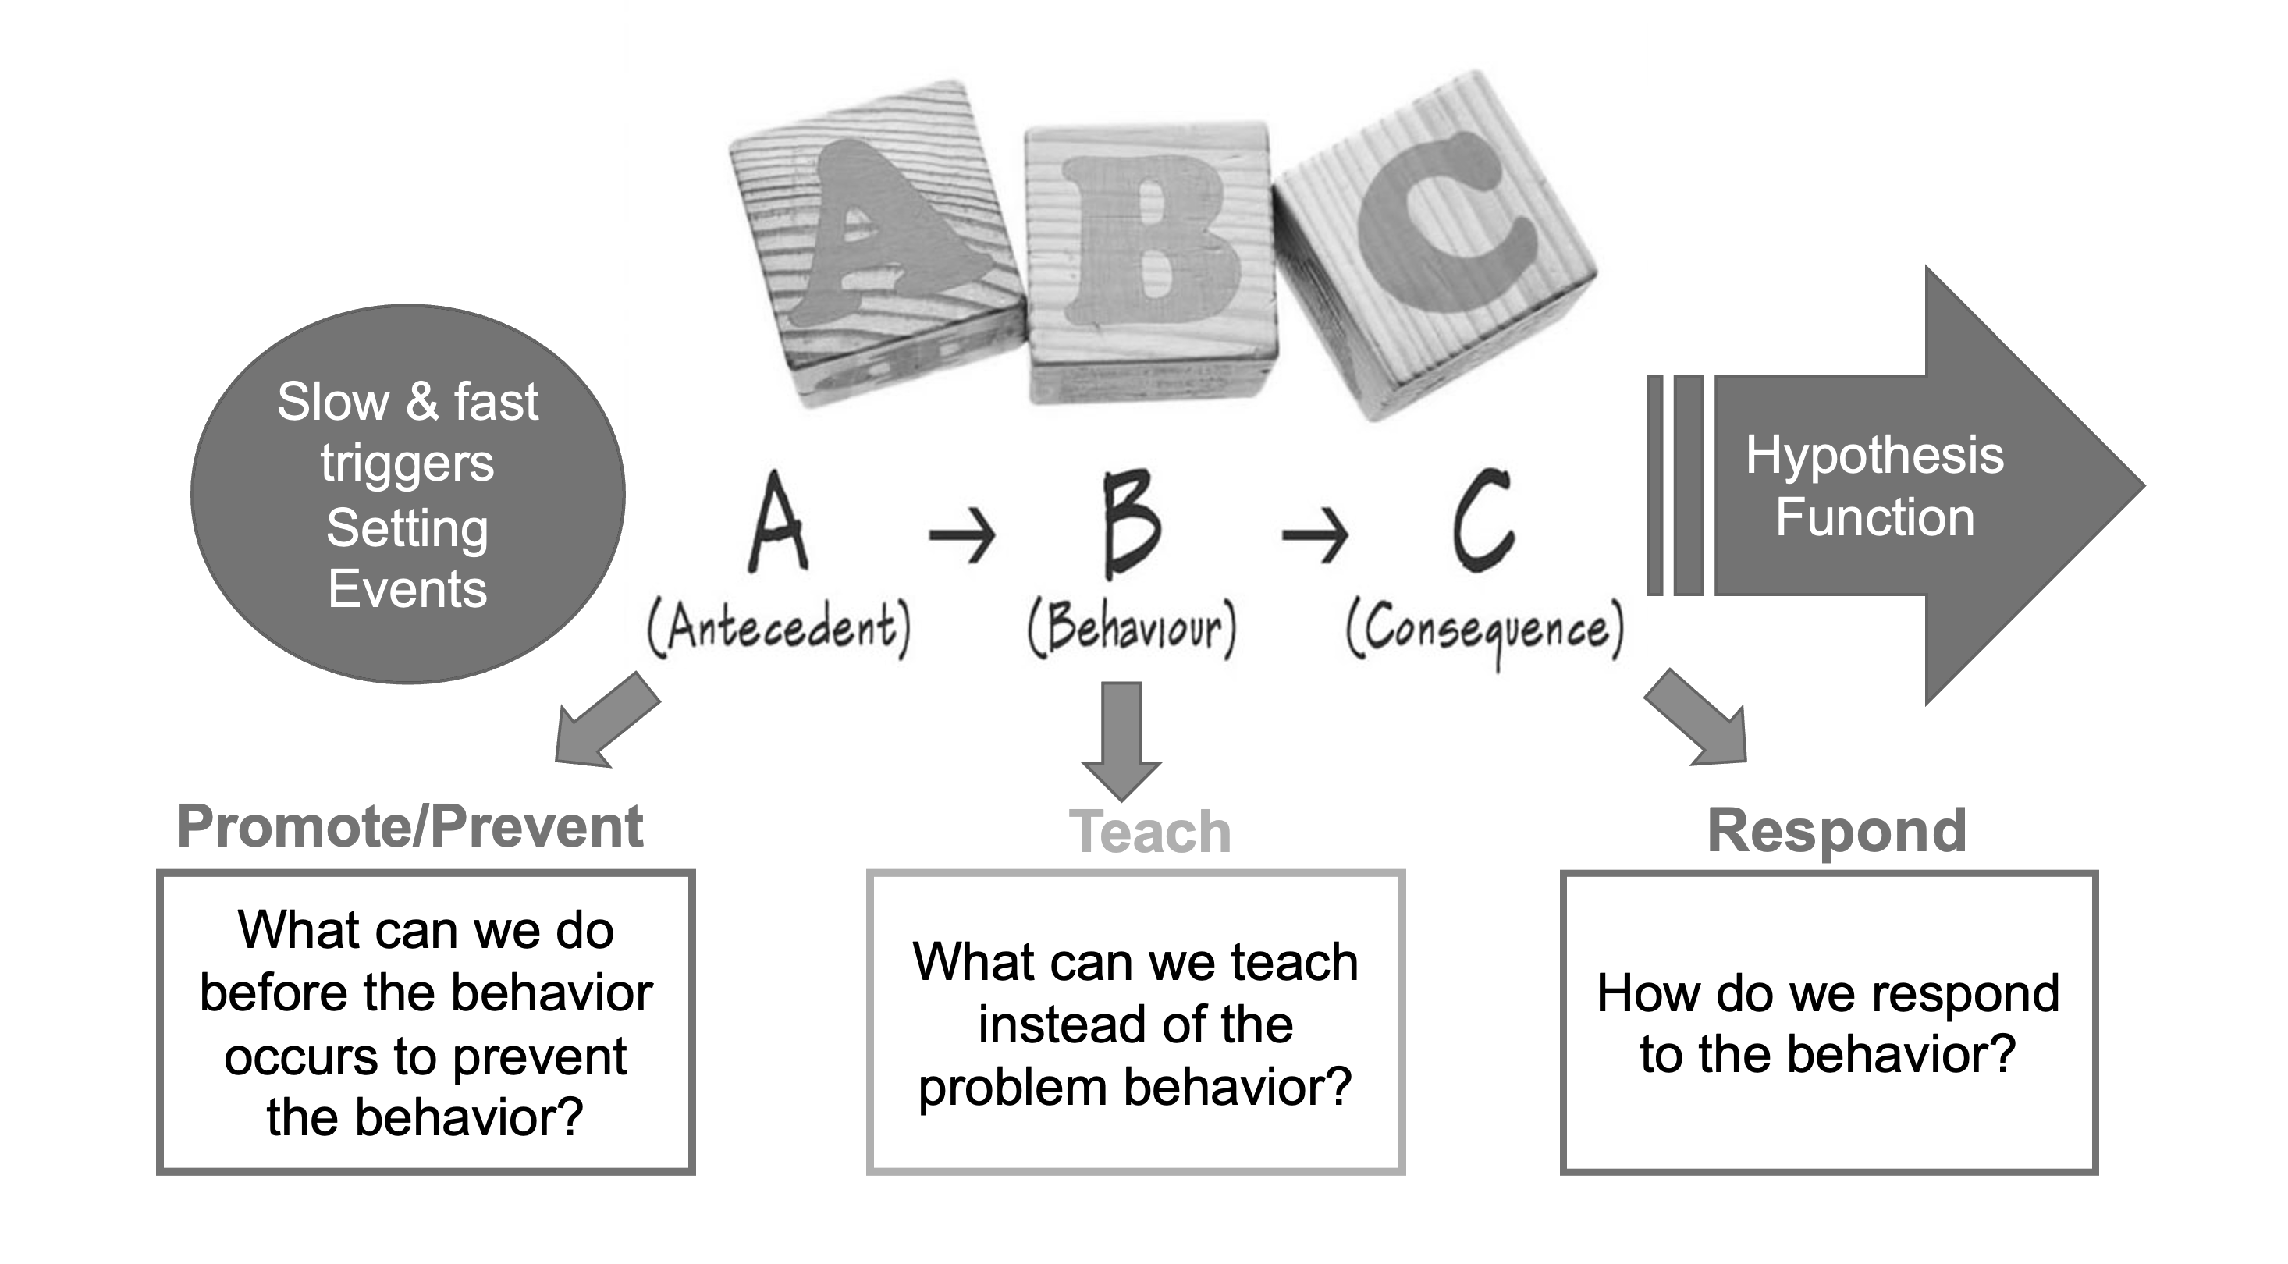
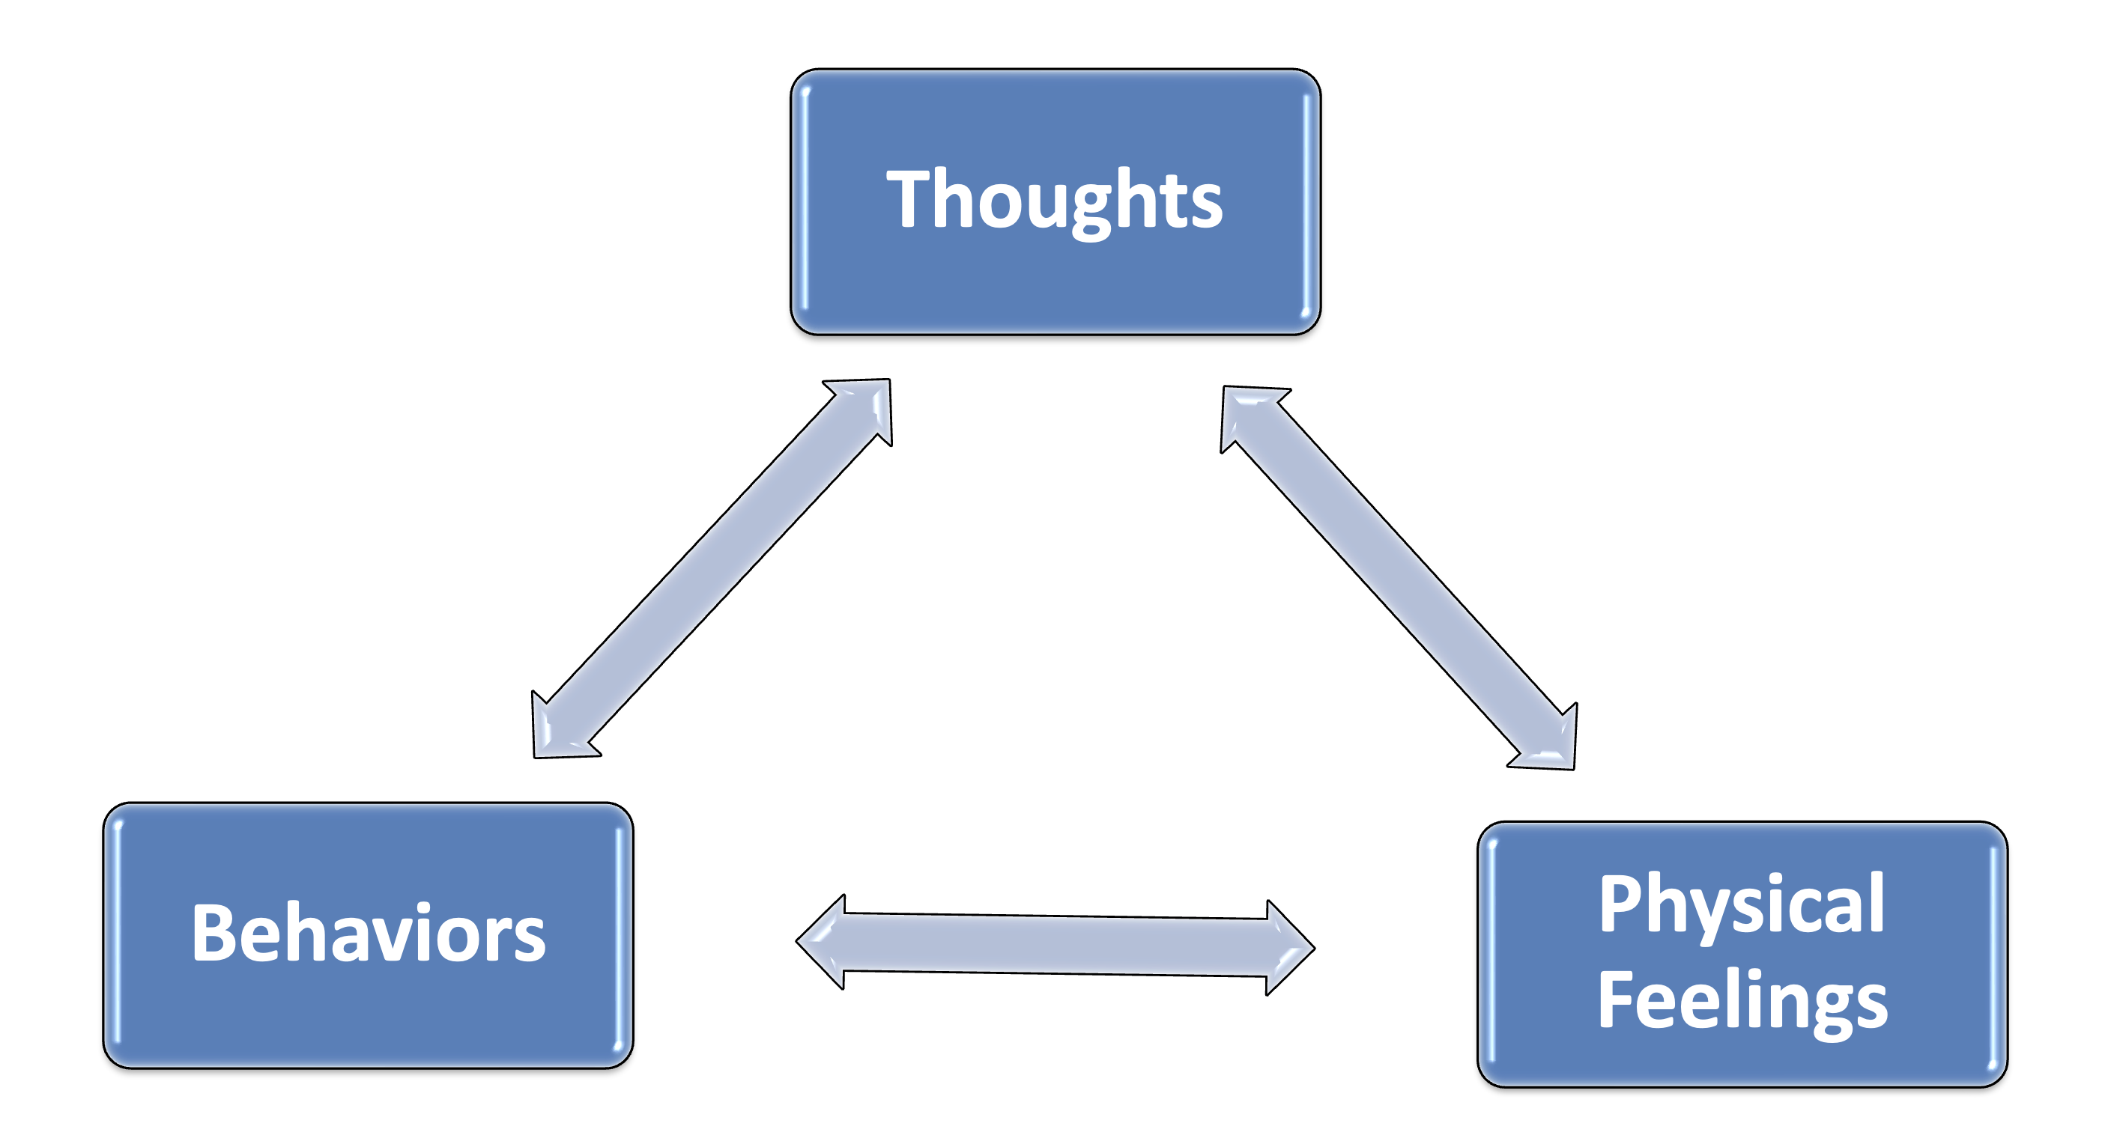
Take what we know
PBS
Prevent-Teach-Respond
Add what’s missing
CBT
Cognitive Triangle

Slide 15
Cognitive Behavioral Therapy (CBT)
3-Component Model:
Thoughts:
Psychoeducation & Cognitive Restructuring
Feelings:
Relaxation & Distress Tolerance
Behaviors:
Gradual Exposure & Positive Reinforcement
Notes:
From Chansky (2004):
Overestimation of Threat + Underestimation of Ability to Cope = Anxious Response

Slide 16
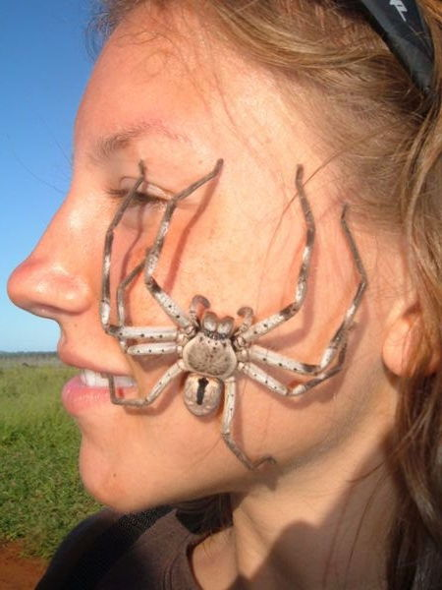
Cognitive Behavioral Therapy (CBT)
Addressing Thoughts
  Psychoeducation
  Cognitive Restructuring
Addressing Behaviors
  Creating a Fear-and-Avoidance Hierarchy
  Gradual Exposure*
  Positive Reinforcement
Addressing Feelings
  Relaxation
*Gradual exposure is the most critical intervention
Notes:
Although both unmodified CBT and CBT that is adapted for autistic youth have more positive effects than treatment-as-usual, adapted CBT (i.e., “BIACA”) was still found to outperform unmodified CBT
promising preliminary evidence for CBT-based approaches in treating social functioning and co-occurring symptoms of anxiety and depression, as well as enhancing quality of life in autistic adults.
emerging literature supporting the effectiveness of CBT for individuals with mild ID.
Schweizer et al (2024): https://www.frontiersin.org/journals/psychiatry/articles/10.3389/fpsyt.2023.1265066/full
Both, CBT and MB-based interventions demonstrated similar effectiveness in treating co-occurring symptoms of anxiety (16, 17), mainly with a maintaining effect (16, 17).
16. Sizoo, BB, and Kuiper, E. Cognitive behavioural therapy and mindfulness based stress reduction may be equally effective in reducing anxiety and depression in adults with autism spectrum disorders. Res Dev Disabil. (2017) 64:47–55. doi: 10.1016/j.ridd.2017.03.004
PubMed Abstract | CrossRef Full Text | Google Scholar
17. Gaigg, SB, Flaxman, PE, McLaven, G, Shah, R, Bowler, DM, Meyer, B, et al. Self-guided mindfulness and cognitive behavioural practices reduce anxiety in autistic adults: a pilot 8-month waitlist-controlled trial of widely available online tools. Autism. (2020) 24:867–83. doi: 10.1177/1362361320909184

Slide 17
Evidence for CBT for Treating Anxiety in IDD
CBT is the most effective evidence-based treatment for anxiety disorders in autistic youth without ID (e.g., Ung et al., 2015)
  CBT program adapted for autistic youth (BIACA) outperformed standard-of-practice CBT (Coping Cat) & Treatment as Usual (TAU) (Wood et al., 2020)
  Both CBT groups achieved higher rates of positive treatment response than TAU
Promising preliminary evidence for CBT in treating anxiety in autistic adults who do not have ID (Schweizer et al., 2024)
Emerging literature supporting the effectiveness of CBT for children/adolescents and adults with mild ID (Fynn et al., 2023)
  Results from pilot study (Blakeley-Smith et al., 2021) & single-subject experimental design of youth with autism & ID (Moskowitz et al., 2017) showed significant reductions on anxiety symptoms
Notes:
NEW SLIDE
CBT is the most effective evidence-based treatment for anxiety disorders in autistic youth without ID (Ung et al., 2015; van Steensel & Bogels, 2015; Wood et al., 2020)
CBT was efficacious for children with autism and interfering anxiety, and an adapted CBT approach showed additional advantages
Although both unmodified CBT and CBT that is adapted for autistic youth have more positive effects than treatment-as-usual, adapted CBT (i.e., “BIACA”) was still found to outperform unmodified CBT
CBT program adapted for autistic youth (BIACA) outperformed standard-of-practice CBT (Coping Cat) and Treatment as Usual (TAU)
Both CBT conditions achieved higher rates of positive treatment response than TAU (BIACA: 92.4%; Coping Cat: 81%; TAU: 11%]
FSIQ: 58.3 (40–79,
Promising preliminary evidence for CBT in treating anxiety in autistic adults who do not have ID (Schweizer et al., 2024)
https://www.frontiersin.org/journals/psychiatry/articles/10.3389/fpsyt.2023.1265066/full
Both, CBT and MB-based interventions demonstrated similar effectiveness in treating co-occurring symptoms of anxiety (16, 17), mainly with a maintaining effect (16, 17).
16. Sizoo, BB, and Kuiper, E. Cognitive behavioural therapy and mindfulness based stress reduction may be equally effective in reducing anxiety and depression in adults with autism spectrum disorders. Res Dev Disabil. (2017) 64:47–55. doi: 10.1016/j.ridd.2017.03.004
PubMed Abstract | CrossRef Full Text | Google Scholar
17. Gaigg, SB, Flaxman, PE, McLaven, G, Shah, R, Bowler, DM, Meyer, B, et al. Self-guided mindfulness and cognitive behavioural practices reduce anxiety in autistic adults: a pilot 8-month waitlist-controlled trial of widely available online tools. Autism. (2020) 24:867–83. doi: 10.1177/1362361320909184
Emerging literature supporting the effectiveness of CBT for children/adolescents and adults with mild ID (Fynn et al., 2023)
Results from pilot study of youth with autism & ID (Blakeley-Smith et al., 2021; Mean IQ=58; range 40-79) and single-subject experimental design of 3 children with autism & ID (Moskowitz et al., 2017) showed significant reductions on anxiety symptoms

Slide 18
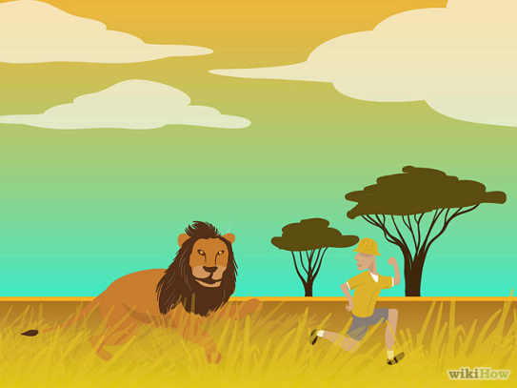
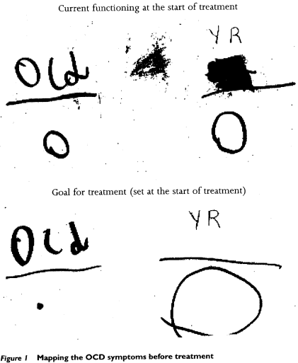
Psychoeducation
Information about nature of anxiety
  Define anxiety
  Normalize anxiety
  Anxiety has a function or purpose
  Externalize anxiety
  Explain rationale for treatment
    e.g., distress tolerance
Notes:
Emotions are:
*Natural
*Necessary
*Harmless
*Helpful
Worry “false alarm”
Anxious feelings will pass (distress tolerance)
From Unified Protocol for Adolescents (pg. 37):
Under normal circumstances, emotions (e.g., fear, anxiety, sadness, anger) are powerful responses to things going on in our lives – they are telling us something about what is going on around us and how we might respond.
When emotions are uncomfortable, they feel that way because the emotion wants us to DO SOMETHING – take action, get away, get help – whatever we need to do to make that emotion less intense.
When emotions make us feel good or enjoyable, they’re also telling us something – they are encouraging us to keep doing the things that resulted in our feeling that way. When things are enjoyable, we want to do them more; when they are uncomfortable, we want to avoid them.
”This is an example of a time when the emotion of fear was helpful or useful. Fear is like nature’s alarm system. It’s a response to your belief that there is danger. It signals the need for immediate action and/or attention.
When you feel afraid you probably feel as though you need to keep an eye on whatever or wherever you think the threat may be (or may come from). Fear is also completely normal, natural, and useful in keeping us safe – at least it’s useful if there is actually something truly dangerous around.

Slide 19
Cognitive Restructuring
Challenging anxious thoughts
  Do I know for certain that____?
  Do I have a crystal ball?
  What evidence do I have that____?
  Is there another explanation for ____?
  What is the worst thing that can happen? How bad is that? How can I cope with that?
Coping self-talk/“Boss-back” talk
  I’ve done this before, so I can do it again.
  I can handle this!
  My brain is just stuck right now; I don’t have to listen to it!
  My anxiety will pass; I’ll get used to it.
  Go away OCD*, you’re not the boss of me!
The spider probably won’t crawl on me and, even if it does, what’s the worst that can happen? I’ll just swat it.
*Give fear/anxiety a name!
Notes:
From Coping Cat:
Do I know for sure that this is going to happen? What else might happen?
Gather evidence: What has happened before? Has this happened to anyone I know?
How many times has it happened before?
Having collected all the evidence:
How likely is it to happen? What is a coping thought I can have in this situation? What is the worst thing that could happen? What would be so bad about that?
https://www.copingcatparents.com/Tips_from_Experts
Anxiety is like a bully: Boss back the bully! (March & Mulle, 1998)
Challenge the anxiety with behavioral experiments, not arguments
When anxiety tells us to do something (avoid), we:
Ignore the demand
Do the opposite (lean into anxiety)
Do the wrong thing (mess with anxiety)
When we stop responding to anxiety, it will get quieter and quieter and will become a less demanding part of our lives.
“Wow, looks like Mr. Clean has been really bossy to you and is telling you that you can’t come down fro breakfast unless you wash your hands again. Do you want to let Mr. Clean keep bossing you around, or should we boss him back?”
Examples of Boss-Back Talk (Chansky, 2011):
Go away OCD, you are not the boss of me!’
Stop it, leave me alone!
Go away, meany, leave me alone!
You are not my friend – you scare me and you don't tell the truth.
This isn’t real.
I’m the boss of me: I’m doing what I want.
Get a life OCD; you can’t have mine!
Goal is for parent and child to join together to boss back the bully who is controlling everybody’s life
From Tamar Chansky: So when your child says, “I’m scared because I think someone might break in the window,” you can say, “Yes, anyone thinking that might feel scared. Worry Brain is using that power of suggestion trick on you – you’re scared because you had the thought, not because it’s true.”
Julia also reported that she was afraid that a spider would crawl into her bathtub in Texas. For remainder of session, worked through “Be Your Own Cognitive Coach” worksheet together, using this fear as an example; Julia’s feelings were afraid and her anxious thoughts included “What if it bites me and I die? What if it’s a black widow? What if I get scared and run out of the bathroom and my sister teases me?” When asked whether she was falling into any Thinking Traps, Julia identified the Catastrophizer, the Fortune Teller, and the Repeater (i.e., “A spider came in my bath once before, so it will happen again”). When asked to challenge her thoughts (e.g., detective thinking) and come up with coping thoughts, Julia was able to do so with some assistance (e.g., “I’ve taken over 1,000 baths in Texas and only time a spider crawled in,” “The one time it did crawl in, it did not bite me – nothing bad happened – I just got out of the bath,” “A spider probably won’t crawl into the bath and, even if it does, I’ll just swat it. Even if it did crawl on me, it would not be the end of the world.”)
Julia also expressed that she did not want to go to summer camp because, last year, she was made fun of at camp. Discussed that this was an example of Julia falling into Thinking Traps (e.g., “All-or-Nothing Thinking”, “The Repeater”) in that she was only focusing on the negative parts of camp and not attending to any of the positive parts. Even though she was made fun of last year, this did not happen in other camps, which she enjoyed, so we do not know that it would happen in this camp this summer.
Began cognitive restructuring (e.g., detective thinking, questioning or challenging her thoughts, coming up with coping thoughts). Worked through “Be Your Own Cognitive Coach” worksheet together; the situation was that Julia was feeling nervous to perform in the school musical last Friday (6/14). Her automatic thoughts were, “What if I mess up? What if people don’t like it? What if I fall off the stage?” She was able to identify that she was falling into Thinking Traps, such as “the Catastrophizer,” “The Fortune-Teller,” and “Mind-Reading.” When asked to challenge her thoughts (e.g., detective thinking) and come up with coping thoughts, Julia was able to do so with some assistance (e.g., “There is no evidence or proof that I would mess up or sing off tune. It never happened before,” “Even if I did mess up, which probably won’t happen, there will be a lot of people singing over me, so no one will probably notice,” “Even if people did notice, they might think it’s part of the show or they might forget about it, or they might not care.”) When asked how she would have put her plan into action (if she thought about this prior to performing), Julia came up with: “I will perform even though I’m scared,” “I’ll remind myself of my coping thoughts,” and “I’ll take 3 deep breaths.” When asked to evaluate how she did, Julia responded (with prompting), “I think I did well. I did not mess up. My worry thought did not come true.”

Slide 20
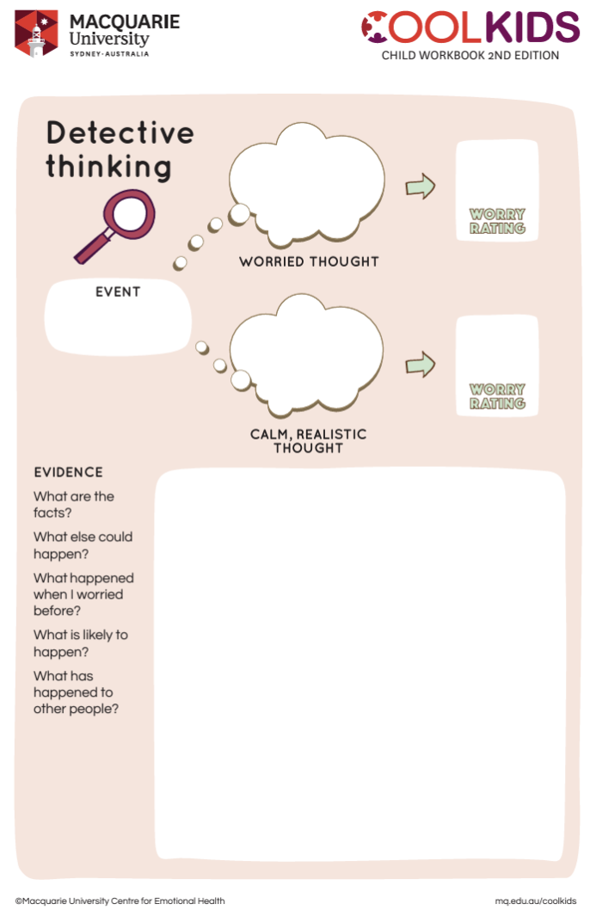
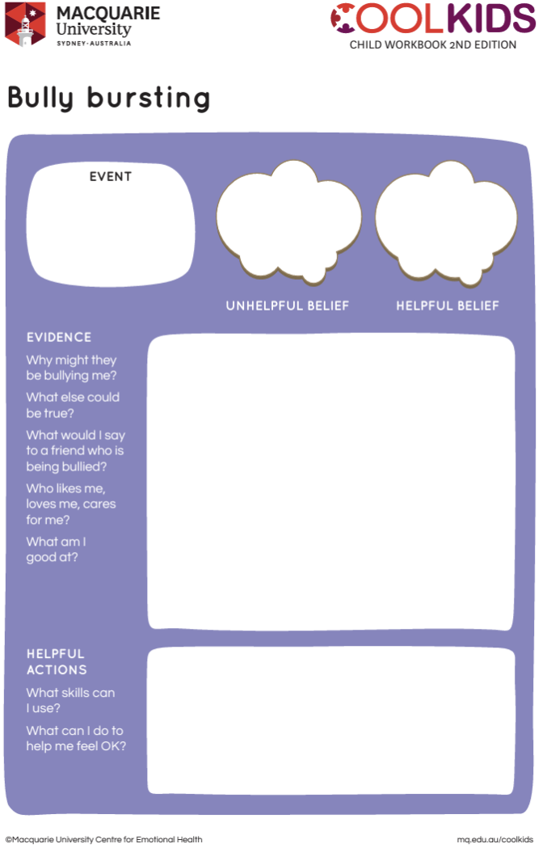
Cognitive Restructuring
Download Cool Kids Worksheets at:
https://www.mq.edu.au/research/research-centres-groups-and-facilities/centres/lifespan-health-and-wellbeing/our-resources/children-and-teens

Slide 21
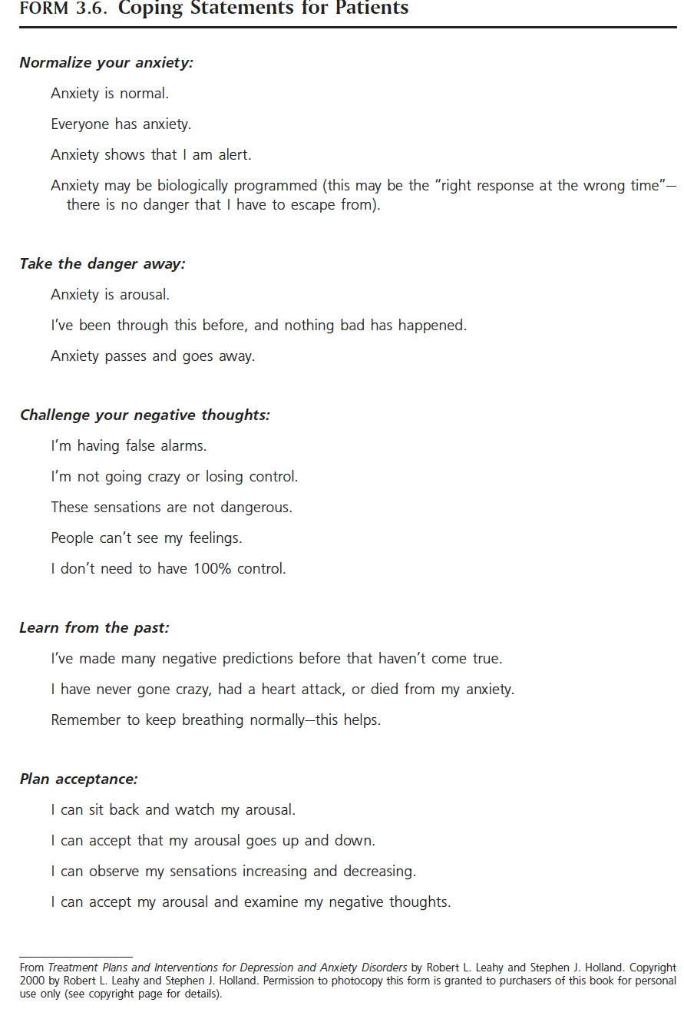
Examples of Coping Self-Talk
(for Adults)

Slide 22
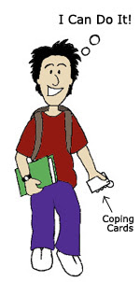
Examples of Coping Self-Talk
(for Kids)
I am brave and can take good care of myself!
Everyone gets nervous… it’s NATURAL!
I can still perform well, even if I’m nervous.
I can deal with whatever comes my way!
It’s probably not as scary as I think it is.
It’s probably not as icky as I think it is.
My fears are just thoughts – it doesn’t mean they’re true.
If I got through it last time, I’ll get through it now.
Instead of thinking a worry thought, I can think about a positive thought to feel calmer.
I’ve done a lot of stuff I’m afraid of, like go to the movies without closing my eyes. I’ve done it before, so I can do it again!
If I feel afraid, I will close my eyes and take a deep breath and try to calm myself down.
Coping Cards
Notes:
I am brave and can take good care of myself.
Everyone gets nervous… it is NATURAL!
I can still perform well, even if I am nervous.
I can deal with whatever comes my way!

Slide 23

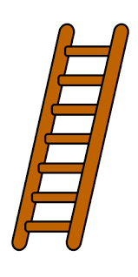
Gradual Exposure
Face your fears (a little at a time)
  Learn that you will get used to it
  Learn that feared consequences do not come true (behavioral experiment)
  Emphasis on TOLERATING fear/anxiety rather than REDUCING fear/anxiety
Fear Ladder (fear-&-avoidance hierarchy)
  Gradually confront anxiety-provoking situations from easy to hard
Goal!
Step 5
Step 4
*Exposure phase led to a more rapid improvement in symptoms than earlier
psychoeducation & cognitive phases;
Highlights the central role of exposure
(Guzick et al., 2022)
Step 3
Step 2
Step 1
Notes:
a recent study of autistic youth with clinically significant anxiety or OCD who were randomized to standard CBT or adapted CBT (i.e., BIACA), the exposure phase led to a more rapid improvement in symptoms than the earlier psychoeducation and cognitive phases, both for standard and adapted CBT (Guzick et al., 2022). These findings highlight the central role of exposure in treating anxiety disorders and OCD in autistic youth and question the usefulness of cognitive strategies without practicing these skills during exposure. Therefore, as long as there is a strong therapeutic alliance, therapists should emphasize and prioritize exposure over the pre-exposure coping phase when treating anxiety/OCD in autistic youth (Guzick et al., 2022).
“Courage is resistance to fear, mastery of fear, not absence of fear” -Mark Twain
*Gradually tackle easy to hard (facing fears a little at a time)
*Reward EFFORTS to face fears
*Encourage DAILY practice
*Traditional approach: remain in contact with feared situation until anxiety reduced by 50% OR until child feels acceptable level of comfort in feared situation
*Newer approach: Is fear reduction necessary for lasting improvement? (Craske et al., 2008).
*Fear reduction versus tolerance of fear
*Discrepancy between expectation and outcome: what did you learn? What surprised you?
*Fear reduction is NOT the best predictor of treatment outcome
AND fear reduction is not evidence of long-lasting improvement
*New learning is fragile – relapse occurs because:
1. Feared situation occurs in new/different circumstenaaces
2. Passing of time
3. ”relearn” original fear.
So anxiety TOLERANCE more important than anxiety REDUCTION

Slide 24
Example “Fear-and-Avoidance Hierarchy”
Notes:
NEW SLIDE
Gradually tackle easy to hard

Slide 25
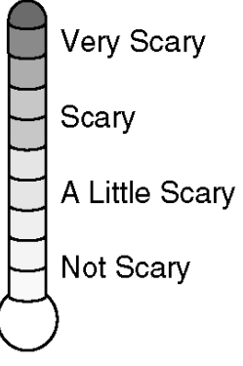

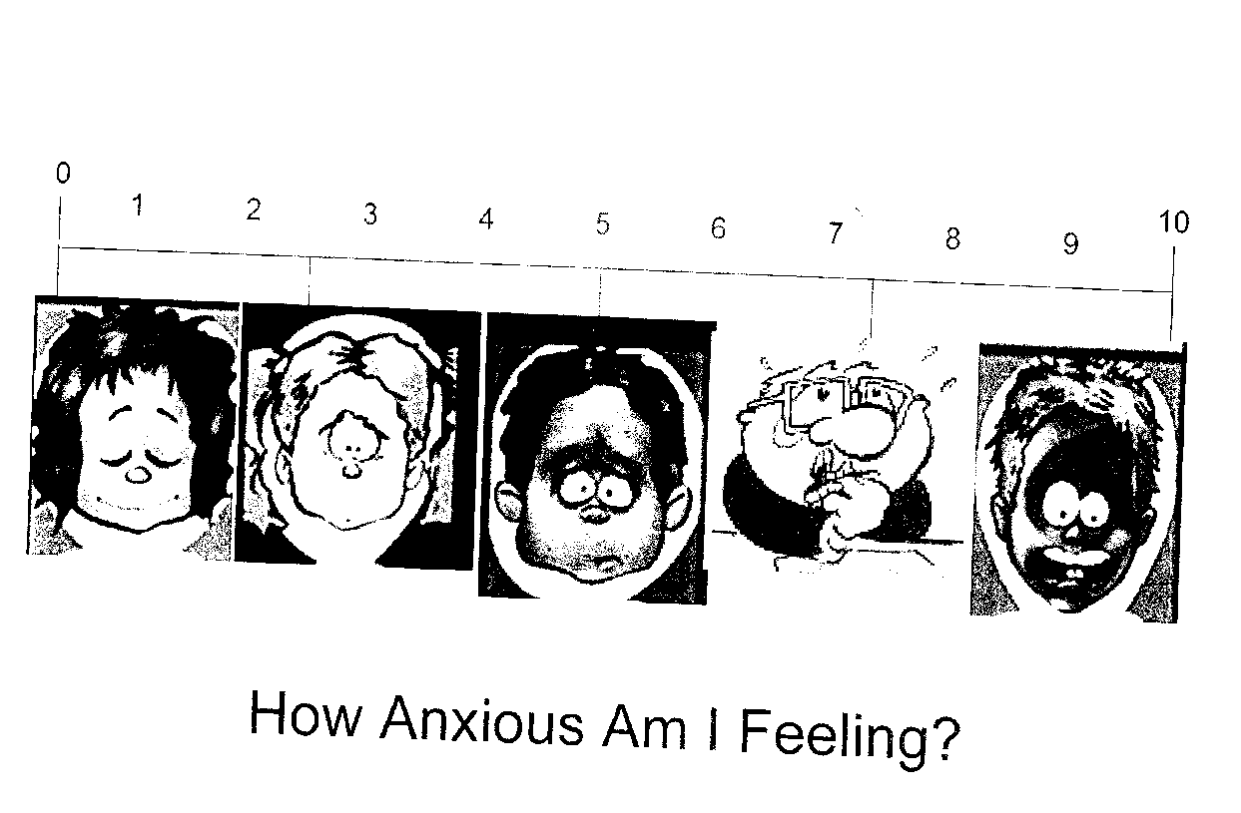


Feelings Thermometer
High
Medium
Low
Notes:
For some kids, it can help to tell us how anxious or afraid they are before they do an exposure. Do you think that (name) would be able to rate his/her fear or anxiety on a thermometer like this? If so, we could try it. If not, it’s no big deal. For a lot of kids, these numbers don’t mean anything. And the good news is they don’t need to be able to rate their anxiety to have their anxiety decrease, and they don’t need to report a decrease or actually have their anxiety decrease in order to be able to cope with their fear/anxiety.

Slide 26
Example “Get-Used-To-It” Exercises
(i.e., Exposures)
Specific Phobias
  e.g., watch videos of shots/blood tests, observe dogs from behind window and later at dog park, ask owners about dog, pet dog, catch dead or live bee in a jar
Separation Anxiety
  e.g., child inside while parent outside in yard; parent goes to pick up mail while child stays busy (supervised) inside house, parent goes out for increasing periods of time during the day, later at night; child goes to playdate & mom remains there in same room, then separate room, mom leaves playdate for increasing periods of time, child goes to playdate alone; decrease # of calls/texts
Social Anxiety
  e.g., smile at classmate, say hi to teacher, tell teacher weekend plans, ask child to play game with you, call a store to find out hours, raise hand & answer a question, compliment a classmate, call/text classmate to ask about assignment
Generalized Anxiety Disorder (GAD)
  e.g., forget a book at home, don’t recopy notes that were sloppy, don’t ask a friend if she’s mad at me, “imaginal exposure” where describe in vivid detail your worst fear
Obsessive-Compulsive Disorder (OCD)
  e.g., delay or shorten ritual, eventually stop ritual; do the opposite (if OCD says start with your left foot, then start with your right), say ”bad thought” out loud
Adapted from Tamar Chansky (2014)
Notes:
imaginal exposure where she described in vivid detail her worst fears about approaching that staff member.

Slide 27

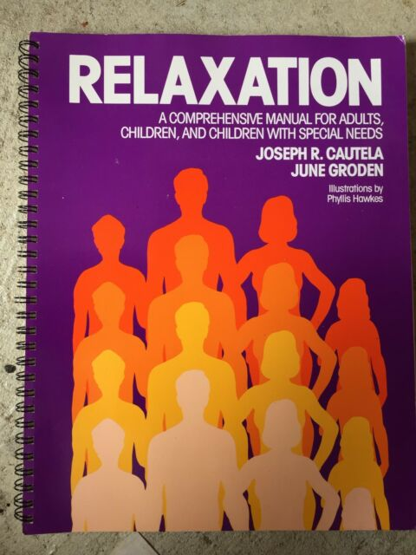
Relaxation*
Belly Breathing
  Example: Blowing up a Balloon
  Take slow, deep breath in, and the balloon fills up with air (count to 3 as child inhales)
  Let the air slowly out of the balloon…it gets smaller (count to 3 as child exhales)
Progressive Muscle Relaxation
  Tighten fist to the count of 5
  Relax fist to the count of 5
    focusing on the relaxed warm feeling in your hand,
    following it into your arm,
    and continuing to follow it as it works its way through your body
  Continue, focusing on 2-3 muscle groups
Elmo Belly Breathe video (https://www.youtube.com/watch?v=_mZbzDOpylA)
*Caution: Important that relaxation doesn’t become another distraction technique that child
uses to avoid anxiety; anxiety is not harmful and can be tolerated (Farrell, Ollendick, & Muris, 2019)
Notes:
A Meta-analysis to Guide the Enhancement of CBT for Childhood Anxiety: Exposure Over Anxiety Management (Whiteside et al., 2020):
Compared to treatments that omitted relaxation, treatments that included relaxation strategies were associated with significantly smaller pre- to post-treatment effect sizes:
https://www.proquest.com/docview/2350718643?pq-origsite=gscholar&fromopenview=true
Blowing up a balloon
May want to use actual balloon to teach this at first
Sit comfortably, limit visual distractions & noise
Instruct child to picture a balloon inside their bellies
Take slow, deep breath in, and the balloon fills up with air
Count to 3 as child inhales
Let the air slowly out of the balloon…it gets smaller
Count to 3 as child exhales
Repeat
Blowing Out the Candles
Hold up 3 fingers in front of your face
In calm & relaxing voice, instruct child to take a deep breath in, and slowly let the air out as you blow out the candles
Put 1 finger down
Repeat until all 3 candles are blown out

Slide 28
Modifications to CBT for Autistic Individuals
Characteristic of autism | How we modify CBT
Intense interests | Incorporate special interests into treatment!
Concrete thinking (e.g., literal, black-and-white thinking) | Use more concrete & visual strategies
“Insistence on sameness” (e.g., difficulty with transitions) | Increase structure & predictability in delivering treatment components
Difficulty generalizing | Increase parent & teacher involvement
Executive functioning difficulties | Add more repetition, practice, & structure; simplify cognitive activities; directly target cognitive inflexibility
Difficulty with social-emotional reciprocity (e.g., difficulty responding to social cues, sharing emotions, imitating) | Use video-modeling & peer-modeling to teach new skills
“Insistence on adherence to rules” | Capitalize on rule-bound nature
Higher levels of Intolerance of Uncertainty (IU), with affective IU highest | Exposures to uncertain situations & target emotion regulation skills when facing uncertainty
Adapted from Durand (2014)
Notes:
TREATMENT IMPLICATIONS: the intense interests mean that we incorporate these special interests into treatment (e.g., use that topic as an example or metaphor for teaching CBT concept) and use the special interest (e.g., talking about that one topic) as a reinforcer after learning CBT skill/strategy
TREATMENT IMPLICATIONS: the concrete and literal thinking mean that we use more concrete & visual strategies when implementing CBT (e.g., make abstract concepts into concrete activities, use literal language, use hands-on activities, use written instead of verbal examples, use video modeling)
TREATMENT IMPLICATIONS: the preferences for sameness and structure and predictability mean that we modify treatment to increase structure and predictability (e.g., use visual schedules, visual timers)
TREATMENT IMPLICATIONS: Use the rules to your advantage (capitalize on rule-bound nature), such as crossing out things they shouldn’t say or do (i.e., rituals), creating new rules, writing these rules down in a “contract,” having them sign that contract, etc. Additionally, I mention this on the next slide (the EF slide), but the cognitive inflexibility often means that we have to directly target that flexibility, such as helping children recognize their rigidity as an external character that tries to stop them from learning new skills, making a flexibility/rigidity hierarchy (similar to an exposure hierarchy) and doing “flexibility challenges” (similar to exposures/”brave challenges”). Not sure if we should mention that on this slide or on the next EF slide, since cognitive flexibility is also an EF. Case Example: One of my supervisees’ patients was rigid about and perseverated on the point system they used in session. The point system in the manual was not sufficient to get through the session. Instead, they made a 4-piece puzzle, first piece for homework review, second piece for talking, third piece for practice, fourth piece was teach-back for parents. Earn a puzzle piece for earning points per section. This worked better. The 5 points over the course of an hour was not enough. For some kids, get rid of point system all together (if becomes more of a distraction then a help).
TREATMENT IMPLICATIONS: EF differences also mean that we need to add more repetition, practice, & structure (e.g., worksheets with multiple choice lists instead of open-ended questions); one of the biggest EF deficits -- the cognitive inflexibility -- means that we have to directly target that flexibility, such as helping children recognize their rigidity as an external character that tries to stop them from learning new skills, making a flexibility/rigidity hierarchy (similar to an exposure hierarchy) and doing “flexibility challenges” (similar to exposures/”brave challenges”)
From Stark et al (2021): In a survey of therapists with experience of working with autistic individuals, the most frequently reported barrier to the therapeutic process was said to be black and white thinking, with 40% of therapists noting this. (Cooper et al., 2018). “Black and white thinking may therefore be a safety behaviour, conscious or not, employed by autistic individuals in order to reduce uncertainty and associated anxiety in the short term. However, in the long term, the individual who relies upon binary outcomes in order to feel certain may never learn that uncertain situations do not end in catastrophe.”
Baker-Ericzén et al (2013): “We teach the youth with AS a rule that every issue or situation requires three responses/options/solutions. We create continuum diagrams and put the categorical way of thinking on each end of the continuum and then work with the youth with AS in populating the numerous middle lines. For example, we will put opposite words such as love and hate, friend and enemy, like and dislike, or even black and white on the ends and then take turns populating the middle sections demonstrating that there is a way to think dimensionally about many things.”
Keefer et al (2022): Total IU levels were higher in autistic compared to NT children. All three IU symptom domains (affective, behavioral, and cognitive) are higher in autistic children compared to NT children. Affective IU symptoms were the highest amongst the three domains. The individual symptoms of IU that were most strongly associated with autism, i.e., increased stress, difficulty relaxing, avoidance of stressors, difficulty functioning in daily life, and less certainty than other children. (2) Autistic children WITH anxiety experience higher levels of IU than autistic children WITHOUT anxiety and are more likely to react behaviorally when presented with uncertainty (trying to avoid uncertainty and difficulty functioning) than autistic children without anxiety. Given the prominence of affective symptoms, child IU interventions should target emotion regulation skills including interoceptive awareness, emotion recognition, and relaxation to reduce distress when facing uncertainty (Conner et al., 2019; Weiss et al., 2018). Some autistic children with high levels of affective IU symptoms may also benefit from mindfulness based activities and practicing distress tolerance skills, such as those utilized in dialectical behavior therapy (Neacsiu et al., 2014; Semple, 2019). IU interventions for autistic children with anxiety should also directly target avoidance given its role in maintaining both anxiety and IU (Arnaudova et al., 2017; Flores et al., 2018). The inclusion of exposure is critical to teach autistic children how to systematically approach rather than avoid uncertain situations. Furthermore, parents would also benefit from learning about the chronic stress of uncertainty on their child and strategies to increase predictability (e.g., visual schedules, warnings for impending changes and transitions). Parent training regarding the negative impact of avoidance and how to help autistic children to face small amounts of uncertainty may also be helpful. https://link.springer.com/article/10.1007/s10803-022-05744-3
targeting intolerance of uncertainty (IU) and parental accommodation, known mechanistic and maintaining variables, respectively, of anxiety in neurotypical and ASD populations, may be effective in reducing anxiety [12, 18, 20].
There is mounting evidence supporting the need to target IU and parental accommodation when treating anxiety in children with ASD. IU is the “dispositional incapacity to endure the aversive response triggered by the perceived absence of salient, key, or sufficient information”
include movement-based activities, concrete strategies, and animated and engaging therapeutic materials

Slide 29
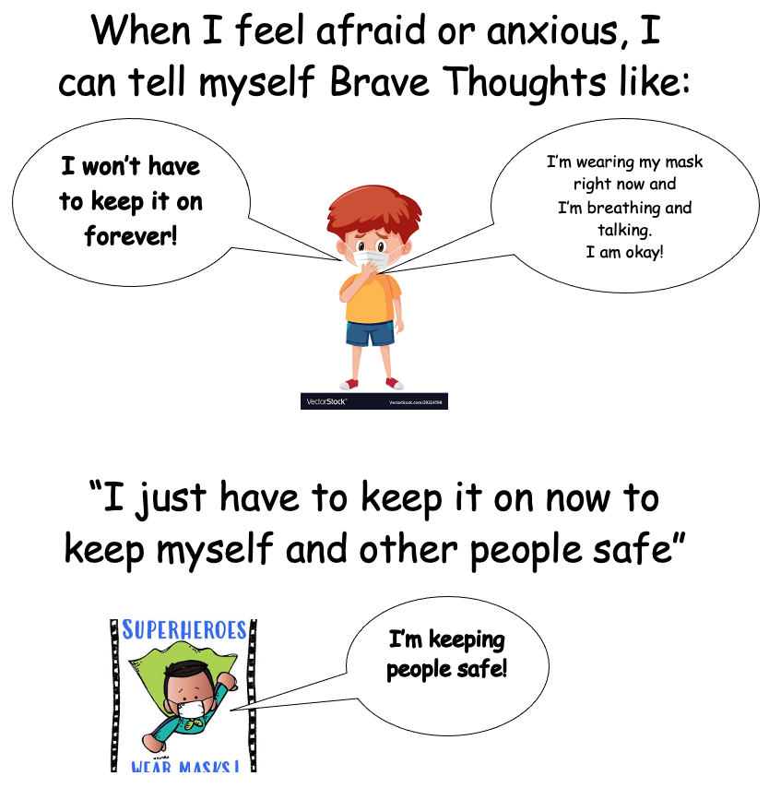
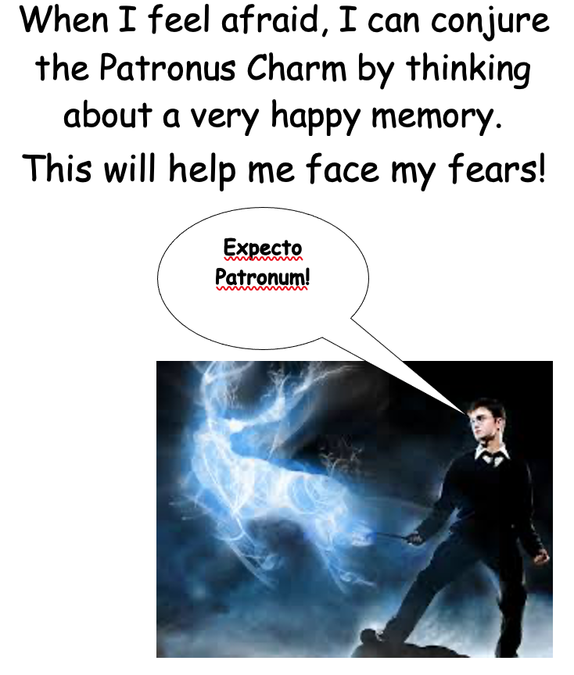
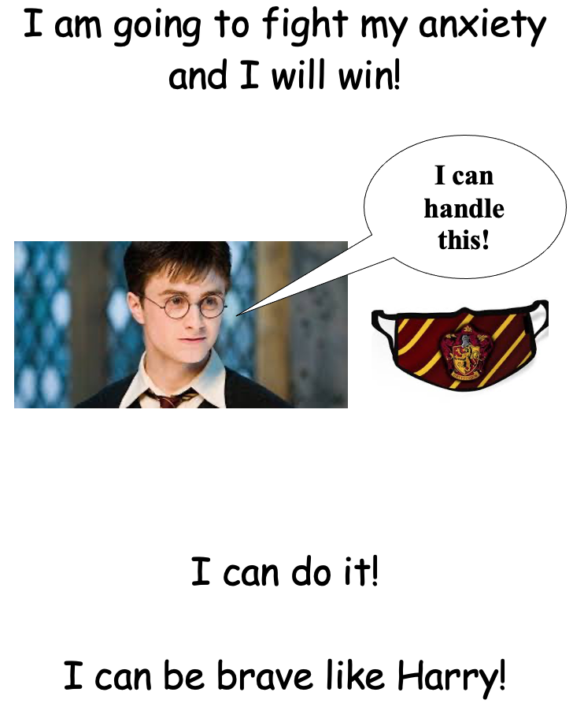
Modifications for Autism:
Psychoeducation & Cognitive Restructuring
I am brave & can take good care of myself!
Concrete & visual teaching strategies
  Cognitive components de-emphasized or simplified or modified to meet developmental level
  Psychoeducation & cognitive restructuring conveyed using VISUAL aids (e.g., Social Stories, illustrations, worksheets with multiple choice lists and/or pictures), acronyms, modeling, video modeling, & role-playing
  Use special interests to increase motivation
Notes:
Increased structure and predictability in delivering treatment components
Incorporation of visual supports
Use of concrete and visual teaching strategies
Increased focus on generalization
Increased parental involvement
Incorporation of children's “special interests” (circumscribed interests & stereotypies)
Consideration of function, setting events, and idiosyncratic triggers and behavioral indicators
Use of antecedent strategies & counterconditioning
Modifications in teaching basic concepts (from Reaven):
*Prequisite skills (feelings vocabulary)
*Written worksheets
*Multiple choice lists
*Drawing and other creative outlets
*Repetition & practice
*Video modeling & video self-modeling
*Strength-based
*Incorporation of special interest
*for ID: Focus on REPLACEMENT with helpful thoughts, not identification & challenge of negative cognitions
*cognitive inserts like “I can handle it” used across the board.
Keefer et al (2018):
Although current MCBT models seek to address anxious cognitions by teaching patients to utilize “helpful thoughts,” these models primarily encourage youth to utilize broad “cognitive inserts” (e.g., “I can handle this”) that may not have direct relevance to an individual’s specific negative automatic thoughts. It is not known to what degree this strategy is effective in this population. It is possible that youth with ASD require more specific and intensive strategies to maximize treatment response. Some individuals with ASD may benefit from traditional cognitive restructuring strategies. Other strategies such as behavioral experiments, a treatment strategy in which individuals collect data during targeted activities to assess the validity of their thoughts and beliefs, or visual restructuring, a technique that involves visualizing a positive response to past distressing situations (Ozsivadjian, Hollocks, Southcott, Absoud, & Holmes, 2016), may also help reduce negative cognitions for some individuals. Mindfulness or movement-focused strategies that focus on awareness, acceptance, and shifting may also redirect focus from negative emotional and cognitive experiences to neutral, present-focused bodily sensations such as the breath or the contact between the soles of the feet and the floor (de Bruin et al., 2015, Singh et al., 2011). Finally, given the association between IU and negative cognitions, it may be possible to reduce maladaptive automatic thoughts through interventions targeted at increasing tolerance of uncertainty. Novel treatments are being developed to address IU, including the Coping With Uncertainty in Everyday Situations (CUES) treatment program (Rodgers et al., 2016), which teaches parents the necessary coping skills to help their child manage distress associated with uncertain situations.
https://www.sciencedirect.com/science/article/pii/S0005789417301314?casa_token=9SleT3j8fn4AAAAA:nFC6e92BlJEKcO2WASedXSjRzgl5LQLo_LAcBG2NLUaygwcxrpBf4VIzblANMeUtjGnbtvtQ

Slide 30
Examples of Psychoeducation using Visual Supports & Incorporating Special Interests
Emotion Recognition
Teach to rate different degrees of anxiety or emotional intensity
Notes:
Use concrete, visual strategies that incorporate special interest to teach emotions!
LM TREATMENT IMPLICATIONS: This means that sometimes we can’t rely solely on self-report and we may have to rely on parent-report and teacher-report of observable behaviors (e.g., whether they are getting out of bed, leaving the house, going to school) and clinicians’ direct observations of behaviors that are indicative of anxiety or depression. This also means that we have to teach the child how to be an emotions detective by using concrete, visual strategies that incorporate special interests (e.g., using special interest in pigs to teach child to identify different emotions)
Hierarchy creation for exposures may be challenging; patients may rate most things as either “very hard” or “not hard at all” and delivery of exposure will require modifications
Patient reactions to their seemingly quick-shifting emotional experience may be experienced as “surprising” to others in patient’s life
LM TREATMENT IMPLICATIONS: This means that sometimes we can’t rely solely on SUDS ratings and we may have to rely on direct observations of behavior. For example, one girl on the spectrum rated her anxiety as an 8 (on a scale of 1-8) at the beginning of her exposure when she was crying, trembling, covering her face, etc. However, she still rated her anxiety as an 8 at the end of the exposure even though she appeared calm and was no longer crying, trembling, covering her face, etc. This means that, for this child, we could not rely solely on SUDS ratings as an indicator of improvement. For other patients, this might mean that we have to teach the child how to rate different degrees of emotional intensity to help counter black-and-white or all-or-none thinking. We can do this by using concrete, visual strategies that incorporate special interests (e.g., using special interest of Harry Potter to teach child how to rate different degrees or gradients of anxiety/discomfort re: wearing a mask).
Roberts-Collins et al (2018):
https://journals.sagepub.com/doi/full/10.1177/1362361317710215?casa_token=-CnZVOebtcQAAAAA:toexyme7R3Jw7xZsie6JJRkJw1tx13oa8GnfJsYyWdRGCR3FIdUwC_qB0kRReuL5koqyWGcpvNUw
In the present study, the YP with ASD who had attended CBT scored significantly lower on the Differentiating Emotions and higher on the Attending to Others’ Emotions subscales than the YP with ASD who had not attended CBT. Although current anxiety and depression were not directly measured, it is plausible that the referral to services for CBT serves as a useful indicator of increased emotional difficulties. Thus, it can be hypothesised that differentiating between emotions may contribute to the development or maintenance of problematic emotional responses, such as anxiety disorders and depression, precipitating CAMHS referrals. Previous research with a non-clinical group of children with ASD suggested that difficulties differentiating between emotions, communicating them and identifying their causes is related to increased internalising disorders such as anxiety and depression (Rieffe et al., 2006, 2008, 2010).
All CBT components were introduced with accompanying visual structures. Somatic management was labelled Calm Body and included a visual menu of strategies such as deep breathing and sensory regulation techniques (e.g. bouncing on a ball, taking a walk) that were modelled and practised. Cognitive strategies were labelled Calm Mind and included a visual menu of self-instructional mantras highlighting self-competence with coping (e.g. I can do it, I’m brave, I can handle it). Calm Body and Calm Mind strategies were taught in a sequential manner with visual structures, building up to exposure practice (i.e. Be Brave) which was supported via in-session practice with a visual structure focused on core CBT components (e.g. Calm Body, Calm Mind, Be Brave) and rewards for brave behaviour. Exposures were conducted on a variety of fears based on each teen’s individual anxiety symptoms and family goals

Slide 31
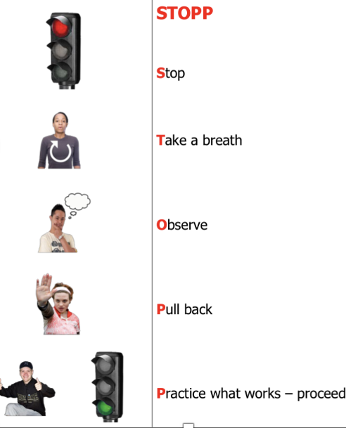
Modifications to Cognitive Restructuring:
Using Acronyms
  Feeling frightened?
  Expecting bad things to happen?
  Attitudes & actions can help
  Results & rewards
  (Coping Cat; Kendall & Hedtke, 2006a,b)
  Knowing I’m nervous
  Icky thoughts
  Calming thoughts
  Keep practicing
  (Wood et al., 2015)
  Problem-Solving based on STAR strategy:
  STOP (identify that one is anxious and needs to calm down)
  THINK (think of possible ways to calm down and/or solutions to the problem)
  ACT (executive a chosen plan)
  REFLECT (evaluate outcome of selected plan & make adjustments if needed)
  (Sung et al., 2011)
Coping with Uncertainty
Notes:
L + then R
From Moskowitz, Braconnier, & Jeffay (2020):
Additionally, Walters et al. (2016) also noted that, in CBT programs that were modified for youth with HFA, cognitive restructuring was often delivered through the use of acronyms such as KICK—Knowing I’m nervous, Icky thoughts, Calming thoughts, Keep practicing (Wood et al., 2015) and “through the use of lists of unhelpful and helpful thoughts from which alternative thinking strategies could be chosen rather than generated.”
Consistent with the work of other researchers (Anderson & Morris, 2006; Attwood, 2003a, 2004; Reaven & Hepburn, 2003), key modications to Building Condence that facilitate the comprehension of concepts such as icky thoughts (catastrophic cognitions), calm thoughts (cognitive restructuring) and knowing when Im nervous (emotion recognition) for children with ASD include reduced emphasis on abstract spoken language, greater use of role playing and visual materials, illustration of key concepts in simplied terms using the childs special interests as examples or metaphors, and using a lively, interactive (rather than didactic) style (Wood et al., 2007).
problem-solving strategies based on the STAR strategy, which has been used at the Child Psychiatric Service at the University of Iowa Hospitals and Clinic since 1980 [31]. STAR is an acronym for STOP (identify that one is anxious and needs to calm down), THINK (think of possible ways to calm down and/or solutions to the problem), ACT (execute a chosen plan) and REFLECT (evaluate the outcome of the selected plan and make adjustment as appropriate).

Slide 32
Coming up with
Coping Thoughts
What if the spider
kills me?
What do you think this kid can say to himself to help
himself feel less anxious or afraid when he sees a spider?
Notes:
Will thinking Worry Thoughts such as “What if the spider bites me and kills me?” make this kid feel more afraid or less afraid?
Will thinking Worry Thoughts such as “What if the spider bites me and kills me?” make this kid feel better or worse?
Do you think (your child’s name) would be able to answer a question like this and come up with some Coping Thoughts? We can try. If not, you can come up with some Coping Thoughts you think might help him. Let’s come up with a few right now that we can use if he can’t come up with any.

Slide 33


Example of Cognitive Restructuring using Visual Supports & Incorporating Special Interests
What calm thoughts could help him?
What icky thoughts
would Harrison Ford have?
Sze & Wood (2007)
Notes:
NEW SLIDE
For instance, in a typical session with Sophie, the therapist presented coping skills in the context of a topic that appealed to Sophie (e.g., imagining Harrison Ford in a dangerous situation in a movie) and eliciting her participation by drawing scenarios that featured cartoon characters corresponding to her special interests. Only then would the therapist guide the activity towards a CBT concept (e.g., what icky thoughts would he have; what kind of calm thoughts could help him?) that could be anchored visually by drawing thought bubbles on the cartoon and writing in appropriate responses generated by an enthusiastic Sophie based on the therapists Socratic questioning. Additionally, discussions incorporated her preference for particular words and phrases (e.g., being a pre-teen) that elicited positive emotion, pride, and a good therapeutic alliance. Cognitive restructuring exercises focused on teaching Sophie to challenge her worries about her parents safety (e.g., My mom has never been in a car accident) and losing her possessions (e.g., Nothing terrible would happen if I dont have all my stuff). Driven by her high level of enthusiasm and rapport, Sophie demonstrated rapid progress with the acquisition of these coping skills.
https://www.proquest.com/docview/217676917?pq-origsite=gscholar&fromopenview=true&sourcetype=Scholarly%20Journals

Slide 34
Example of Cognitive Restructuring using Visual Supports & Incorporating Special Interests
What if I mess up? What if I sing out of tune? What if people don’t like it? What if I fall off the stage?
There’s no evidence I would mess up or sing off-tune. It’s never happened before. But even if I did mess up, there will be a lot of people singing over me, so no one will probably notice. And even if people did notice, they might think it’s part of the show or they might forget about it or might not care.
Notes:
NEW SLIDE
“I’ve done it before, I can do it again.” or “I can handle this.”
Julia also reported that she was afraid that a spider would crawl into her bathtub in Texas. For remainder of session, worked through “Be Your Own Cognitive Coach” worksheet together, using this fear as an example; Julia’s feelings were afraid and her anxious thoughts included “What if it bites me and I die? What if it’s a black widow? What if I get scared and run out of the bathroom and my sister teases me?” When asked whether she was falling into any Thinking Traps, Julia identified the Catastrophizer, the Fortune Teller, and the Repeater (i.e., “A spider came in my bath once before, so it will happen again”). When asked to challenge her thoughts (e.g., detective thinking) and come up with coping thoughts, Julia was able to do so with some assistance (e.g., “I’ve taken over 1,000 baths in Texas and only time a spider crawled in,” “The one time it did crawl in, it did not bite me – nothing bad happened – I just got out of the bath,” “A spider probably won’t crawl into the bath and, even if it does, I’ll just swat it. Even if it did crawl on me, it would not be the end of the world.”)
Julia also expressed that she did not want to go to summer camp because, last year, she was made fun of at camp. Discussed that this was an example of Julia falling into Thinking Traps (e.g., “All-or-Nothing Thinking”, “The Repeater”) in that she was only focusing on the negative parts of camp and not attending to any of the positive parts. Even though she was made fun of last year, this did not happen in other camps, which she enjoyed, so we do not know that it would happen in this camp this summer.
Began cognitive restructuring (e.g., detective thinking, questioning or challenging her thoughts, coming up with coping thoughts). Worked through “Be Your Own Cognitive Coach” worksheet together; the situation was that Julia was feeling nervous to perform in the school musical last Friday (6/14). Her automatic thoughts were, “What if I mess up? What if people don’t like it? What if I fall off the stage?” She was able to identify that she was falling into Thinking Traps, such as “the Catastrophizer,” “The Fortune-Teller,” and “Mind-Reading.” When asked to challenge her thoughts (e.g., detective thinking) and come up with coping thoughts, Julia was able to do so with some assistance (e.g., “There is no evidence or proof that I would mess up or sing off tune. It never happened before,” “Even if I did mess up, which probably won’t happen, there will be a lot of people singing over me, so no one will probably notice,” “Even if people did notice, they might think it’s part of the show or they might forget about it, or they might not care.”) When asked how she would have put her plan into action (if she thought about this prior to performing), Julia came up with: “I will perform even though I’m scared,” “I’ll remind myself of my coping thoughts,” and “I’ll take 3 deep breaths.” When asked to evaluate how she did, Julia responded (with prompting), “I think I did well. I did not mess up. My worry thought did not come true.”

Slide 35
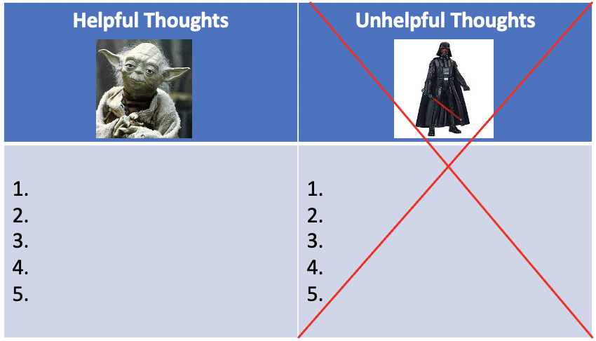
Example of Cognitive Restructuring using Visual Supports & Incorporating Special Interests
Can you think of 1 or 2 possible possible ways we can convey Coping Thoughts visually
that might be helpful for your child?
Notes:
R: while kids can do more complex cognitiverstucturing/discputation in office, irl when dysregulated, simplified may be a more accessible alternative
A much as possible, we try to use concrete and visual teaching strategies.
We often use find it can be helpful to use visual supports such as visual schedules or First-Then cards or Social Stories or just pictures to make things more predictable and help the child to understand the concept of being brave and fighting against anxiety.
This slide shows examples, but not every child is going to be able to understand examples like this, and that’s totally fine. Again, it’s not necessary, but can be helpful.
Can you think of 1 or 2 possible possible ways we can convey Coping Thoughts visually that might be helpful for (name of your child)?
1. _____________________________?
2. _____________________________?

Slide 36
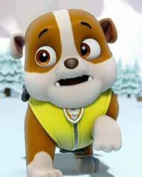
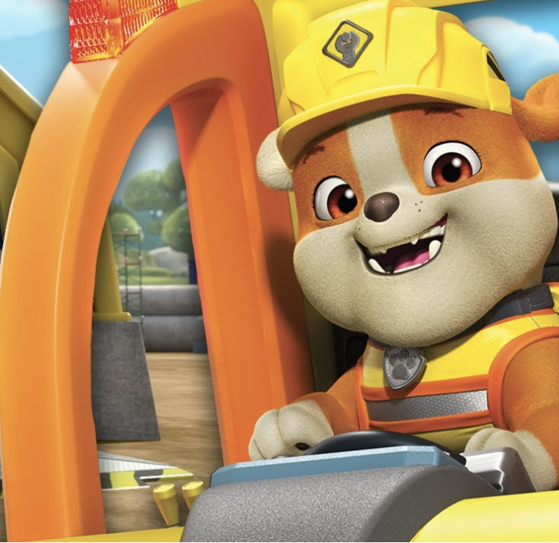
Example of Cognitive Restructuring using Visual Supports & Incorporating Special Interests
How much of the day is spent worrying? How much of the day is spent having fun?
Notes:
Motivational Interviewing (from UP for Adolescents):
What makes X think that you need to come here?
What will convince X that you don’t need to come here?
Are you happy with the way things have been going in your life lately?
Is there anything you would like to see change in your life?
Students visually depict how much time they spend worrying, to demonstrate how much of their day is spent worrying in comparison to how much time they spend having fun. The intent of this activity is to garner motivation or “buy-in” for the importance of managing anxiety symptoms, and eventually increase the amount of time engaging in fun activities
Rosen et al (2022):
https://d1wqtxts1xzle7.cloudfront.net/86628969/rosentamara-libre.pdf?1653794815=&response-content-disposition=inline%3B+filename%3DFrom_Clinic_to_Classroom_Two_Case_Studie.pdf&Expires=1714421806&Signature=Lj3fSCY6dtHCnjCKB~Ub37gJYNot7GbSD2TtR0YfdvVfd7ih-7PXMBffdOPUQekBefZeDc~4gw9fQSn7vTdYKkRLOkyZaTVxn5PGO-SrWY5Jr8M3Gk5AEcO-VkQwSFcsvR8nM3rHGmTfoJ3ocmfNZtCdqhZ9Ill7aopC-HFSxJ35t59FEm8W9d0ql9TcvXZAfZQKXwKGJeYjrlGSTSn~tPMvdYNEO4OH0XnbXPVeIT3E-LLuJZ0u8PGTb7pb~pm-KScAjyuAIsF-n9jxoxYDigwJbelowMgYPTdjSIj2PztKKcFETI1Ixa5WhYQPkZTSYJconQ25I~IHME04gJhZ~w__&Key-Pair-Id=APKAJLOHF5GGSLRBV4ZA

Slide 37
Example of Cognitive Restructuring using Visual Supports
Note: ‘Detective Thinking’ is from the Cool Kids treatment manual & workbook (Rapee et al., 2006),
but this is a worksheet created by L. Moskowitz using Google Images
Rapee, R. M., Lyneham, H. J., Schniering, C. A., Wuthrich, V., Abbott, M. A., Hudson, J. L., & Wignall, A. (2006). Cool kids: child & adolescent anxiety program. Centre for Emotional Health.
Cool Kids Worksheets and Videos
Notes:
“Detective Thinking” is from ‘Cool Kids’ treatment manual and workbook (Rapee et al., 2000)
Rapee, R.M., Schniering, C.A., Lyneham, H.J.W.V.H.J. & Wignall, A. (2006). Cool Kids (Chilled) Adolescent Anxiety and Depression Program. Sydney AU, Macquarie University.
The adaptations to the Cool Kids program were made in order to account for the challenges and concrete learning style of children with high functioning autism (Chalfant et al. 2007) and included more visual aides, structured worksheets, simplified cognitive restructuring exercises, relaxation techniques, and concrete exposure tasks. The program was amended into a second version following the feasibility study leading up to this trial (Kilburn et al. 2019).
Kilburn, T. R., Sørensen, M. J., Thastum, M., Rapee, R. M., Rask, C. U., Arendt, K. B., ... & Thomsen, P. H. (2023). Group based cognitive behavioural therapy for anxiety in children with autism spectrum disorder: a randomised controlled trial in a general child psychiatric hospital setting. Journal of Autism and Developmental Disorders, 53(2), 525–538.

Slide 38
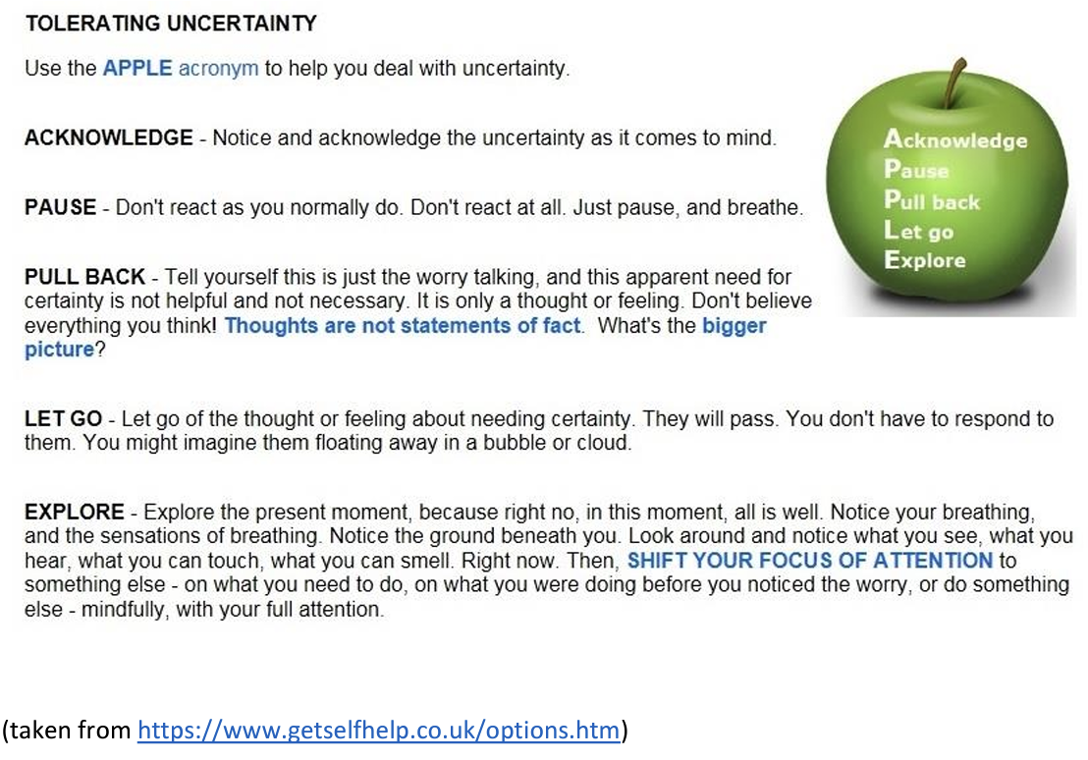
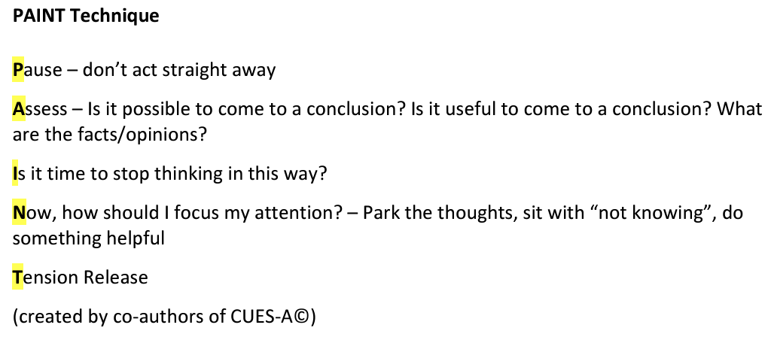
Modifications for Autism:
Tolerating Uncertainty
Rodgers, J., et al. (2023). A Pilot Randomised Control Trial Exploring the Feasibility and Acceptability of Delivering a Personalised Modular Psychological Intervention for Anxiety Experienced by Autistic Adults: Personalised Anxiety Treatment-Autism (PAT-A).
Rodgers, J., et al. (2023). Coping with uncertainty in everyday situations (CUES©) to address intolerance of uncertainty in autistic children: an intervention feasibility trial.
Rodgers, J., et al. (2017). Towards a treatment for intolerance of uncertainty in young people with autism spectrum disorder: Development of the coping with uncertainty in everyday situations (CUES©) programme.
Rodgers, J., et al. (2018). Towards a treatment for intolerance of uncertainty for autistic adults.
Coping with Uncertainty in Uncertain Times
Notes:
Research also identified Intolerance of Uncertainty (IU) (Carleton, 2016) as a transdiagnostic factor in anxiety experienced by autistic people (Jenkinson et al., 2020). The Coping with Uncertainty in Everyday Situations (CUES) (Rodgers et al., 2018) psychological therapy was developed for autistic people to address IU and has demonstrated acceptability, feasibility and promising effectiveness.
The intolerance of uncertainty model of anxiety (Dugas et al. 1998) identifies IU as an assumption that uncertainty is stressful and upsetting and not knowing what is going to happen is negative and should be avoided at all costs. IU is considered to be a ‘broad dispositional risk factor for the development and maintenance of clinically significant anxiety’ (Carleton 2012). I
Keefer et al. (2016) in a multisite manualised group intervention for autistic children with high anxiety in the USA demonstrated that high levels of pre-treatment IU significantly predicted poorer treatment response.
A parent based group intervention (CUES©: Coping with Uncertainty in Everyday Situations), aimed at providing parents of autistic children with effective strategies to reduce IU in their children in everyday situations has recently been developed and the intervention is reported to be acceptable and feasible to families (Rodgers et al. 2016a). However, there is a critical need to develop effective interventions specifically for autistic adults.
CUES© is an eight-week manualised programme (Rodgers et al., 2017, 2019) for parents of autistic children (6-16 years old)
CUES-A is for adults ages 18 years old and over

Slide 39



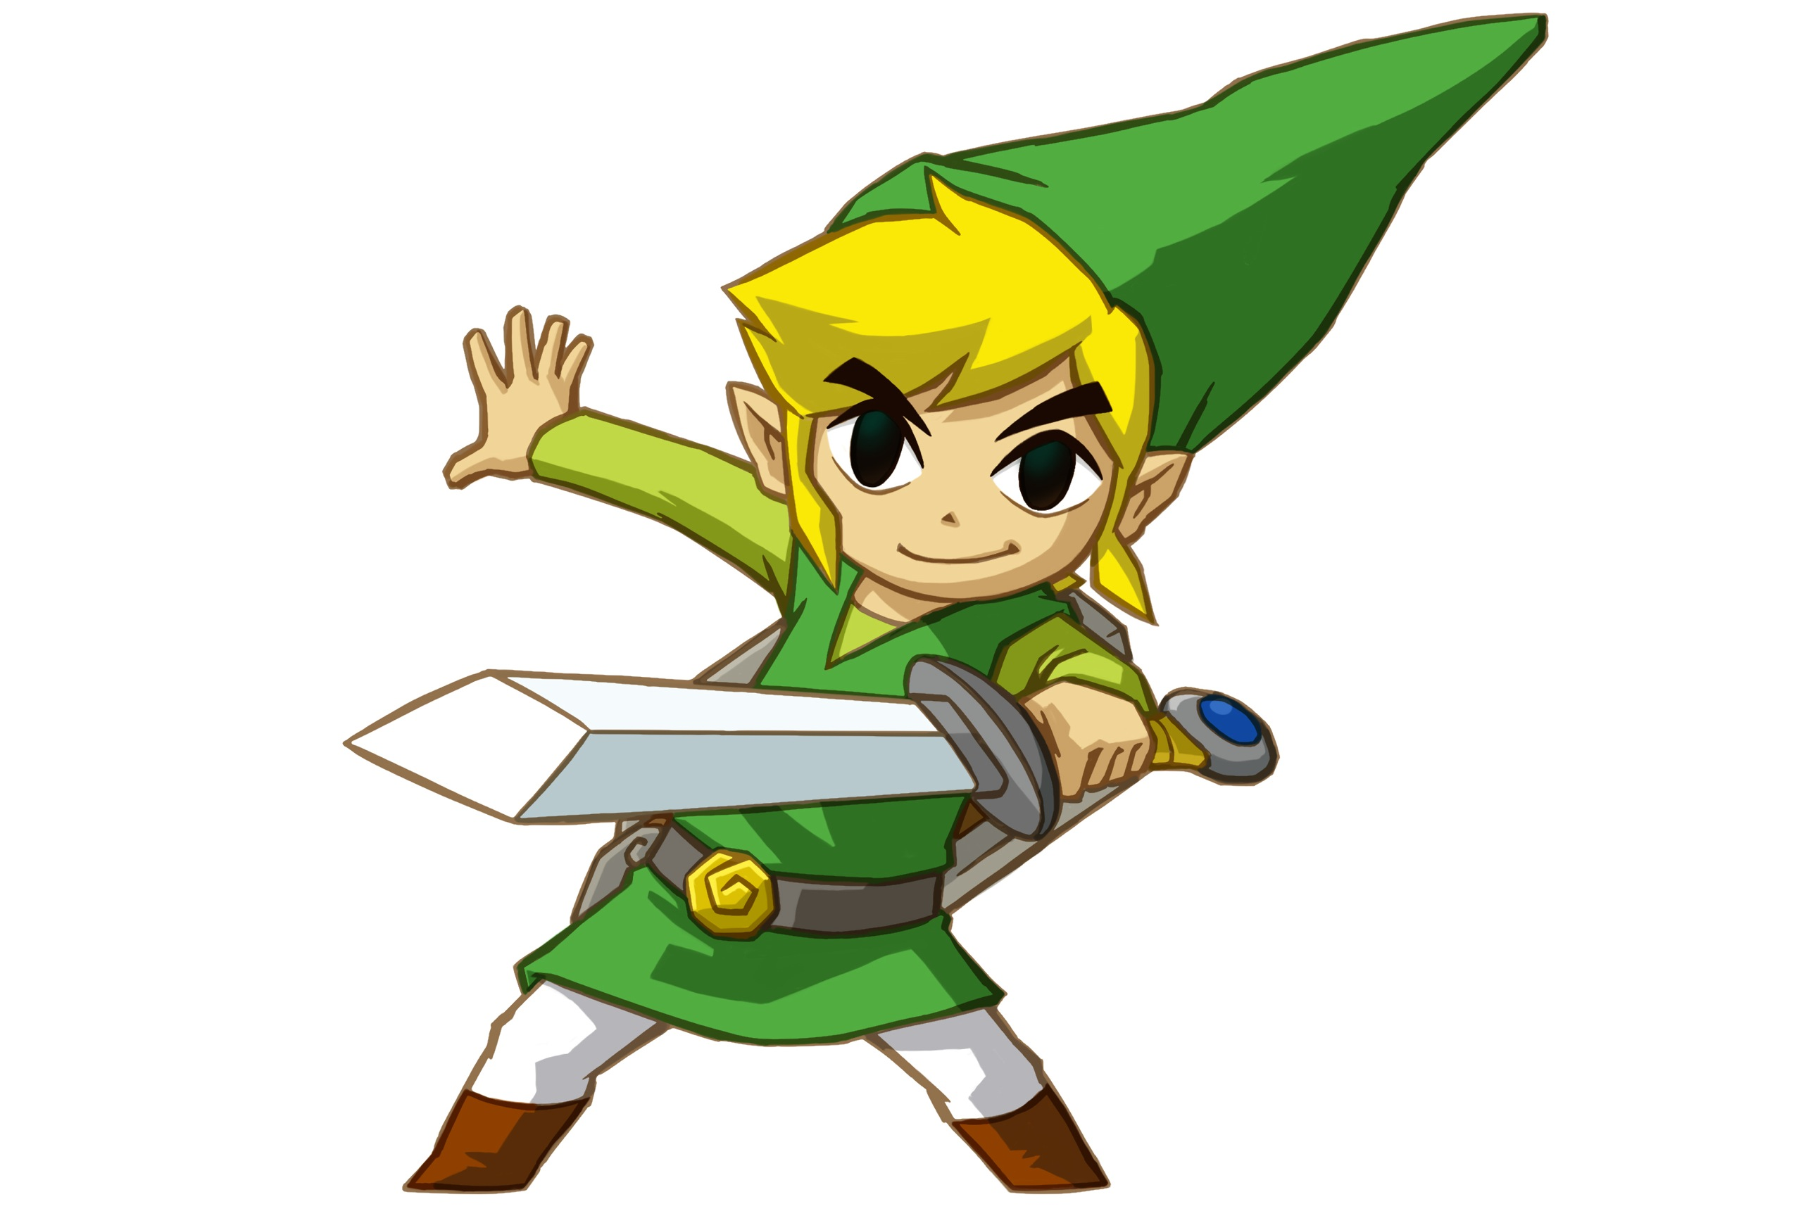
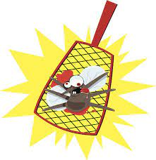
Additional Modifications for ID and/or
Nonverbal or Minimally Verbal Individuals
Modifications to Cognitive Restructuring
\
  More CONCRETE (e.g., visual, multiple choice)
  Focus on REPLACING with general coping thoughts rather than identifying & challenging anxious thoughts
Shoo Ganondorf!
I’m not afraid of you!
I can’t
do it!
I can
do it!
Worry Bug
Helper Bug
Cognitive components often simplified
or adapted to cognitive/language level,
or may be excluded altogether
Squash the Worry Bug!
Moskowitz et al (2019). Anxiety and Phobias in Individuals with Intellectual Disabilities
Notes:
Cognitive components de-emphasized or modified to meet developmental level
Psychoeducation & cognitive restructuring conveyed using VISUAL aids (e.g., Social Stories, illustrations, lists with pictures, reward charts), modeling, video modeling, & role-playing
Increased structure and predictability in delivering treatment components
For kids who have an intellectual disability, instead of identifying and challenging anxious thoughts, we focus on REPLACING anxious thoughts with general coping thoughts such as “I can handle it!” or “I can do it!”
Use of concrete and visual teaching strategies such as visual supports or multiple choice visual options
For example, you could try to have kids draw or create a Worry Bug and a Helper Bug (or build out of legos or playdoh, etc.). The Helper bug will help defeat the Worry Bug! Help child squash the Worry Bug. Child can draw picture of squashing the worry bug or if you make worry bug out of play doh, you can squash it for real.
Increased focus on generalization
Increased parental involvement
When individuals have a cognitive deficit or are impaired in their ability to understand and/or express language, the cognitive components of CBT (i.e., cognitive restructuring, psychoeducation) are often downplayed, de-emphasized, simplified, modified, adapted to the individual’s level, or most typically excluded altogether so that the intervention is “behavioral” (e.g., exposure, reinforcement, modeling) rather than “cognitive-behavioral.”
Modifications in teaching basic concepts (from Reaven):
*Prequisite skills (feelings vocabulary)
*Written worksheets
*Multiple choice lists
*Drawing and other creative outlets
*Repetition & practice
*Video modeling & video self-modeling
*Strength-based
*Incorporation of special interest
*for ID: Focus on REPLACEMENT with helpful thoughts, not identification & challenge of negative cognitions
*cognitive inserts like “I can handle it” used across the board.
Keefer et al (2018):
Although current MCBT models seek to address anxious cognitions by teaching patients to utilize “helpful thoughts,” these models primarily encourage youth to utilize broad “cognitive inserts” (e.g., “I can handle this”) that may not have direct relevance to an individual’s specific negative automatic thoughts. It is not known to what degree this strategy is effective in this population. It is possible that youth with ASD require more specific and intensive strategies to maximize treatment response. Some individuals with ASD may benefit from traditional cognitive restructuring strategies. Other strategies such as behavioral experiments, a treatment strategy in which individuals collect data during targeted activities to assess the validity of their thoughts and beliefs, or visual restructuring, a technique that involves visualizing a positive response to past distressing situations (Ozsivadjian, Hollocks, Southcott, Absoud, & Holmes, 2016), may also help reduce negative cognitions for some individuals. Mindfulness or movement-focused strategies that focus on awareness, acceptance, and shifting may also redirect focus from negative emotional and cognitive experiences to neutral, present-focused bodily sensations such as the breath or the contact between the soles of the feet and the floor (de Bruin et al., 2015, Singh et al., 2011). Finally, given the association between IU and negative cognitions, it may be possible to reduce maladaptive automatic thoughts through interventions targeted at increasing tolerance of uncertainty. Novel treatments are being developed to address IU, including the Coping With Uncertainty in Everyday Situations (CUES) treatment program (Rodgers et al., 2016), which teaches parents the necessary coping skills to help their child manage distress associated with uncertain situations.
https://www.sciencedirect.com/science/article/pii/S0005789417301314?casa_token=9SleT3j8fn4AAAAA:nFC6e92BlJEKcO2WASedXSjRzgl5LQLo_LAcBG2NLUaygwcxrpBf4VIzblANMeUtjGnbtvtQ

Slide 40
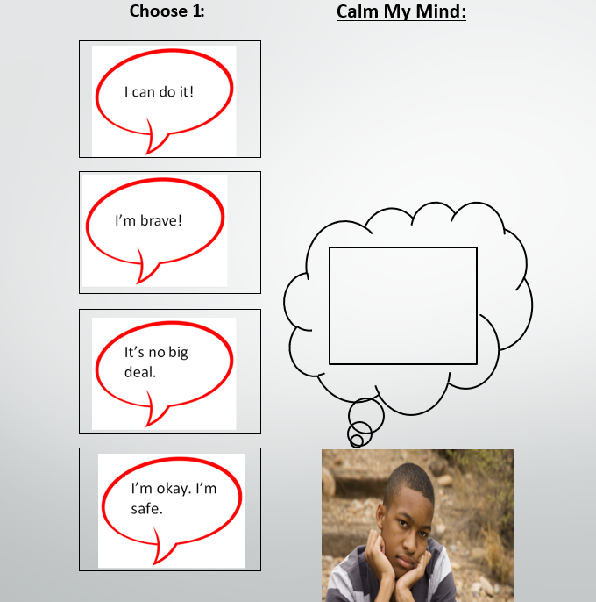
Additional Modifications for ID and/or
Nonverbal or Minimally Verbal Individuals
Facing Your Fears (FYF) modified for autistic adolescents with ID
Cognitive strategies were labeled “Calm Mind”
Visual menu of self-instructional mantras highlighting self-competence with coping
For verbally fluent adolescents:
  Activity identifying anxiety as false alarm
  Visual structure containing helpful thoughts (e.g., fight fear with facts)
For adolescents with emerging verbal skills
  Visual structure containing helpful thoughts
  Video modeling of use of visual structure
Blakeley-Smith et al., (2021)
Notes:
Facing Your Fears (FYF) modified for autistic adolescents with intellectual disability
Cognitive strategies were labeled Calm Mind
Visual menu of self-instructional mantras highlighting self-competence with coping (e.g. I can do it, I’m brave, I can handle it)
For emerging verbal skills (single words, phrase speech):
Visual structure containing helpful thoughts.
Vide modeling of use of visual structure
For verbally fluent adolescents (e.g., sentences):
activity identifying anxiety as false alarm;
visual structure containing helpful thoughts
e.g., fight fear with facts)
All CBT components were introduced with accompanying visual structures. Somatic management was labelled Calm Body and included a visual menu of strategies such as deep breathing and sensory regulation techniques (e.g. bouncing on a ball, taking a walk) that were modelled and practised. Cognitive strategies were labelled Calm Mind and included a visual menu of self-instructional mantras highlighting self-competence with coping (e.g. I can do it, I’m brave, I can handle it). Calm Body and Calm Mind strategies were taught in a sequential manner with visual structures, building up to exposure practice (i.e. Be Brave) which was supported via in-session practice with a visual structure focused on core CBT components (e.g. Calm Body, Calm Mind, Be Brave) and rewards for brave behaviour. Exposures were conducted on a variety of fears based on each teen’s individual anxiety symptoms and family goals

Slide 41
Things to do Before Next Workshop:
Psychoed & Cognitive Restructuring
Normalize anxiety
Have child draw a picture of his or her Anxiety or OCD – and/or come up with a name for it
Coach your child by talking back to Anxiety/OCD with him/her
Help your child to come up with a list of Coping Statements (Coping Self-Talk)
Model brave behavior
  Be a “coping model” (rather than a “mastery model”)

Slide 42
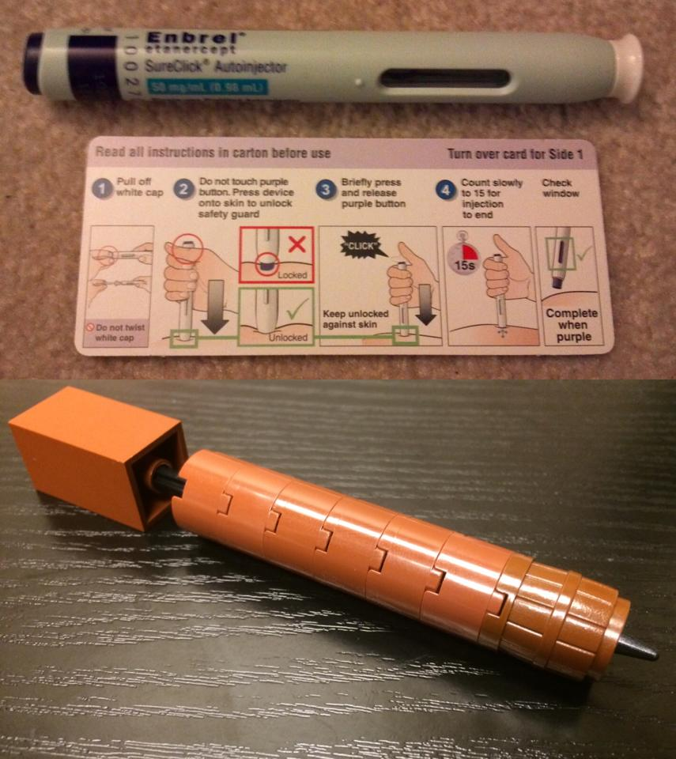
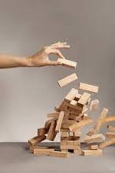
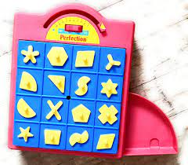
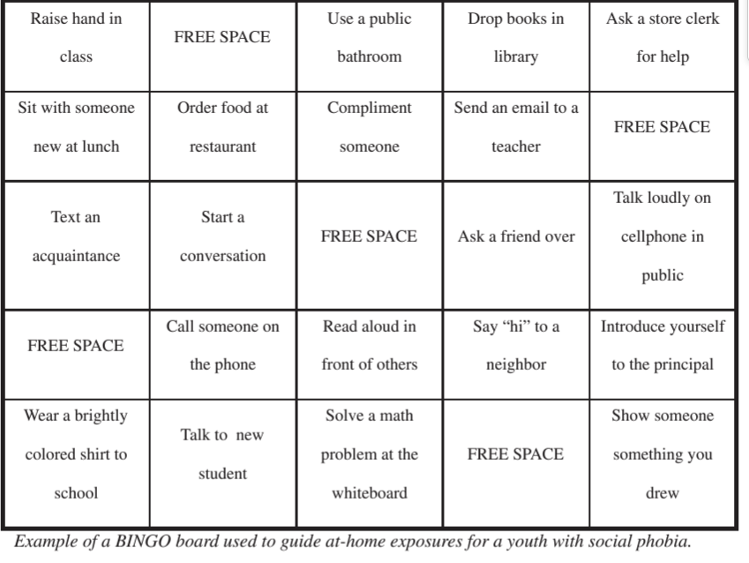
Modifications for Autism:
Gradual Exposure
Incorporate special interests into the exposures
Incorporate video modeling or video video priming
Increase caregiver involvement (e.g., (coach, prompt, reinforce brave behavior [e.g., reward chart], reduce accommodation)
Exposures to uncertainty (encountering situations or completing tasks in which the expectations are uncertain; Keefer & Vasa, 2021)
Inhibitory learning approach; focus more on tolerating anxiety than reducing it
Lego Needle
created by
Dr. Ali Mattu
Peterman et al (2014)
Notes:
Incorporate special interests into the exposures
Incorporate video modeling or video video priming
Increase caregiver involvement (e.g., (coach, prompt, reinforce brave behavior [e.g., reward chart], reduce accommodation)
Exposures to uncertainty (encountering situations or completing tasks in which the expectations are uncertain; Keefer & Vasa, 2021)
Treatments tend to target exposure to feared stimuli (e.g., exposure to thunderstorms) rather than exposures to uncertainty (e.g., distress about the uncertainty of changing weather patterns)
Intolerance for uncertainty exposures could involve a youth sitting in a movie theater with their cell phone on full volume.
Inhibitory learning approach; focus more on tolerating anxiety than reducing it
That said, we focus more on anxiety tolerance than habituation (emphasizing tolerating/coping with fear over fear reduction), meaning that “we can feel afraid and still cope with it – we can still live our lives.”
However, autistic youth may not habituate as quickly or in the same way as non-autistic youth. This difference in habituation may not matter, as newer research suggests that fear reduction may not even be necessary for lasting improvement (Craske et al., 2008). Thus, we recommend placing more emphasis on tolerance of fear versus reduction of fear, indicating that fear and anxiety are not dangerous; we can feel afraid and we can still cope with it.
To our knowledge, current MBCT approaches do not typically include recommendations specifically targeting IU. Rather, treatments tend to target anxiety more frequently through stimuli-focused exposure hierarchies (e.g., exposure to thunderstorms) rather than hierarchies eliciting exposures to uncertainty (e.g., distress about the uncertainty of changing weather patterns), which may maintain anxiety and worry.
Given the repeated finding of high levels of IU in the ASD population (Boulter et al. 2014; Chamberlain et al. 2013; Kreiser et al. 2016), current MCBT models may be enhanced by emphasizing the importance of evaluating and potentially targeting IU through graded exposure in ASD youth. Additionally, the use of “exposure optimizing strategies” which are based in inhibitory learning models of anxiety (Craske et al. 2014) may enhance treatment response. Strategies such as “deepened extinction” in which individuals are exposed to two anxiety-triggering stimuli in isolation and then in combination have been demonstrated to reduce relapse of anxiety (Rescorla 2006).
The use of this strategy to simultaneously target IU and co-occurring anxiety may produce greater reduction in anxiety and worry in ASD youth.
Additionally, behavioral support strategies such as introducing periods of uncertainty throughout a child’s day (e.g., including a “question mark” in a visual schedule during a certain time period) to prepare individuals for the possibility of uncertainty and opportunities to utilize behavioral coping strategies (e.g., physical exercise, pleasurable sensory experiences) when facing uncertainty may be helpful in managing distress related to IU (Hodgson et al. 2016).

Slide 43
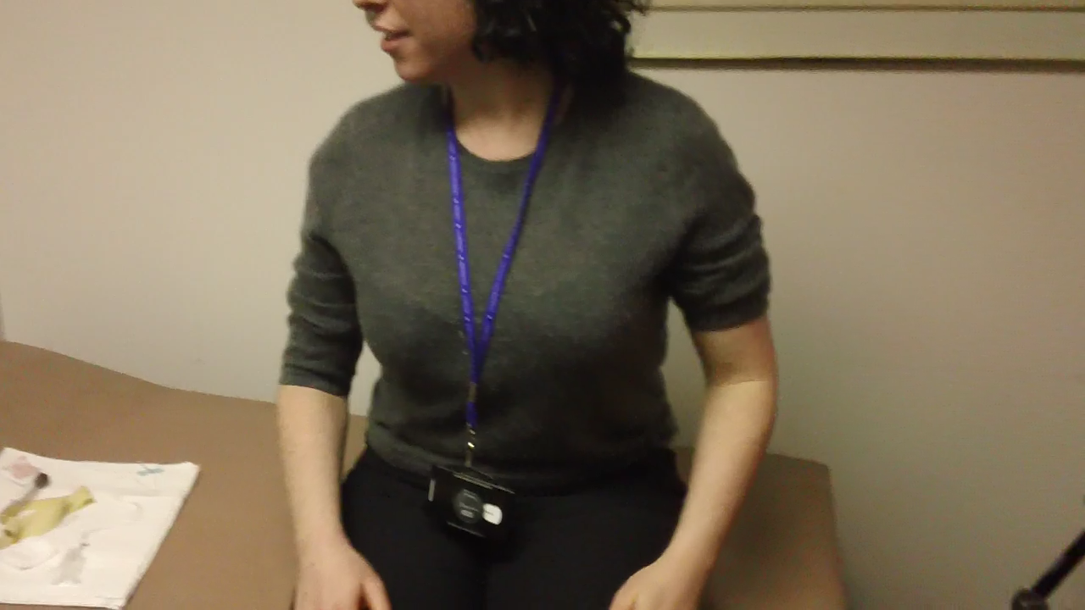
Example of Exposure using
Video Modeling

Slide 44

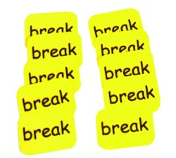
Additional Modifications for ID and/or
Nonverbal or Minimally Verbal Individuals
Modifications to Exposure
  Incorporate special interests
  Use Counterconditioning: Pair anxiety-provoking stimuli with highly positive stimuli (incorporating special interest)
  Involve parents/caregivers in all intervention sessions
  Incorporate Functional Communication Training (FCT) (e.g., may need to teach to ask for break from exposure)
Moskowitz et al. (2017); Moskowitz et al. (2020)
Notes:
Increased structure and predictability in delivering treatment components
Incorporation of visual supports
Use of concrete and visual teaching strategies
Increased focus on generalization
Increased parental involvement
Incorporation of children's “special interests” (circumscribed interests & stereotypies)
Consideration of function, setting events, and idiosyncratic triggers and behavioral indicators
Use of antecedent strategies & counterconditioning
When individuals have a cognitive deficit or are impaired in their ability to understand and/or express language, the cognitive components of CBT (i.e., cognitive restructuring, psychoeducation) are often downplayed, de-emphasized, simplified, modified, adapted to the individual’s level, or most typically excluded altogether so that the intervention is “behavioral” (e.g., exposure, reinforcement, modeling) rather than “cognitive-behavioral.”
Modifications in teaching basic concepts (from Reaven):
*Prequisite skills (feelings vocabulary)
*Written worksheets
*Multiple choice lists
*Drawing and other creative outlets
*Repetition & practice
*Video modeling & video self-modeling
*Strength-based
*Incorporation of special interest
*for ID: Focus on REPLACEMENT with helpful thoughts, not identification & challenge of negative cognitions
*cognitive inserts like “I can handle it” used across the board.
Keefer et al (2018):
Although current MCBT models seek to address anxious cognitions by teaching patients to utilize “helpful thoughts,” these models primarily encourage youth to utilize broad “cognitive inserts” (e.g., “I can handle this”) that may not have direct relevance to an individual’s specific negative automatic thoughts. It is not known to what degree this strategy is effective in this population. It is possible that youth with ASD require more specific and intensive strategies to maximize treatment response. Some individuals with ASD may benefit from traditional cognitive restructuring strategies. Other strategies such as behavioral experiments, a treatment strategy in which individuals collect data during targeted activities to assess the validity of their thoughts and beliefs, or visual restructuring, a technique that involves visualizing a positive response to past distressing situations (Ozsivadjian, Hollocks, Southcott, Absoud, & Holmes, 2016), may also help reduce negative cognitions for some individuals. Mindfulness or movement-focused strategies that focus on awareness, acceptance, and shifting may also redirect focus from negative emotional and cognitive experiences to neutral, present-focused bodily sensations such as the breath or the contact between the soles of the feet and the floor (de Bruin et al., 2015, Singh et al., 2011). Finally, given the association between IU and negative cognitions, it may be possible to reduce maladaptive automatic thoughts through interventions targeted at increasing tolerance of uncertainty. Novel treatments are being developed to address IU, including the Coping With Uncertainty in Everyday Situations (CUES) treatment program (Rodgers et al., 2016), which teaches parents the necessary coping skills to help their child manage distress associated with uncertain situations.
https://www.sciencedirect.com/science/article/pii/S0005789417301314?casa_token=9SleT3j8fn4AAAAA:nFC6e92BlJEKcO2WASedXSjRzgl5LQLo_LAcBG2NLUaygwcxrpBf4VIzblANMeUtjGnbtvtQ

Slide 45
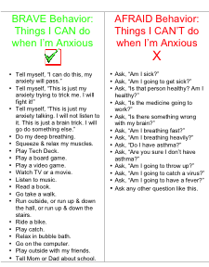
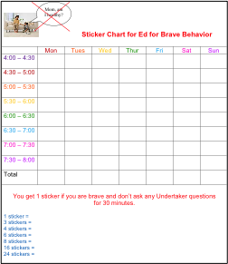
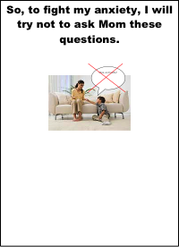
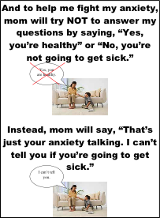
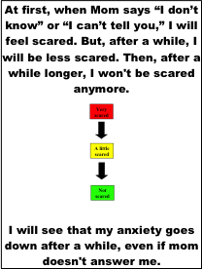
Case Example: Autism + OCD
  Psychoeducation & cognitive component of treatment conveyed using visual aids (e.g., Social Stories, illustrations, lists with pictures, reward charts), modeling, video modeling, role-playing
  Positive reinforcement: he only earned stickers if he engaged in brave behavior rather than anxious behavior
Moskowitz et al. (2017)
Notes:
Increased structure and predictability in delivering treatment components
Incorporation of visual supports
Use of concrete and visual teaching strategies
Increased focus on generalization
Increased parental involvement
Incorporation of children's “special interests” (circumscribed interests & stereotypies)
Consideration of function, setting events, and idiosyncratic triggers and behavioral indicators
Use of antecedent strategies & counterconditioning
A common finding in the ASD intervention literature is that skills and behavioral improvements acquired in therapeutic programs do not generalize to the settings where they are needed (e.g., school) (e.g., Hwang & Hughes, 2000). Therefore, additions and modifications to standard CBT protocols are necessary in order to produce generalized and durable change in children with ASD (e.g., Attwood, 2004)

Slide 46
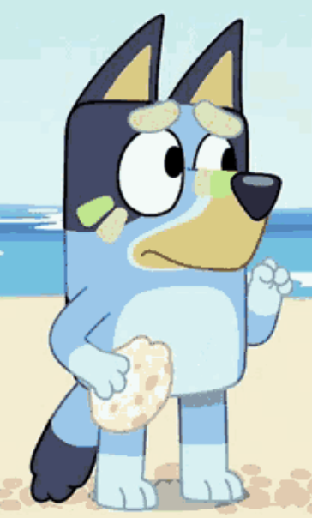
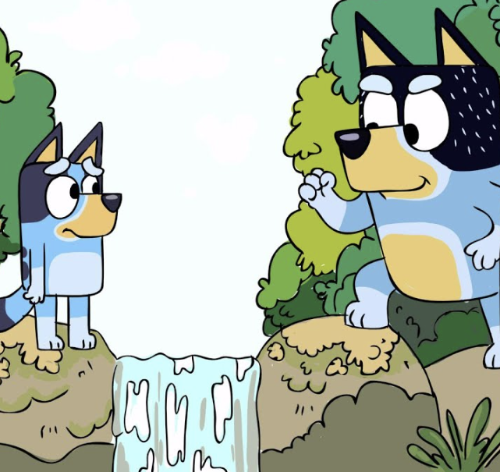
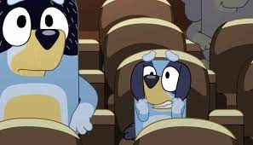

Things to do Before Next Workshop:
Gradual Exposure
Identify client’s strongest, most powerful reinforcer(s) (usually related to special interest)
Create a fear-and-avoidance hierarchy with your client and/or with the client’s caregiver
Try the easiest possible exposure (lowest level on the hierarchy)
  Most likely video modeling or video priming or even a picture
  May need to pair the feared object/situation with FAVORITE THING (special interest) reserved only for this
Reinforce/reward brave behavior with another powerful reinforcer!

Slide 47
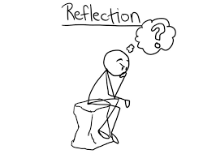
Reflection & Feedback
What is something you liked about today’s training?
What is something you learned today?
What is something you would like us to change in the future?
Adapted from
Minnesota Positive Behavior Support Intensive Training (Day 1)

Slide 48
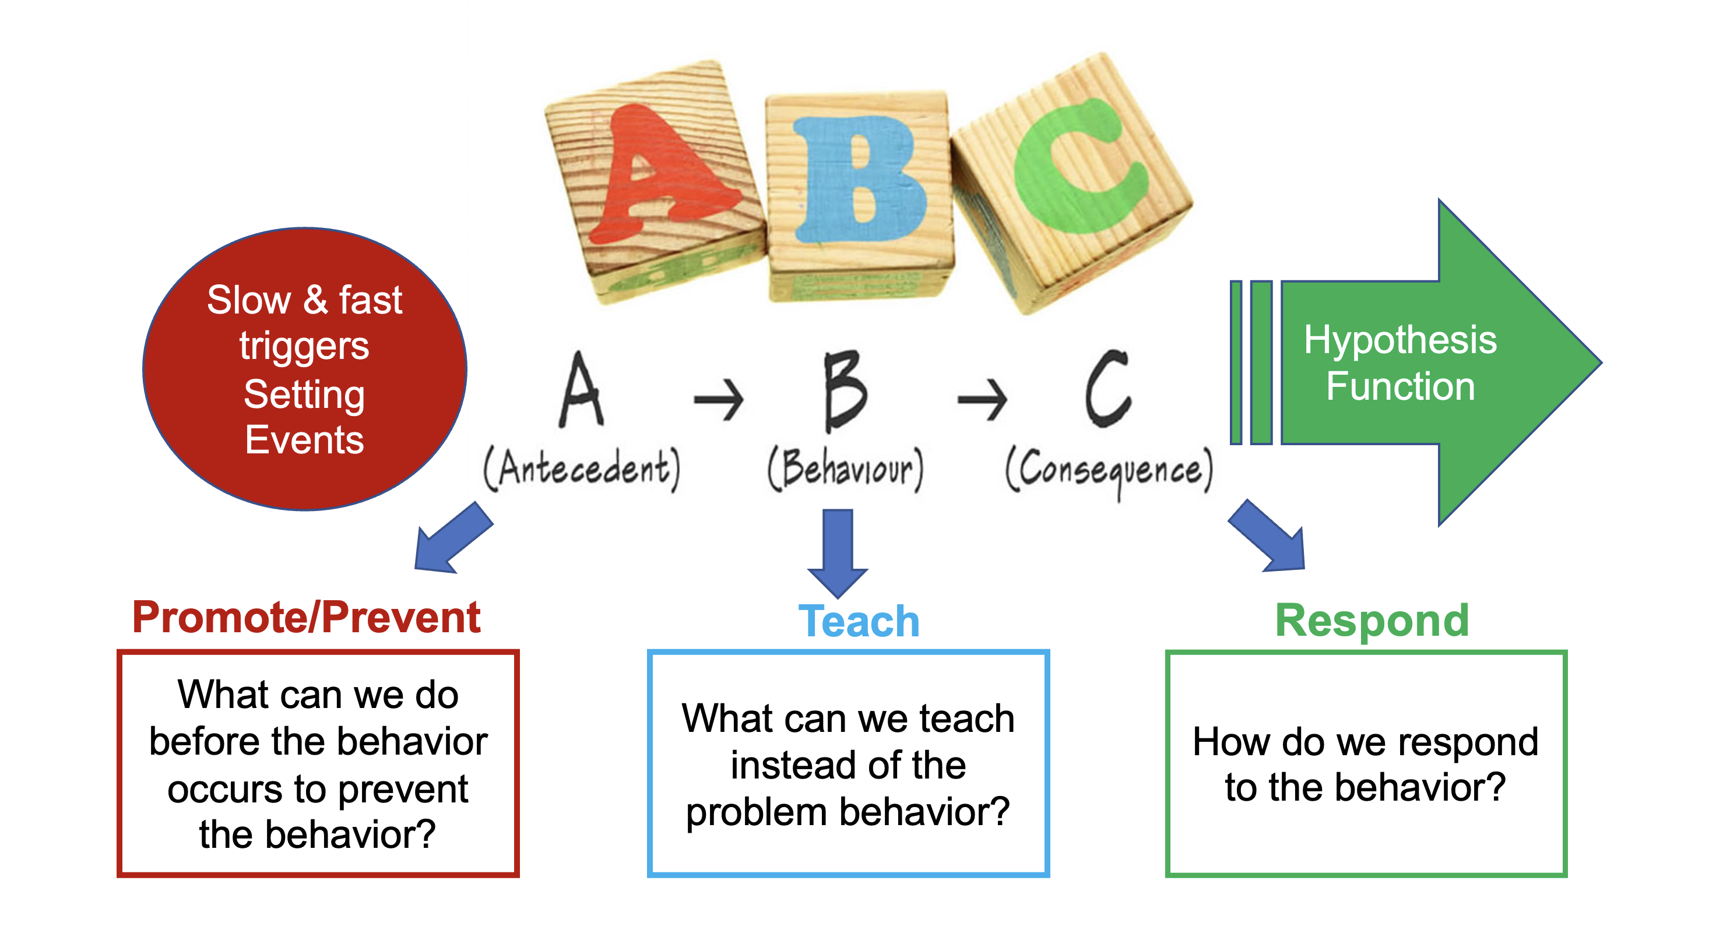
Take what we know
PBS
Prevent-Teach-Respond
Add what’s missing
CBT
Cognitive Triangle

Slide 49
What is Positive Behavior Support (PBS)?
PBS is a set of research-based strategies used to improve a person’s quality of life and decrease challenging behavior by teaching new skills and making changes in a person’s environment
These research-based strategies are based in a thorough understanding of the person and environmental influences affecting their behavior; proactive, educative, and functional strategies; and making decisions on the basis of objective information (data)
https://apbs.org/pbs/
https://hcpbs.org/what-is-positive-behavior-support/
Notes:
Positive behavior support (PBS) is a positive support practice that is included in the organization-wide training and technical assistance effort in Minnesota. PBS refers to a set of tools and strategies for improving quality of life and creating positive social environments. PBS is a value-driven practice that incorporates the principles of behavior and biomedical research with an emphasis on empowering people to identify strategies that are the best fit for each social context.
chrome-extension://efaidnbmnnnibpcajpcglclefindmkaj/https://files.eric.ed.gov/fulltext/ED607739.pdf
From APBS website: Positive Behavior Support (PBS) is a set of research-based strategies used to increase quality of life and decrease problem behavior by teaching new skills and making changes in a person’s environment. Positive behavior support combines:
From HCPBS website: Positive behavior support is an approach to supporting people’s behavior in typical home, school, work, and community environments that combines the principles of applied behavior analysis, implementation science, and best practices from other human service fields. It is characterized by a commitment to collaboration; basing interventions on a thorough understanding of the person and environmental influences affecting behavior; proactive, educative, and functional strategies; making decisions on the basis of objective information; and focusing not just on behavior change, but also improvements in quality of life.
In 2002, Carr et al. provided an updated definition of “positive behavior support”:PBS is an applied science that uses educational methods to expand an individual’s behavior repertoire and systems change methods to redesign an individual’s living environment to first enhance the individual’s quality of life and, second, to minimize his or her problem behavior. (p. 4)
From Kincaid et al (2016):
PBS is an approach to behavior support that includes an ongoing process of research-based assessment, intervention, and data-based decision making focused on building social and other functional competencies, creating supportive contexts, and preventing the occurrence of problem behaviors. PBS relies on strategies that are respectful of a person’s dignity and overall well-being and that are drawn primarily from behavioral, educational, and social sciences, although other evidence-based procedures may be incorporated. PBS may be applied within a multi-tiered framework at the level of the individual and at the level of larger systems (e.g., families, classrooms, schools, social service programs, and facilities).
https://journals.sagepub.com/doi/full/10.1177/1098300715604826?casa_token=QCEJIxd08CwAAAAA:244vdHh8cm5cHBPcNvhg_kiCQYknty532WWDy6hskbRU1QwMjlU0yJ5qu7BC3wl5gDRAIB83ZuiZUQ

Slide 50
Key Features of PBS
Assessment-Based (understanding reasons for challenging behavior; use data for decision-making)
Lifestyle-focused (improving quality of life)
Preventive: change environment (systems change)
  PBS plans require caregivers to change THEIR behavior
Educative: teach alternative skills (e.g., functional communication skills, daily living skills, social & emotional skills)
Person-centered & customized
Ecologically valid (feasible & effective in the real world)
Socially valid (outcomes that are meaningful & relevant)
Collaborative (collaboration with stakeholders; team-based)
Comprehensive
Long-term focused (lifespan perspective)
Notes:
50
PBS Plans Require Those Supporting Children and Adults to Change Behavior
Family-centered PBS helps parents learn to apply those principles to improve family routines and quality of life by focusing on family goals, values, skills, and resources; encouraging lifestyle enhancement; and developing multi-component intervention plans that emphasize prevention and teaching skills in a way that is ecologically and socially valid (Lucyshyn et al., 2007). In family-centered PBS, parents not only learn strategies to prevent, replace, and manage their child’s challenging behaviour, but are viewed as collaborators in assessing the problem, selecting goals, and choosing and implementing interventions
From MN PBS Intensive Training:
https://mnpsp.org/wp-content/uploads/2023/11/PBS-Intensives-Day-1_2024_Accessibility-Checked.pdf
Investing in change across the entire organization,
Focusing on teaching social and emotional skills,
Focus on prevention and early, less restrictive intervention for challenging behavior,
Actively using data for decision making, and
employing a three-tiered continuum of behavioral support (Freeman et al., 2006)
GROUP ACTIVITY:
*Form groups of 3 people and discuss your definitions
• Develop a group definition for these terms
• Share out your definitions – write on flipchart paper
Task analysis
Shaping
Prompting behavior
Quality of Life:
Emotional Wellbeing -(Feeling Empowered and Experiencing Positive Emotions)
Interpersonal Relations - (Opportunities for Friendship and Intimacy, Quality of Interactions With Others)
Material Well-being -(Ownership of Possessions, Meaningful Employment)
Personal Development –(Opportunities for Education and Habilitation)
Self-determination -(Setting Personal Goals, Making Decisions About Important Life Choices)
Physical Well-being -(Optimal Health Care and Nutrition, Mobility & General Wellness)
Social Inclusion -(Natural Support Networks Inclusive and Integrated Environments)
Rights -(Experience of Ownership of Key Items and Property, Allowed Due Process, Privacy and Barrier Free Environments are Available).
Hopes and fears
A functional approach to assessment assumes that people behave in adaptive ways to ongoing changes in their environment.
Behavior is “lawful” and it is happening for a reason.
We need to figure out why it is happening to help to modify the environment, support the person, and to teach, and reinforce socially appropriate alternative behaviors for them to get their wants and needs met.

Slide 51
PBS Integrates Science with
Values
PBS is a value-driven practice that incorporates the principles of behavior and biomedical research with an emphasis on empowering people to identify strategies that are the best fit for each social context (https://publications.ici.umn.edu/impact/29-2/a-model-for-building-a-statewide-infrastructure-for-person-centered-practices-and-positive-supports-minnesotas-approach#:~:text=Authors)
Values:
Our needs are met
We have choices
Events are predictable
People listen and communicate
Quality of life is assessed and prioritized
Adapted from
Minnesota Positive Behavior Support Intensive Training (Day 1)
Notes:
Positive behavior support (PBS) is a positive support practice that is included in the organization-wide training and technical assistance effort in Minnesota. PBS refers to a set of tools and strategies for improving quality of life and creating positive social environments. PBS is a value-driven practice that incorporates the principles of behavior and biomedical research with an emphasis on empowering people to identify strategies that are the best fit for each social context.
chrome-extension://efaidnbmnnnibpcajpcglclefindmkaj/https://files.eric.ed.gov/fulltext/ED607739.pdf
Positive Behavior Support is the Integration of
– Valued Outcomes
– Behavioral and Biomedical Science
– Validated Procedures
– Systems Change
– In Order to Enhance Quality of Life and Prevent Problem Behavior
Note: PBS Plans Require Those Supporting Children and Adults to Change Behavior
Creating a Positive Environment
• Our Needs Are Met
• We Have Choices
• Events Are Predictable
• People Listen and Communicate (verbal & nonverbal)
• Quality of Life is Assessed

Slide 52
Establishing Goals
First step: create clear, positive vision for future
  Consider values & what broad goals want to achieve
  Create a positive vision for the individual, identifying their strengths, interests, challenges, & needs
Broader life goals might focus on:
  Improving person’s health or emotional state
  Going more places or doing more things
  More opportunities to make own choices
  Enhancing or expanding friendships & relationships
  Improving child or family quality of life in general
From Durand (2008)
Durand & Hieneman (2008); Freeman et al. (2014) Hieneman et al., (2015)
Notes:
*Use person-centered planning, a collaborative process for creating a positive vision for the individual; identifying their strengths, interests, challenges, & needs; and establishing action steps for achieving particular goals (Freeman et al. 2014)
First step: create clear, positive vision for future
*Before trying to understand & address child’s problem behavior, important to consider what broad goals we want to achieve
*Consider why changing a child’s behavior is so important & what we would ultimately like to see in terms of changes in child’s life
*Want to achieve more than just changing or stopping certain behaviors: we want your child & family to have better lives
*Broader life goals might focus on:
Improving child’s health or emotional state
Making it possible for child to go more places or do more things (e.g., being able to attend birthday parties unsupervised)
Giving a child more opportunities to make his own choices (e.g., selecting and preparing his own snacks)
Enhancing or expanding a child’s friendships and other relationships (e.g., improving ability to communicate and interact with peers)
Improving family life in general (e.g., “enjoying meals together”)
*Goals give parent & family members hope & direction, and builds unity.
*In establishing these goals, it is important to think about the child’s strengths and interests as well as difficulties.
*We can then build on child’s strengths as well as respond to his needs.

Slide 53
Consider Quality of Life:
Not all fears need to be “faced”
Is it person-centered? Aligned with values?
6
Is it necessary to encourage person to face this fear?
Is it ethical?
Does the person appear distressed by their fear/anxiety?
Is this fear/anxiety harming child’s or family’s QUALITY OF LIFE?
  If child afraid of roller coasters, no need to do exposures (no need for them to go on a roller coaster; they can live their life without going on a roller coaster) – not impairing quality of life
  BUT if a child is afraid of trees, there’s a need for exposures, since that’s hard to avoid and impairing daily life/functioning
Notes:
Is it person-centered?
It IS okay for kid to say no and "not be brave." The goal of an exposure or "brave challenge" is to try to make it as reinforcing as possible to motivate them to be brave, IF this “brave behavior” will improve the child’s quality of life and/or family quality of life. I completely agree that not every behavior needs to or should be changed, and that not everything needs to be confronted; e.g., if I’m afraid of roller coasters, there is no need for me to go on roller coasters. If I'm afraid of cocktail parties, I don't see why I need to go to cocktail parties. But if I’m afraid of trees, it’s pretty hard to live a life avoiding trees forever, and probably makes a lot more sense to try to help the kid do brave challenges to learn to cope with trees. I was going to say this in a VoiceThread but do you have any suggestions for how to modify this slide?

Slide 54
Steps of FBA & FBI Process
Identify goals & behaviors of concern
  Identify broad lifestyle goals through person-centered planning
  Operationally define target behavior & what we want to occur
Collect Functional Behavior Assessment (FBA) information
  Collect indirect data (e.g., interviews, questionnaires) on context
  Collect direct observation data: Observe person’s behavior, antecedents that ”trigger” person’s behavior, & consequences that follow the behavior to understand WHY person is behaving this way
Analyze patterns
  Using FBA data, determine circumstances affecting person’s behavior & what person is getting or avoiding as a result
Develop & implement Function-Based Intervention (FBI) plan
  Based on patterns, create strategies to prevent problems, teach better ways to get needs met, & respond appropriately to behaviors
Monitor outcomes
  Review progress to ensure strategies are working , modify as needed
Durand & Hieneman (2008); Hieneman et al (2015)
Notes:
Positive behavior support may best be described as an individualized, problem-solving process grounded in ABA principles. The process includes (1) identification of broad goals and behaviors of concern, (2) gathering and analyzing of information to identify probable patterns affecting behavior, (3) selecting and delineating strategies based on the patterns and integrating them into a comprehensive plan, (4) implementing the plan across settings and caregivers, and (5) monitoring outcomes
This occurs through person-centered planning, a collaborative process for creating a positive vision for the individual; identifying his strengths, challenges, and needs; and establishing action steps for achieving particular goals (Freeman et al. 2014).
Establish goals
Define the problem, including the child’s behaviors of concern and specific changes we want to occur
Gather information
Watch the child’s behavior and talking to other people to understand WHY the child is behaving in this manner
Analyze patterns
Determine what circumstances are affecting the child’s behavior and what the child is getting or avoiding as a result
Develop a plan
Create strategies to prevent problems, teach child better ways of behaving, and respond appropriately to behaviors when they occur
Monitor results
Review progress to ensure that the strategies are working and making changes as needed

Slide 55
Why Does Challenging Behavior Occur?
PBS takes a functional approach to behavior
People engage in challenging behavior because it serves a FUNCTION or PURPOSE
  These behaviors meet an IMMEDIATE NEED
Behaviors persist because people want/need to…
Get something | Escape or avoid something
Obtain parent/peer/staff attention Obtain preferred tangible items or activities Obtain sensory input | Escape/avoid difficult or disliked tasks Escape/avoid social interaction Escape, avoid, or reduce sensory stimulation or pain or discomfort
(Positive Reinforcement) | (Negative Reinforcement)
Notes:
Although challenging behavior does not serve the person well in the long-run, it persists because it meets an immediate need.
Feel a sense of control/mastery when engaging in predictable interactions.
From MN PBS Intensive Training, Day 3:
A functional approach to assessment assumes that people behave in adaptive ways to ongoing changes in their environment.
– Behavior is “lawful” and it is happening for a reason.
– We need to figure out why it is happening to help to modify the environment, support the person, and to teach, and reinforce socially appropriate alternative behaviors for them to get their wants and needs met.

Slide 56
Why Does Anxious Behavior Occur?
(Reconceptualizing Functions of Behavior)
Get something | Escape or avoid something
Obtain comfort/reassurance Obtain comforting object or calming activity | Escape or avoid anxiety-provoking situation Escape or avoid or reduce feelings of physiological arousal associated with anxiety (self-soothing)
(Positive Reinforcement) | (Negative Reinforcement)
Notes:
NEW SLIDE FOR INTENSIVE TRAINING

Slide 57
Creating a Function-Based
Behavior Intervention Plan (BIP)
Once you figure out the ANTECEDENTS that trigger the behavior & the CONSEQUENCES that maintain the behavior….
Design intervention plan to:
  PREVENT challenging behavior by changing circumstances that trigger it (modify the environment; i.e., remove/minimize antecedents)
  TEACH appropriate ways to help them get what they need
  Teach skills to replace challenging behavior with more desirable behavior that serves the same function/purpose
  RESPOND to challenging behavior by changing consequences
  Change how you respond to challenging behavior so that the challenging behavior NO LONGER WORKS
  Reinforce replacement behaviors & positive behaviors instead!
Notes:
We need to figure out why the challenging behavior or anxious behavior is happening to help to modify the environment,
support the person, and to teach, and reinforce socially appropriate alternative behaviors for them to get their wants and needs met

Slide 58
Positive Behavior Support (PBS)
  PREVENTION strategies
    Incorporate “special interests”
      Pair anxiety-provoking situation with “anti-anxiety” stimuli
    Increase Predictability (e.g., visual supports, Social Story)
    Provide Choices
    Psychoeducation/cognitive restructuring (e.g., using Social Stories)
    Model (and possibly prompt) brave behavior
  REPLACEMENT strategies
    Teach person to APPROACH feared situation rather than avoid
    Teach COPING SELF-TALK
    Teach RELAXATION skills
    Teach COMMUNICATION: e.g., to ask for a BREAK from anxiety-provoking situation (if necessary)
  RESPONSE strategies: respond to brave & anxious behavior
    Reinforce/reward brave behavior!
    Reduce accommodation! (Minimize reinforcement for anxious/avoidant behavior)
Notes:
PREVENTION
– Change the trigger (antecedent)!
– Make the behavior irrelevant
– Address the function AHEAD of time!
Prevention Strategies (incorporating the child’s “special interests,” increasing predictability with visual schedule, social stories, modeling, and offering choices)
Replacement strategies (e.g., teaching a communication skill or competing response)
Response/Consequence strategies including (5) positively reinforcing brave behavior and (6) minimizing reinforcement for anxious behaviors.
This training workshop will discuss how to assess anxiety as part of a functional behavior assessment as well as how to address anxiety in a family-based PBS plan. We will present a multimethod strategy for assessing anxiety and a parent-implemented multicomponent intervention package that integrates PBS and CBT (Moskowitz et al., 2017). The CBT procedures include gradual exposure, psychoeducation, and cognitive restructuring. These CBT-for-anxiety strategies as well as PBS strategies that are traditionally used to address challenging behavior are incorporated into a PBS Prevent-Replace-Respond framework, with PBS Prevention strategies including incorporating the individual’s “special interests” into treatment; increasing predictability; providing choices between various aspects of the exposure; and modelling and/or verbally prompting an approach response. PBS Response strategies will include teaching the provider to positively reinforce the individual’s attempts to approach a feared situation and teaching the provider to minimize reinforcement/accommodation for the individual’s anxious behaviors. Finally, PBS Replacement strategies may include teaching the individual a competing response, Functional Communication Training (FCT), and teaching a relaxation response. Although gradual exposure and positive reinforcement are used with all individuals, other strategies are chosen in collaboration with families and providers to promote a good contextual fit.
Many providers want to address mental health problems in individuals with IDD, but do not know how. This presentation aims to empower more providers to treat anxiety in individuals with IDD.
Example Context/Setting Event Interventions:
•Minimize or eliminate the setting event
• Design interventions that are implemented when setting events may be present
• Neutralize the setting event (ear phones in noisy environment)
• Add more prompts for desirable behavior (offer free assistance to lessen aversiveness)
• Increase the value of reinforcement for desirable behavior
• Offer alternative reinforcer (attention during difficult task if learner enjoys attention )

Slide 59

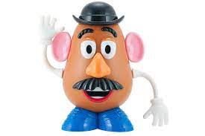




PBS Prevention Strategies:
Incorporate “Special Interests”
Incorporate special interests into psychoeducation, cognitive restructuring, relaxation, and the exposure itself
Don’t just use a toy or treat or activity that person likes, but rather their MOST HIGHLY PREFERRED toy or song or activity or character or theme
Using person’s obsessions are the most effective reinforcer
  Examples:
    Potato Head
    Dr. Seuss
Not only using special interest as a reward but also incorporating it into the exposure itself
  Examples:
    Sesame Street
    Sneetches
Notes:
Given the level of anxiety that the feared object or situation often provokes in children with autism, it might help to not just pair the anxiety-provoking situation with a toy or treat or activity that is simply reinforcing, but to take it one step further by incorporating the child’s special interests into the exposure.
That means incorporating the toys/items or books or songs or activities or characters that are THE MOST highly salient/preferred in an attempt to override or counteract the aversiveness of the anxiety-provoking contexts.
“Special interests” (also sometimes called “perseverative interests” or “circumscribed interest” or “obsessive interest”) refers to an object, activity, or topic with which the child is INTENSELY PREOCCUPIED.
(NOTE: THERAPIST CAN FEEL FREE TO USE YOUR OWN EXAMPLES, OR USE MY EXAMPLES BELOW)
For example, let’s take Tom, who was afraid of the doctor and had to go to the doctor often due to seizures; it often took several doctors and nurses to hold him down to get his blood drawn or any other procedure, and this loss of control obviously just made him more afraid. His parents had tried many rewards/reinforcers, and none of them had been strong enough. When we brainstormed the thing he had been most obsessed with in life, his parents immediately said “Mr. Potato Head!” In fact, he had been so obsessed with Potato Head that his parents had taken him away a year or two ago and were reluctant to try my idea of bringing back Potato Head. I assured them that Potato Head would live at the Doctor’s office (would only be paired with the doctor’s office) and would not come home with them. On the first we took him to the doctor’s office for intervention, we told him Potato Head would be living there. He seemed excited to go, which his mother said was unusual. When we got to the doctor’s office and entered, the doctor immediately was holding Mr. Potato Head. Tom did not have to do anything at the doctor’s office other than sit and play with Mr. Potato Head. This pairing of potato head (his most special interest) with the doctor’s office created a positive association with the doctor’s office. The next time, Tom was able to sit on the examining table while playing with potato head (no procedures). The third time, he was able to get procedures done such as looking in his ears, listening to his heart, etc. The fourth time, he was able to get his blood drawn, all while playing with Potato head and without showing any visible distress.
As another example, let’s take Sam, the boy who was afraid of left/right turns while driving in the car: his parents paired Sam’s riding in the car with his main special interest (Dr. Seuss). The Sneetches was not just a book that Sam liked, but a book that he LOVED and that his parents described him as being “obsessed with.” Although Sam's favorite book, “The Sneetches” by Dr. Seuss, was an item he owned before intervention and could access at home, audio-recordings of The Sneetches and other Dr. Seuss books was created at the start of intervention; Sam was only allowed to listen to these Dr. Seuss recordings during car rides. As much as he loved the book, he was even more obsessed with listening to the audio-recording, which he only got to do on car rides.
It is important to emphasize that, by incorporating special interests, we are not only referring to using the special interest as a reinforcer/reward or pairing it with the feared situation, but we also mean incorporating the special interest into the exposure itself.
For example, Jon had a special interest in Sesame Street; in addition to providing Jon with the Sesame Street pop-up toy at first noncontingently when presented with the birthday cake, and later contingent upon approaching the birthday cake, we also incorporated Sesame Street into the exposure by using Sesame Street characters singing happy birthday in video modeling, by using Sesame Street candles in the birthday cake, etc.
Special interests also include referring to favorite cartoons or stories or characters, such when I made a video of myself getting a blood test for a child who was afraid of blood tests and I repeatedly said comments such as “I’m going to be brave like Harry Potter” in the video (and I coached the child to use that same self-talk to motivate her to face her fears)
NOTE: Parents and teachers and therapists often use food and treats as reinforcers/rewards, which of course can be effective. But researchers have found that using a child with autism’s obsessions as reinforcers were the most effective at reducing challenging behaviors (Charlop-Christy & Haymes, 1996) and were even superior to using food reinforcers ( Charlop, Kurtz, & Casey, 1990). For example, some researchers (O'Brien & Repp, 1990) found that “stimulatory” reinforcers resulted in successful treatment 75-100% of the time, whereas food reinforers were only successful 50-70% of the time. This could be because of the anxiety-reducing properties of a child’s stimulatory or obsessive reinforcers, in contrast to other tangible or social reinforcers.
Uljarević et al. found that 75% of autistic youth had at least one interest and that 50% of those children showed two or more different interests. The most frequent interests were sensory-based (43%), with a majority of these interests relating to the visual modality. Interest within vehicles/transportation, fictional characters, television/digital versatile disk/movies, computers, and video games, constructive, mechanical objects, animals and plants, and attachment to specific objects were also prevalent. Logistic regression showed that being male, having a co-occurring intellectual disability and having more severe social and communication impairments were associated with a higher probability of having one or more restricted interests.
https://journals.sagepub.com/doi/abs/10.1177/13623613211056720

Slide 60




PBS Prevention Strategies:
Pairing with Anti-Anxiety Stimuli
We can reinforce/reward person AFTER they engage in the brave challenge
But we can also reinforce person DURING or WHILE they are engaging in the brave challenge
  Pair anxiety-provoking stimuli with Anti-Anxiety Stimuli (i.e., special interests)
  Give child his favorite reward BEFORE or DURING the exposure to the feared situation in order to override fear
Examples
  Tom: Pair doctor with Potato Head
  Sam: Pair left/right turns with Dr. Seuss
  Jon: Pair happy birthday w/pop-up toy
Notes:
When your child engages in brave behavior, we can reinforce/reward him AFTER he engages in the brave challenge (completes a step on the fear hierarchy… approaches the feared object or tolerates the feared situation).
BUT we can also reinforce your child DURING or WHILE he is engaging in the brave challenge.
In other words, we can pair the anxiety-provoking object or animal or situation with your child’s most powerful reinforcer(s) -- his favorite toys or books or treats or songs or activities (”anti-anxiety stimuli”), i.e., his SPECIAL INTERESTS -- presenting it or giving it to him BEFORE or DURING the exposure to the feared stimulus/situation in order to override or overpower or counteract his fear
For example, for Sam, a boy with autism who was afraid of his parents making left/right turns while they were on car rides, we immediately provided Sam with noncontingent access to his most highly preferred items -- the Dr. Seuss book “The Sneetches,” along with listening to an audio-recording of the Sneetches – as soon as he entered the car. So, we paired the car ride with Sam’s most favorite thing: Dr. Seuss.
As another example, when we first started treating Jon’s fear of happy birthday, as soon as his mom brought the birthday cake into the room while we were singing happy birthday, Jon was immediately given his most highly preferred item, a Sesame Street pop-up toy, noncontingently (meaning that he didn’t have to do any behavior to receive the pop-toy) (Moskowitz et al., 2017).
NOTE: Their favorite thing was only paired with the feared situation, meaning that Sam did not get the Sneetches (or any Dr. Seuss book) except for on car rides, and Jon did not get the pop-up toy outside of Happy Birthday.
This “prevention” strategy of pairing the anxiety-producing stimuli with “anti-anxiety” stimuli before or during the exposure stands in contrast to positively reinforcing or rewarding the child after he completes a brave challenge or step in the hierarchy (e.g., reinforcing Jon only after he attempts to blow out the candle).

Slide 61








PBS Prevention Strategies:
Increase Structure & Predictability
Visual Schedules
Social Stories
Advanced Warnings (e.g., timers, countdowns)
Priming (previewing future events)
McClannahan & Krantz (1999); Mesibov, Browder, & Kirkland (2002)
Notes:
reduce uncertainty by ensuring that where possible autistic people know what to expect • reduce anxiety related to uncertainty through very gradual exposure to uncertain situations, if suitable for the individual.

Slide 62



PBS Prevention Strategies:
Increase Predictability – Visual Schedules
Helps prepare for transitions, preview what’s coming next
Helps make the environment, activities & tasks more predictable, less overwhelming
Enhances sense of control over environment; promotes independence
Builds on child’s strengths
Reduces uncertainty (Note: however, ultimately need gradual exposure to uncertain situations; Rodgers, 2018)
FIRST | THEN
https://www.patinsproject.org/news-networking/patins-blog
Mesibov, Browder, & Kirkland (2002)
Notes:
reduce uncertainty by ensuring that where possible autistic people know what to expect • reduce anxiety related to uncertainty through very gradual exposure to uncertain situations, if suitable for the individual.
https://www.patinsproject.org/news-networking/patins-blog
Keefer et al (2017):
behavioral support strategies such as introducing periods of uncertainty throughout a child’s day (e.g., including a “question mark” in a visual schedule during a certain time period) to prepare individuals for the possibility of uncertainty and opportunities to utilize behavioral coping strategies (e.g., physical exercise, pleasurable sensory experiences) when facing uncertainty may be helpful in managing distress related to IU (Hodgson et al. 2016).
https://link.springer.com/article/10.1007/s10803-016-2852-z

Slide 63
PBS Prevention Strategies:
Increase Predictability – Social Stories
Depict the sequence of events in a routine or situation and describe appropriate behavior relevant to that situation
Provide advance information about what will happen next and coping strategies to deal with the situation
Can convey psychoeducation and cognitive restructuring in a visual format or modality such as Social Story
Notes:
Social Stories are individualized narratives that visually depict the sequence of events involved in a routine or situation and describe appropriate behavior relevant to the situation, which may decrease unpredictability and provide a model for socially acceptable behavior (in this case, non-anxious behavior or “coping behavior”).
Providing advance information about upcoming changes in routine or any upcoming event (what will happen next) can reduce anxiety and provide alternative coping strategies to deal with such a situation.
May help develop better understanding of social expectations & provide coping techniques for difficult situations
For example, to increase predictability for Sam, who was afraid of left/right turns while riding in the car, we created a Social Story about riding in the car with his parents which included information about what would happen on the car ride, how he should behave, what positive activities he would engage in while riding in the car, and why his parents needed to make left/right turns to get to where they needed to go. In addition, to capitalize on Sam's special interest in Dr. Seuss books, a second Social Story was created about making left turns and right turns while driving, which was written in the format of Dr. Seuss' “The Foot Book.”
For children with autism, we often convey psychoeducation in a visual format or modality, such as using a Social Story.
Social Stories are a way to provide psychoeducation (e.g., normalizing anxiety, explaining that anxiety has a function or purpose, explaining habituation) and a simplified form of cognitive restructuring in a visual modality that could be more easily comprehended.
For example, for a boy we’ll call “Ben” who had ASD and ID and who exhibited separation anxiety, Ben's Social Story (a) normalized anxiety (e.g., “Everyone feels worried or afraid or anxious sometimes”); (b) explained that anxiety has a function or purpose (e.g., “If a lion is chasing you, it is okay to feel afraid, because your fear will make you run from the lion”); (c) described the specific nature of Ben's anxiety (e.g., “I am very, very afraid when Mommy or Daddy leave the house and go out without me”); (d) explained the concept of habituation (e.g., “After a while longer, I won’t be scared anymore; I will see that my anxiety goes down after a while, even when Mommy and Daddy are not home”); and (e) provided Ben with replacement behaviors that he could do instead of crying, screaming, and trying to run after them (i.e., coping self-statements such as “This is just my anxiety talking,” relaxation techniques such as deep breathing, and activities such as playing, watching a movie, and playing video games).
Ben's Social Story provided him with coping statements that he could tell himself when he was feeling anxious, such as “I am going to fight my anxiety and I will win!” that appeared to help calm him when his parents left the house.
Read Ben’s Social Story as an example (showing pictures along with it)

Slide 64


PBS Prevention Strategies:
Increase Predictability – Timers/Countdowns
Advanced warnings: Used to alert person to end of activity
  Makes transition a gradual process, instead of abrupt ending
  Provides child with time to prepare
  Provides greater sense of control
  Prevents/reduces anxiety associated with transitions
Dettmer, Simpson, Myles, & Ganz, 2000
Notes:
Despite the increased risk for anxiety disorders in children w/ASD, there is a lack of research on assessment & treatment of anxiety in this population, relative to the large body of literature on anxiety in TD children.
This may be due in part to the difficulty of assessing anxiety in children with ASD as well as to the reluctance of operant researchers to consider factors other than behavior (i.e., cognition and affect).

Slide 65
PBS Prevention Strategies:
Increase Predictability - Priming
Previewing future events, materials, or learning activities on a 1:1 basis, under relaxed conditions, so they become more predictable (Wilde, Koegel, & Koegel, 1992)
Effective for children for whom group instruction may be overwhelming
  e.g., parents read story at home the night before
  Video priming (Schreibman et al., 2000)
    e.g., Carried camera through transition setting to show the environment as the child would see it when progressing through the transition
Notes:
reduce uncertainty by ensuring that where possible autistic people know what to expect • reduce anxiety related to uncertainty through very gradual exposure to uncertain situations, if suitable for the individual.

Slide 66





PBS Prevention Strategies:
Provide Choices
Provide frequent opportunities to make choices
  Enhances sense of control
  Person learns to become an active participant, rather than a passive, helpless bystander
  Examples of choices: which toy to play with, order of activities, which materials to use, people, choosing between clothes or snacks/meals
Offer
fixed choices
(2-3 options)
Cale, Carr, Blakeley-Smith, & Owen-DeSchryver (2009); Shogren, Faggella-Luby, Bae, & Wehmeyer (2004)

Slide 67

Prevention Strategy:
Modeling
Modeling involves child observing you (or someone else) confront the feared situation
Can be live modeling or video modeling
Examples:
  Let child watch you get a blood test, or videos of you getting a blood test
  Video of Bert & Ernie singing happy birthday
Be a “coping model” rather than a mastery model
  Verbalize your actions
Notes:
Modeling involves your child observing you (or another person) confront the feared situation or interact with the feared object/animal.
With modeling, you (or another adult or sibling or peer) demonstrates engaging in the anxiety-provoking situation or engaging with the feared object appropriately while your child observes you.
This can include you modeling/demonstrating a step in the hierarchy and/or receiving reinforcement for brave behavior.
Can be live modeling or video modeling
Examples:
Jon, who was afraid of “happy birthday,” viewed several internet videos of his favorite Sesame Street characters singing happy birthday and blowing out candles on the birthday cake (one DVD of Elmo, another YouTube video of Bert & Ernie singing happy birthday)
BE A COPING MODEL RATHER THAN A MASTERY MODEL!
Ask parent: What things are YOU afraid of or worry about? How do you handle your anxiety? What do you do when you are worried about something or afraid of something?
To be a “coping model,” when you do something that makes you afraid or nervous or worried, you can tell your child. Or show them how you talk through your own stress (e.g., “I’m feeling really stressed right now; I’m going to take a couple of deep breaths to calm down and then try again!”)
A mastery model is a person who exhibits competence, confidence, and fearless behavior when he or she is approaching the feared object or situation (Ginther & Roberts, 1983). A mastery model demonstrates ideal behavior, such as correct performance with an absence of fear or frustration or difficulty. While that may seem to be the best approach, that could actually lead the child to think, “Oh, it’s easy for you, but I can’t do it.” (Kendall).
In contrast, a coping model is a person who initially displays apprehension and fearful behavior, subsequently overcomes this fear, and demonstrates the final acts with confidence and fearlessness (Ginther & Roberts, 1983). A coping model occasionally makes mistakes and shares with the child any difficulties that are encountered while facing his/her fears or completing a difficult task (Kendall). A coping model may display some discomfort or distress, yet he/she is able to perform the task with persistent effort (Dobson, 2009). The coping model demonstrates coping strategies for dealing with anxiety or difficulties or failures (Kendall), such as coping self-talk. Then, what the child needs to witness is not something who can do everything well, but rather someone who is willing to try and maybe make mistakes, but deal with those mistakes or anxiety or frustration and, in the end, confront the fear or solve the problem.
Example of being a COPING MODEL from MASSI: “Even though I feel nervous about how she will respond, I will smile and say ‘hello’ because that is how I should greet someone”; White et al., 2010).
A coping model has been found to be superior to a mastery model (e.g., Kazdin, 1974; Meichenbaum, 1971; Sarason, 1975).

Slide 68
Prevention Strategy:
Prompting
A prompt is an instruction or cue or guidance to help get a behavior started
You can PROMPT your child to engage in brave behavior (e.g., approach a feared object)
Caution: prompting should be used to TEACH or encourage brave behavior rather than FORCE child to approach something he is afraid of
  This is NOT coercive
  Make sure child understands that he/she is in control of how much he/she does
Notes:
A prompt is a verbal instruction/direction or cue (a verbal or picture or gestural cue) or physical guidance to help get a behavior started.
You can prompt your child to engage in brave behavior, meaning to complete the steps of the exposure hierarchy (e.g., approach a feared object).
One note of caution is that prompting should be used to teach or encourage approach responses rather than force your child to approach something he is afraid of or remain in a feared situation, as this can lead to negative emotions and challenging behaviors such as aggression or self-injury or tantrums.
For example, for a child we will call “Jon” who was afraid of birthday cakes and anyone singing happy birthday, when we fist entered the room with the birthday cake with the candles lit, Jon was cowering in the corner approximately 4 meters away from the birthday cake; we prompted an “approach response” (i.e., prompted him to approach the cake) by gently physically guiding Jon to sit in a chair that was approximately 2 meters away from the cake. When Jon made a sound of distress in response to being physically prompted, we realized we should not have done that, and instead switched to using a verbal prompt (e.g., “Jon, first blow out the candle, then you get Sesame Street pop-up toy!”) to encourage Jon to approach the birthday cake, which was very successful.

Slide 69

Type in Chat Box: PREVENT
Think of a Client Who Displays
Anxious Behavior
(or Challenging Behavior that may be related to Anxiety)
Based on your FBA hypothesis…
  What might prevent the behavior from occurring?
    e.g., Incorporate special interests
    e.g., Increase predictability (e.g., visual supports, Social Story)
    e.g., Provide choices
    e.g., Psychoed/cognitive restructuring
    e.g., Model (and possibly prompt) ”brave” behavior
Now, 2 minutes of brainstorming
  Pick 1 prevention strategy to try with this client for the next 7 days

Slide 70
Reducing Challenging Behaviors Requires Increasing Alternatives
If challenging behavior is functional, it meets some need for the child
  We can’t remove something that is serving a purpose without replacing it with a more appropriate alternative
First step: understand the function it serves (what need does the behavior meet?)
Next step: offer child a better way to meet that need
Types of SKILLS that serve as Alternative Behavior:
    Communication skills (e.g., request for help)
    Social skills (e.g., conversational skills)
    Academic skills (e.g., analytic ability)
    Coping or Emotion Regulation skills (e.g., relaxation skills)
    Problem-solving skills
Notes:
70

Slide 71




Replacement Strategy:
Opposite Action
Emotion | Emotion-Driven Behavior | Opposite Action
Afraid (Afraid of talking in front of your teacher) | Avoid: Look down or stay quiet (even when you know the answer to a question your teacher asked) | Approach: Look at your teacher and respond to a question asked in class
Angry | Yell, use physical aggression (e.g., hitting, kicking) | Speak in calm voice, apologize, put yourself in other person’s shoe, go for a walk (instead of acting on aggression)
Adapted from:
Ehrenreich-May, J., Kennedy, S. M., Sherman, J. A., Bilek, E. L., Buzzella, B. A., Bennett, S. M., & Barlow, D. H. (2017). Unified protocols for
transdiagnostic treatment of emotional disorders in children and adolescents: Therapist guide. Oxford University Press.
Notes:
Unified Protocol for Transdiagnostic Treatment of Emotional Disorders in Children and Adolescents

Slide 72


Replacement Strategy:
Replace “Scared Thoughts” with “Helping Thoughts” or “Coping Self-Talk”
  I’ve done this before, so I can do it again.
  My anxiety will pass; I’ll get used to it.
  My brain is just stuck right now; I don’t have to listen to it!
  Back off Voldemort, I’m the boss of me!
  Undertaker, you can’t tell me what to do anymore!
  It’s no big deal!
  It will be hard, but I can do it!
  I can handle this!
  I can do it!
  Surprises can be fun! (when confronting uncertainty; Keefer & Vasa, 2021)
I am brave and strong like a T-Rex!
Use this Coping Self-Talk before, during, and after exposure!
Notes:
Parents are encouraged to help their child identify “helping thoughts” to replace “scared thoughts” and prompt their use. These can include short thoughts that are positive and empowering (e.g., “I can be brave.” when facing specific fears or “Surprises can be fun.” when confronting uncertainty), or fact-based thoughts that apply directly to the child’s specific fear (e.g., “Tornados don’t usually happen where I live.”) Keefer & Vasa, 2021. https://jneurodevdisorders.biomedcentral.com/articles/10.1186/s11689-021-09396-9
Corney, Nevill, & Mazurek (2023): 12 autistic adults: Each participant chose one of two secularized, predetermined mantra-like phrases provided by the researchers: “I am calm” or “You’re okay.” After training, participants were instructed to listen to a 15-min pre-recording of their chosen phrase twice a day for 6 weeks. After 2 weeks of guided recitation, participants were encouraged to independently practice mantra-like recitation, either mentally or verbally, with or without the recording for at least 30 min per day.
participants reported significant decreases in negative emotions, specifically anxiety, stress, depression, and rumination, and significant increases in emotion regulation.
Many anxiety experts (e.g., Chansky, 2004) say that anxiety is really an Overestimation of Threat + Underestimation of Ability to Cope. Most of the time, as parents and teachers, our natural tendency is to focus on the overestimation of threat… on reducing the threat… to try to tell our children that the thing they’re afraid of really isn’t that scary. That’s only natural and makes sense. I still find myself trying to do that with my kids. But the interesting thing is, it turns out trying to convince children that their feared object/situation isn’t scary is actually less effective than teaching children that they can COPE with that feared situation – and cope with anything -- even when they are scared or afraid.
For example, an old study (Kanfer et al., 1975, though don’t cite this to the parent) on children’s fear of the dark taught one group of little kids (5-6 years old) to rehearse self-talk that focused on the dark being positive rather than scary (“The dark is a fun place to be; there are many good things in the dark”) and another group of kids to rehearse self-talk that emphasized the child’s active control or competence ("I am a brave boy [girl]; I can take care of myself in the dark.”) They found that “competence” self-talk – positive self-descriptions involving active coping with a stressful situation – were more effective in increasing tolerance of the dark than the rehearsal of statements focusing on the positive aspects of the dark. So, basically, the kids who were taught that they could COPE with the dark did better than the kids who were taught that the dark wasn’t that scary.
One of the components to CBT to treat fear/anxiety is “cognitive restructuring,” which means identifying anxious thoughts or “self-talk”; challenging the accuracy, likelihood, or usefulness of those anxious thoughts; and replacing the anxious self-talk with more accurate, probable, or productive thoughts that promote coping with anxiety-provoking situations rather than avoiding them (i.e., teaching coping self-talk).
The main goal of this “cognitive restructuring” is to to help the child learn that, as Mark Twain said, “Courage is resistance to fear, mastery of fear – not absence of fear.” In other words, we’re trying to help children learn that being brave is NOT about eliminating fear or anxiety, but rather confronting the things that make you anxious and COPING with them.
For kids on the spectrum who have more limited verbal abilities, we’re usually not able to identify or challenge the anxious thoughts, but sometimes we are still able to teach the child to say simple “Coping Self-Talk” statements such as “I’ve done it before, I can do it again!” or even simpler statements such as “I can be brave!” or “I can handle it!” or “I can do it!”
For some kids, it helps to give their anxiety or feared situation the name of a “bad guy” such as Darth Vader, to help them focus on fighting their fear or anxiety – to “boss back” their fear/anxiety -- much as if they were Luke Skywalker fighting Darth Vader. For example, one child named his fear/anxiety Ganendorf and would often say, when he felt afraid, “Shoo Ganendorf! I’m not afraid of you!”
For some kids, it will be too difficult for them to understand naming their anxiety, and it’s best to just teach a simple coping statement such as “I can do it!”
And for some kids, learning any coping statement can be too challenging, and that’s okay too. It’s not necessary, but can be helpful.
Coping statements such as, “I’ve handled this before and I will handle it again,” or simpler statements such as, “I can be brave!” are often used before exposures to help reduce anticipatory anxiety and/or during exposures to help reduce anxiety. They can also be used after exposures to reinforce their brave behavior.
Here are some examples of Coping self-talk/“Boss-back” talk:
I’ve done this before, so I can do it again.
I’ve handled this before and I will handle it again!
If I got through it last time, I’ll get through it now.
My anxiety will pass; I’ll get used to it.
My brain is just stuck right now; I don’t have to listen to it
Back off Voldemort, I’m the boss of me!
Undertaker, you can’t tell me what to do anymore!
“I see what you're trying to do Undertaker, and I’m not going to fall for it!!
“You’re in charge, Darth Vader is not in charge, so don’t let him tell you what to do!”
I’m gonna beat you, Darth Vader!
It will be hard, but I can do it!
I can handle this!
I can do it!
I can be brave!
This is just a ’false alarm!’
This is no big deal.
I can beat this fear!
It will be okay.
It’s just my imagination.
It’s just my worry bug; I can squash it!
Instead of thinking a worry thought, I can think about a positive thought to feel calmer
Shoo Ganondorf! I’m not afraid of you!
Can you think of 2 possible coping statements that might be helpful for (name of your child)?
1. _____________________________?
2. _____________________________?
From Reaven et al (2011) Facing Your Fears Manual:
Fight back with Facts (Example: fear of snakes):
The glass cage is very thick.
Snakes hardly ever escape from cages.
The snake does not know where I live.
Note: I am often hesitant to have kids or adults try to talk themselves out of being anxious with facts, because at the end of the day most facts are not 100% certain and the goal is coping with uncertainty; a spider probably won’t bite you, but it COULD bite you.
For example, in Jonathan Grayson’s talk about COVID, when his patients worry, “what if I give it to my family?”, the answer is that might happen… let’s talk about realistically how would you cope with that? It’s like any other horrible disaster… it can happen, how would you try to live with it?
You never say “You WON’T get sick” or “You WILL get sick,” but rather “You MIGHT get sick”… this MIGHT happen…. so how would you cope with it?
But obviously that kind of thinking about tolerating uncertainty is probably too cognitively demanding for children with autism who have an intellectual disability, so it might make sense to tell them “facts” such as that snakes hardly ever escape from cages.
Other examples of Boss-Back Talk from Freeman & Garcia manual (don’t need to share unless you think it could be helpful or relevant, but these are probably too cognitively complex):
“Back off, I’m the boss of me, you can’t tell me what to do anymore!”
“I know it will be hard to face my fears, but I think I can; I’ll use my tools to help me. I can do this one step at a time.”
“What would you do if you were in charge, not the worry? Don’t stand there and let anxiety bully you; pick yourself up and move on to what you want to do. It’s your time, you’re the boss, you choose what to do with it. E.g., throw ball back and forth, go for a run with the dog, dance, sing, play tag, name all the foods that begin with the letter P.
Additional info from Kanfer et al. 1975 fear of dark study (don’t need to share this level of detail with parents unless you think it could be helpful or relevant):
Competence group: “When you are in the dark you know that you can turn on the light when you feel like it. In your room, when it's dark, you know exactly where everything is—your bed, your dressers, your toys. When you are in the dark if you felt like talking to someone you could always talk to your parents and they could hear you. Even though you are in the dark, when the door is closed you know that nobody can come in that you would not know.”
Stimulus group: “The dark is the best place to go to sleep and have good dreams. The dark is a special place where you can play games. It is more fun to watch a movie or the TV in the dark because you can see the picture better. When it is dark it is nice to cuddle up with stuffed animals.”

Slide 73

Replacement Strategy:
What Else Can Child do to Relax or Calm Down?
Sing a favorite song
Listen to music
Dance
Draw/color
Playdoh
Squeeze fidget toy
Pet my dog
Go for a walk
Watch Ipad or TV or computer
Jump on trampoline
Play video game · Ride a bike
Play musical instrument · Snuggle up
Take a warm bath · Read a book in a bean bag chair
*Caution: Important that this calming activity doesn’t become another way to avoid anxiety; therefore, we might use initially, but may eventually fade out depending on situation
Notes:
It is better to schedule at least one calming/relaxing activity per daily into your child’s Daily Routine (schedule relaxing activities at a regular time each day) rather than engage in a calming/relaxation activity to calm yourself down when you’re anxious (since that can become a crutch--- the child might think he/she NEEDS to do that particular thing in order to be able to face his fears)
Given that relaxation can often be contraindicated, I rarely use Relaxation, though I occasionally have used it with certain children. I rarely start out teaching a Relaxation skill such as Belly Breathing or PMR, though I would consider as an initial step to help the child calm down enough to handle the fear/anxiety.
What else does your child like to do to relax? (e.g., 5-5-5-: 5 steps back, jump 5 times, 5 deep breaths)
Post this list somewhere visible in your house… perhaps in multiple places… where your child will be sure to see it. If your child can’t read, add visual pictures illustrating the relaxing activities.
*Caution: Just as with belly breathing or PMR, it is important that this calming activity doesn’t become another crutch or distraction technique that the child uses to avoid anxiety; therefore, we might use initially to help the child calm down when afraid, but eventually fade out
Which relaxing/calming activity (or activities) would you like to try?
When would you like to schedule these activities for?
Hartmann et al (2012):
Distress tolerance is not about resolving or changing the current state of affairs, but rather about tolerating it and practicing functional behavior, even when upset. In STR, clients learn to use their wise mind by employing skills such as self-distraction (for example, holding an ice cube to focus on the sensation of physical cold, or singularly concentrating one’s attention on being helpful to others) and self-soothing (going to a mental “happy place” or changing one’s physical response to a stressful stimulus).
https://www.researchgate.net/profile/Kathrin-Hartmann/publication/282370979_Modified_dialectical_behavior_therapy_to_improve_emotion_regulation_in_autism_spectrum_disorders/links/592309fcaca27295a8a7b740/Modified-dialectical-behavior-therapy-to-improve-emotion-regulation-in-autism-spectrum-disorders.pdf

Slide 74




PBS Replacement Strategy:
Teach Communication
Child engages in challenging behavior because it helps him get what he wants
Teach child a better way to get what he wants
  Is challenging behavior getting child something he wants?
    Teach to ask for preferred food or item or activity
  Is challenging behavior getting child attention?
    Teach to ask for praise, social interaction, comfort, or reassurance
  Is challenging behavior letting child escape or avoid something he doesn’t want (e.g., anxiety-provoking situation)?
    Teach to ask for break, help, or for change in activity
  Is challenging behavior giving child sensory reinforcement?
    Teach child to ask for item that provides sensory stimulation or reduces sensory stimulation (or ask for privacy)
    Note: Must fade the number of “Break Cards” available or attention/hugs we provide over time so that child is exposed to the feared situation for increasingly longer periods of time (i.e., “gradual exposure”)

Slide 75

Behavior Pathway for Eli?
Participate in class
Transitions
Girl crying/screaming
Aggression
Escape from class
(escape crying)
Ask for break
Direct observation of Eli’s target behavior: After readaloud, the students returned to their desks. Eli ran to the classroom phone several times to check what time it was (the time was shown on the phone). Five minutes later, the bell rang and students began entering the classroom. Jen then coughed near Cindy, which was followed by Cindy starting to cry. When Cindy started crying and screaming, Eli threw a large ball at Cindy. After Eli threw the ball at Cindy, his teacher took him out of the classroom and to the Break Room. Eli waited in the Break Room with Grace for 10 minutes until Lunch time.
Notes:
You may remember this behavior pathway from our last meeting. Can anyone remind us what a setting event is? The slow trigger to behavior. Things that set the occasion for the behavior to occur. These might include things like being tired, hungry, missing medication. Other examples? Antecedent? The stimulus the occurs immediately prior to the target behavior or challenging behavior
Consequence? The stimulus that occurs immediately following the target or challenging behavior
What are the functions of behavior? Obtain or Escape-> tangible, social, sensory

Slide 76

Case Example:
Functional Communication Training (FCT)
Eli (9 year-old boy with autism & moderate ID)
Step 1: Assess Function of Behavior
  Eli's challenging behavior primarily functioned to escape situations that were anxiety-provoking, particularly classmates crying and/or transitions
Step 2: Select Mode of Communication (visual Break Card)
Step 3: Arrange Environment to Create Teaching Opportunities for Eli to use his communication skill
  Gradual Exposure to CRYING
Step 4: Prompt Communication
Step 5: Fade the Prompts
Step 6: Teach new forms of communication & expand the settings in which the requests are made
Step 7: Modify the Environment (visual schedule, warnings of upcoming transitions, video priming)
    Moskowitz, L. J. & Durand, V. M. (2021). Case 5: Replacing challenging behavior with a better way to communicate: A fourth-grader with autism.
    In P. A. Prelock & R. J. McCauley (Eds.), Case Studies for the Treatment of Autism Spectrum Disorder. Paul Brookes Publishing.
Notes:
HYPOTHESIS STATEMENT:
We collected C-ABC and the functional assessment indirect assessment information. Based on this information, we hypothesize that aggression occurs with Jessica that consists of attempts to scratch and kick others (operational definition) in situations where attention is being given to others in the environment and she needs to wait (antecedents) . This aggression is likely maintained by access to verbal attention from staff members. (Function!) We observed the aggression is more likely to occur on days when there has been a sudden staffing change or when Jessica has not gotten enough sleep. (Context).

Slide 77
Replacement Strategy:
Mindfulness
Visual from Manualized SoF Adaptation for Schools (from Felver and Singh, 2020):
Shah, Moskowitz, and Felver (2022)

Slide 78


Replacement Strategy:
Mindfulness
Coping with Uncertainty in Uncertain Times
Prepared by Professor Jacqui Rodgers, Professor Mark Freeston, Renske Herrema. Newcastle University March 2020

Slide 79



Replacement Strategy:
Mindfulness
When anxiety feels overwhelming - Tips for Managing Anxiety (text & symbol based leaflet)

Slide 80


Replacement Strategy:
Sitting with Feelings of Uncertainty
Coping with Uncertainty in Uncertain Times
Prepared by Professor Jacqui Rodgers, Professor Mark Freeston, Renske Herrema. Newcastle University March 2020

Slide 81
Type in Chat Box: REPLACE
Think of a Client Who Displays Anxious Behavior
(or Challenging Behavior that may be related to Anxiety)
Based on your FBA hypothesis…
  What skill(s) can you teach to replace the challenging behavior or anxious behavior with a better alternative behavior?
    e.g., Teach to APPROACH feared situation rather than avoid
    e.g., Teach COPING SELF-TALK
    e.g., Teach RELAXATION or MINDFULNESS skills
    e.g., Teach COMMUNICATION (e.g., to ask for a BREAK, ask for help, ask for comfort, ask for self-soothing object/activity, ask for reassurance)
Now, 2 minutes of brainstorming
  Pick at least 1 replacement strategy to try with this client for the next 7 days!

Slide 82
Responding to Anxious Behavior
When person does something brave, REINFORCE them!
  Give child specific praise about what they did
  Give child most powerful reinforcer contingent upon completing exposure or “brave challenge” (e.g., approach behavior)
    May also give stickers or points or “Brave Bucks” that count towards favorite activities
  Give child the thing they’re asking for (break, help, comfort) as long as it’s not enabling avoidance or accommodating anxiety
When person engages in anxious behavior, DO NOT reinforce them!
  Eliminate (or at least reduce) your accommodation
  Do not allow them to escape/avoid (or at least minimize escape/avoidance, if possible)
    Instead, encourage approach behavior or coping with feared situation (encourage, don’t force)
    May prompt them to ask appropriately, and then give them what they’re asking for
Notes:
NEW SLIDE

Slide 83

Response Strategy: Reinforcement
Reinforce BRAVE behavior!
  Reward person for doing something that is hard for them!
What is reinforcing to the person?
  Social rewards (positive attention)
  Tangible rewards (e.g., toy, treat)
  Activity rewards/privileges
Reinforce partial success or attempts
Give MOST POWERFUL reward (favorite thing/s or activity/s) ONLY as a reward for facing fears
BRAVE
BUCK
Notes:
When your client engages in BRAVE behavior (i.e., approaches a feared object or animal, tolerates a feared situation), reinforce/reward them!
Rewards have to be delivered CONSITENTLY!
We can reward the PRESENCE of brave behavior (e.g., moving closer to a dog, petting the dog, sitting still during blood draw) and/or the ABSENCE of fearful or avoidance behavior (e.g., not running out of the room, not asking mother reassurance-seeking questions, not washing hands if you fear they are germy).
(It’s usually preferable to reinforce the PRESENCE of brave behavior because our goal is to teach skills rather than just eliminate avoidance.)
Praise or a sticker or an M&M probably isn’t going to cut it. You have to bring out the BIG GUNS (the most potent or powerful reinforcer)… what is it that your child WANTS MOST? What does he care about most? What is it that he actually does in his free time if left to his own devices (since whatever he does is probably the most reinforcing thing).
I like ice cream, but that does not mean it is a strong enough of positive reinforcer to motivate me to stop biting my nails (because the sensory reinforcement is too great), for example….or a strong enough reinforcer to motivate me to confront a cockroach. I would need something way more reinforcing than ice cream. So it’s the same with your kid. We need to find the reinforcer/reward that he loves more than anything in the world… that will be so powerful it will help to counteract or overpower his anxiety.

Slide 84







Reinforcer Assessment:
What is Reinforcing to your client?
Tangible reinforcers (toys, objects)
Edible reinforcers (food, drinks)
Sensory reinforcers (e.g., massage, tickles)
Activity reinforcers (e.g., watching TV, playing a game)
Social reinforcers (e.g., physical proximity, social interaction, praise)
*If left to his own devices, what would he choose to do?
Notes:
Reinforcer Assessment: What is Reinforcing to your child?
What does your child like to do? What does he like to talk about (if he/she can talk)? Who does he most like to be with?
If left to his/her own devices, what would your child choose to do? (If you weren’t around to put any demands on him… if he was home alone or in the room alone and could do anything he wants)… that could be watching TV, playing a video game, listening to the same line from a song over and over, lining up his toys by color, sitting rocking or flapping by himself, etc. THINK OUTSIDE OF THE BOX!
Top 3 in each category
Activity reinforcers: not just watching any TV, but watching FAVORITE tv show or youtube video or playing FAVORITE video game
Social reinforcers: POSITIVE ATTENTION! E.g., physical proximity, social interaction (such as talking about his special interest or engaging in perseverative activity), praise, etc. Think outside the box, not just praise… but maybe child likes idiosyncratic or unconventional social interactions, like when you say “knee squeeze!” and squeeze his knees, or when you engage in a perseverative/repetitive activity with him. WHO ARE THE PEOPLE YOUR CHILD REALLY LIKES TO PLAY WITH OR BE AROUND?

Slide 85
Response Strategy: Reduce Accommodation
Accommodation means anything you are doing (or NOT doing) to help your child escape or avoid or reduce his anxiety, fear, or distress
  e.g., leaving friend’s house because child afraid of dog
  e.g., allowing a child to stay home who is afraid of going to school
  e.g., speaking for a child who is afraid of talking
  e.g., reassuring child that they are healthy/not sick
  e.g., sleeping next to child who is afraid of sleeping alone
  e.g., not leaving the house (or taking child with you) when you are supposed to leave because child is afraid of being without you
May reduce child’s distress in short term BUT strengthens anxiety in long term
So, what should you do instead?
  Validate child’s anxiety, respond with empathy
  Show confidence in your child’s ability to cope
  Encourage child to approach or face their fears
“Don’t cry! There’s
nothing to be afraid of!”
“It’s hard, but
you can do it!”
Notes:
“Accommodation” refers to anything you or parent or teacher may be doing or not doing to try to avoid/escape or reduce or “give into” your child’s anxiety
e.g., Although it might seem to help child in the moment to accompany them to every room in the house, it’s actually making the anxiety worse, because child never getting the chance to learn that he can be alone (Lebowitz & Omer, 2013
A big part of treating child’s anxiety is to eliminate or at least reduce accommodations
You can validate anxious emotions, but do not reinforce avoidant behavior
Never force a child to confront feared situation, but minimize escape/avoidance, if possible (e.g., prompt them to approach, if they are willing)
Discuss how parental accommodation can maintain anxiety, and parents are given techniques to manage their own anxiety about their child.
May accommodate anything that promotes engagement & independence (but does not accommodate avoidance)
Accommodation refers to anything you may be doing or not doing to try to avoid/escape/reduce or “give into” your child’s anxiety. Although accommodations may reduce your child’s anxiety in the moment, it does not help them deal with their anxiety in the long run and instead maintains the child’s anxiety. For example, although it might seem to help your child in the moment to accompany them to every room in the house, this accommodation is actually making the separation anxiety worse, because your child is never getting the chance to learn that they can be alone (Lebowitz & Omer, 2013). Therefore, part of treating your child’s anxiety is to eliminate or at least reduce accommodations. For example, for Sam, an autistic child who was afraid of left/right turns, his parents had been accommodating his anxiety for years by driving straight as much as possible and making as few turns as possible; this took them twice as long to make every trip as it should have taken. Therefore, once we started treatment, we encouraged his parents to no longer accommodate Sam’s anxiety by altering their driving route.
In some cases, accommodation takes the form of excessively reassuring your child. For example, an autistic child with OCD engaged in the ritual of repeatedly asking his mother if he was sick or healthy; his “brave challenge” involved NOT asking these questions. If he did ask these questions, rather than continuing to provide reassurance by repeatedly answering his questions, his mother was encouraged to respond with, “I can’t tell you if you’re sick. That’s just your OCD (nicknamed ‘The Undertaker’) talking. To help you fight the Undertaker, I’m not gonna answer that question.”
In sum, instead of responding to your child’s anxiety with criticism, excessive reassurance, or minimizing their anxiety, it is better to respond honestly with empathy but also showing confidence in your child’s ability to cope with their anxiety. For example, instead of saying, “Don’t cry, there’s nothing to be afraid of,” try to convey acceptance and validation but also confidence in your child by saying something such as, “I understand how scary this is for you, but I know you can do it” or “It’s hard, but you can do it.” Ultimately, your job as a parent is to build up your child’s sense of competence and confidence.
Validate the child’s anxiety
Can you guess which of the following is a validating statement?
There is nothing to be scared of!
That must have been so scary, but you will be okay
That is scary, but at least I will be with you
1. It makes sense that you are scared and I know you can face your fears
2. I have felt that way too. We can figure this out.
3. You must be so disappointed. Thank you for sharing that with me. You’re being so brave.
4. That would frustrate me too. Do you remember another time you overcame this?
5. I understand that this must be really hard, and I know you can handle this.
6. So you are feeling.. [rephrase what the child told you]. I know you can cope with this feeling.
7. I am on your side. You are so strong.

Slide 86
Do’s & Don’ts for Parents & Teachers
What can parents & teachers do to make it WORSE? | What can parents & teachers do to make it BETTER?
Allow child to avoid anxiety-provoking situation; accommodate or “rescue” Punish or criticize anxious behavior Intolerance of negative emotions Be unpredictable & inconsistent Model anxious behavior OR model perfection Reassure child | Encourage child to approach anxiety-provoking situation Reinforce brave behavior; praise for effort Tolerate negative emotions; find out how child feels & empathize Be predictable & consistent Model coping behaviors Coach child to use coping self-talk
Notes:
86
From Freeman & Garcia:
Praise child for going to a friend’s house rather than for LACK of time washing hands.
Brainstorm with child how to approach anxiety-provoking situation (e.g., “You’ll be in charge, not the OCD,” “ the OCD wants you to believe that you can’t do it”)
What your child is facing is uncomfortable, not unbearable.
Encourage and model APPROACH rather than AVOIDANCE.
Validate child’s anxious emotions! You do not have to validate their anxious behaviors!
Intolerance of negative emotions: it is not okay to feel… (versus all feelings are important)

Slide 87
Type in Chat Box:
Think of a Client Who Displays Anxious Behavior
(or challenging behavior that may be related to anxiety)
Based on the hypothesis…
  What consequences can you use to decrease anxious behavior (or CB) and increase replacement behaviors?
  How can you respond differently to the Anxious CB?
  How can you respond differently to the replacement skill(s) or positive behavior(s)?
    Focus on FUNCTION
Now, 5 minutes of brainstorming
  Review working hypothesis
  Suggest at least one response/consequence strategy
  Pick 1 response strategy to try for the next 7 days!

Slide 88





Case Example #1: “Happy Birthday” Anxiety
Prevention Strategies
Increasing predictability
  Video modeling (psychoed, cognitive restructuring)
Incorporating special interests (Sesame Street)
Counter-conditioning (pair with anti-anxiety stimuli noncontingently)
Replacement Strategies
Approach rather than avoid (Gradual exposure)
Consequence-based Strategies
Positive reinforcement for brave behavior (e.g., contingent on approach)
Reduce reinforcement for anxious behavior (minimize escape/avoidance; i.e., extinction)
Moskowitz et al., (2017); JADD
Notes:
88
*Psychoeducation (e.g., social stories, video priming)
*Increasing predictability (i.e., visual schedule, Social Story, video modeling, priming)
*Providing choices
*Incorporating child’s perseverative interest
*Graduated exposure. exposure constituted a setting event that made problem behavior less likely to occur in the presence of the anxiety-inducing discriminative stimulus (the birthday cake, left/right turns, separation from parents).
*Counter-conditioning: altering MO by reducing the aversiveness of the feared context/stimulus
*Generalized reinforcement (noncontingent presentation of positive reinforcement) (e.g., Sam’s balls, book, toys)
*Contingent presentation of positive reinforcement
*Escape extinction (e.g., not alter driving route to avoid left/right turns)
*DRA (Differentially respond to children’s brave and anxious behavior)
*Introducing discriminative stimuli for nonproblem behavior. These preferred items/activities (e.g., watching videos, swinging on swing, reading or listening to Dr. Seuss books) may have functioned as discriminative stimuli for non-problem behavior
*Coping self-talk (e.g., “I am going to be brave and fight my anxiety”)
studies have shown that obsessions as reinforcers provided contingent upon nonoccurrence of problem behavior were the most effective at reducing inappropriate behaviors (Charlop-Christy & Haymes, 1996). Charlop, Kurtz, and Casey (1990) found that using a child’s “aberrant behaviors” (stereotypy, delayed echolalia, and perseverative behaviors) as reinforcers was superior to using food reinforcers, and O'Brien and Repp (1990) found that edible reinforcers resulted in successful treatment 50-70% of the time whereas the stimulatory reinforcers were successful 75-100% of the time. This could be because of the anxiety-reducing properties of a child’s idiosyncratic perseverative, stimulatory, or obsessive reinforcers, in contrast to other tangible or social reinforcers. By pairing the grocery store with an obsessive/perseverative reinforcer that Bobby cannot access at home (e.g., a picture of the Wiggles or singing the Wiggles song), the formerly anxiety-inducing situation of grocery shopping then would become a trigger (SD) for approach rather than escape and avoidance through problem behavior.

Slide 89





Case Example #2: Separation Anxiety
Prevention Strategies
Psychoeducation/cognitive restructuring (e.g., using Social Story)
Increasing predictability (e.g., using Social Story)
Providing choices
Incorporating special interests
Counter-conditioning (pair with anti-anxiety stimuli noncontingently)
Replacement Strategies (teaching replacement skills)
Gradual exposure (replacing avoidance with approach response)
Coping self-talk (boss-back talk)
Consequence-based Strategies
Positive reinforcement for brave behavior
Extinction
I can do it!
Moskowitz et al., (2017); JADD
Notes:
89
*Psychoeducation (e.g., social stories, video priming)
*Increasing predictability (i.e., visual schedule, Social Story, video modeling, priming)
*Providing choices
*Incorporating child’s perseverative interest
*Graduated exposure. exposure constituted a setting event that made problem behavior less likely to occur in the presence of the anxiety-inducing discriminative stimulus (the birthday cake, left/right turns, separation from parents).
*Counter-conditioning: altering MO by reducing the aversiveness of the feared context/stimulus
*Generalized reinforcement (noncontingent presentation of positive reinforcement) (e.g., Sam’s balls, book, toys)
*Contingent presentation of positive reinforcement
*Escape extinction (e.g., not alter driving route to avoid left/right turns)
*DRA (Differentially respond to children’s brave and anxious behavior)
*Introducing discriminative stimuli for nonproblem behavior. These preferred items/activities (e.g., watching videos, swinging on swing, reading or listening to Dr. Seuss books) may have functioned as discriminative stimuli for non-problem behavior
*Coping self-talk (e.g., “I am going to be brave and fight my anxiety”)
studies have shown that obsessions as reinforcers provided contingent upon nonoccurrence of problem behavior were the most effective at reducing inappropriate behaviors (Charlop-Christy & Haymes, 1996). Charlop, Kurtz, and Casey (1990) found that using a child’s “aberrant behaviors” (stereotypy, delayed echolalia, and perseverative behaviors) as reinforcers was superior to using food reinforcers, and O'Brien and Repp (1990) found that edible reinforcers resulted in successful treatment 50-70% of the time whereas the stimulatory reinforcers were successful 75-100% of the time. This could be because of the anxiety-reducing properties of a child’s idiosyncratic perseverative, stimulatory, or obsessive reinforcers, in contrast to other tangible or social reinforcers. By pairing the grocery store with an obsessive/perseverative reinforcer that Bobby cannot access at home (e.g., a picture of the Wiggles or singing the Wiggles song), the formerly anxiety-inducing situation of grocery shopping then would become a trigger (SD) for approach rather than escape and avoidance through problem behavior.

Slide 90




Case Example #3: Fear of Left/Right Turns
Prevention Strategies
Increasing predictability (e.g., using visual schedules, Social Story, video priming)
Providing choices
Incorporating special interests
Counter-conditioning (pair with anti-anxiety stimuli noncontingently)
Replacement Strategies
Gradual exposure
Consequence-based Strategies
Positive reinforcement for brave behavior
Extinction
Moskowitz et al., (2017); JADD
Notes:
90
*Psychoeducation (e.g., social stories, video priming)
*Increasing predictability (i.e., visual schedule, Social Story, video modeling, priming)
*Providing choices
*Incorporating child’s perseverative interest
*Graduated exposure. exposure constituted a setting event that made problem behavior less likely to occur in the presence of the anxiety-inducing discriminative stimulus (the birthday cake, left/right turns, separation from parents).
*Counter-conditioning: altering MO by reducing the aversiveness of the feared context/stimulus
*Generalized reinforcement (noncontingent presentation of positive reinforcement) (e.g., Sam’s balls, book, toys)
*Contingent presentation of positive reinforcement
*Escape extinction (e.g., not alter driving route to avoid left/right turns)
*DRA (Differentially respond to children’s brave and anxious behavior)
*Introducing discriminative stimuli for nonproblem behavior. These preferred items/activities (e.g., watching videos, swinging on swing, reading or listening to Dr. Seuss books) may have functioned as discriminative stimuli for non-problem behavior
*Coping self-talk (e.g., “I am going to be brave and fight my anxiety”)
studies have shown that obsessions as reinforcers provided contingent upon nonoccurrence of problem behavior were the most effective at reducing inappropriate behaviors (Charlop-Christy & Haymes, 1996). Charlop, Kurtz, and Casey (1990) found that using a child’s “aberrant behaviors” (stereotypy, delayed echolalia, and perseverative behaviors) as reinforcers was superior to using food reinforcers, and O'Brien and Repp (1990) found that edible reinforcers resulted in successful treatment 50-70% of the time whereas the stimulatory reinforcers were successful 75-100% of the time. This could be because of the anxiety-reducing properties of a child’s idiosyncratic perseverative, stimulatory, or obsessive reinforcers, in contrast to other tangible or social reinforcers. By pairing the grocery store with an obsessive/perseverative reinforcer that Bobby cannot access at home (e.g., a picture of the Wiggles or singing the Wiggles song), the formerly anxiety-inducing situation of grocery shopping then would become a trigger (SD) for approach rather than escape and avoidance through problem behavior.

Slide 91


Case Example #4: Fear of Dentist
Prevention Strategies
Increasing predictability (in vivo modeling)
  parent models the next step of the hierarchy at home with dinosaur
Providing choices
e.g., “What do you want next, put on the bib or turn on the light?”
Incorporating special interests (outer space)
Counter-conditioning
Anti-anxiety stimuli paired with anxiety-provoking stimulus (the dental exam)
Replacement Strategies
Gradual exposure
Consequence-based Strategies
Positive reinforcement for brave behavior
Child is provided reinforcement with a highly preferred item or activity (different than their noncontingent reinforcer) after the successful trial of the current step
Alex Vernice Dissertation
Notes:
91
the dental environment incorporated a dinosaur for in-vivo modeling, a space-themed blanket to lay on the dental chair, “space goggles” (orange-tinted sunglasses), and a projector that projected planets and stars onto the ceiling

Slide 92
Resources: Positive Behavior Support (PBS)
  Routine-Based Interventions: Positive Behavior Support for Parents
  https://practicedroutines.com/
  Home & Community Positive Behavior Support website:
  https://hcpbs.org/families-3/
  The Association for Positive Behavior Support (APBS)
  www.apbs.org
  The Behavior Doctor – Positive Interventions & Effective Strategies
  www.behaviordoctor.org
  Positive Behavior Support – Beach Center on Disability
  http://www.beachcenter.org/pbs/default.aspx
  Technical Assistance Center on Social Emotional Intervention for Young Children
  www.challengingbehavior.org
  Center on the Social & Emotional Foundations for Early Learning
  www.vanderbilt.edu/csefel
  OSEP Center on Positive Behavioral Interventions & Supports
  www.pbis.org
  Kansas Institute for PBS -Florida's Positive Behavior Support Project
  www.kipbs.org http://flpbs.fmhi.usf.edu

Slide 93
Resources: Treating Anxiety in Autism
Modular Evidence-Based Practices for Youth with Autism Spectrum Disorder (MEYA) (clinical training for providers who want to learn to treat anxiety in autistic youth): https://meya.ucla.edu/public/
  MEYA videos: https://www.youtube.com/@uclameyaautismintervention1480/videos
Facing Your Fears (virtual groups available for autistic youth and their parents): https://medschool.cuanschutz.edu/jfk-partners/clinical-services/facing-your-fears-program
NASDDS Adaptive Strategies Videos – Modifications & Adaptations to CBT for people with I/DD: https://www.nasddds.org/i-dd-and-mental-health-support-resources/
Coping with Uncertainty & Tips for Managing Anxiety (Newcastle University Neurodevelopment & Disability): https://research.ncl.ac.uk/neurodisability/leafletsandmeasures/copingwithuncertaintyeasyreadversion/
A Parent’s Guide to Evidence-Based Practice and Autism: https://nationalautismcenter.org/resources/for-families/
Children’s and Adult Center for OCD & Anxiety: www.worrywisekids.org
The Child Anxiety Network: www.childanxiety.net
Anxiety Disorders Association of America: www.adaa.org
Parent Training Resources for Anxiety: http://www.copingcatparents.com/
Meg Foundation for Pain (empowering families with strategies to manage pain & medical anxiety): www.megfoundationforpain.org
Notes:
Modular Evidence-Based Practices for Youth with Autism Spectrum Disorder (MEYA) (clinical training for providers who want to learn to treat anxiety in autistic youth): https://meya.ucla.edu/public/
Facing Your Fears (virtual groups available for autistic youth and their parents): https://medschool.cuanschutz.edu/jfk-partners/clinical-services/facing-your-fears-program
Children’s and Adult Center for OCD & Anxiety: www.worrywisekids.org
The Child Anxiety Network: www.childanxiety.net
Anxiety Disorders Association of America: www.adaa.org
Parent Training Resources for Anxiety: http://www.copingcatparents.com/
Meg Foundation for Pain (empowering families with strategies to manage pain & medical anxiety): www.megfoundationforpain.org
A Parent’s Guide to Evidence-Based Practice and Autism: https://nationalautismcenter.org/resources/for-families/
Free Online Intervention Study to Treat Fear/Anxiety in Autistic Youth for Parents of Children with Autism and Intellectual Disability (see FLYER and contact Dr. Moskowitz at moskowil@stjohns.edu if you’re interested and have a child with autism & ID between the ages of 4 and 12 years old)

Slide 94
Reflection & Feedback
What is something you liked about today’s training?
What is something you learned today?
What is something you would like us to change in the future?
Adapted from
Minnesota Positive Behavior Support Intensive Training (Day 1)

