Slide 1
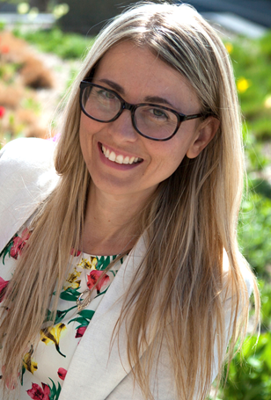
Jessica Simacek, PhD
Dr. Jessica Simacek serves as the Director of the TeleOutreach Center and Research Service Hub at the Institute on Community Integration in the Masonic Institute for the Developing Brain at the University of Minnesota.

Slide 2
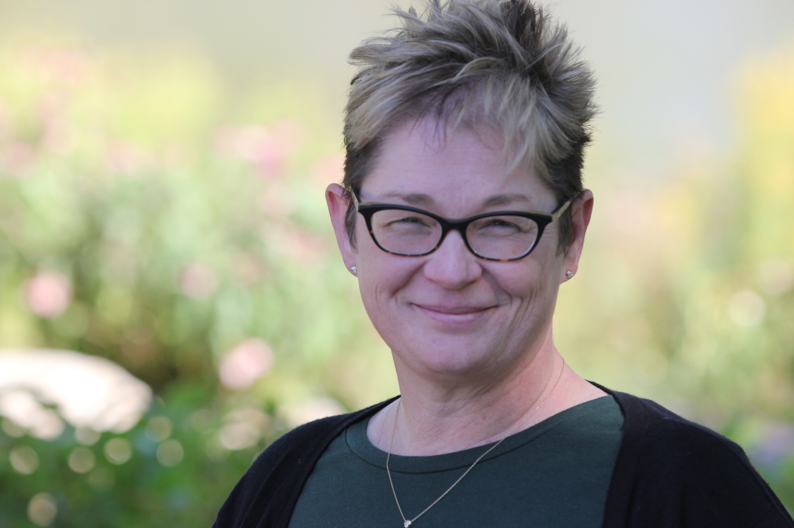
Rachel Freeman, PhD
Rachel Freeman is the Director of State Initiatives in the Institute on Community Integration at the Masonic Institute for the Developing Brain at the University of Minnesota. Dr. Freeman has been actively involved in positive behavior support (PBS), statewide research and technical assistance systems for evidence-based practices, evaluation design and implementation, and person-centered practices for over 25 years. She is an Associate Editor for the Journal of Child and Family Studies and serves as a Board of Director for Arc Minnesota and the Association for Positive Behavior Support.

Slide 3
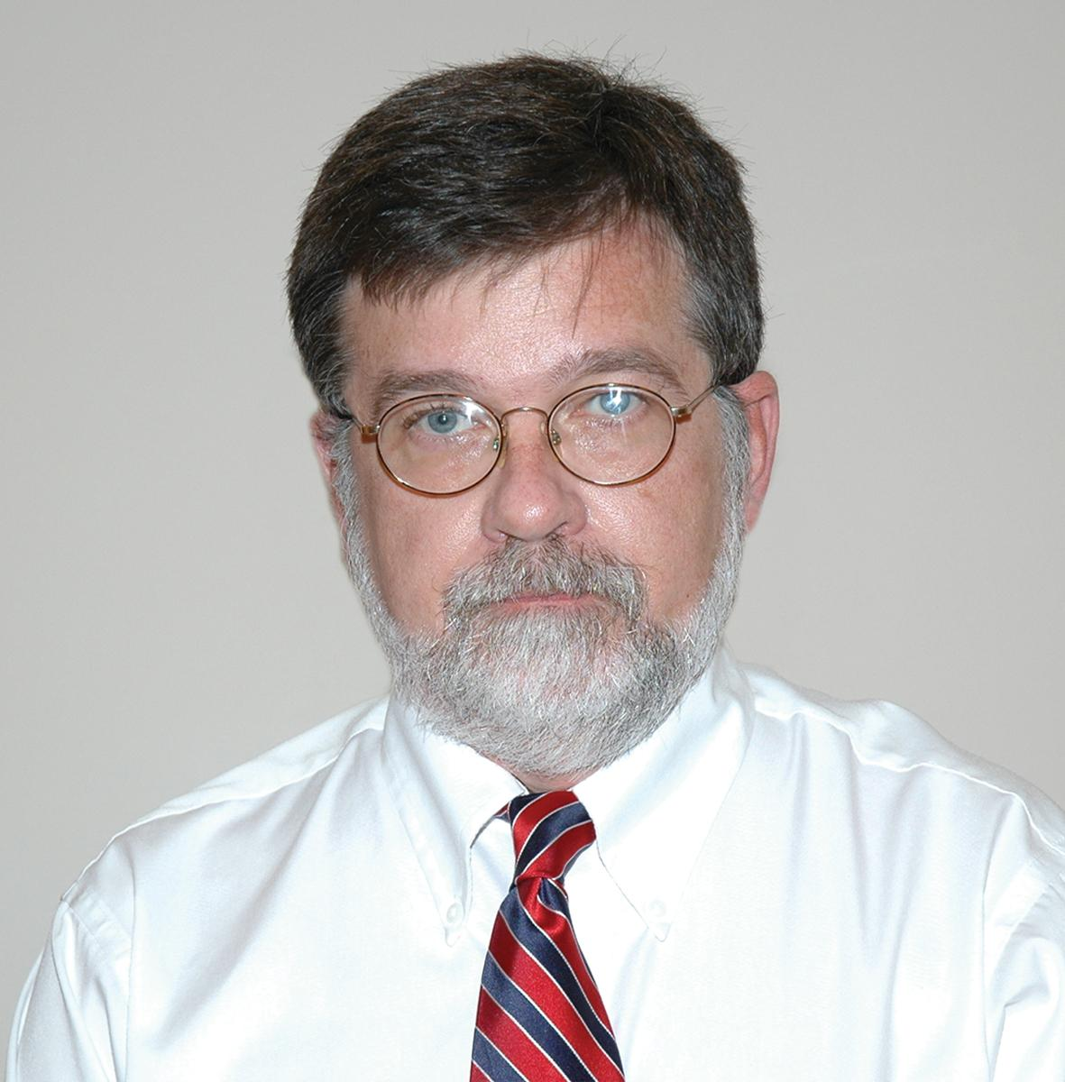
Joe Reichle, PhD
Joe Reichle, PhD, is Professor of Speech- Language- Hearing Sciences and former Director of the Leadership and Education in Neurodevelopmental Disabilities Training Program at the University of Minnesota. A Fellow of the American Speech- Language- Hearing Association, Dr. Reichle has expertise in positive behavior interventions & supports, augmentative communication, communication intervention for persons with significant developmental disabilities, and positive approaches to meet the needs of persons who engage in challenging behavior. He has published over 140 articles, chapters, and books, and served as an associate editor of the Journal of Speech, Language, and Hearing Research and Language, Speech, and Hearing Services in Schools. He has extensive experience delivering technical assistance to public schools and group homes.

Slide 4
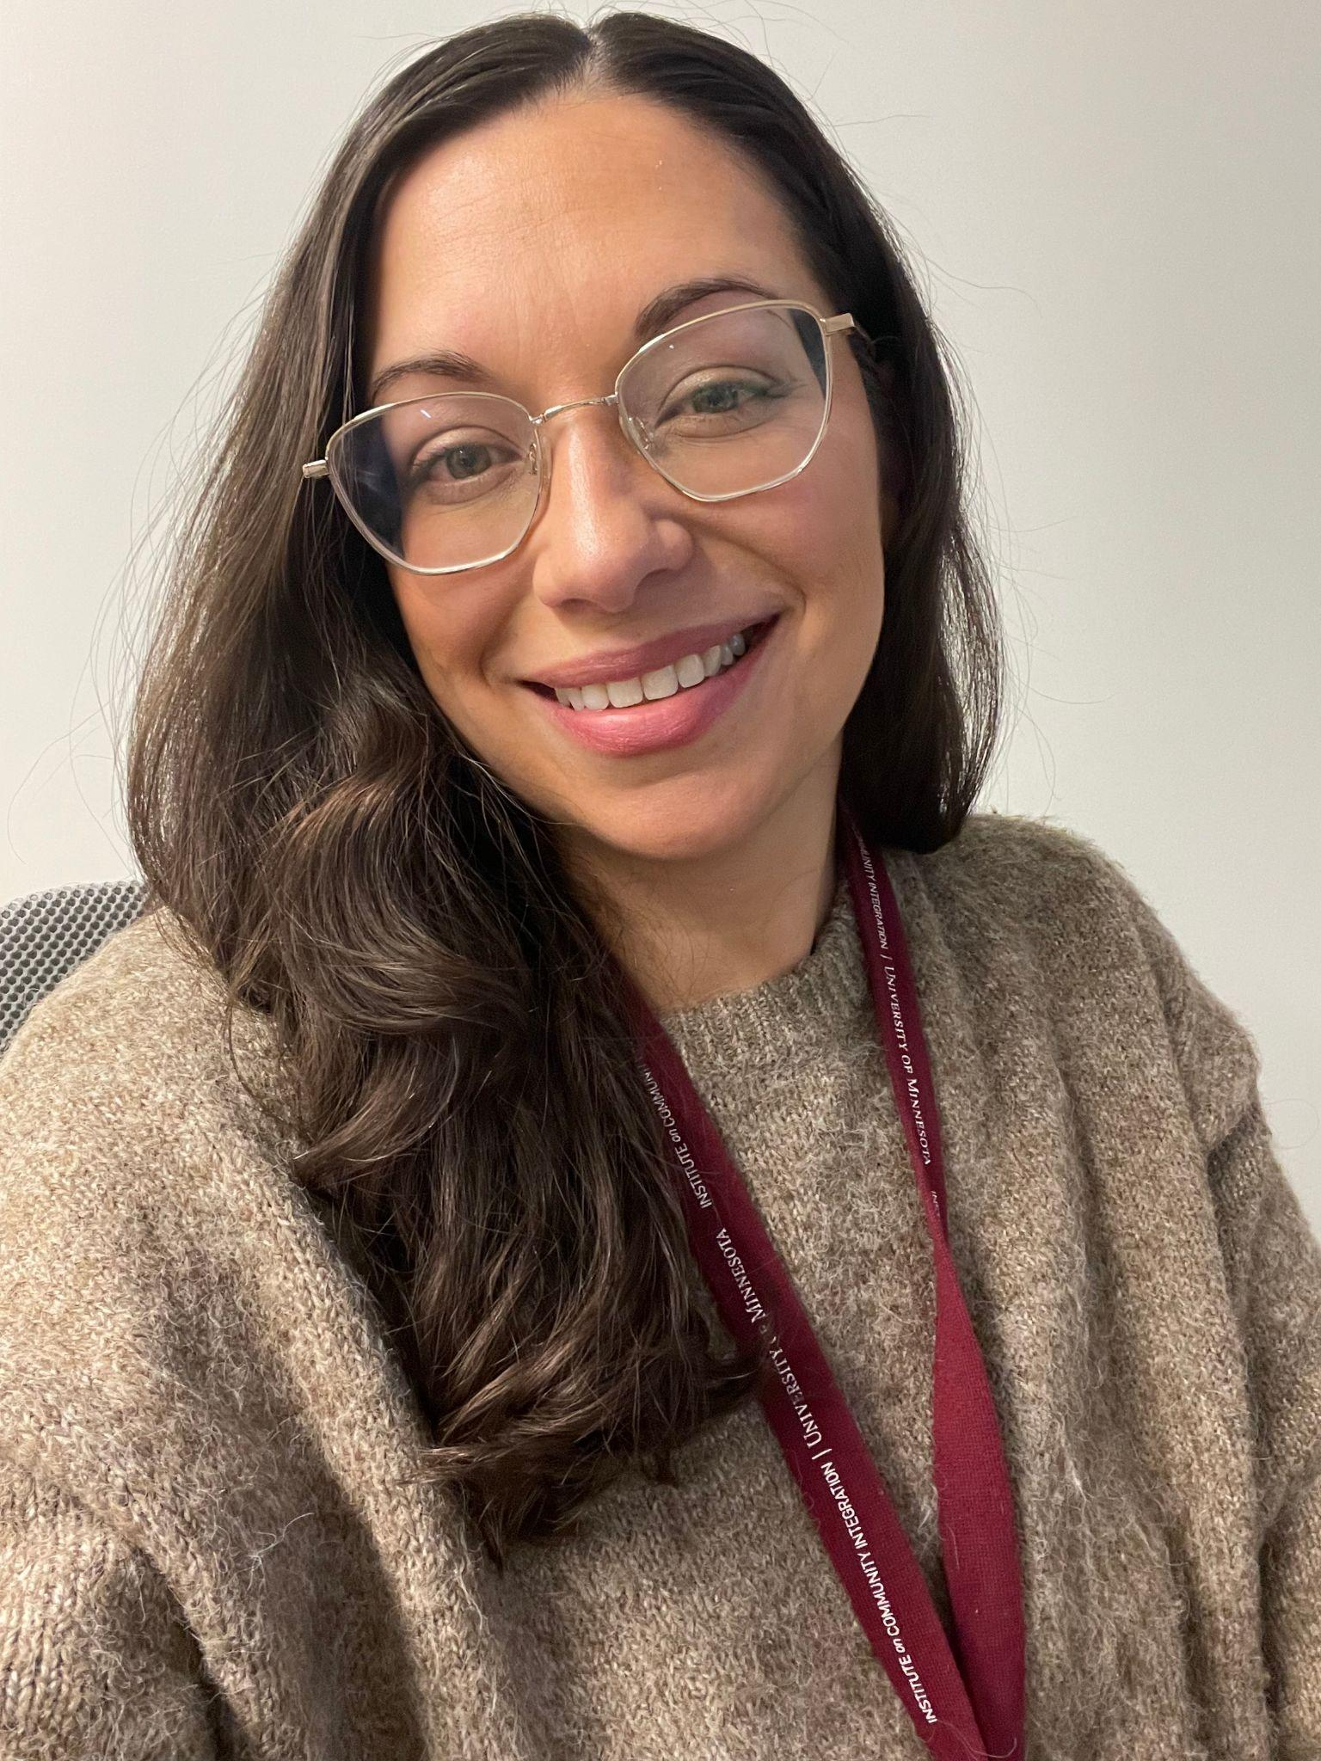
Adele Dimian, PhD
Adele Dimian, Ph.D. serves as a research associate in the Institute on Community Integration (ICI) and the associate director of the TeleOutreach Center, which uses video communication technology to provide support for young people with mental health and neurodevelopmental disabilities. In her dual roles, Dimian co-leads the Masonic Institute for the Developing Brain Tele Core and multiple telehealth research projects. She specializes in early intervention especially relating to self-injurious behavior among children with intellectual and developmental disabilities.

Slide 5
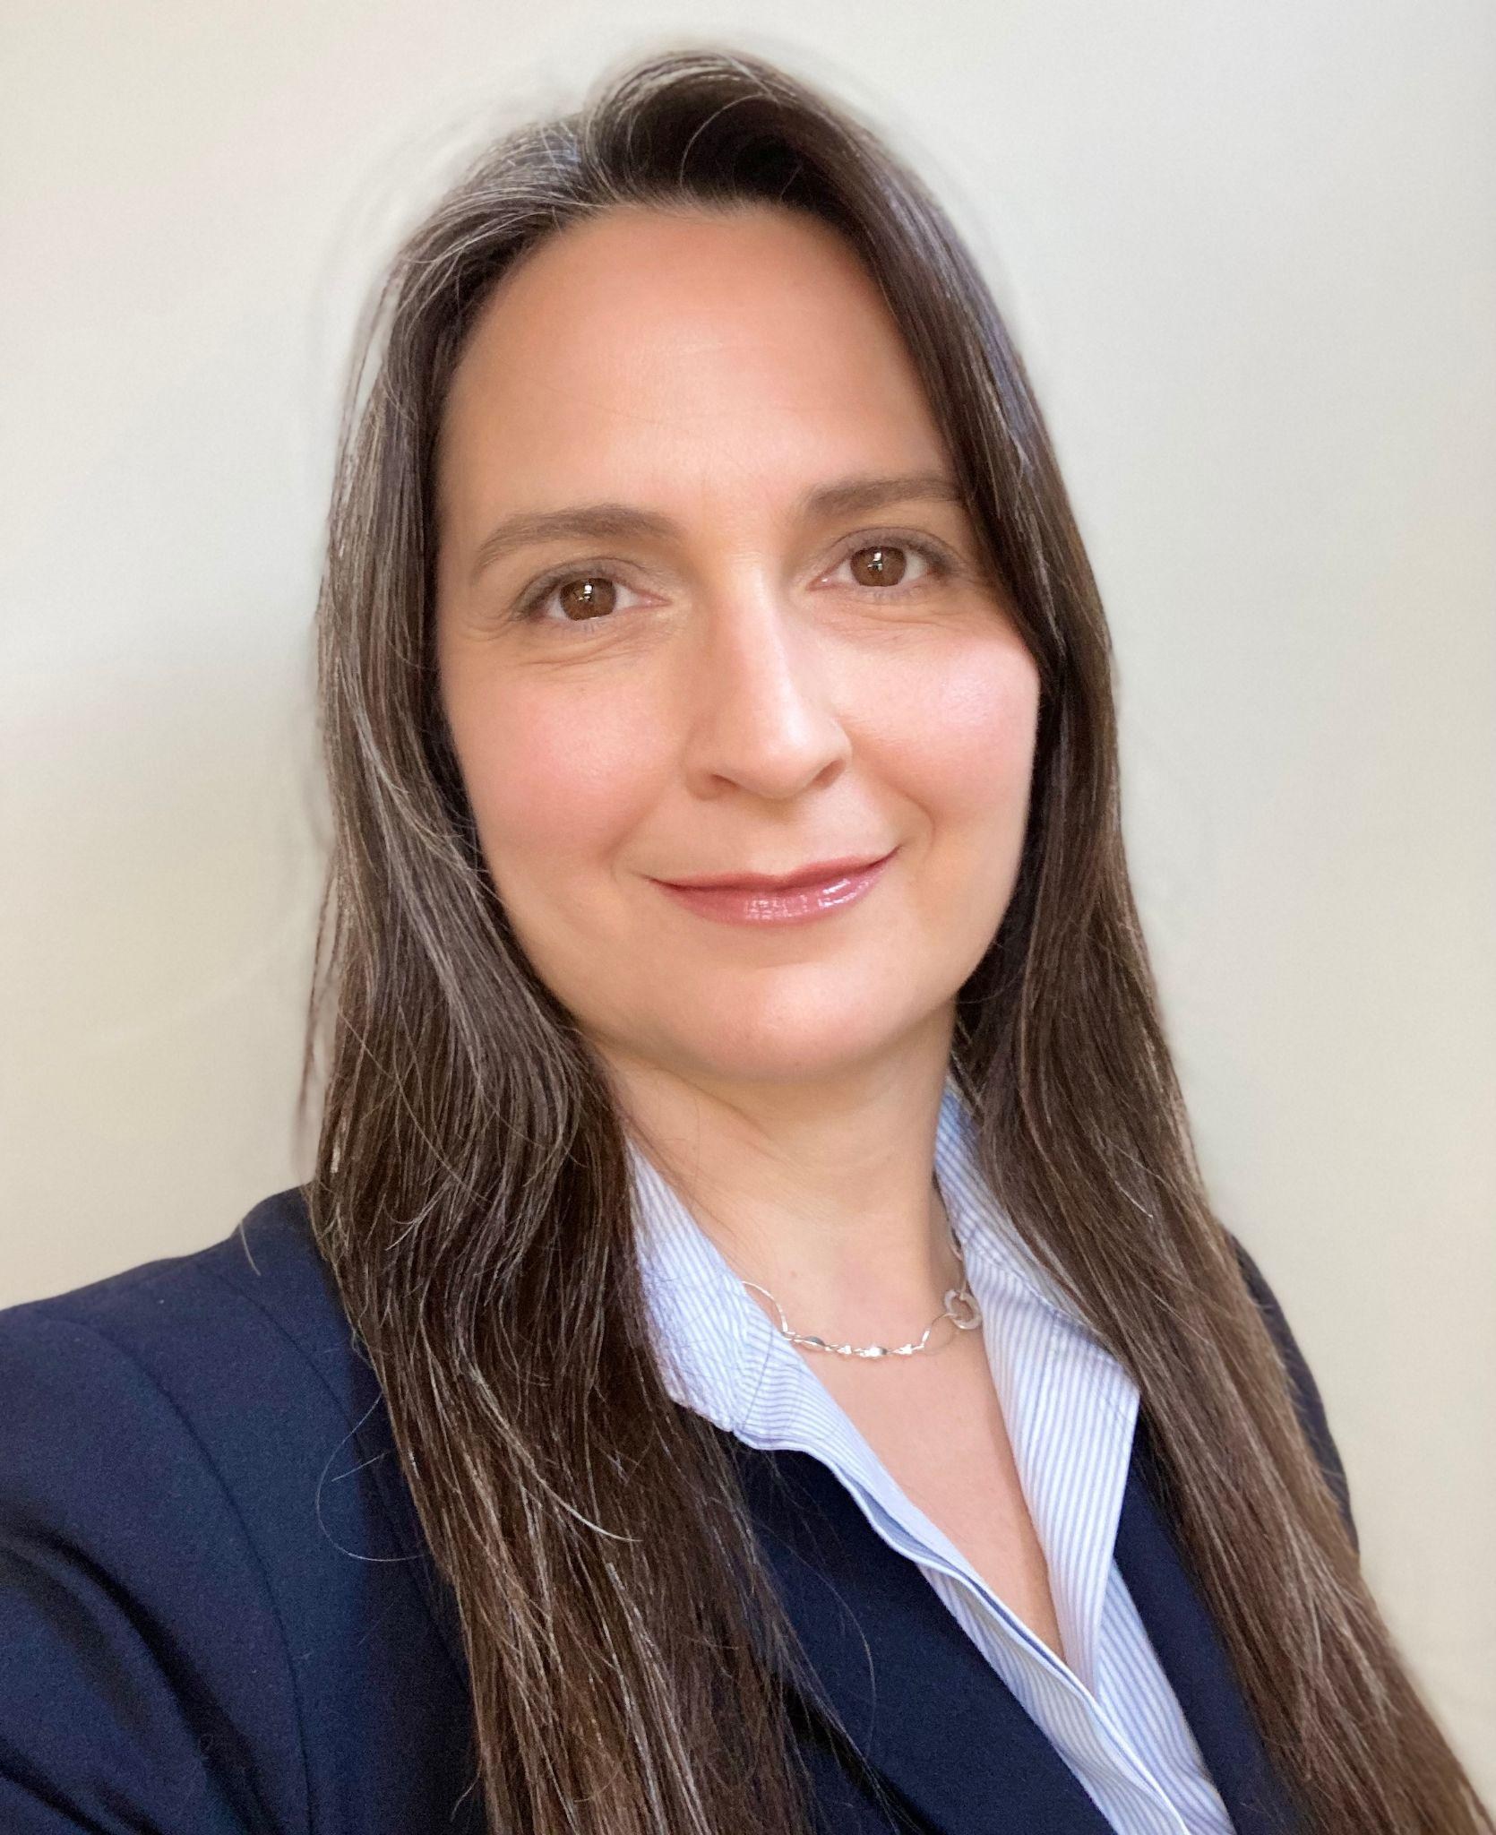
Jennifer Jeffrey- Pearsall, PhD
Jennifer Jeffrey-Pearsall, PhD is a contractor with the Institute on Community Integration (ICI) and the Director of the Positive Behavioral Interventions and Supports Training and Technical Assistance Center at Sheppard Pratt. She has over 20 years of experience supporting systems with organization-wide implementation of positive behavior support. Systems supported include comprehensive schools, approved private day-schools and residential treatment facilities in Pennsylvania and Georgia, juvenile justice facilities, and organizations supporting adults with intellectual and developmental disabilities in Maryland and Minnesota. She has served as a consultant to the Maryland Developmental Disabilities Administration, Maryland Department of Juvenile Justice, and Maryland and Pennsylvania Departments of Education.

Slide 6
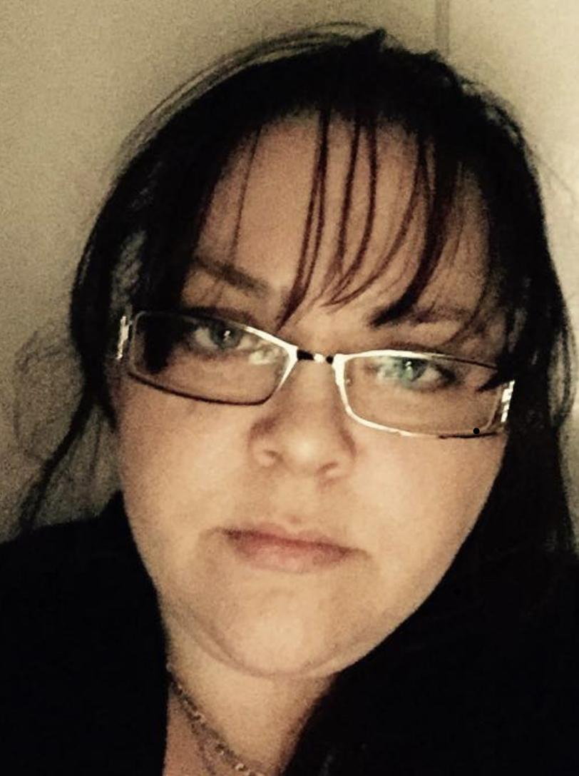
Dani Dunphy, MSW, LGSW
Dani Dunphy is a Consultant for the Institute on Community Integration at the University of Minnesota, an Adjunct Professor for the Department of Social Work at the University of Minnesota Duluth, a practicing Therapist for Behavioral Services Inc. in Duluth Minnesota, as well as a social worker with St. Louis County Public Health and Human Services.

Slide 7
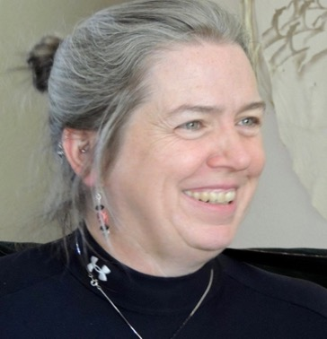
Margaret Moore, PhD
Dr. Margaret “Maggie” Moore, Ed.D., is a singer/songwriter, teacher, healer, consultant, and behavior support specialist. She is founder of the Center for Human Engagement, located in Huntington, WV. Her mission is to teach lifelong creativity and resilient growth to build social wellbeing for all. She has a doctorate in education, is an Endorsed Positive Behavior Support Professional and serves on the Endorsement Board of the West Virginia Association of Positive Behavior Support Network. Dr. Moore serves on the West Virginia Adverse Childhood Experiences (ACEs) Coalition, the West Virginia Association of Positive Behavior Support, and the Barboursville Rotary. She has taught positive behavior support, trauma-informed practices, music as stress reduction, and music as prayer as part of her work in West Virginia, Colorado, and Canada.

Slide 8
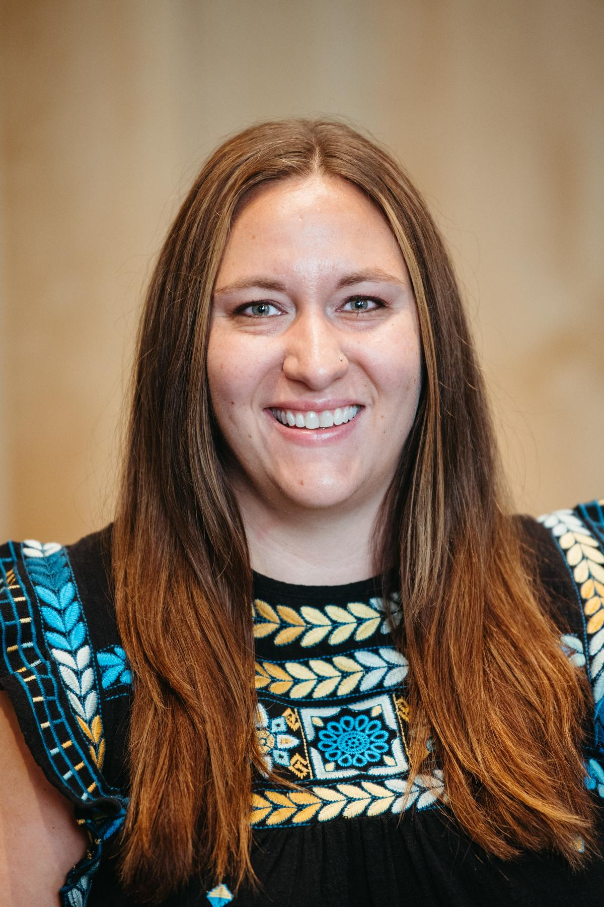
Tanya Misgen, M.Ed.
Tanya Misgen, M. Ed., is an education specialist at the Institute on Community Integration at the Masonic Institute for the Developing Brain at the University of Minnesota. She is a special education teacher, licensed in the areas of specific learning disabilities and Autism Spectrum Disorder. She has 13 years of experience in the field of education working in various positions including paraprofessional, classroom teacher, and case manager. During her time in schools, she implemented research based interventions, data- based decision making, and PBIS. She is currently serving as a consultant for the IDD Committee with the Association for Positive Behavior Support.

