Slide 1
The Learning Log for Coaches Training
Presented by: Bobbi Hoppman
Tom Wildes

Slide 2
Some ways to use a Learning Log
The learning log is a skill masquerading as a form.
It is a way to journal learning as it happens
A learning-focused, structured progress note
To focus on a specific topic area
A way to record learning towards an identified goal
Pinpoint/Intense discovery for a short time period
Notes:
TIME FOR SLIDES 29-42 60 minutes
Content Trainer:
We’re ready to look at another new skill.
This skill falls in the category of Everyday Learning Skills and is called the Learning Log.

Slide 3
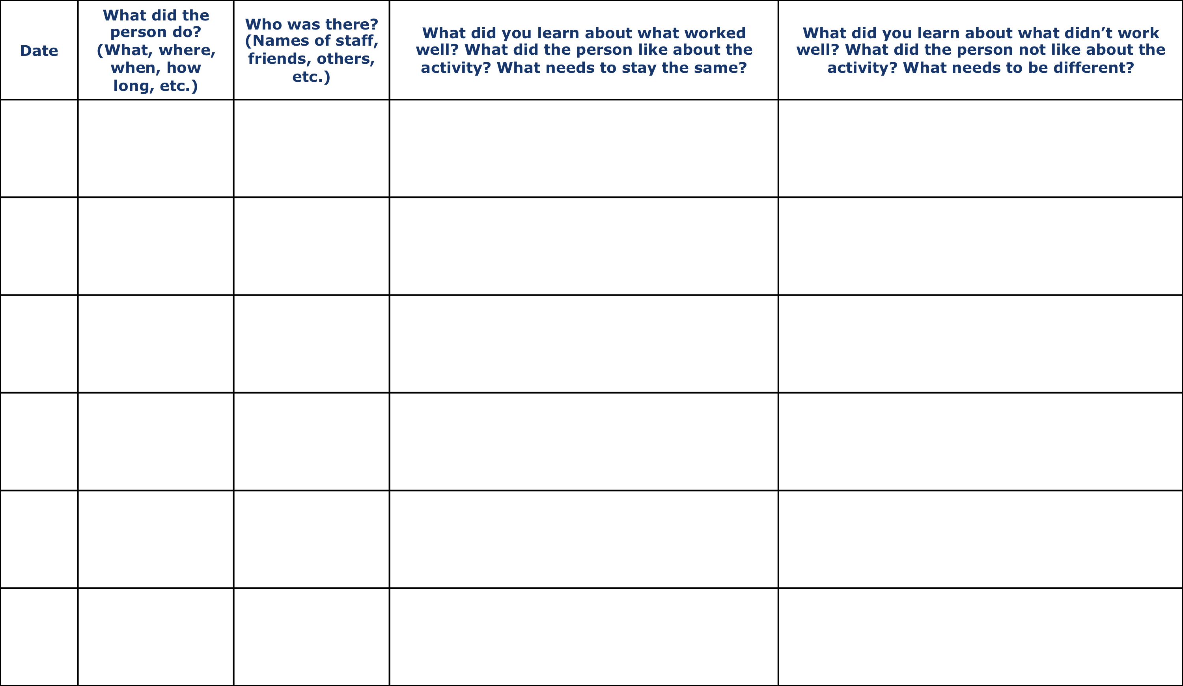
Learning Log
Workbook Pg # 43
©TLCPCP 2020 Remote www.tlcpcp.com
Notes:
Content Trainer:
The learning log is a skill masquerading as a form.
It is a way to journal learning as it happens.
Review the columns and the contents. Hold down the <control> button on your keyboard while you left-click your mouse to that your cursor is temporarily converted to a laser pointer.
Point out that learning logs can be used to replace or enhance progress notes (or whatever your audience calls them).
Progress notes tend to be one of 2 kinds:
The minimalist type that could be done with a rubber stamp – “went for coffee, enjoyed himself, slept through the night.”
The novelist – “As I took Charlie out the door, the wind stirred the leaves…
Neither do a good job of recording learning – one is too short with too little content, the other is too long with any learning being buried in the narrative.
Tell Sally’s story at the State Fair.
At the end of the story ask if having the information in the LL would have changed their willingness to take Sally to the fair next year.

Slide 4
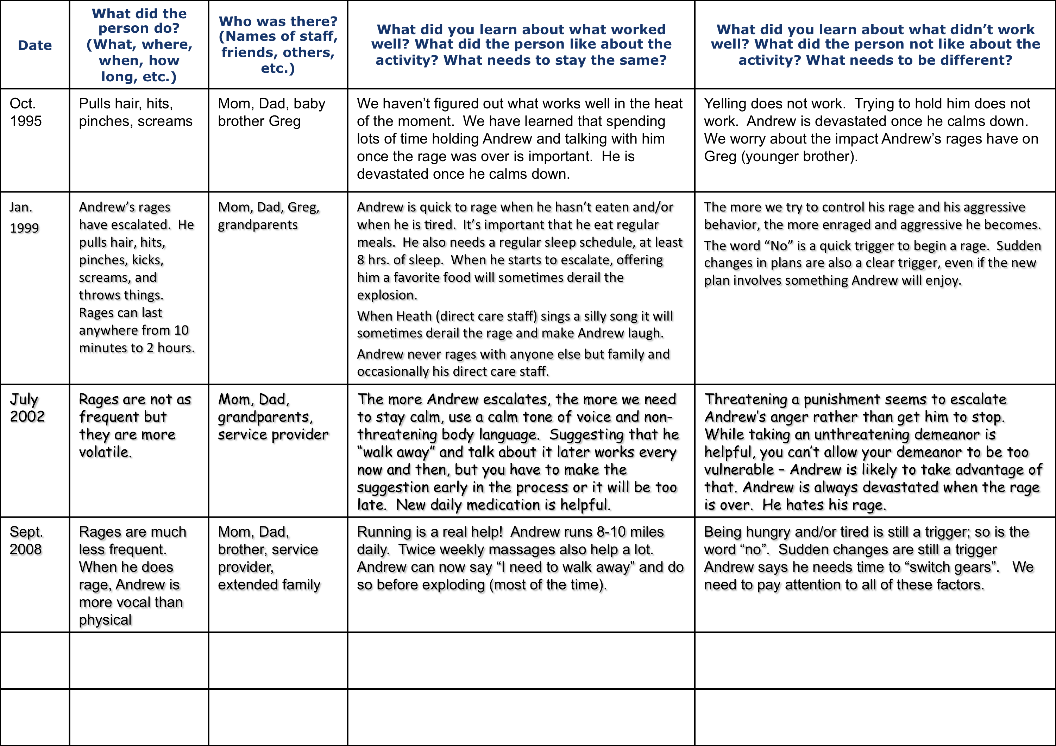
Learning Log for Andrew (page 1)
Example Pg # 21
Using the learning log to show a family’s learning over time
©TLCPCP 2020 Remote www.tlcpcp.com
Notes:
Content Trainer:
Review Andrew’s LL briefly (2 pages)
Discuss with the group these questions (Use Chat or open mic to debrief):
What have you learned?
How does this help you support this family today?
What would you do for Andrew?
What supports do you think this family would appreciate?
What does this save you from doing/trying?
How could this help you in your work?
Point out these things:
Developing trust – this usually takes time!
Respecting family as experts
How does this help you support an individual/family today?

Slide 5
Learning Log for David
Date | What tool or skill did you use? (what, where, when, how long, etc.) | Who was there? (roles not names) | What did you learn about what worked well? What did you like about the process of using the skill or tool? Would you do it again? | What did you learn about what didn’t work well? What did you not like about the process of using the skill or tool? What needs to be different the next time? | What did you learn that might be used in training or might be a good example during delivery of PCT training?
ongoing | 4+1 | Dave, Mom, Dad | It was helpful to see on paper what we had tried before and what we liked and didn’t like. It was helpful during brainstorming sessions to keep adding on to the areas that were working and just continue to adapt them as time goes on. | It took some time for David to understand the process until we were two or three trials in. I would spend more time explaining or possibly showing more examples. | Using the tool with my son was helpful to personalize it a little more, allowing me to understand what family members may be going through when the tools are used.
3/14/15 | One page profile | Dave, Dad | It was such an easy tool to explain to David, we discussed each area of the profile and then together we brainstormed a few items in each area. I then just gave David some time to create the profile on his own. He stated he thought it was great to see everything about him in one place. David also stated that he would like to use this at school in his English class. He felt it would be important for everyone to see that everyone is different but may have things in common. | When we began the exercise, it was difficult for David to think of positive things about himself, we made some phone calls to other family members and asked what they liked and admired about him. Continuing to learn ways of gathering this information will be helpful. | This is a process that takes more than an hour or so, it takes time to get information. As people and their environments change so should their profiles. We discuss how this would be beneficial for individuals who we support, but if we do not continually update and revisit the profile, it would quickly become another outdated form.

Slide 6
At our last meeting you were asked to try a new recipe.
Please take this time to complete a learning log for the item you tried.

Slide 7
Discussion time with your partner
This Photo by Unknown Author is licensed under CC BY

Slide 8
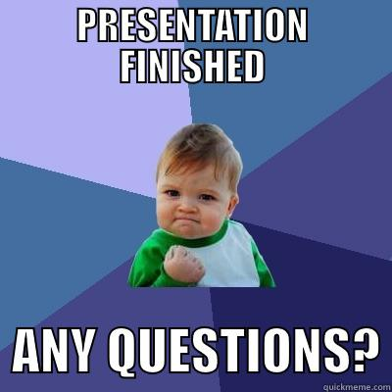
Questions and Discussion

Slide 9
This Photo by Unknown Author is licensed under CC BY-NC-ND

