Slide 1
Positive Behavior Support – Day 3
긍정적 행동 지원
Rachel Freeman and Seunghee Lee
Institute on Community Integration
University of Minnesota
Notes:
(handouts: good day, bad day; communication chart, ppt, All trainings handout)

Slide 2
함께 하는 4일 훈련
_Four Days of Training Together
Day 1 사람중심이 되기 위한 보편적인 전략
_Universal strategies for being person centered
Day 2 사람중심실천 확대
_Increasing person-centered practices
Day 3 긍정적 행동지원 및 사람 중심주의
_Positive behavior support and person-centeredness
Day 4 발전을 위한 팀 접근 방식 만들기
_Creating a team approach for moving forward

Slide 3
주제_Agenda
9:00 - 10:30 Review and Focus of Today
Introduction to Positive Behavior Support
10:30 - 10:45 휴식_Break
10:45 – 12:00 Key Elements of Tier 1 PBS Continued
12: 00- 1:00 점심_Lunch
1:00 – 2:30 Using Data for Decision Making
2:30 – 2:45 휴식_Break
2:45 – 3:30 Brief Description of Tier 2 and 3
3:30 – 4:00 마무리_Wrap up

Slide 4
Getting Started
시작하기
Form an organization-wide team that represents all stakeholders
조직 전체를 대상으로 모든 이해 관계자를 대표할 수 있는 팀을 형성한다.
Assess readiness and buy in
준비성과 받아드릴 준비가 되어 있는지 평가한다.
Complete a self-assessment
자기평가를 수행한다.
Create an action plan
행동계획을 설계한다.
Use data for decision making
데이터를 의사결정에 이용한다.

Slide 5

Team Planning Model
팀 구성 모델
Political Support & Policy
정치적 지원 및 정책
Interagency & Natural Supports
관계 부처 간 지원 및 자연적 지원
Funding
자금
Visibility
가시성
Leadership Team
리더십 팀
Active Coordination
능동적 조직화
PCP, PBS (다른 PS) Expertise
전문성
Training
교육
Mentoring
멘토링
Evaluation
평가
Start Small and Build on Success
작게 시작해서 성공을 바탕으로 확대한다
Notes:
5

Slide 6
Part of Systems is a Strong Team Action Plan!
PBS and Organizations
OUTCOMES
Supporting
Staff Behavior
SYSTEMS
DATA
Supporting
Decision
Making
PRACTICES
Systems That Promote Success
Teaming
Training
Coaching/performance feedback
Evaluating fidelity
Evaluating outcomes
Supporting
All People
Notes:
Workforce, implementation science. Review outcomes, data, practices, and talk a bit more about the systems features that the training and technical assistance (through this partnership with DDA) will focus on – to promote long term success (sustainable high fidelity implementation).

Slide 7
Organization-wide Annual Action Plan (Provider Agency Examples)
조직 전체 연례 행동 계획 (제공자 기관 예)
Date: May 10, 2016
날짜: 2016년 5월 10일
Team Members: Alice, Amy, Jane, Steve, Bella, Joe
팀 구성원: 앨리스, 에이미, 제인, 스티브, 벨라, 조
For the People We Support 우리가 지원하는 사람들을 위해
Person-Centered Practices 사람 중심 실천 | Who 누가 | By When 언제까지 | Status Update 현황 업데이트
Learn about each individual by using person-centered thinking tools 사람 중심 사고 도구를 이용해 각 개인에 대해 안다 | Coach 코치 | 10/1/16
2. With each person, create a one-page profile 한 장짜리 프로필을 각 개인과 만든다 | Coach 코치 | 10/1/16
3. Create one meaningful personal connection based on gifts, talents and interests 장점, 재능, 그리고 관심사를 바탕으로 하나의 개인적인 연결고리를 만든다 | Coach, person & circle of support 코치, 개인과 돕는 주변 사람들 | 3/1/17 | In progress Sept 2016 2016년 9월 진행중
4. Have all staff attend PCT training 전 직원이 PCT 교육을 받게 한다 | Brandon 브렌던
Positive Behavior Support 긍정적 행동 지원 | Who 누가 | By When 언제까지 | Status Update 현황 업데이트
Confirm pilot area for consensus building 의견합의를 위해 실험할 부분 확인한다 | Steve 스티브 | October, 2016 2016년 10월 | Completed 완료
Schedule meeting time for review of policies across organization 기관 전반에 걸친 정책 확인을 위해 회의 시간을 정한다 | Jane/Team 제인/팀 | Sept, 2016 2016년 9월 | Completed 완료
Dedicate 15 minutes in staff meetings to share PBS updates. PBS 업데이트를 위해 직원 회의 때 15분을 할애한다. | Coaches/Leaders 코치/리더들 | August 15, 2016 2016년 8월 15일 | In Progress 진행중
Organization-wide 전 조직 | Who 누가 | By When 언제까지 | Status Update 현황 업데이트
Tenure and retention data are gathered with attention to pilot areas for self-assessment 자기 평가를 위해 실험 중인 부분에 중점을 두고 재직 및 유지 데이터를 모은다 | Alice and Andy 앨리스와 앤디 | July 31, 2016 2016년 7월 31일 | Not Yet Started 시작 안함
2. Team gathers information about different cultures represented for both people supported and staff members 지원받는 사람과 직원 모두에게서 나타나는 문화적 다양성에 대한 정보를 팀이 모은다 | Brandon, Kayla & Nicole 브랜던, 케일라, 니콜 | July 31, 2016 2016년 7월 31일 | Not Yet Started 시작 안함
Information about different cultures are integrated within staff development 문화적 다양성에 대한 정보를 직원 개발에 통합한다 | Steve 스티브 | October, 2016 2016년 10월 | Completed 완료

Slide 8
Historical Definition of Positive Behavior Support
Positive Behavior Support is the Integration of:
  Valued Outcomes
  Behavioral and Biomedical Science
  Validated Procedures
  Systems Change
In Order to Enhance Quality of Life and Prevent Problem Behavior
Carr, Dunlap, Horner, Koegel, Turnbull, Sailor, & Fox, 2002
http://apbs.org/new_apbs/files/PBSevolutions.pdf

Slide 9
Positive Behavior Support
긍정적 행동 지원
Implementing Organization-Wide Planning
조직 전체 계획 실행
Tertiary Stage 3차적 단계
Individualized PBS Plans
Integrated with Other Positive Supports (PCP, Trauma-Informed Care, DBT, Etc.)
Plans Are Monitored- Data-Based Decision Making
Teams Monitor Progress of Each Person
개별화된 PBS 계획
다른 긍정적 지원과 통합 (PCP 트라우마 인폼드 치료, DBT, 기타 등등)
계획을 모니터링한다- 데이터에 중점을 둔 의사 결정
각 개인의 발전상황을 팀이 모니터링한다.
Positive Behavior Support
소수
긍저적 행동 지원
Person Centered Practices & Planning
Person-Centered Practices & Planning
사람 중심 실천 및 계획
Organizational Workforce Development
Organizational Workforce
몇몇
조직적 인력
Secondary Stage 2차적 단계
Early Intervention and Data Monitoring
Additional Supports for Key Social Skills
Function-Based Decisions
Simple Interventions
Mental Health and Wellness Interventions
조기개입과 데이터 모니터링
핵심 사회성 기술을 위한 추가적 지원
기능 기반 의사결정
간단한 개입
정신건강 개입
Universal Stage 보편적 단계
Teach and Encourage Communication
Predictable and Proactive Settings
Encourage and Reinforce Social Skills
Consensus-Based Team Focus
Emphasis on Using Data For Decisions
소통을 교육 및 권장
예측가능하고 주도적인 환경
사회성 기술을 격려 및 강화
합의 기반으로 한 팀의 주안점
의사 결정을 위해 데이터 사용을 강조
모두

Slide 10
Positive Behavior Support Provides a Framework for Prevention
긍정적 행동 지원은 예방을 위한 체제를 제공
Most PBS efforts only respond when Tertiary
supports are needed
대부분 PBS에 대한 노력은 3차적 지원이 필요할 때만 대응한다
소수
몇몇
Intensive, individual interventions
Individuals with intense needs
Assessment-based
High intensity
Appropriate for professionals across agencies and systems
집중된 개별적 개입
강도 높은 요구사항이 있는 개인
평가 기반
고강도
조직 및 시스템 전반에 걸친 전문가들에게 적합
모두

Slide 11
Moving Away From Traditional
Behavior Management
전통적 행동 관리로부터 벗어나기
Traditionally Problem Behavior Has Been Viewed As:
  a Function of a Person’s Disability
  Existing Solely Within the Person Who Engages in the Problem Behavior
  Maladaptive (i.e., Non-Functional, Meaningless)
  전통적으로 문제 행동을 다음과 같이 바라보았다:
  - 한 사람의 장애로 인한 기능
  - 부적응 (다시 말해 비기능적, 의미없는)
The Goal of Intervention has been to Eliminate the Behavior by Suppressing It
개입의 목적은 행동을 억제시킴으로써 행동을 없애는 것이었다

Slide 12
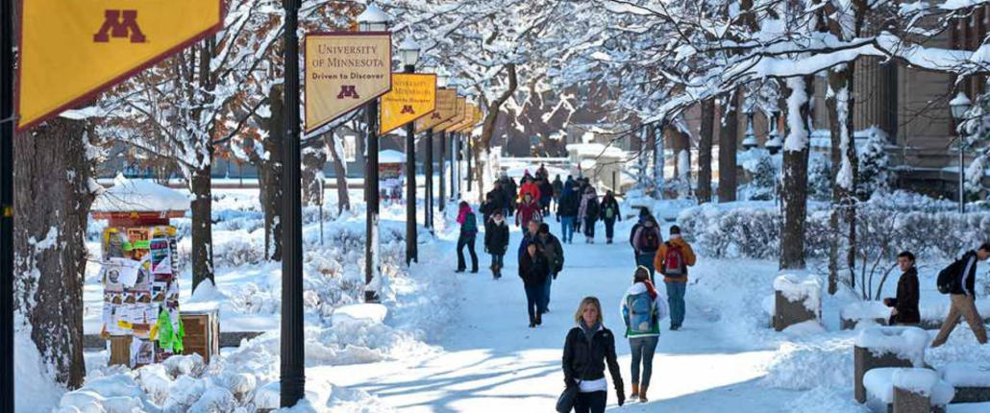
Valued Experiences
가치있는 경험들
Personal relationships
Sharing places & activities
Making choices
Being treated with respect
Having valued social roles
개인적인 관계들
공간과 활동을 공유하는 것
선택을 하는 것
존중받는 것
가치있는 사회적 역할이 있는 것
John and Connie O’Brien 1989
존과 코니 오브리엔 1989
Notes:
Relationships: KEEPING good ones and DEVELPING new ones
Sharing ORDINARY places, activities
Contributing to OTHERS, and SOCIETY
Being treated with respect & having roles…being KNOWN

Slide 13

Focus On Prevention
예방에 집중
“It’s a whole shift in paradigm of fighting fires to building capacity within the organizations--whether it is a contracted service provider or residential or day treatment program....I see our role as...helping people build capacity...”
“불을 꺼가며 조직내에 수용력을 증가시키는것은 인식 체계의 대전환이다. 계약된 서비스 제공자이던 상주 치료 프로그램이던 아니던…우리의 역할은 사라들이 수용력을 키울 수 있게 도와주는 것…”
www.pbskansas.org/files/missouri_interagency_pbs_team_newsletter_part1.pdf

Slide 14
“Face it, we are the human race and
we do not like being told what to do….”
World’s End Movie
“받아들여. 인류는 시키는 걸 싫어해….”
-더 월드스 엔드 영화
“Almost everybody I work with has ‘behavior’, including staff, that is problematic to them on a daily basis. I mean we need to not think of it as [problem behavior]”
--Person Supporting People With Traumatic Brain Injury in Kansas
“나와 일하는 직원을 포함한 거의 모든 사람들은 매일 그들에게 문제가 되는 ‘행동’을 가지고 있다. 그러니까, 우리는 그것을 [문제 행동]으로 생각하지 말아야 한다.”
--캔사스에서 외상성 뇌손상이 있는 사람들을 지원하는 사람

Slide 15
Positive Behavior Support Provides a Framework for Prevention
긍정적 행동 지원은 예방을 위한 체제를 제공
Focus First on Universal Positive Behavior Support
보편적인 긍정적 행동 지원에 우선 집중
Teach and Practice New Social Skills
Reinforce, Recognize, & Celebrate Success
Respond in a Consistent Manner to Problems
Monitor and Intervene Before Serious Problems
새로운 사회성 기술을 가르치고 연습시킨다
성공을 장려하고, 알아주고, 축하해 준다
문제들에 있어 일관되게 대처한다
심각한 문제가 되기 전에 모니터링하고 개입한다
소수
몇몇
모두

Slide 16
Universal Strategies
Person Centered Thinking Strategies
Social Skills Curriculum
Health and Wellness Strategies
Efforts to Build Inclusion
Strategies for Increasing Positive Relationships
Cultural Responsiveness
Community Mapping & Building Natural Supports

Slide 17
Impact on Workforce: From the State of Missouri
After Implementing Coaching Model for The Tools of Choice (Universal Strategy)…Staff Turnover Rates Decreased:
2013 – 167%
2014 – 70%
2015 – 65%
2016 – year to date – 40%

Slide 18
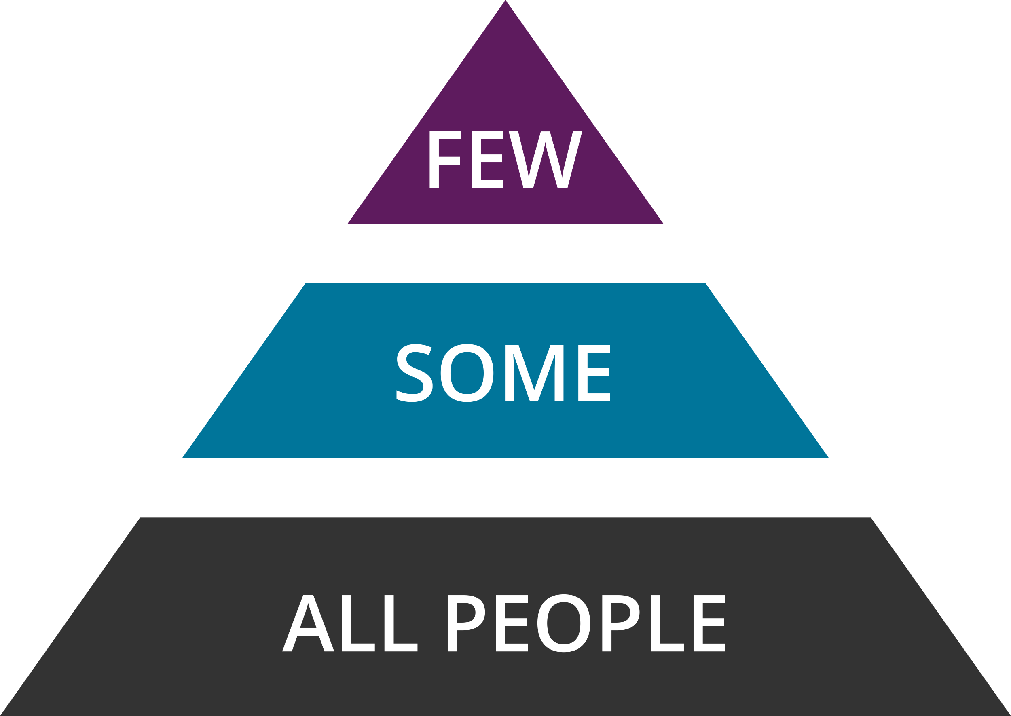
모든 사람에게 보편적인 전략 우선 집중
_Focus First on Universal Strategies for Everyone
왜 보편적인 노력이 먼저인가?
_Why Universal Efforts First?
모두의 삶의 질 향상
_Improve quality of life for everyone
문제가 발생하지 않도록 방지
_Prevent problems from occurring
긍정적이고 안전하며 쾌적한 환경 조성
_Create a positive, safe, and pleasant setting
보다 집중적인 계획의 필요성 감소
_Decrease the need for more intensive planning
절약된 시간을 사용하여 보다 집중적인 지원이 필요한 사람들을 지원하는데 시간을 할애하세요
_Use time saved to spend time supporting people
who need more intensive support)

Slide 19
Positive Behavior Support Provides a Framework for Prevention
긍정적 행동 지원은 예방을 위한 체제를 제공
Focus First on Universal Positive Behavior Support
보편적인 긍정적 행동 지원에 우선 집중
Teach and Practice New Social Skills
Reinforce, Recognize, & Celebrate Success
Respond in a Consistent Manner to Problems
Monitor and Intervene Before Serious Problems
새로운 사회성 기술을 가르치고 연습시킨다
성공을 장려하고, 알아주고, 축하해 준다
문제들에 있어 일관되게 대처한다
심각한 문제가 되기 전에 모니터링하고 개입한다
소수
몇몇
모두

Slide 20
Universal PBS Means Building a Positive Social Experience
보편적 PBS는 긍정적 사회적 경험을 구축함을 의미
Everyone Works Together to:
List Key Person-Centered Values
Identify the Social Behaviors That Reflect These Values
Create a Plan for Increasing Social Interactions
Support and Recognize Each Other, Help Encourage and Prompt
Celebrate Success
모두가 협력하여:
핵심 사람 중심 가치 명단을 만든다.
이 가치를 반영하는 사회적 행동을 식별한다.
사회적 교류를 증가시키기 위한 계획을 만든다.
서로를 돕고 서로에게 감사하고 권장하고 유도한다.
성공을 축하한다.

Slide 21
Matrix Completed in
A Residential Setting with Two Women
Matrix Completed by
Two Women Living Together
함께사는 두 여성이 완성한 매트릭스

Slide 22

The Roommates Created a Unique Way to Celebrate Progress
Each time one of the women observed a positive social behavior that was part of the matrix, they wrote a note down on a strip of paper and connected it to by creating a paper chain….they celebrated when the chain reached across the living room

Slide 23
Create a Training Plan
교육 계획 생성
Practice Teaching Skills in the Matrix
Identify Person-Centered Behavior
Choose Setting Where Behavior is Encouraged
Assess What Each Person Needs to Learn and Practice Skill
  Show Examples and Nonexamples
  Create a Task Analysis (If Needed)
Schedule Opportunities to Practice Social Interactions
Create a Plan to Reinforce, Recognize and Support
매트릭스에서 가르치는 방법을 연습
사람 중심 행동을 식별한다
그 행동이 권장되는 상황을 선택한다
각 개인이 배워야 하는것이 무엇인지 가늠하고 기술을 연습한다
예와 예가 아닌 것을 보여준다
필요할 시, 작업 분석을한다
4. 사회적 교류를 할 수 있는 기회를 만든다
5. 장려하고, 감사하고, 그리고 지원할 계획을 세운다

Slide 24

Create a Plan to Teach the Values in Each Setting
 | Times of Day | Free Time | Dinner | Lunch Time | Fundraising | During Outside Activities
Values | Respecting Each Other | Respect another's privacy, Understanding differences | Offer to help each other, talk to each other kindly if something isn't working | Push in/pull out chairs for others, Ask if help is needed | Everybody can do something, break bigger jobs into smaller parts | Respect each other's preferences, follow the rules, watch out for each other
 | Having a Positive Attitude | Be aware of your environment, Be aware of how other's are feeling | Respect people's differing abilities, Get involved | Talk to people that you may not otherwise talk to | Help out where you can, participate in Clubhouse meetings and offer suggestions | Appreciate the moment and activity, say thank you to those who plan activities
 | Working Together | If there is nothing to do, get together and decide to do something, Clean up after yourself | Offer to help each other with the bigger tasks | Clean up after yourself, allow people time to finish eating before cleaning up/try not to rush people | Develop committees to break down the bigger jobs | Be friendly, clean up after yourself, be neat
 | Positive Communication | Respect boundaries, have compassion, use humor respectfully | Ask for help if you need it, offer help if you see someone needs it | Use manners (please and thank you), thank the people who cook and serve you | Plan more fundraisers, talk about how to plan them at Clubhouse meetings | Be polite to the public and each other
 | Volunteering | Welcoming new members, help others to particiapte more | Try out different tasks, try not to always do the same things | Pay attention to what chore/cleaning needs to be done | Volunteer for what you can, attend Clubhouse meetings to learn of and present opportunities | Help other people stay on time and with the group
 | Support for Each Other | Offer to help, share computer time, only share things with others that you are comfortable sharing | Take turns doing tasks, develop teams for getting bigger cleaning projects done | Help out where you can - 2 people can do a job faster than 1 | If someone or a committee needs help, offer assistance | Be friendly, get involved in planning activities

Slide 25
Teaching Lessons & Growing Skills
Create a simple plan to teach roommates how to offer to help others
Write down what you are teaching
  Offer to help
  Work together
Pick the routine from the matrix
Prepare to teach
  What is needed?
  Use examples and nonexamples

Slide 26
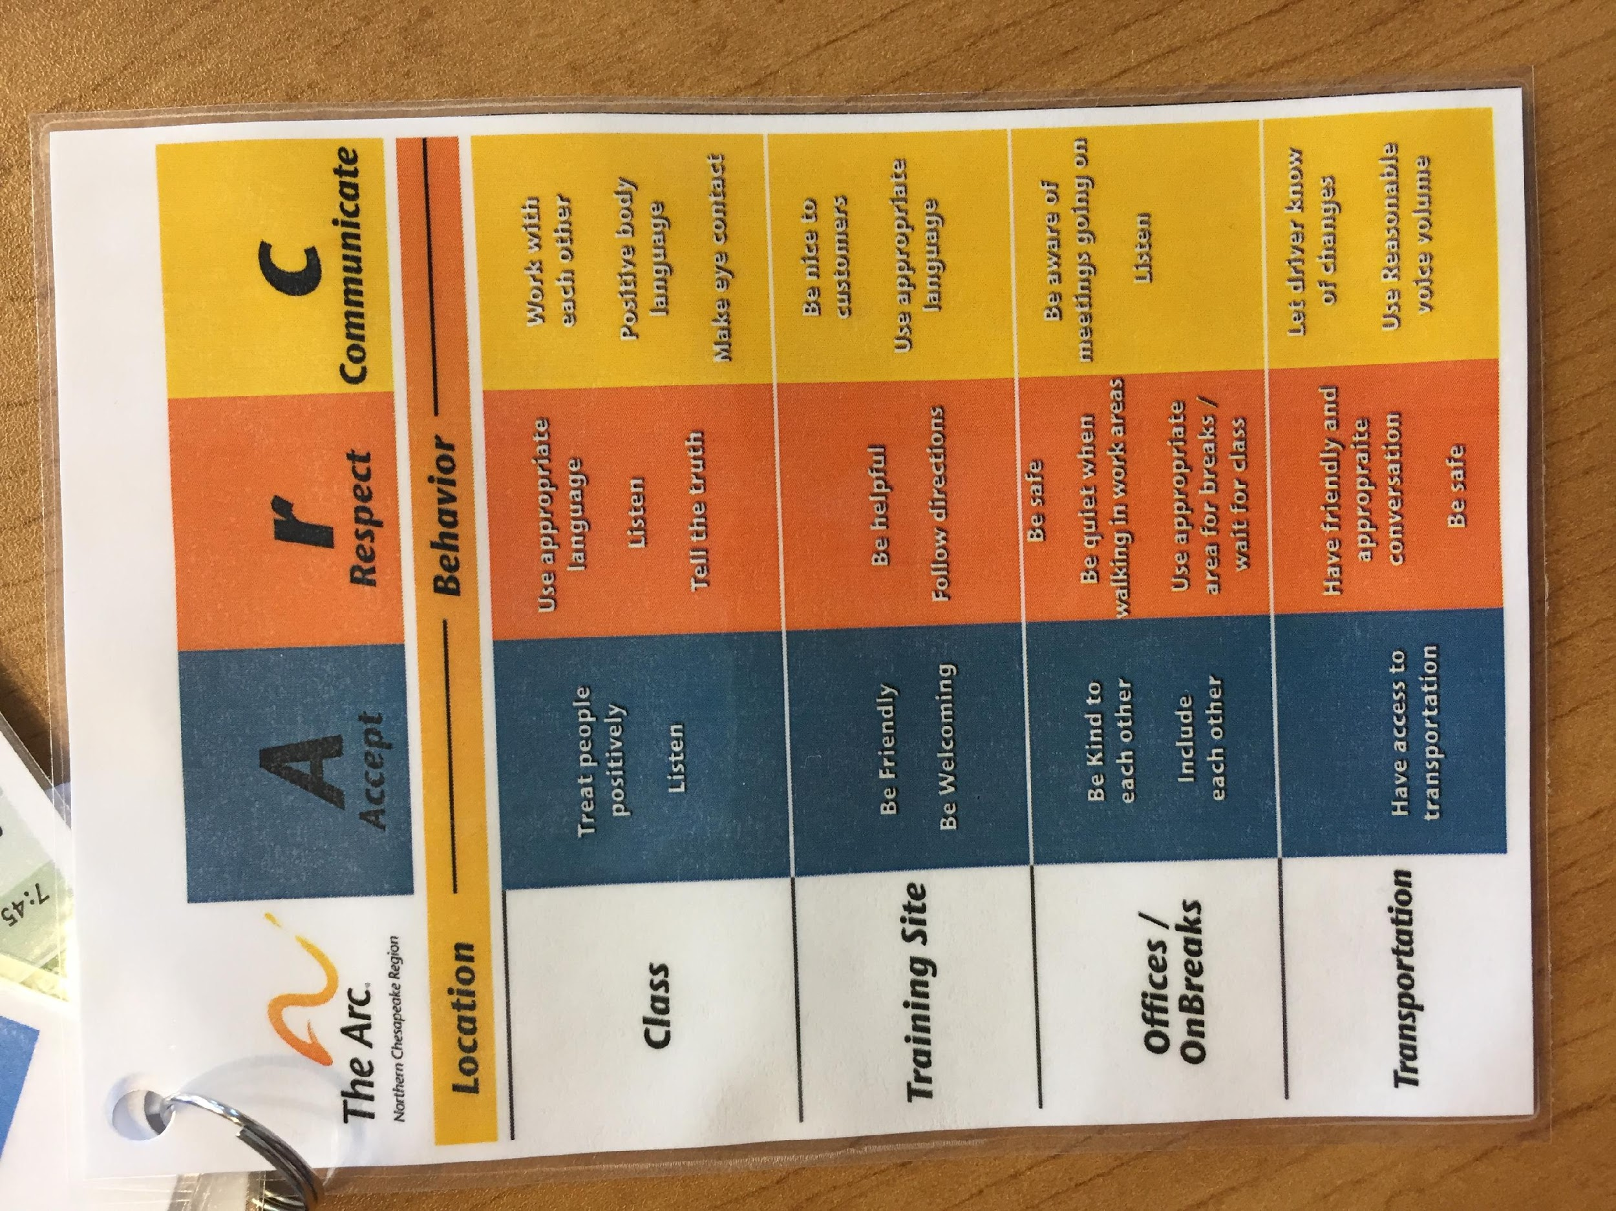
Some Matrix Examples are for Staff

Slide 27
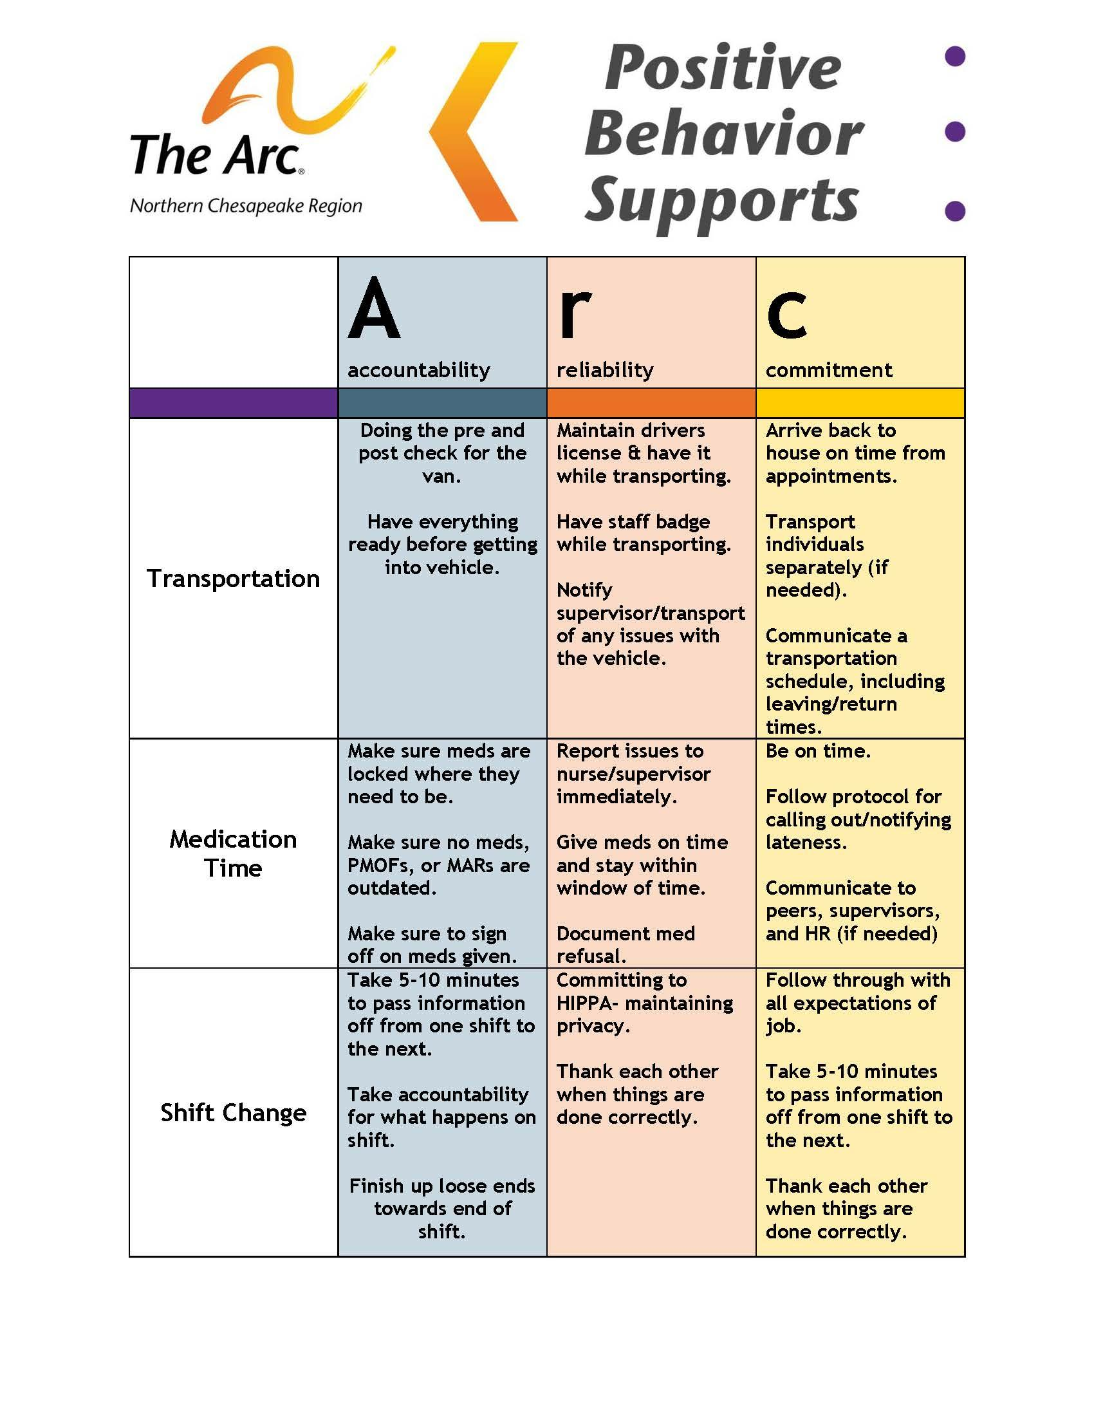
Staff Expectations (Home)

Slide 28
Families and the Matrix
Families with more than one child can teach family values
All siblings receive attention, practice social skills, and receive positive reinforcement
Focus on teaching what to do and creating a positive environment
Reducing the amount of time talking about negative issues that come up

Slide 29
Activity: Use the PBS Social Skills Handout
In Your Breakout….
Talk about settings to use a matrix and write down one setting
Pick one social value that is important in that setting
Write down one social behavior that you could teach

Slide 30
Positive Behavior Support Provides a Framework for Prevention
긍정적 행동 지원은 예방을 위한 체제를 제공
Focus First on Universal Positive Behavior Support
보편적인 긍정적 행동 지원에 우선 집중
Teach and Practice New Social Skills
Reinforce, Recognize, & Celebrate Success
Respond in a Consistent Manner to Problems
Monitor and Intervene Before Serious Problems
새로운 사회성 기술을 가르치고 연습시킨다
성공을 장려하고, 알아주고, 축하해 준다
문제들에 있어 일관되게 대처한다
심각한 문제가 되기 전에 모니터링하고 개입한다
소수
몇몇
모두

Slide 31
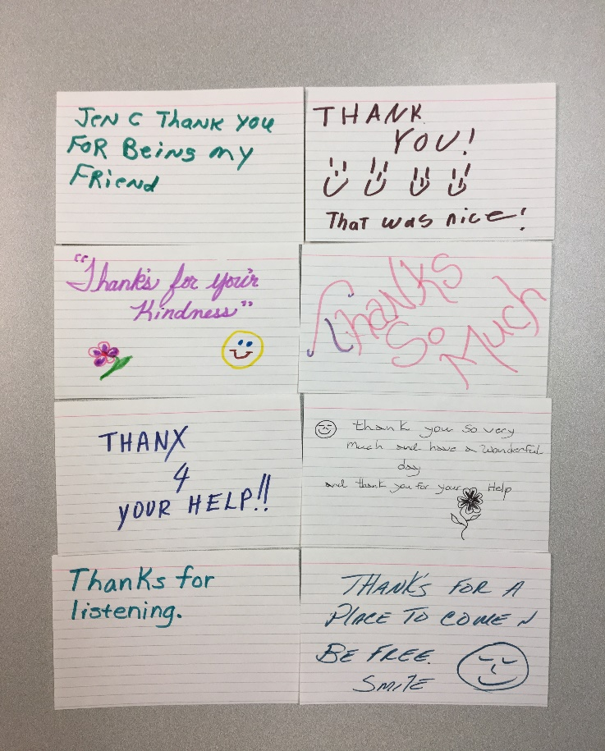
Recognizing and Reinforcing People
감사를 표하고 장려하기
Reinforce the Positive!
긍정적인 것을 강화시켜라!
Be clear
  “Thank you for helping Anne put the groceries away.”
  명확해라
  - “앤을 도와 장봐온 거 정리해줘서 고마워.”
Watch for opportunities to promote positive social interactions
긍정적 사회적 교류를 장려할 기회를 엿보아라.
Give 4 positive statements for every demand/correction
요구사항/수정사항 마다 4개의 긍정적인 말을 해라.

Slide 32
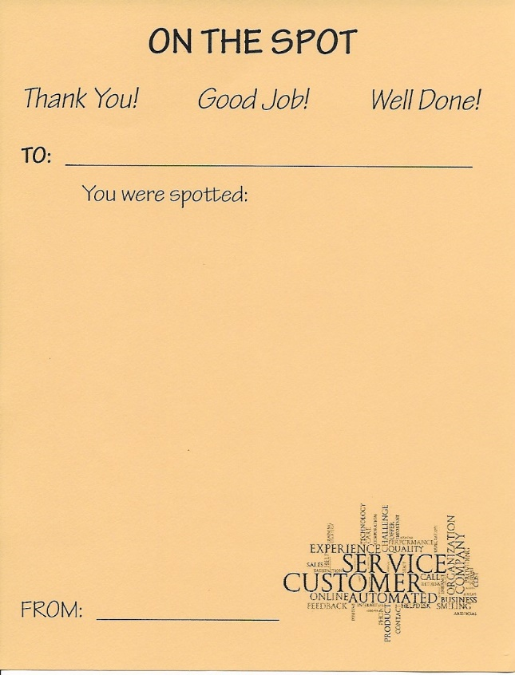

Bee Cards 꿀벌카드
Examples of Reinforcers Used to Support
Positive Social Behavior
긍정적 사회적 행동을 지원하는데 사용되는 강화물의 예
I SAW
__________________________
(name of individual)
_____________________________________________________________
_____________________________________________________________
(describe positive behavior)
Date_________________ Staff_____________
나는 _______(이름)가 ________________(긍정적 행동 묘사)것을 보았다.
날짜___________ 직원____________

Slide 33
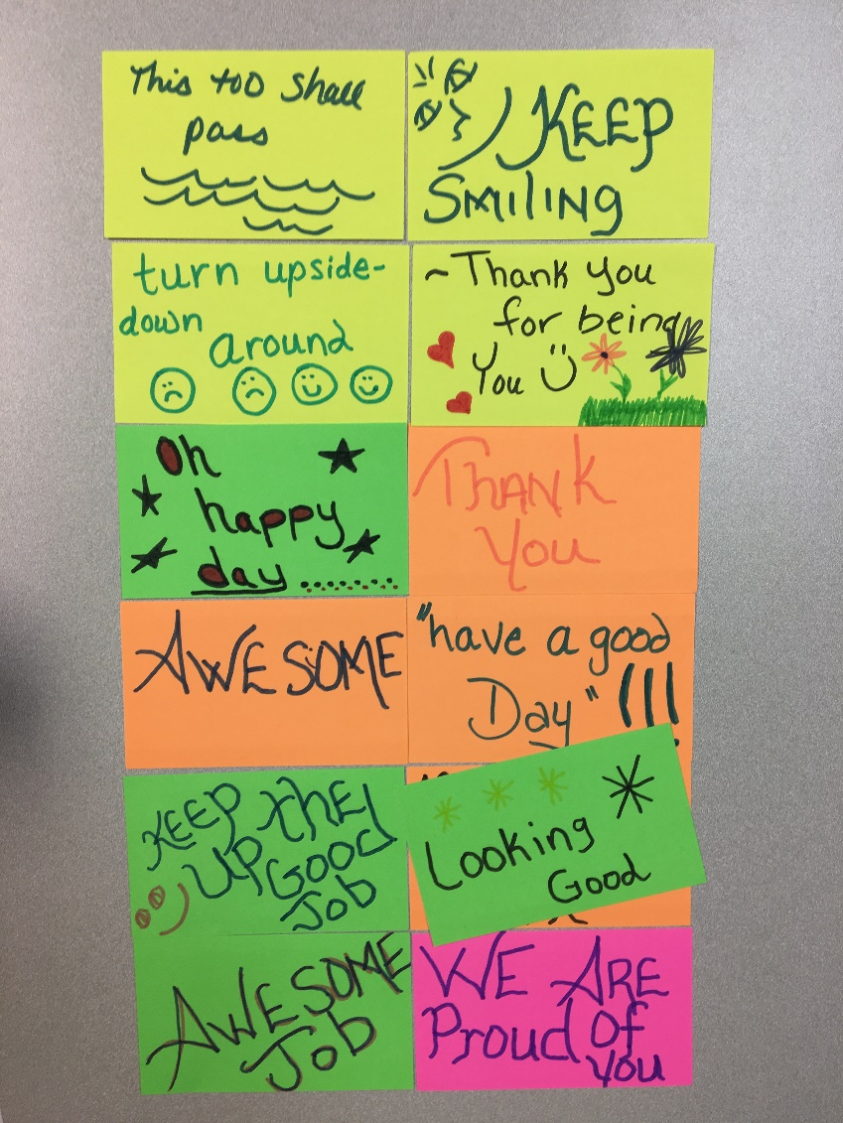
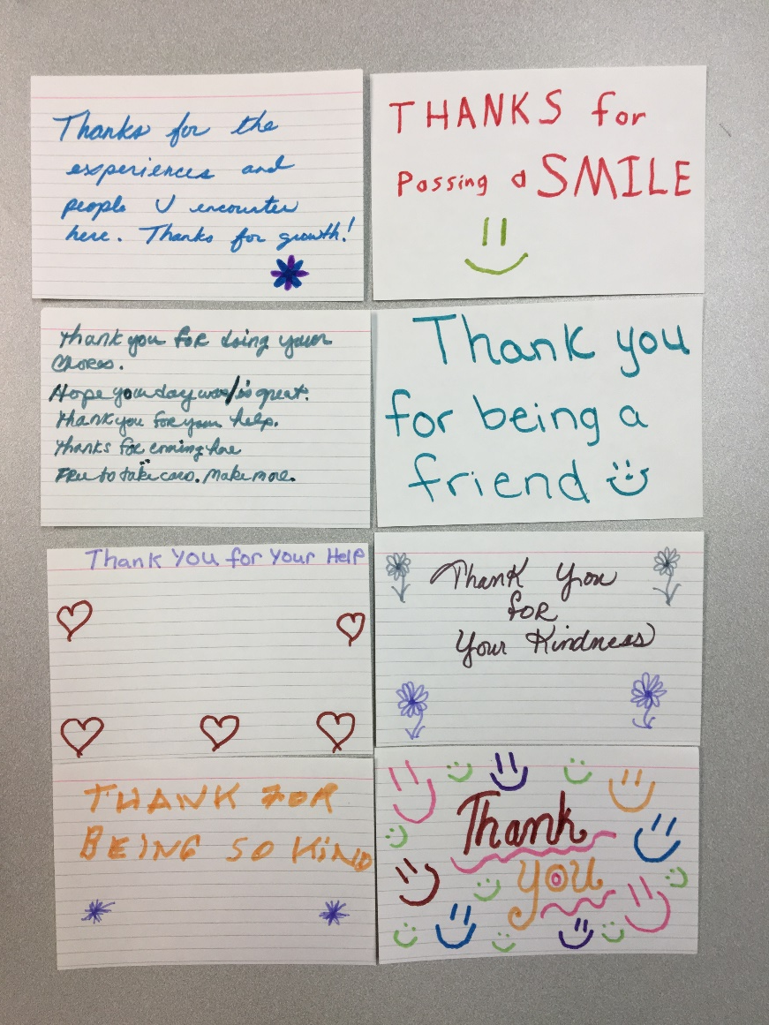
Thank You Notes That Are Given To Each Other When Behaviors That Reflect Values Are Observed
가치가 반영된 행동이 관찰되었을 때 서로에게 전달하는 감사카드

Slide 34
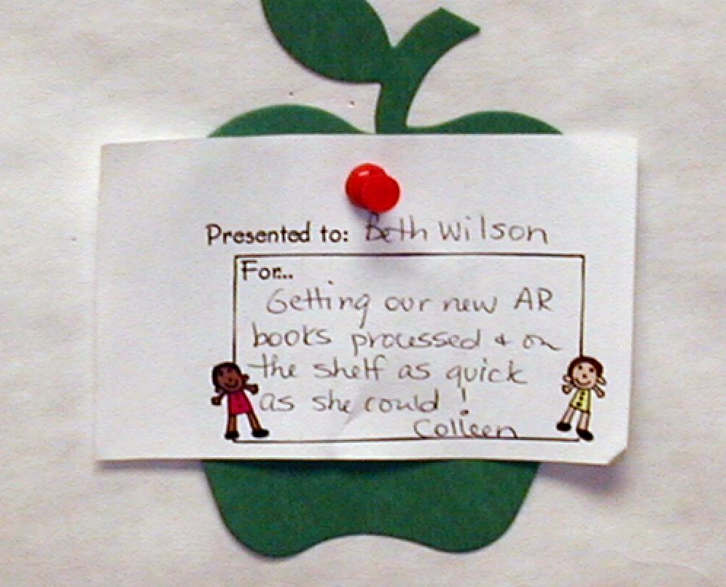
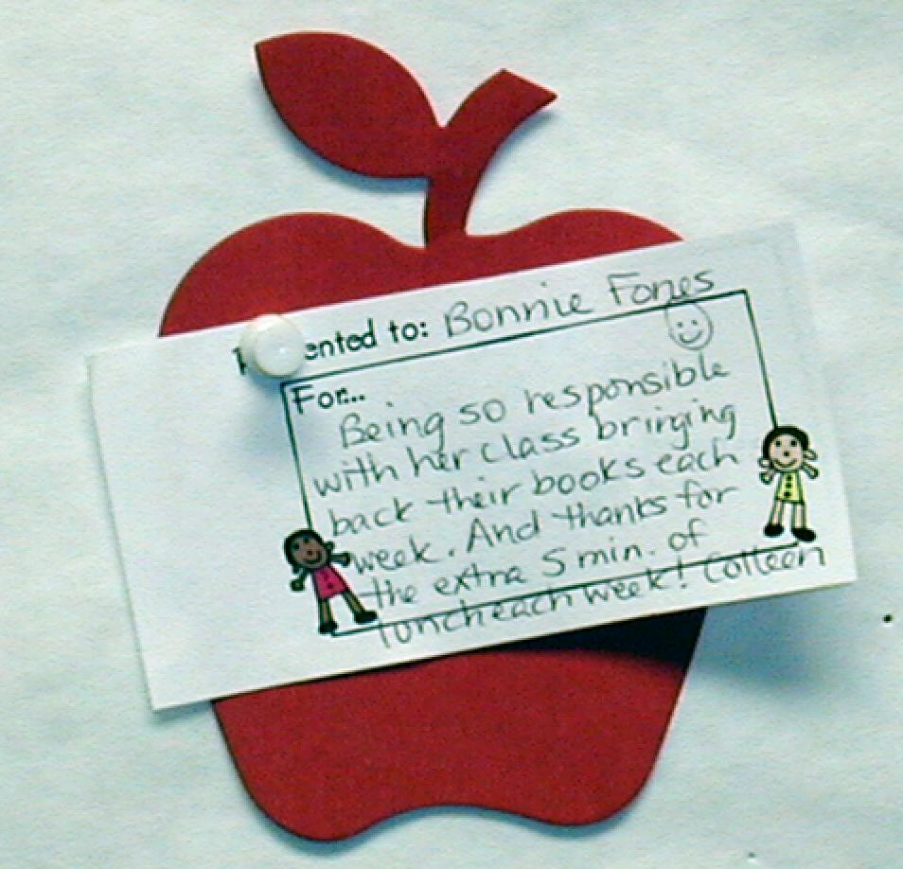
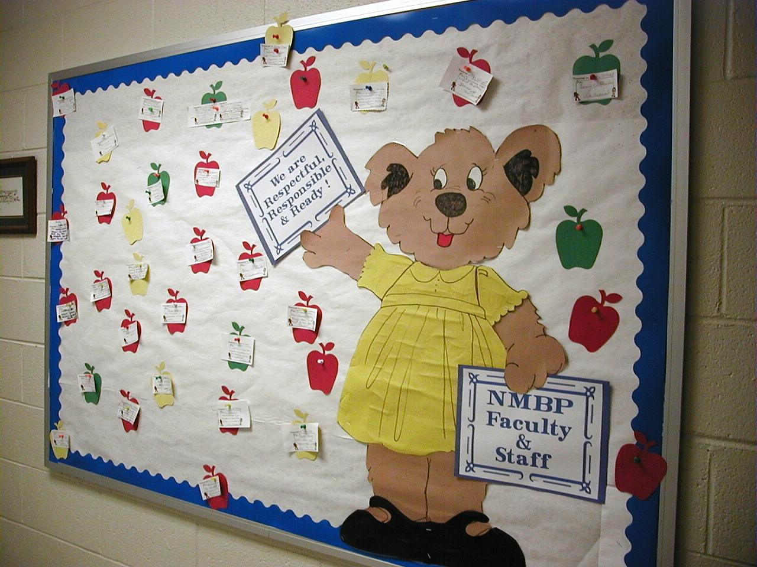
North Myrtle Beach Primary June 8, 2004 SC
노스 머틀 비치 초등학교 2004년 6월 8일 SC
Notes:
34

Slide 35
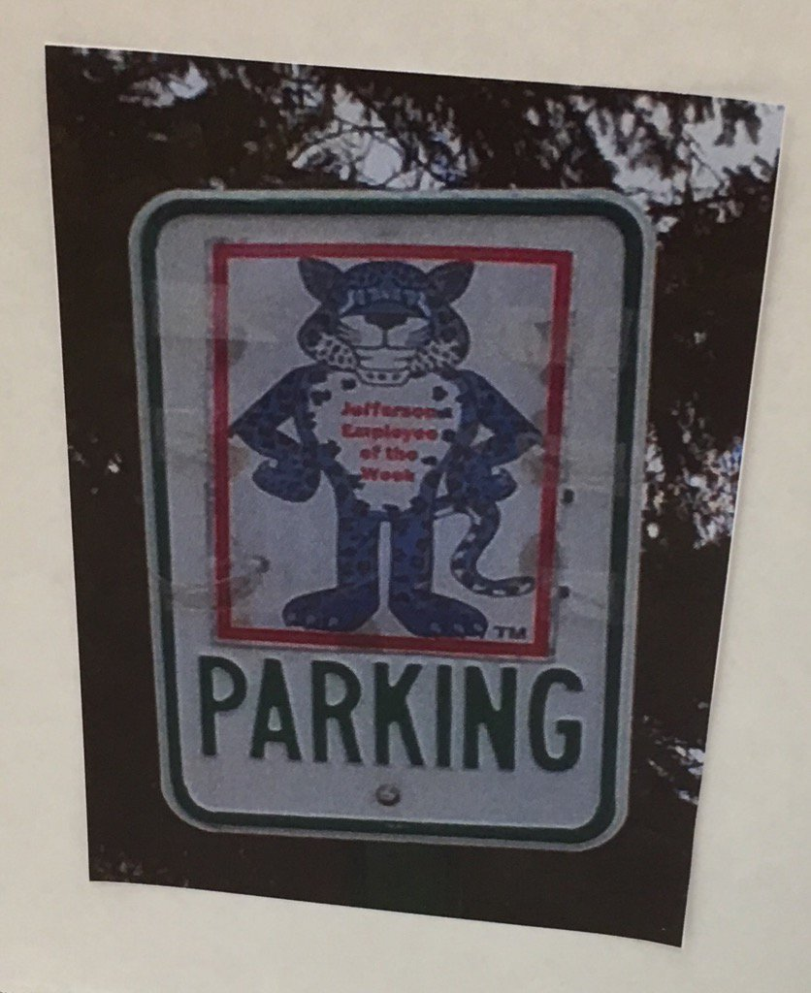
Consider Strategies for Recognizing Staff – Designated Parking Spot
직원에게 감사를 표하는 전략--지정주차
(This Would be a Big Hit at the University of Minnesota)
미네소타 주립대에 있다면 크게 성공할 것 같은 예)

Slide 36
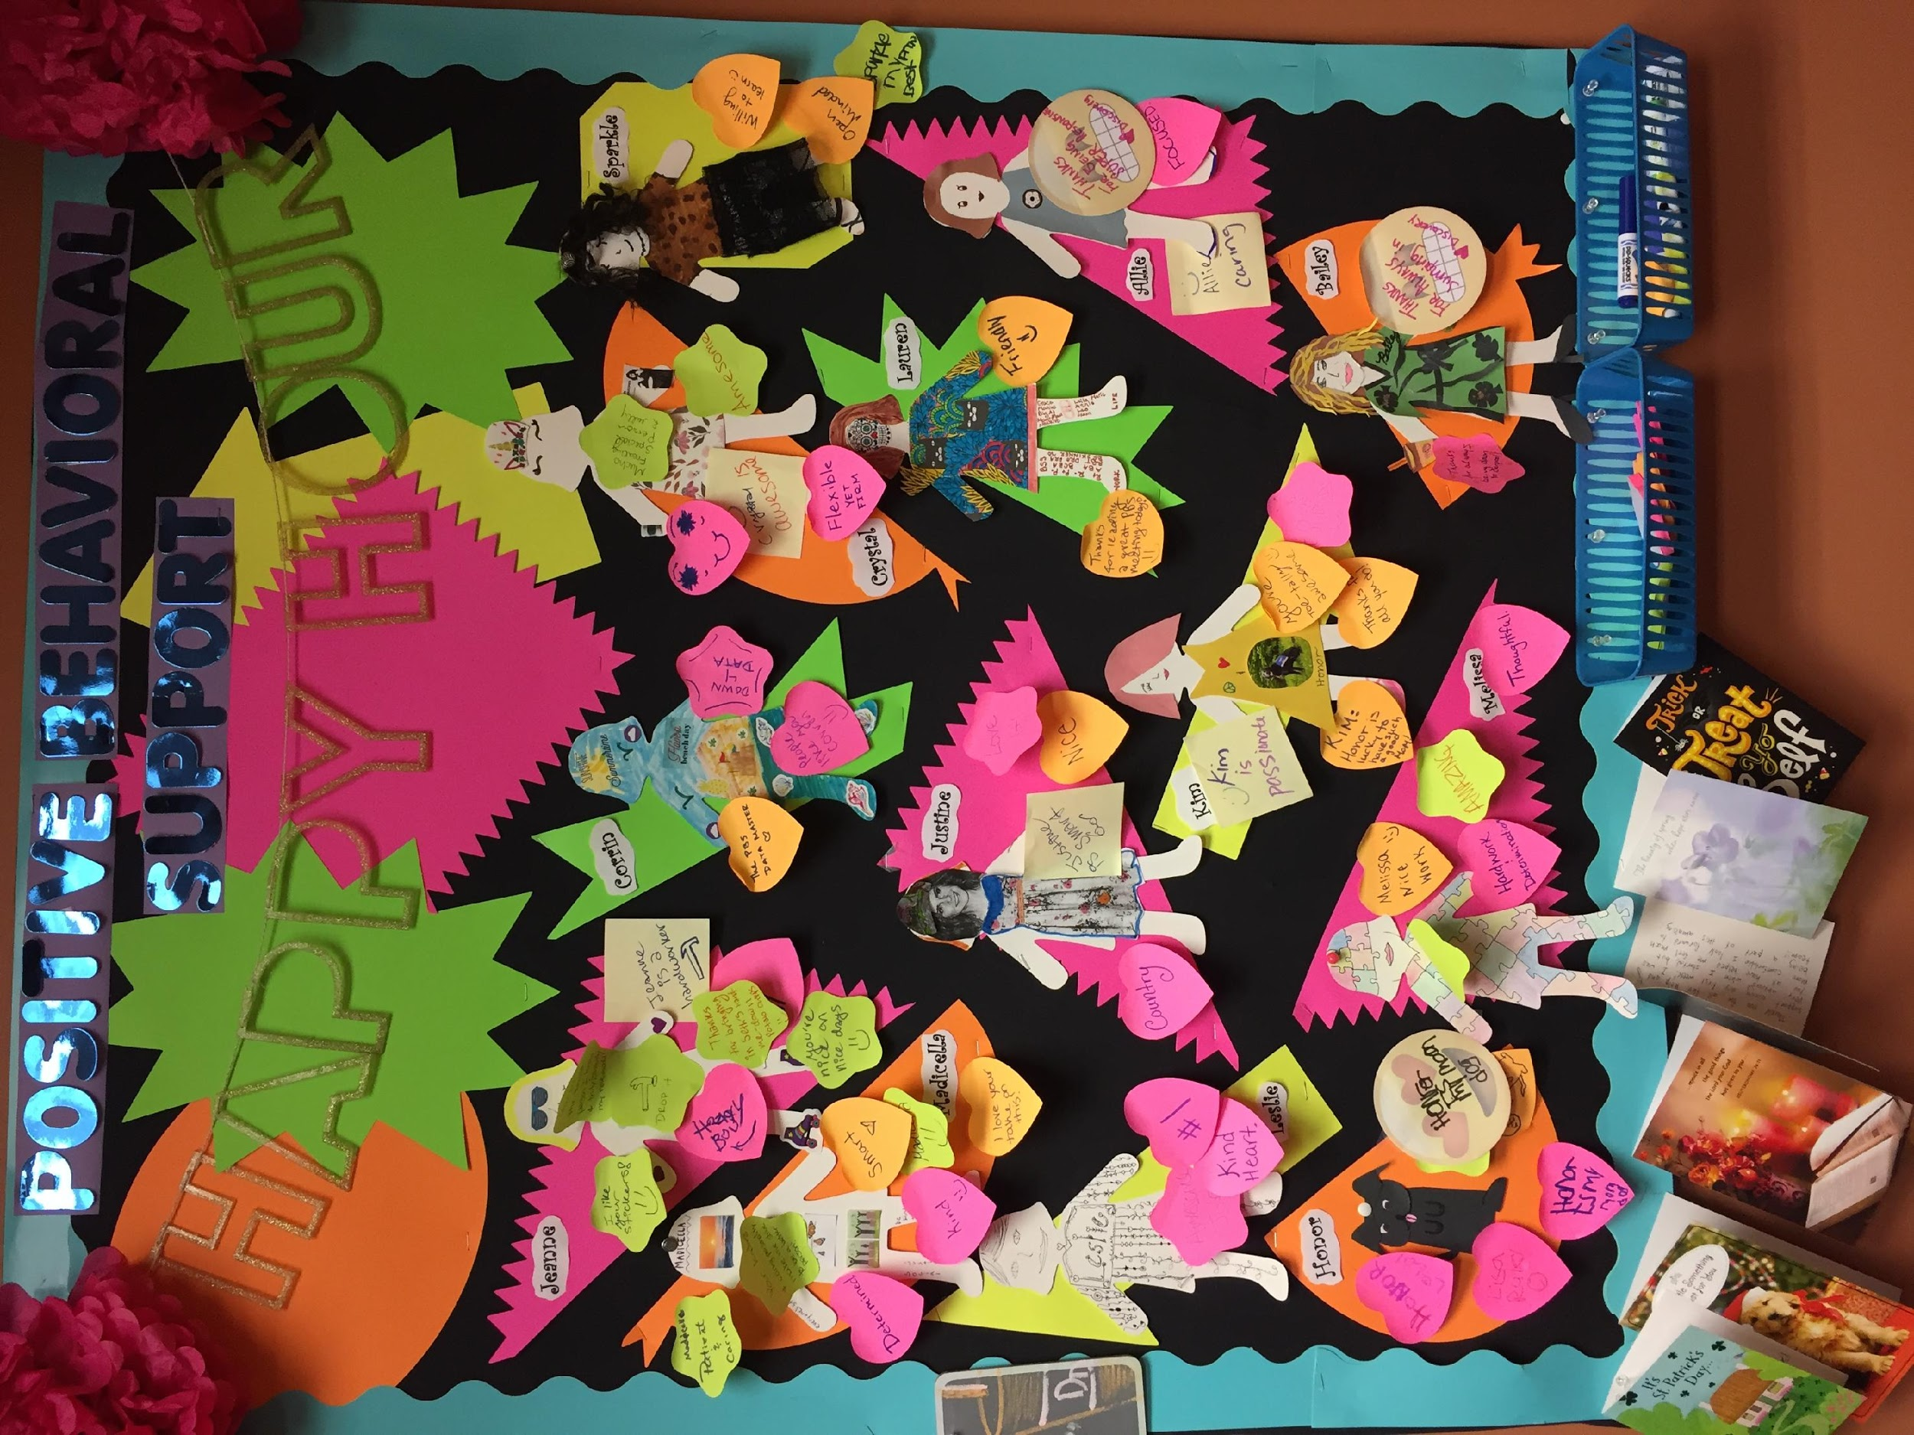
직원 인식 전략을 고려하기
_Consider Strategies for Recognizing Staff

Slide 37
Reinforcement is Personal
Reinforcers Vary for Each Person
People Sometimes Hold a Negative View of Reinforcement (Bribery)
  Use Meetings to Help People Understand Reinforcement
Create An Awareness Activity for Meetings and Trainings
  Ask Each Person What They Really Like
  Compare Responses & Pass to Your Right
  Would You Find Another Person’s Idea Reinforcing?

Slide 38
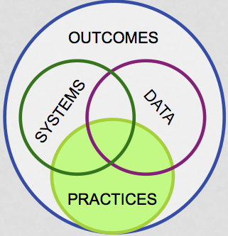
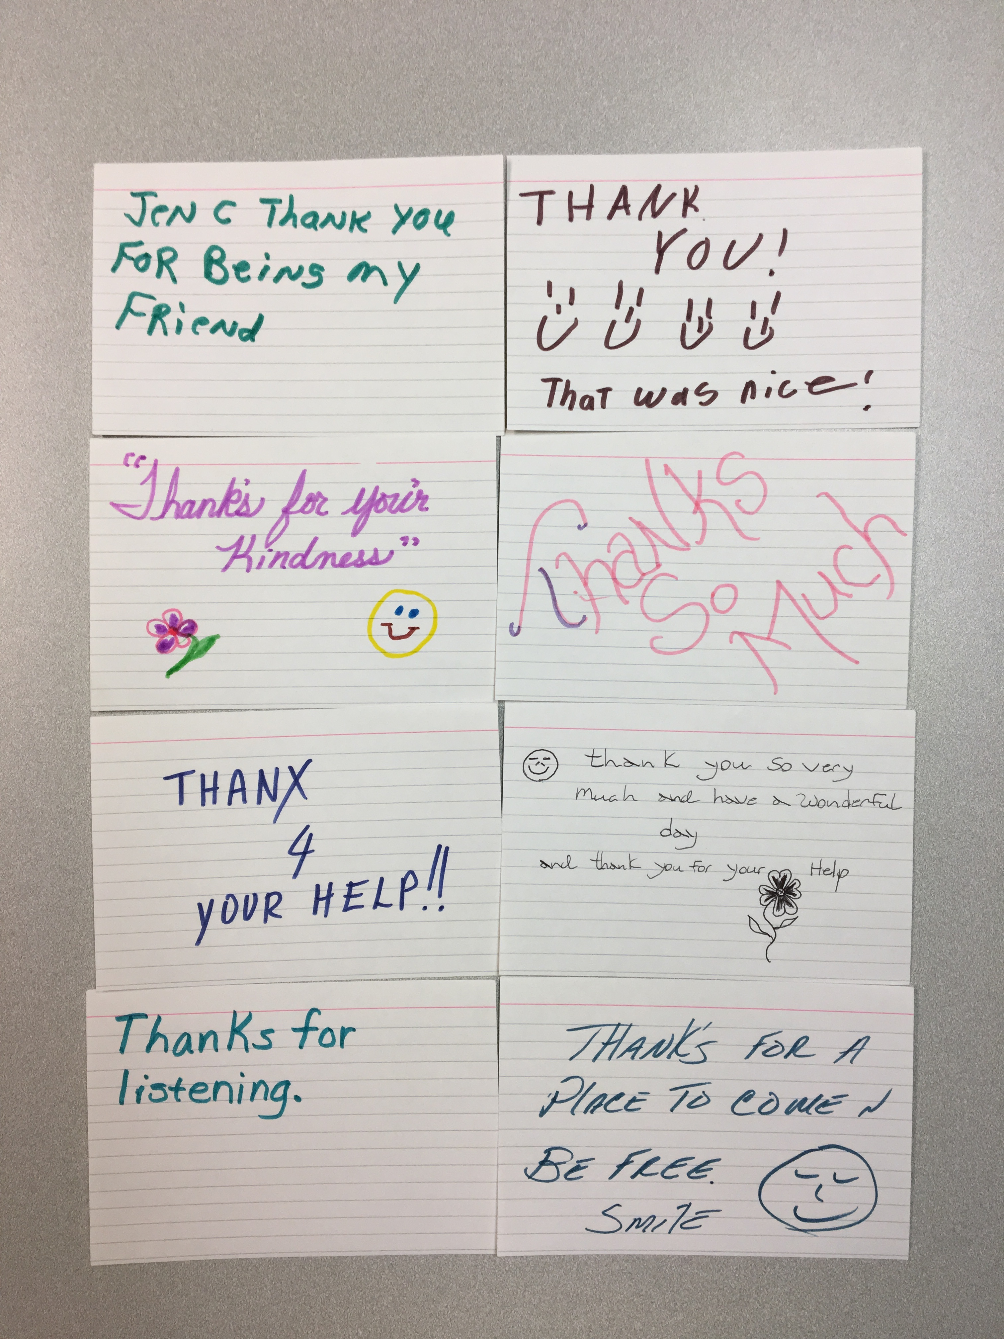
All People (Universal): Acknowledgement
Reinforce the Positive!
Be clear
  “Thank you for helping Anne put the groceries away.”
Watch for opportunities to promote positive social interactions
Give 6 positive statements for every demand/correction
Teach, promote, model positive social interactions
Design positive, proactive, predictable environments

Slide 39
Start With What You Have:
Verbal Praise/Behavior Specific Praise
A behavior-specific praise statement is verbal or written feedback that is:
Person specific
Behavior specific
Provides praise
(contingent)

Slide 40
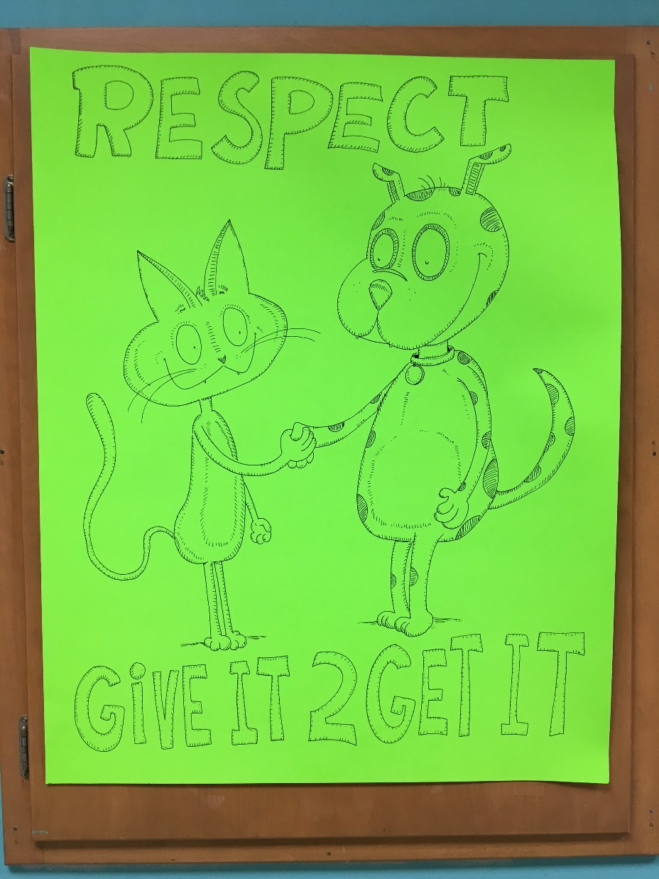

Slide 41
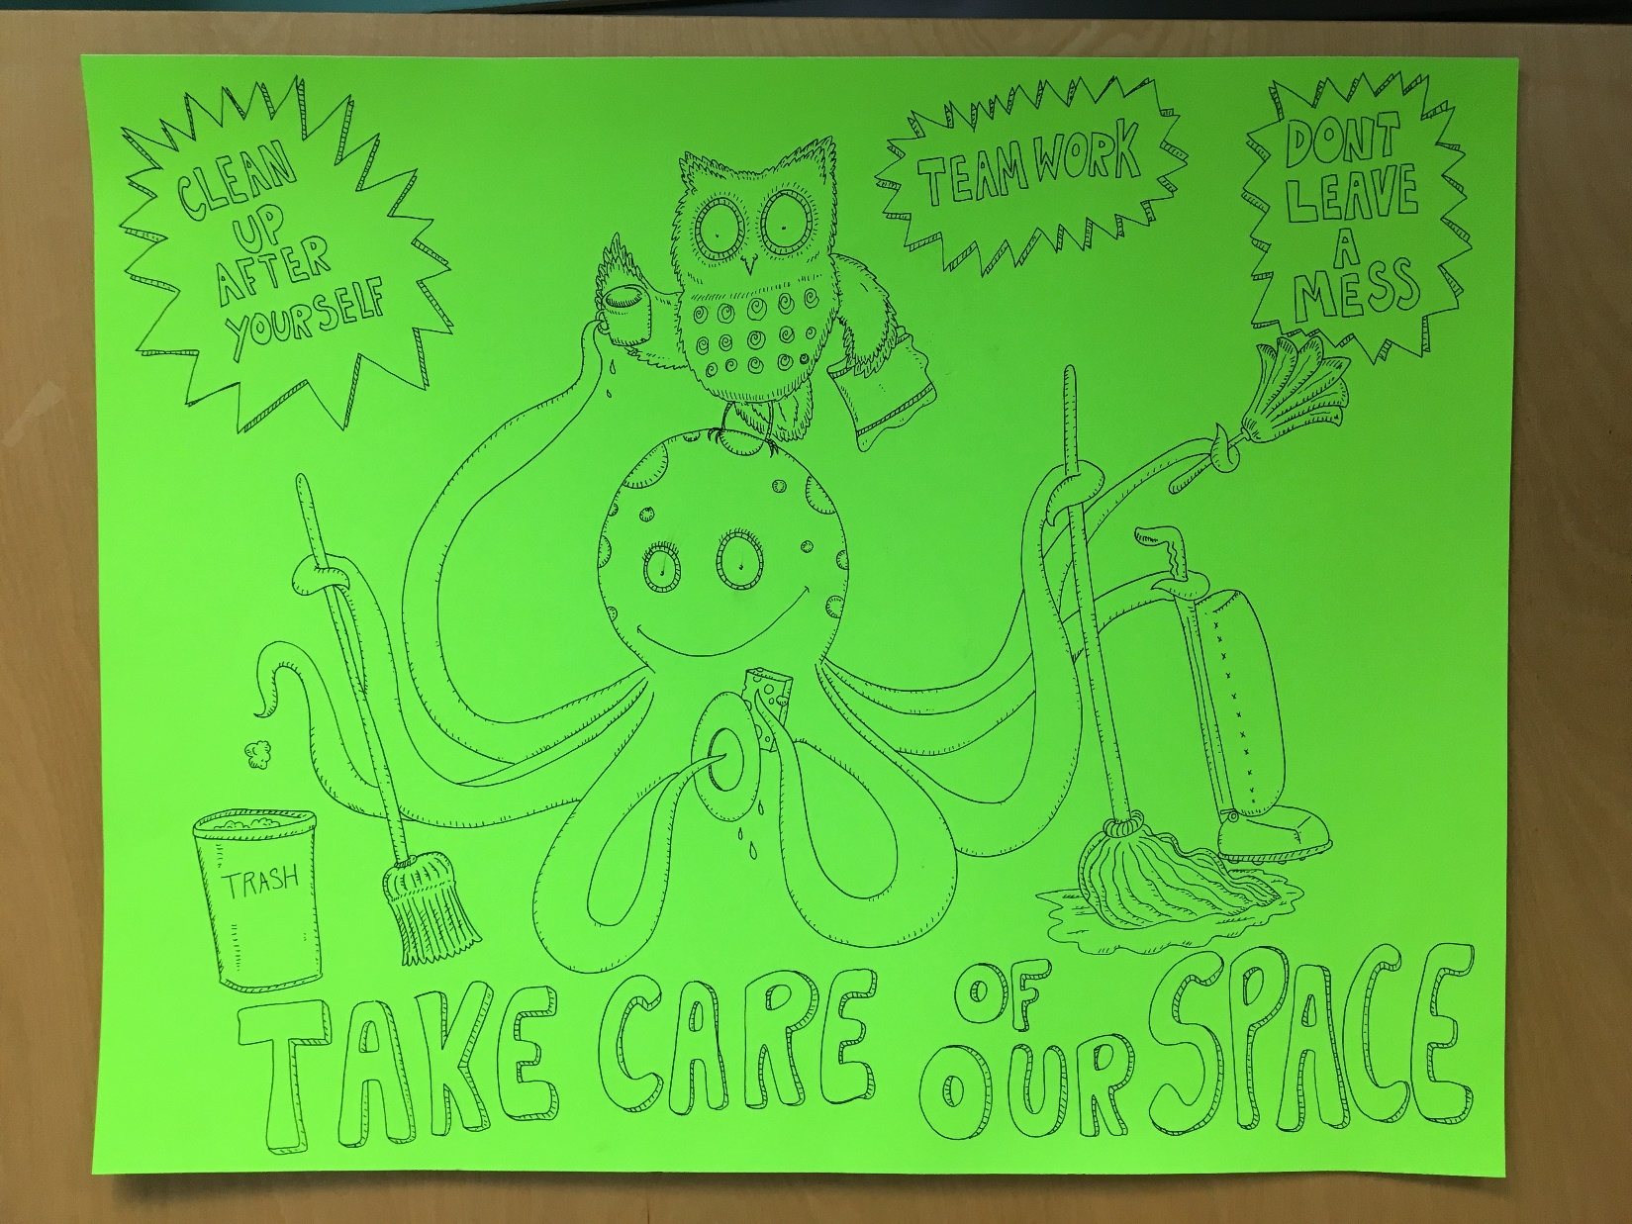

Slide 42
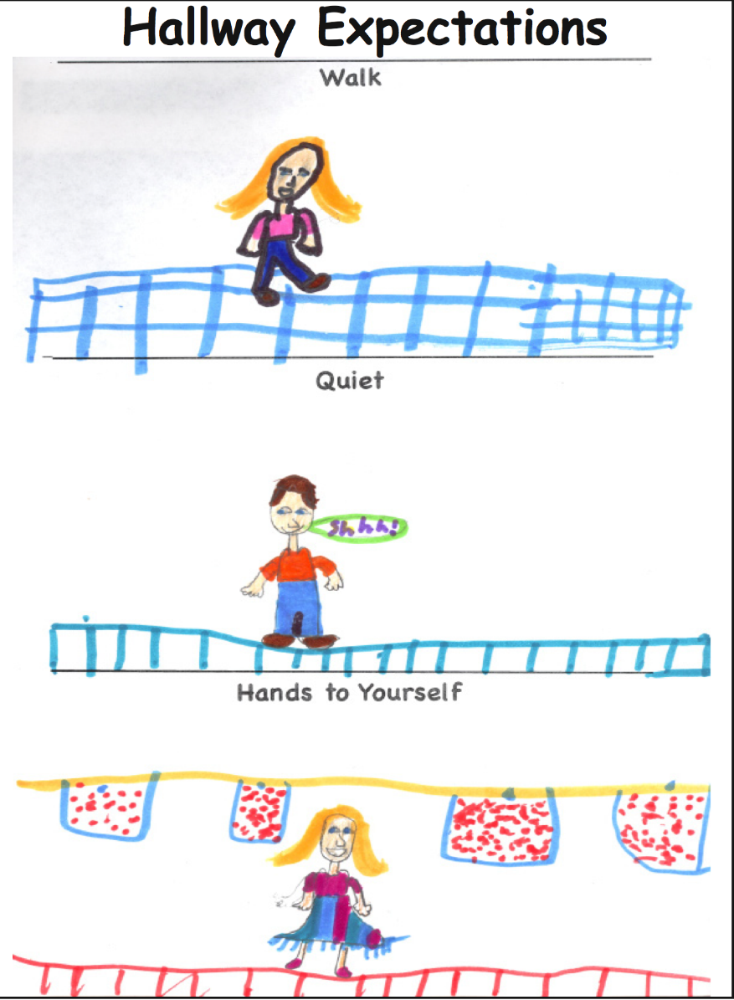
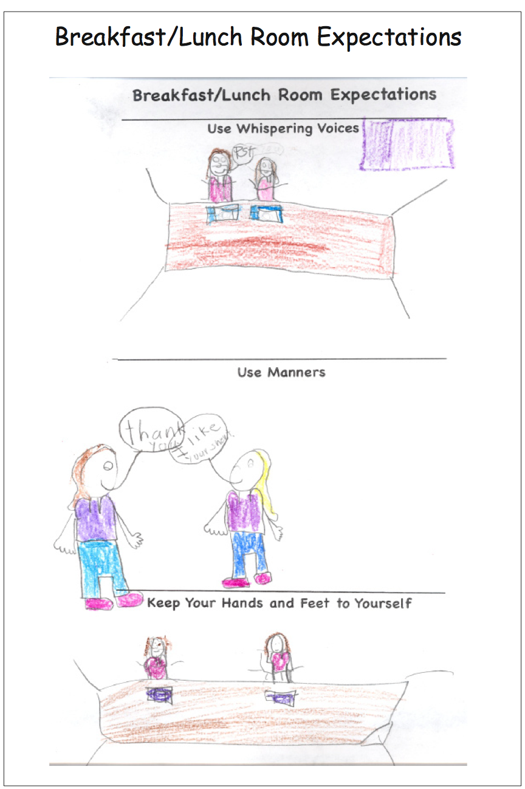
Create Posters Using Low
Cost Methods
저렴한 방법으로 포스터 제작

Slide 43
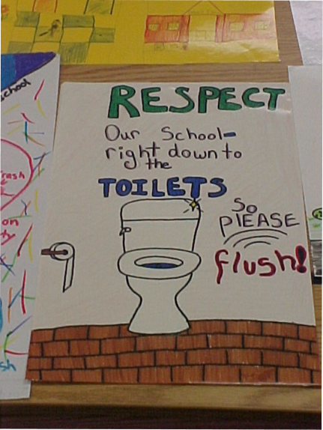
Create Posters Using Low
Cost Methods

Slide 44
Specific Praise Prompt
6 TO 1
Create Posters and Visual Reminders to Recognize Positive Social Interactions

Slide 45
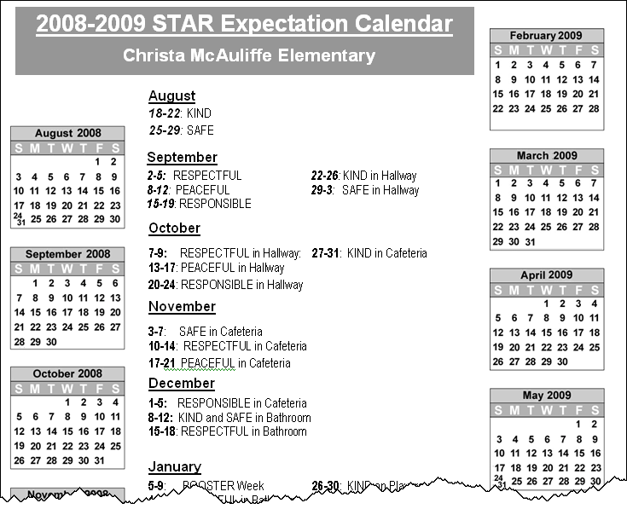
Create a Schedule to Highlight Important Cultural Values
Create a Plan for the Year
Focus on Skills Each Week
Everyone Highlights and Practices Skills

Slide 46
Activity: Look at Your Notes From the Social Skills Handout
In Your Breakout you….
Talked about settings to use a matrix and write down one setting
Picked one social value that is important in that setting
Wrote down one social behavior that you could teach
Now…..on the next slide….

Slide 47
Activity: Creating a Plan to Teach & Reinforce Social Skills
In Your Breakout….
Use the form provided to think about teaching a skill
Write down the one social behavior and setting you chose in the earlier activity
Make a list of examples and nonexamples of what it would look like if a person used this social skill in the setting
Create (or describe) ways to celebrate and recognize people using positive social skills

Slide 48
Positive Behavior Support Provides a Framework for Prevention
긍정적 행동 지원은 예방을 위한 체제를 제공
Focus First on Universal Positive Behavior Support
보편적인 긍정적 행동 지원에 우선 집중
Teach and Practice New Social Skills
Reinforce, Recognize, & Celebrate Success
Respond in a Consistent Manner to Problems
Monitor and Intervene Before Serious Problems
새로운 사회성 기술을 가르치고 연습시킨다
성공을 장려하고, 알아주고, 축하해 준다
문제들에 있어 일관되게 대처한다
심각한 문제가 되기 전에 모니터링하고 개입한다
소수
몇몇
모두

Slide 49
Responding in a Consistent Manner to Problems
문제에 일관성있게 대처하기
Prevention of Problem Behavior
문제 행동의 예방

Slide 50
Setting Events
Internal Events
Social
Consequences
Reactions Or Results
Physical Setting
Clear Definition of Challenging Behavior That Can Be Measured
Behavior
Antecedents
“Triggers”
Write Down What Occurs Immediately Before Challenging Behavior
What Occurs After the Behavior
What is the Function?
(Obtain or Escape)

Slide 51

Function-Based Thinking
기능 기반 사고
Identify why we engage in behaviors
  Escape or avoid
    People
    Situations
    Things
    Internal Physiological Response
  Obtain access to
    People
    Situations
    Things
    Internal Physiological Response
우리가 행동을 하는지 알아본다
--벗어나거나 피하기 위해
사람
상황
어떤 것
내부적인 생리학적 반응
--접근을 위해
사람
상황
어떤 것
내부적인 생리학적 반응
Replace problem behavior with a positive alternative
문제행동을 긍정적인 것으로 대체

Slide 53
Two Common Problems That Occur in Most
Social Settings
대부분의 사회적 상황에서 일어나는 흔한 두 가지 문제
A Person Makes a Request/Demand and the Other Person Refuses
  (Escape From People, Activities, Events, Items)
  누군가가 부탁/요구를 했고 다른 사람이 거절을 했다
  (사람, 활동, 행사, 물건으로 부터 벗어나기
Someone is Ignored or Left Alone With No Social Interaction for a Period of Time
  (Strategies to Communicate With Others)
  2. 누군가가 무시당하거나 특정 시간 동안 사회적 교류없이 혼자 남겨졌다
  (남들과 소통하는 방법)

Slide 54
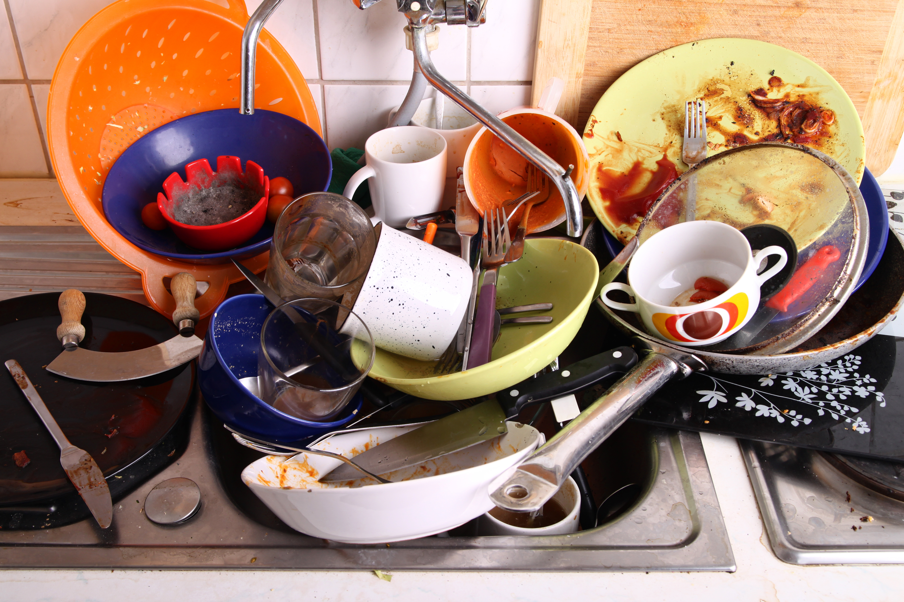
Can We Create the Context That Will Make This Task Fun?
이 일이 즐겁기 위한 상황을 만들 수 있을까?
Slide From: Freeman, R., Matthews, K., Enyart, M. & Griggs, P. (2013). Building positive behavior support plans [Online]. Lawrence, KS: University of Kansas. Available: http://kmhpbs.org

Slide 55
Increase Awareness of How Negative Interactions Escalate
부정적인 교류가 악화되는 것에 대한 인식을 높이기
Universal Goal: Teach Strategies for Preventing and Interrupting Negative Social Interactions
보편적인 목표: 부정적인 사회적 교류를 예방하고 중단하는 전략 가르치기

Slide 56
Learn to Prompt Communication Here Not Later
Escalating Chain Of Problem Behaviors
Frowning
Mumbling “This Is So Stupid”
Slapping Hand On The Computer
Cursing Loudly
Pounds On The Keyboard
Throws The Computer Out Of The Window

Slide 57
The Escalation Cycle of Behavior
행동의 악화 사이클
High
높은
Peak
절정
Acceleration
행동 강도
가속
De-escalation
단계적 축소
Agitation
동요
침착
낮은
Calm
Trigger
촉발
회복
Low
Recovery
시간
Colvin & Sugai, 1989

Slide 58
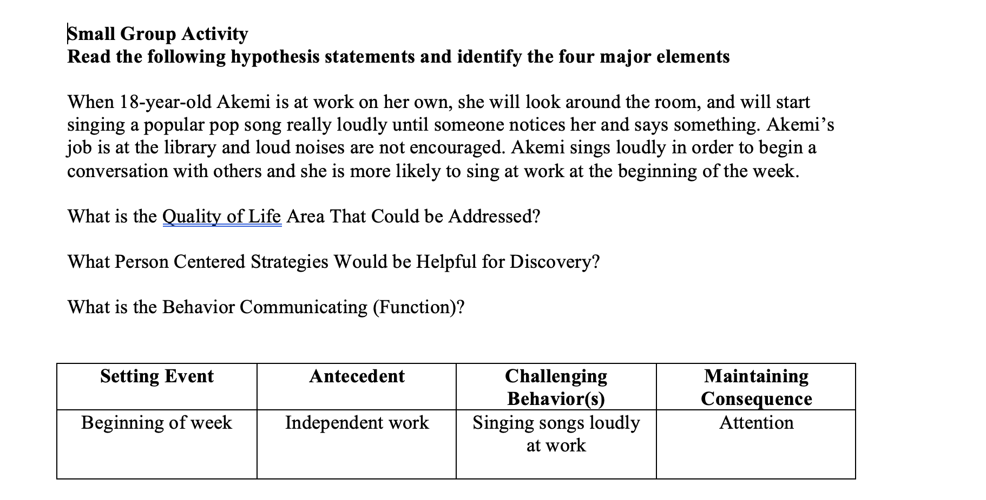
Activity: Understanding Function

Slide 59
Actively Teach Conflict Resolution on an Ongoing Basis
지속적으로 갈등 해결에 대해 가르쳐라
Move Beyond Knowing About Conflict to Practicing Skills for Preventing Problems
갈등에 대해 아는 것에 그치지 않고 문제를 예방하는 기술을 연습

Slide 60
Conflict Resolution
갈등 해소
Suspending Your Opinion
Listen First, Then Express Yourself
Focus on Needs Before Solutions
Look for Ways to Achieve Goals by Combining Ideas
Embracing Differences of Ideas
Stay Calm & Be Respectful
자신의 의견 유보
먼저 듣고 후에 감정 표현
해결책 찾기 전에 무엇이 필요한지 집중
아이디어를 모아서 목표를 달성하는 방법을 찾기
사고의 다양성 수용하기
침착하고 서로 존중하기

Slide 61
Conflict Resolution:
Strategies for Teaching Awareness
갈등 해소: 인식 가르치는 전략

Slide 62

Practice Conflict Resolution Over Time
Use in supervisory sessions and talk about strengths
Celebrate the use of strategies during tough situations
Create a plan to work on areas that are harder for you
Review incidents and discuss how to prevent conflict in the future

Slide 63
Positive Behavior Support Provides a Framework for Prevention
긍정적 행동 지원은 예방을 위한 체제를 제공
Focus First on Universal Positive Behavior Support
보편적인 긍정적 행동 지원에 우선 집중
Teach and Practice New Social Skills
Reinforce, Recognize, & Celebrate Success
Respond in a Consistent Manner to Problems
Monitor and Intervene Before Serious Problems
새로운 사회성 기술을 가르치고 연습시킨다
성공을 장려하고, 알아주고, 축하해 준다
문제들에 있어 일관되게 대처한다
심각한 문제가 되기 전에 모니터링하고 개입한다
소수
몇몇
모두

Slide 64

Using Data to Monitor and Prevent Challenges

Slide 65

조직에서 수집하는 데이터 검토
_Review Data Your Organization Collects
문서화된 정책 변경 사항
_Documented Changes in Policies
직원 교육 및 성과 데이터
_Staff Training & Performance Data
조사 및 조치
_Surveys and Measures of
  삶의 질_Quality of Life
  기후_Climate
  스트레스_Stress
직원 유지 및 감소
_Staff Retention and Attrition
삶의 질 측정
_Quality of Life Measures
사고 보고서_Incident Reports
부상, 병가_Injuries, Sick Days
근로자 보상_Workers Compensation
Notes:
Organizations are encouraged to collect four kinds of data that can help them indicate their progress toward their goals. Teams are encouraged to collect the data regularly and have data graphed and ready to look at in regularly scheduled team meetings. The data can help teams determine their progress toward their goals. This process is called data-based decision making. Teams often get coaching at cohort trainings on collecting and monitoring data. Some examples of data types collected by teams are (1) measures and training hours on staff development, (2) surveys on quality of life or climate, (3) number of incident reports or sick days, or (4) data related to retention, staff injuries.

Slide 66
Activity: Using the Quality of Social and Physical Environment
Assessment

Slide 67
Assessing the Climate

Slide 68
Activity
Review the Quality of the Social and Physical Environment
Complete the first five items
Discuss how this tool might be used in your organization

Slide 69
Family Quality of Life Assessment
Family Quality of Life Survey Instrument
https://beachcenter.lsi.ku.edu/sites/default/files/inline-files/Family%20Quality%20of%20Life%20Psychometric%20Characteristics%20and%20Scoring%20Key.pdf

Slide 70
Steps for Improving Incident Report Systems
사건 보고서 시스템 향상하는 단계들

Slide 71
Year 연도
Month
월
Number of Days
일 수
Number of Incidents
사건 수
Average Incidents
Per Day
1일 평균 서건 수
2001
Aug
8
0
0
0.00
2001
Sep
9
19
5
0.26
2001
Oct
10
21
18
0.86
2001
Nov
11
18
17
0.94
2001
Dec
12
14
21
1.50
2002
Jan
1
22
18
0.82
2002
Feb
2
17
15
0.88
2002
Mar
3
19
26
1.37
2002
Apr
4
21
14
0.67
2002
May
5
18
13
0.72
2002
Jun
6
11
2
0.18
2002
Jul
7
0
0
0.00
Totals:
총:
180
149
0.83

Slide 72
Ways to Use Incident Report Data
Review Individual Person’s Incident Reports
  Most Common Approach
  Individualized Problem Solving
Assess Patterns Across Organization
  Evaluate Universal PBS Strategies
  Identify Staff Development Needs

Slide 73
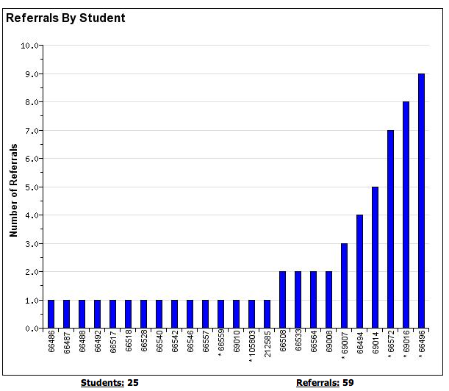

Incident Reports &
Data-based Decision Making
사건 보고서 및 데이터 기반 의사 결정
People: 25
사람
Incidents: 59
사건
Notes:
Student with 2-5 are candidates for more support in behavior, academic, or both areas.

Slide 74

Where
어디에서
What
무엇을
The BIG 5
중요한 5가지
When
언제
How often
얼마나 자주
Who
누가

Slide 75
What Patterns Occur Across All Incidents
Number of Incidents 사건의 수

Slide 76
What Locations Are Associated With the Problems?
Number of Incident Reports

Slide 77
Where Are the Challenges Occurring?
Number of Incident Reports

Slide 78
Number of Incident Reports

Slide 79
Number of Incident Reports
Time

Slide 80
Number of Incidents
Type of Trigger (Antecedent) 촉발 종류 (선행사건)

Slide 81
Number of Incidents
Function of Behavior
행동의 기능

Slide 82
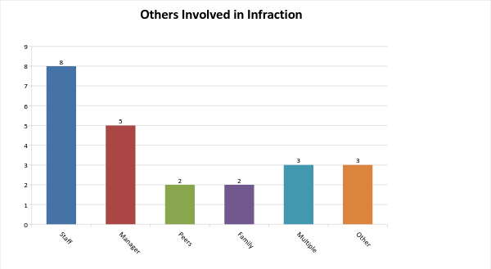
Who is Involved?
관여된 사람

Slide 83
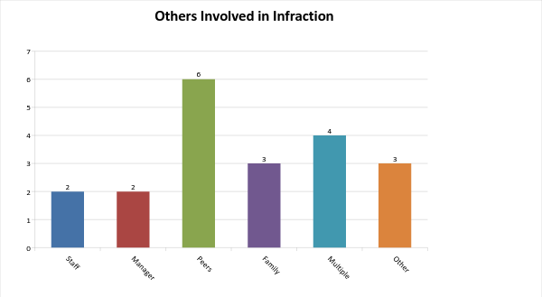
Who is Involved?
관여된 사람

Slide 84
Number of Incidents
People Supported
지원 받은 사람

Slide 85
Data-Based Decision Making
데이터 기반 의사 결정
Define the problem behavior
  What
문제 행동을 정의
무엇
Clarify problem by identifying
  Who
  When
  Where
다음을 확인하므로써 문제를 명확하게
누가
언제
어디에서
Develop a logical explanation
  Why
논리적 설명 만글기
왜

Slide 86
Write a Precision Statement
프리시전 보고서 (데이터를 바탕으로 객관적인 사실을 기록) 작성하기
From January to March, we had 15 incidents of aggression that occurred between two people supported in the same home. These incidents occurred between the times of 10:00PM-11:30PM in one home and from 3:00 – 4:30PM in another home with 3 people. Aggression occurred during staff transitions in both homes.
1월부터 3월까지 같은 집에서 지원 받는 두 사람 사이에서 공격성 사건이 15번 발생하였다. 이 사건들은 한 집에서는 밤 10시-11:30 사이에 발생하였고 다른 집에서는 오후 3시-4:30 사이에 3명 사이에서 벌어졌다. 공격성은 두 홈 모두 직원 교체시기에 발생하였다.
These incidents involved 5 people with all incidents occurring when staff were not directly interacting with the people supported. Motivation of the behaviors were marked as to obtain attention in the evening for the first home and to communicate need to access transportation in the second afternoon pattern.
이 사건들에는 5명이 관여했는데 직원이 지원 받는 사람들과 직접 교류를 하지 않을 때 모두 발생했다. 행동의 동기는 첫번째 홈의 경우 저녁 시간에 관심을 받기 위해서 였고 두 번째, 오후 패턴에서는 교통수단을 이용해야 함을 표현하기 위해셔였다.

Slide 87
Solution Development: For Incidents of Aggression
해결책 개발: 공격성을 띈 사건
Prevention 예방 | *Create Plan for Each Transition in a Way That Ensures People Have Access to Communicate With an Identified Staff at all Times * Prompt & Encourage Communication During Transitions * 직원 교체시기에도 항시 직원과 소통할 수 있도록 계획을 세운다. * 직원 교체시기에 소통을 권장하고 유도한다
Teaching 교육
Reward 보상 | Celebrate Days When No Problems Occur Use Behavior Specific Praise Throughout Transitions 문제가 발생하지 않는 날을 축하한다 모든 변화 시기에 행동 구체적인 칭찬을 사용
Extinction 소멸 | Decrease Likelihood That Problem Behavior is Directly Reinforced 문제 행동이 직접적으로 강화될 가능성 줄이기
Consistent Consequence 지속적인 결과 | Ignore Problem Behavior or Decrease Intensity 문제행동을 무시하거나 강도가 낮아진다
Data Collection 데이터 수집 | Review All Incidents and Continue Monitoring 모든 사건을 확인하고 계속적으로 모니터링한다

Slide 88
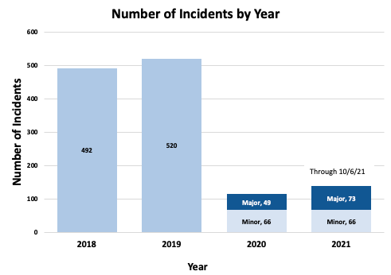
시간이 지남에 따라
발생하는 사고 수의 감소가 있습니까?
_Are There Decreases in the Number of Incidents That Occur Over Time

Slide 89
Streamlining Data Collection
수집된 데이터 능률화
Clear Definitions of Problem Behaviors
문제행동의 명확한 정의
Major Incidents Requiring Crisis Plan Response
위기 계획 반응을 ㅁ요구하는 주요 사건들
Meet With Staff To Clarify and Introduce New Referral Process
직원과 만나 새로운 소개 과정을 소개한다
Easy to Complete Referral Form
쉽게 완성하는 소개 양식
Data Entered Promptly
신속하게 데이터 입력
Summarized for Meetings
회의를 위해 요약

Slide 90
Create a System for Recording Information:
Who
When
Where
Why
How
Function

Slide 91
Use the Compatibility Checklist to Create an
Effective Tracking Form
양립 가능성 체크리스트를 이용해 효과적인 추적 양식을 만듬

Slide 92
Teach Staff Members About How to Document Incidents
사건을 문서화 하는 방법을 직원에게 가르친다

Slide 93
Strategies for Working with Staff
직원과 일하는 전략
Introduce purpose
  Consistency activities to show differences in opinions
  Increase Consistency of staff
  Group consensus of what intensity of problem behavior is considered an incident
  목적을 소개
  일관성 액티비디를 통해 의견의 다양성 보여줌
  직원의 일관성 증가
  어떤 강도의 문제 행동이 사건이 되는지 그룹 의견 합의
Structure activities to discuss behavioral definitions and major/minors
  Break into groups and
  Assign each group definitions
  Create skits and act out behaviors and confirm understanding and consensus
  행동 관련 용어 정의 및 주요 행동과 사소한 행동르 논의할 구페적 액티피비
  그룹으로 나뉘어
  각 그룹마다 용어 정의를주며 콩트나 행동을 재현하며 이해와 합의에 도달함

Slide 94
Increasing Staff Awareness & Consistency
직원 인식과 일관성 늘리기
Tell a story about a problem behavior
문제 행동에 대한 이야기를 나눔
Ask staff members to walk to
  One corner of the room if they would fill out an incident report
  One corner if they would ignore the behavior or redirect the person
  One corner if they would call 911
  직원에게 다음으로 걸어 가라고 말한다
  사건 보고서를 작성하고 싶으면 방 한쪽 귀퉁이로
  행동을 못본체 하고 당사자가 다른 생각하게 하고 싶으면 방 한쪽 귀퉁이로
  911에 전화 걸고 싶으면 나머지 한쪽 귀퉁이로
Discuss how staff can begin to respond in more consistent manner
직원이 어떻게 더 일관성 있게 대응할 수 있는지 논의
Add skits to staff meetings or other events to continue progress
콩트를 직원 회의나 다른 행사에 접목 시켜 계속적으로 진행

Slide 95
Activity for Coming to Consensus
합의점에 도달하기 위핸 액티비티
Create a circle of staff members with continuous rope and indicate the rope should not be broken at any time
이어진 밧줄을 이용해 직원들로 원을 만든다. 밧줄은 그 어떤 순간에도 끊어져서는 안된다고 말한다
Ask staff to take one step forward for “yes” and one step backward for “no”
직원에서 “예”면 앞으로 한 발자국, “아니오”면 뒤로 한 발자국 가라고 말한다
Ask the following types of questions:
  Would you drink a diet coke if it was offered to you?
  Would you drink a diet pepsi if it was offered to you?
  Would you drink a latte from Starbucks?
  다음과 같은 질문을 한다:
  다이어트 콜라를 누군가가 준다면 마시겠어요?
  다이어트 펩시를 누군가가 준다면 마시겠어요?
  스타벅스에서 라떼를 마시겠어요?
Discuss as the rope tightens what to do to avoid breaking the rope
밧줄이 탱탱해 질 수록 어떻게 하면 밧줄이 끊어지지 않을지 토론한다.
Discuss importance of consistency and predictability when many people work together
많은 사람이 함께 일하면 중요한 일관성과 예층 가능성에 대해 토론한다

Slide 96
Support for Staff Members
직원을 위한 지원
Create Staff Development Activities to Help Staff Identify Ways to Address Minor Problems
  Prompt Communication
  Offer Choices
  Ignore Minor Problems
  Effective Redirection
  직원 개발 활동을 만들어 사소만 문제를 다를 수 있는 방법을 찾을 수 있도록 돕는다
  신속한 소통
  선택권 제공
  사소한 문제 무시
  효과적인 방향 전환
Create a Review of Incidents to Learn More About Preventing Challenging Interactions
사건 검토지를 만들어 어려운 상황을 예방하는 방법에 대해 배운다

Slide 97
Incident Report Excel Program Link
Robert Putnum
May Institute
2017

Slide 98
Activity
How can you improve your incident report tracking systems?
What steps would be helpful from the presentation today?
Use the action planning form to record your ideas

Slide 99
앞으로 나아가기 위해 직장에서 다른 사람들과 공유할 수 있는 3~5가지 목록을 만드세요
_Make a list of 3-5 things you can share with others at work to move forward
앞으로 나아가기 위한 단계 _Steps for Moving Forward | 관여하는 사람 _Who is Involved | 완료 목표 날짜 _Targeted Completion Date

Slide 100
Brief Description of Tiers 2 & 3
소수
몇몇
모두

Slide 101
Incident Reports &
Data-based Decision Making
사건 보고서 및 데이터 기반 의사 결정
People: 25
사람
Incidents: 59
사건
Notes:
Student with 2-5 are candidates for more support in behavior, academic, or both areas.

Slide 102
Organization-Wide
Team
Addresses
Universal Systems
At Secondary Stage Organizations
Form Two Teams
Tier 2/3
Team

Slide 103
Secondary/Tertiary Team
Monitor Plans and Intervene Early to Improve Outcomes for:
PCT Action Plans
Person-Centered Plans
PBS Plans
Organizational Issues Impacting QOL
Provide Support to Individuals to:
Assist Person is Finding Job
Foster and Encourage Relationships
Problem Solve to Help Person Find Ideal Home
Supported Decision Making
Bring in Positive Support Expertise
Tier 2/Tier 3 Team

Slide 104
Tier 1
Organization-Wide
Team
Universal Systems
Organizations With All 3 Tiers
Form Two Teams for Oversight
Tier 2 & 3
Team
John’s Team
Satish’s Team
Akemi’s Team
Alfonso’s Team
Notes:
Trainer Talk:
“A third option is that a separate team is formed within your school that’s charged with focusing on the Tier II/Tier III systems. It will be extremely important that these groups establish careful feedback loops in order to align the work and ensure that resources and supports are leveraged to the maximum benefit of students. A potential benefit is that this brings more people to the work of supporting a multi-tiered system of support but the potential disadvantage is that without clearly established communication, the work could splinter in the isolation.”

Slide 105
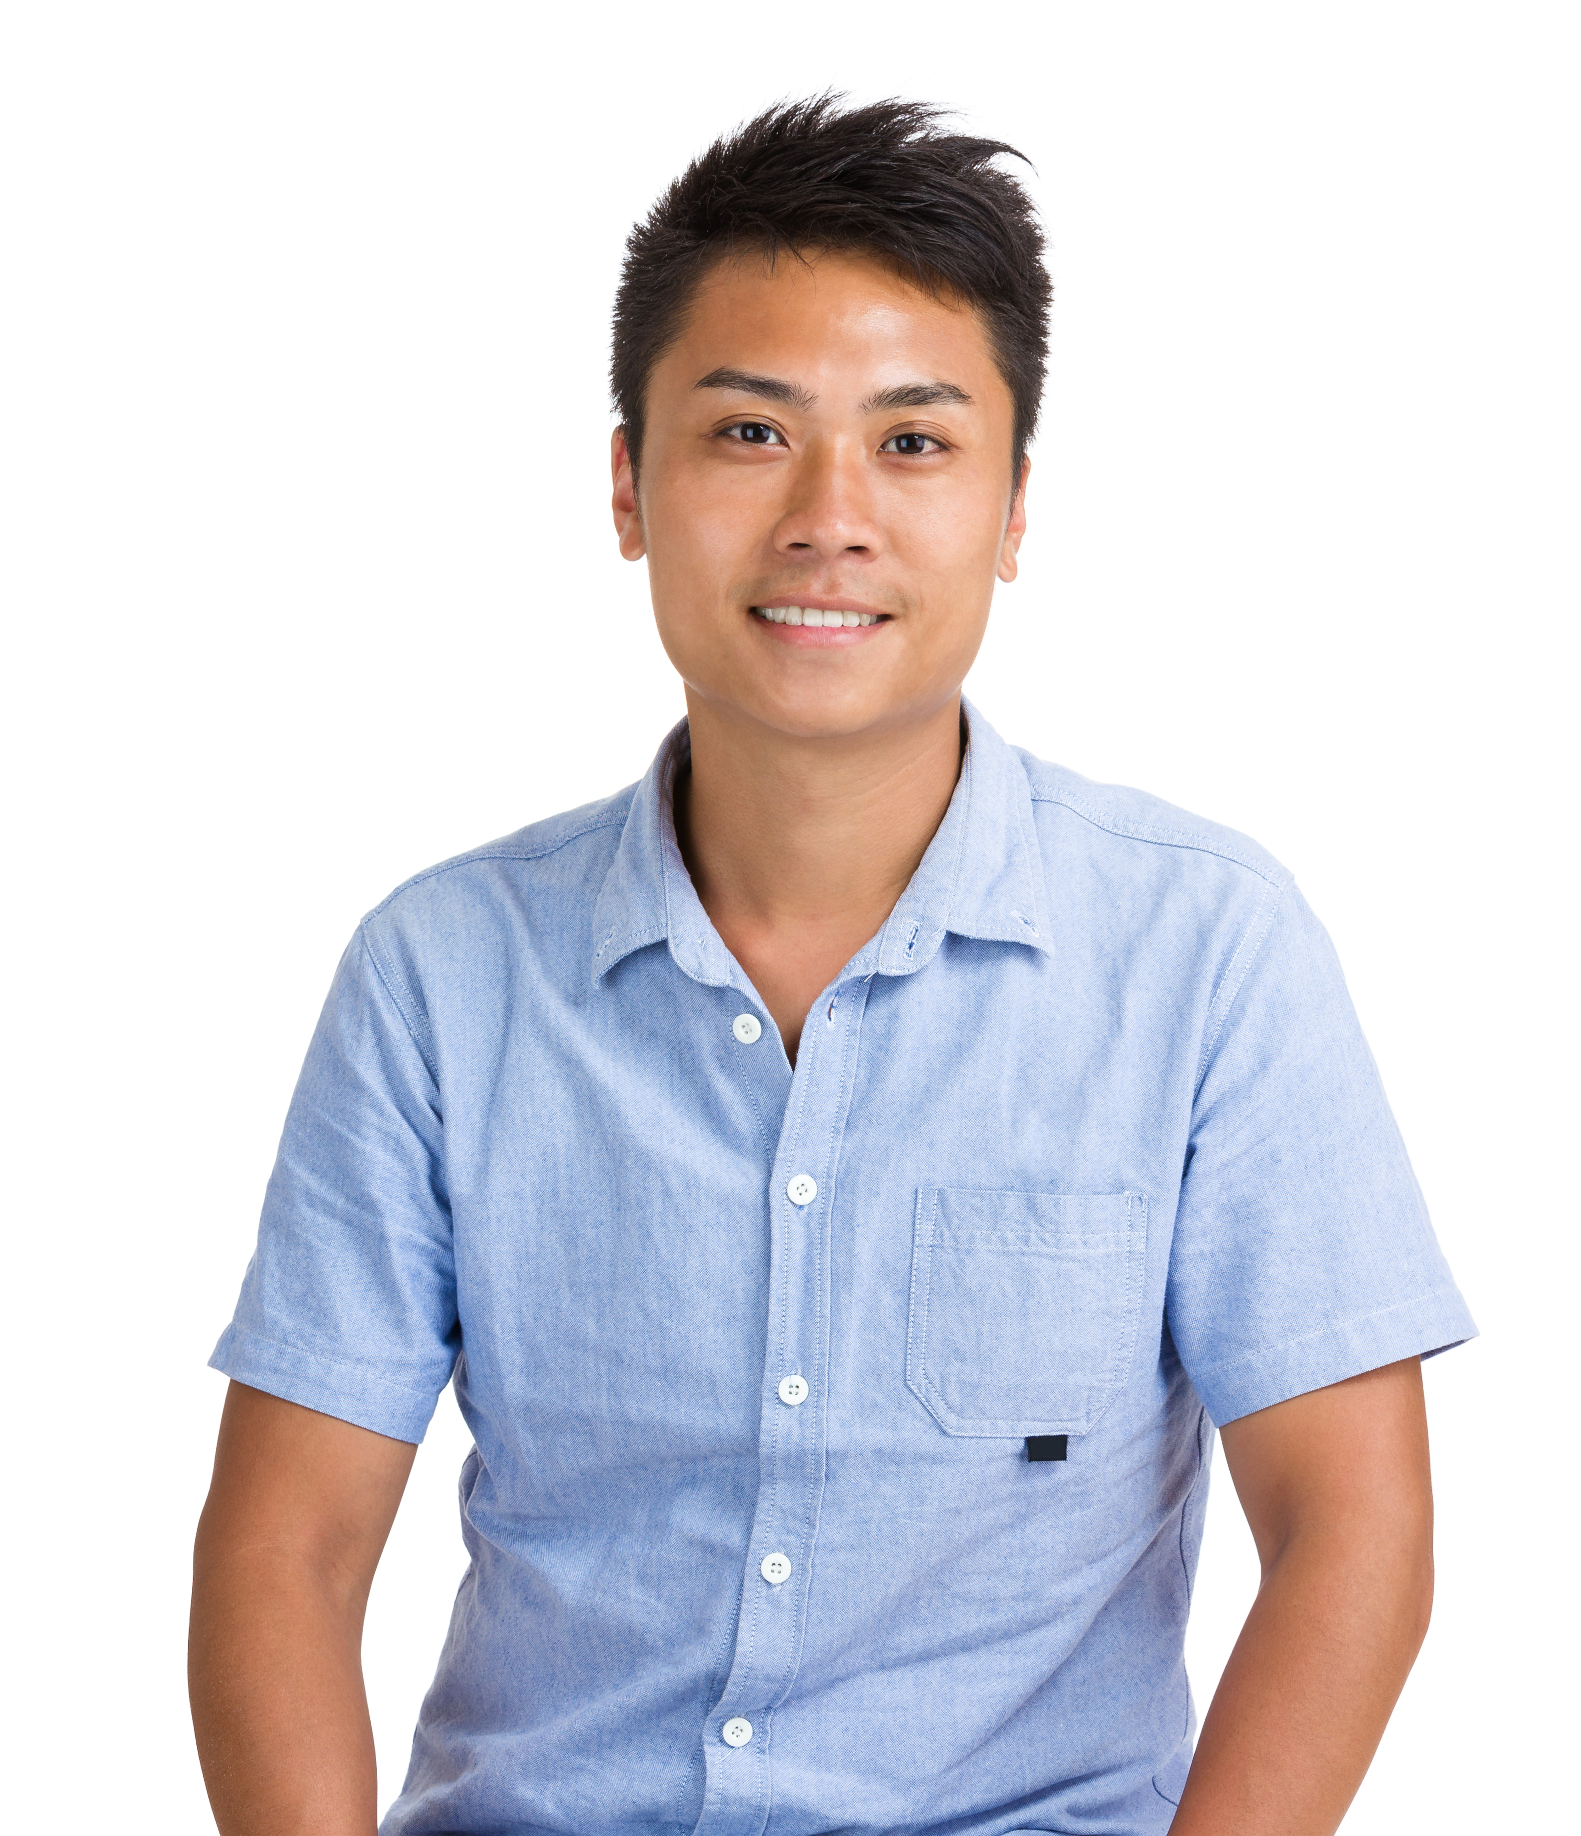
Andy’s Story
Andy was interviewed by one of his favorite staff
  He said he didn’t always know what to do when he wanted to reach out to other people.
  He agreed that finding a way to invite others to talk would be better
Andy doesn’t like waiting for people to finish whatever they are doing
    He said he feels like he is being ignored
    He indicated that feels angry and frustrated when this happens
    He does understand that it can also be frustrating for other people to be interrupted.

Slide 106
Grey Boxes Indicate
Challenges Occurred
Adapted From: Freeman, R., Matthews, K., Griggs, P. & Quick, S. (2013). Functional behavioral assessment [Online]. Lawrence, KS: University of Kansas. Available: http://kmhpbs.org

Slide 108
Setting Events
Internal Events
Social
Consequences
Reactions Or Results
Physical Setting
Clear Definition of Challenging Behavior That Can Be Measured
Behavior
Antecedents
“Triggers”
Write Down What Occurs Immediately Before Challenging Behavior
What Occurs After the Behavior
What is the Function?
(Obtain or Escape)

Slide 110
Challenging Interactions Reported by Staff
At First, All You Have is This First Part of the Graph
Freeman, R., Matthews, K., Griggs, P. & Quick, S. (2013). Functional behavioral assessment [Online]. Lawrence, KS: University of Kansas. Available: http://kmhpbs.org

Slide 112
Talk About Andy’s PBS Plan
Use the information to talk about…
Setting event interventions
Antecedent (immediate triggers)
Teaching new skills
Consequences (How to respond)

Slide 114
Fidelity of Intervention at the Individual Level….
Andy’s Intervention Fidelity Checklist | Check if/when observed OR indicate N/A. if Not Applicable
1. Practice showing Andy how to initiate a request to talk or spend time with someone using the visual card
2. Staff prompts Andy to use the social invitation card as soon as he arrives home from work.
3. Andy’s staff and roommate respond immediately any time Andy requests attention.
4. Remind Andy’s roommate that it is important to let Andy spend time with him if he hands him the social invitation card.
5. When Andy has been playing on his alone for an hour but no challenges have occurred, remind him that he can use the social invitation card. Total Checkmarks for Replacement Behavior Interventions =
Replacement Behavior Intervention Fidelity = (Total checkmarks/Total # interventions to be observed) X 100 =
…Shows that the intervention is being implemented in the way it was intended
…Means that we know that people have the support they need to implement an intervention
Notes:
have

Slide 115
After Positive Behavior Support Planning….
You are Assessing Progress
Freeman, R., Matthews, K., Griggs, P. & Quick, S. (2013). Functional behavioral assessment [Online]. Lawrence, KS: University of Kansas. Available: http://kmhpbs.org

Slide 116
Continuing Jack’s Story
Using Person-Centered Information to Create a PBS Plan

Slide 117
Teaching People Key Areas of Positive Behavior support
 | Informal Function-Based Thinking 비공식적인 기능기반 사고 | Simple Function-Based Thinking 간단한 기능기반 사고 | Complex Functional Assessment 복잡한 기능 평가 | High Level of Expertise 높은 강도의 전문성
Universal Team & Staff 보편적 팀과 직원 | X
Tier 2/3 Team 2/ 3 단계 팀 | X | X
PBS Facilitator PBS 진행자 | X | X | X
PBS Facilitator Trainer PBS 진행자 트레이너 | X | X | X | X

Slide 118
Invest in a PBS Facilitator (Trainer Level)
Support PBS at each tier
  Assist with Matrix
  Help Monitor Data
Help Team Access Resources
Facilitate PBS Plans
Participate and/or Lead Tier 2
Mentor New Staff Members to Become PBS Facilitators (Trainer Level)

Slide 119
Pick a “Doable List”
“실현 가능한 목록”을 선택
This is a Marathon – Not a Sprint
마라톤이지 단거리 경기가 아닙니다
Start Small!
작게 시작하세요!
Include Only What Is Reasonable for the Year
한 해 동안 할 합리적인 것만 포함시키세요.
Work Smarter Not Harder With Time
시간이 지날 수록 더 열심히보다는 더 똑똑하게 일하기
  Practice Effective Meeting Behaviors!
  효과적인 회의를 위한 행동을 연습하세요!
Embed Actions Into Every Day Meetings and Work
행동들을 회의와 일등 일상 깊숙히 적용시켜 사용하세요.

Slide 120
Activity: Discussion 토론
Does Your Mission and Vision Statement & Policies Include an Emphasis on
  Person-Centered Practices?
  On positive social skills and Prevention?
  여러분의 기관의 미션과 비전 강령 및 정책은 다음과 같은 것들을 강조하나요?
  사람 중심 실천
  예방에 관하여
How Do Your Training Systems Address teaching social skills?
  교육 시스템은 사람 중심적 접근을 어떻게 다루나요?
How Many People in Your Organization are Familiar with
  Person-Centered Practices?
  Positive Behavior Support?
  여러분의 기관에서 몇명이나 다음 사항들에 대해 알고 있나요?
  사람 중심 실천
  긍정적 행동 지원

Slide 121
앞으로 나아가기 위해 직장에서 다른 사람들과 공유할 수 있는 3~5가지 목록을 만드세요
_Make a list of 3-5 things you can share with others at work to move forward
앞으로 나아가기 위한 단계 _Steps for Moving Forward | 관여하는 사람 _Who is Involved | 완료 목표 날짜 _Targeted Completion Date

Slide 122
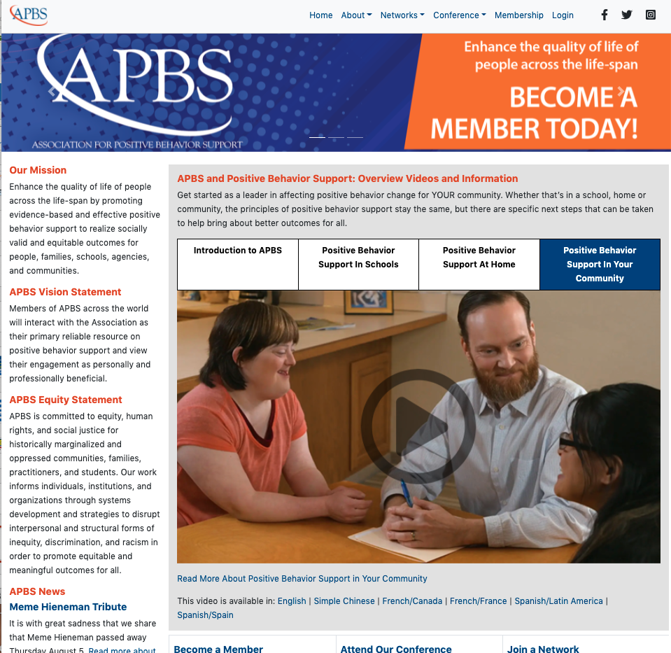
Want To Learn More About PBS?
https://www.apbs.org/
PBS Asia Network

Slide 123

APBS Conference 2022 – 19th Annual Conference
Learn More About the International Association for Positive Behavior Support and the Upcoming Conference!
Onsite and Virtual Options
https://www.apbs.org/conference

Slide 124
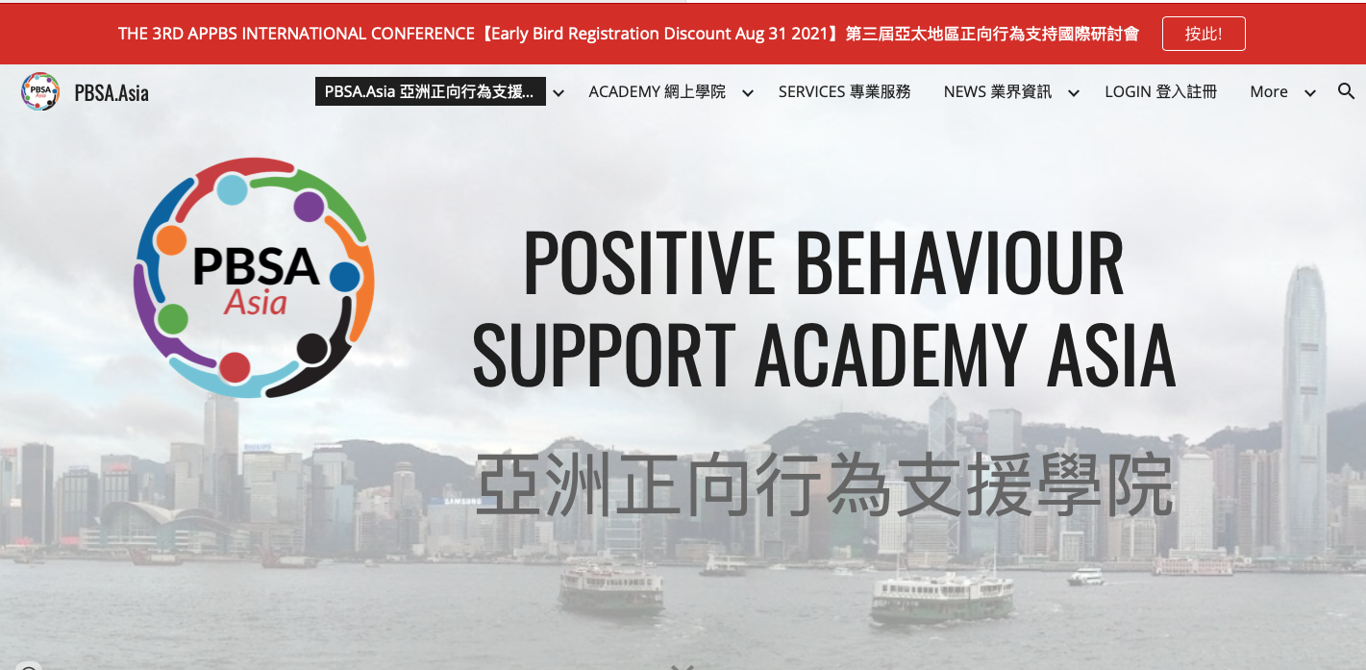
Learn More About PBS Asia https://www.pbsa.asia

Slide 125
Helpful Links
Incident Report Program
https://mnpsp.org/wp-content/uploads/2016/12/Excel-Incident-Tracking.xls
Early Childhood Behavior Incident Report System
http://challengingbehavior.cbcs.usf.edu/Implementation/data/BIRS.html
Quality of Social and Physical Environment
https://mnpsp.org/wp-content/uploads/2016/12/PBS-QOL-socialphysical-next-version9-11-17.pdf
Minnesota Team Checklist – Positive Behavior Support Subscale
https://mnpsp.org/wp-content/uploads/2016/12/Blue-MN-checklist-PBSNext-Version-Minor-Edit.pdf

Slide 126
Mindfulness Studies in the Disability Field
Free Articles Online
Singh N. N., Lancioni G. E., Karazsia B. T., Myers R. E. (2016b). Caregiver training in Mindfulness-Based Positive Behavior Supports (MBPBS): effects on caregivers and adults with intellectual and developmental disabilities. Front. Psychol. 7:98 10.3389/fpsyg.2016.00098
https://www.frontiersin.org/articles/10.3389/fpsyg.2016.01549/full
Singh N.N., Lancioni GE, Karazsia BT, Chan J, Winton ASW. Effectiveness of caregiver training in mindfulness-based positive behavior supports (MBPBS) vs. training-as-usual (TAU): a randomized controlled trial. Frontiers in Psychology. 2016;7:1549
https://www.ncbi.nlm.nih.gov/pmc/articles/PMC5053082/
Singh, N. N., Lancioni, G. E., Karazsia, B. T., Myers, R. E., Winton, A. S. W., Latham, L. L., et al. (2015). Effects of training staff in MBPBS on the use of physical restraints, staff stress and turnover, staff and peer injuries, and cost effectiveness in developmental disabilities. Mindfulness 6, 926–937. doi: 10.1007/s12671-014-0369-0
https://link.springer.com/article/10.1007/s12671-014-0369-0

Slide 127
Thank You For Your Time!

