Slide 1




Implementation Example: Provider Organization for People With Intellectual and Developmental Disabilities
Moving Into Year 3

Slide 2
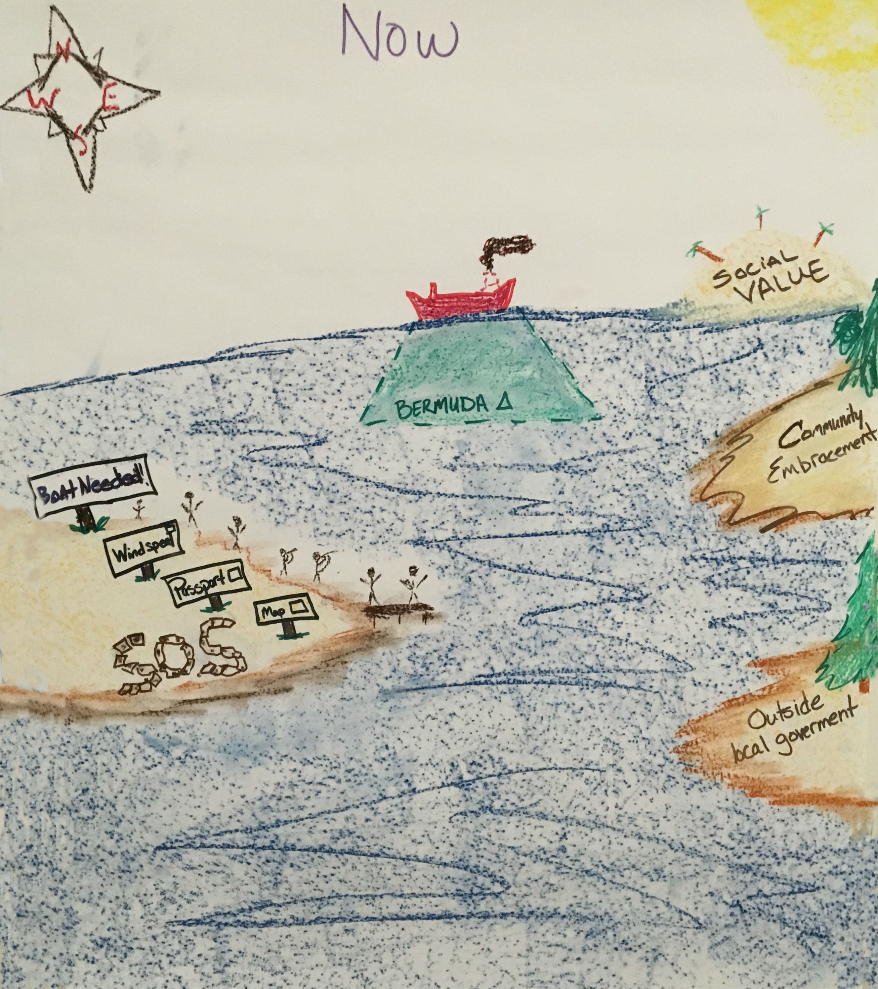
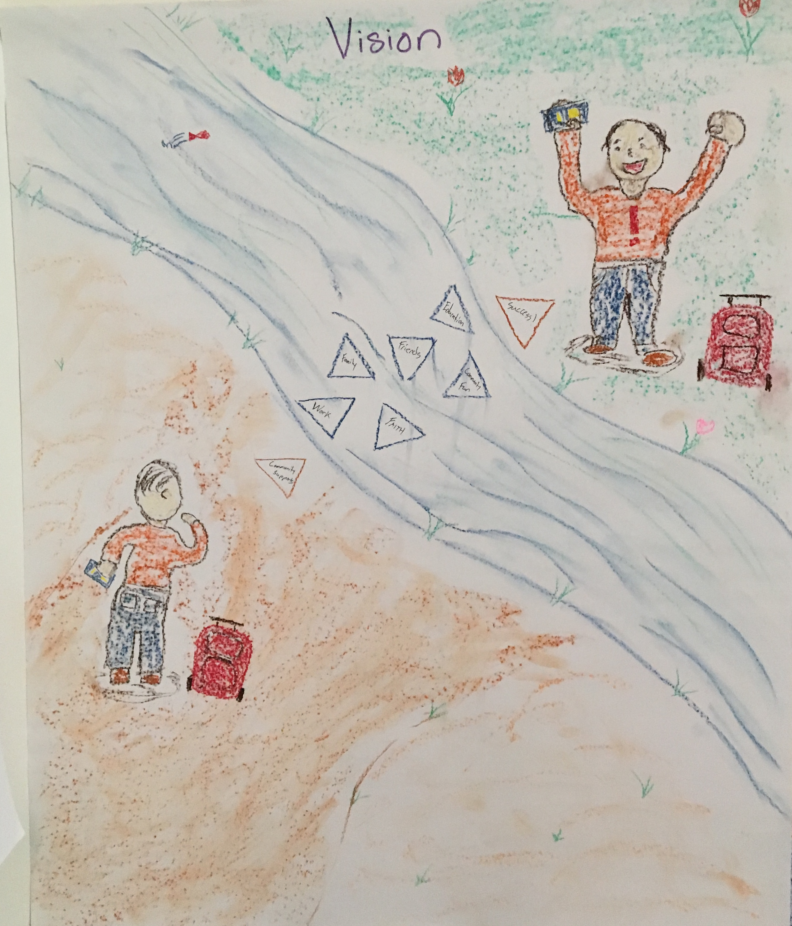
Now
Future

Slide 3
Outcome Statements
Outcomes for People Who Receive Support
  People who receive support feel respect, acceptance, and value in the community.
  People who receive support drive their plans and services.
Outcomes for Employees/Staff
  Staff understand person centered thinking are are working for/with the person receiving supports.
  Staff feel valued and want to work at SSI.
Outcomes for Organization
  SSL will match staff with person receiving supports.
  Organization will restructure the way services and supports are provided.
Outcomes for Community
  Community members will be excited to welcome, participate, engage, with SSL and person receiving support.
  Community members expand awareness of mental health.

Slide 4
Action Plan Examples
Overall Management Activities | Who | By When | Status Update
Last 30 minutes of Wednesday Meeting used for PC/PS Grant Discussion | ALL | Start 7/27/16 | Achieved/In progress, 1/12/17 need to look at accomplishing one task at each meeting, setting assignments to comment next meeting, look at different meeting locations, flip charts/post it notes
Exit Interviews | Anyone with Employees | Start Friday 7/22/16 | Completed- distributed to all supervisors/managers 7/26/16, 1/12/17 look at if these are being done
Pancake Breakfast, changed to staff role out pizza | Team Member Assistance | 10/31/16 | Picked dates of 11/11 and 11/18, need to work on agenda and get marketing about it out by 10/30/16 Completed both roll outs as of 1/12/17
Staff matching pilot- determine plan for pilot and start system | Key Contacts, | 10/31/16 | Will meet on 8/1/16 at 10:30am to develop action plan
Leadership training | Team | 12/31/16 | In progress, completed, DP in progress
Meet & Greet site visit with politician | Steve, Anna, John | 11/14/16 | Nothing done as of 1/12/17
Police Department Outreach | Lana, Steve | 10/1/16 | 2 came to ice cream social First One completed 1/12/17
Booth at SLC Health & Human Services Conference | Anna | 7/1/17 | Waiting for email response from Mary Bridget Lawson, missed out on 2016 conference, will look at attending 2017
Neighborhood gathering (Ice cream social Appreciation Event for police, fire department, etc) | Lana, Bob, Rae | 8/30/16 | Completed, 2 police came
Policy language revision | HR, Lana | Monthly | In progress
Need Help Here

Slide 5
Action Plan Examples
9 Person-Centered Thinking Coaches trained
2 Key Contacts
2 people are trained in Picture of a Life Planning
2 people are in the process of becoming PBS Facilitators
2 PBS Trainers already within the agency
Training with new employees about Person-Centered Practices
Adding person-centered questionnaires into behavior plans
Implemented social skills instruction (matrix) in two settings
Staff training and direct observation started
Improved incident reporting data collection system

Slide 6
Responding to:
“Our Agency is Already Person-Centered”
Fidelity of Implementation
Strategy for Providing Evidence That an Organization is Implementing a Practice in the Manner Intended
A List of Key Elements of a Practice Teams Can Use for
  Self-Assessment and Evaluation
  Help Guide Implementation
External Evaluation
  Unbiased Assessment of Practice

Slide 7
Self-Assessment Data
Notes:
Rachel does slides 8-15

Slide 8
Minnesota Self-Assessment Checklist - Overall

Slide 9
External Onsite Evaluation
2-4 Hours Visit to Organization
Review of Documentation
Interviews
Observations
Notes:
Rachel does slides 8-15

Slide 10
Onsite Evaluation Scores

Slide 11
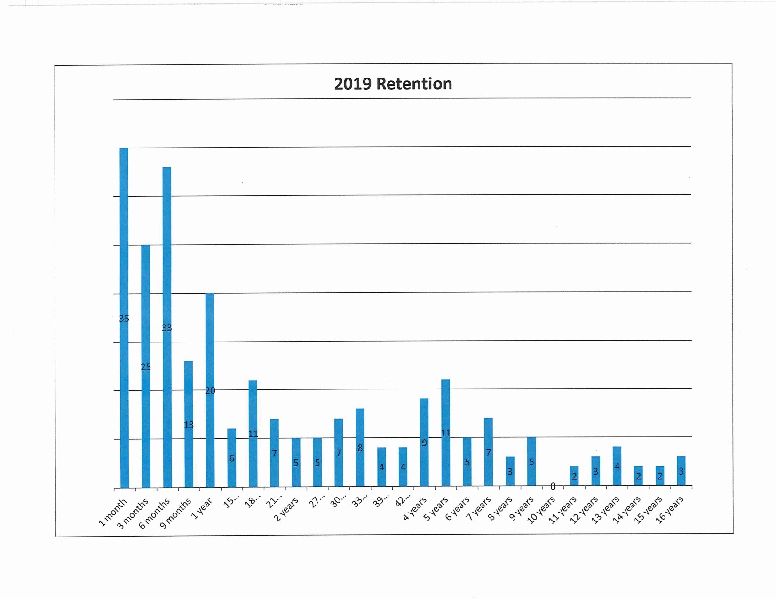
Staff Retention Data

Slide 12
Outcome Data:
Incident Reports
Notes:
Rachel does slides 8-15

Slide 13
Incidents by Month
Number of Incidents
Months

Slide 14
Incidents by Day of the Week
Number of Incidents
Days of the Week

Slide 15
Incidents by Location
Number of Incidents
Locations

Slide 16
Incidents by Time of Day
Number of Incidents

Slide 17
Incidents by Antecedents
Number of Incidents
Types of Antecedents

Slide 18
Incidents by Behavior
Number of Incidents
Types of Behaviors

Slide 19
Incidents by Program
Number of Incidents
A B C D E F G H I J K L M N O P
Organizational Settings

Slide 20
Incidents by Motivation
Number of Incidents

Slide 21
Incidents by Gender

Slide 22
Direct Observation Data for Matrix
Observations Conducted in Two Settings
Lunch
Employment classes

Slide 23
Direct Observation Strategy
Part 1 – Staff Members Observed
PC Practices
Person-First Language
Nonjudgmental Language
Working in Alliance
Reflective Listening Skills
Universal Person-Centered Strategies
Empathic Behaviour
PBS Practices
Encouraging Social Interaction
Supporting Choices
Reinforcing Others
Part 2 – Person Supported
Active Involvement in Conversations/Meetings/Activities
Engaging in Identified Social behaviors
Operational Definitions for…
  Respect
  Inclusion
  Support
  Empathy

Slide 24
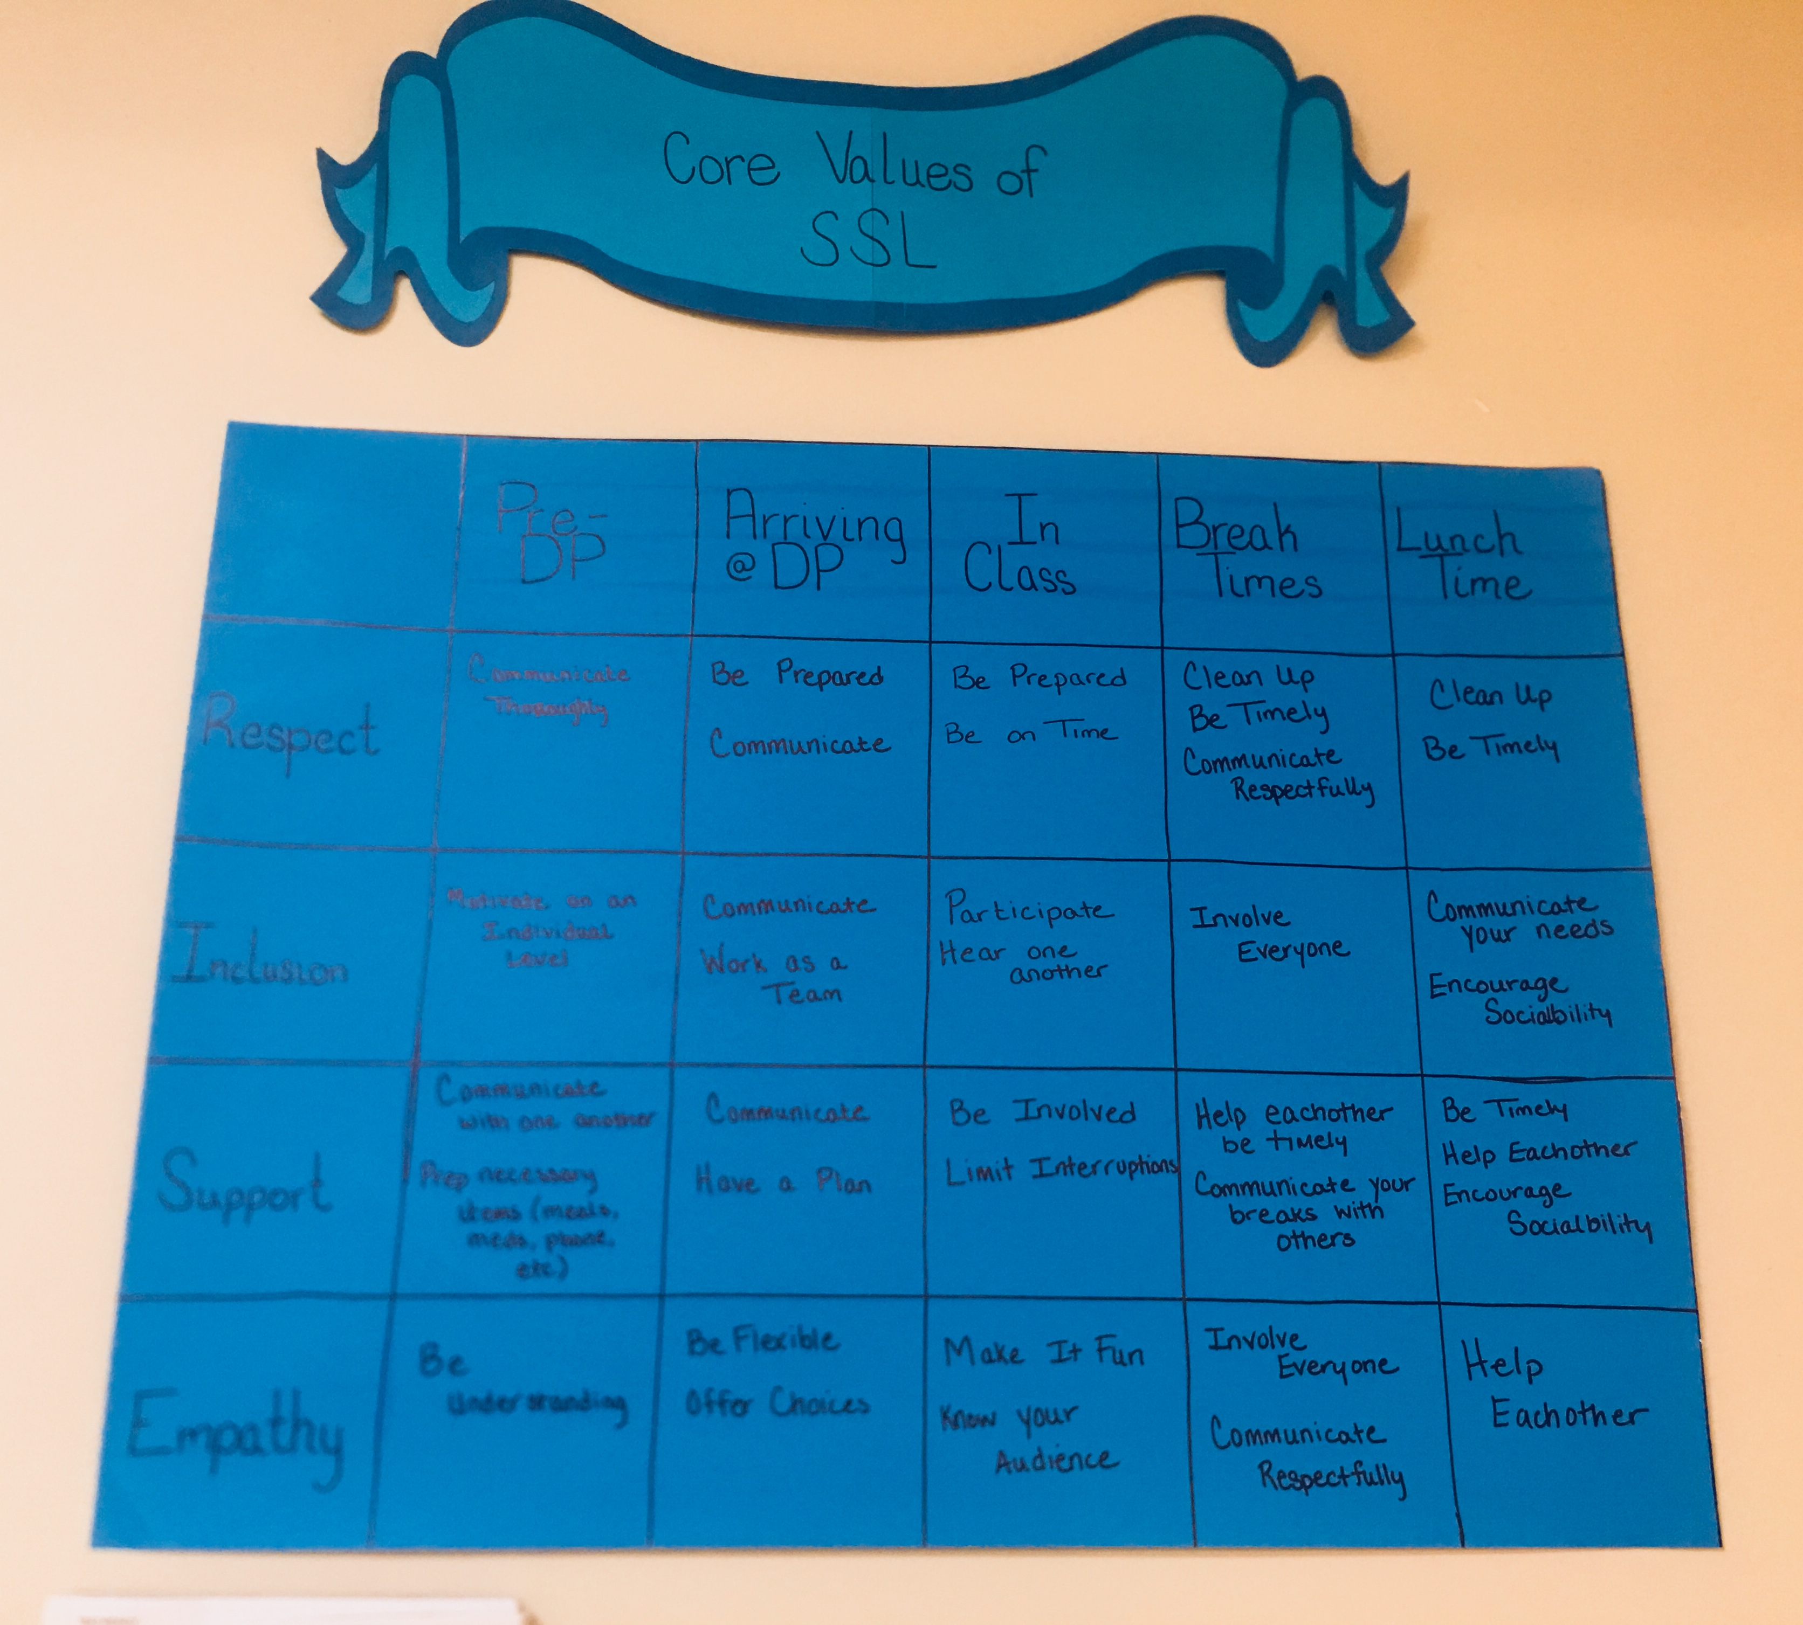
First Steps for Matrix
Team of staff members, supervisor involved in observations, people supported met to identify positive social values
Following initial observations, the PBS team member and employment site supervisor initiated:
  Large printed versions of the matrix displayed in hallways, employment classrooms, and the cafeteria
  Larger scale employee training on the matrix
  Training and education on the matrix to the employees and people being supported during employment classes.

Slide 25
 | Before Day Program | Arrival | In Class | Break Times | Lunchtime
Respect | Communicate thoroughly | Being Prepared & Communicate | Be Prepared & Be on time | Clean up, Be Timely, & Communicate Respectfully | Clean up & Be Timely
Inclusion | Motivate on an individual level | Communicate and work as a team | Participate and hear one another | Involve Everyone | Communicate your needs Encourage Socialbility
Support | Communicate with one another Prep necessary items (Meals, Meds,Phone, etc) | Communicate and have a plan | Be Involved, Limit Interruptions | Help each other be timely Communicate your breaks with others | Be Timely, Help each other Encourage Sociability
Empathy | Be understanding | Be Flexible & Offer Choices | Make it fun, Know your audience | Involve Everyone, Communicate Respectfully | Help each other

Slide 26
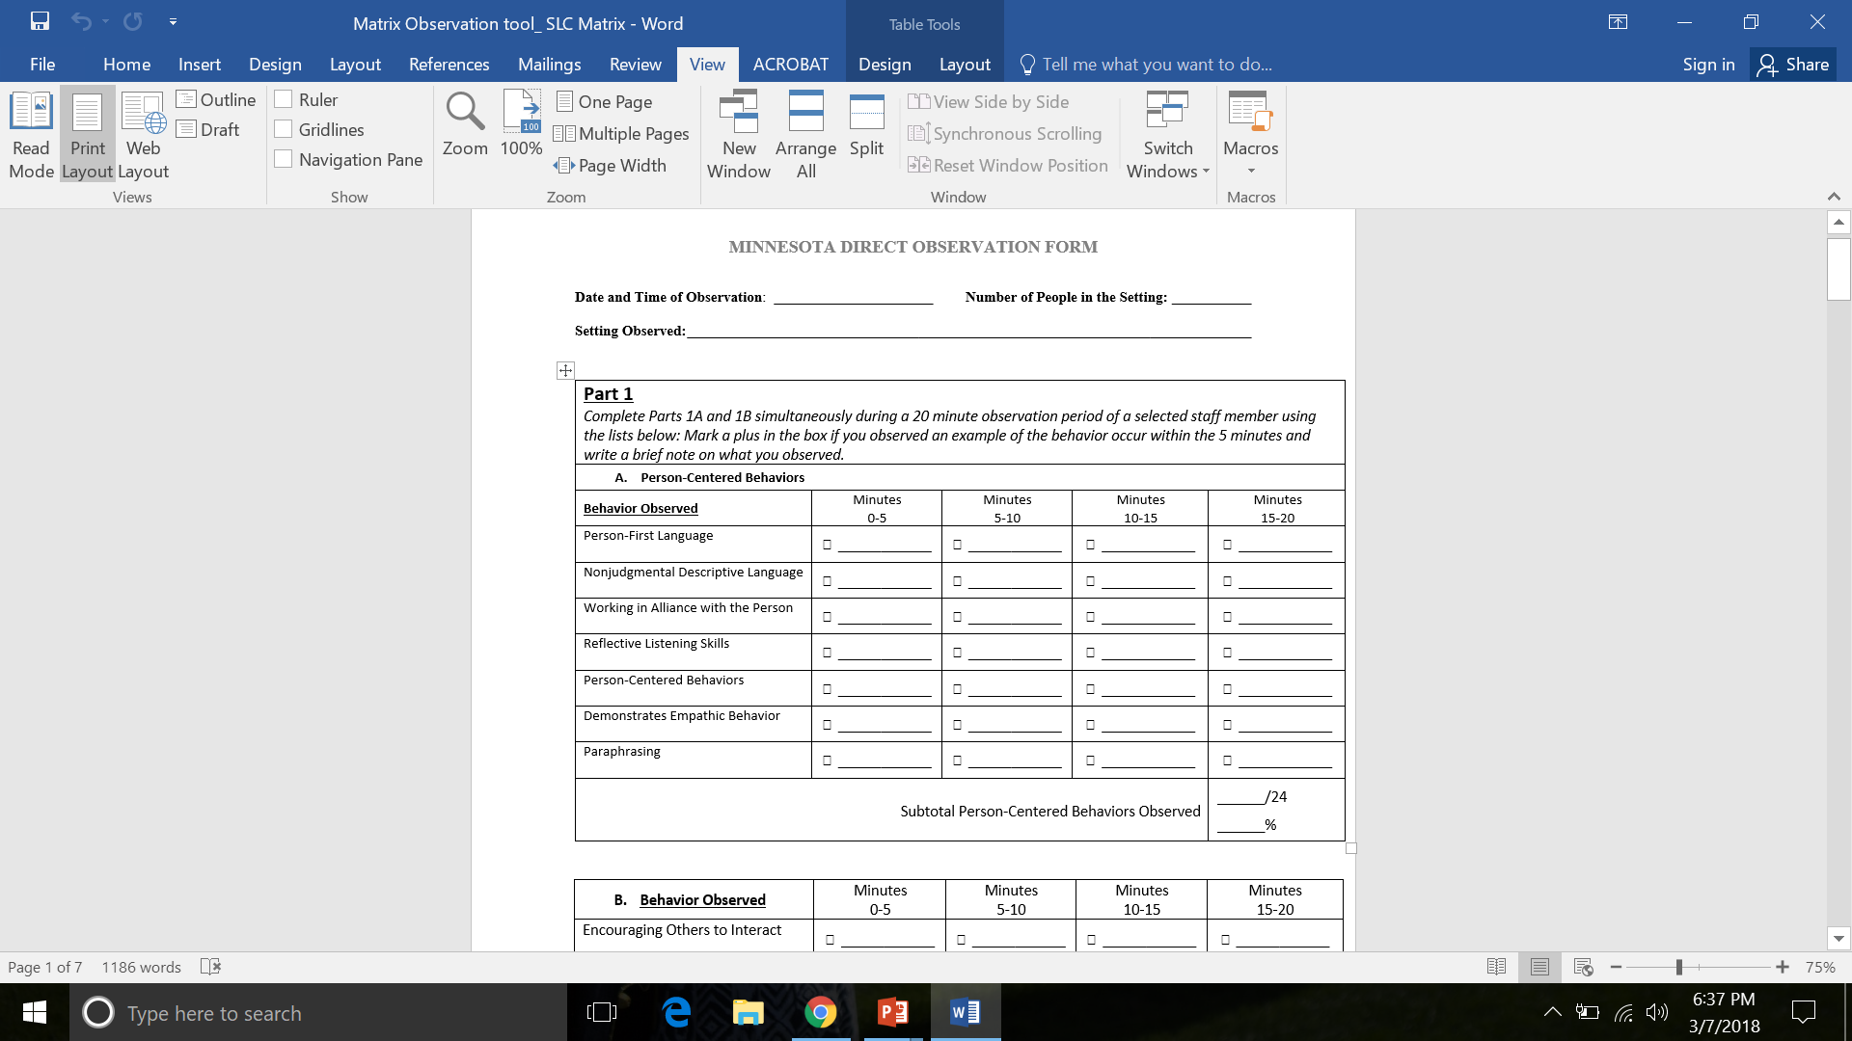
Part 1
Matrix Observation Process
Initially complete a goal of 3 matrix observations (20 to 40 min each).
Inter-observer agreement—initially have 2 observers (initially one observer can be PBS team member over TelePBS). Eventually, have 2 observers at your site.
Make sure that you “agree” on observations approximately 80% of the time
If you don’t, talk through the codes, write down specific examples to help get in better agreement.
Following initial observations, your teams take over and collect regular data (e.g., monthly)

Slide 27
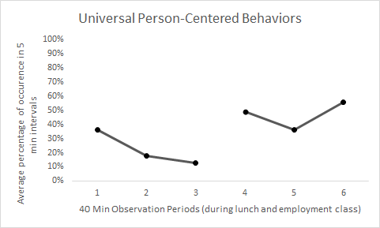
Initial Observations
Post-Training Observations
Notes:
Initial range: 13-36%
Post training range: 36 to 56%
Equal observations across settings (2 classroom/1 lunch at BOTH initial observation AND post-training)

Slide 28
Post-Matrix-Specific Training

Slide 29
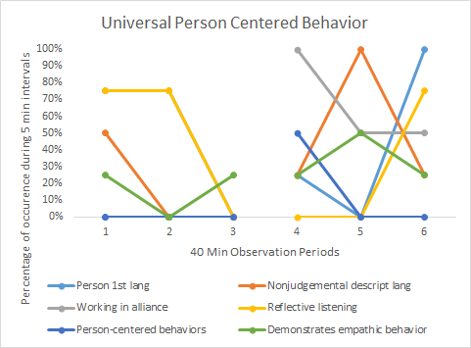

Slide 30
Part 2
Are People Actively Using the Social Interactional Skills Considered Important?

Slide 31
Post Matrix-Specific Training

Slide 33
Organizational Data In Development
Quality of Life Evaluation
Incident Reports
Injuries, Sick Days
Information Related to Retention, Workers Compensation, Staff Injury
Orientation Staff Development & Performance Data
Surveys and Other Documentation Related to
  Quality of Life
  Climate
  Stress
Information about Other Positive Supports Used in Organization

Slide 34
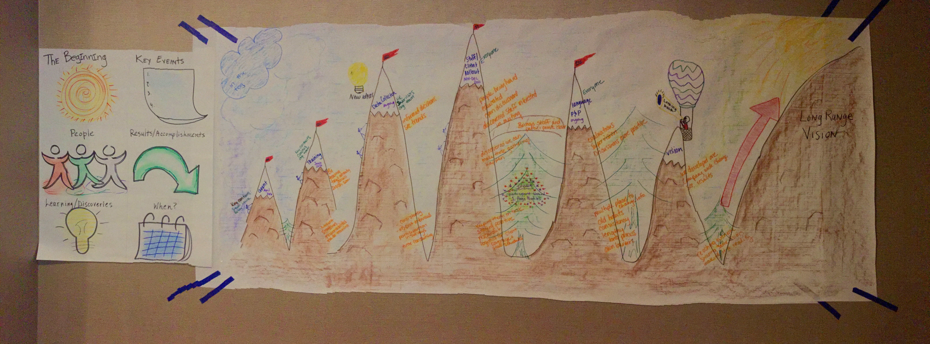
History Map

