Slide 2
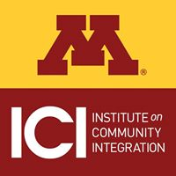



Examples of Implementation:
Residential Support for People With Disabilities

Slide 3
Team

Slide 4
Person-Centered and PBS Self-Assessment and Action Planning—Provider Organization
Team Roles
17 Organization-wide Team Members
2 Key Contacts
12 Coaches
4 PBS Facilitators (in training)
1 Person Centered Thinking Trainer (in training)
Monthly Team Meetings
Implementation Areas Targeted
Integrate Michael Smull Method With Existing Person-Centered Practices
Integrate PBS Tiered Model

Slide 5
Assessing

Slide 6
Assessing Organizational Data
Alignment of Organizational Policies
Orientation Staff Development & Performance
Surveys and Other Documentation Related to
  Quality of Life
  Climate
  Stress
Information about Other Positive Supports Used in Organization
Quality of Life Evaluation
Incident Reports (Preparation in Year 1)
Injuries, Sick Days
Information Related to Retention, Workers Compensation, Staff Injury

Slide 7
Vision Boards

Slide 8
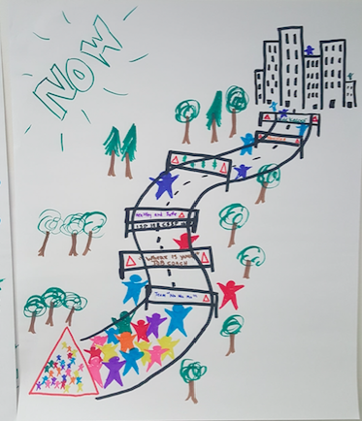
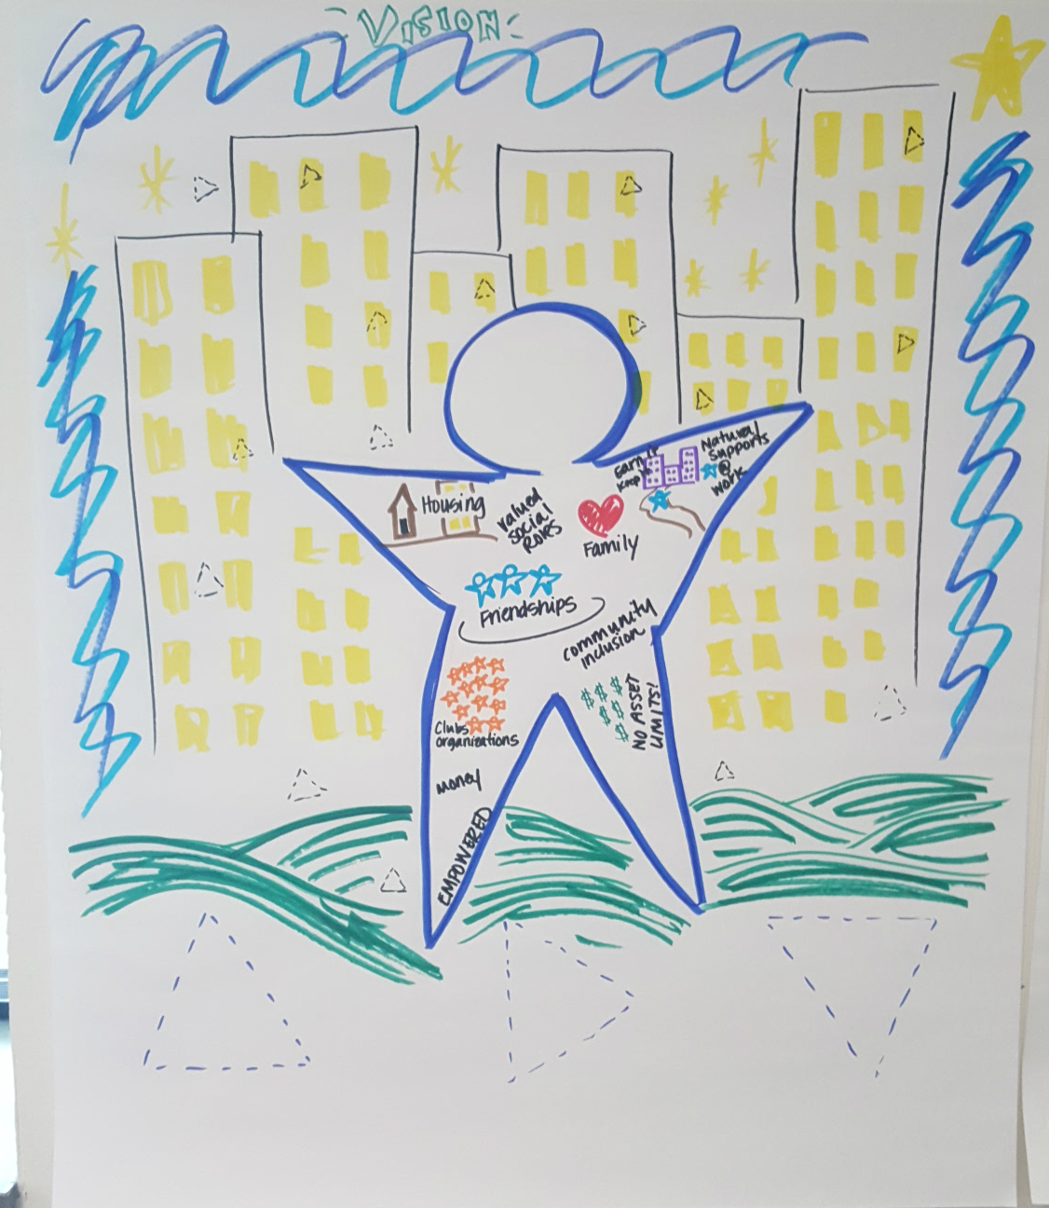
Provider Organization – Residential Supports
Now
Future
Notes:
This image represents the where the orgaizations feels they are now, people living outside of the community, with only one way to get to the coummnuty

Slide 9
Outcome Statements

Slide 10
Outcome Statements for Organization
Outcomes for People Who Receive Support:
  All people will lead a meaningful life.
Outcomes for Employees/Staff:
  Employees will use person-centered thinking as their first language.
  Employees will demonstrate the core values in all areas of service delivery and in their interactions with each other.
Outcomes for Organization:
  Trillium Services will invest the time and resources to make sure it has the adequate numbers of staff trained in positive support.
  Trillium Services will invest in their employees though coaching, mentoring, training, and facilitating person-centered thinking skills.
Outcomes for Community:
  The community embraces its role as a natural support.
  Trillium will offer opportunities for community members to be educated in person centered practices.

Slide 11
Action Plan

Slide 12
Provider Example - Action Plan Examples
PATH Completed With All Stakeholders
Used Newsletter to Share Information
Coaches are Mentoring Staff
4 Total PBS Facilitators in Training
25 Person-Centered Plans
1 PCT Trainer
PATH/MAPS Facilitator Training
Working on Piloting Matrix in Residential Setting
Revamp Staff Incentive Program
Implement Matrix in Pilot Areas
Annual Celebration
Policy Reviews to:
  Insert Person-Centered Language
  Remove Jargon

Slide 13
Matrix

Slide 14
Matrix Completed in
A Residential Setting with Two Women

Slide 15
PATH

Slide 16
Stakeholder PATH

Slide 17
Data

Slide 18
Minnesota Team Implementation
Checklist -Overall
Subscale Areas

Slide 19
History Map

Slide 20
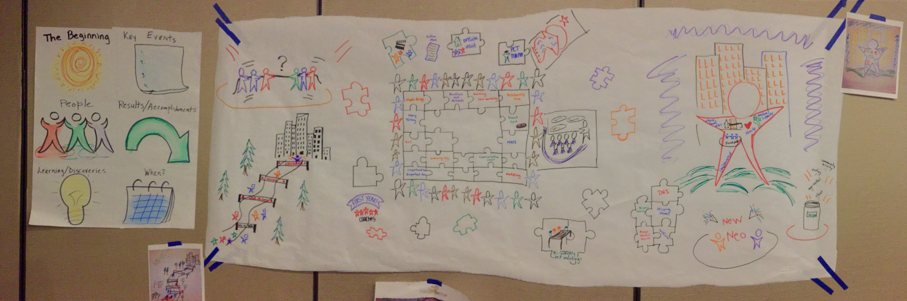
History Map for Organization

Slide 21
Funding Used to Support This Story
Preparation of these modules was supported, in part, by cooperative agreement from the Minnesota Department of Human Services (MN DHS) with the Institute on Community Integration. The University of Minnesota undertaking projects under government sponsorship are encouraged to express freely their findings and conclusions. Points of view or opinions do not, therefore necessarily represent official MN DHS policy.
The University of Minnesota's mission, carried out on multiple campuses and throughout the state, is threefold: research and discovery, teaching and learning, and outreach and public service. The University of Minnesota shall provide equal access to and opportunity in its programs, facilities, and employment without regard to race, color, creed, religion, national origin, gender, age, marital status, disability, public assistance status, veteran status, sexual orientation, gender identity, or gender expression.

Slide 22
