Slide 2
Public Health Organization
Implementation Story 4
Person-Centered Organization-Wide Person-Centered Practices &
Positive Behavior Support Action Planning
Notes:
Rachel does slides 8-15

Slide 3
Team

Slide 4
Person-Centered and PBS Self-Assessment and Action Planning--Public Health Team
Team Roles
8 Team Members
1 Key Contact
4 Coaches
2 PBS Facilitators (In Training)
1-2 PCT Trainers (Identified to be Trainers)
Monthly Team Meetings (5)
Implementation Areas Targeted
2016 Case Management (Over and Under 65)
2017 Family Health and Hospice

Slide 5
Assessing readiness

Slide 6
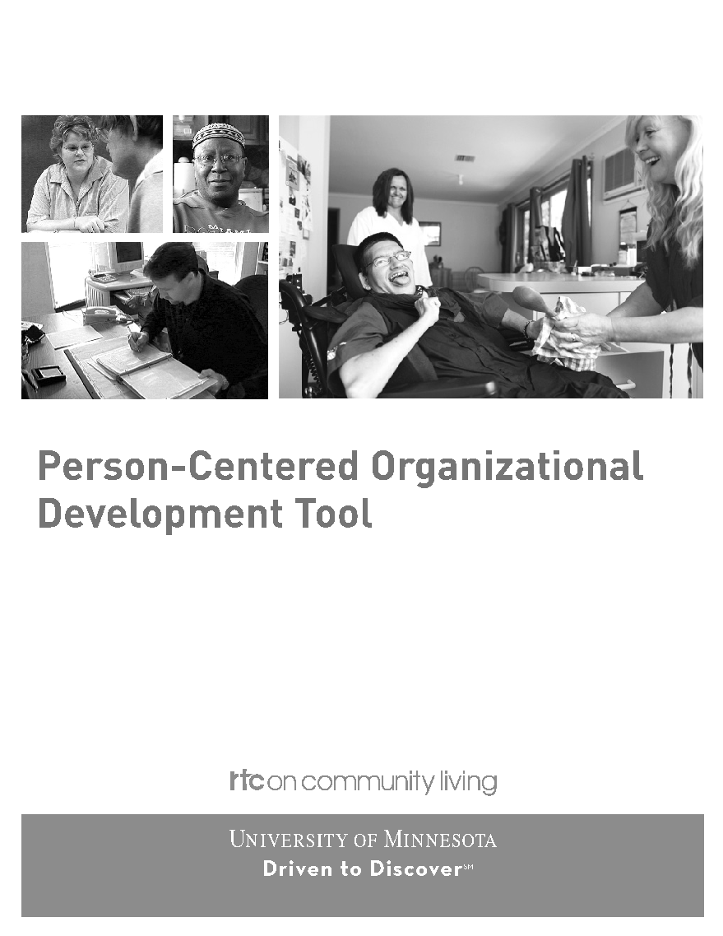
Person-Centered Organizational Tool
Perosn-Centered Organizational Development Tool

Slide 7
Vision Future and Now

Slide 8
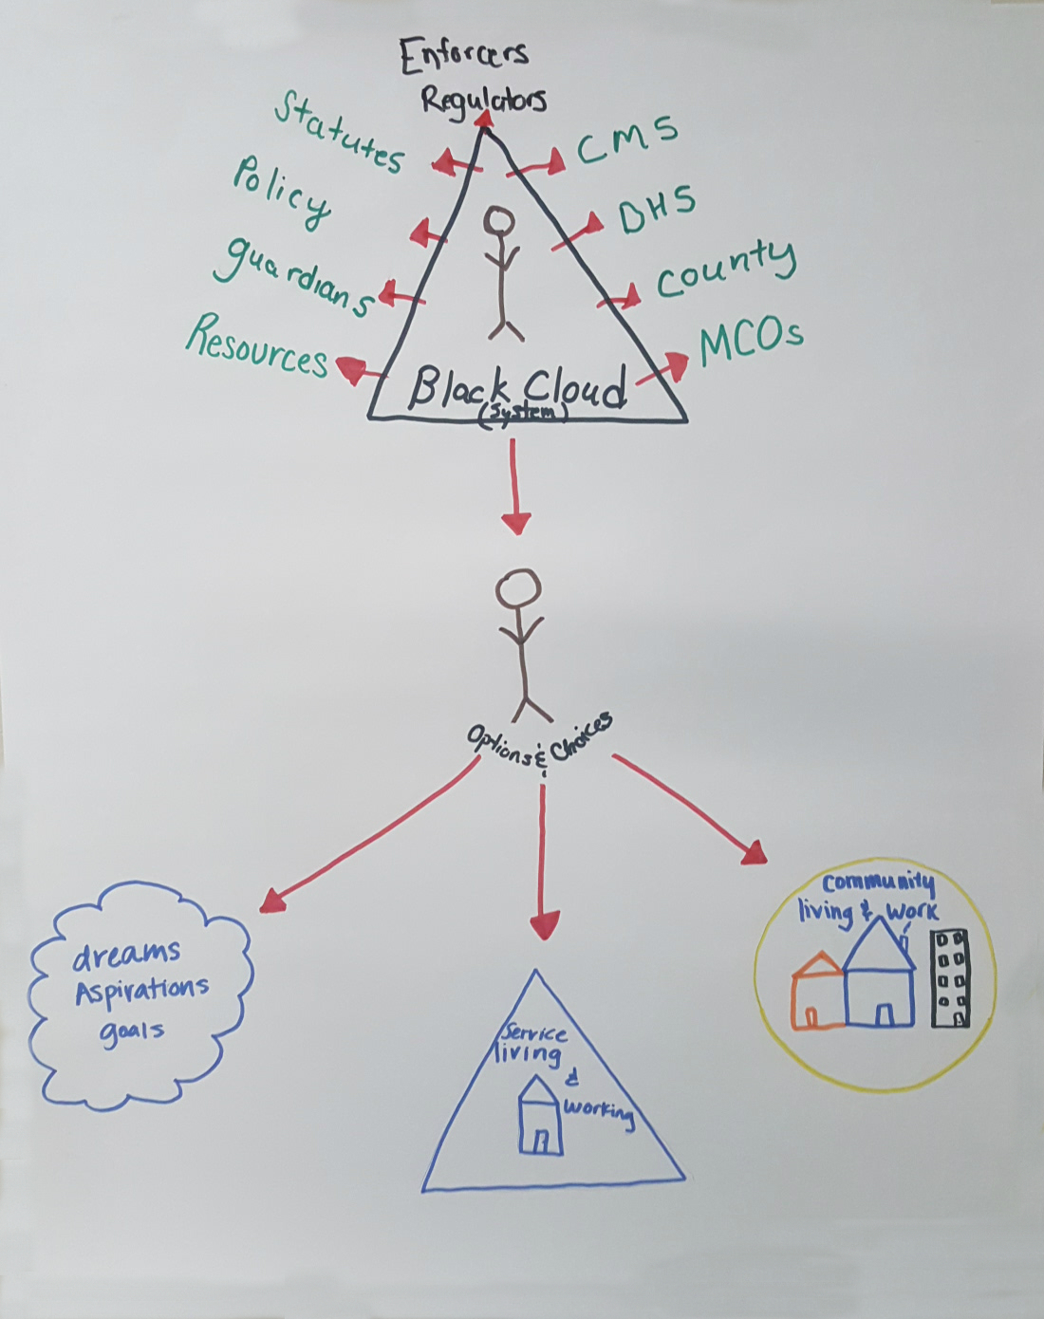

Vision Boards
Now
Future

Slide 9
Outcome Statements

Slide 10
Establishing the Vision
Public Health Outcomes Statements
People Who Receive Support:
People are feeling a part of the community
Have enough supports available so people who receive services can succeed
Employees/Staff:
Leadership works to balance the important “to’s” of staff vs. the important “for’s” for the agency
Staff are willing to adapt to others’ to’s and for’s

Slide 11
Public Health Outcomes Statements (Continued)
  Organization
  The organization will empower people to succeed in reaching goals that are important to them
  The organization will foster better relationships with other community partners
Community
  The community members will work, live and play with each other side by side
  The community will provide more inclusive services with less stigma

Slide 12
Action Plan

Slide 13
Action Planning Item Examples
All Case Managers Participate in PCT Training by 2016
Policy Changes Made to Care Plan Format
  Person-Centered Language
  Ease of Use/Decrease in page numbers
Coaches Teach Tools to Case Managers
  Monthly Meetings Over and Under 65
  All Case Managers Quarterly
Implement PBS Matrix Within Case Management Meetings as First Step
PBS Training for Two Members
PCT Training 1-2 Members

Slide 14
Action Planning Item Examples Continued
Person-Centered Planning (Picture of a Life)
  2 People
Increase Visibility of Implementation Efforts
  Restroom “The Installment”
  Website
New Staff Orientation Training in PCT
Integrating Person-Centered Principles into Employee Performance Evaluations
Collaboration with 5 Counties in Regional Rural Area:
  Share Trainers
  Leverage Resources
  Monthly Regional Meetings

Slide 15
Public Health Matrix for Case Managers

Slide 16
DATA – MN Team Checklist

Slide 17
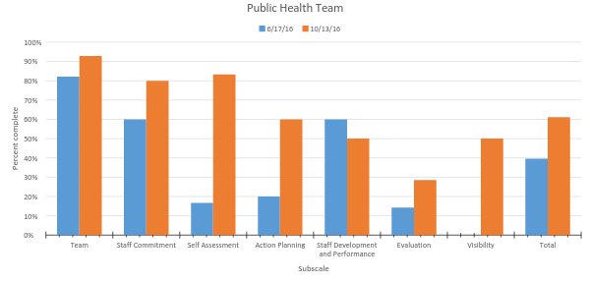
Public Health Organization Example
MN Team Checklist

Slide 18
History Map

Slide 19
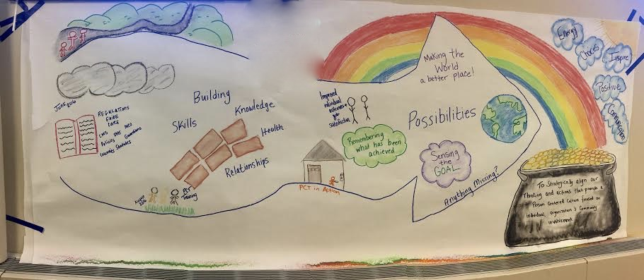
History Map for Organization

Slide 20

U of MN Director and staff

