Slide 1
9 Core Features of PBS Webinar Series Part 2 of 4
Early Childhood (birth to age 6)
October 27, 2020 | 10:00-11:30
Keynote: Bonnie Ingelin– University of St. Thomas
Facilitator: L. Lynn Stanberry Brusnahan – University of St. Thomas
Zoom Host: Erin Farrell – Minnesota Department of Education
Friday, June 19, 2020

Slide 2

MNPBS Network Purpose
MNPBS Network is bringing practitioners together across settings, populations and the lifespan to articulate key PBS features and share about exemplary PBS at a community level.
Notes:
Takeaway 1: There are a finite number of core features are not unique for positive behavior support, regardless of the setting, context, situation, group, etc. We share more similar than different, so we can focus on those universal PBS core features that also apply to increased layers of support. As a result, people in Minnesota now have this thing that we believe works to both increase desirable behaviors by supporting people in the ways they find the most pleasant or literally, positive.
Takeaway 2 As a result of Takeaway #1, we expect our competencies to be more similar than different across school, community, demographics, cultures, etc. especially if they match with what is important shared values to the people we support.
Takeaway 3: Tiered systems coordinate efforts too. We expect, and want to select teams and networks that have a variety of skills that they bring that are integrated and compensatory. Think of it as a potluck. It would be a lot of work for one person to do the entire meal and sustain it over and over again. It also would be a problem if all 10 people brought a bag of chips. Tiered systems is coordination and alignment so that the right people with the right skills are bringing the right information at the right time to make decisions.
Takeaway 4: MNPBS Network is a way to structure to keep people coming back and staying in the right level of consistent communication. It ties back to Takeaway 3 by ‘setting the table’ at and expected and consistent time and place so that we can all get the benefit of all the ‘dishes’ that people bring. There’s perhaps a human tendency to want to ‘make it your own’, but ultimately we have to have non-negotiable core features. We could give all of our blueprints, fidelity assessments being developed, terms of references, Give/Gets, etc. as examples for people to do it on their own (e.g., “Letting it Happen”), but we each have to have that experience making it work for your team with experience doing it collaboratively as a network in a less high pressure, high stakes situation.

Slide 3


Collaborators Forum Webinar Series
Theme: 9 Core Features of PBS
Changes lifestyle
Works across lifespan
Used across all settings
Involves the people supported
Creates effective change
Helps improve outcomes by involving everyone in making changes together
Decreases the likelihood of problems
Uses research knowledge across science
Integrates multiple theories and values
Keynotes in the following areas
Early Childhood (0-5): Dr. Bonnie Henning
Children and Young Adults (6-21): Dr. Kevin Filter
Adult Services (21 plus): Dr. Rachel Freeman
Elderly & Aging: Dr. Jeffrey Buchanan
The Collaborators Forum is an event for people interested in positive behavior supports (PBS) across settings and the lifespan in Minnesota. This year the MNPBS Network is planning to increase the number of host sites in other parts of the state, and to increase the amount of interactivity for audience members who can’t travel but want to be a part of the Forum.
More information and registration:
mnpsp.org/mnpbs
Notes:
The Collaborators Forum webinar series is a four session event every two months with keynotes from across Minnesota.

Slide 4
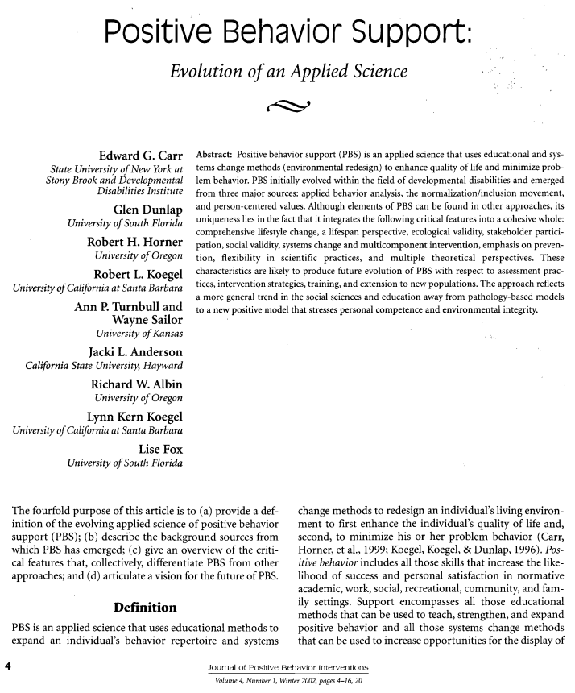
JPBI Article in 2002
9 Core Features
Changes lifestyle
Works across lifespan
Used across all settings
Involves the people supported
Creates effective change
Helps improve outcomes by involving everyone in making changes together
Decreases the likelihood of problems
Uses research knowledge across science
Integrates multiple theories and values
Based on:
“Positive Behavior Support: Evolution of an Applied Science” (Journal of Positive Behavior Interventions, 2002)
“These characteristics are likely to produce future evolution of PBS with respect to assessment practices, intervention strategies, training, and extension to new populations….”
https://journals.sagepub.com/doi/pdf/10.1177/109830070200400102
Notes:
The theme for the Forum is “9 Core Features of Positive Behavior Support”, which is based on the article from Carr et al. 2002 that provides an overview of the critical features that differentiate PBS from other approaches to enhance quality of life and minimize problem behavior across all demographics and settings. The nine core features from the article are in plain language from the MNPBS Network, as shown in the most current save-the-date flyer on the back of this letter.
https://journals.sagepub.com/doi/pdf/10.1177/109830070200400102
Positive behavior support (PBS) is an applied science that uses educational and systems change methods (environmental redesign) to enhance quality of life and minimize problem behavior. PBS initially evolved within the field of developmental disabilities and emerged from three major sources: applied behavior analysis, the normalization/inclusion movement, and person-centered values. Although elements of PBS can be found in other approaches, its uniqueness lies in the fact that it integrates the following critical features into a cohesive whole: comprehensive lifestyle change, a lifespan perspective, ecological validity, stakeholder participation, social validity, systems change and multicomponent intervention, emphasis on prevention, flexibility in scientific practices, and multiple theoretical perspectives. These characteristics are likely to produce future evolution of PBS with respect to assessment practices, intervention strategies, training, and extension to new populations. The approach reflects a more general trend in the social sciences and education away from pathology-based models to a new positive model that stresses personal competence and environmental integrity.

Slide 5
Positive Behavior Support
Across the Life Span
9 Core Features of PBS
Changes lifestyle
Works across lifespan
Used across all settings
Involves the people supported
Creates effective change
Helps improve outcomes by involving everyone in making changes together
Decreases the likelihood of problems
Uses research knowledge across science
Integrates multiple theories and values
9 Core Features – Universal for All

Slide 6






Impact On Life Trajectory
If We Collaborate to Provide Positive Supports and Choice Across the Lifespan…
End of Life
Achieve each person’s vision for a full life in the community
Aging
Adulthood
Transition
School
Early
Childhood
Life Trajectory
Community Life
Good Paid Life
Birth
… Instead of a life defined by …
[FILL IN THE BLANK]
Service Life Trajectory
Adapted from Integration of LifeCourse Life Trajectory©

Slide 7
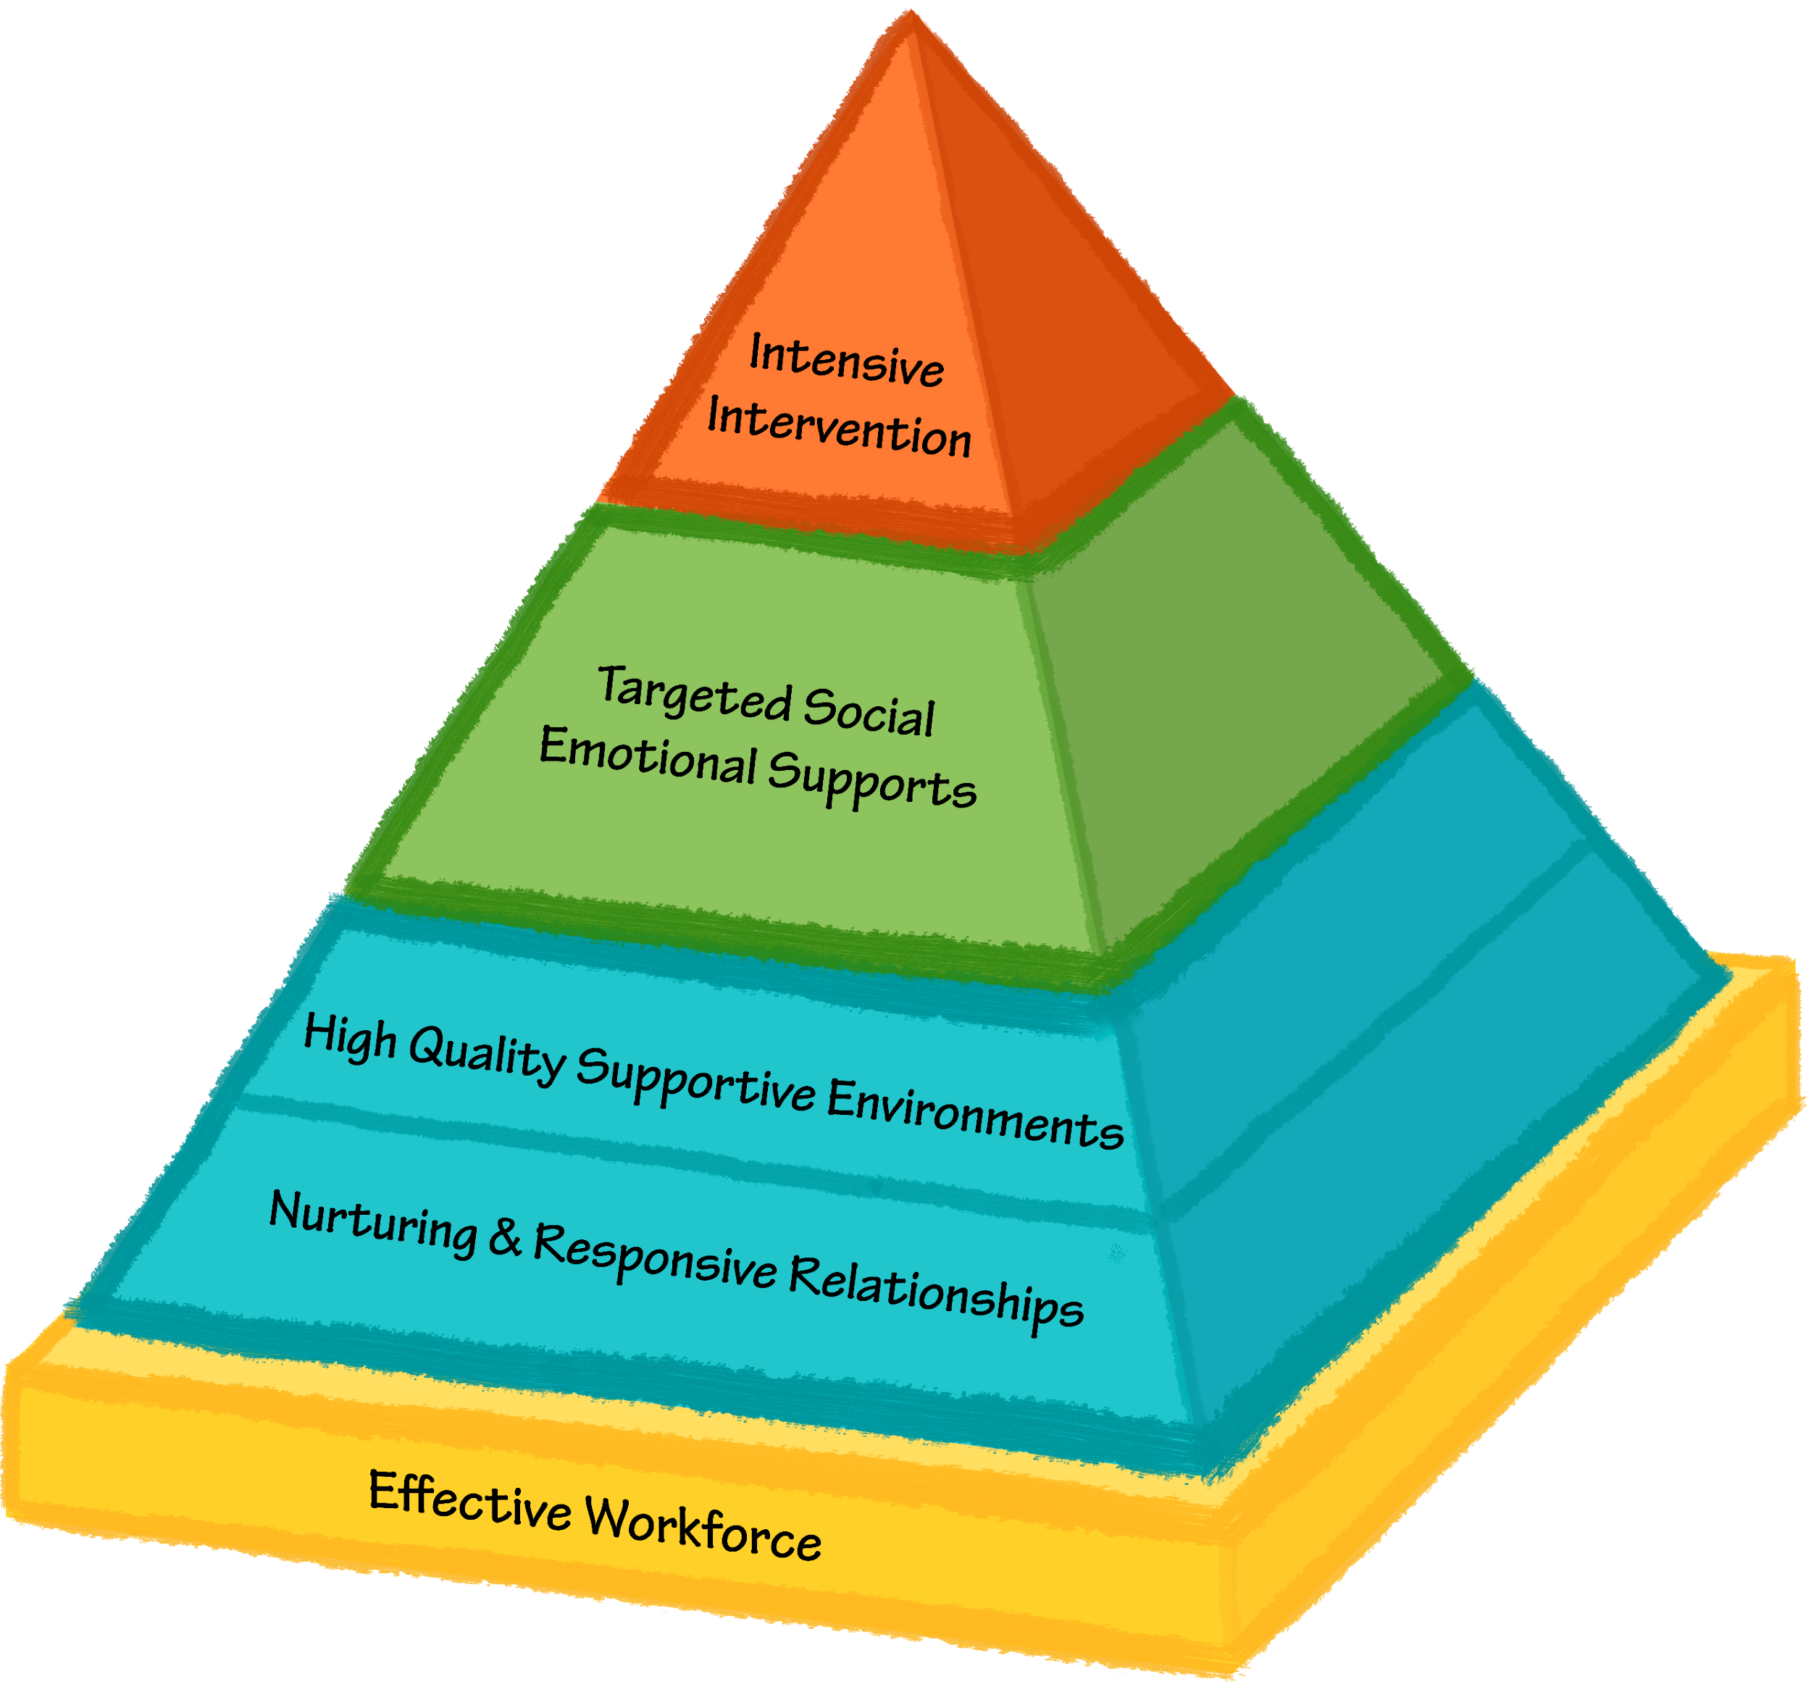
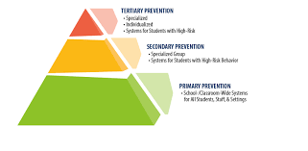
Minnesota Positive Behavior Support Network Tier 1
Aspirational to Exemplary Communities – Continuum of Positive Behavior Support Across the Lifespan
Early Childhood | K-21 years old | Adulthood
Systems & Supports Team with administrative and behavioral expertise meets regularly and spans birth through kindergarten systems Cross-sector program-wide buy-in Collaborative effort with families Capacity to collect data at child, classroom, and program level System for coaching workforce expertise in place, including behavioral expertise Strategies & Skills Implementation & Outcome Measures for Decision-making Measure/promote nurturing & responsive relationships & quality learning environments Easy access to graphs/data on teacher and child performance BoQ, TPITOS/TPOT, Coaching Logs collected and reviewed regularly Ongoing assessment for child outcomes across developmental areas and BIRs Transition Considerations IEP meetings Teacher connections Kindergarten visits (at K and Pre) | Systems & Supports Team with administrative and behavioral expertise meets regularly 3-5 positively stated expectations across the building and classes Have discipline policies in place, including positive and restorative approaches Feedback system built in Families and stakeholders where data are shared Strategies & Skills Implementation & Outcome Measures for Decision-making Measure teaching to expectations Define student and teacher behaviors Easy access to graphs/data on where, when, why & location of problems TFI, SET, BoQ are collected and reviewed annually Transition Considerations | Systems & Supports Team meets regularly All stakeholders involved within the framework of consensus building Mission and policy aligns with PBS values Promotion of universal positive behavior Promoting and acknowledging positive behavior among staff Actively recruiting people from diverse cultures Staff development includes competency based training PBS and person centered strategies are taught throughout the organization Strategies & Skills Implementation & Outcome Measures for Decision-making Fidelity data (direct observation quarterly) Individual outcome measures (including quality of life) Staff retention data Review of all data regularly Annual evaluation on-site from external expert or peer supports Transition Considerations
Notes:
EC Tier 1 things to note – there are teams, just as in K-21 and adulthood. There is a need for greater cross sector and family collaboration given all the different places children are and ways they interact with different systems, greater emphasis on professional development and coaching of the EC workforce given the diversity of training backgrounds (yellow foundation of the pyramid), tier 1 supports focus on measuring and promoting nurturing and responsive relationships as well as high quality learning environments (blue sections of pyramid), gathered data includes fidelity within classrooms and coaching information in addition to program wide benchmarks and child specific behavioral incident data
Especially for PBS in the home setting
Through distance learning school supports and partnerships at home
Everyone is at home

Slide 8
Minnesota Positive Behavior Support Network Tier 2
Aspirational to Exemplary Communities – Continuum of Positive Behavior Support Across the Lifespan
Early Childhood | K-21 years old | Adulthood
Systems & Supports Team meeting regularly to address Tier 1 while linking to Tier 2 or Tier 3 approaches Ongoing coaching and support Strategies & Skills Program wide behavior expectations and social emotional skills taught and referenced throughout the day Social-emotional curriculum, teaching key competencies Implementation & Outcome Measures for Decision-making TPITOS/TPOT, coaching logs, BIRs Fidelity of Tier 2 interventions Transition Considerations Connectedness and alignment from Pre-K to Kindergarten | Systems & Supports Team of expertise meeting regularly, possible overlap with Tier 1 Linkage back to Tier 1 expectations (across people, classes, etc.) and Tier 3 approaches Strategies & Skills Implementation & Outcome Measures for Decision-making TFI Tier 2 or MATT Fidelity of Tier 2 interventions Transition Considerations | Systems & Supports Team composition is diverse, clear role and expectations – smaller and more specialized to work with Tier 1 team on planning and decision-making Accessing higher services Strategies & Skills Implementation & Outcome Measures for Decision-making Proportion of people participating in Tier 2 Outcomes of programs at Tier 2 Implementation of programs at Tier 2 Transition Considerations
Notes:
EC Tier 2 things to note – regular review of classroom level implementation and coaching supports focus on how the environment and adult relationships promote developmentally appropriate social emotional and behavioral skills. Pyramid includes lots of explicit teaching about emotions, regulating emotions, following planned routines, and problem solving social situations and/or conflict. Assumption is all of those things must be explicitly taught as part of Tier 1 and further reinforced/intensified as part of Tier 2

Slide 9
Minnesota Positive Behavior Support Network Tier 3
Aspirational to Exemplary Communities – Continuum of Positive Behavior Support Across the Lifespan
Early Childhood | K-21 years old | Adulthood
Systems & Supports Behavioral supports expertise (BCBA or similar training) Family collaboration FBA and BIP when appropriate Wraparound and coordination with mental health supports Planning includes all members of team Strategies & Skills Prevent, Teach, and Reinforce for Young Children (PTRYC) guides problem solving and intervention planning Generalization training for parents and caregivers to promote skills in home setting Implementation & Outcome Measures for Decision-making Using BIR data (behavior incident report) Transition Considerations Connectedness and alignment from Pre-K to Kindergarten | Systems & Supports Behavioral supports expertise (BCBA or similar training) FBA and BIP Wraparound, RENEW Screening Stakeholder involvement and feedback Coordination with mental health supports Training includes all members of team Strategies & Skills Implementation & Outcome Measures for Decision-making Quality of life indicators Fidelity Transition Considerations | Systems & Supports Each person using Tier 3 supports has team Direct involvement of person and stakeholders within and external to the organization Ongoing plan for professional development – all staff involved in delivering supports Paid and unpaid supports Alignment with Tier 1 and 2 supports Strategies & Skills Implementation & Outcome Measures for Decision-making Proportion of people participating in Tier 2 Outcomes of programs at Tier 2 Implementation of programs at Tier 2 Transition Considerations
Notes:
EC Tier 3 – Family collaboration is emphasized, PTRYC informs structured problem solving and intervention planning
Especially for PBS in the home setting
Through distance learning school supports and partnerships at home
Everyone is at home

Slide 10
2020 Theme: 9 Core Features of PBS
Changes lifestyle
Works across lifespan
Works across all settings
Involves the people supported
Creates effective change
Provides supports for person tied to supports for all,
with supports provided by all
7. Decrease the likelihood of experiencing problems
8. Measurable in multiple resource areas
9. Includes multiple theories and values
Core Features of PBS we will addressed in each webinar!

Slide 11

MNPBS Collaborators Forum 2020 Keynote – June 19th
Children and Young Adults (6-21): Dr. Kevin Filter
Dr. Filter was invited to keynote
Children and Young Adults (6-21)
That session was recorded.
These are the 3 of the 9 core features that he focused on.
Involves the people supported
Creates effective change
Provides supports for person tied to supports for all, with supports provided by all

Slide 12

MNPBS Collaborators Forum 2020 Web Series Kickoff – June 19th
Children and Young Adults (6-21)
Theme: 9 Core Features of PBS
Continuation of Webinar Series
#2 Early Childhood
Focus on core features...
Change of Lifestyle
Works Across Life Span
Involves the People Supported
Emphasis on Prevention
More information and registration:
mnpsp.org/mnpbs

Slide 13
Early Childhood: Alignment of Pyramid Model and SCHOOL-WIDE POSITIVE BEHAVIOR INTERVENTIONS AND SUPPORTS (PBIS)
ADD PHOTO
Keynote Speaker: Dr. Bonnie Ingelin
University of St. Thomas
Email address

Slide 14
Pyramid Model and SCHOOL-WIDE POSITIVE BEHAVIOR INTERVENTIONS AND SUPPORTS (PBIS) as Aligned AND Complementary systems
Supporting Systems and Practices that
Support Children during Early Childhood
Notes:
Add pyramid

Slide 15


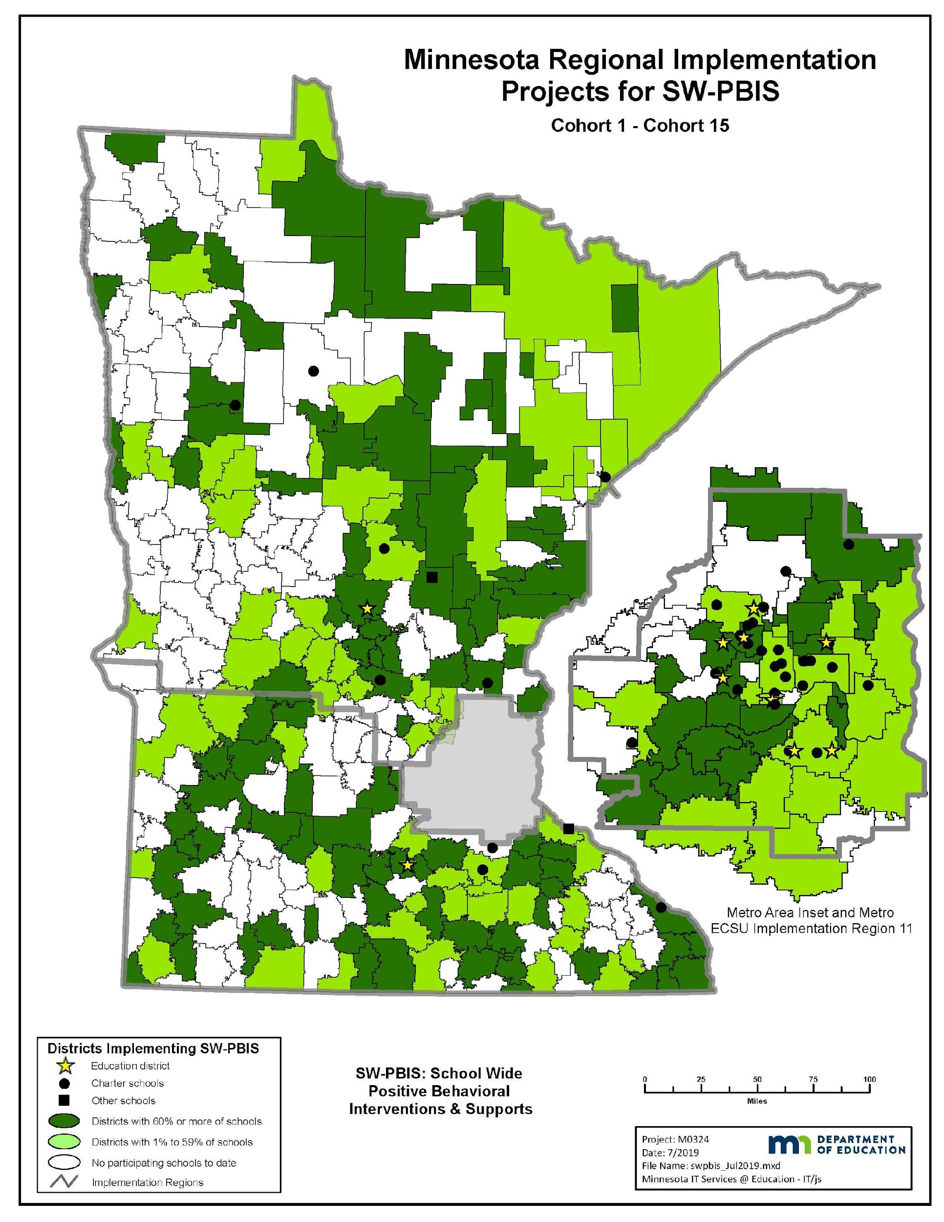
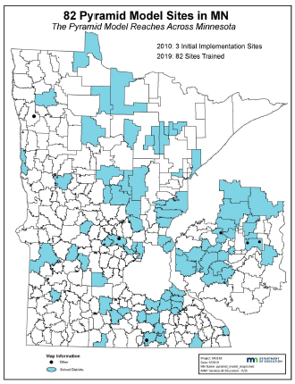
PBS in Minnesota: Two Aligned Systems
Since 2005, PBIS has been a state initiative. As of 2020:
274 districts/charters
  55% of districts/charters in MN
821 schools
    02% early childhood
    58% elementary schools
    15% middle school
    25% high schools or ALCs
  39% of schools in Minnesota
378,097 of students
  43% of students in Minnesota
Since 2010, Pyramid Model has been a state initiative. As of 2020:
87 early childhood programs
  School districts are primary point of entry
  Early childhood programs may encompass different combinations of early childhood special education/early intervention, school readiness, head start, child care, or early childhood family education offerings
Notes:
Early childhood programs are supported with PBS related knowledge, skills, and systems whether they join the work through MN PBIS as a partner of school or district joining an PBIS cohort OR joining through Pyramid Model as an early childhood program representing the breadth of early childhood offerings associated with their school district.

Slide 16
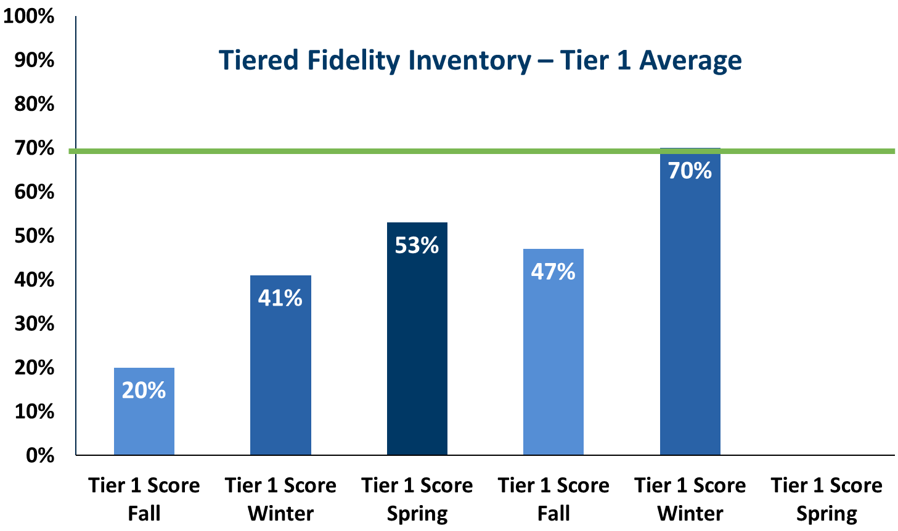
Growth and Impact of PBIS in Minnesota
2005-2020
821

Slide 17
Growth of Pyramid in Minnesota
2005-2020

Slide 18
4 key features of Tier 1 PBIS (Horner & Sugai, 2015)
Define and teach a small set of behavioral expectations
Establish a ubiquitous system to reinforce performance of behavior expectations
Implement a consistent system to interrupt, correct, and redirect behavioral errors
Build an efficient system to collect, summarize, and use data for decision-making

Slide 19
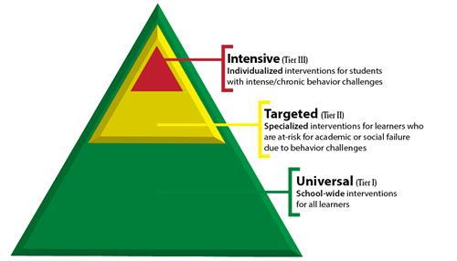
Tiered Supports
In a PBIS system, all children receive behavioral support
  Universal or primary: Support to support the needs of all students
  Targeted or Secondary: Targeted supports to support at-risk students
  Intensive, Individualized or Tertiary: Individualized supports with intense needs
    Those with more intensive needs, received individualized supports as needed

Slide 20
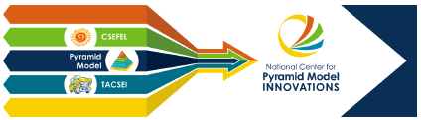
Early Childhood Tier 1
Systems & Supports
Team with administrative and behavioral expertise meets regularly and spans birth through kindergarten systems
Cross-sector program-wide buy-in
Collaborative effort with families
Capacity to collect data at child, classroom, and program level
System for coaching workforce expertise in place, including behavioral expertise
Strategies & Skills
Implementation & Outcome Measures for Decision-making
Measure/promote nurturing & responsive relationships & quality learning environments
Easy access to graphs/data on teacher and child performance
BoQ, TPITOS/TPOT, Coaching Logs collected and reviewed regularly
Ongoing assessment for child outcomes across developmental areas and BIRs
Transition Considerations
IEP meetings
Teacher connections
Kindergarten visits (at K and Pre-K)

Slide 21
Early Childhood Tier 2
Systems & Supports
Team meeting regularly to address Tier 1 while linking to Tier 2 or Tier 3 approaches
Ongoing coaching and support
Strategies & Skills
Program wide behavior expectations and social emotional skills taught and referenced throughout the day
Social-emotional curriculum, teaching key competencies
Implementation & Outcome Measures for Decision-making
TPITOS/TPOT, coaching logs, BIRs
Fidelity of Tier 2 interventions
Transition Considerations
Connectedness and alignment from Pre-K to Kindergarten

Slide 22
Early Childhood Tier 2
Systems & Supports
Behavioral supports expertise (BCBA or similar training)
Family collaboration
FBA and BIP when appropriate
Wraparound and coordination with mental health supports
Planning includes all members of team
Strategies & Skills
Prevent, Teach, and Reinforce for Young Children (PTRYC) guides problem solving and intervention planning
Generalization training for parents and caregivers to promote skills in home setting
Implementation & Outcome Measures for Decision-making
Using BIR data (behavior incident report)
Transition Considerations
Connectedness and alignment from Pre-K to Kindergarten

Slide 23
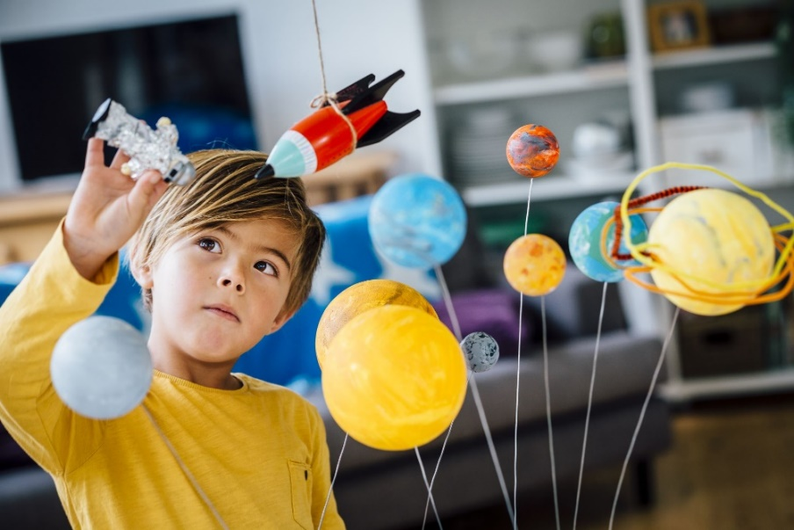
Theme 1: Changes Lifestyle
When behavioral needs occur, it affects the child globally
  Family life
  Building and creating friendships
  Play and engaging with toys/activities
  Learning across developmental domains
  Pre-school suspension and expulsions Policy Statement
Notes:
I added the last bullet Here is some information from the Policy Statement on Expulsion and Suspension in Early Childhood Settings
https://www.acf.hhs.gov/sites/default/files/ecd/expulsion_suspension_final.pdf
Although early childhood settings differ in contexts from K-12 settings , the Guiding Principles are applicable to both, such that focusing on prevention, developing and communicating clear behavioral expectations, ensuring fairness, equity, and continuous improvement, can and should be applied across settings where children can learn.”
Young students who are expelled or suspended are:
Ten times more likely to drop out of high school
Experience academic failure
Repeat a grade
Hold negative school attitudes
Face incarceration at a higher rate than those who are not
Early suspension and expulsion may delay or interfere with identifying mental heath issues or underlying disabilities

Slide 24
Examples
Focus instruction to Create Change
Teach specific skills during routines
Support development of social emotional skills
Plan transitions throughout the day
Teach routines (school & home settings)
Teach how to share and play with other students
Teach self-regulation strategies (independent without parental support)
Coach families to support them in providing positive supports and specific feedback
Provide specific descriptive positive praise
Focus on positive feedback
Remind & reteach daily routines
Practice desired behaviors (such as sharing and taking turns)
Create schedules and first/then charts
Practice social emotional skills with adults
Design calm down corners and utilize sensory strategies to support self-regulation

Slide 25

Theme 2: Life Span Perspective
What happens now will affect students as they grow and develop
Early intervention is key to creating change
Choices and decision made by adults in a young child's life will have a long last affect for outcomes
Notes:
Some of the suspeonsisn and expulsion could go in here or it might be e a better fit. Could also be the work of teacher prep and the foundational basis as seen in the PM
Could the effective workforce fit in here. With the PM training the staff is able to help families and students with changes that really never ends and can me seen for decades not months. That is the goal of the foundation of effective workforce for PM

Slide 26
Examples
Provide Intensive Supports Related to Behaviors
Focus instruction on Challenging Behaviors
Teach Meaningful Behaviors for Success
Provide Inclusive Opportunities
Develop theory of mind about the perspectives of others and empathy
Plan Transitions
Provide Inclusive Experiences
Utilize Social Skill Curriculum
Provide Specific Descriptive Positive Praise and Reinforcement to Increase Pro-social Behaviors
Provide Inclusive Experiences
Create Behavioral Support Plans
Teach Replacement behaviors
Provide opportunities to engage with peers

Slide 27

Theme 4: Involves People Supported
Coach and support families
Work together collaboratively with everyone in the classroom
Work with the student to make good choices

Slide 28
Examples
Social Worker, Mental Health Practitioners
Special Education Teacher, Support Staff, etc.
Families, Preschool Teachers, Childcare Workers, Peers, Student etc.

Slide 29
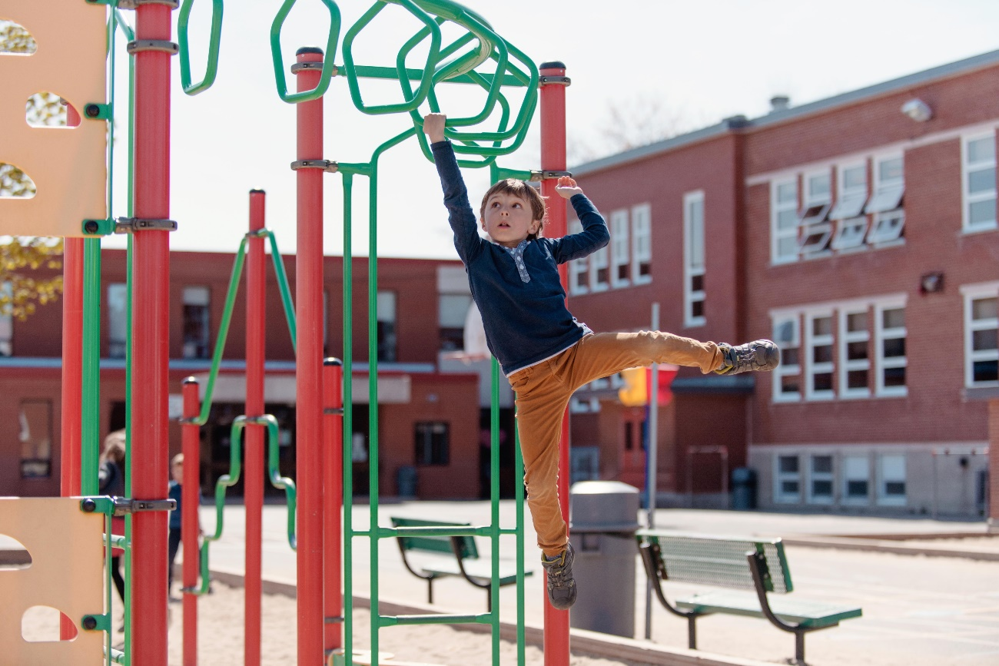
Theme 7: Decrease Likelihood of Problems
Prevent behavior before they occur
Coach families through daily routines
Focus on changing the environment to support the needs of all students
Notes:
PM is built as a preventative model that focusses on supporting the adults who support the child.

Slide 30
Examples
Modify and Make Significant Environmental Changes
Add Needed Environmental Supports
Create Environment that Supports Positive Behaviors
Set up Physical Environment
Limit Wait Time
Consider Impact of Environmental Stimuli
Use a Zone Defense Support System
Provide Consistency such as Schedule with Visual Supports
Remove antecedents (triggers for behaviors)
Teach pro-social replacement behaviors
Write Social Stories / Narratives
Create Developmentally Appropriate Expectations

Slide 31
PBIS…
Is an effective approach to supporting student behavior in schools
Requires work across multiple levels
  Implementation Components: Teams, administrators, coaches
  Practice Elements: Teachers and staff
Involves the people supported
Creates effective change
Provides supports for person tied to supports for all, with supports provided by all

Slide 32
Closing and Wrap-Up
Thanks, Bonnie!

Slide 33
Collaborators Forum Monthly Webinar Series
June – August – November – January
Theme: 9 Core Features of PBS
Changes lifestyle
Works across lifespan
Works across all settings
Involves the people supported
Creates effective change
Provides supports for person tied to supports for all, with supports provided by all
Decrease the likelihood of experiencing problems
Measurable in multiple resource areas
Includes multiple theories and values
Keynotes in the following areas
Early Childhood (0-5): Dr. Bonnie Henning
Children and Young Adults (6-21): Dr. Kevin Filter
Adult Services (21 plus): Dr. Rachel Freeman
Elderly & Aging: Dr. Jeffrey Buchanan
The Collaborators Forum is an event for people interested in positive behavior supports (PBS) across settings and the lifespan in Minnesota. This year the MNPBS Network is planning to increase the number of host sites in other parts of the state, and to increase the amount of interactivity for audience members who can’t travel but want to be a part of the Forum.
More information and registration:
mnpsp.org/mnpbs
Notes:
The Collaborators Forum webinar series is a four session event every two to three months with keynotes from across Minnesota.

Slide 34


APBS Conference 2021 – Minneapolis
18th Annual Conference
March 17th-20th
Hyatt Regency – Minneapolis, MN
Learn More About the International Association for Positive Behavior Support and the Upcoming Conference!
www.apbs.org
https://twitter.com/MNPBS/status/960660570532990976

Slide 35
Organization Members

Slide 36
Thank you for attending and meeting the needs of young children!
MNPBSnetwork@gmail.com

Slide 37
EXTRA PYRAMID STUFF

Slide 38

What is the Pyramid Model?
Tertiary Intervention: Few Children
Secondary Prevention: Some Children
Universal Promotion: All Children

Slide 39
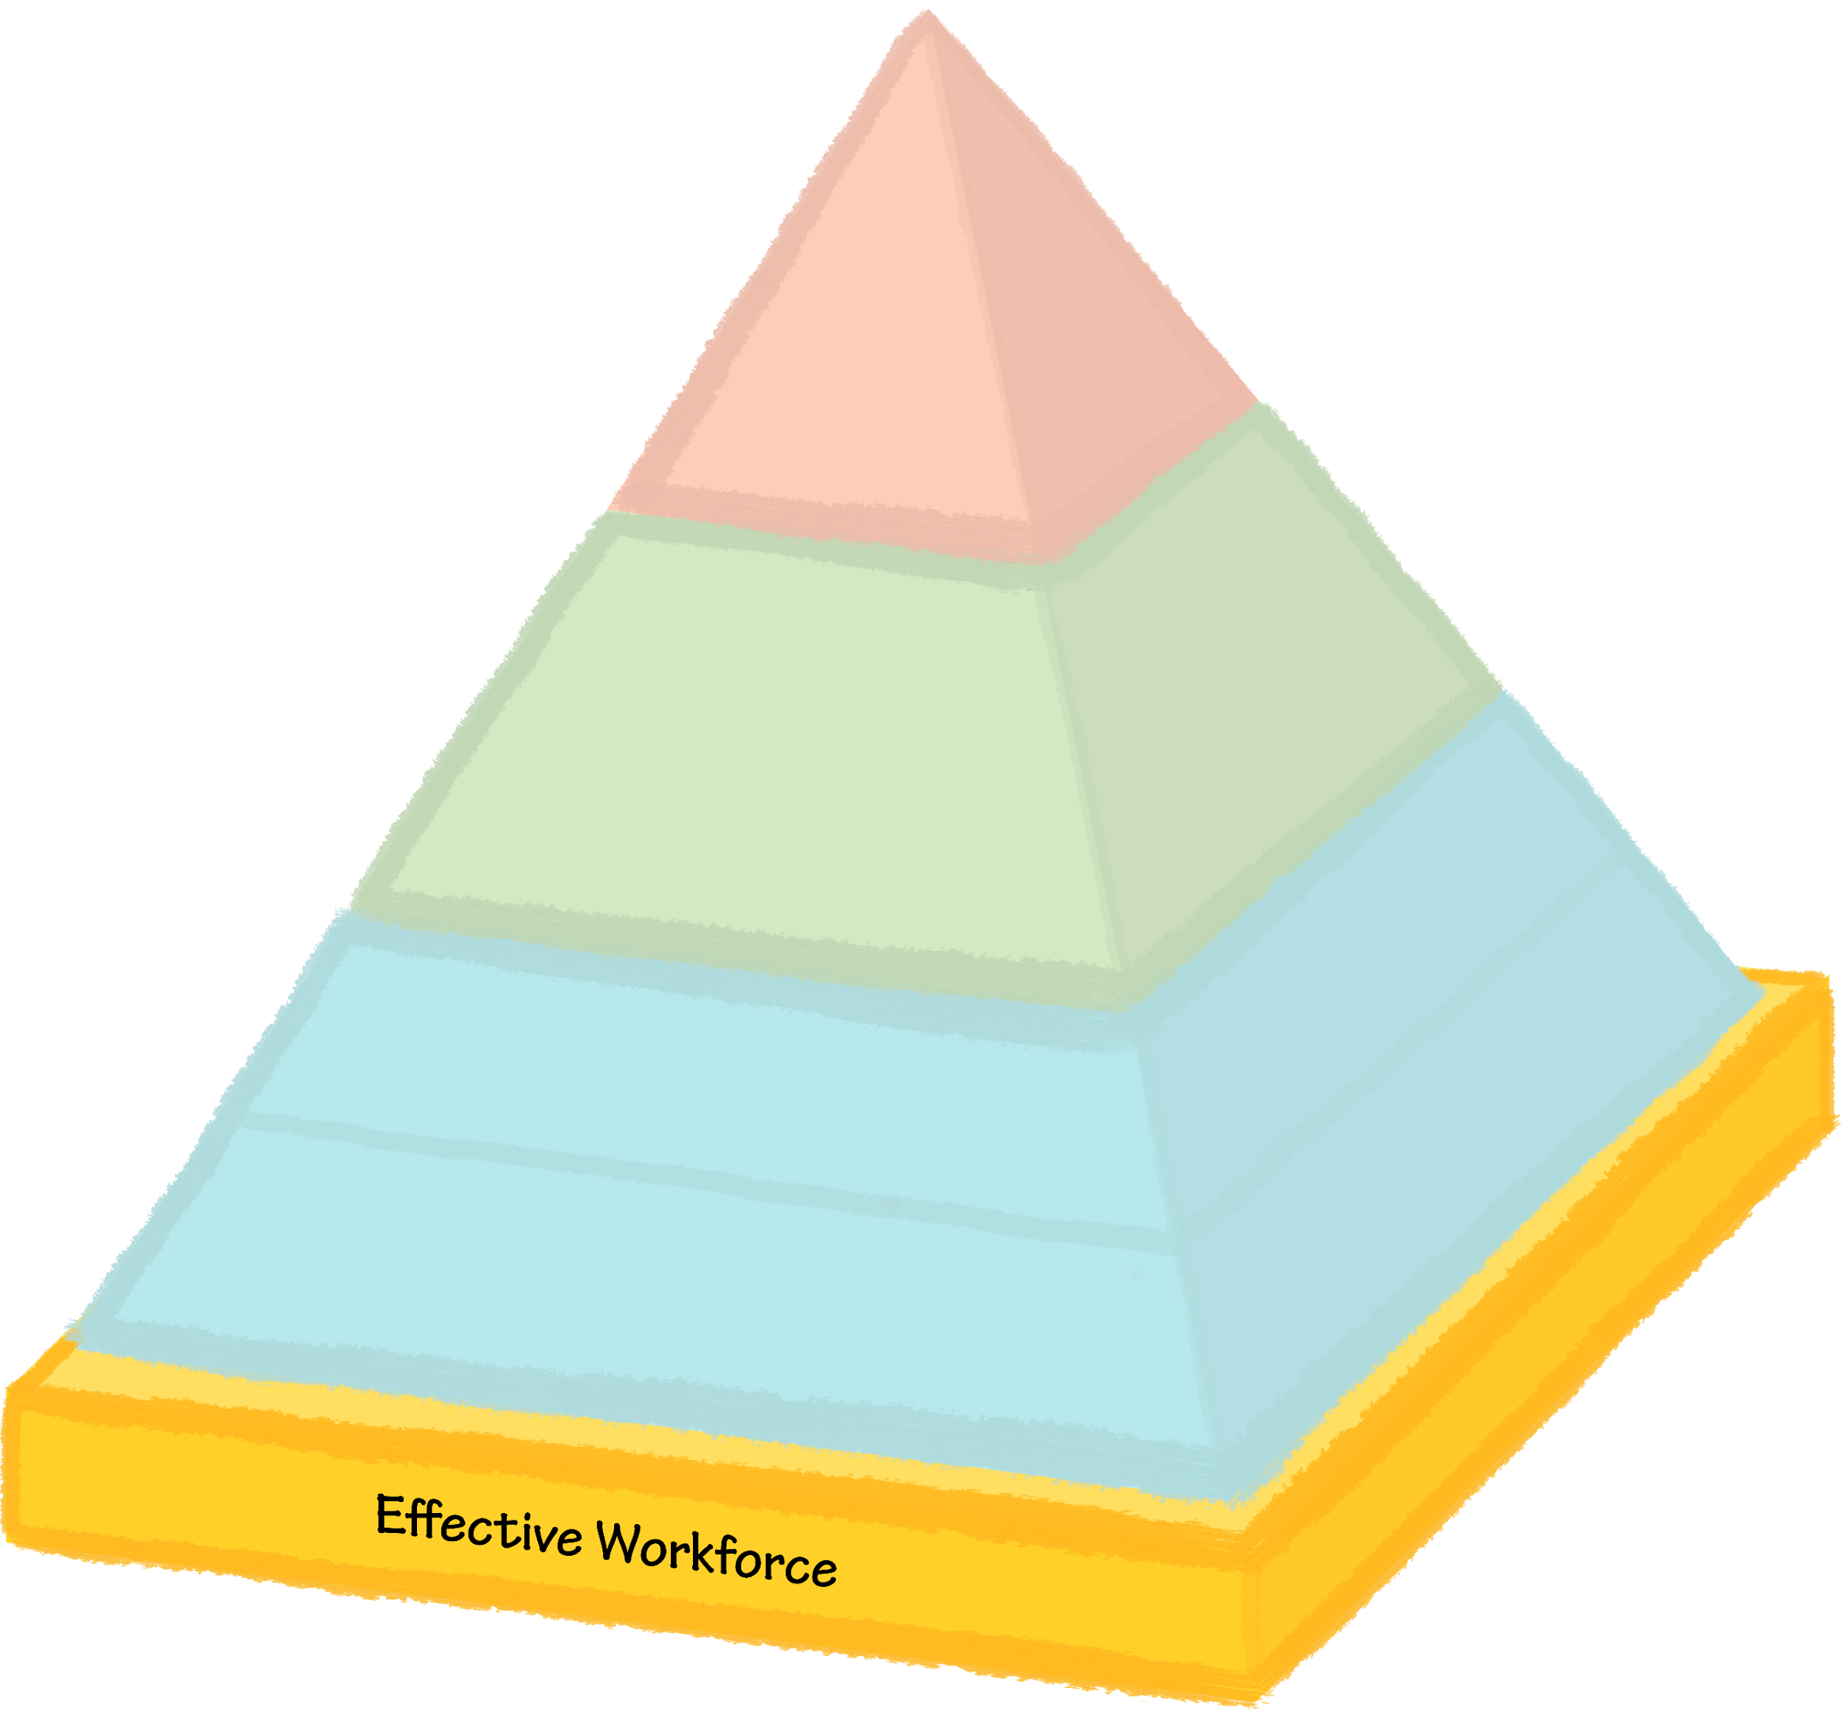
Foundation: Effective Workforce
The foundation for all practices in the Pyramid Model are the systems and policies necessary to ensure a workforce that is able to adopt and sustain the evidence-based practices.
39

Slide 40
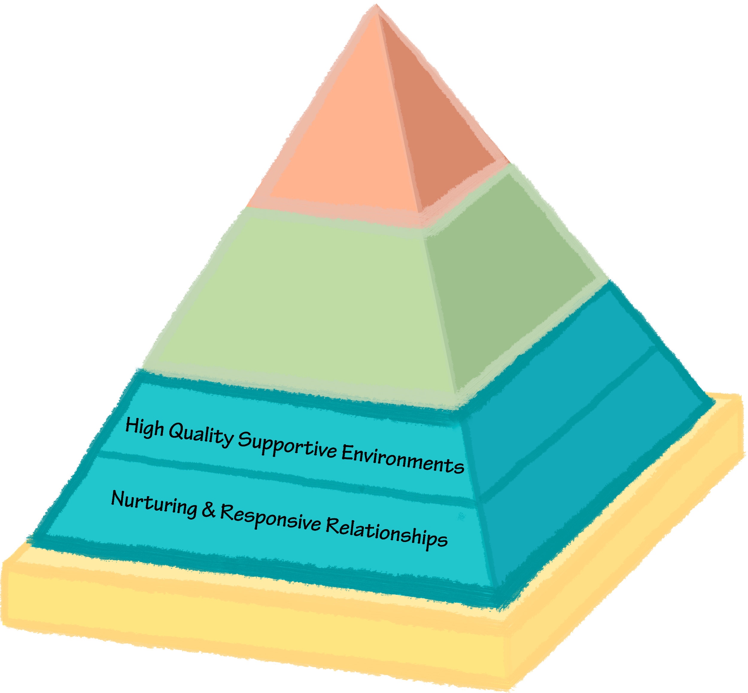
TIER 1
Supportive and responsive relationships among adults and children is an essential component to promote healthy social emotional development.
High quality early childhood environments promote positive outcomes for ALL children.
40

Slide 41

What do these Strategies Look Like?
Supporting engagement
Embedding instruction within routine
Responding to conversations
Promoting communication
Providing encouragement
Strong collaborative partnerships
Providing support to caregivers
Guiding caregivers in establishing responsive and nurturing interactions
41

Slide 42
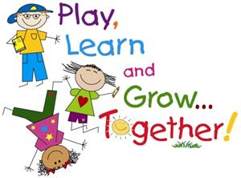
What Strategies Support High Quality Supportive Environments
Inclusive early care and education environments
Comprehensive system of curriculum, assessment, and program evaluation
Environmental design, instructional materials, scheduling, child guidance, and adult interactions
42

Slide 43
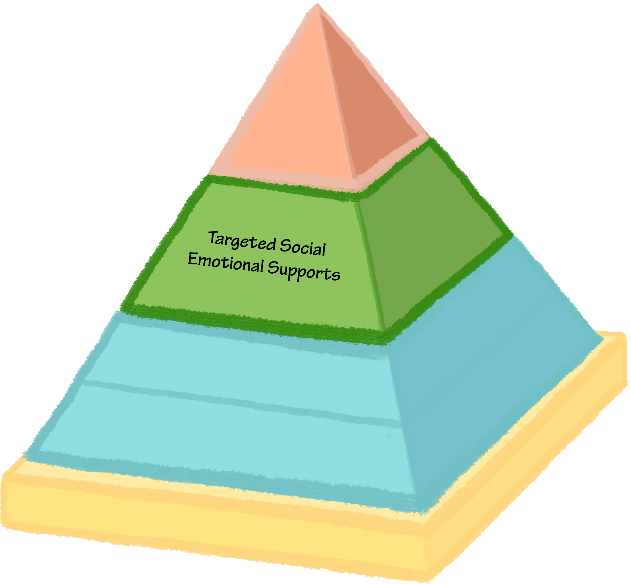
TIER 2
Provides explicit instruction around social emotional skills.
Addresses self regulation, expressing and understanding emotions, and developing social relationships.
Some children need systematic and focused instruction to learn discrete social emotional skills.
Example of Targeted Supports
43

Slide 44
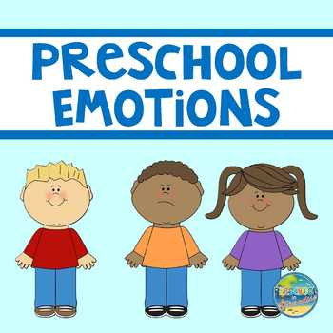
What Specific Targeted Strategies are Used?
Explicit instruction around:
Expressing and understanding emotions
Developing social relationships
Problem solving
Interactions with peers
Cooperative responding
Friendship skills
Handling Disappointment and anger
44

Slide 45
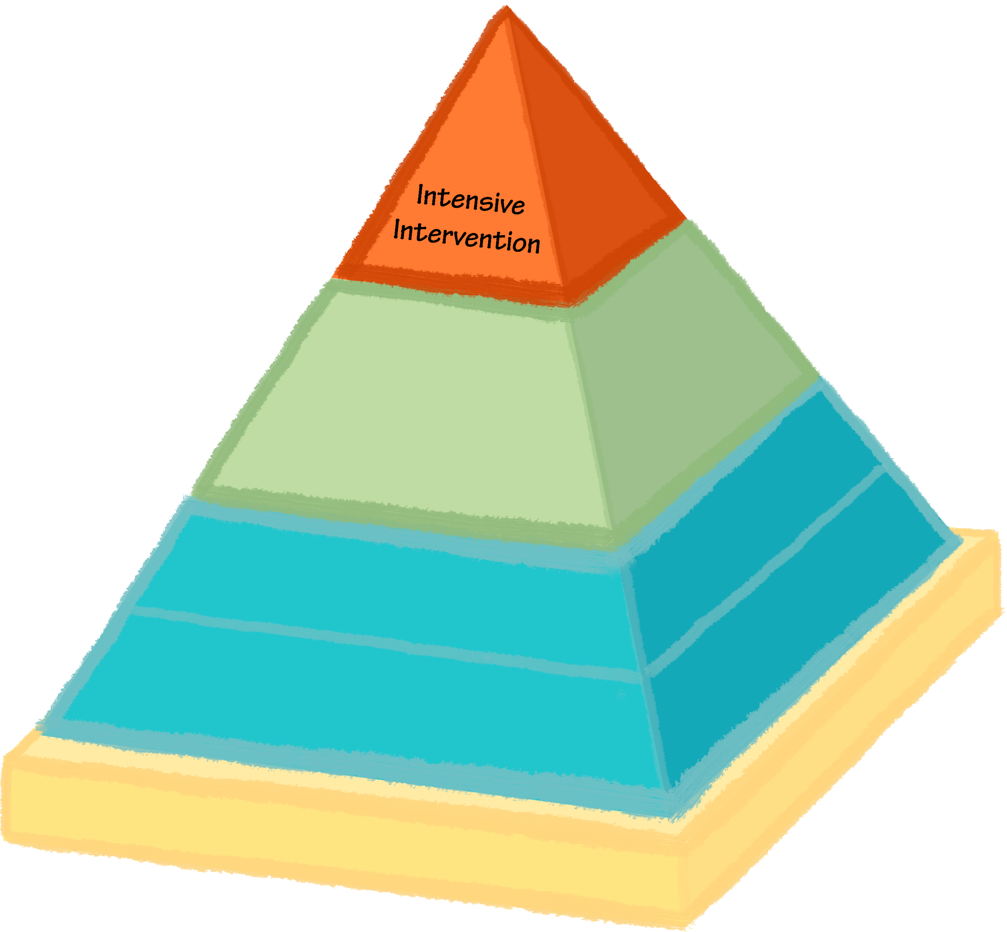
TIER 3
When children have ongoing challenging behavior, comprehensive interventions and plans are developed that are:
Family Centered
Assessment Based
Focused on Skill Building
Require Collaborative Teaming
45

