Slide 1
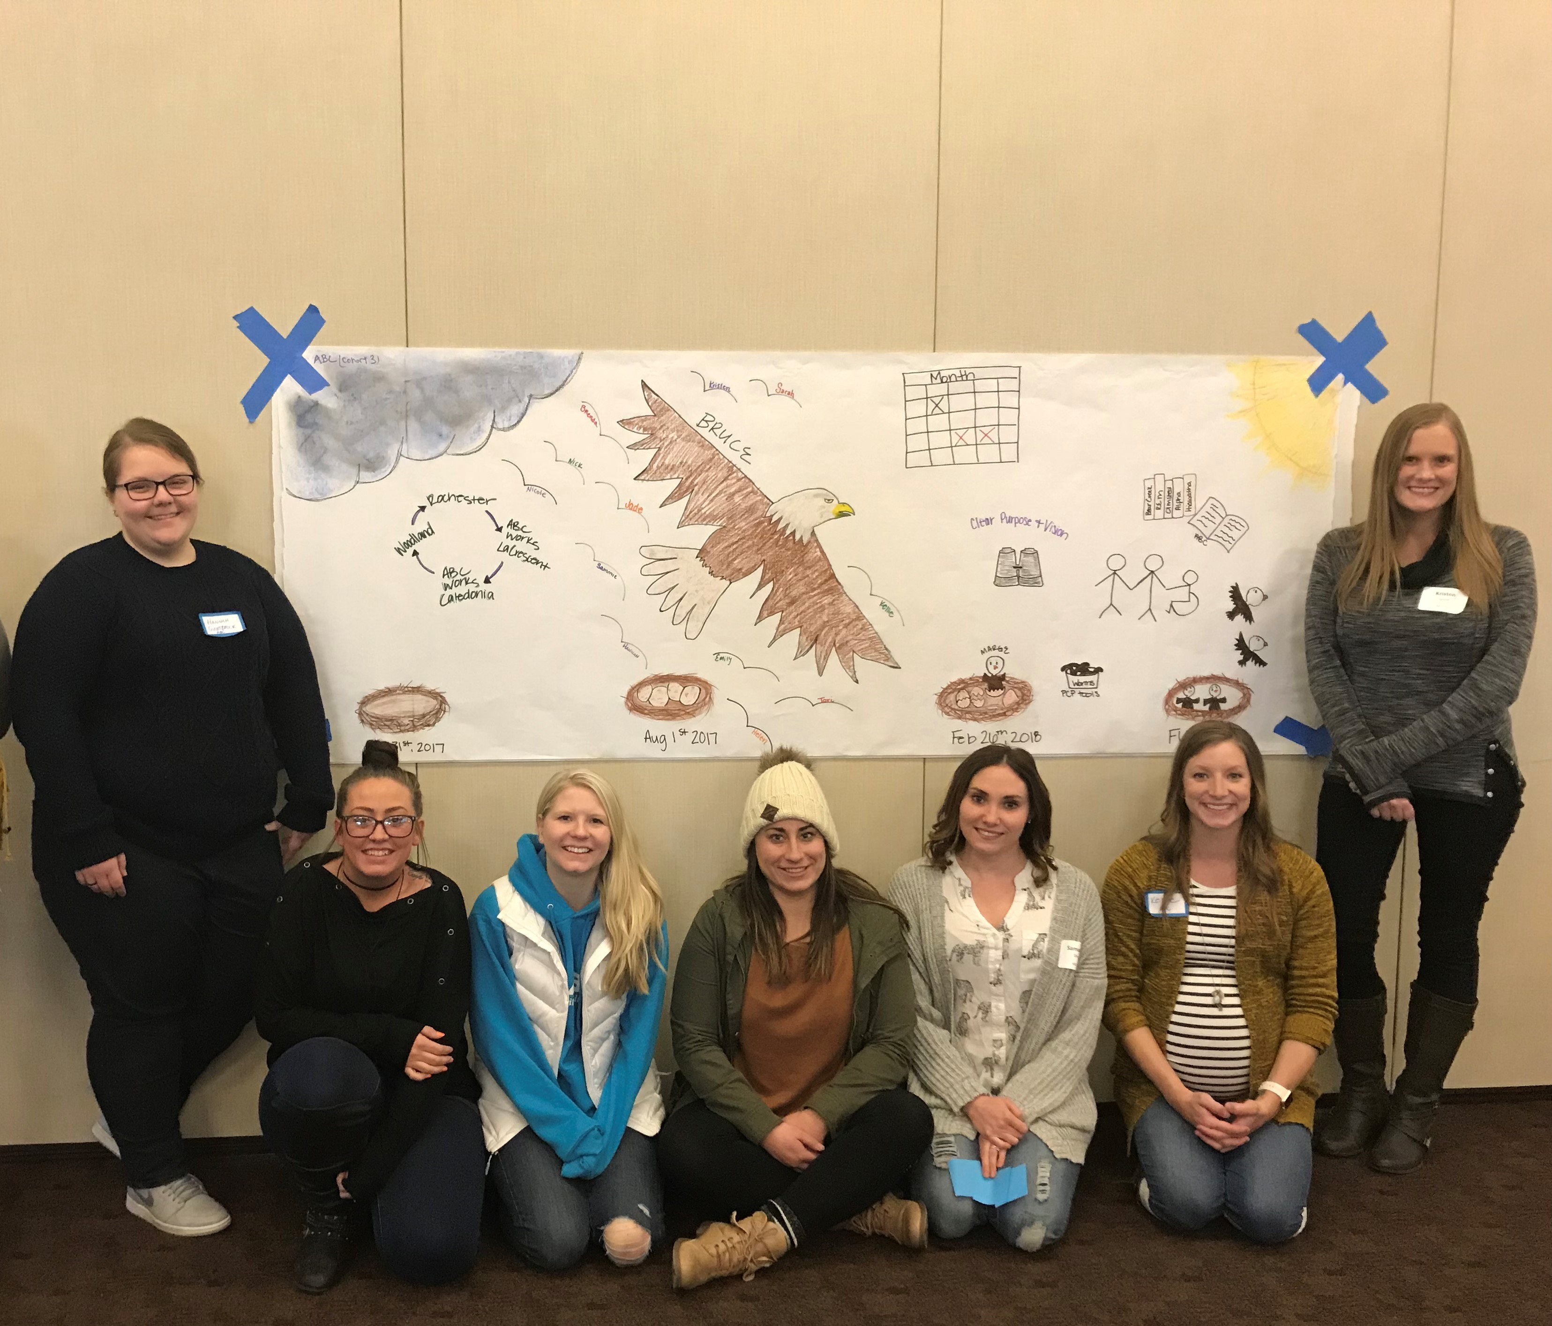
Positive Support Team
Ability Building Center

Slide 2
NOTES for Last Steps
CHANGE TITLES OF SLIDES THAT SAYS THE VISION BOARD IS THE HISTORY MAP
CHANGE THE TITLE NOW VERSUS FUTURE BY ADDING VISION BOARD TITLE
PROBABLY HAVE TO TAKE WILL FERRILL OUT FOR COPYRIGHT
CHECK WITH ABC
  IF IT IS OKAY TO POST AND TO FIX TITLES
  CHECK THAT COPYRIGHT IS CLEAR FOR ALL PHOTOS (NEED WRITTEN PERMISSION FROM ABC THAT THIS IS A PUBLIC DOCUMENT AND ALL IMAGES ARE APPROVED BY ABC

Slide 3
The Team
  Sarah Timmerman
  Kellie Wendland
  Kristen Lynne
Houston County
  Helen Olson
  Sami Sherry
  Nick Rohrer
  Nicole Karl
Rochester
  Hannah Giehtbrock
  Jade Harvey
  Tori Nelsen
  Mia Falconer-Smith
  Joan McKiness
  Bethanie Bentz
  Karalee Senjem
  Devon Majerus
  Chris Gillard
  Holli Possehl

Slide 4
Purpose, Vision, & Outcomes
Purpose:
To better the lives of the individuals that we serve and the staff that work at ABC by creating a positive and inclusive environment.
Vision:
Person Centered practices are the heart of our organization and are fully integrated into all aspects of ABC.
Outcomes:
Staff will feel valued and want to work at ABC
Individuals served find their time at ABC meaningful and feel their goals accurately reflect their desires
Spread awareness throughout the agency about person centered practices.

Slide 5
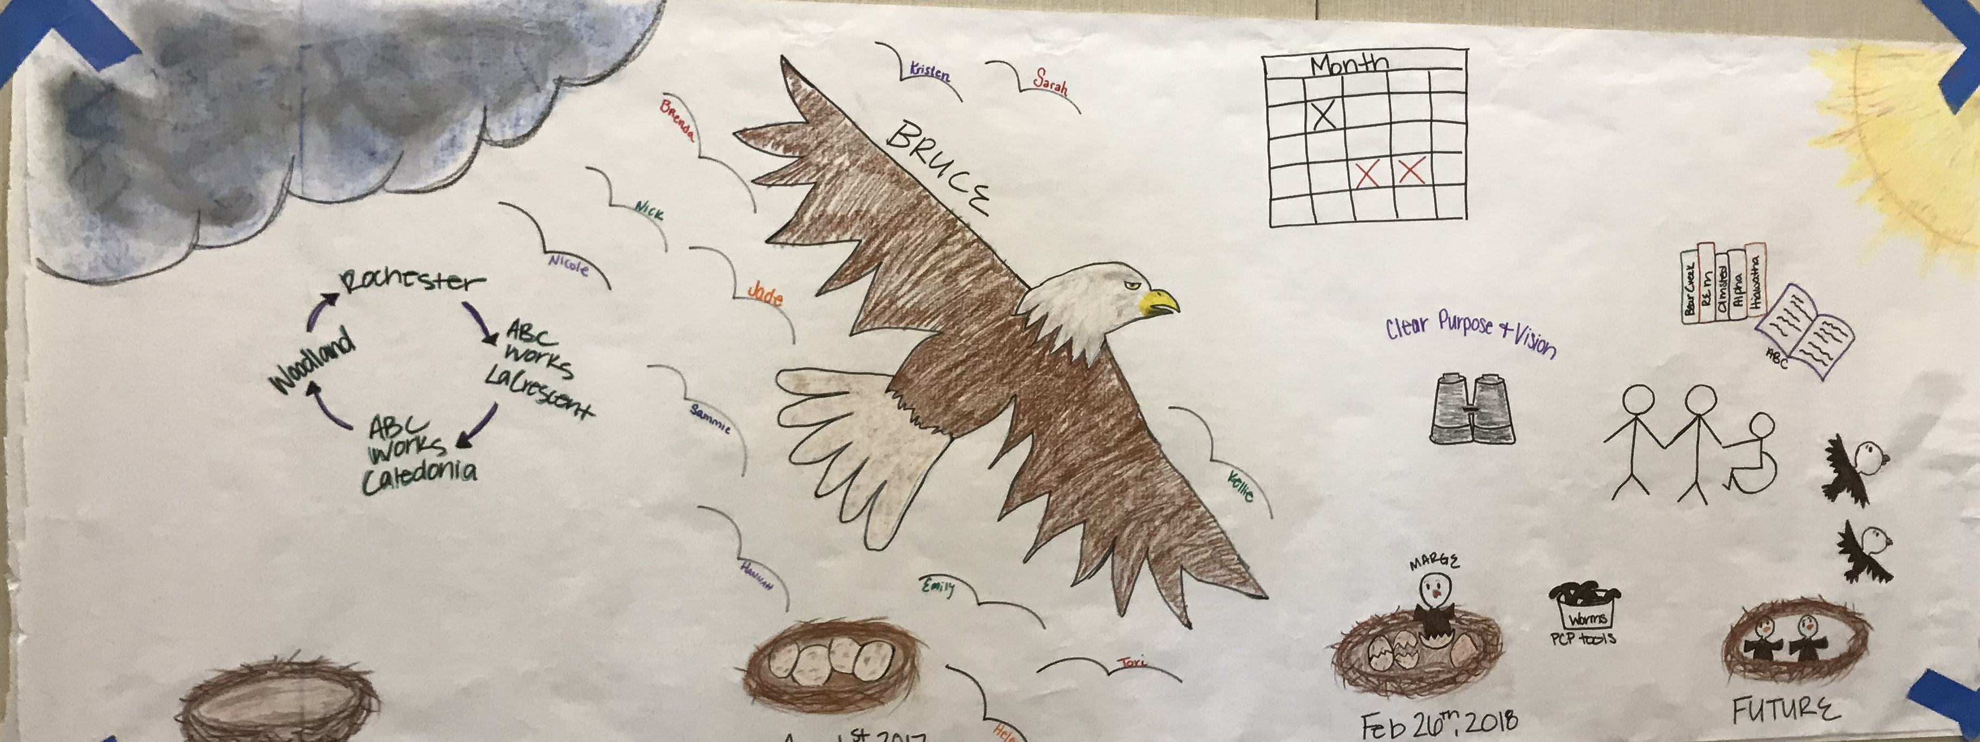
Vision Board

Slide 6
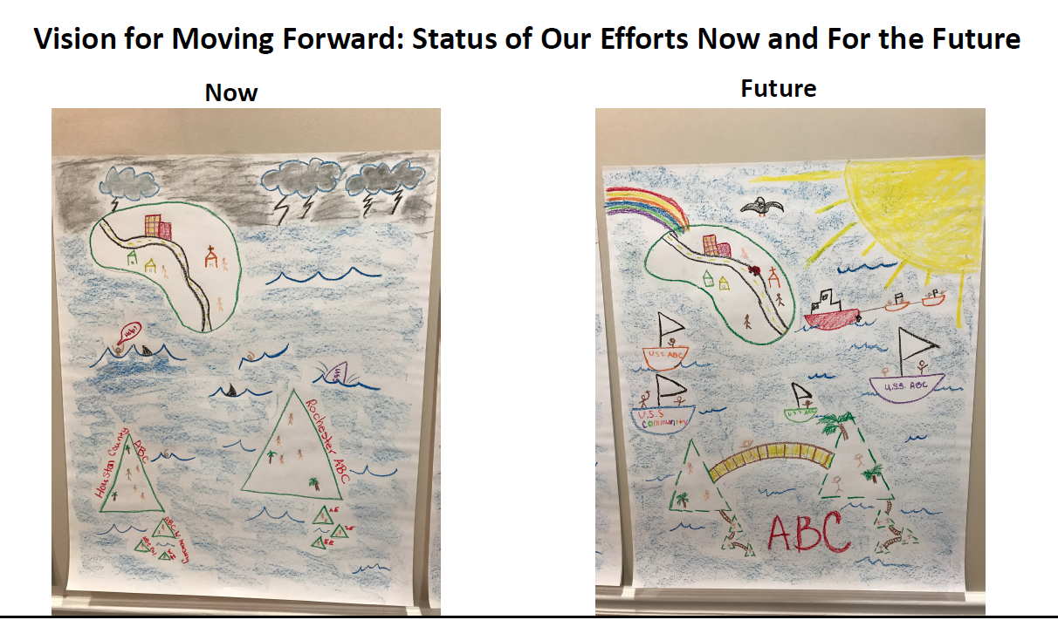
Now Vs. Future

Slide 7

Action Plan
Goal | Purpose | Status
Develop Clear Purpose & Vision | Purpose and vision should accurately reflect team’s goals and action plan items should be developed to support the purpose and vision. | Achieved
Develop Person Centered Profiles for all new staff | The person centered profile will be completed during orientation. The profiles will be displayed in the computer room. The bulletin will also be utilized to share these profiles. | Achieved
Develop application for direct-care staff to apply to attend the 2 day person centered training. | By developing an application we are giving coaches the opportunity to express their interest in engaging in person centered practices. This process will allow us to learn about staff that are interested in training opportunities that we may not have previously realized. | Achieved
Rochester Team visit Houston County location | In order to fully understand the needs of all locations and unify our efforts it is important that we spend time at all locations | Achieved

Slide 8
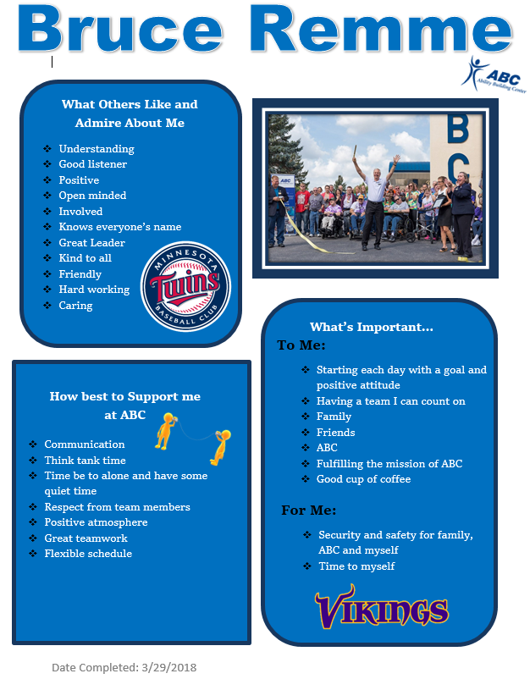
Person Centered Profiles

Slide 9
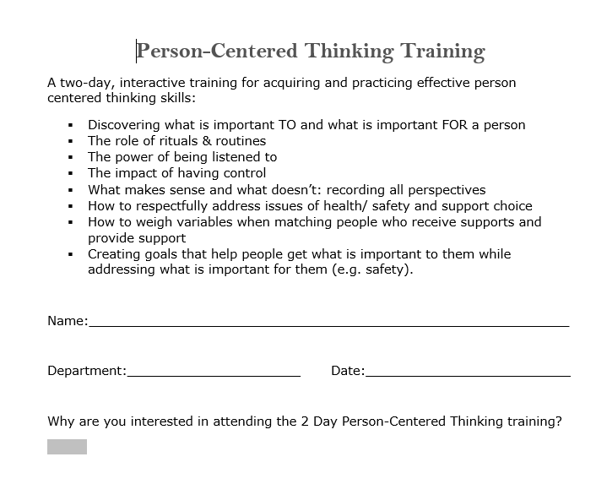
Training Opportunity for Direct Care Staff

Slide 10

Action Plan
Goal | Desired Result
Board Presentation | The board will have a basic understanding of PCT/PBS and understand what the team’s mission, vision, and goals are. By understanding the teams vision the board will be able to better assist with the team’s action plan.
All Staff Presentation on Person Centered Thinking and Positive Behavior Supports | Staff will have a basic understanding of PCT/PBS and understand what the team’s mission, vision, and goals are. Staff will have the opportunity to give feedback and will learn about their role in the process.
Have all Program Coordinators, Administrative Staff, and key Job Coaches attend the 2 day person centered training. | Attending the 2 day training will expose staff to person centered practices and allow them an opportunity to better understand the outcomes that we are working towards.
Develop agency-wide recognition practices for staff. | Recognition can improve staff retention and increase overall job satisfaction. We have been piloting recognition practices in certain departments but need to standardize them agency wide.
Develop a staff mentoring program. | ABC’s Direct-Care turnover rate was 42% in 2017. Developing a mentoring program will provide staff with positive supports outside of supervision.
Develop or partner with local agencies (IMAA, Diversity Council) to offer a Cultural Competency and Privilege training for staff. | It is important for staff to be culturally competent and understand how privilege plays a role in our lives and the lives of the individuals that we serve.
Make examples of each tool along with a description of when/how they should be used. | We will create a resource folder for staff to review examples of how Person Centered Tools are developed and how they can be utilized.

Slide 11
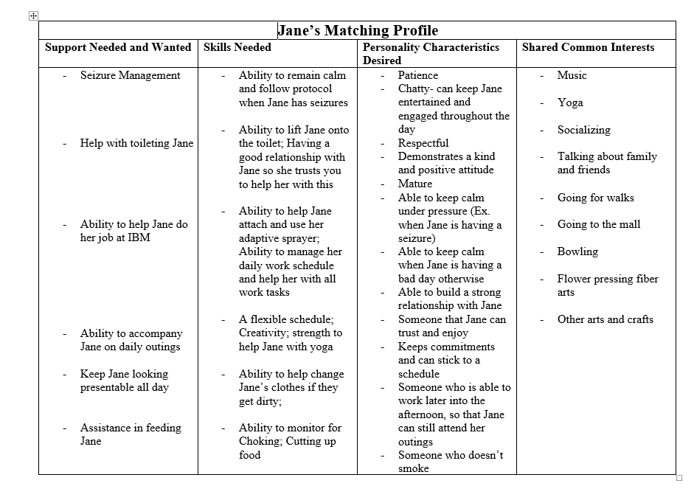
Matching Profile

Slide 12
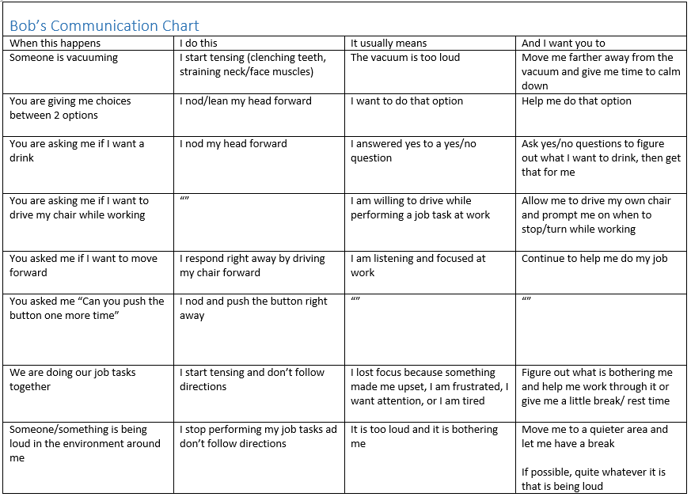
Communication Chart

Slide 13


Good Day/Bad Day
Joe’s Good Day | Joe’s Bad Day
One of the best days I have had was going to visit the Harley Davidson showroom and assembly plant. When my friends at home are calm in the morning and evening When my room is safe - no one touches my stuff Getting a good night of sleep Looking for a job – picking up applications, visiting possible places to work Getting new stuff: Harley Davidson models, Star Wars, Star Trek movies and figures Following my routine in the morning: up at 6am, glasses on, get dressed, make my bed (Chiefs football sheets), coffee, then breakfast, then chores We watch wrestling at 7pm on Friday night Planting vegetables in my garden Playing air guitar and listening to Def Leopard Going out to eat, shooting pool Hanging out with Linda, my staff. She is really nice. | Not getting enough sleep Being bored at home all day – I sit in my room or watch boring television. Working where there is lots of arguing – this is why I quit my last job at the workshop At home, my friends arguing or too much noise! When Gary tells me what to do and banging on my door to tell me it is time to take my medication When my friends move my stuff my room Remembering sad things – and Lisa isn’t there to talk.

Slide 14
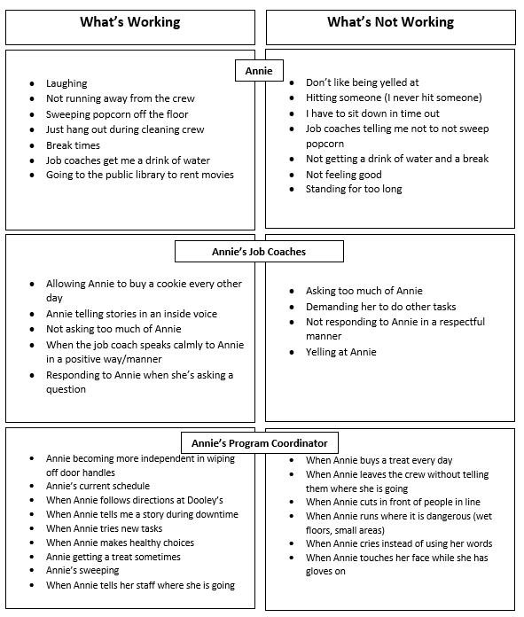
What’s Working/Not Working

Slide 15
Mentoring Program

Slide 16
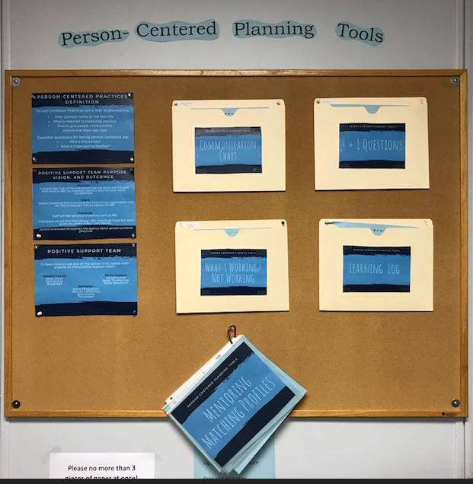
Person Centered
Planning Tools
Resource
Located in the clerical area so that all staff can access the tools
Staff have easy access to mentor profiles
All staff on the Positive Support Team have a sign on their door

Slide 17
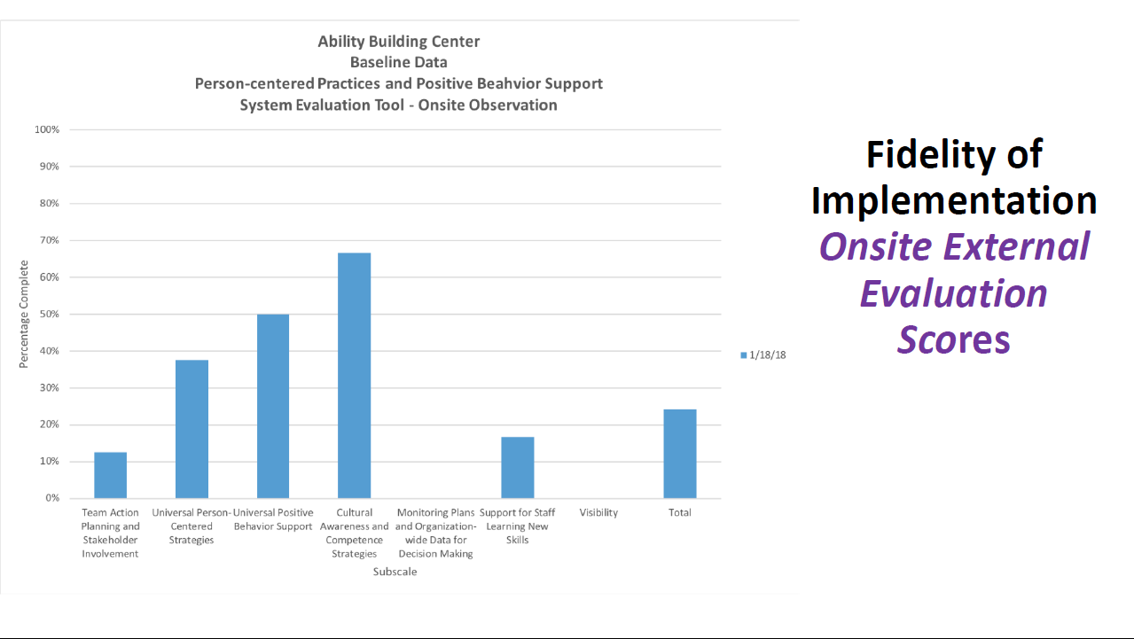
Onsite Evaluation

Slide 18
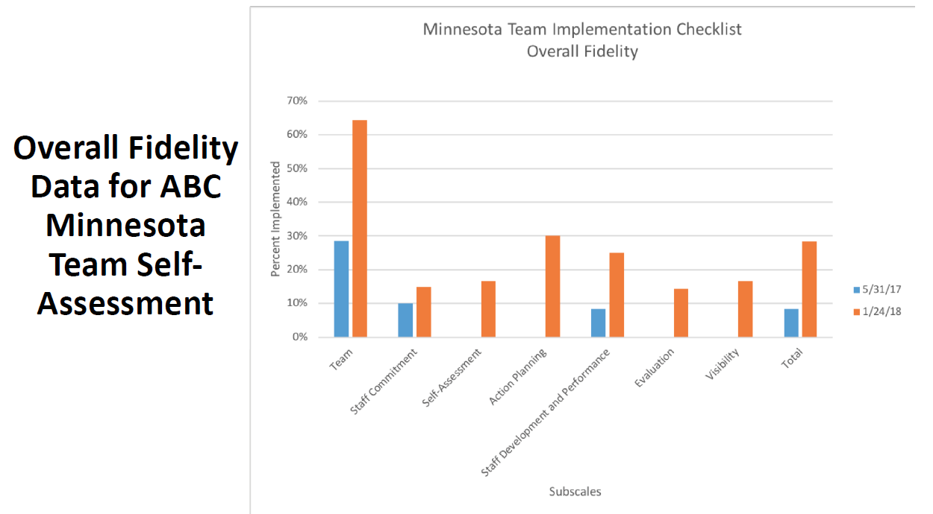
Fidelity Data

Slide 19
How You Can Help
Staff Satisfaction Survey
Mission, Vision, and Goals Restructure
Support & Advocacy
Feedback

Slide 20

Questions?

