Slide 1




Introduction to Positive Behavior Support
Day 1 Webinar & Onsite

Slide 2
Webinar Goals for Diverse PBS Facilitators Who Are Here Today
Some of you are new to PBS…..feel free to listen and absorb the messages
  Role of the PBS Facilitator
  Major messages
People who know these slides well…..
  You will be presenting this content to other people as a PBS Facilitator
  Think about who needs to know about this information
    Different Meetings
    Direct Support, Mental Health Practitioners, Community
  Use handout to select slides you want us to provide and let Stephanie know
  Write 3 messages as prompts so you have notes for slide presentations

Slide 3
Becoming a PBS Facilitator
Begin Putting Messages Into Your Own Words….
Think about how you would present it to different types of people
What would you be most comfortable saying
Adapt messages to address cultural differences

Slide 4
Introduction to Positive Behavior Support
Day 1 Webinar

Slide 5
Purpose of Today
Talk about the organizational changes throughout Minnesota
Person centered practices as the foundation of PBS
Learn about Universal Positive Behavior Support
  Building positive social interactions strategies
  Consistent responses to problematic interactions
  Data-based decision making

Slide 6
Webinar Agenda
  Introductions
  Review of statewide community working on building person centered organizations
  Person centered practices as universal foundation
  What is PBS? Review of universal strategies
  Consistent responses to problems
  Using data for decision making
  Questions

Slide 7
Statewide Organization-Wide Change Throughout Minnesota

Slide 8
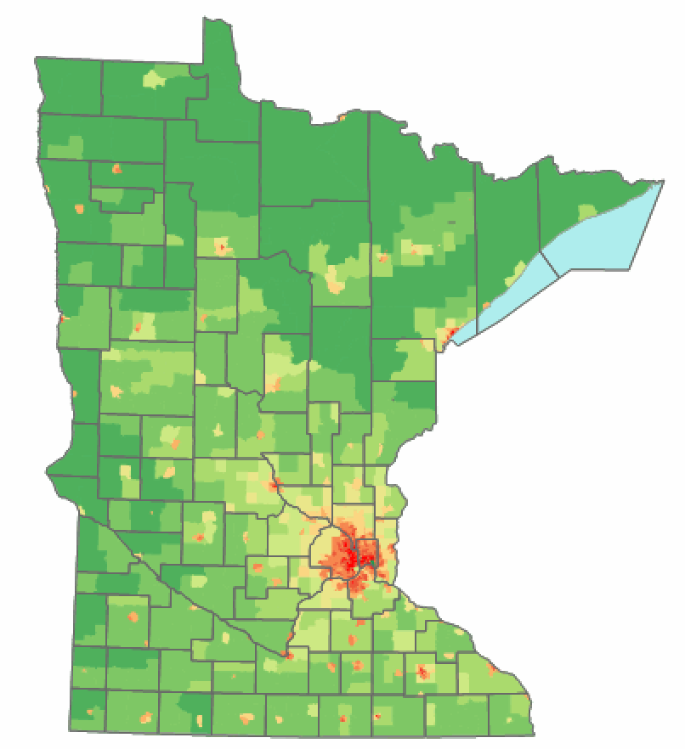
Minnesota Regional Person-Centered Model
Training Layers
Team Training
Coach Training
Person-centered Thinking Trainers/Coach Training
Picture of a Life Planners/Trainers
PBS Facilitators
Cohort 2 A
St. Louis County Region
(1 County & 3 Organizations)
Cohort 2B
West Central
(5 Counties, Public Health Dept., 2 Organizations)
Integrated Model
Cohort 1
Support Development Associates
Person-centered Practices Model
1 County, 3 Organizations
Cohort 3
Olmsted County
1 County, 5 Organizations
Total=22 Organizations

Slide 9

Improving Quality of Life
OUTCOMES
Supporting
Decision
Making
Supporting
Staff Behavior
SYSTEMS
DATA
PRACTICES
Supporting
All People

Slide 10
Person-Centered Practices & Planning
Implementing Multi-Tiered Systems of Support
Positive Behavior Support
Tertiary Stage
In Depth Person-Centered Plans
Integrated Plans (PCP, PBS, Trauma-informed Therapy)
Teams Monitor Plan Progress
Positive Behavior Support
Person-Centered Practices & Planning
Organizational Workforce Development
Secondary Stage
Monitor PCT Action Plans
Additional Quality of Life Strategies
Increase Strategies for Supporting Independence and Community Involvement
Mental Health and Wellness Interventions
Organizational Workforce
Primary Stage
Universal Person-Centered Strategies
Encourage Self Expression
Self-Determination and Choice Making
Meaningful Participation in the Community
Notes:
PC is driving force behind pbs

Slide 11
Organizational Workforce Development
Implementing Multi-Tiered Systems of Support
Tertiary Stage
Tailor Problem Solving for Specific Problematic Situations
Individualize Training and Mentoring to Address Unique Settings Where Problems Occur
Improve Supervision and Mentoring for Locations Experiencing Challenges
Establish Matching/Hiring Tailored to Individualized Plans
Positive Behavior Support
Person-Centered Practices & Planning
Organizational Workforce
Secondary Stage
Monitoring and Early Intervention
Training Targeted for Groups
Targeted Strategies to Improve Specific Settings
Simple Problem Solving for Challenging Situations That Occur in More Than One Situation
Universal Stage
Align Policies to Person-Centered Practices
Revise Job Descriptions, and Performance Evaluations
Integrate Person-Centered Practices and PBS With New Orientation and Ongoing Instruction
Use Data for Decision Making
Notes:
How does workforce fit in
Attrition of staff may indicate that we need to do something to increase their skills so that attrition decreases

Slide 12
Positive Behavior Support
Implementing Multi-Tiered Systems of Support
Tertiary Stage
Individualized PBS Plans
Integrated with Other Positive Supports (PCP, Trauma-Informed Care, DBT, Etc.)
Plans Are Monitored- Data-Based Decision Making
Teams Monitor Progress of Each Person
Positive Behavior Support
Secondary Stage
Early Intervention and Data Monitoring
Additional Supports for Key Social Skills
Function-Based Decisions
Simple Interventions
Mental Health and Wellness Interventions
Universal Stage
Teach and Encourage Communication
Predictable and Proactive Settings
Encourage and Reinforce Social Skills
Consensus-Based Team Focus
Emphasis on Using Data For Decisions
Notes:
What do all people need-
Choice making
What is telling us that quality of life is not good enough, how to help before we reach crisis
More time preventing fires than putting them out

Slide 13
What are Positive Supports?
  Support Strategies and Practices that are:
    Person-centered and respectful
    Culturally sensitive
    Evidence-based
    Prevention-focused
    Adapted and improved over time
    Often implemented together
    Used across the life span

Slide 14
Positive Support Examples
Person-Centered Thinking/Planning – Foundational Values
Positive Behavior Support
Applied Behavior Analysis
Assertive Community Treatment
Cognitive Behavior Therapy
Dialectical Behavior Therapy
Motivational Interviewing
Wraparound Planning/Systems Of Care
Trauma Informed Practices
School-Linked Mental Health

Slide 15
First Step: Establish a Person-Centered Environment

Slide 16
Core Concept:
What is important to a person includes those things in life which help us to be satisfied, content, comforted, fulfilled, and happy
important to
and
important for
AND
The balance between them

Slide 17

Good Day
Bad Day
Relationship
Map
Routines &
Rituals
Donut
Matching
2-Minute Drill
Management Tools
Reputation
Learning Logs
Communication
Working
Not Working
Important To Important For & The Balance Between
Discovery/
Listening Tools
4 + 1 ?s
Everyday Learning Tools
Wrkbk pg 9
Notes:
PURPOSE:
Providing participants with a visual overview of the tools, how they are organized, what they look like and how they might be used.
SCRIPT
The tools we will be learning and practicing can be divided into 3 categories:
Discovery/Listening
Everyday Learning
Management
“Before actually learning to use the tools, this overview will quickly show you what the tools look like, describe how they can be used and begin to familiarize you with what they are called.”
TIPS:
The main thing here is to say “The tools work together…we’ve got a lot to talk about.” Don’t get tied up trying to explain every tool right now.
Go thru all the skill slides quickly – just tell the participants a little about each skill. You are only doing this so that they will be familiar with them when they are taught in more detail.
Slide is animated.
TIME: 1 minute for this slide, no more than 15 minutes for the entire overview

Slide 18
Levels of Change
Any changes that results in a positive difference in the lives of people who use services or in your own work life.
Level 1
Any changes an organization makes to its practices, structure or rules that result in positive differences in the lives of people. (Organization Level/Managers/Supervisors/CEO/Administrative Support).
Level 2
Any change in practice, structure and rules made at the system level. These changes have an effect on many organizations, and therefore many peoples’ lives. (Larger State Level or National Organizational or Leadership Level Issues).
Level 3
Notes:
PURPOSE:
To help the participants understand how change happens at different levels and how it trickles down.
SCRIPT
Discontent leads to change and it is helpful to think about change as happening at several levels.
Level one, you don’t need any permission to implement. Changes in such things as routines, rituals, approach. These are changes that can be made immediately.
Level two changes require approval from management. It is a change in practice, policy, or structure.
The need for Level two changes is best identified by having a structured way for the shared learning of direct support level go to the organizations leadership.
Level three changes can be thought of as “systemic” changes. A change in state law or regulation is an example of a level three change.
TIPS:
If you have primarily direct support staff in your training, you do not need to spend a lot of time on level three changes. Simply refer to them as state or federal rules.
TIME: 3 minutes
NOTES:

Slide 19
Positive Behavior Support
Universal PBS Strategies

Slide 20
Changing Our Understanding of PBS
Many People in MN Think PBS Relates Only to Individualized Interventions
Intensive, Individual Interventions
* Individuals with Intense Needs
* Assessment-based
High Intensity
Appropriate for Professionals Across
Agencies and Systems
Notes:
Most people think about pbs only in tertiary level but that’s not all

Slide 21
Positive Behavior Support Provides a Framework for Prevention
Focus First on Universal Positive Behavior Support
Work Together to Create a Plan
Prompt, Teach, & Encourage Positive Social Interactions
Practice New Social Skills
Reinforce, Recognize, & Celebrate Success
Consistent Responses to Problematic Social Interactions
Early Prevention and Monitoring
Build Positive Social Settings Where Everyone Practices and Celebrates Social Skills That Are Important
Notes:
Today we’re going to focus on universal
How do we set the stage for universal level

Slide 22

Focus On Prevention
“It’s a whole shift in paradigm of fighting fires to building capacity within the organizations--whether it is a contracted service provider or residential or day treatment program....I see our role as...helping people build capacity...”
–www.pbskansas.org/files/missouri_interagency_pbs_team_newsletter_part1.pdf
Notes:
Teachin communication, modeling etc
Not fixing others but a way to think about behavior change
Can’t change other people as easily as we can change ourselves
When we change others usually follow suit
Changing the environement can really make a difference

Slide 23
Major Goals of Universal PBS
Promote Positive Social Interactions
Design Positive, Proactive, Predictable Environments
Consistent Response to Problems
Establish Data-based Decision Making Systems
Build Capacity for Individualized PBS

Slide 24
Key Elements of Positive Behavior Support
Positive Behavior Support is the Integration of
  Valued Outcomes
  Behavioral and Biomedical Science
  Validated Procedures
  Systems Change
In Order to Enhance Quality of Life and
Prevent Problem Behavior
Note: PBS Plans Require Those Supporting Children and Adults to Change Their Own Behavior

Slide 25
PBS Assumptions & Values
We are Interdependent – We All Help Each Other to Be Our Better Selves
Everyone Can Improve Their Social Skills
Even When We Know the Right Way to Model Good Social Behavior, We Don’t Always Choose to

Slide 26
Examples of Universal Strategies
Person-Centered Thinking Strategies
AAIDD Positive Behavior Support Curriculum
The Tools of Choice Social Skills Curriculum
Health and Wellness Strategies
Efforts to Build Natural Supports
Strategies for Increasing Positive Social Interactions
Notes:
Examples of some tools-also available on website
Wellness can set the stage for positive behaviors because no pain less behavior for example
Natural community connections

Slide 27
“Almost everybody I work with has ‘behavior’, including staff, that is problematic to them on a daily basis. I mean we need to not think it as [problem behavior]”
--Person Supporting People With Traumatic Brain Injury in Kansas
Notes:
We all engage in behaviors, some of them challenging

Slide 28
Positive Social Interactions

Slide 29
Major Goals of Universal PBS
Promote Positive Social Interactions
Design Positive, Proactive, Predictable Environments
Consistent Response to Problems
Establish Data-based Decision Making Systems
Build Capacity for Individualized PBS

Slide 30
Creating a Positive Environment
Our Needs Are Met
We Have Choices
Events Are Predictable
People Listen and Communicate
  Verbal
  Nonverbal
Quality of Life is Assessed
Notes:
Encouraging dsp to be model good behavior
Regional quality council
Pbs quality of life comes first
If life is good less likely to engage in some of the challenging behaviors

Slide 31
Who Is Involved In Building a Positive Social Environment?
People Receiving Services and Supports
Staff members, Managers and Administrators
Family Members, Guardians
Advocates and Community Members

Slide 32
”The Matrix” – A tool for building positive social interactions.
Person-centered Values | Setting 1 | Setting 2 | Setting 3 | Setting 4
Value 1
Value 2
Value 3
Positive behavioral definitions of the values for each setting

Slide 33
Matrix Development
Everyone Works Together to:
List Key Person-Centered Values
Identify the Social Behaviors That Reflect These Values
Create a Plan for Increasing Social Interactions
Support and Recognize Each Other, Help Encourage and Prompt
Celebrate Success

Slide 34
Matrix Examples

Slide 35
Using Person-Centered Strategies to Encourage Community – Mental Health Clubhouse Example
First Meeting Naturally Scheduled to Manage Clubhouse
  28 People with Mental Illness Use the Clubhouse
  2 Staff Members Support the Clubhouse
  4 Person-Centered Thinking Coaches
Coaches Used Facilitated Groups of 4 People
Discussed What Works and What Doesn’t Work at the Clubhouse
Identified Times of Day That Are Important and Completed
Agreed on Person-Centered Values & Social Behaviors

Slide 36
 | Times of Day | Free Time | Cleaning Up | Lunch Time | Fundraising | During Outside Activities
Values | Respecting Each Other | Respect another's privacy, Understanding differences | Offer to help each other, talk to each other kindly if something isn't working | Push in/pull out chairs for others, Ask if help is needed | Everybody can do something, break bigger jobs into smaller parts | Respect each other's preferences, follow the rules, watch out for each other
 | Having a Positive Attitude | Be aware of your environment, Be aware of how other's are feeling | Respect people's differing abilities, Get involved | Talk to people that you may not otherwise talk to | Help out where you can, participate in Clubhouse meetings and offer suggestions | Appreciate the moment and activity, say thank you to those who plan activities
 | Working Together | If there is nothing to do, get together and decide to do something, Clean up after yourself | Offer to help each other with the bigger tasks | Clean up after yourself, allow people time to finish eating before cleaning up/try not to rush people | Develop committees to break down the bigger jobs | Be friendly, clean up after yourself, be neat
 | Positive Communication | Respect boundaries, have compassion, use humor respectfully | Ask for help if you need it, offer help if you see someone needs it | Use manners (please and thank you), thank the people who cook and serve you | Plan more fundraisers, talk about how to plan them at Clubhouse meetings | Be polite to the public and each other
 | Volunteering | Welcoming new members, help others to particiapte more | Try out different tasks, try not to always do the same things | Pay attention to what chore/cleaning needs to be done | Volunteer for what you can, attend Clubhouse meetings to learn of and present opportunities | Help other people stay on time and with the group
 | Support for Each Other | Offer to help, share computer time, only share things with others that you are comfortable sharing | Take turns doing tasks, develop teams for getting bigger cleaning projects done | Help out where you can - 2 people can do a job faster than 1 | If someone or a committee needs help, offer assistance | Be friendly, get involved in planning activities

Slide 37
Times of Day | Free Time | Cleaning Up
Respecting Each Other | Respect another's privacy, Understanding differences | Offer to help each other, talk to each other kindly if something isn't working
Having a Positive Attitude | Be aware of your environment, Be aware of how other's are feeling | Respect people's differing abilities, Get involved
Notes:
Zoom in of previous slides

Slide 38
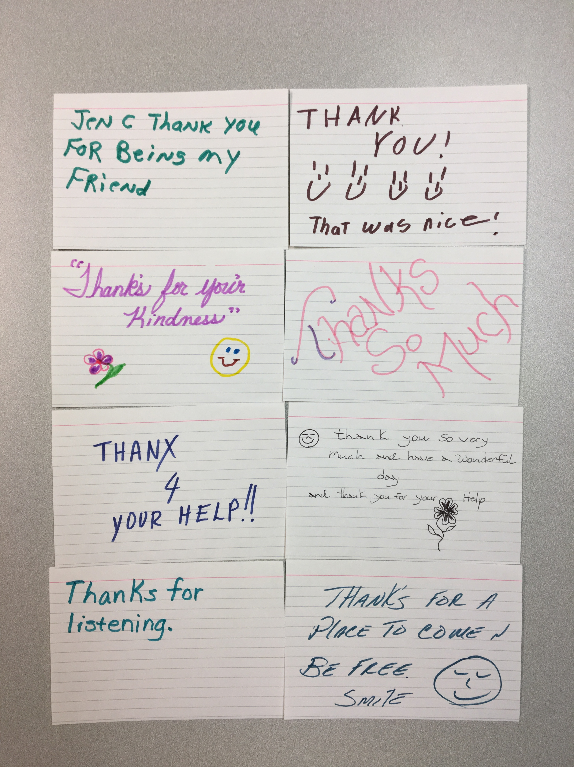
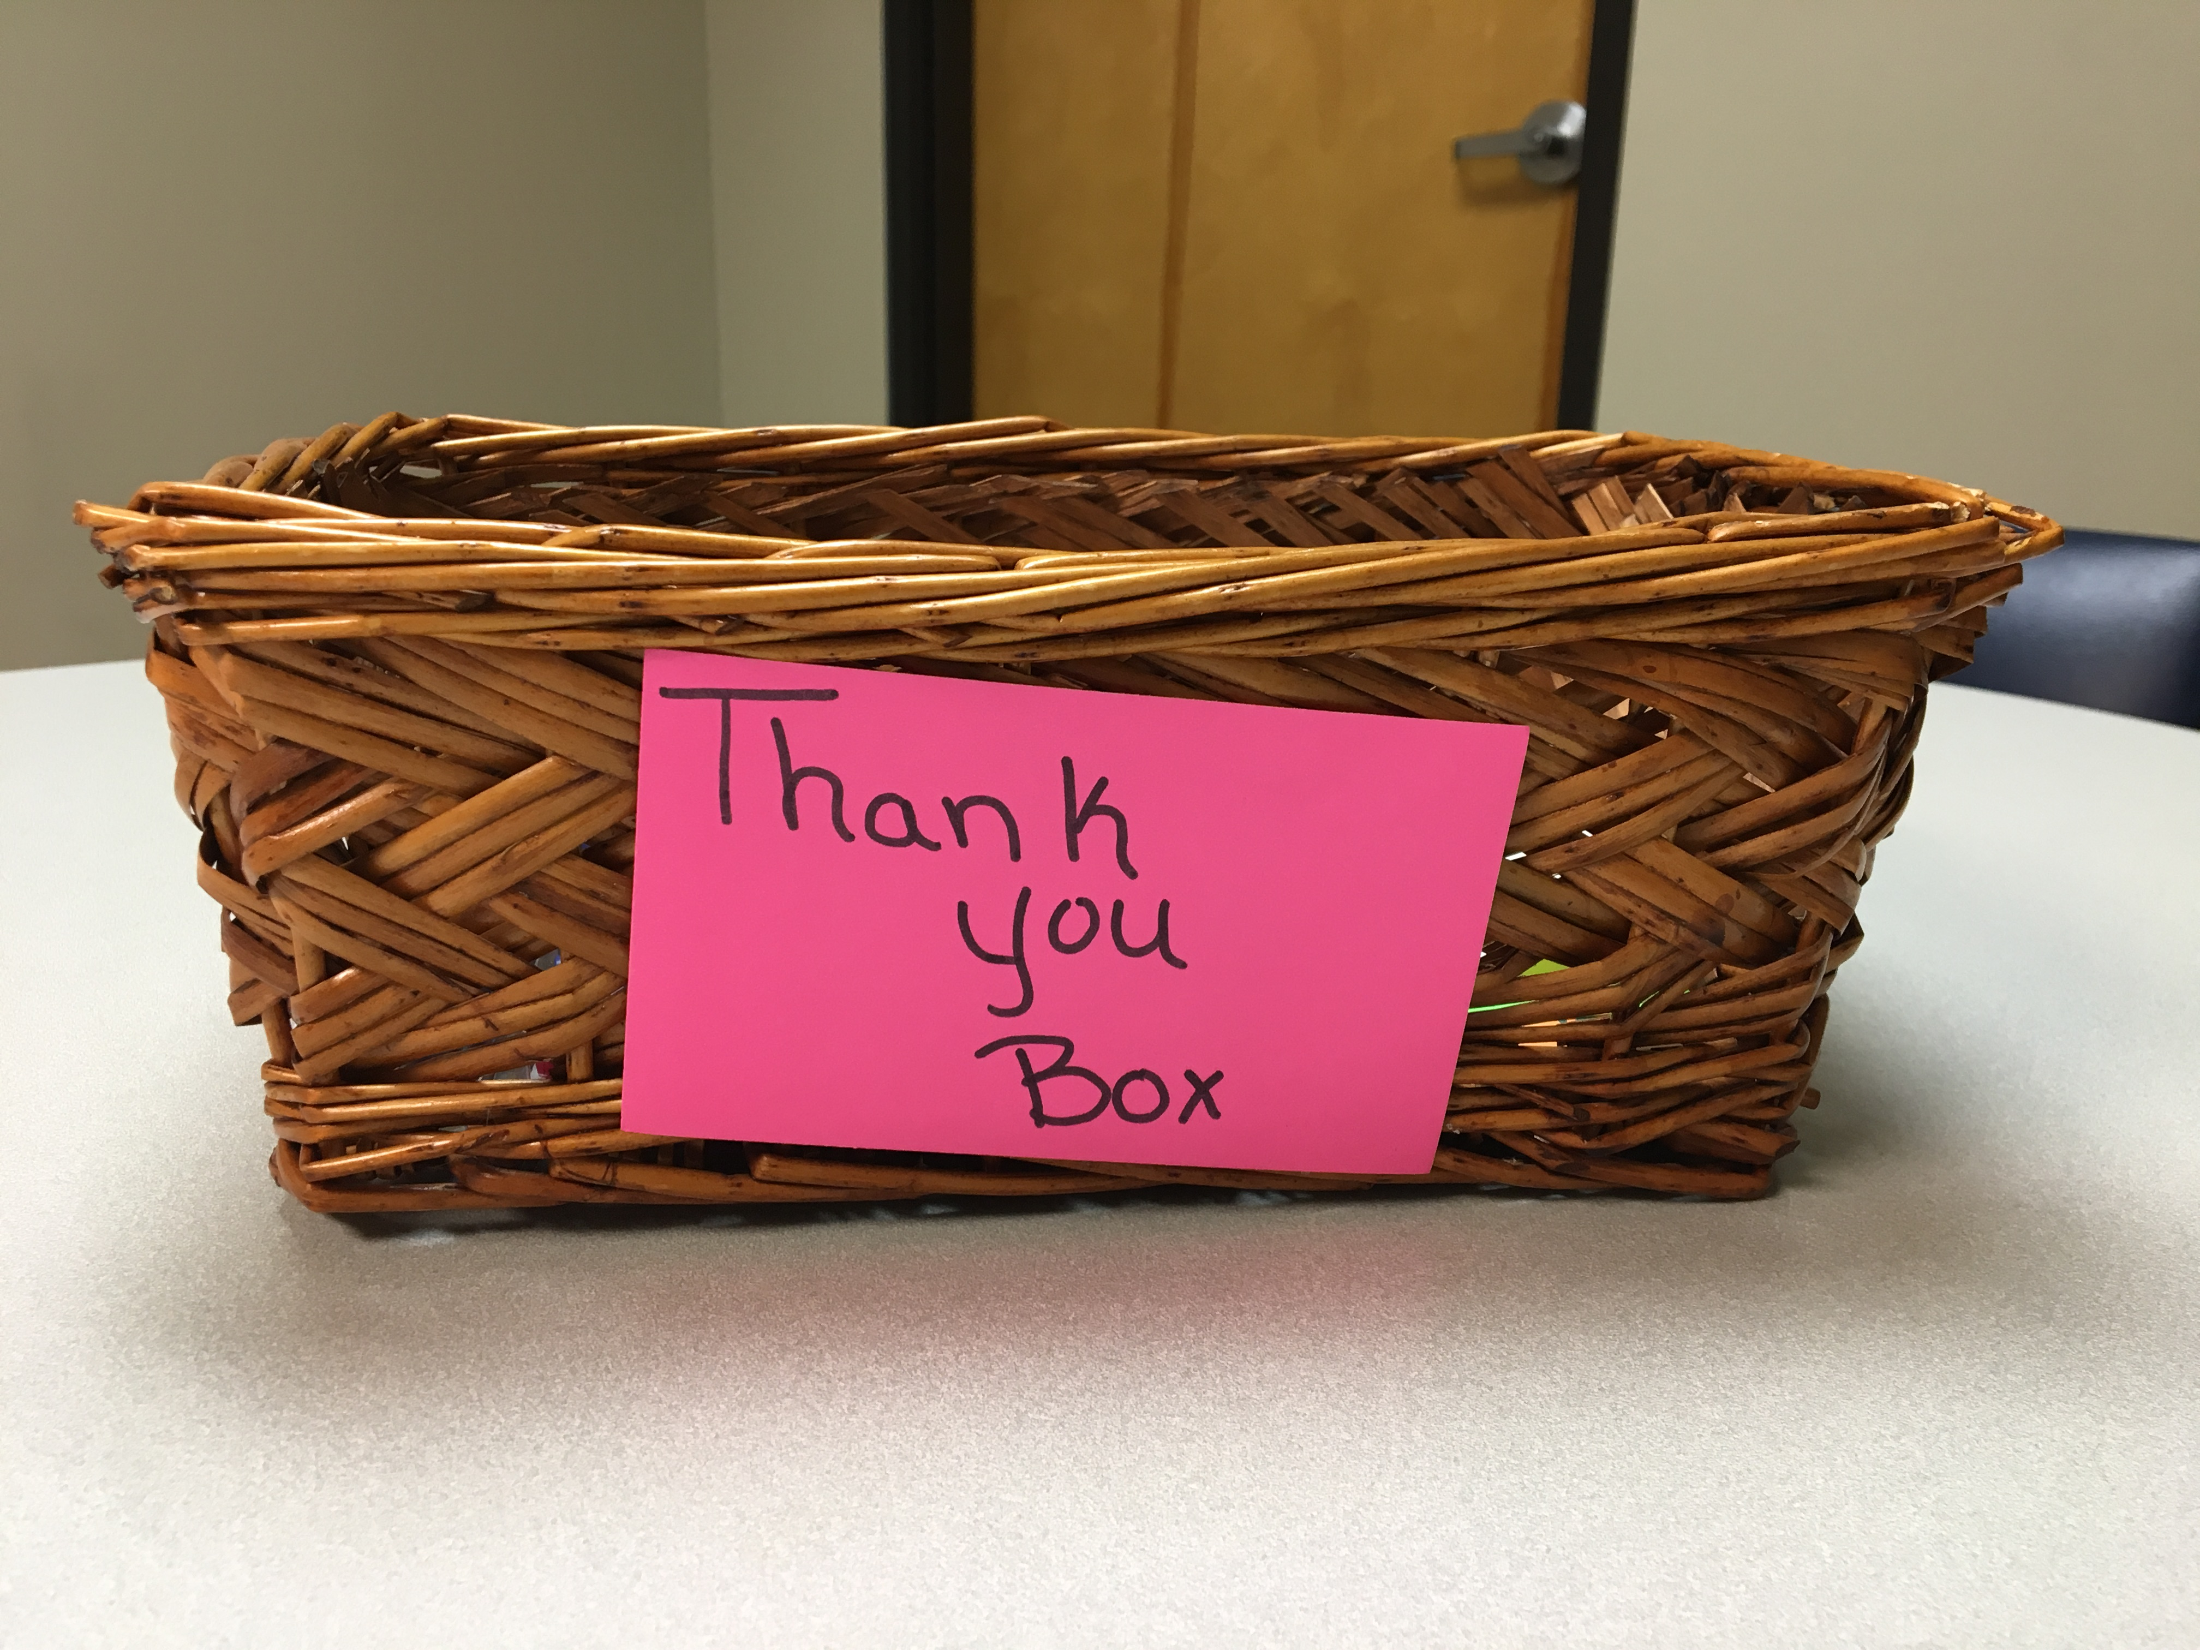
Clubhouse Participants Created Thank You Notes and Give Each Other Recognition and Thanks When They See Examples of Values

Slide 39
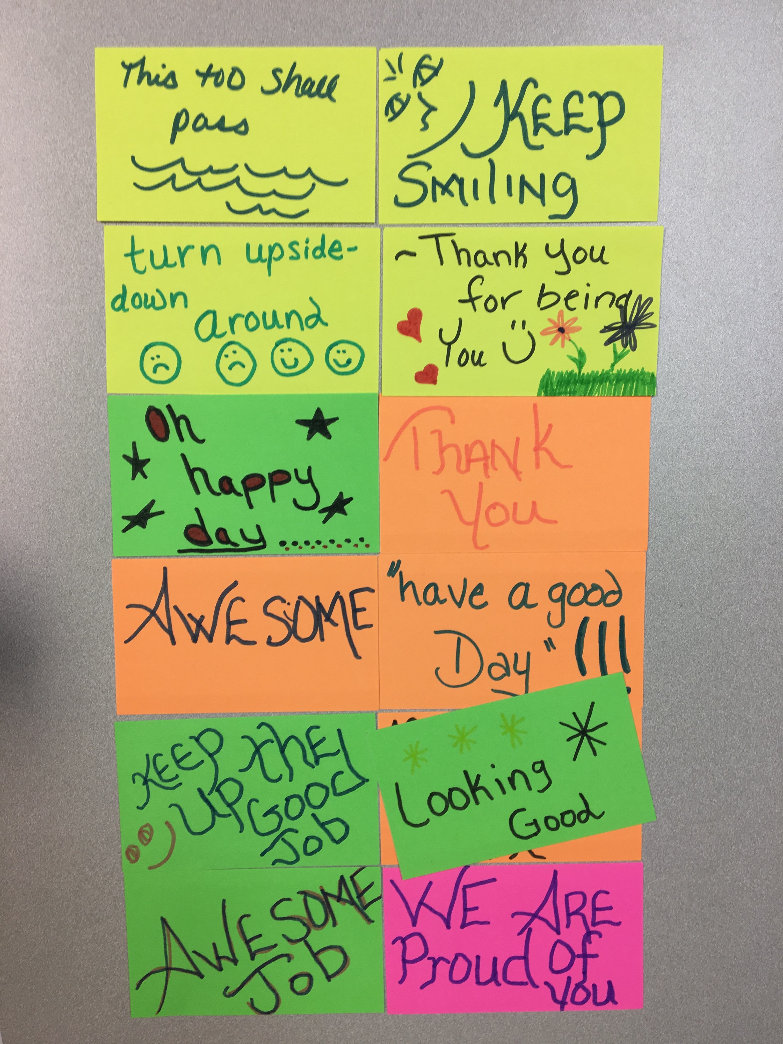
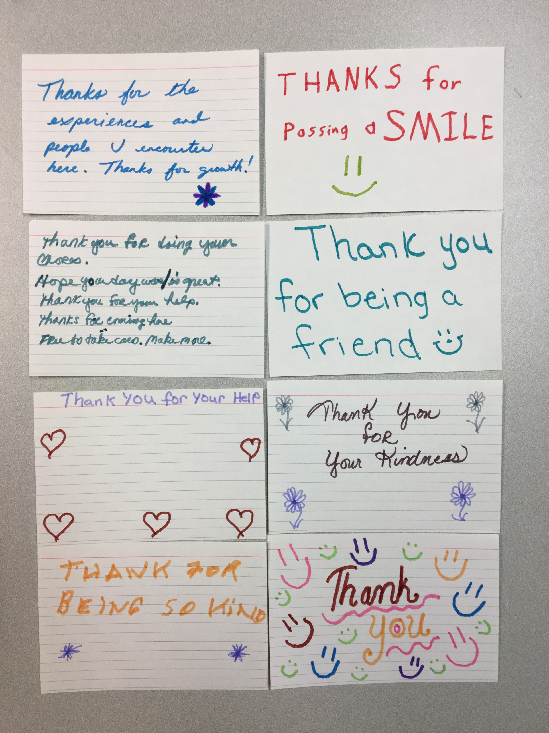

Slide 40
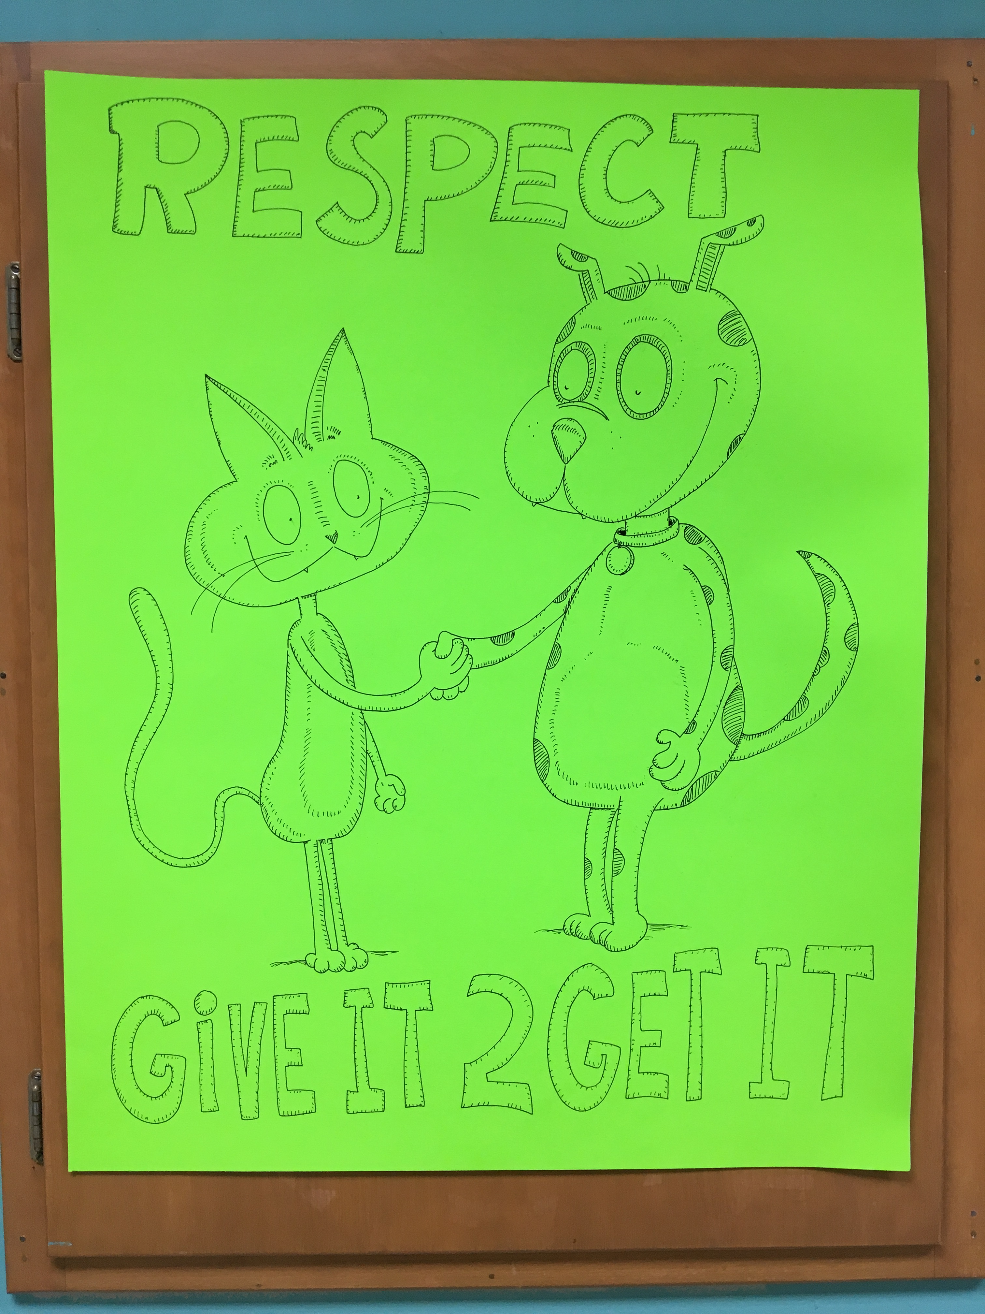
Clubhouse Artist Created Visual Reminders of Key Person-Centered Values

Slide 41
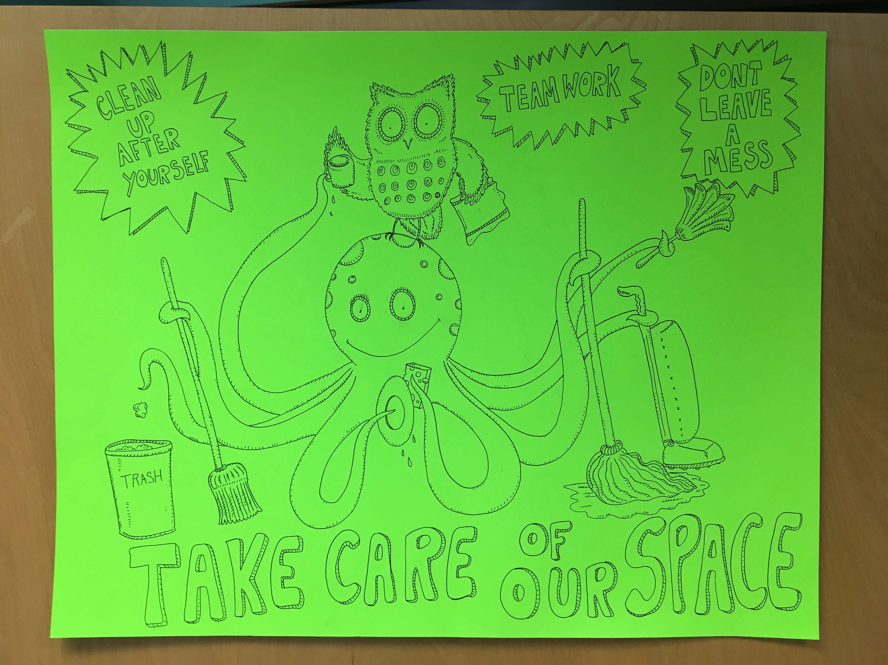

Slide 42
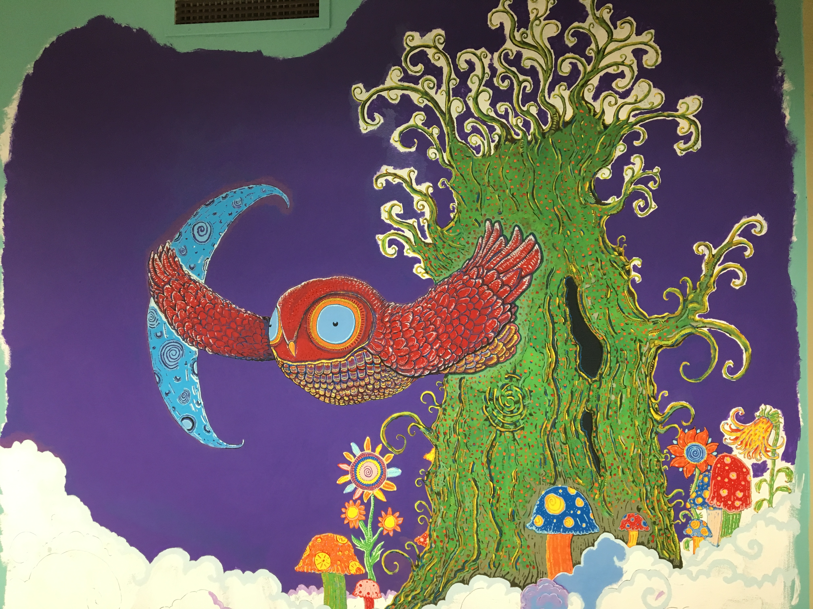
More Artwork Under Construction at the Clubhouse

Slide 43
Other Examples of the Matrix

Slide 44
Person-Centered Community Supports – County Meeting
Values | Before Meetings | At the Beginning of Meeting | While Sharing Person’s Information | Supporting Other Team Members
Use Person-Centered (PC) Language | Use PC Language in Documents (Emails, Handouts) | Provide Reminders Before Meeting (Be Sensitive to Acronyms Too) | Be Receptive and Aware of Language Used | Celebrate Use of PC Language as Team
Show Your Respect for People | Use Active Listening During Conversation | Attend Meetings on Time Cell Phones to Vibrate | Share Only Information Needed Provide Feedback to Others | Listen to Others and Ask if Feedback is Invited
Demonstrate Appreciation of Culture | Review Plans and Discuss Role and Identity & Culture | Review Possible Cultural Bias and Assumptions | Share Thoughts on the Role of Culture in Person’s Life | Discuss How Culture Can be Incorporated Into Plan

Slide 45
Person-Centered Values in Residential Settings
Values | Getting Up in the Morning | Work | Dinner & House Chores | Community
Encouraging Choice | Each Person Creates Their Own Routine | Work With Supervisor to Choose Activity And Schedule | Decide Whether to Eat Together or Individually | Explore New Activities and Make New Friends
Respect Each Other | Ask Before Using Other’s Personal Items | Let People Know When You Need a Break | Work Together to Choose Food Weekly | Be Sensitive to Each Person’s Comfort Levels in the Community
Encourage Each Other | Know When Someone Needs Time and Space (Coffee First!) | Recognize Others for Hard Work | Help Other People Complete House Chores | Reach Out to Others and Make New Friends

Slide 46
Practicing Positive Social Behaviors
After Completing the List of Social Behaviors and Locations
Assess the Ability of People Living or Working in a Setting and Staff
Create a Plan for Teaching New Skills
Schedule Opportunities to Practice Social Interactions
Show Examples and Non-examples of Social Interactions
Create a Plan to Recognize and Reinforce the Positive Social Interactions We Observe!

Slide 47
McAuliffe’s Frequent, Specific Praise Prompt
6 TO 1
Create Visual Reminders to Recognize Positive Social Interactions

Slide 48
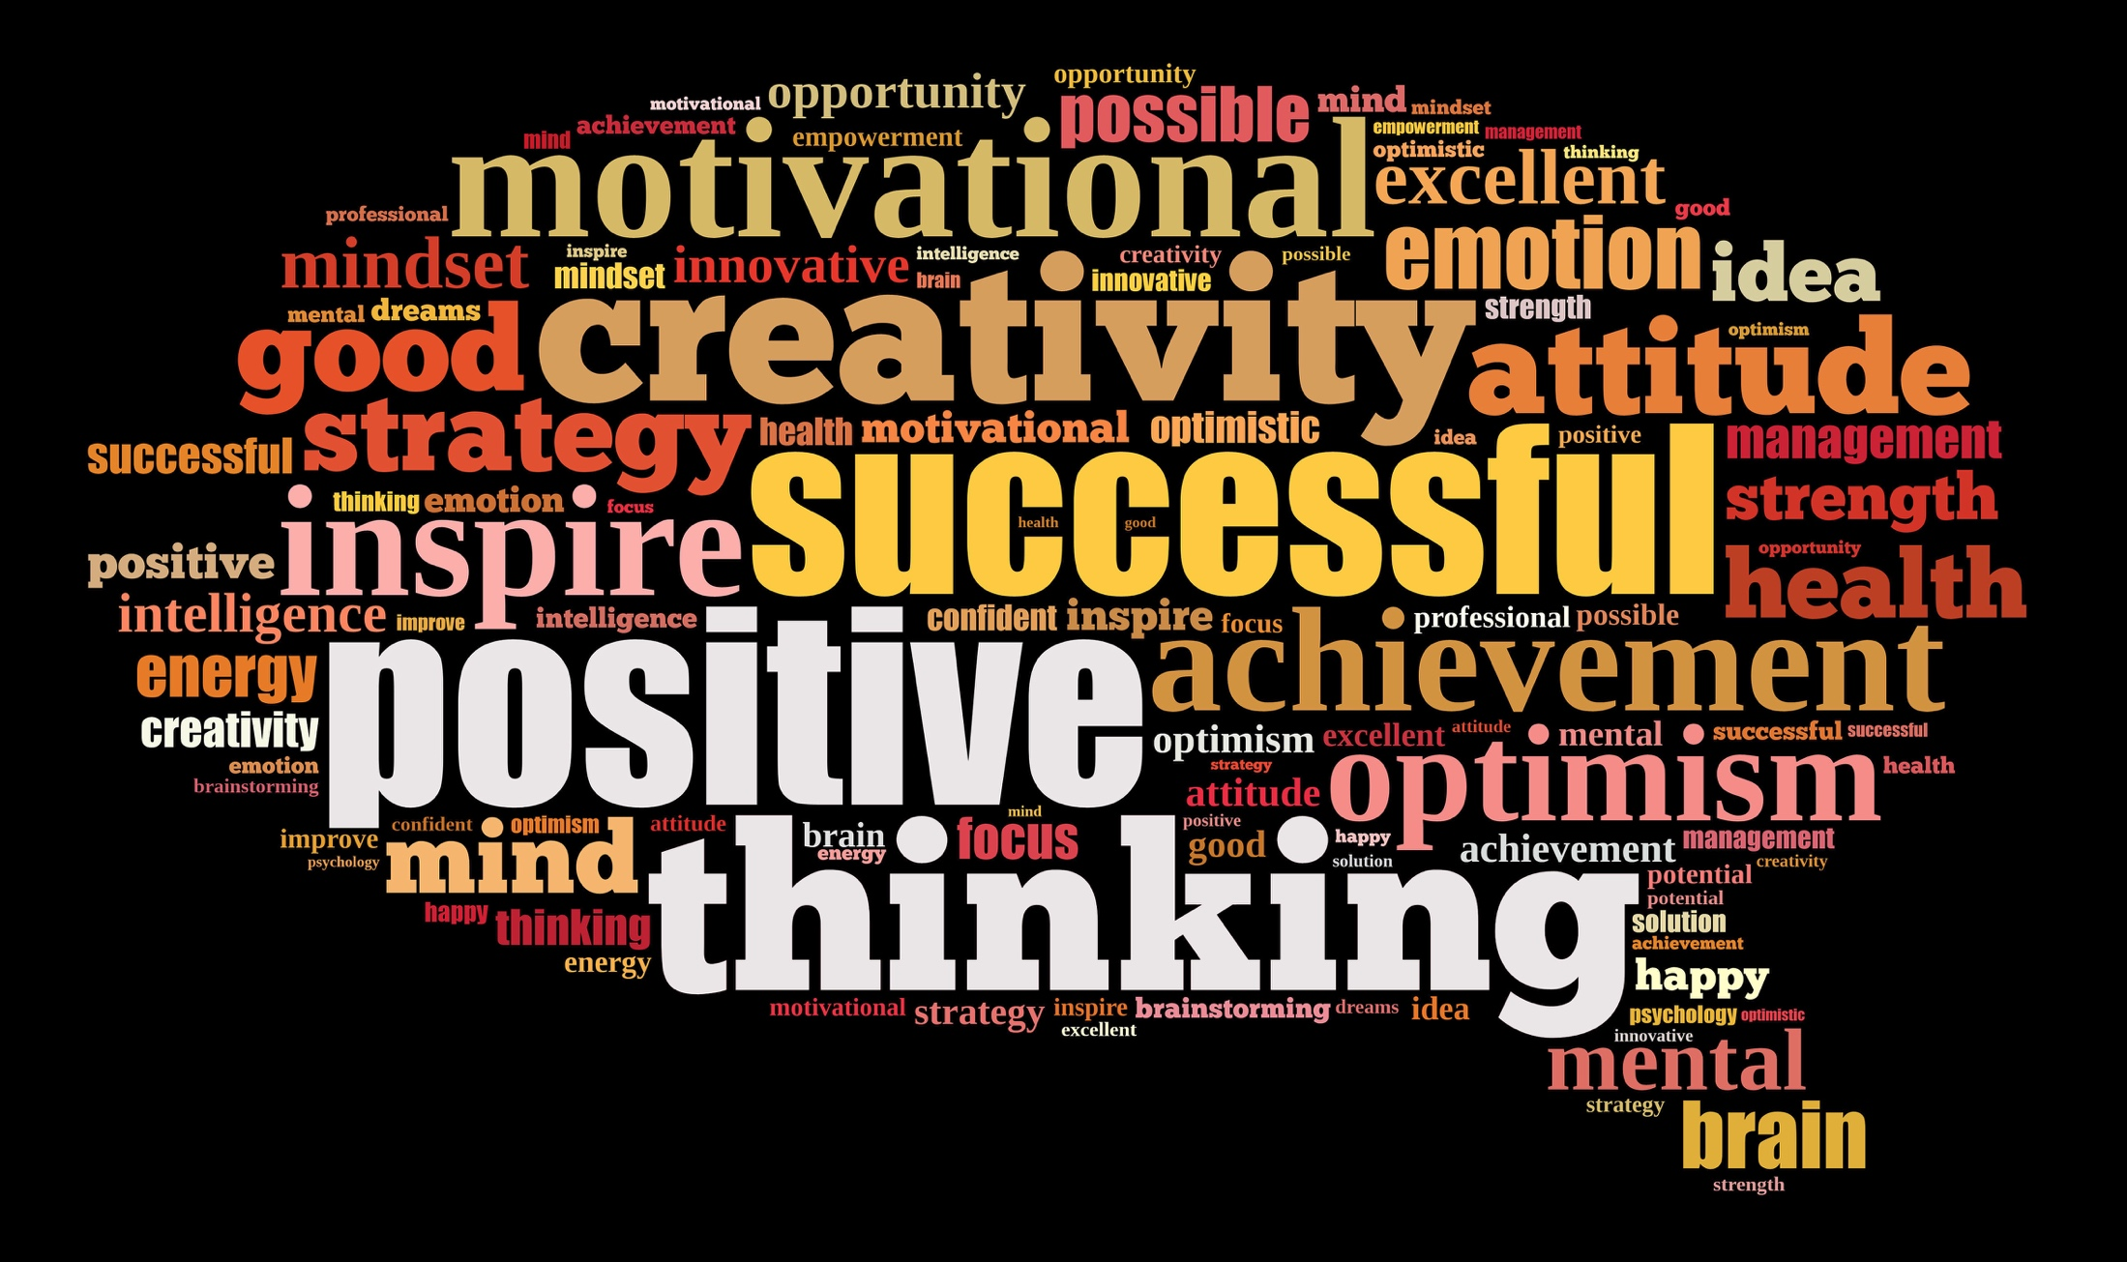
Focus on Our Values in Action
Celebrate Successes!
Model and Practice Social Interactions
Emphasizing the Value of Social Interactions

Slide 49
Consistent Responses to Problems

Slide 50
Major Goals of Universal PBS
Promote Positive Social Interactions
Design Positive, Proactive, Predictable Environments
Consistent Response to Problems
Establish Data-based Decision Making Systems
Build Capacity for Individualized PBS

Slide 51
Moving Away From Traditional
Behavior Management
Traditionally Problem Behavior Has Been Viewed As:
  a Function of a Person’s Disability
  Existing Solely Within the Person Who Engages in the Problem Behavior
  Maladaptive (i.e., Non-Functional, Meaningless)
The Goal of Intervention has been to Eliminate the Behavior by Suppressing It

Slide 52
Common Functions that Maintain Problem Behavior
To Escape from Tasks, People, Situations, or Internal Sensations
To Obtain Attention from Teachers, Peers, or Other Individuals
To Obtain Access to Preferred Items or Events
To Either Escape or Obtain Internal Sensations Due to Physiological Events

Slide 53
Common Themes That Set the Stage for Problems
Choices Available
Predictability of My World
Control Over My Life

Slide 54
Two Common Problems That Occur in Most
Social Settings
A Person Makes a Request/Demand and the Other Person Refuses
  (Escape From People, Activities, Events, Items)
Someone is Ignored or Left Alone With No Social Interaction for a Period of Time
  (Strategies to Communicate With Others)

Slide 55
Assessing Incident Report Systems
Using Incident Report Data in Team Meetings
  Guide Staff Development
  Decide PBS Strategies to Use
  Early Intervention and Monitoring
Assessing Current Incident Report Form
Definitions of Problem Behavior
Steps for Moving Forward

Slide 56
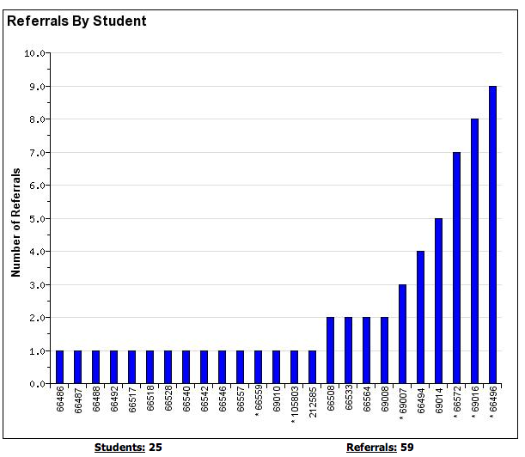
Incident Reports &
Data-based Decision Making
People: 25
Incidents: 59
Notes:
Student with 2-5 are candidates for more support in behavior, academic, or both areas.

Slide 57
Streamlining Data Collection
Clear Definitions of Problem Behaviors
Major Incidents Requiring Crisis Plan Response
Meet With Staff To Clarify and Introduce New Referral Process
Easy to Complete Referral Form
Data Entered Promptly
Summarized for Meetings

Slide 58
Questions?

Slide 59
Take a Minute to Think About….
What your organization is already working on
If you are already implementing person-centered practices and PBS
  Who needs to learn more about this topic?
  What slides from this presentation would you share with others?
Write 3 actions you want to bring to your colleagues at work

Slide 60
Upcoming Dates
PBS Webinars/Training Days
11/27/2017 PBS Day 2
01/08/2018 PBS Day 3
02/12/2018 PBS Day 4
03/19/2018 PBS Day 5
04/30/2018 PBS Day 6

Slide 61
End of Webinar

Slide 62
Introduction to Positive Behavior Support
Day 1 Onsite

Slide 63
Agenda after Webinar
11:15 – 12:00 Introductions
Role of PBS Facilitators
Telehealth Set UP Tasks
12:00 -1:00 Lunch
1:00 – 2:30 Matrix (Activity)
2:30 – 2:45 Break
2:45 -3:45 Incident Reports
3:45 – 4:15 Planning Introductory Presentations
4:15 – 4:30 Wrap-up, Like-Learn-Change

Slide 64
Overview of Roles

Slide 65
Getting Started in Organizational Work
Form an Organization-wide Team That Represents All Stakeholders
Assess Readiness and Buy in
Complete a Self-assessment
Create an Action Plan
Use Data for Decision Making
Make Changes to Improve Outcomes

Slide 66
Team Members
Core team representation (planning and coordination)
Key Contact
Coaches
PBS Facilitators
PCT Trainers
Person Centered Planners

Slide 67
Positive Behavior Support Facilitators
1-2 people in each organization
Facilitate a Person Centered Plan, Functional Behavioral Assessment, and Positive Behavior Support Plan
Help your team expand PBS
Provide guidance/monitoring for PBS plans
Introduce PBS via orientation and in-service training
Mentor new staff in learning to facilitate PBS
Help move team into secondary stage in coming years of organizational work

Slide 68
Why think about Functions?
Some behaviors that look different may serve the same function
Behaviors that look the same may serve different functions
When we understand the function of the behavior we can choose a different positive behavior that will serve the same function.

Slide 69
Function-based Thinking
  Identify Why We Engage in Behaviors
  Escape or Avoid
    People,
    Situations,
    Things
    Internal Physiological Response
  Obtain Access to
    People,
    Situations,
    Things
    Internal Physiological Response
  Replace Problem Behavior With a Positive Alternative

Slide 70
 | Seeking/Obtain | Avoiding/Escaping
Attention | Making peers laugh Intimidating peers or staff Slow transitions between classes because he has to stop and chat | Looking away whenever the teacher asks the class a question Not turning in assignments that s/he knows will score poorly on
Tangibles/ Activities | Working for a token (can of pop) Wants to have free time | Acting up at the beginning of math to go to the dean’s office Intimidating staff because s/he doesn’t want to go to class.
Sensory | Acting very irritable because s/he hasn’t eaten yet today Hand-flapping | Wants to be kicked out of the room because it’s too noisy Won’t take medicine because of the way it makes him/her feel

Slide 71
Function-Based Thinking at All Levels
 | Universal Team & Staff | Tier 2/3 Team | PBS Facilitator | PBS Facilitator Trainer
Informal Function-Based Thinking | X
Simple Function-Based Thinking | X | X
Complex Functional Assessment | X | X | X
High Level of Expertise | X | X | X | X

Slide 72
Function-Based Thinking at All Levels
PBS Facilitators Help Teach Universal PBS
 | Universal Team & Staff | Tier 2/3 Team | PBS Facilitator | PBS Facilitator Trainer
Informal Function-Based Thinking | X
Simple Function-Based Thinking | X | X
Complex Functional Assessment | X | X | X
High Level of Expertise | X | X | X | X

Slide 73
Function-Based Thinking at All Levels
PBS Facilitators Participate in Monitoring and Supporting People Needing
Tier 2 or Tier 3
 | Universal Team & Staff | Tier 2/3 Team | PBS Facilitator | PBS Facilitator Trainer
Informal Function-Based Thinking | X
Simple Function-Based Thinking | X | X
Complex Functional Assessment | X | X | X
High Level of Expertise | X | X | X | X

Slide 74
Function-Based Thinking at All Levels
PBS Facilitators Help
Facilitate PBS Planning
 | Universal Team & Staff | Tier 2/3 Team | PBS Facilitator | PBS Facilitator Trainer
Informal Function-Based Thinking | X
Simple Function-Based Thinking | X | X
Complex Functional Assessment | X | X | X
High Level of Expertise | X | X | X | X

Slide 75
Working Smarter Not Harder
Using technology to bridge distances
Use existing meetings to teach about PBS
Embed universal PBS strategies into routines
Build on strengths
Create a plan that:
  Is doable
  Addresses priority areas
  Can be done is areas with support

Slide 76
6 Training Day Layout
Day 1- Overview and Matrix Planning
Day 2- Person Centered Planning Methods
  PBS Facilitators start PCP with person
Day 3- PBS and Data Collection
  PBS Facilitators start FBA with Person and design interventions
Day 4- Support Strategies and Functions of Behavior
  PBS Facilitators finish FBA with Person
Day 5- Strategies for Implementing Matrix, Teaching, and Reinforcement
Day 6- Reviewing Interventions, analysis of future routes, taking learning to your agency
  PBS Facilitators monitor results and use data to drive future decisions

Slide 77
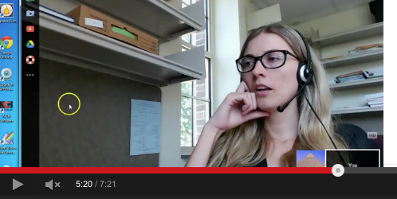
What is telehealth?
The World Health Organization defines telehealth as including:
  “surveillance, health promotion and public health functions. [telehealth] is broader in definition than telemedicine as it includes computer-assisted telecommunications to support management, surveillance, literature and access to medical knowledge” (WHO; December, 2015: Retrieved from http://www.who.int/trade/glossary/story021/en/)

Slide 78
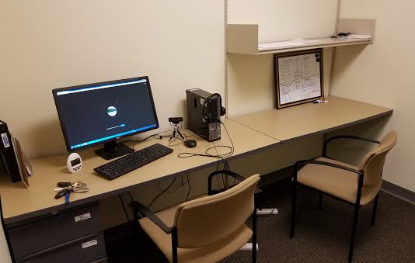
How does telehealth fit into the PBS training?
  Aids in the collection of direct observation data (more data = better informed training)
  Aids in the collection of Tier 3 observation data (more data = better training, and better positive behavior support plan)
  Provides live coaching (e.g, instructions, feedback) and support on data collection for PBS facilitators
  Provides live coaching for training for PBS facilitators and their teams
  Can become a tool for teams to utilize to increase training and data collection opportunities as they implement PBS

Slide 79
How do we start using telehealth
Pre-assess technology capability and safety for telehealth implementation.
  Determine technology capacity/needs (e.g., do you have internet, computer or tablet with webcam?)
  Utilize our technology lending library, if needed
  Get team familiar with WebEx, a HIPPA secure platform from our University secure server; we can use a different HIPPA secure platform if your group already has access to one
  Discuss appropriateness of telehealth for the people being supported and behaviors/activities being monitored
  Acquire permission from person being supported, guardians, and direct support professional involved
Collect direct observation (matrix) data, 3-4 time points
Collect Tier 3 observation data, 3-4 time points
Provide support and coaching for Tier 3 positive behavior support plan
  Continue to collect data as plan implemented to monitor success

Slide 80
Deeper Dive: Universal PBS

Slide 81
Major Goals of Universal PBS
Promote Positive Social Interactions
Design Positive, Proactive, Predictable Environments
Consistent Response to Problems
Establish Data-based Decision Making Systems
Build Capacity for Individualized PBS

Slide 82
You can’t change anyone else but people do change in relationship to your change. All relationships are a system, and when any one part of a system changes, it affects the other part
-Jack Canfield
PBS is Not Used to “Fix” People….It is a Strategy for Changing How We Support Each Other and Encourage Positive Social Interactions

Slide 83
Planning for the Matrix

Slide 84
Matrix Development
Everyone Works Together to:
List Key Person-Centered Values
Identify the Social Behaviors That Reflect These Values
Create a Plan for Increasing Social Interactions
Support and Recognize Each Other, Help Encourage and Prompt
Celebrate Success

Slide 85
STEP ONE: Identifying Matrix Examples
Decide on a pilot area to start (or create a plan to expand your work)
Identify staff members that are motivated to be involved
Recruit people supported who are interested in participating
Administrative support is also helpful

Slide 86
STEP TWO: Prepare for Matrix Development
Prepare with Coaches or PBS Facilitators what you may expect to find in discussions with people supported:
List Key Person-Centered values
Outline settings in which these values could occur
Identify the social behaviors that Reflect these values

Slide 87
”The Matrix” – A tool for building positive social interactions.
Person-centered Values | Setting 1 | Setting 2 | Setting 3 | Setting 4
Value 1
Value 2
Value 3
Positive behavioral definitions of the values for each setting

Slide 88
The Matric- A Tool for Building Positive Social Environments
Example Values | Setting 1 | Setting 2 | Setting 3 | Setting 4
Use Person-centered Language
Show Your Respect for People
Demonstrate Appreciation of Culture

Slide 89
Prepare for Meetings by Anticipating Roommate Expectations

Slide 90
STEP THREE: Building the Matrix
Meet with people served/employees and complete Matrix tasks
Suggestions:
  Working/Not Working Tools
  Get values from what’s working
  Ask people to vote on top values
  Build consensus around settings/times of day
  Complete positive social behaviors

Slide 91
Quality of the Social and Physical Environment Tool

Slide 92
Quality of the Social and Physical Environment Tool
Use the Quality of the Social and Physical Environment to assess what’s working and not working in a setting from the perspective of
  People supported
  Employees within organizations
Identify domain areas that suggest additional universal strategies
Assess whether the perceptions in the setting change over time after implementing the matrix

Slide 93
STEP FOUR: Review and finalize
Review all positive social interactions to ensure they are positively stated!
Bring completed Matrix to people for agreement

Slide 94
Implementing the Matrix

Slide 95
Create a Training Plan
Practice Teaching Skills in the Matrix
Identify Person-Centered Behavior
Choose Setting Where Behavior is Encouraged
Assess What Each Person Needs to Learn and Practice Skill
  Show Examples and Nonexamples
  Create a Task Analysis (If Needed)
Schedule Opportunities to Practice Social Interactions
Create a Plan to Reinforce, Recognize and Support

Slide 96
Inservice Training and Staff
Create Skits That Show Examples and Non-examples of a Positive Social Interaction
Review Each Person-Centered Value and Ask Staff to Make Up a Skit For Each Location/Setting
  Encouraging Choice In The Morning
  Example/Non-example
  Schedule Opportunities to Practice
Create Activities With Skits Ask
  Staff to Act Out Non-example of Social Interaction
  Staff Act Out the Positive Example

Slide 97
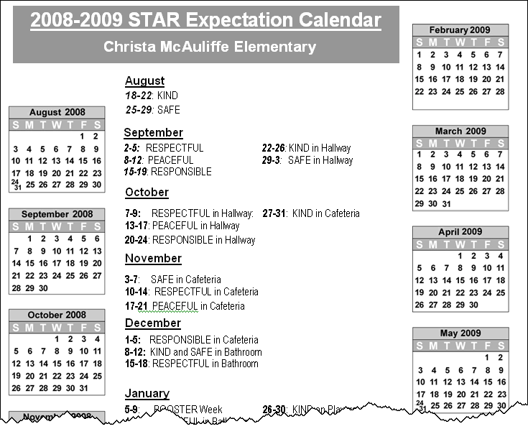
Create Ways to Prompt Awareness

Slide 98
Strategies for Teaching New Skills
Break Down A Task (Task Analysis)
Shaping Behavior Towards New Skills
Prompting Behavior
Reinforcement

Slide 99
Teaching New Skills: Task Analysis
Break Down Steps Into Basic Elements
Below is an example of a task analysis of teaching a learner to turn on the Wii.
1) Find remote
2) Press power button on remote for TV
3) Press channel 3
4) Walk to Wii
5) Press power button on Wii
6) Go to shelf
7) Pick out game
8) Take game out of case
9) Press Wii game into Wii
10) Put case on shelf
11) Sit on couch
12) Play!
http://www.kcbehavioranalysts.com/aba-toolbox

Slide 100
Shaping Occurs When….
Encouraging the Behavior You Want to See
If You Wait for this Behavior to Occur….It Won’t Happen
Break Down Activity Into Steps and Reinforce Easier to Achieve Steps First
Gradually Increase Expectations Until Entire Activity is Being Completed
Example: The Person in the Park Who Has Taught Birds to Eat Directly Out of His Hand Used Shaping

Slide 101
Prompting Behavior
Types of prompts
  Verbal
    Spoken language
    Speech generating device
  Visual
    Manual sign
    Pictures
    Written words
    Modeling
  Physical guidance
    Full
    Partial

Slide 102
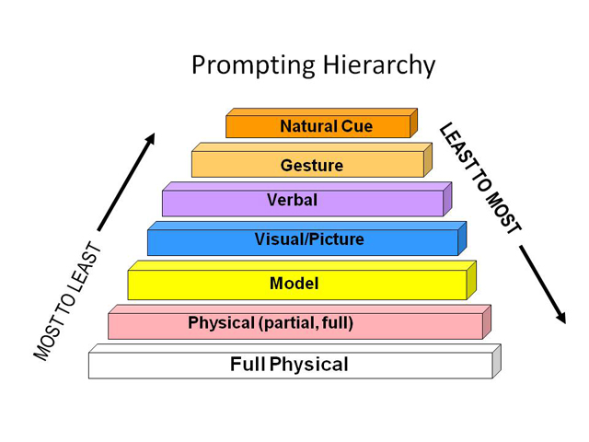

Slide 103
Reinforcement is Personal
Reinforcers Vary for Each Person
Create An Activity
  Ask Each Person What They Really Like
  Compare Responses
Strategies for Reinforcement Must Take Into Account Each Person’s Preferences for Reinforcers

Slide 104
Reinforcement Activity
Each person write down three things that would reinforce your own behavior on a piece of paper.
  EXAMPLE
    Verbal praise
    Naptime
    Beer

Slide 105
    Reinforcement Activity
Now pass your reinforcer list two people to the left
These things/activities will now be used to reinforce your behavior
How does this make you feel?
Would these things increase the likelihood you will engage in behavior?

Slide 106
Working on the Matrix
If you are just getting started….
Review what your team has discussed so far
What are the next steps
If your agency has already started implementing the matrix…
What steps have not been completed yet
Where are you expanding

Slide 107
Example From the Clubhouse
How are people modeling and practicing social skills?
Would a calendar highlighting parts of the matrix be helpful?
Are the reinforcer cards still being used?
How many cards are handed out by people in the clubhouse?
  Over time, recognition and reinforcer systems need to be updated to keep them interesting
  Do we need to add other types of reinforcers?
What other areas could benefit from a matrix?

Slide 108
Prevention of Problem Behavior
Responding in a Consistent Manner to Problems

Slide 109
Major Goals of Universal PBS
Promote Positive Social Interactions
Design Positive, Proactive, Predictable Environments
Consistent Response to Problems
Establish Data-based Decision Making Systems
Build Capacity for Individualized PBS

Slide 110
Moving Away From Traditional
Behavior Management
Traditionally Problem Behavior Has Been Viewed As:
  a Function of a Person’s Disability
  Existing Solely Within the Person Who Engages in the Problem Behavior
  Maladaptive (i.e., Non-Functional, Meaningless)
The Goal of Intervention has been to Eliminate the Behavior by Suppressing It

Slide 111
Common Functions that Maintain Problem Behavior
To Escape from Tasks, People, Situations, or Internal Sensations
To Obtain Attention from Teachers, Peers, or Other Individuals
To Obtain Access to Preferred Items or Events
To Either Escape or Obtain Internal Sensations Due to Physiological Events

Slide 112
Common Themes That Set the Stage for Problems
Choices Available
Predictability of My World
Control Over My Life

Slide 113
Two Common Problems That Occur in Most
Social Settings
A Person Makes a Request/Demand and the Other Person Refuses
  (Escape From People, Activities, Events, Items)
Someone is Ignored or Left Alone With No Social Interaction for a Period of Time
  (Strategies to Communicate With Others)

Slide 114
Understanding Coercive Interactions
Coercive Interactions Develop Between Two People When One Person Engages in a Negative Behavior to Achieve a Social Outcome
The Other Person Responds in an Equally Negative Way
The Initiator of this Exchange Increases the Intensity of the Negative Response
The ongoing exchange continues until one person “gives up”---One Person “wins” because he is willing to increase the intensity of his response

Slide 115
Increase Awareness of How Negative Interactions Escalate
Universal Goal: Teach Strategies for Preventing and Interrupting Negative Social Interactions

Slide 116
The Escalation Cycle
High
Peak
Acceleration
De-escalation
Agitation
Trigger
Calm
Recovery
Low
Colvin & Sugai, 1989

Slide 117
Assessing Incident Report Systems
Using Incident Report Data in Team Meetings
  Guide Staff Development
  Decide PBS Strategies to Use
  Early Intervention and Monitoring
Assessing Current Incident Report Form
Definitions of Problem Behavior
Steps for Moving Forward

Slide 118
Incident Reports &
Data-based Decision Making
People: 25
Incidents: 59
Notes:
Student with 2-5 are candidates for more support in behavior, academic, or both areas.

Slide 119
Ways to Use Incident Report Data
Review Individual Person’s Incident Reports
  Most Common Approach
  Individualized Problem Solving
Assess Patterns Across Organization
  Evaluate Universal PBS Strategies
  Identify Staff Development Needs

Slide 120
Data-Based Decision Making
Define the problem behavior
  What
Clarify problem by identifying
  Who
  When
  Where
Develop a logical explanation
  Why

Slide 121
Number of Incidents

Slide 122
Streamlining Data Collection
Clear Definitions of Problem Behaviors
Major Incidents Requiring Crisis Plan Response
Meet With Staff To Clarify and Introduce New Referral Process
Easy to Complete Referral Form
Data Entered Promptly
Summarized for Meetings

Slide 123
Incident Report Referral Form Name: _________________________ Date: _____ Referring Person: ________________________Time: ________ Others involved: None Peers Staff Community Unknown Other
Problem Behavior |  | Location |  | Possible Motivation
Major Inappropriate language Fighting/ physical aggression Self-Injury Property Destruction Other_____ | Minor Inappropriate language Disruption Property misuse Non-compliance Other_____ | Bathroom Bedroom Kitchen Living Room Yard Community ________ | On the way to work Other_____ | Attention from others Attention from staff Avoid others Avoid staff | Avoid work Communicate need Don’t know Other_____
What Preceded the Problem? |  |  | Additional Notes

Slide 125
Discussion About Incident Reports
If You Are Using Therap….
Meet as a group with Stephanie
Work on a set of requests to share with Therap
If you are Working on Improving your organization’s Incident Reports….
Where are you in the process
What do you need to do to help keep your team moving forward
If you are a County Person….
What are the major messages we need to share with case managers, providers, and others
What do you need to do to help keep your team moving forward

Slide 126
Update on Definitions ICI is Working On…

Slide 127
Major Goals of Universal PBS
Promote Positive Social Interactions
Design Positive, Proactive, Predictable Environments
Establish Data-based Decision Making Systems
Consistent Response to Problems
Build Capacity for Individualized PBS

Slide 128
Identify Ways to Communicate
Team Meetings
Staff Meetings
Trainings
Coach Meetings
Other Events
Newsletters
Website
* Build Into Existing Communication Whenever Possible

Slide 129
Homework: Create an Introduction to PBS to Share
For those of you just getting started….
Use slides from the Training Materials site on MNPSP.ORG
Describe what your team is working on and simple messages about PBS
Bring to the Day 2 training
People Who Are Ready….
Make a list of different types of presentations and trainings needed. For example:
Staff meetings
Community Presentations
Case manager training
Onboarding new staff

Slide 130
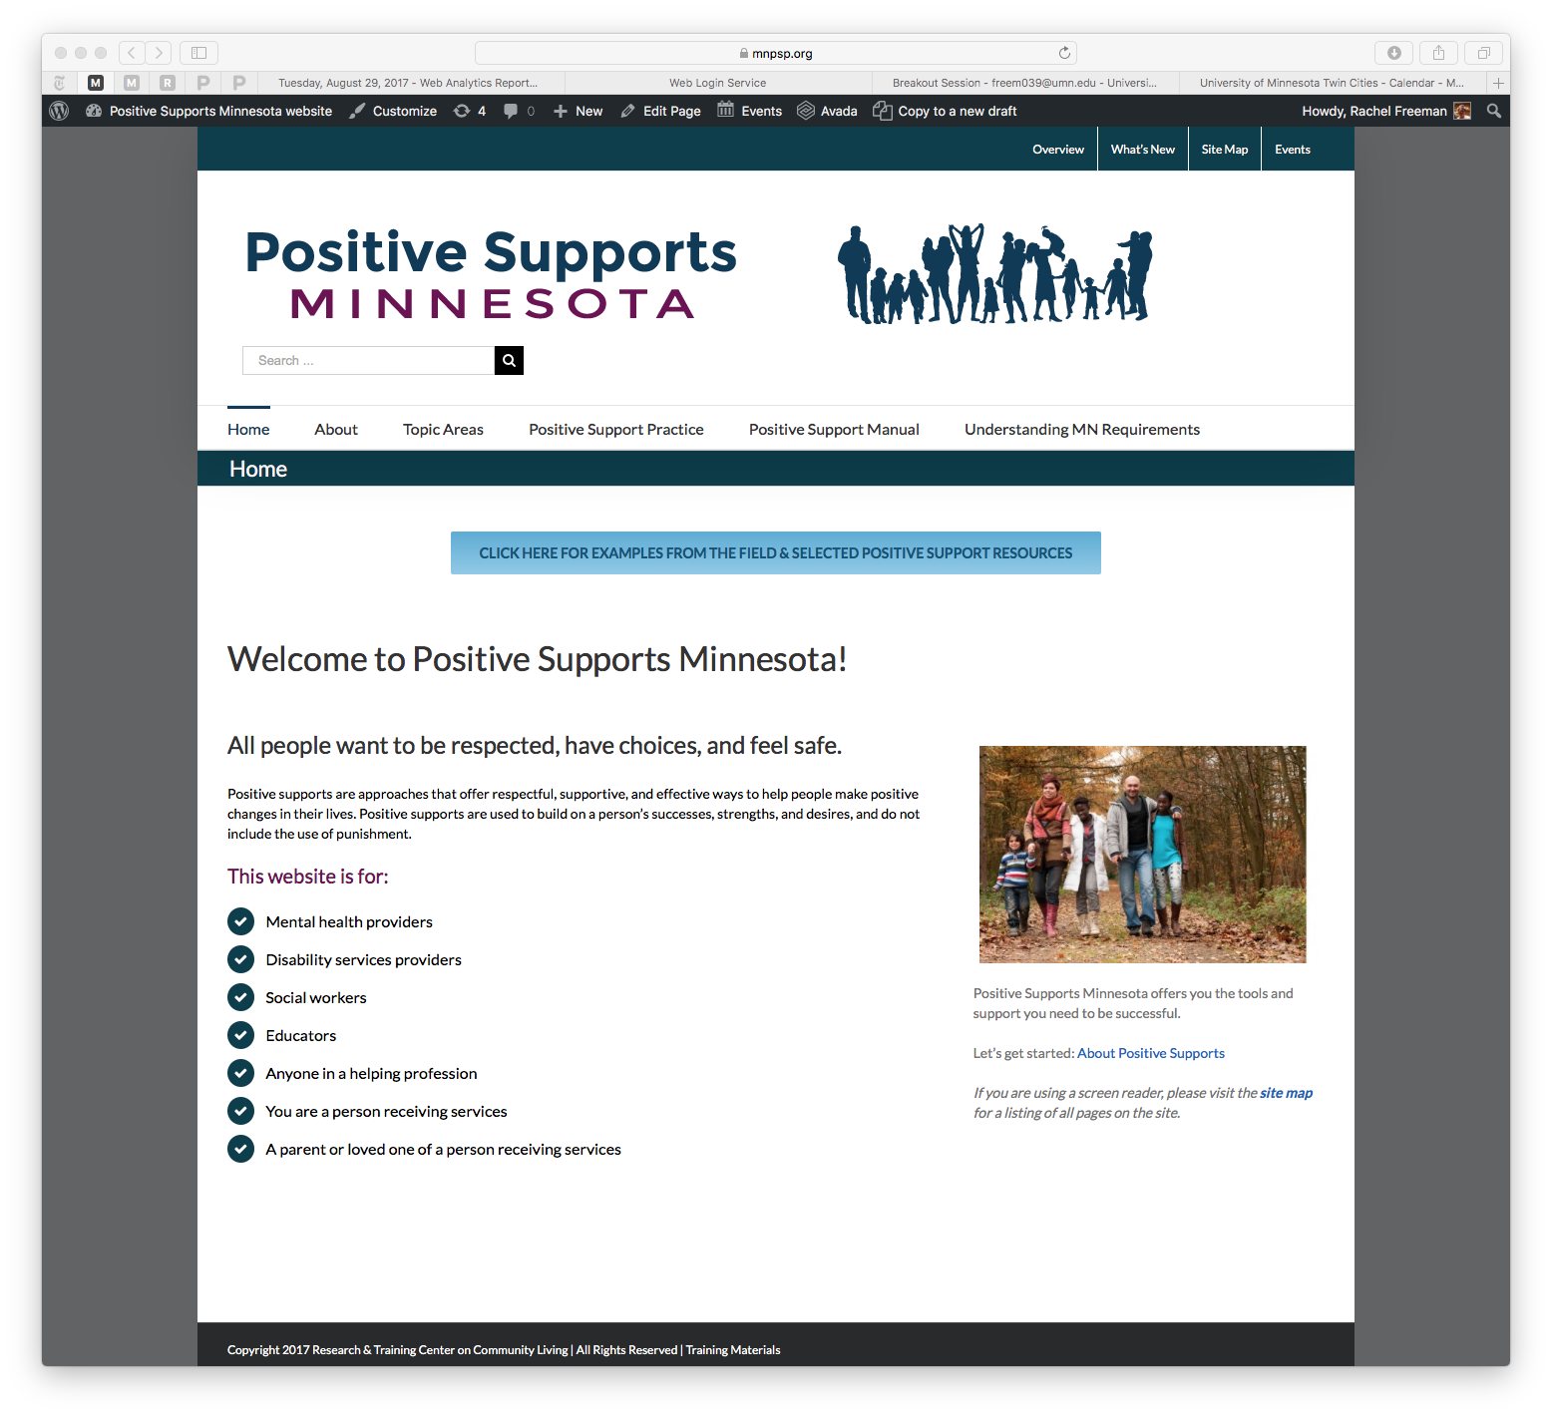
For Free Resources, Visit MNPSP.ORG
Look for Training Materials at the Bottom of the Home Page

Slide 131

Contact Information
PBS Intensive Training
Stephanie Benson
Email: meye0657@umn.edu
Jessica Simacek
Email: sima0034@umn.edu

Slide 132
Contact Information
Team Trainings and Onsite Visits
Erin Watts
Email: flic0016@umn.edu
Rachel Freeman
Email:freem039@umn.edu
Julie Kramme
Email: dahl0488@umn.edu

Slide 133
Free Resources
Minnesota Positive Support Website
www.mnpsp.org
Kansas Institute for PBS
www.kipbs.org
Toolbox
http://www.kipbs.org/new_kipbs/fsi/modlinks.html
Kansas Mental Health & PBS
http://kmhpbs.org/resources/training-materials

Slide 134
Free Resources
Association for PBS
www.apbs.org
PBS Facilitator Guide (on apbs.org website)
http://www.apbs.org/files/PBSwhole.pdf
Early Childhood PBS Tutorial
http://challengingbehavior.fmhi.usf.edu/explore/pbs/process.htm

Slide 135
Free Resources From
Dean Fixsen and Colleagues
Implementation Research: A Synthesis of the Literature
http://nirn.fpg.unc.edu/resources/implementation-research-synthesis-literature
The National Implementation Research Networks’s Active Implementation Hub
Home Page: http://implementation.fpg.unc.edu
Modules and Lessons:
http://implementation.fpg.unc.edu/modules-and-lessons

Slide 136
Cats and Cowboys
https://www.youtube.com/watch?v=Pk7yqlTMvp8

Slide 137
Organization-Wide Change
It Will Have Its Ups and Downs…
https://www.youtube.com/watch?v=TIlryvmrxEY
Encountering Resistance to Change
https://www.youtube.com/watch?v=4VC1XWtiPUo

Slide 138
Additional Wisdom From Social Media
Validation Video
https://www.youtube.com/watch?v=Cbk980jV7Ao
Leadership From a Dancing Guy
https://www.youtube.com/watch?v=V_qO7NFp4-s

Slide 139
Preparation of this [presentation/report] was supported, in part, by cooperative agreement JPK%50470 from the Minnesota Department of Human Services. The University of Minnesota undertaking projects under government sponsorship are encouraged to express freely their findings and conclusions. Points of view or opinions do not, therefore necessarily represent official MN DHS policy.

