Slide 1
Individual Positive Behavior Support: Preparing for First Steps Person-Centered Planning

Slide 2
First Steps in PBS Process
Regular medical and mental health check-ups to ensure there isn’t a health problem or medical issue developing
Establish the team
Family members
School professionals
Friends and community
Person-centered Planning

Slide 3
Building Effective Teams
Teach team building skills before starting PBS process
Establish facilitator, time keeper, recorder
Agenda and meeting minutes
Create group vision
Ground rules (no interrupting, being on time)
Continue to build team skills throughout process
Pay attention to ratio of positive statements

Slide 4
Establishing the Vision & Building the Team
Person-Centered Planning

Slide 5
Important TO
What is important to a person includes those things in life which help us to be satisfied, content, comforted, fulfilled, and happy. It includes:
People to be with/relationships
Status and control
Things to do and Places to go
Rituals or routines
Rhythm or pace of life
Things to have
Wrkbk pg 5
Notes:
PURPOSE:
Define Important TO
6 categories that commonly make people happy, fulfilled, content, satisfied, comforted. (other synonyms: pleased, at ease, comfortable)
SCRIPT
Emphasize that this is about humans not just about disability –
Ask how many people are living with another adult
How do they know if the person they live with is happy? What do they do?
Select 1 person and ask her (him) if her partner’s behavior is ever at odds with what he says (his words)
Ask “when what he says is different from what he does – which do you listen to, words or deeds?”
Hopefully the person will answer – “deeds” – so we already know that we should listen to behavior
Note that when we do not trust people we are hyper-vigilant about what they do much more than about what they say
For people who use disability services -
We often need to look at behavior because we have done a really good job of training people to tell us what we want to hear
When people don’t use words to talk, we have to listen to their behavior
TIPS:
TIME: 2 minutes
NOTES:

Slide 6
Important FOR
Issues of health
Prevention of illness
Treatment of illness / medical conditions
Promotion of wellness (e.g.: diet, exercise)
Issues of safety
Environment
Well being ---- physical and emotional
Free from Fear
And…what others see as necessary to help the person be valued and be a contributing member of their community
Wrkbk pg 5
Notes:
Purpose:
To define important for and help people see that that health and safety are complex issues, not just labels.
SCRIPT
Much of what is important for is already emphasized but the more nuanced parts are often omitted.
TIPS:
TIME: 1 minute
NOTES:

Slide 7
Important To And For Are Connected
They influence each other
No one does anything that is “important for” them (willingly) unless a piece of it is “important” to them
Balance is dynamic (changing) and always involves tradeoffs:
Among the things that are “important to”;
Between important to and for
Notes:
PURPOSE:
To point out the connectedness between Important TO and FOR
SCRIPT
Nobody will do what’s important FOR them unless there’s a piece of what’s important TO them – there has to be a hook. IT is very helpful to have a story that illustrates this. If you don’t have a story - ask if there are ex-smokers in the room…”Why did you quit?” Even when someone names “health”, there’s a deeper reason there because smoking was never healthy. What’s the Important TO hook that can lead a person to the important FOR?
TIPS:
Healthy eating, regular exercise can be examples of when we do something important FOR us because of something that is Important TO us (my clothes fit better…I want to live long enough to see my grandchildren grow up…I need more energy…etc)
Slide is animated
TIME: 2 Minutes
NOTES:

Slide 8
Defining Characteristics of PCP
Meetings Driven by the Person
Important Goal: Empower Person to Lead and Make Important Decisions
Team Members Are Chosen by the Person
Meetings Are Tailored to the Preferences of the Person

Slide 9
Defining Characteristics of PCP (Continued…)
Build Opportunities to Experience Respect and Community Involvement
Examples of Team Members:
Team members
Friends
Community members
Professionals in school and work settings
Family and peers
Etc.
Self-determination and the Expression of Choice

Slide 10
Other Types of Person-Centered Planning
Disabilities
Essential Lifestyle Planning
Picture of a Life (PoL)
PATH
MAPS
Mental Health
Assertive Community Treatment
WRAP
Wraparound Planning

Slide 11
Defining Characteristics of Wraparound Planning
Individuals and Their Families Are Empowered to Lead Meetings
Supports Identified in Meetings Are Provided in Community Settings
Supports Are Individualized, Strength Based, and Meet the Needs of the Individual and Families
Planning Processes Are Culturally Competent

Slide 12
Defining Characteristics of Wraparound Planning (Continued…)
Plans are Designed Within a Team-based Context and Are Coordinated Across Agencies
Flexible Noncategorical Funding is Available
Both Informal and Formal Supports Are Included in Plans
Services Provided to the Individual and Family Are Unconditional in Nature
Interagency Collaboration Occurs During Meetings and in Implementation of the Plan
Outcomes Are Measured and Evaluated for Each Service and Intervention

Slide 13
Wraparound/PCP Life Domains
Medical/Health
Recreational • Cultural
Education/Vocational
Legal
Relationships
Other
Spiritual
Social/Fun
Safety
Emotional/behavioral
Basic Needs

Slide 14
Wraparound: Steps Involved
Step 1: Initial Conversation
Step 2: Start meeting with Strengths
Step 3: Develop a mission statement
Step 4: Identify Needs across Domains
Step 5: Prioritize Needs
Step 6: Develop Actions
Step 7: Assign Task/Solicit Commitments
Step 8: Document Plan: Evaluate, refine,
monitor & transition

Slide 15
Strengths of Wraparound Planning
Person and Family Driven
Focus on Improving Quality of Life
Encourages Tailored Supports
Focus on Systems Change
Systems of Care Meetings
Wraparound Planning
Improves Service Coordination Across People
Children and Family Services
Mental Health
Education
Disability Services

Slide 16
Strengths of Person-Centered Planning
Visual Planning Strategies Reduces Dependence on Verbal and Written Information
Different Strategies Available
Helps Focus the Team on the Person as the Lead During Meetings
Provides Ways for Person to Directly Lead and Participate

Slide 17
Defining Characteristics of PCP (Continued…)
Natural Supports Are Tailored (Avoiding an Over-reliance on Existing Services)
Goals and Actions Build on the Person’s Strengths (Not Their Deficits)
Long-Term Goals & Short-term Actions Focus on Immediate Optimal Quality of Life Changes
Develop & Maintain Significant Relationships

Slide 18
Other Types of Person-Centered Planning
Disabilities
Essential Lifestyle Planning
Picture of a Life (PoL)
PATH
MAPS
Mental Health
Assertive Community Treatment
Wraparound Planning

Slide 19
Essential Lifestyle Planning (ELP): principle outcome is giving some power to the person’s voice in the present, shifting from power over to power with, and bringing some order to chaos.
Picture of a Life: applies person-centered thinking and planning tools that are focused on helping people envision the life they want in their community their desired future.

Slide 20
McGill Action Planning System (MAPS): principle outcome is a series of actions to get from here to there.

Slide 21
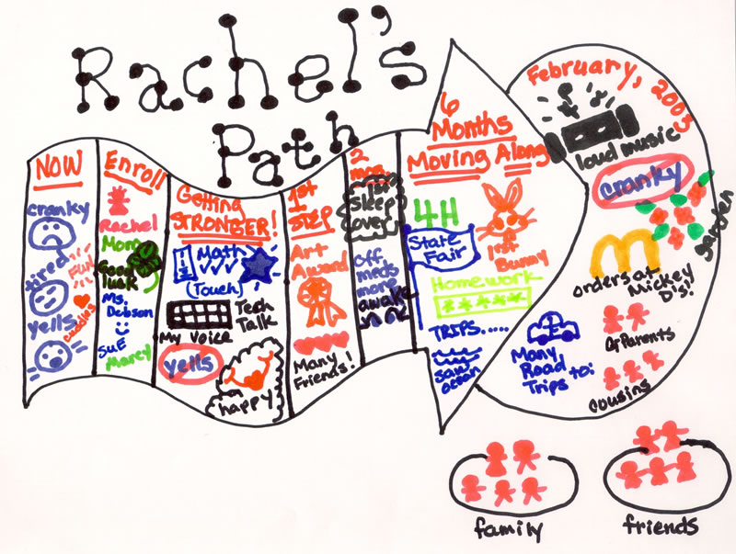
Planning Alternative Tomorrows with Hope (PATH): principle outcome is a series of steps to get from here to there.

Slide 22
Personal Futures Planning (PFP): principle outcome is a clear, desirable future.

Slide 23
Key Elements of Person-Centered Planning

Slide 24
Discussion and Examples
Choosing the Person-Centered Process that Works Best

Slide 25
Review PBS Notebook

Slide 27
Person-Centered Planning Examples
Britney’s Story
Jack’s Story

Slide 28
Next Steps for Person-Centered Plan
Do You Already Facilitate Person-Centered Plan Approaches?
Review the Person-Centered Guide as it Applies to Person Interested in Participating in a Person-Centered Plan
Discuss Person’s:
Location
Interests
Strengths
What Do You Need to Find Out to Prepare
Document the Steps You Will Take to Prepare

Slide 29
Homework for Person-Centered Planning (From Notebook)
Background Reading
Review Angela Amado’s PCP Manual
Review DHS Person-Centered Planning Protocol and Tool
Preparation
Use “Guide to Key Features” Document to Prepare for Meeting
Create a List of What You Need to Decide With Focus Person
Location
People Invited
Ways to Tailor Process
Meeting with Focus Person to Gather Information
Meetings with Invited Folks to Share How Planning Works and Gather Initial Information
Set a Date That Works for Everyone for Planning Meeting

