Slide 1
9 Core Features of PBS Webinar Series Part 4
Supporting Adults
January 29, 2020 | 9:00-10:30
Keynote: Rachel Freeman, Institute on Community Integration, University of Minnesota
Facilitator: Erin F. Farrell – Minnesota Department of Education
Zoom Host: Muna Khalif – University of Minnesota
Monday, November 16, 2020

Slide 2
Upcoming Collaborator Forum Webinars
PBS Across the Lifespan – Supporting Adults
Building Team-Based Planning in Saint Louis County to Improve Person-Centered and Positive Behavior Support Outcomes
        Rachel Freeman
        Institute on Community Integration
        and
        Dani Dunphy
        Kim Hoffmockel
        Saint Louis County

Slide 3

MNPBS Network Purpose
MNPBS Network is bringing practitioners together across settings, populations and the lifespan to articulate key PBS features and share about exemplary PBS at a community level.
Notes:
Takeaway 1: There are a finite number of core features are not unique for positive behavior support, regardless of the setting, context, situation, group, etc. We share more similar than different, so we can focus on those universal PBS core features that also apply to increased layers of support. As a result, people in Minnesota now have this thing that we believe works to both increase desirable behaviors by supporting people in the ways they find the most pleasant or literally, positive.
Takeaway 2 As a result of Takeaway #1, we expect our competencies to be more similar than different across school, community, demographics, cultures, etc. especially if they match with what is important shared values to the people we support.
Takeaway 3: Tiered systems coordinate efforts too. We expect, and want to select teams and networks that have a variety of skills that they bring that are integrated and compensatory. Think of it as a potluck. It would be a lot of work for one person to do the entire meal and sustain it over and over again. It also would be a problem if all 10 people brought a bag of chips. Tiered systems is coordination and alignment so that the right people with the right skills are bringing the right information at the right time to make decisions.
Takeaway 4: MNPBS Network is a way to structure to keep people coming back and staying in the right level of consistent communication. It ties back to Takeaway 3 by ‘setting the table’ at and expected and consistent time and place so that we can all get the benefit of all the ‘dishes’ that people bring. There’s perhaps a human tendency to want to ‘make it your own’, but ultimately we have to have non-negotiable core features. We could give all of our blueprints, fidelity assessments being developed, terms of references, Give/Gets, etc. as examples for people to do it on their own (e.g., “Letting it Happen”), but we each have to have that experience making it work for your team with experience doing it collaboratively as a network in a less high pressure, high stakes situation.

Slide 4

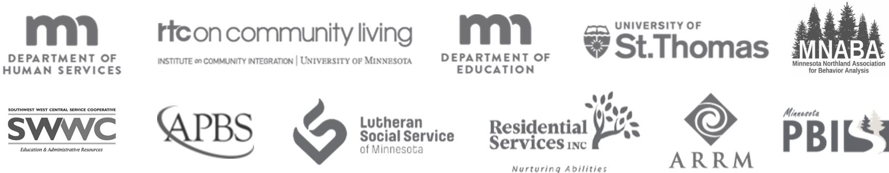
Collaborators Forum Webinar Series
Theme: 9 Core Features of PBS
Changes lifestyle
Works across lifespan
Used across all settings
Involves the people supported
Creates effective change
Helps improve outcomes by involving everyone in making changes together
Decreases the likelihood of problems
Uses research knowledge across science
Integrates multiple theories and values
Keynotes in the following areas
Early Childhood (0-5): Dr. Bonnie Henning
Children and Young Adults (6-21): Dr. Kevin Filter
Adult Services (21 plus): Dr. Rachel Freeman
Older Adults (65+): Dr. Jeffrey Buchanan
The Collaborators Forum is an event for people interested in positive behavior supports (PBS) across settings and the lifespan in Minnesota. This year the MNPBS Network is planning to increase the number of host sites in other parts of the state, and to increase the amount of interactivity for audience members who can’t travel but want to be a part of the Forum.
More information and registration:
mnpsp.org/mnpbs
Notes:
The Collaborators Forum webinar series is a four-session event every two months with keynotes from across Minnesota.

Slide 5
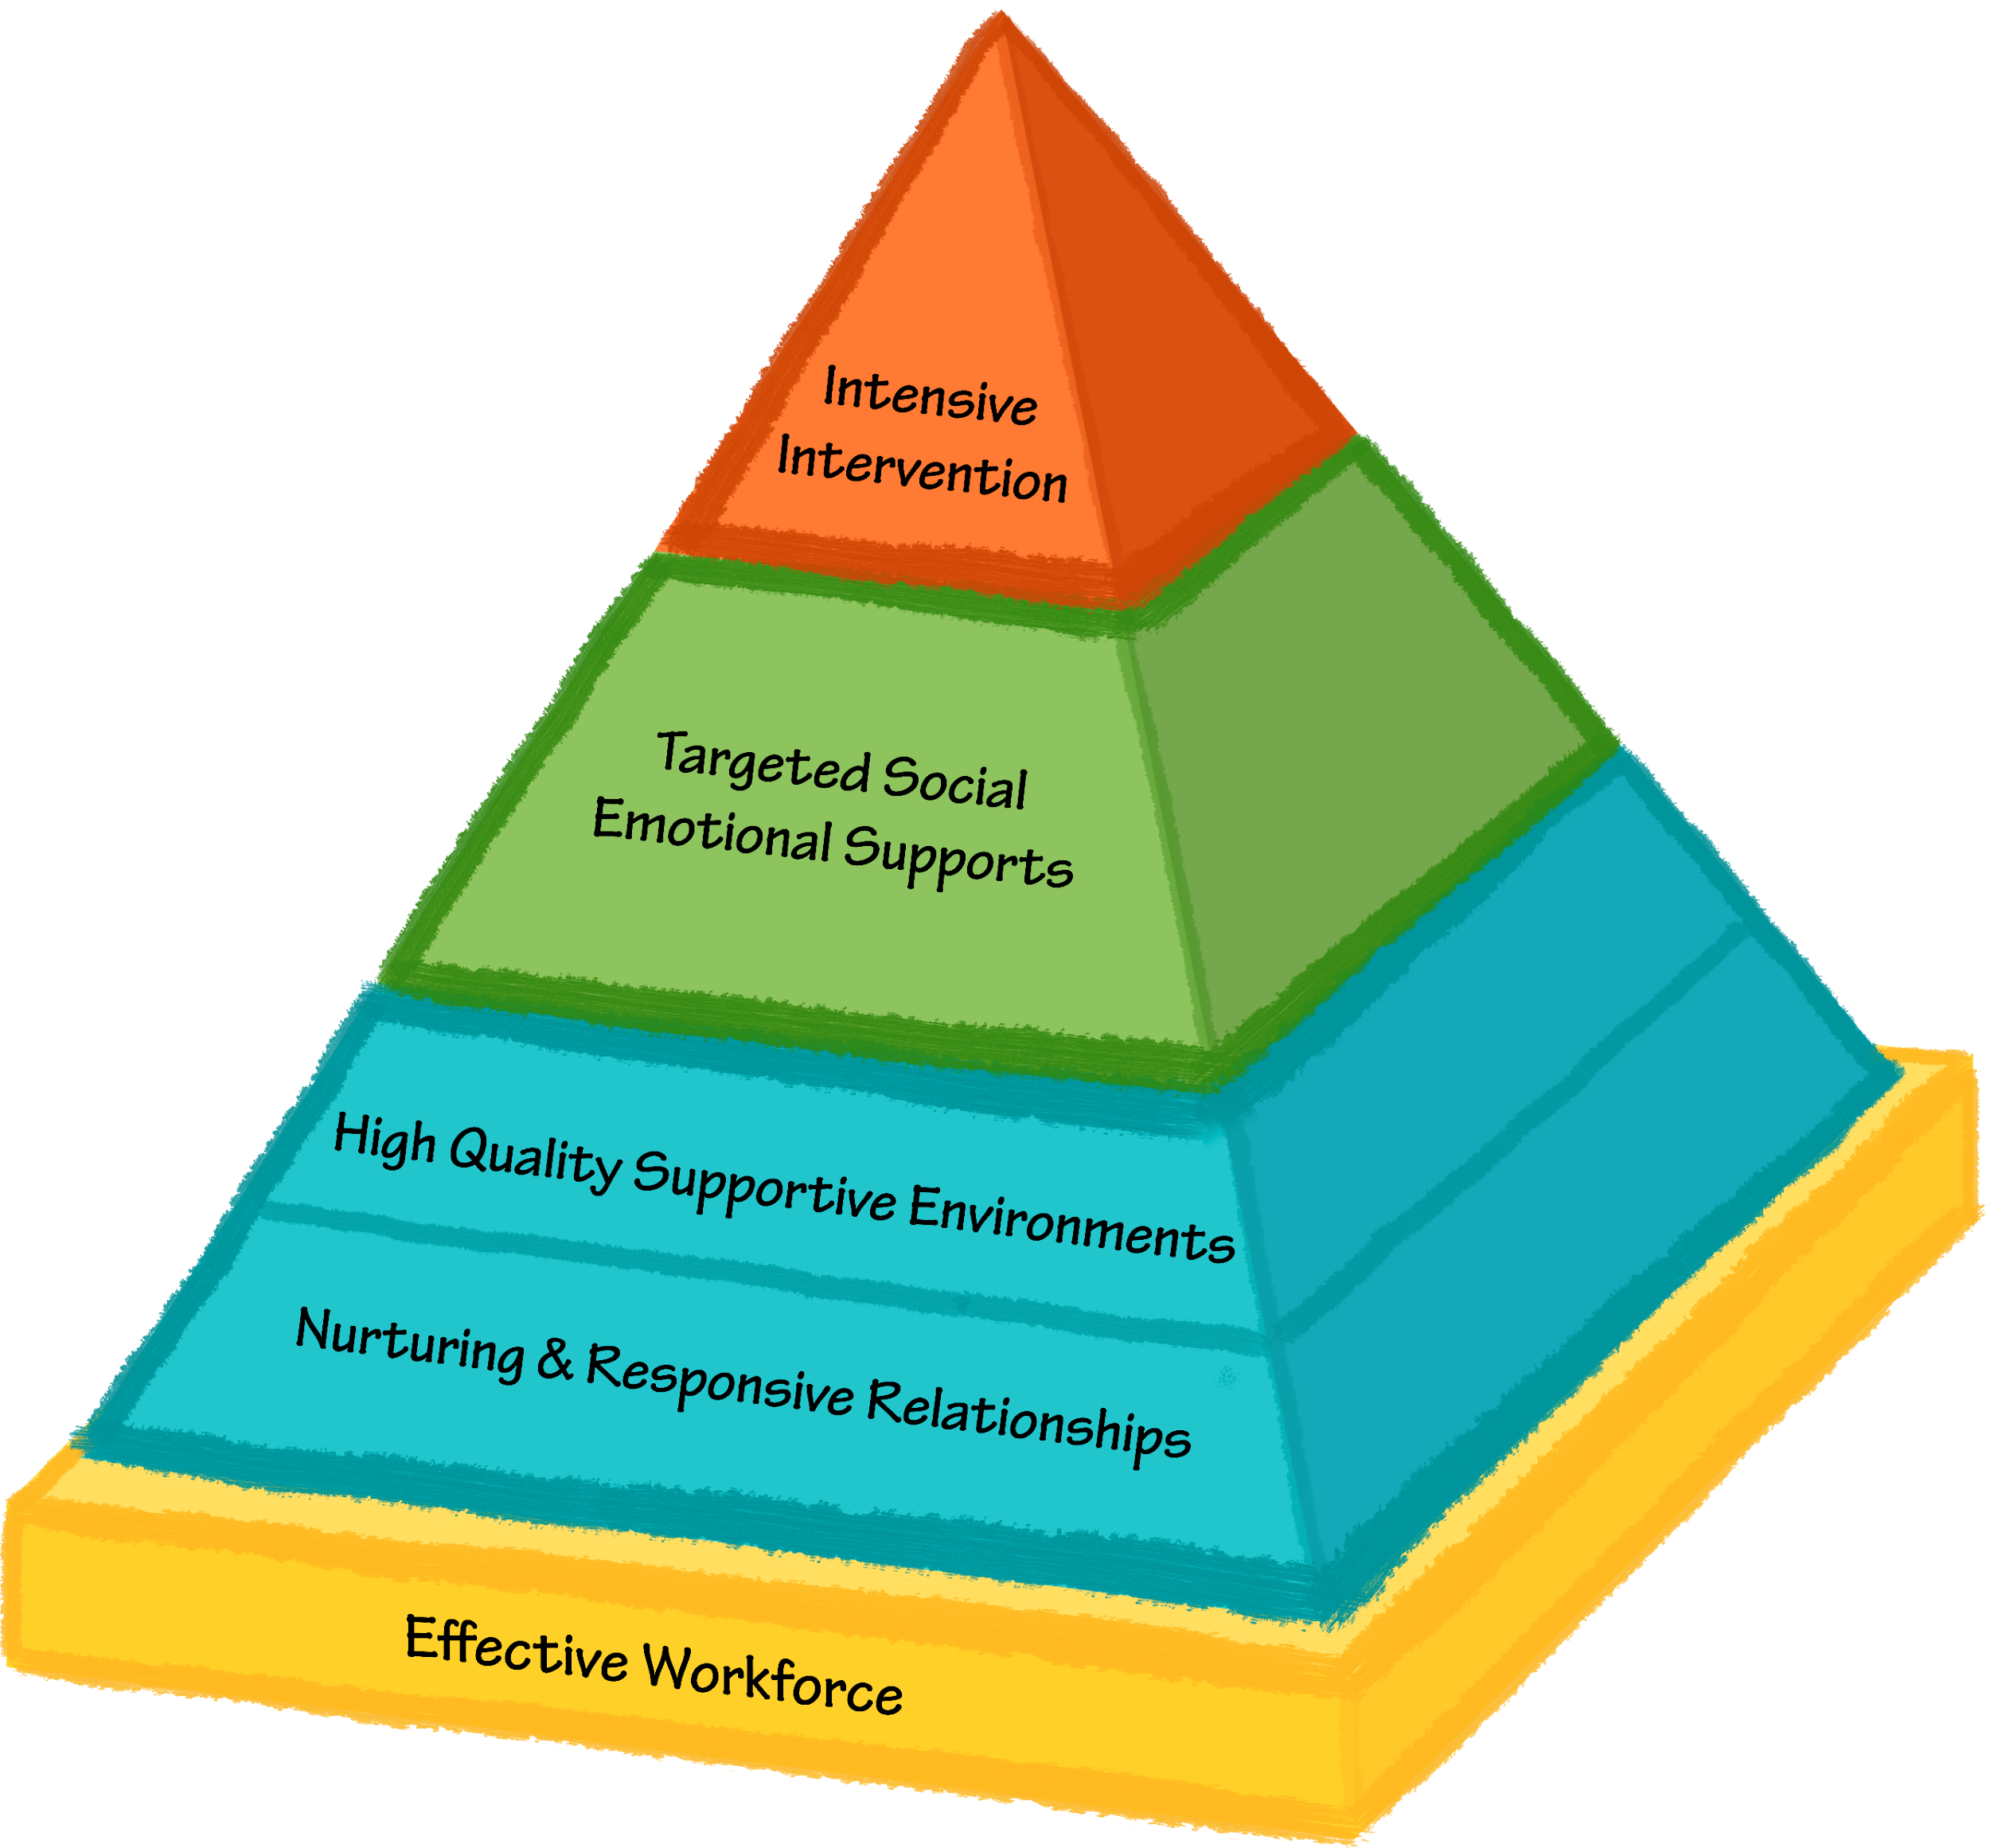
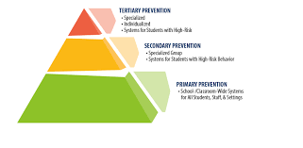
Minnesota Positive Behavior Support Network Tier 1
Aspirational to Exemplary Communities – Continuum of Positive Behavior Support Across the Lifespan
Early Childhood | K-21 years old | Adulthood
Systems & Supports Team with administrative and behavioral expertise meets regularly and spans birth through kindergarten systems Cross-sector program-wide buy-in Collaborative effort with families Capacity to collect data at child, classroom, and program level System for coaching workforce expertise in place, including behavioral expertise Strategies & Skills Implementation & Outcome Measures for Decision-making Measure/promote nurturing & responsive relationships & quality learning environments Easy access to graphs/data on teacher and child performance BoQ, TPITOS/TPOT, Coaching Logs collected and reviewed regularly Ongoing assessment for child outcomes across developmental areas and BIRs Transition Considerations IEP meetings Teacher connections Kindergarten visits (at K and Pre) | Systems & Supports Team with administrative and behavioral expertise meets regularly 3-5 positively stated expectations across the building and classes Have discipline policies in place, including positive and restorative approaches Feedback system built in Families and stakeholders where data are shared Strategies & Skills Implementation & Outcome Measures for Decision-making Measure teaching to expectations Define student and teacher behaviors Easy access to graphs/data on where, when, why & location of problems TFI, SET, BoQ are collected and reviewed annually Transition Considerations | Systems & Supports Team meets regularly All stakeholders involved within the framework of consensus building Mission and policy aligns with PBS values Promotion of universal positive behavior Promoting and acknowledging positive behavior among staff Actively recruiting people from diverse cultures Staff development includes competency based training PBS and person centered strategies are taught throughout the organization Strategies & Skills Implementation & Outcome Measures for Decision-making Fidelity data (direct observation quarterly) Individual outcome measures (including quality of life) Staff retention data Review of all data regularly Annual evaluation on-site from external expert or peer supports Transition Considerations
Notes:
EC Tier 1 things to note – there are teams, just as in K-21 and adulthood. There is a need for greater cross sector and family collaboration given all the different places children are and ways they interact with different systems, greater emphasis on professional development and coaching of the EC workforce given the diversity of training backgrounds (yellow foundation of the pyramid), tier 1 supports focus on measuring and promoting nurturing and responsive relationships as well as high quality learning environments (blue sections of pyramid), gathered data includes fidelity within classrooms and coaching information in addition to program wide benchmarks and child specific behavioral incident data
Especially for PBS in the home setting
Through distance learning school supports and partnerships at home
Everyone is at home

Slide 6
Minnesota Positive Behavior Support Network Tier 2
Aspirational to Exemplary Communities – Continuum of Positive Behavior Support Across the Lifespan
Early Childhood | K-21 years old | Adulthood
Systems & Supports Team meeting regularly to address Tier 1 while linking to Tier 2 or Tier 3 approaches Ongoing coaching and support Strategies & Skills Program wide behavior expectations and social emotional skills taught and referenced throughout the day Social-emotional curriculum, teaching key competencies Implementation & Outcome Measures for Decision-making TPITOS/TPOT, coaching logs, BIRs Fidelity of Tier 2 interventions Transition Considerations Connectedness and alignment from Pre-K to Kindergarten | Systems & Supports Team of expertise meeting regularly, possible overlap with Tier 1 Linkage back to Tier 1 expectations (across people, classes, etc.) and Tier 3 approaches Strategies & Skills Implementation & Outcome Measures for Decision-making TFI Tier 2 or MATT Fidelity of Tier 2 interventions Transition Considerations | Systems & Supports Team composition is diverse, clear role and expectations – smaller and more specialized to work with Tier 1 team on planning and decision-making Accessing higher services Strategies & Skills Implementation & Outcome Measures for Decision-making Proportion of people participating in Tier 2 Outcomes of programs at Tier 2 Implementation of programs at Tier 2 Transition Considerations
Notes:
EC Tier 2 things to note – regular review of classroom level implementation and coaching supports focus on how the environment and adult relationships promote developmentally appropriate social emotional and behavioral skills. Pyramid includes lots of explicit teaching about emotions, regulating emotions, following planned routines, and problem solving social situations and/or conflict. Assumption is all of those things must be explicitly taught as part of Tier 1 and further reinforced/intensified as part of Tier 2

Slide 7
Minnesota Positive Behavior Support Network Tier 3
Aspirational to Exemplary Communities – Continuum of Positive Behavior Support Across the Lifespan
Early Childhood | K-21 years old | Adulthood
Systems & Supports Behavioral supports expertise (BCBA or similar training) Family collaboration FBA and BIP when appropriate Wraparound and coordination with mental health supports Planning includes all members of team Strategies & Skills Prevent, Teach, and Reinforce for Young Children (PTRYC) guides problem solving and intervention planning Generalization training for parents and caregivers to promote skills in home setting Implementation & Outcome Measures for Decision-making Using BIR data (behavior incident report) Transition Considerations Connectedness and alignment from Pre-K to Kindergarten | Systems & Supports Behavioral supports expertise (BCBA or similar training) FBA and BIP Wraparound, RENEW Screening Stakeholder involvement and feedback Coordination with mental health supports Training includes all members of team Strategies & Skills Implementation & Outcome Measures for Decision-making Quality of life indicators Fidelity Transition Considerations | Systems & Supports Each person using Tier 3 supports has team Direct involvement of person and stakeholders within and external to the organization Ongoing plan for professional development – all staff involved in delivering supports Paid and unpaid supports Alignment with Tier 1 and 2 supports Strategies & Skills Implementation & Outcome Measures for Decision-making Proportion of people participating in Tier 2 Outcomes of programs at Tier 2 Implementation of programs at Tier 2 Transition Considerations
Notes:
EC Tier 3 – Family collaboration is emphasized, PTRYC informs structured problem solving and intervention planning
Especially for PBS in the home setting
Through distance learning school supports and partnerships at home
Everyone is at home

Slide 8
2020 Theme: 9 Core Features of PBS
Changes lifestyle
Works across lifespan
Works across all settings
Involves the people supported
Creates effective change
Provides supports for person tied to supports for all,
with supports provided by all
7. Decrease the likelihood of experiencing problems
8. Measurable in multiple resource areas
9. Includes multiple theories and values
Core Features of PBS we will addressed in each webinar!

Slide 9
Implementing Person-Centered Positive Behavior Support
Saint Louis County

Slide 10
Universal Tier 1 Implementation
Person-Centered Practices
Encourage Relationship Building
Model and Practice Active Listening
Create Outcome Statements
  People Supported
  Employees
  Organization
  Community
Create Action Plan for Moving Forward
Build Cultural Awareness and Celebrate Diversity
Positive Behavior Support
Model, Teach, and Prompt Positive Social Interactions
Teach and Practice Problem Solving and Conflict Resolution
Recognize and Celebrate Positive Interactions
Practice Social and Emotional Skill Building
Use Data-Based Decision Making
Actively Monitor Equity Using Data
Notes:
Verbal reference to org-wide team training

Slide 11

Organization and County Model for Planning
Political Support & Policy
Interagency & Natural Supports
Funding
Visibility
Leadership Team
Active Coordination
PCP, PBS (Other PS)
Expertise
Training
Mentoring
Evaluation
Start Small and Build on Success
Notes:
11

Slide 12
County-Wide Annual Action Plan
Date: May 10, 2016
Team Members: Alice, Amy, Jane, Steve, Bella, Joe, Samantha, John
For the People We Support
Person-Centered Practices | Who | By When | Status Update
1. Assessors work together to integrate person-centered approaches into CSP | Coach | 10/1/16 | In progress
2. Demonstrate how to create a one-page description for all people involved in Jensen Settlement | Coach | 10/1/16 | Completed
3. Design video that demonstrates how to use person centered tools to explore relationships and create personal descriptions | Coach, person & circle of support | 3/1/17 | In progress Sept 2016
4. Work with Case Managers to create plan to complete one-page descriptions for all persons with DD receiving services | Brandon & Bella | 10/1/16-9/28/17 | In progress
2. Schedule meeting time for review of policies across related to case management | Jane/Team | Sept, 2016 | Completed
Positive Behavior Support | Who | By When | Status Update
1. Set meeting to introduce matrix consensus building to providers | Alice and Andy | July 31, 2016 | Not Yet Started
2. Case manager training to introduce key elements of PBS | Brandon, Kayla & Nicole | July 31, 2016 | Not Yet Started
3. Dedicate 15 minutes in staff meetings to share PBS updates | Steve | October, 2016 | In progress

Slide 13
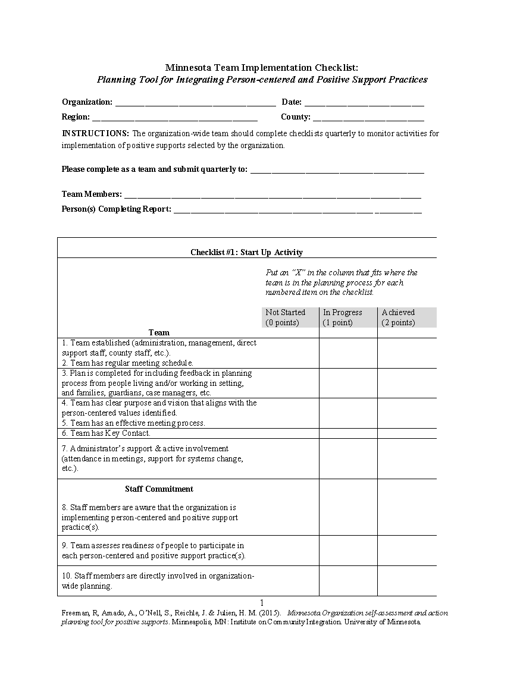
Fidelity of Implementation: MN Team Checklist
White Form
Team Implementation Across Positive
Supports
Blue Form
PBS Subscale Items
Pink Form
Person-centered Practice Items
Domains for Overall Fidelity
Team
Staff Commitment
Self-Assessment
Action Planning
Staff Development
Evaluation
Visibility

Slide 14
Scoring the TOET
Implementation Points
  Achieved = 2
  In progress = 1
  Not Started = 0
Each Item Has Criteria Defining Score
Percentage of Items Implemented
  Overall Total
    Number of items scored as “Achieved” divided by Total # of items
  Subscale Scores
    Number of items in each subscale area scored as “Achieved” divided by the number of items in that subscale area
Notes:
14

Slide 15
* Agency 4 trained via different method and joined region in 2017; data collected again in 2019
* Data collected for Agencies 2,3, 5 in 2016, 2018, 2019

Slide 16
Fidelity of Implementation

Slide 17
Evaluation & Data Systems
Organization-Wide Evaluation | Related Evaluation Data/Tools
What impact did the training have on capacity building? | Number of coaches, key contacts Number of staff involved in implementation Number of people supported
What are the strengths and needs of the organization? | Person-centered organizational tool Quality of social and physical environment
How well are the practices implemented? | Fidelity of implementation self-assessment (twice a year) Onsite evaluation (annual)
Are there improvements in conceptual knowledge of staff? | Pre/post tests for staff using DC/CDS
Are there changes in behavior of staff and people living and working in a setting? | Direct observation of staff person-centered practices (Quarterly) Direct observation of people supported (Quarterly) Incident reports, restraint, 911 calls, etc. (Quarterly) Organizational data (retention/tenure, etc.)
Are there changes in universal quality of life? | Quality of social and physical environment interviews Regional Quality Council Interview Tools

Slide 18
Assessing Impact of Person-Centered Practices- County Examples
Evidence of Changes in Policies & Procedures
Changes in Process (Easier, Shorter, Person-Centered Reports)
Evaluation of Staff Development & Performance
  Coaching and Use of Universal PC Tools
  PBS Matrix
Surveys and Other Documentation Related to
  Quality of Life
  Climate
  Cultural Responsiveness
  Stress
Strategic Action Planning Alignment
Larger Public Health Data
Quality of Life Evaluation
Notes:
Organizations are encouraged to collect four kinds of data that can help them indicate their progress toward their goals. Teams are encouraged to collect the data regularly and have data graphed and ready to look at in regularly scheduled team meetings. The data can help teams determine their progress toward their goals. This process is called data-based decision making. Teams often get coaching at cohort trainings on collecting and monitoring data. Some examples of data types collected by teams are (1) measures and training hours on staff development, (2) surveys on quality of life or climate, (3) number of incident reports or sick days, or (4) data related to retention, staff injuries.

Slide 19

Tools & Resources
Person-Centered Incident Manual
MNPSP.ORG Resources
  Training Materials Page
  HCBS Modules (in beta test now but available)
  Positive Social Strategies
  Universal Social Skills Across the Lifespan

Slide 20
Tools for Implementation
Tiered Onsite Evaluation Tool
Team Self-Assessment Overall
Person-Centered Subscale
PBS Subscale
Direct Observation Tool
Definitions for Observations

Slide 21
Dani Dunphy
Saint Louis County
Implementing a Team-Based Approach Using
Person-Centered Practices and Positive Behavior Support
Notes:
This slide shows a triangle that represents a multi tiered system of support for implementing person centered and positive support practices. The triangle is divided into 3 sections: the base of triangle is the universal stage: strategies that are used to support everyone, the middle of the Triangle is the Secondary stage: these strategies build on universal and and an extra layer of support, not all people will need this level of support and finally the top of the triangle is the Tertiary stage: very few people will need this level of support. This 3rd level builds on the other two levels and adds specific additional supports, The yellow that outlines the triangle represents culture. Culture is a part of everything we do.
A multi tiered system is simply a system that starts with the universal tier and implements person-centered and positive support practices that are used with everyone. This includes a wide variety of strategies such as teaching positive social skills, relationship building, empathy, cultural responsiveness, and person-centered thinking skills.
Supporting all people includes ,people supported, families and the workforce. with these universal practices supports people to have a life that makes sense to them and increases their quality of life. When people have a life that makes sense to them it is less likely that they will need tier 2 and 3 supports. For some people they may need additional support to have a life that makes sense and is meaningful – these are tier 2 supports. The universal supports are still in place but maybe we need to add a social skills group or maybe they need a formal person centered plan to help them figure out an area of their life that doesn’t make sense. These additional supports may be all that is needed. For a few people, they will need more specific additional supports. This is where a Positive support plan might be added. Tier 3 includes universal support as well.
Person Centered Thinking and Planning
Positive Behavior Support
Cultural Humility and Responsiveness

Slide 22
Person-Centered and PBS Self-Assessment and Action Planning—A County Example
Team Roles
26 Organization-wide Team Members
4 Key Contacts
10 Coaches
2 PBS Facilitators (in training)
2 Person-Centered Thinking Trainer
Monthly Team Meetings
Implementation Areas Targeted
Developing Person-Centered Plans for people receiving services
Improving interactions between team members
Integrating Cultural Awareness into Organization Development Process

Slide 23
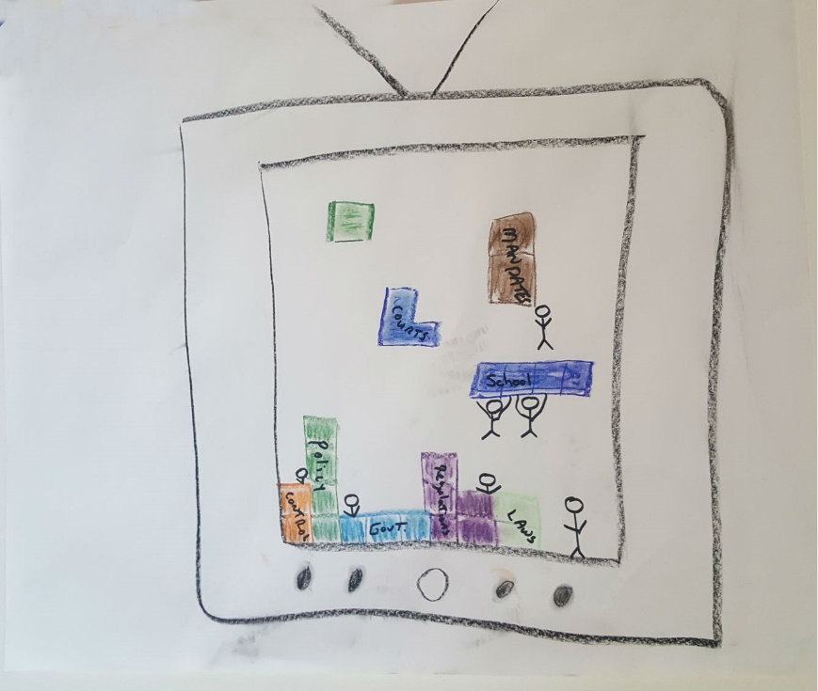
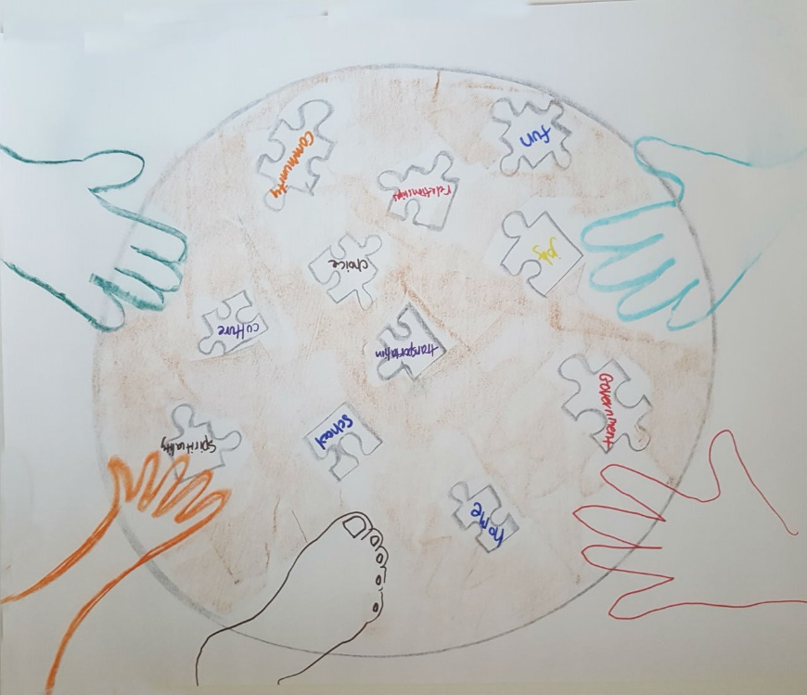
Outcomes for People Who Receive Support:
I make meaningful contributions to my community.
I am who I want to be, not who others expect me to be.
Outcomes for Employees/Staff:
We are honest, have integrity, and are respectful of others.
We have time to spend with people to really listen and intentionally engage with the people and partners.
Outcomes for Organization:
People are our priority and we value and take time to see and understand others’ perspectives.
People are our priority.
Outcomes for Community:
Inclusive collaborative community campaign.
There are no “those” people. No more us and them.

Slide 24
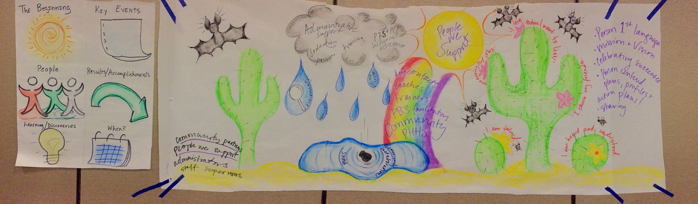
History Map -- Year One

Slide 25
Action Plan Implementation Examples
Completed multiple person-centered plans
Using person-centered thinking (PCT) tools with people receiving case management services
Awareness presentations and discussions across other units
Integrating PCT across meetings
Training PBS facilitators and county team
2 PCT Trainers with a focus on small corporate and family providers
Tools available to employee’s
Planning to make a “skit” showing how to complete a personal description and action plan for co-workers
Added PCT tools to adult services portal
Protocol for connecting with new employee’s

Slide 26
Embedding Cultural Responsiveness Across Positive Supports
Move Beyond the Annual Training
Teach Broader Understanding
Use a Tiered Approach
Actively Practice Awareness
Celebrate Diversity
Assess Strengths and Areas of Improvement
Use Data to Guide Action Planning
Notes:
This slide shows a triangle that represents a multi tiered system of support for implementing person centered and positive support practices. The triangle is divided into 3 sections: the base of triangle is the universal stage: strategies that are used to support everyone, the middle of the Triangle is the Secondary stage: these strategies build on universal and and an extra layer of support, not all people will need this level of support and finally the top of the triangle is the Tertiary stage: very few people will need this level of support. This 3rd level builds on the other two levels and adds specific additional supports, The yellow that outlines the triangle represents culture. Culture is a part of everything we do.
A multi tiered system is simply a system that starts with the universal tier and implements person-centered and positive support practices that are used with everyone. This includes a wide variety of strategies such as teaching positive social skills, relationship building, empathy, cultural responsiveness, and person-centered thinking skills.
Supporting all people includes ,people supported, families and the workforce. with these universal practices supports people to have a life that makes sense to them and increases their quality of life. When people have a life that makes sense to them it is less likely that they will need tier 2 and 3 supports. For some people they may need additional support to have a life that makes sense and is meaningful – these are tier 2 supports. The universal supports are still in place but maybe we need to add a social skills group or maybe they need a formal person centered plan to help them figure out an area of their life that doesn’t make sense. These additional supports may be all that is needed. For a few people, they will need more specific additional supports. This is where a Positive support plan might be added. Tier 3 includes universal support as well.
Person Centered Thinking and Planning
Positive Behavior Support
Cultural Humility and Responsiveness

Slide 27
County Team Matrix Example
Values | Before Meetings | At the Beginning of Meeting | While Sharing Person’s Information | Supporting Other Team Members
Use Person-Centered (PC) Language | Use PC Language in Documents (Emails, Handouts) | Provide Reminders Before Meeting (Be Sensitive to Acronyms Too) | Be Receptive and Aware of Language Used | Celebrate Use of PC Language as Team
Show Your Respect for People | Use Active Listening During Conversation | Attend Meetings on Time Cell Phones to Vibrate | Share Only Information Needed Provide Feedback to Others | Listen to Others and Ask if Feedback is Invited
Demonstrate Appreciation of Culture | Review Plans and Discuss Role and Identity & Culture | Review Possible Cultural Bias and Assumptions | Share Thoughts on the Role of Culture in Person’s Life | Discuss How Culture Can be Incorporated Into Plan

Slide 28
Team Activity – Integrating Cultural Awareness
Cultural Awareness Item | Action | Date | Person Responsible
Assess diversity of organization and the local community | Use Wednesday meeting to discuss |  | ALL
Work with staff to create strategies for increasing cultural awareness across the organization aligned to team’s outcome statements | Spell out the different cultural backgrounds of employees and service recipients in the company and discuss how to effectively work with these members |  | Pete, Ryan
Integrate cultural awareness into staff development and competency-based training | Add to as an element into reviews? |  | HR
Identify as a team the dominant cultures within the organization and whether there are subcultures that team needs to learn more about | Sit down as a team in the Wednesday meeting to discuss this |  | ALL
Reach out to community members to increase natural supports, recruit diverse staff members, etc | Add this as an element of action plan items - reaching out to community members - use SSL Facebook page |  | Ryan
Team evaluates impact of cultural awareness (surveys, disparities related to incidents, 911 calls, diversity of staff, staff turnover, etc.) | Review incident reports, send staff survey, talk with diverse groups of staff to see how to make changes to help and educate clients in multi-cultural group |  | Laura, Beth, Pete

Slide 29
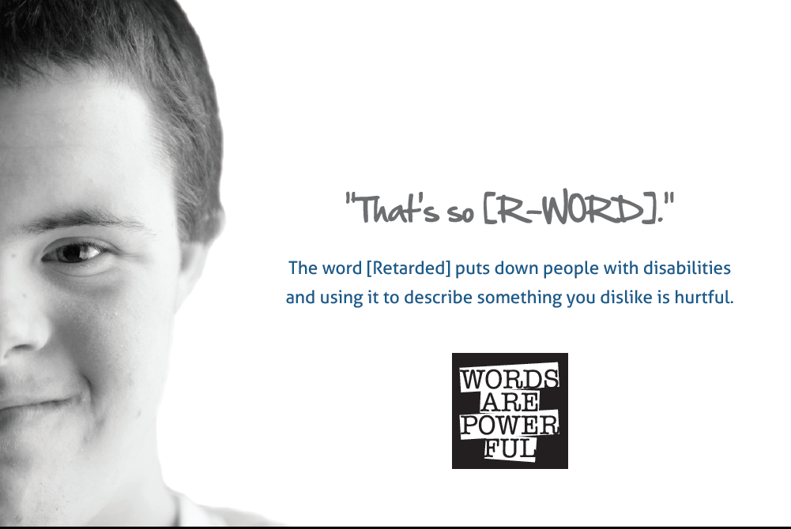
Public Service Announcement Highlighting How Language Can Hurt People

Slide 30
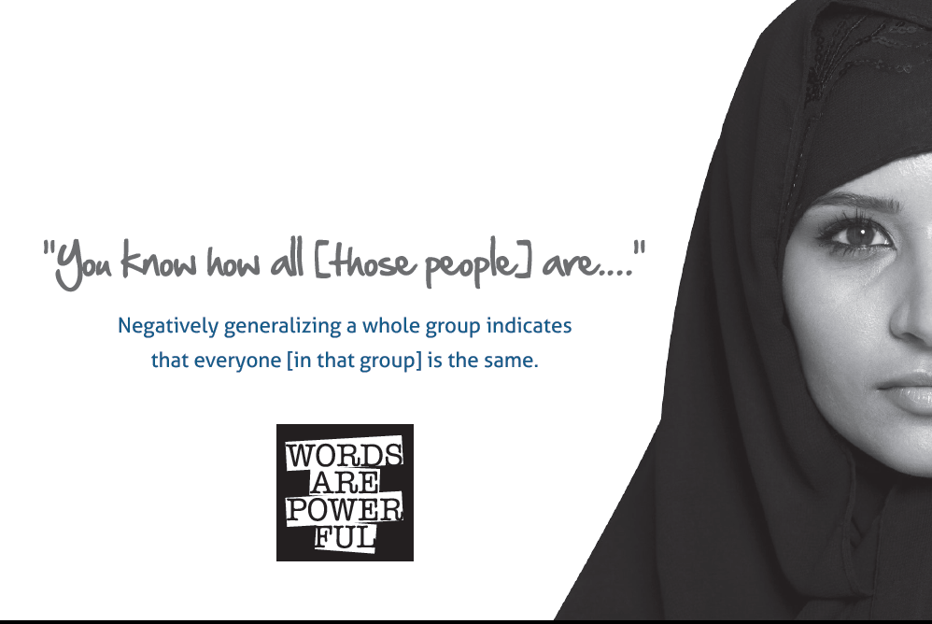
Public Service Announcement to Encourage Avoiding Generalizations

Slide 31

Public Service Announcement About Sexual Orientation

Slide 32

Public Service Announcement Addressing Culture

Slide 33
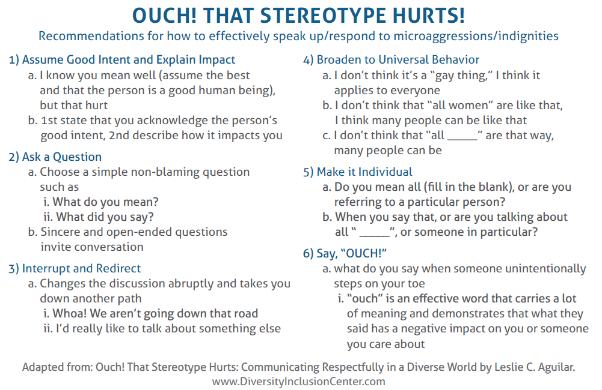
Suggestions for Addressing Situations Where Stereotyping Occurs

Slide 34
Person Centered Incident Matrix
Person-Centered Incident Manual
Interagency Collaboration Example
Kim Hoffmockel
Saint Louis County
Community collaboration to implement person centered responses to adults experiencing crisis and in need services and supports

Slide 35
Person Centered Community Collaboration
Parties:
  St. Louis County Adult Services
  Law Enforcement (Duluth Police Department and St. Louis County Sheriff’s Department)
  Adult Foster Care Providers
  Hospitals (Essentia and St. Luke’s)
  Birch Tree Center
  Crisis Response Team (CRT)
Objective: Our overarching goal is to develop a strong community collaboration where each partner in the process provides person centered supports and services to adults in need experiencing crisis:
  Clarifies their role
  Understands each of the other community partner’s roles and appropriately utilizes the services they provide
  Engages in regular communication and feedback
  Implements a standard for person centered responses to adults in crisis
  Coordinates services to effectively meet the needs of adults in crisis
  Collects, analyzes and shares data to guide improvements in the systems involved (on a regular basis)

Slide 36
Collective Definition of Emergency
Emergency: a time of a critical and dangerous circumstance requiring immediate assistance/action/relief due to imminent threat to life or health of a person or group of people.
  Health - relates to physical and psychological
  All emergencies are a crisis, but not all crises are an emergency.

Slide 38
PCIM Manual Overview
A general guide
Available on-line: http://www.stlouiscountymn.gov/ADULT-FAMILIES/Adult/Adult-Foster-Care
  Can modify PCIM to reflect your process
Develop a clear and standard process

Slide 39
PCIM Manual Overview
Follows flow chart by color code
Page 2: Includes Proactive Efforts to prepare for Interventions with:
    Law Enforcement
    Hospitals
General Information on:
  Prevention
  Trauma Informed Care
  Person Centered Practices
  Definitions
  Assessing Suicidality & Suicide Prevention Resources
  Crisis Planning

Slide 40
PCIM Manual Overview
Community Resources (pg. #9-11)
  South St. Louis County
      Birch Tree Center
      Mobile Crisis
  North St. Louis County
      Merrit House IRTS
      Wellstone Center for Recovery
      Mobile Crisis

Slide 41
Closing and Wrap-Up
Thanks, Jeff!

Slide 42
2020 Theme: 9 Core Features of PBS
Changes lifestyle
Works across lifespan
Works across all settings
Involves the people supported
Creates effective change
Provides supports for person tied to supports for all,
with supports provided by all
7. Decrease the likelihood of experiencing problems
8. Measurable in multiple resource areas
9. Includes multiple theories and values
Core Features of PBS we will addressed in each webinar!

Slide 43
Minnesota PBS VALUES
V =
A =
L =
U =
E =
S =
Values are building on the strengths of children and adults, empowering people, and encouraging culturally-responsive problem solving
All settings are important -- home, school, community members working together
Lifespan emphasis of PBS supports diversity and inclusion
Understanding strengths and building on social and emotional skills (Kincaid)
Evidence-based practices using behavioral, biomedical, and social science research
Systems change includes universal strategies for preventing challenges, minor problem solving, and intensive individualized supports

Slide 44
Organization Members

Slide 45

APBS Conference 2021 – 18th Annual Conference
Learn More About the International Association for Positive Behavior Support and the Upcoming Conference!
https://www.apbs.org/conference

Slide 46
Thank you for attending!
MNPBSnetwork@gmail.com

