Slide 1
Hennepin County Minnesota

Slide 2
Positive Behavior Support

Slide 3
Introduction to Positive Behavior Support
Introduction Video to PBS
Big Bang Theory & PBS

Slide 4
Incorporating PBS into PCT

Slide 5
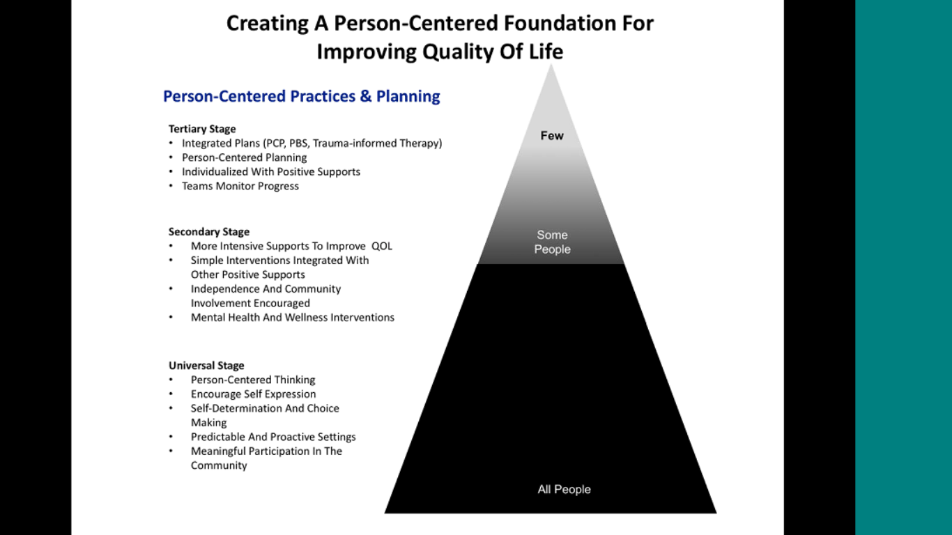
Hennepin County

Slide 6
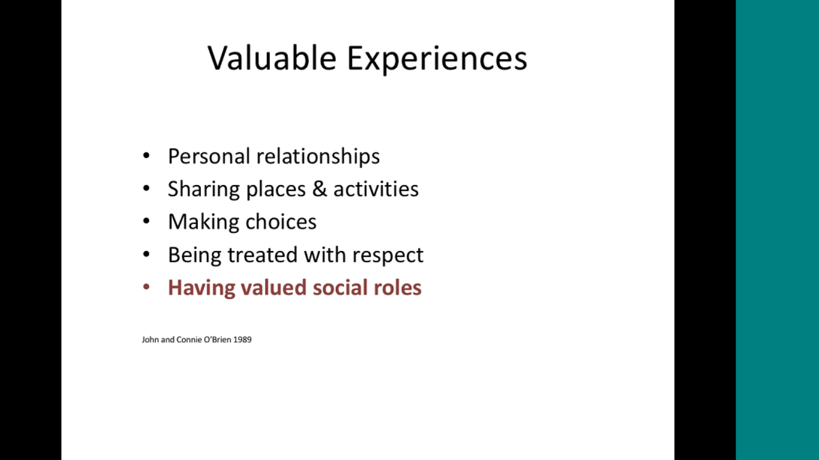
Valuable Experiences

Slide 7
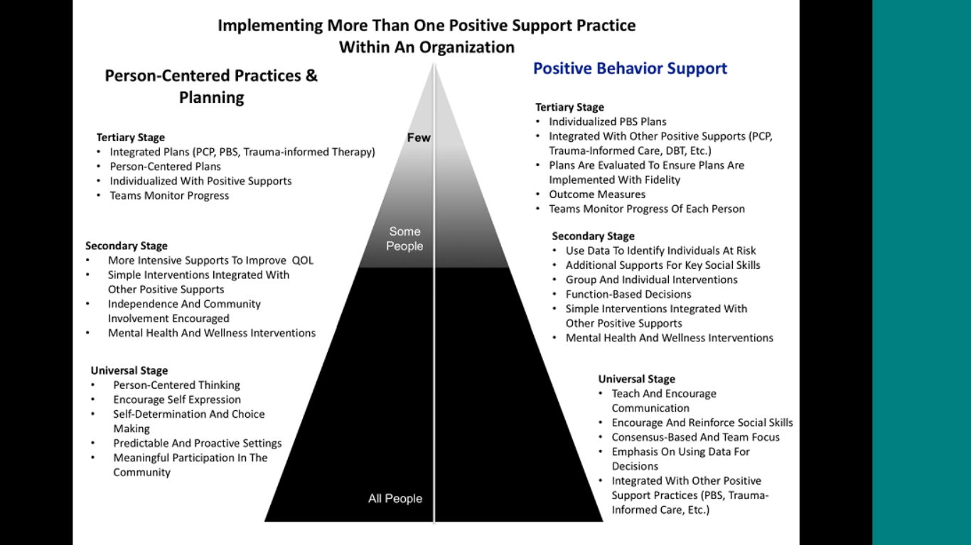
1) Hennepin County

Slide 8
Developing a PBS Plan

Slide 9
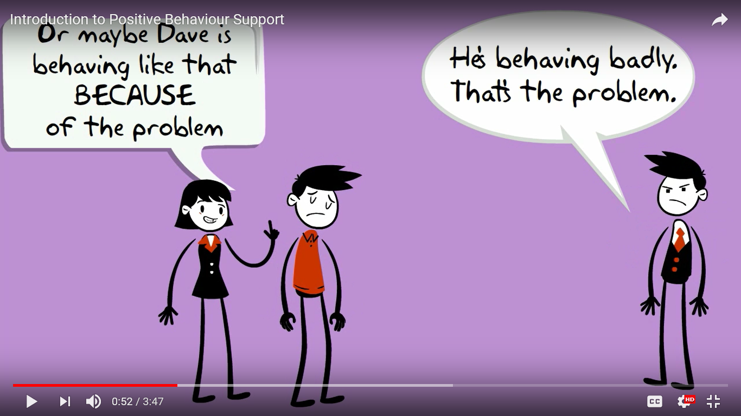
Understanding the message in the behavior

Slide 10
What is the message?
Use Assessment tools to identify the message in the behavior
Collect information from multiple sources
Always keep the person at the center
Look closely at the person’s day to day life

Slide 11
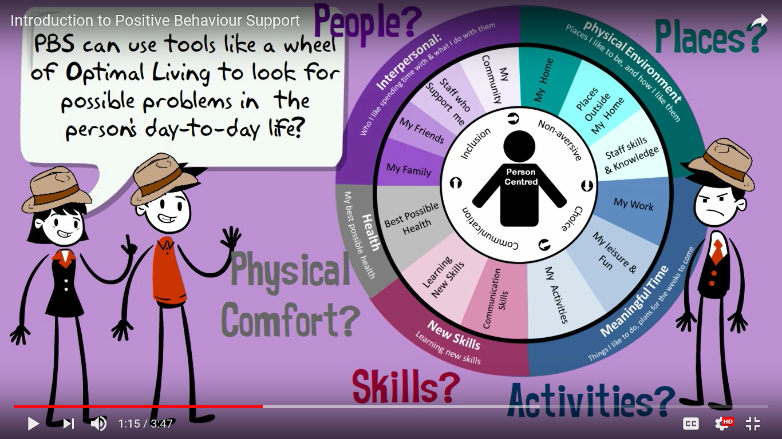
2) Hennepin County

Slide 12
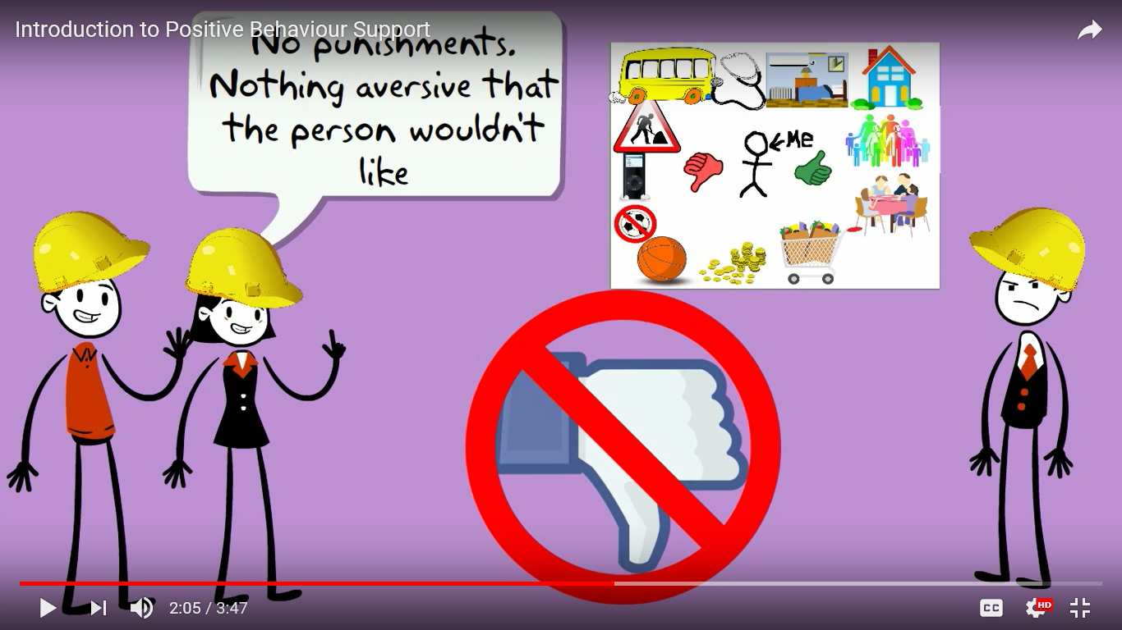
Positive Reinforcement not Punishment

Slide 13
PBS Plan
Nothing aversive in the plan
Based on science (applied behavioral analysis)
Include other treatments
Evaluate the plan – how is it working?

Slide 14
Positive Behavior Support within Hennepin County

Slide 15
1) Incorporating PBS into PCP at Hennepin County
What are problem “behaviors” that are hindering optimal performance for an individual or a team?
  Resistance to change
  Underperformance
  Team disagreements
  Inter-personal communication/interactions
What are PCT tools we can use to assess what the message might be?
Notes:
Small Group discussion & Report out

Slide 16
2) Incorporating PBS into PCP at Hennepin County
How can we use PBS to improve our work?
  For ourselves
  In 1:1 interactions
  Within our teams
  Across other areas/departments
  With external partners
Notes:
Small Group Discussion & report out

